Slide 1
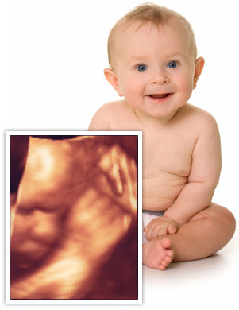
Fetal assessment
Lateefa Al Dakhyel FRCSC, FACOG
Assistant professor & consultant
Obstetric & gynecology department
Collage of medicine
King Saud University

Slide 2
Early pregnancy assessment
Fetal heart activity
Fetal movement
Fetal growth
Late pregnancy assessment
Fetal movement counting kick chart
Contraction stress test CST
Non stress test NST
Doppler Velocimetry UAV
amniotic fluid index AFI

Slide 3
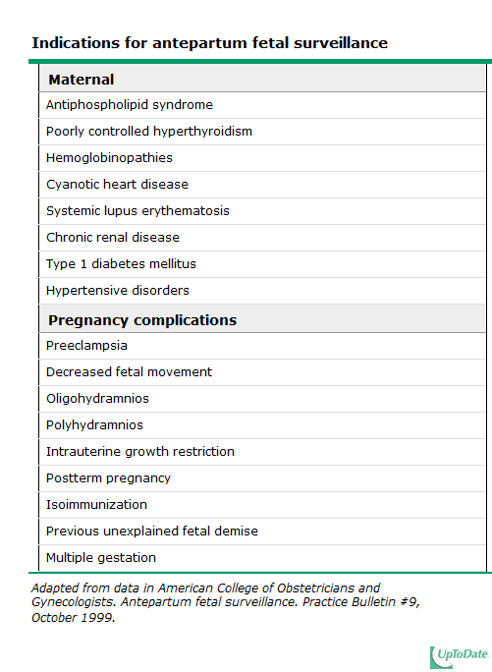

Slide 4
fetal movement counting
It should be started ~28w in normal pregnancy
&~24w in high risk pregnancy
It can reduce avoidable stillbirth
CARDIFF TECHNIQUE
-10 movement in 12 hours
-If abnormal patient should get further assessment
SADOVSKY TECHNIQUE
-4 movement /hour if not felt another hour
If not patient need more assessment

Slide 5
Contraction stress test (CST)
Causing uterine contraction over 20minutes
At least 2 uterine contractions
Uterine contraction restrict O2 delivery to the fetus
Normal fetus will tolerate contraction
Hypoxic fetus will have late deceleration
High false positive rate ~50%
100% true negative rate

Slide 6
Non stress test (NST)
Maine advantage over CST is no need for contraction
False +ve & false –ve higher than CST
done
Non stress test
The base line 120-160 beats/minute
Different criteria in fetuses <32w
Reactive:
At least two accelerations from base line of 15 bpm for at least 15 sec within 20 minutes
Non reactive:
No acceleration after 20 minutes- proceed for another 20 minutes

Slide 7
Non stress test (NST)
If non reactive in 40 minutes---proceed for contraction stress test or biophysical profile
The positive predictive value of NST to predict fetal acidosis at birth is 55%
Amniotic fluid volume ~AFI
Amniotic fluid index AFI
-the sum of the maximum vertical fluid pocket diameter in four quarters
-the normal value 5-25cm
-<5~ oligohydraminous
->24cm polyhydraminous

Slide 8
Biophysical profile (BPP)
Combines NST with USS estimation AFV, fetal breathing, body movement & reflex/tone/extension-flexion movement .
it is a scoring system
it is done over 30minute
It measure acute hypoxia(NST, body mov. &breathing) & chronic hypoxia (AFI)

Slide 9
Fetal Biophysical profile/NST+
Abnormal (score= 0) | Normal (score=2) | Biophysical Variable
Absent FBM or no episode >30 s in 30 min | 1 episode FBM of at least 30 s duration in 30 min | Fetal breathing movements
2 or fewer body/limb movements in 30 min | 3 discrete body/limb movements in 30 min | Fetal movements
Either slow extension with return to partial flexion or movement of limb in full extension Absent fetal movement | 1 episode of active extension with return to flexion of fetal limb(s) or trunk. Opening and closing of the hand considered normal tone | Fetal tone
Either no AF pockets or a pocket<2 cm in 2 perpendicular planes | 1 pocket of AF that measures at least 2 cm in 2 perpendicular planes | Amniotic fluid volume

Slide 10
BPP
The risk of fetal death within 1 week if BPP is normal~ 1/1300
Modified BPP (mBPP)
-NST & AFI
-low false negative 0.8/1000
-high false positives ~60%
Doppler velocimetry
Measurement of blood flow velocities in maternal & fetal vessels
Reflect fetoplacental circulation
Doppler indices from UA, Uterine A & MCA
Doppler studies is mostly valuable IUGR
In IUGR absent or reversed EDF (end diastolic flow) associated with fetal hypoxia

Slide 11
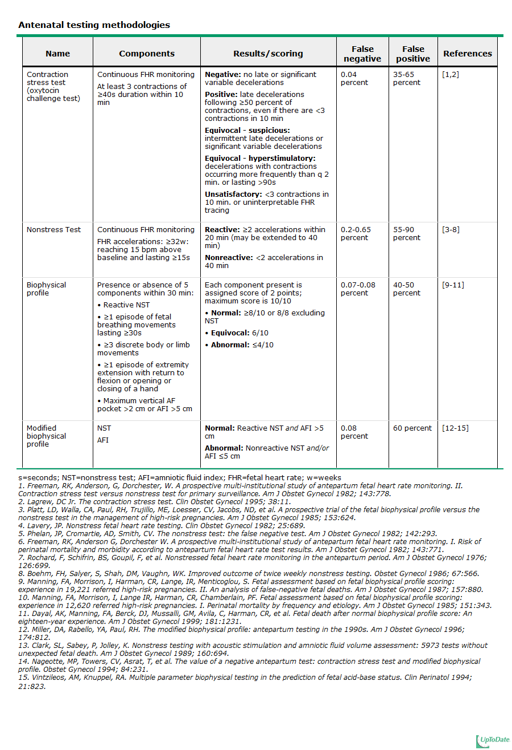

Slide 12
Amniocentesis
Obtaining a sample of amniotic flui during pregnancy.
Usullay done after 15w (can be done after 11w)
Indication
-genitic (karyotype)
-billirubine level (RH-isimunisation)
-fetal lung maturity (L/S)
-therputic in polyhydranios
Risks: ROM ~1%, abortion 0.5%, infection 1/1000

Slide 13
CVS chorionic villus sampling
Usually done after 10w
It is the procedure of choice for first trimester prenatal diagnosis of genetic disorders
Complication: fetal loss (0.7 percent within 14 days of a TA CVS procedure and 1.3 percent within 30 days), Procedure-induced limb defects
Second trimester amniocentesis is associated with the lowest risk of pregnancy loss; chorionic villus samplings safer than early (ie, before 15 weeks) amniocentesis.
.

Slide 14
cordocentesis
Indication: - rapid karyotyping
-diagnosis of inherited disorders
-fetal HB assessment
-fetal plt level
-fetal blood transfusion
Complication: bleeding, bradycardia, infection….

