Slide 1
Preterm Labour(PTL) & Prelabour Rupture of Membrane (PROM)
Dr.Saeed Mahmoud
MBBS, MRCOG, MRCPI, MIOG

Slide 2
Definitions
Pregnancy dating
Term / Gestational period
Different species
Labour True/False
Effacement / Dilatation /Descend
ROM / PROM / PPROM

Slide 3
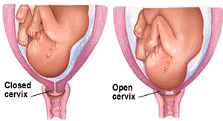
Effacement & dilatation

Slide 4
Preterm Labour
Preterm labour (PTL): Presence of contractions which cause progressive effacement and dilatation of the cervix between 24 and 37 weeks’ gestation.
Extreme 24-28
Very 28- 32
Preterm 32-37
Preterm birth (PB): Occurs in 6-10% of pregnancies.

Slide 5
Premature rupture of membranes (PROM)
PROM membrane rupture before the onset of uterine contractions;
PPROM preterm PROM (is the term used when the pregnancy is less than 37 completed weeks of gestation.
PPROM 3% and associated with, approximately one-third of PTL

Slide 6
Prematurity/ Low birth weight
Premature infant: An infant born before 37 weeks of estimated GA.
Low birth weight (LBW): BW<2,500 g
Very low birth weight (VLBW): BW<1,500 g
Extremely low birth weight (ELBW):
BW<1,000 g

Slide 7
Terms Related to Prematurity
SGA: Birth weight below the 10th percentile for GA or > 2 standart deviations below the mean for GA.
IUGR: A process that causes a reduction in an expected pattern of fetal growth.
1. Symmetric IUGR
2. Asymmetric IUGR (head-sparing IUGR):

Slide 8
Etiology of Preterm Labour
Spontaneous:
a. Idiopathic
b. (PPROM)
c. UTI , Asymptomatic bacteriuria
d. Infection Bacterial vaginosis
e. Multiple pregnancy
f. Polyhydramnios
g. Uterine congenital anomalies

Slide 9
Iatrogenic:
a. Pre-eclampsia 40%
b. Fetal distress 30%
c. IUGR 10%
d. APH ,, Abruption placenta or
placenta previa 10%
e. Fetal death 5%

Slide 10
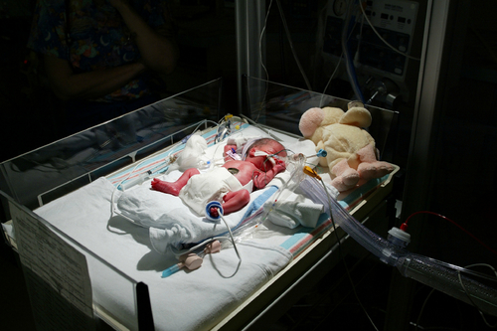
Complications of Premature ,IUGR or SGA Infants
RDS
IVH
NEC
Infection
Anemia
PDA
Apnea

Slide 11
Complications of Premature ,IUGR or SGA Infants
Metabolic disorders: Hypoglycemia, hypocalcemia
Hypothermia
Hematologic disorders: polycytemia
Hypoxia: birth asphyxia, meconium aspiration,
Associated withCongenital malformation
Ref: Utpala G et al: Pediatr Clin N Am 2004;51: 639-654.

Slide 12
Survival in Premature Infants
26 wks – 80%
27 wks – 90%
28-31 wks – 90 to 95%
32-33 wks – 95%
34-36 wks – approaches term survival rates

Slide 13
Prevention of PTB
Reduce/eliminate risk factors, if possible
Not proven to be effective: bedrest, home uterine monitoring, prophylactic tocolytics, prophylactic antibiotics, abstinence
Supplemental progesterone
Women with previous spontaneous preterm delivery at less than 34 weeks gestation

Slide 14
Prevention of PTB
Cervical cerclage
Shirodkar / Mc Donald
Amnio-reduction in Polyhydramnios
Early treatment of UTI or Bacteriuria
Embryo reductions in IVF

Slide 15
Prediction / Detection
Assessment of risk factors
Vaginal examination to assess the cervical status
Ultrasound visualization of cervical length and dilatation
Detection of foetal fibronectin in cervicovaginal secretions

Slide 16
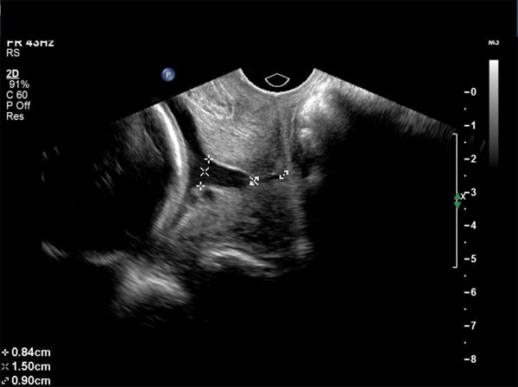
Sonographic Cervical Length
More than3.5
No funneling

Slide 17
Management : Antenatal Steroids
Indicated in the delivery of a fetus at 24-34 weeks’ gestation in the absence of clinical infection.
Why?
Reduces the incidence of RDS, IVH and NEC.
Delay of delivery- A minimum of 24 hours.
Betamethasone or Dexamethasone & How
Single /multiple courses

Slide 18
Tocolysis:
Beta agonists (ritodrine, terbutaline)
Were 1st drugs of choice
S/E Tachycardia, hypotension, tremor, palpitations, chest discomfort, hypokalemia, hyperglycemia
Magnesium sulfate
esp. with severe PET
Nausea, flushing, fatigue, respiratory depression, cardiac arrest
Indomethacin
Esp. with Polyhydramnois
Maternal GI /se ,premature closure of ductus & oligohydramnios

Slide 19
Tocolysis:
Nifidipine
Cheap, with high BP / PET (calcium channel blocker)
Atosiban
The most used one now .
Oxytocin receptor antagonist
Tractocile

Slide 20
PROM/PPROM
Risks:
Cord prolapse
PTL
Infection
Pulmonary hypoplasia, Skeletal deformities.

Slide 21
management of P/PROM
Diagnosis
Expectant management versus intervention
Maternal / Foetal surveillance
Hospital/ Home
Steroids.
Antibiotics
Timing of delivery.

Slide 22
Management of Premature Infants
Delivery room management
Temperature and humidity control
Fluids and electrolytes
Blood glucose
Calcium
Nutrition
Respiratory support
Surfactant
PDA
Transfusion
Skin care
Other special considerations

Slide 23
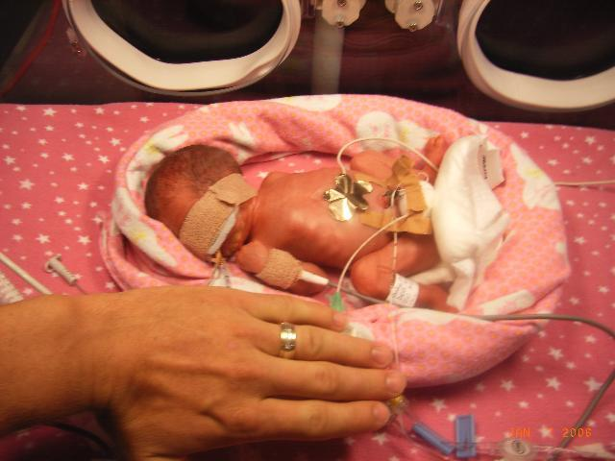
THANK YOU Any Question

