Slide 1
Fetal assessment
Dr. Saeed Mahmoud MRCOG,MRCPI,MIOG,MBSSCP
Assistant professor & consultant
Obstetric & gynecology department
Collage of medicine
King Saud University

Slide 2
Fetal assessment
Fetal assessment is to identify fetuses at risk of neurologic injury or death in order to prevent it
It can be divided into:
-early pregnancy fetal assessment
-late pregnancy fetal assessment
OR
-assessment of low risk pregnancy
-assessment of high risk pregnancy

Slide 3
Rational & Pathophysiology
fetal oxygenation challenged:
blood flow directed to brain, heart & adrenal & blood flow away from the kidney decrease fetal urine production decrease AF volume.
- CNS hypoxia Fetal movement decrease
-chemoreceptor's vegally-mediated reflex
Fetal heart rate abnormality late deceleration.

Slide 4
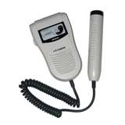
Early pregnancy assessment
Fetal heart activity
fetal auscultation (special stethoscope or doppler)
~12weeks

Slide 5
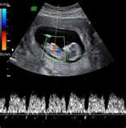
fetal heart activity seen by USS
Can be seen from 6weeks

Slide 6
Early pregnancy assessment
Fetal movement
Fetal movement are usually first perceptible to mother ~17w-20w (quickening)
50% of isolated limb movements are perceived
80% of trunk and limb movements
Fetal growth
SFH
USS

Slide 7
Late pregnancy assessment
Fetal movement counting kick chart
Non stress test NST
Contraction stress test CST
Doppler Velocimetry UAV
Biophysiacl Profile BPP
Amniotic fluid index AFI
there is fair (Class B) evidence to support the recommendation that antenatal testing strategies should be employed in specific pregnancy populations identified to be at risk for foetal asphyxia.

Slide 8
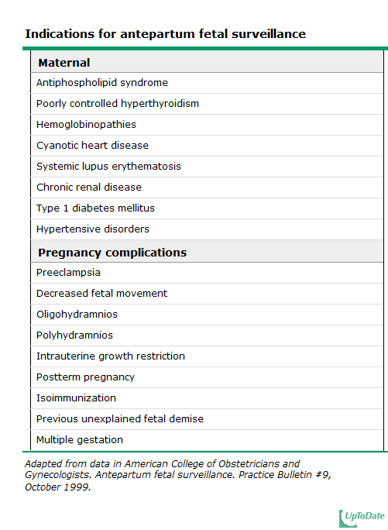

Slide 9
fetal movement counting
It should be started ~28w in normal pregnancy
&~24w in high risk pregnancy
It can reduce avoidable stillbirth
CARDIFF TECHNIQUE
-10 movement in 12 hours
-If abnormal patient should get further assessment
SADOVSKY TECHNIQUE
-4 movement /hour if not felt another hour
If not patient need more assessment

Slide 10
Non stress test (NST)
Main advantage over CST is no need for contraction
False +ve & false –ve higher than CST
done

Slide 11
Non stress test
The base line 120-160 beats/minute
Different criteria in fetuses <32w
Reactive:
At least two accelerations from base line of 15 bpm for at least 15 sec within 20 minutes
Non reactive:
No acceleration after 20 minutes- proceed for another 20 minutes

Slide 12
Non stress test (NST)
If non reactive in 40 minutes---proceed for contraction stress test or biophysical profile
The positive predictive value of NST to predict fetal acidosis at birth is 44%

Slide 13
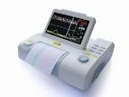
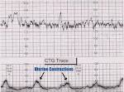
NST

Slide 14
Contraction stress test (CST)
Causing uterine contraction over 20minutes
At least 2 uterine contractions
Uterine contraction restrict O2 delivery to the fetus
Normal fetus will tolerate contraction
Hypoxic fetus will have late deceleration
High false positive rate ~50%
100% true negative rate

Slide 15
Amniotic fluid volume Or Liqour volume
Amniotic fluid index AFI
-the sum of the maximum vertical fluid pocket diameter in four quarters
-the normal value 5-25cm
-<5~ oligohydraminous
->24cm polyhydraminous
Pools & Pockets
More than 1 pool each 2-8 cm

Slide 16
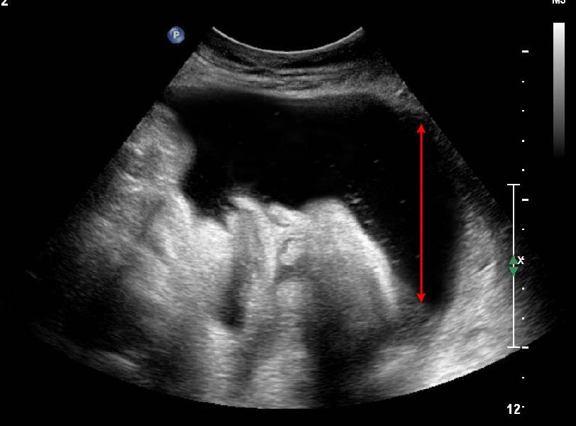
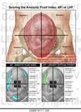

Slide 17
Biophysical profile (BPP)
Combines NST with USS estimation AFV, fetal breathing, body movement & reflex/tone/extension-flexion movement .
it is a scoring system
it is done over 30 minutes
It measures acute hypoxia(NST, body mov. &breathing) & chronic hypoxia (AFI)

Slide 18
Fetal Biophysical profile
Abnormal (score= 0) | Normal (score=2) | Biophysical Variable
Absent FBM or no episode >30 s in 30 min | 1 episode FBM of at least 30 s duration in 30 min | Fetal breathing movements
2 or fewer body/limb movements in 30 min | 3 discrete body/limb movements in 30 min | Fetal movements
Either slow extension with return to partial flexion or movement of limb in full extension Absent fetal movement | 1 episode of active extension with return to flexion of fetal limb(s) or trunk. Opening and closing of the hand considered normal tone | Fetal tone
Either no AF pockets or a pocket<2 cm in 2 perpendicular planes | 1 pocket of AF that measures at least 2 cm in 2 perpendicular planes | Amniotic fluid volume

Slide 19
BPP
The risk of fetal death within 1 week if BPP is normal~ 1/1000
8/10 89/1000
6/10 89/1000
4/10 91/1000
2/10 125/1000
0/10 600/1000

Slide 20
Doppler velocimetry
Measurement of blood flow velocities in maternal & fetal vessels
Reflect fetoplacental circulation
Doppler indices from, Uterine A (UA) & MCA
Doppler studies is mostly valuable in IUGR
In IUGR absent or reversed EDF (end diastolic flow) associated with fetal hypoxia

Slide 21
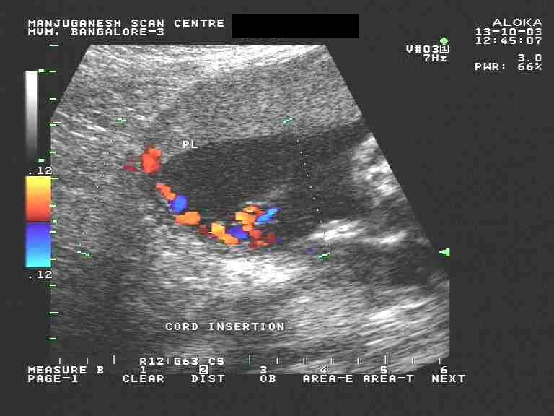
umbilical artery waveform

Slide 22
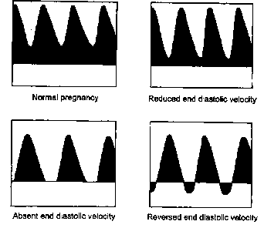
Umbilical Artery Doppler

Slide 23
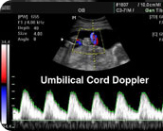

Slide 24
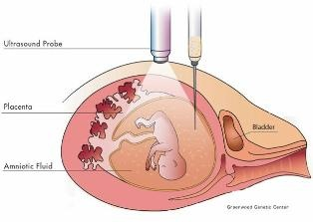
Invasive fetal assessment
Amniocentesis

Slide 25
Amniocentesis
Obtaining a sample of amniotic flui during pregnancy.
Usullay done after 15w (can be done after 11w)
Indication
-genitic (karyotype)
-billirubine level (RH-isimunisation)
-fetal lung maturity (L/S)
-therapuetic in polyhydranios
Risks: ROM ~1%, abortion 0.5%, infection 1/1000

Slide 26
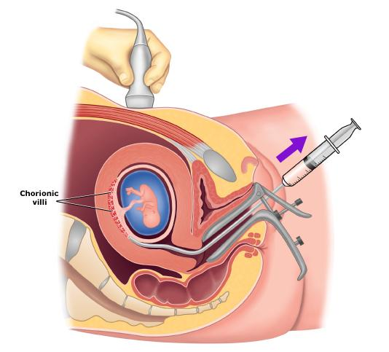
chorionic villus sampling (CVS )

Slide 27
chorionic villus sampling (CVS )
Usually done after 10w
It is the procedure of choice for first trimester prenatal diagnosis of genetic disorders
Complication: fetal loss (0.7 percent within 14 days of a CVS procedure and 1.3 percent within 30 days), Procedure-induced limb defects
Second trimester amniocentesis is associated with the lowest risk of pregnancy loss; chorionic villus samplings safer than early (ie, before 15 weeks) amniocentesis.
.

Slide 28
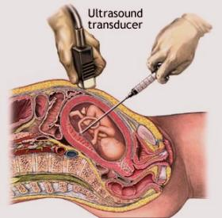
cordocentesis

Slide 29
cordocentesis
Indication: - rapid karyotyping
-diagnosis of inherited disorders
-fetal HB assessment
-fetal plt level
-fetal blood transfusion
Complication: bleeding, bradycardia, infection….

Slide 30
Thanks & good luck

