Slide 1
DYSMENORRHEA, PMS & ENDOMETRIOSIS
Basim Abu-Rafea, MD, FRCSC, FACOG
Assistant Professor & Consultant
Obstetrics & Gynecology
Reproductive Endocrinology & Infertility
Advanced Minimally Invasive Gynecologic Surgery
Department of Obstetrics & Gynecology
College of Medicine
King Saud University

Slide 2
DYSMENORRHEA
Introduction.
Classification.
Clinical features.
Diagnosis.
Management

Slide 3
INTRODUCTION
Painful menstrual period, characterized by cramping lower abdominal pain radiating to the back and legs, often accompanied by GI & neurological symptoms as well as general malaise.
Affects approximately 50% of menstruating women, but about 5-10% have severe dysmenorrhea affecting daily activities.

Slide 4
CLASSIFICATION
Primary or idiopathic → without pelvic pathology.
Secondary → underlying pelvic pathology.

Slide 5
PRIMARY DYSMENORRHEA
Usually appear within 1-2 yrs of menarche, when ovulatory cycles are established.
Main physiological basis is increased endometrial prostaglandin productions.

Slide 6
PRIMARY DYSMENORRHEA
PGF2 alpha & PGE2 in high concentrations sp. in secretory endometrium because of decline of progesterone levels in late luteal phase.
Increased uterine tone with high amplitude contractions→ reduced blood flow→ ischemic pain.

Slide 7
CLINICAL FEATURES OF PRIMARY DYSMENORRHEA.
Pain usually begins a few hours prior to or just after the onset of period & may last as long as 48-72 hrs.
Labor-like pains with suprapubic cramping, lumbosacral backache radiating down the anterior thigh.

Slide 8
CLINICAL FEATURES OF PRIMARY DYSMENORRHEA.
Colicky pain improved with massage, counter pressure or movement.
Nausea, vomiting, diarrhea with rarely syncope episodes.
Normal findings except some tenderness.

Slide 9
DIAGNOSIS
Necessary to rule out underlying pelvic pathology.
Confirm the cyclic nature of the pain.
Consider differential diagnosis:
Fibroid uterus
Endometriosis
Pregnancy complications like abortions & ectopic
PID
UTI
Other causes of acute abdomen.

Slide 10
TREATMENT
Reassurance.
Prostaglandin synthetase inhibitors are effective in approximately 80% of cases. Also improve menorrhagia if associated.
NSAIDs-Mefenamic acid, Ibuprofen, Diclofenac etc may be taken with/ without antispasmodics.
Drugs should be taken just prior to or at the onset of pain and continuously every 6-8 hrs to prevent reformation of PG by-products.

Slide 11
TREATMENT
Drugs should be taken for first few days of period for 3-6 cycles.
Combined oral contraceptive pills is drug of choice in patients who fail to improve with NSAID ,or when NSAID contraindicated, or pt who desire contraception or associated with menorrhagia.

Slide 12
TREATMENT
OCP- suppress endometrial proliferation, inhibits ovulation → no corpus luteum→ decrease prostaglandin synthesis.
Should be taken from day 5→day 21 for 3-6 cycles.
In non-responders- codeine may be added.

Slide 13
TREATMENT
Usually relieved spontaneously after delivery.(sympathetic nerves at isthmus & cervix destroyed).
Invasive procedures like D & C not desirable in nulliparous / unmarried.

Slide 14
TREATMENT
Transcutaneous electrical nerve stimulation, paracervical block etc. may be useful.
Laparoscopic uterine nerve ablation or pre-sacral neurectomy –used rarely in severe & non-responding cases.

Slide 15
SECONDARY DYSMENORRHEA.
Usually occurs many years after the onset of menarche.
Pain often begins 3-5 days prior to period & relieved with onset of period, but sometimes may persist continuously up to a few days after the cessation of bleeding.

Slide 16
UNDERLYING PATHOLOGY IN SECONDARY DYSMENORRHEA.
Endometriosis / Adenomyosis.
Fibroid uterus
Congenital uterine anomalies- bicornuate, septate etc.
Cervical stenosis.
Endometrial polyps.
Pelvic inflammatory disease.
IUCD

Slide 17
DIAGNOSIS
Abdominal & vaginal examination may reveal the underlying lesion.
May need investigations like US, laparoscopy, hysteroscopy, hysterosalpingogram etc.

Slide 18
TREATMENT
Analgesics.
Treatment of underlying cause accordingly.

Slide 19
PREMENSTRUAL SYNDROME

Slide 20
PMS
Is a group of physical, emotional & behavioral symptoms that occur in the 2nd half (luteal phase) of the menstrual cycle
Often interfere with work & personal relationships followed by a period entirely free of symptoms starting with menstruation
Notes:
Premenstrual syndrome
T1- A group of physical, emotional & behavioral symptoms that occur in the second half of the menstrual cycle
F2-It starts before the menses & continues untill ovulation
T 3-40% of women are significantly affected at one time or another
T 4- 2-3% of women will have sever symptoms that will affect their work & lifestyle

Slide 21
INCIDENCE
40% Significantly affected at one time or another.
2-3%  Severe symptoms with impact on their work & lifestyle
5% by the American psychiatric association definition
Notes:
Premenstrual syndrome
T1- A group of physical, emotional & behavioral symptoms that occur in the second half of the menstrual cycle
F2-It starts before the menses & continues untill ovulation
T 3-40% of women are significantly affected at one time or another
T 4- 2-3% of women will have sever symptoms that will affect their work & lifestyle

Slide 22
PHYSICAL SYMPTOMS
Bloating
Weight gain
Breast pain & tenderness
Skin disorders “acne”
Hot flushes
Headache
Pelvic pain
Changes in bowel habits
Joint or muscle pain
edema
Notes:
F 5-

Slide 23
EMOTIONAL / PSYCHOLOGICAL SYMPTOMS
Irritability
Aggression
Tension
Anxiety
Depression /  interest in the usual activities
Lethargy
Sleep disturbances
Change in appetite  overeating or food craving
Crying
Change in libido
Thirst
Loss of concentration
Poor coordination, Clumsiness, accidents

Slide 24
ETIOLOGY
Unknown cause.
Many theories have been postulated, most of them have to-do with various hormonal alterations.
Vitamin B6 deficiency
Multi-factorial psycho-endocrine disorder
Ovulation / progesterone production are important in this syndrome  Drugs that inhibit ovulation  relief of PMS symptoms
Notes:
F 5- PMS is a psychiatric disorder & it is not related to the hormonal changes of the menstrual cycle

Slide 25
EVALUATION
Pt should keep a diary of her symptoms throughout 2-3 menstrual cycles.
Complete History & physical examination to R/O any medical problem

Slide 26
DIAGNOSIS
The Diagnostic Statistical Manual for Mental Disorders requires 5 of the following:
Depressed mode
Anxiety
Emotional Liability
Irritability
Change in appetite
Lethargy
Sleep disturbance
Out of control
Lack of interest
Physical symptoms
Occur in the week before menses in most menstrual cycles
Disappear few days after the onset of menses
Impair social, occupational function or the ability to interact with others.

Slide 27
TREATMENT
1- SUPPORTIVE
2-MEDICATIONS:
The selection of medications should be tailored to the patient’s main symptoms.
Notes:
Treatment of PMS
T 1-The selection of medications should be tailored to the patients main symptoms

Slide 28
LIFE STYLE CHANGES
Adequate rest & sleep
Aerobic exercise  20-30 min 3-7 times/wk 
-↑ β-endorphins in the brain
-Distract the women from her emotional feelings
Healthy diet  Avoid fasting
Frequent small meals
↑ Complex carbohydrates
 Simple sugars, Salt & Caffeine
Avoid fat free diet
High protein diet
Notes:
F 2- Aerobic exercise & high protein diet worsen the symptoms of PMS

Slide 29
MEDICAL THERAPY
SYMPTOMATIC Rx
1- Bloating & feeling of fluid retention  Diuretics
(spironolactone)
2-Cramping, back pain, heat intolerance  Antiprostaglandines
3-Breast tenderness  Bromocriptine
4-Depression, anxiety, irritability  Alprazolam 0.25 mg bd
SSRI Fluoxetine (Prozac) 5-20 mg/D (D20-28)
Notes:
T 3- Fluoxetine (prozac) is helpful for the depressive symptoms of PMS

Slide 30
MEDICAL THERAPY
SUPPRESSION OF OVULATION
1-Danazol 200 mg QID D 20-28
2-Oral Contraceptives
3-Medroxyprogestrone acetate 10 mg BID/TID
contiuously
MISCILANEOUS Rx
1-Micronized progestrone 100mg AM
200mg PM
D 20-28
2-Multiple Vitamines
3-Pyridoxine B6  50 mg/ day or B-complex
4-Ca Carbonate 1200mg/D
5-Prime rose oil γ linolenic acid
Notes:
F4-Oral contraceptive pills should be avoided in patients with PMS because it will increase their anxiety & depression
T 5- Vitamine B6 & prime rose oil are helpful in the management of PMS

Slide 31
ENDOMETRIOSIS

Slide 32
ENDOMETRIOSIS
Definition: Ectopic Endometrial Tissue
True Incidence Unknown: ? 1-5%
30 -40 % Infertility patients
Does NOT Discriminate by Race
Histology: Endometrial Glands with Stroma +/- Inflammatory Reaction

Slide 33
SIGNS AND SYMPTOMS
Chronic Pelvic Pain, Dysmenorrhea
Infertility
Deep Dyspareunia
Pelvic Mass (Endometrioma)
Misc: Tenesmus, Hematuria, Hemoptysis

Slide 34
AGE AT DIAGNOSIS
> 45
< 19
36 –45
3%
6%
15%
19 – 25
24%
26 –35
52%

Slide 35
ETIOLOGY: THEORIES
Sampson: “Retrograde Menstruation”
Hematologic Spread
Lymphatic Spread
Coelomic Metaplasia
Genetic Factors
Immune Factors
Combination of the Above
No Single Theory Explains All Cases of Endometriosis

Slide 36
DIAGNOSIS
Laparoscopy (“Gold Standard)
Laparotomy
Inconclusive: CA-125, Pelvic Exam, History, Imaging Studies
Biopsy Preferable Over Visual Inspection

Slide 37
APPEARANCE
Endometriosis May Appear
Brown
Black (“Powder burn”)
Clear (“Atypical”)

Slide 38
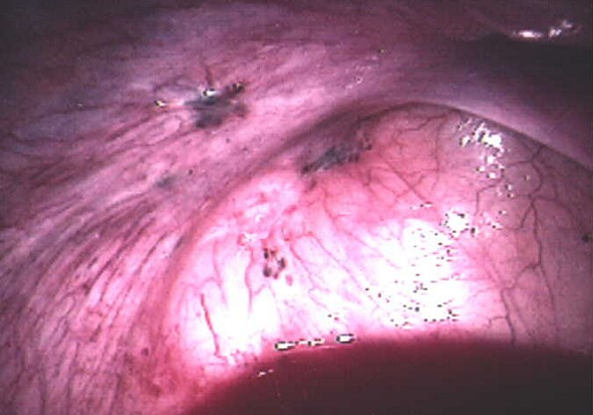
APPEARANCE

Slide 39
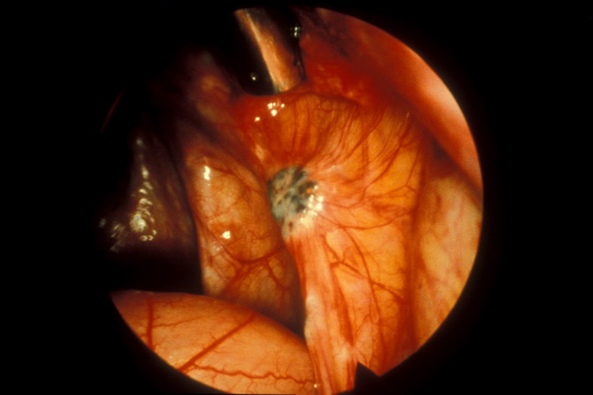
APPEARANCE

Slide 40
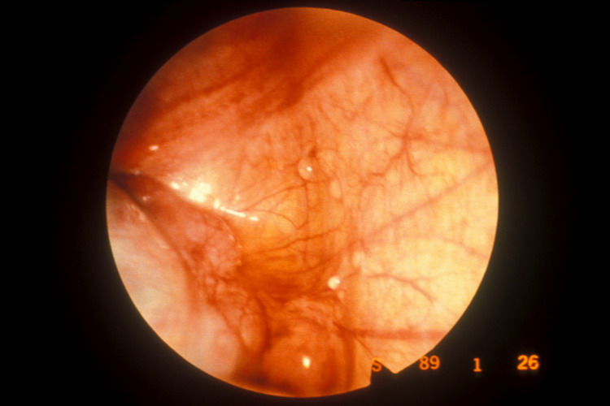
APPEARANCE

Slide 41
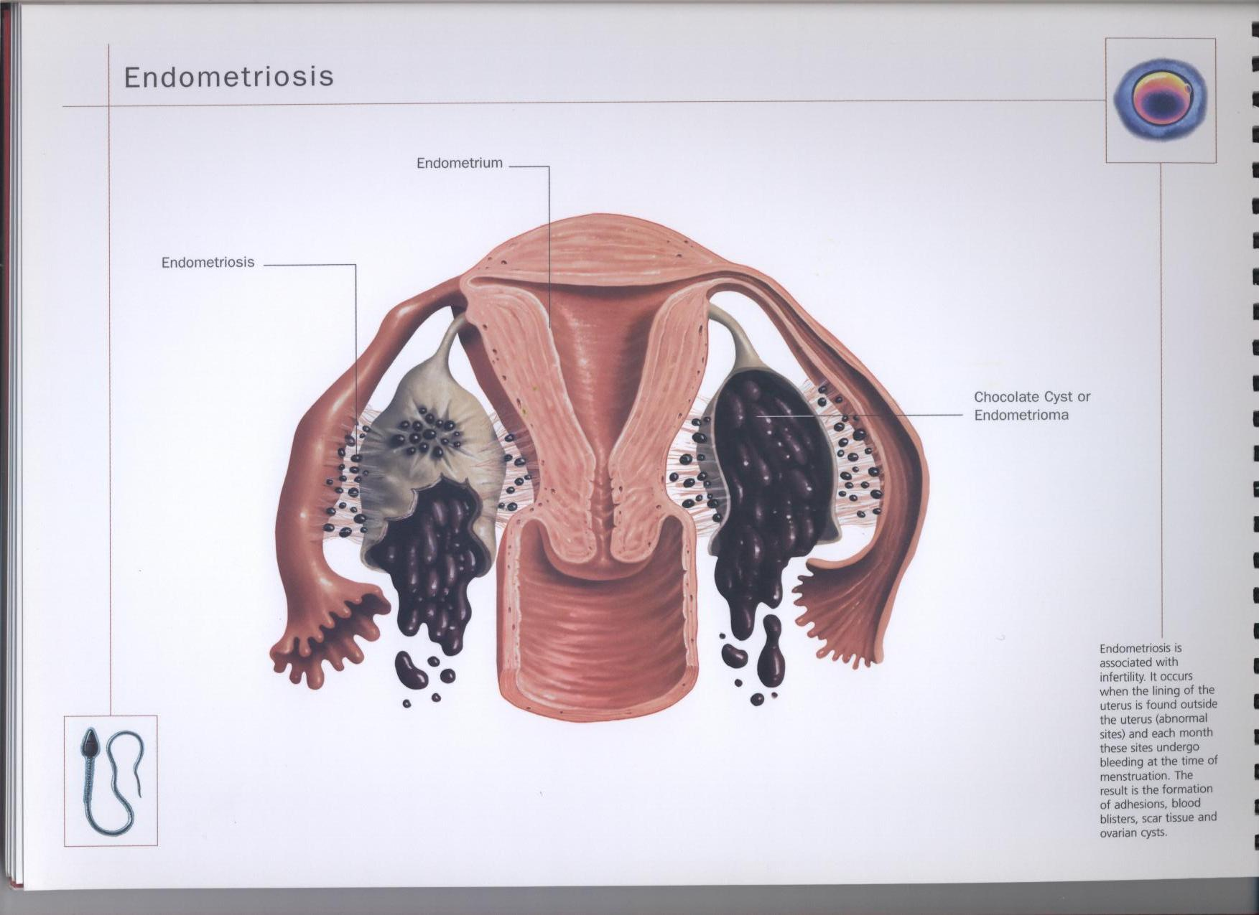
APPEARANCE

Slide 42
CLASSIFICATION / STAGING
Several Proposed Schemes
Revised AFS System: Most Often Used
Ranges from Stage I (Minimal) to Stage IV (Severe)
Staging Involves Location and Depth of Disease, Extent of Adhesions

Slide 43
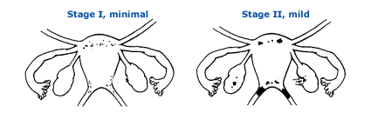
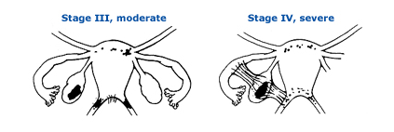
CLASSIFICATION / STAGING

Slide 44
TREATMENT: OVERALL APPROACH
Recognize Goals:
– Pain Management
– Preservation / Restoration of Fertility
Discuss with Patient:
– Disease may be Chronic and Not Curable
– Optimal Treatment Unproven or Nonexistent

Slide 45
PAIN MANAGEMENT: MEDICAL THERAPY
NSAIDs
OCPs (Continuous)
Progestins
Danazol
GnRH-a
GnRH-a + Add-Back Therapy
Misc: Opoids, TCAs, SSRIs

Slide 46
CONTINUOUS OCP’S
“Pseudopregnancy” (Kistner)
? Minimizes Retrograde Menstruation
Choose OCP’s with Least Estrogenic Effects, Maximal Progestin Effects

Slide 47
PROGESTINS
May be as Effective as GnRH-a for Pain Control
MPA 10-30 mg/day, DP 150 mg Semi-Monthly
Relatively Inexpensive
Side-Effects: AUB, Mood Swings, Weight Gain, Amenorrhea

Slide 48
DANAZOL
Weak Androgen
Suppresses LH / FSH
Causes Endometrial Regression, Atrophy
Expensive
Side-Effects: Weight Gain, Masculinization, Occ. Permanent Vocal Changes

Slide 49
GnRH-a
Initially Stimulate FSH / LH Release
Down-Regulates GnRH Receptors–”Pseudomenopause”
Long-Term Success Varies
Expensive
Use Limited by Hypoestrogenic Effects
May be Combined with Add-Back

Slide 50
SURGICAL TREATMENT (LAPAROSCOPY / LAPAROTOMY)
Excision / Fulguration
Resection of Endometrioma
Lysis of Adhesions, Cul-de-sac Reconstruction
Uterosacral Nerve Ablation
Presacral Neurectomy
Appendectomy
Hysterectomy +/- BSO

