Slide 1
بسم الله الرحمن الرحيم
Ophtha OSCE B1-2009

Slide 2
Instructions
مرحبا جميعا..وعالبركه آخر سايكل السنة هذه : )
بما ان اسئلة المراجعة في الاوفثا كثيرة وعشان ما اضيع وقتكم اكثر..كتبت الاسئلة اللي ما مرت علي وانا اقرا اسئلة القروبات والسنوات الماضية --> اشوا اني متعيجز
وبقية الاسئلة اللي جتنا..ان كان الذاكرة ما خانتني فهي مرت علي بطريقة او بأخرى قبل ما ادخل الاختبار
واعذرونا اذا لقيتوا خطأ+صححوه :P

Slide 3
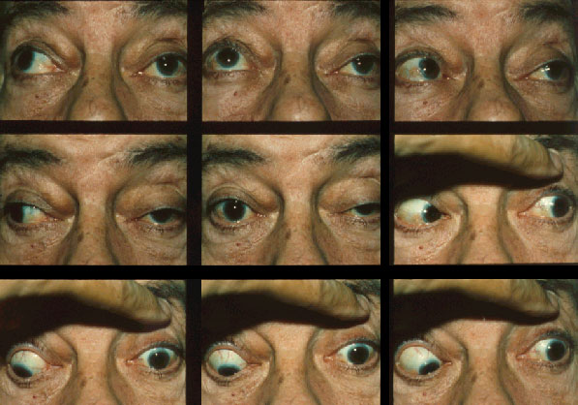
1- Dx? 2- On examination there was an absent light reflex, what is the cause?
http://www.nanosweb.org/patient_info/brochures/images/MicrovascularC_3.jpg

Slide 4
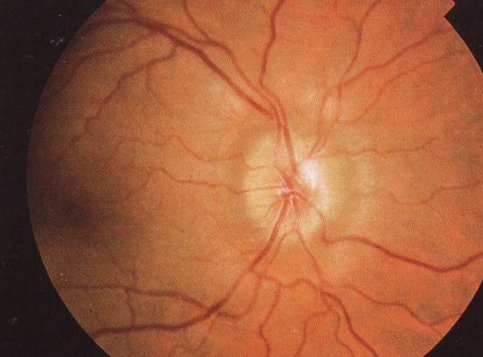
This is a BILATERAL finding in a 30 years old obese lady complaining of headache, nausea & vomiting. Her CT is normal.
1-Dx?
Idiopathic increase in ICP=pseudotumor cerebri.
2- Management?

Slide 5
Pseudotumor cerebri
Pseudotumor cerebri, also known as idiopathic intracranial hypertension (IIH) is a disorder of unknown etiology. It affects predominantly obese women of childbearing age. The primary problem is chronically elevated intracranial pressure (ICP), and the most important neurologic manifestation is papilledema, which may lead to progressive optic atrophy and blindness.
Management
A-Medical:
1- Patients without visual loss most often are treated with a carbonic anhydrase inhibitor (eg, acetazolamide) to lower the intracranial pressure (ICP). Some authors believe digoxin has the same effect and is associated with fewer adverse effects.
2- In patients with severe symptoms, early visual field loss, or poor response to standard medical therapy, some clinicians utilize a short course of high-dose corticosteroids (eg, prednisone).
3- When new visual field loss is documented, medical management should be coupled with plans for emergency surgical intervention if the visual function continues to deteriorate or does not improve immediately with corticosteroid treatment.

Slide 6
Pseudotumor cerebri
B-Surgical :
For patients with idiopathic intracranial hypertension (IIH) who have progressive visual field loss, currently 2 general surgical approaches can be considered: CSF shunting procedures or optic nerve sheath fenestration.
useful link : )

Slide 7
D3awatkom
&
Jooood luck :D
425 B1

