Slide 1
OPHTHA OSCE
AII 427
Good luck
Saad Hamdan

Slide 2
Q. What is this instrument : A. Pinhole Q. What is it the value ? A. Central vision testing to recorrect refraction if necessary .

Slide 3
1- Dx = nasolacrimal duct obstruction 2- Rx = recanalization or massage
صورة طفل وضع له صبغة الاختبار وكأنه يبكي الصبغة ؟؟

Slide 4
1- INSTRUMENT ? Prism 2- value ? Test eye deviation (strabismus)
إذا حابين تشوفونها تلقونها بالعيادات

Slide 5
1- Dx ? Neurofibromatosis 2- associated symptoms ( ocular )? - sphenoidal dysplsia - -

Slide 6
Q. What is the diagnosis? Vitreous Hemorrhage Q. Name 3 causes; Trauma, HTN , DM

Slide 7
Dx? Sumluxated lens (SuperoTemporally) associated with ? → Marfan’s Syndrome

Slide 8
Dx? Posterior synechia risk factor? - -

Slide 9
Dx? Iridodialysis causes? - trauma - iatrogenic ( cataract surgery)

Slide 10
Dx? Xanthelasma lab test ? - lipid profile
طبعاً فيه اسهم على المطلوب

Slide 11
This was a bilateral finding in a young obese woman with 120/80 BP. CT scan imaging was negative. Q. What is the most likely diagnosis? papilledema Q. How would you manage her? A. 1.Medical: weight reduction and carbonic-anhydrase inhibitors (e.g. acetazolamide) 2.Surgical: CSF shunt.

Slide 12
Q. What is the diagnosis? A. Right facial (7th) nerve palsy (LMNL). Q. Mention 2 ocular manifestations of this condition. A. Exposure keratitis, epiphoria (excessive tearing), ectropion.

Slide 13
Identify 1- Optic Tract 2- Optic Radiation
يجيب صور طبيعية ... جدا واضحة

Slide 14
Q. What is the diagnosis? A. Accommodative esotropia in the right eye. Q. Which type of refractive error is associated with this condition? A. Hyperopia.

Slide 15
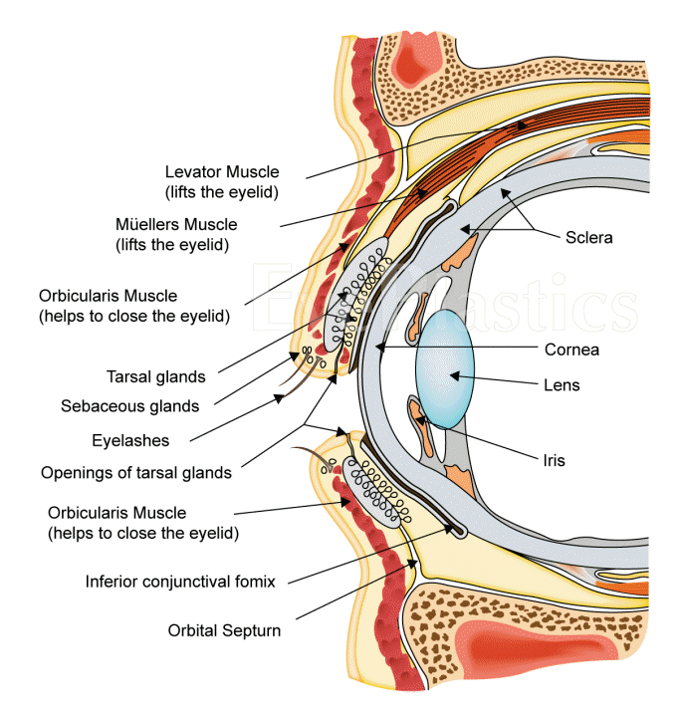
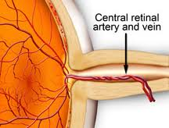
2
1
1- Ciliary Body
2- central retinal artery

Slide 16
Q. DIAGNOSIS ? PROLIFERATIVE DIABETIC RETINOPATHY Q. What is the sign ? Fan shaped neovascularization on optic disc Q. How would you manage this patient? A. Pan-retinal photocoagulation (PRP) and control blood sugar.

Slide 17
Q. What is this sign? A. Leucokoria in the right eye. Q. Mention 2 differential diagnoses. A. Congenital cataract, retinoblastoma.

Slide 18
Q. What is the diagnosis? A. Subconjuctival hemorrhage. Q. Mention 2 causes of this condition. A. Trauma, blood coagulopathies, anti-coagulants (OCP), cough, valsalva maneuver, old age, idiopathic.

Slide 19
A patient with a history of glaucoma Q. Dx? A. Open angle glaucoma Q. What is this sign? A. Cupping (increased cup:disk). Q. Which type of visual field defect is associated with this condition? A. Peripheral visual field defect.

Slide 20
A 25 year old patient with a history of sinusitis and fever Q. What is the diagnosis? A. Orbital cellulitis. Q. How would you manage her? A. Admission, temperature chart, culture and sensitivity, IV antibiotics, CT scan. Q. SYMPTOMS ? - PROPTOSIS - RESTRICTED EYE MOVEMENT

Slide 21
A patient with a history of wearing contact lenses Q. What is the diagnosis? A. Corneal ulcer. Q. How would you manage this patient? A. Remove the contact lenses and topical antibiotics.

Slide 22
Q. What is the diagnosis? A. Herpitic keratitis. Q. What is the name of the stain that was used? A. Fluorescein dye. Q. Rx? acyclovir

Slide 23
Q. What is the diagnosis? A. Senile cataract. Q. Mention 2 postoperative complications for this condition. A. Endophthalmitis, hemorrhage.

Slide 24
A patient with a history of cataract surgery Q. What is the diagnosis? A. Endophthalmitis. Q. How would you manage this patient? A. Administer intravitreal antibiotics.

Slide 25
Q. What is this procedure called? A. Peripheral iridotomy. Q. What is the indication of this procedure?. A. Acute closed angle glaucoma, narrow angle glaucoma.

Slide 26
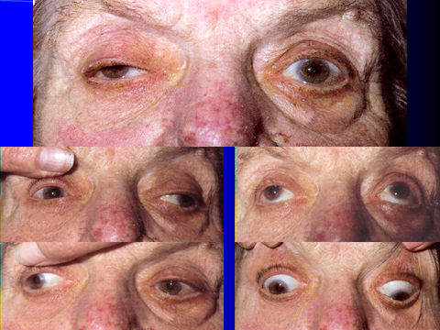
Q. What is the diagnosis?
A. Right oculomotor (3rd) nerve palsy.
Q. If patient has a history of nausea, vomiting and dizziness. What will be the most likely diagnosis?
A. Neoplasm (brain tumor).

Slide 27
Hx of corneal abrasion 1- Rx ? 2- complication? - -
مو نفس الصورة

Slide 28
Dx ? Chalazion Rx ? –warm compress - antibiotics - incision

Slide 29
1- Dx ? Foreign body in eye 2- Rx? - anesthesis - remove FB - topica antibiotics

Slide 30
1- Dx ? Herpes zoster ophthalmus 2- Rx? Acyclovir 3- associated symptoms? - -

Slide 31
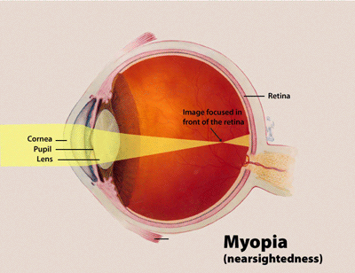
The Error : Myopia
Correction by : Concave

Slide 32
Q. What is the diagnosis? A. Central retinal vein obstruction (CRVO). Q. Mention 2 predisposing factors. A. HTN, diabetes, atherosclerosis, etc.

Slide 33
Dx? Retinal detachment Risk factor? Nearsightedness Previous cataract surgery Glaucoma Severe eye injury Previous retinal detachment in the other eye Family history of retinal detachments

