Slide 1
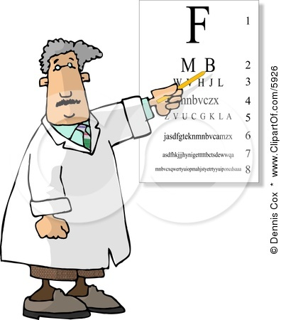
427 C1 OPHTHA OSCE
Done by: Latifah Abdullah

Slide 2
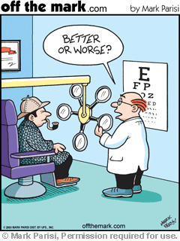
30 slides
2 minutes each slide
2 minute break after 15 slides- 2 minutes in the end to review
60 marks
Questions are on the paper, sometimes you can know the answer before seeing the slide
Almost all from Past Osces

Slide 3
A
B
Name the structure.
A/ Right Superior Canaliculus
B/ Right Nasolacrimal sac

Slide 4
A/ What is this instrument?
Pinhole
B/ What is it’s clinical value?
For testing central vision, if vision gets better indicates a refractive error

Slide 5
3 year old child with excessive tearing since birth
A/What is the diagnosis?
Congenital Nasolacrimal duct obstruction
B/ What’s the treatment?
Stenting/ Probing to open the duct

Slide 6
Bilatertal finding in obese woman, pressure 120/80, CT scan normal
A/ What is the diagnosis?
Papillodema (can be caused by pseaudotumor cerebri)
B/ What is the management?
Reduce weight
Medically: Carbonic anhydrase inhibitor (acetozalamide)
Surgically: CSF shunt

Slide 7
A/ What is the diagnosis?
Accommodative Esotropia in the right eye
B/ What kind of refractive error is associated?
Hyperopia

Slide 8
A/ What is the diagnosis?
Proliferative Diabetic Retinopathy (neovasculirization at the optic disk)
B/ What is the management?
Pan Retinal Photocoagulation (PRP) + Control blood sugar

Slide 9
A/ What is the diagnosis?
Orbital Cellulitis
B/ Mention 2 complications.
Meningitis- Brain abscess- Cavernous sinus thrombosis

Slide 10
This is a direct ophthalmoscope.
A/What is the magnification?
x15
B/Mention 2 characteristics.
Real image not inverted- high magnification- monocular vision- Narrow field

Slide 11
A/ What is the name of this procedure?
Peripheral Iridotomy
B/Mention 2 indications.
Closed Angle glaucoma- Narrow angle glaucoma – prophylaxis in other eye

Slide 12
A/ What is the diagnosis?
Subconjuctival hemorrhage
B/Mention 2 causes.
Trauma- Valsalva maneuver- Bleeding disorder- OCP

Slide 13
A/ What type of visual defect is this?
Bitemproal Hemianopia
B/ What’s the possible cause?
Pituitary Adenoma

Slide 14
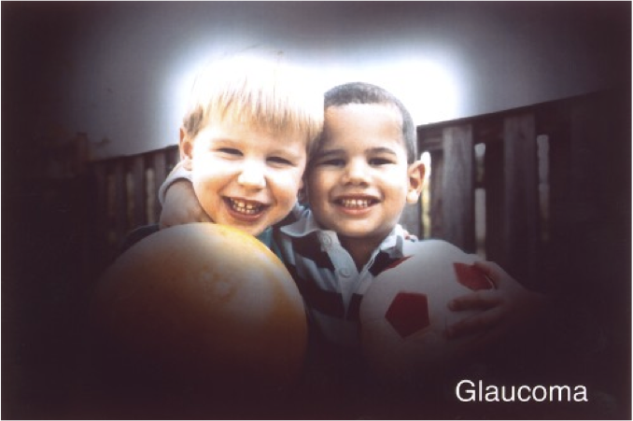
A/ Describe the image you see in the picture on the right.
Tunnel vision
B/What causes this?
Glaucoma

Slide 15
A/ What is the diagnosis?
Herpetic Keratitis
B/ What is the treatment?
Topical Antiviral (acyclovir)

Slide 16
A/ What is the sign in this picture?
Cupping of the disk
B/ Mention 2 types of visual defects associated with this condition.
Arcuate scotoma- Nasal step defect

Slide 17
Name the structure.
3/ Optic Tract
5/ Optic radiation

Slide 18
This is the picture in the exam.
A/What is the diagnosis?
Retinal Detachment
B/ Mention 1 cause.
High myopia- Trauma

Slide 19
This patient presented with red painful eye post cataract surgery. (this is the picture we got in the exam)
A/What is the diagnosis?
Endophthalmitis
B/How do manage?
Intravitreal Antibiotics+ intravitreal sample for culture

Slide 20
A/What is this instrument?
Prism
B/What is it’s clinical value?
Measure the degree of deviation (strabismus)

Slide 21
A/ What is the diagnosis?
Foreign Body
B/ What is the management?
Local anesthetic >> remove foreign body >> Topical antibiotic

Slide 22
A/ Mention 2 complications of surgery for this condition.
Endophlamitis- hemorrhage- vitreous loss
B/ Mention 2 indications for surgery.
Phacomorphic glaucoma-Phacolytic glaucoma- occupation requiring sharp vision (Pilot)

Slide 23
3 months history of swelling.
A/ What is the diagnosis?
Left Lower lid chalazion
B/ What’s the treatment?
Warm compresses+ Incision+ drainage

Slide 24
This is a trauma due to fingernail scratch.
A/How do you manage?
Topical antibiotics+ Patch the eye
B/ Mention 2 complications.
Corneal scarring- Keratitis

Slide 25
A/What is the diagnosis?
Non-proliferative Diabetic Retinopathy
B/What is the management?
Focal laser+ Control blood sugar

Slide 26
3 year old boy on his routine visit to the ophthalmology clinic.
A/ What is this patch for?
To prevent amblyopia in the left eye (weaker)
B/Mention 2 possible causes.
Anisometropia – Strabismus

Slide 27
Name the structure.
23/ Tarsal plate.
14/ Ciliary body.

Slide 28
A/ What is the diagnosis?
Leukocoria of the right eye
B/Mention 2 causes.
Retinoblastoma- Congenital cataracts- ROP

Slide 29
A/What is the diagnosis?
Herpes Zoster Ophthalmicus
B/Mention 2 ocular complications.
Keratitis-Uveitis- Blindness

Slide 30
A/ What’s the type of Refractive error?
Myopia
B/ Type of lens used to correct it.
Concave lens

Slide 31
A/What is the diagnosis?
Left facial nerve palsy (LMNL)
B/Mention 2 ocular presentations.
Epiphoria- Ectropian- Exposure Keratitis

Slide 32
Contact lenses wearer.
A/ What is the diagnosis?
Corneal ulcer
B/ How do you manage?
Remove contact lens+ topical antibiotics and do Not patch

Slide 33
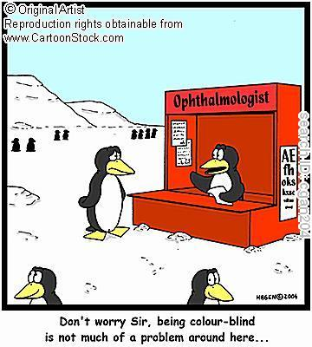
Thank you to Nour AlMalki for her help.
GOOD LUCK!!

