Slide 1
Ophthalmology OSCE
11 March, 2012
428 C2
Done By:
Hala Alrugaib
Maha Alyousef

Slide 2
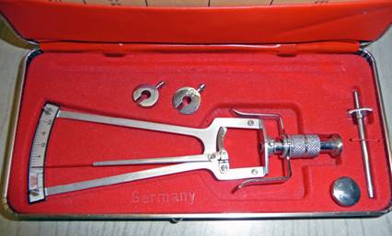
Slide #1
Q: Identify this instrument?
A: Schoizt Tonometer
Q: What is this instrument used for?
A: I.O.P (intraocular pressure) measurement; through indentation method.

Slide 3
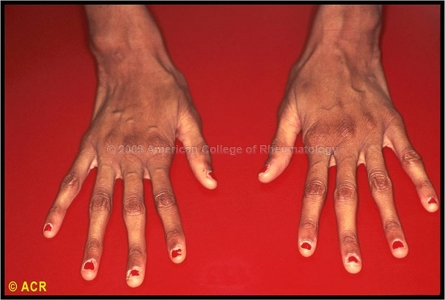
Slide #2
Q: What is this sign?
A: arachnodactyly; spider fingers (Marfan Syndrome)
Q: Mention 2 ocular manifestations that will be associated.
A:
Lens subluxation.
Axial Myopia (large globe)
Early Onset Glaucoma
Retinal Detachment

Slide 4
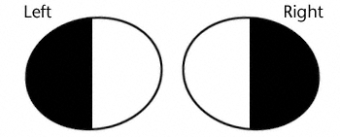
Slide #3
Q: This is the visual filed of a 30 years old lady. Name the defect?
A: Bitemporal Heminopia.
Q: What is the most likely cause?
A: Pituitary Adenoma.

Slide 5
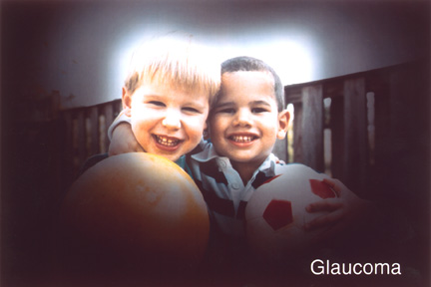
Slide #4
Q: Name the type of visual field defect?
A: Tunnel vision; peripheral visual field loss
Q: What is the most likely cause/Diagnosis?
A: Open Angle Glaucoma (chronic).

Slide 6
Slide #5
Q: What is the Magnification for this instrument?
A: 15 times/diopters
Q: Mention 2 characteristic for the image obtained.
A:
Erect
Virtual (not real)
Narrow field of vision
Some said monocular which is true, but they asked for the image itself

Slide 7
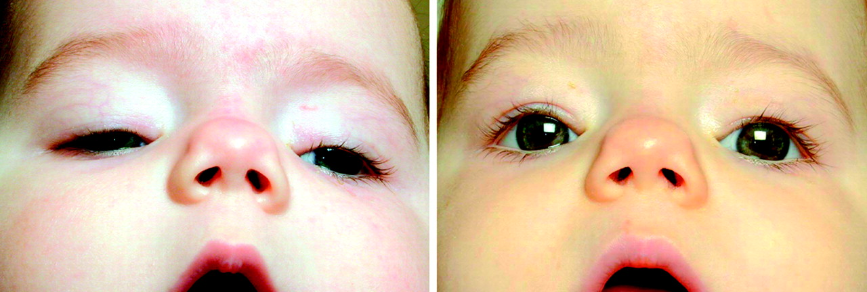
Slide #6
Q: What is the sign/diagnosis?
A: Bilateral ptosis, most likely congenital type.
Q: When should you start the treatment?
A: After 1 year but before 2 years to prevent C-spine deformity. These kids tend to lift their chins as a compensatory mechanism. If its unilateral surgery before 2 months to prevent amblyopia
The picture in the exam was very clear.

Slide 8
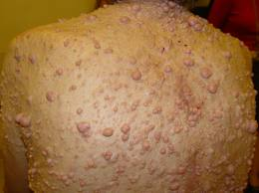
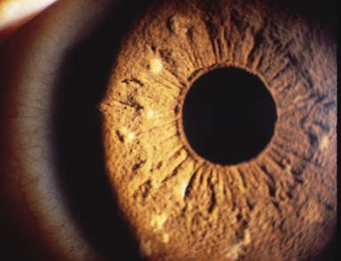
Slide #7
Q: What is the systemic disease?
A: Neurofibromatosis.
Q: What is the name of the lesion in the iris?
A: Lisch Nodules.
Other manifestations :
Sphenoidal hypoplasia “Pulsatile proptosis”.
Plexiform neurofibromas
Choroid hamartomas
Optic nerve gliomas
Prominent corneal nerves

Slide 9
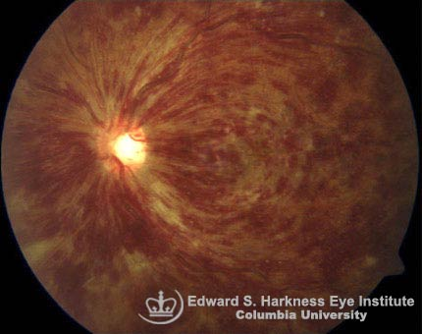
Slide #8
Q: What is the diagnosis?
A: Central retinal vein obstruction (CRVO).
Blood and Thunder sign.
Q: How does he/she present?
A: Painless Sudden Visual Loss

Slide 10
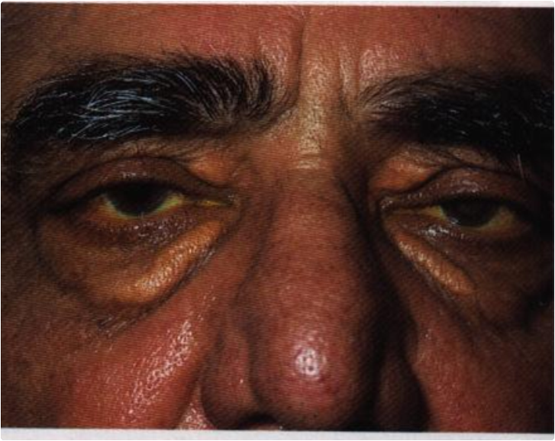
Slide #9
Q: What is the sign?
A: Xanthelasma.
Q: What other test would you perform?
A: Lipid profile.

Slide 11
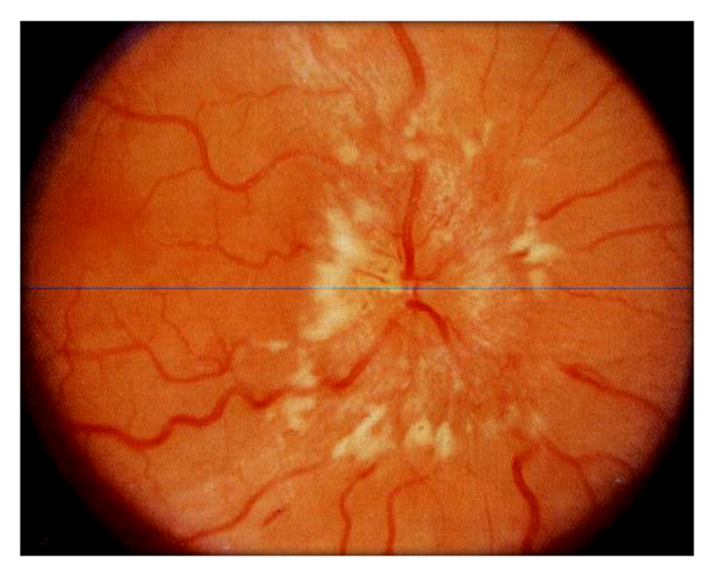
Slide #10
Q: This was a bilateral finding in a young obese woman with 120/80 BP. CT scan imaging was negative. What is the sign/How would you manage her?
A: Papilloedema, Pseudotumor cerebri; benign intracranial hypertension.
A: Management depending on the severity:
weight reduction.
Diuretics, fluid & saults restrictions
Shunt
Q: other modality to confirm
A: Spinal Tap (Lumber Puncture).
Some students wrote MRI.

Slide 12
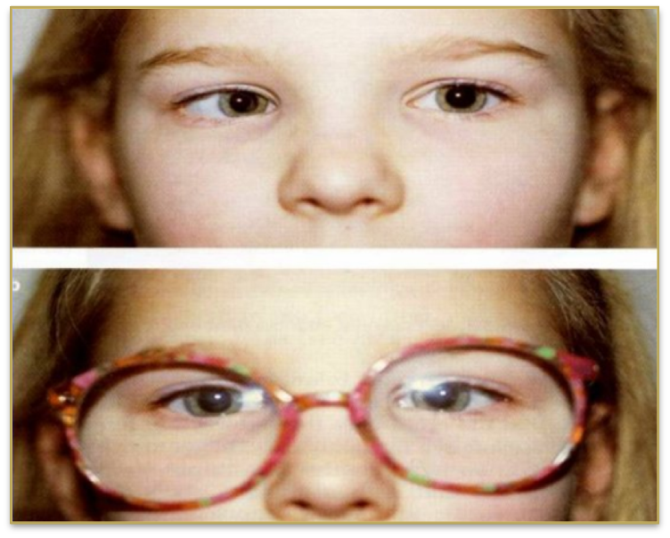
Slide #11
Q: What is the diagnosis?
A: Accommodative esotropia in the right eye.
Q: Which type of refractive error is associated with this condition?
A: Hyperopia.

Slide 13
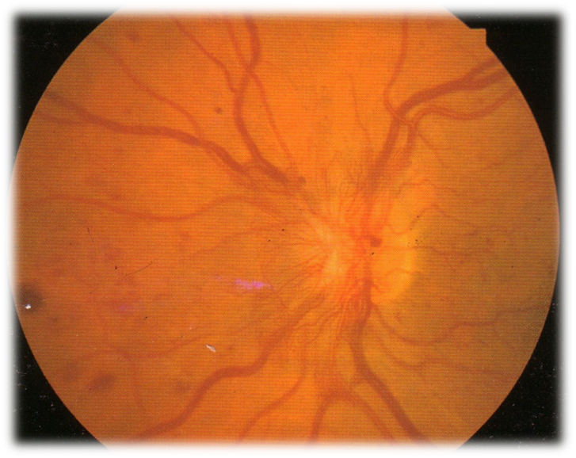
Slide #12
Q: Hx: DM, 56 year-old. What is the diagnosis/sign?
A: Proliferative Diabetic Retinopathy/Optic N. head neovascularization (NVD).
Q: How would you manage this patient?
A: Pan-retinal photocoagulation (PRP) and control blood sugar.

Slide 14
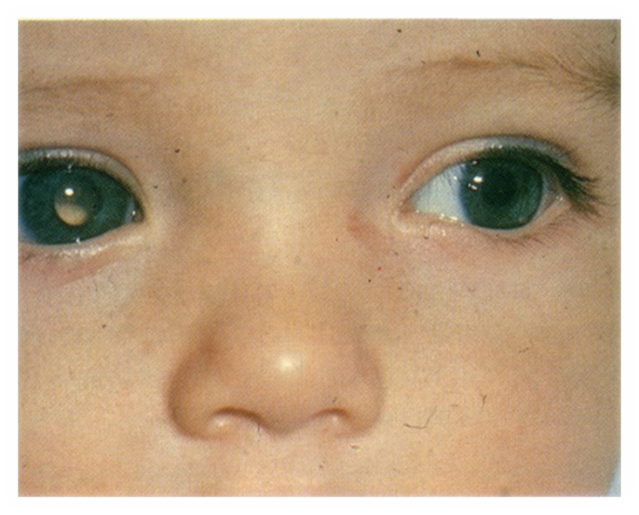
Slide #13
Q: What is this sign?
A: Leukocoria in the right eye.
Q: Mention 2 differential diagnoses.
A:
Congenital cataract
Retinoblastoma.
In the picture we had, there was red reflex in the left eye and leucokoria in right eye.

Slide 15
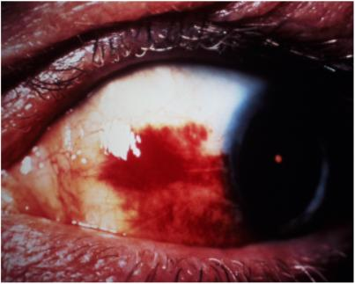
Slide #14
Q: What is the diagnosis?
A: Subconjuctival Hemorrhage.
Q: Mention 2 causes of this condition.
A:
Trauma.
Old age.
HTN.

Slide 16
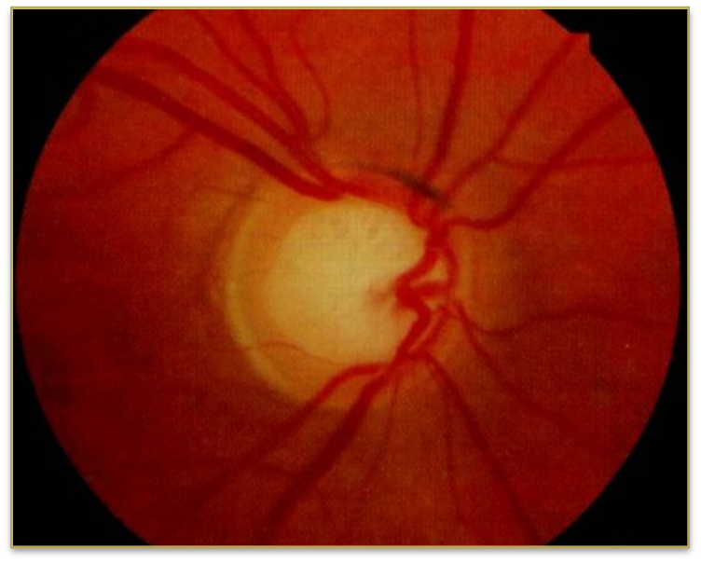
Slide #15
Q: What is the sign?
A: Increase cup to disc ratio
Q: . Mention 2 types of visual field defect is associated with this condition?
A:
Nasal step
Arcuate scotoma
Peripheral visual field defect.

Slide 17
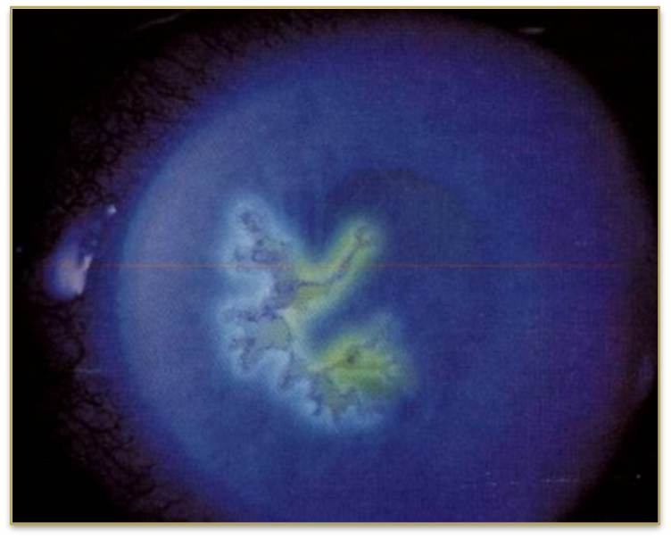
Slide #16
Q: What is the diagnosis/ causing organism?
A: Herpetic keratitis. (Dendritic ulcer)
A: herpes simplex & herpes zoster
Q: What is the treatment?
A: Topical antiviral: trlfluridine, may consider systemic: Acyclovir

Slide 18
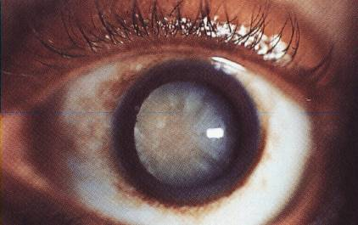
Slide #17
Q: What is the diagnosis?
A: Senile cataract.
Q: Mention 2 postoperative complications for this condition.
A:
Posterior Subcapsular Cataract
Endophthalmitis
hemorrhage.
Macular Edema

Slide 19
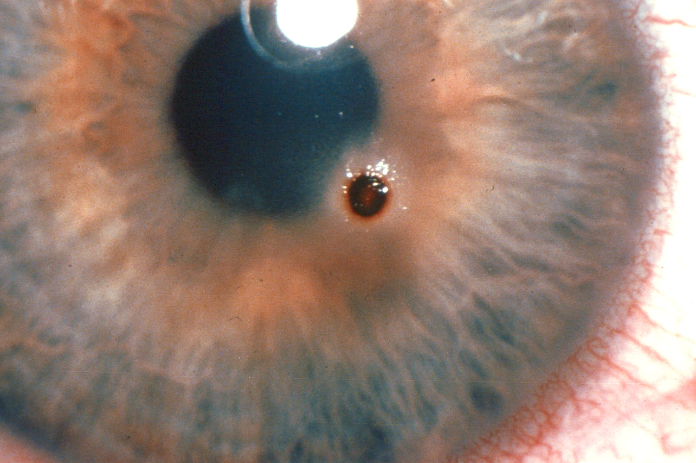
Slide #18
Q: What is the diagnosis?
A: Foreign body in the eye (cornea).
Q: What is your managment?
A:
Remove the foreign body under local anesthesia
Topical antibiotic.
consider topical NSAID, cycloplegic.

Slide 20
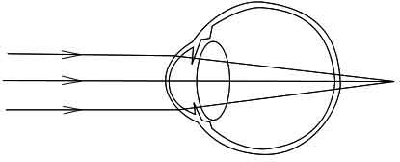
Slide #19
Q: What is the refractive error?
A: Hyperopia.
Q: If this error was without accommodation, when accommodation occur will it increase or decrease the error?
A: decrease.

Slide 21
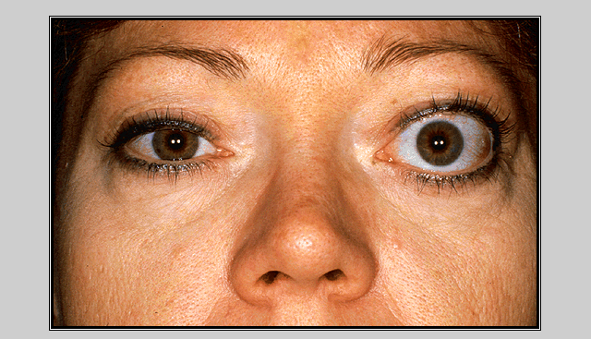
Slide #20
Q: What is the diagnosis?
A: unilateral proptosis with lid retraction
Q: Is it active or inactive?
A: Inactive

Slide 22
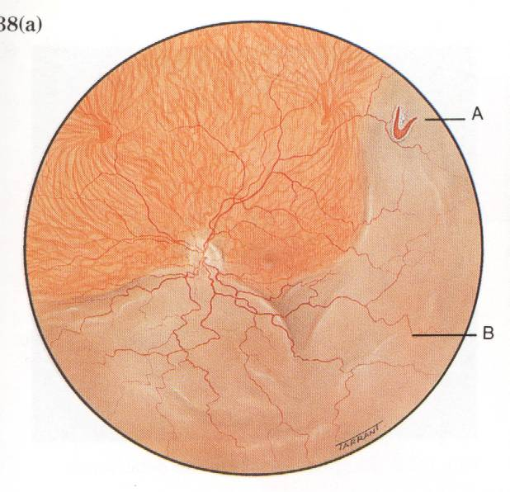
Slide #21
Q: What is the diagnosis?
A: Retinal detachment (Rhegmatogenous type; mostly sub-temporal ”horse shoe sign”)
Q: What is the treatment?
A: Surgical:
Scleral buckling
vitrectomy plus injection of silicone oil
Some wrote just surgical Tx, not sure if they’ll take it as a right answer though.

Slide 23
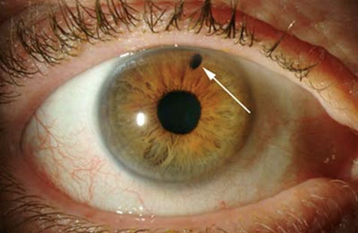
Slide #22
Q: What is the name of this procedure?
A: Laser Peripheral Iridotomy; yag laser.
Q: What is the indication for this procedure?
A: Angle Closure Glaucoma

Slide 24
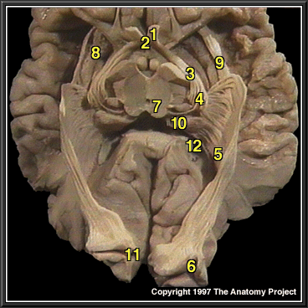
Slide #23
Q: Identify 2.
A: Optic chiasm.
Q: Identify 5.
A: Left Optic Radiation.

Slide 25
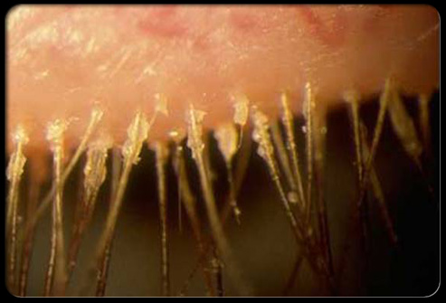
Slide #24
Q: What is the diagnosis?
A: Acute blephritis.
Q: what is your management?
A:
Lid hygiene.
Ointment antibiotic.
Worm compressors

Slide 26
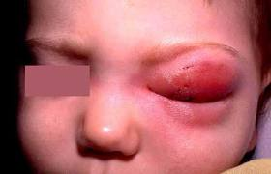
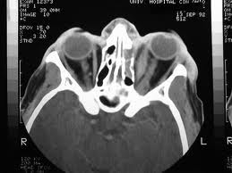
Slide #25
Q: cant remember the Hx but it was very clear.
A: orbital cellulitis
Q: what are the CT findings suggestive of your diagnosis?
A:
Ethmoid sinus opacity
Subperiosteal abscess
Protrusion of the globe
Similar pictures plz note CT scan not for the same kid

Slide 27
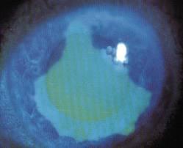
Slide #26
Q: A boy came to the ER complain of red eye and tearing and Hx of finger nail injury?
A: Corneal abrasion
Q: Management?
A:
Topical antibiotic (drops or ointment),,
consider topical NSAID, cycloplegic,,
Patch: not sure if we can use it after nail! Infection!
Similar picture

Slide 28
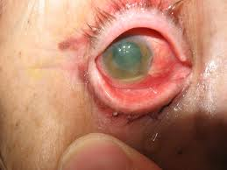
Slide #27
Q: An old gentleman had a complicated cataract surgery, on the second postoperative day he presented with this picture: what is the most likely complication?
A: Endophthalmitis
Q: How would you manage such a case?
A: Admission, start empirical Intra-vitreal antibiotics, culture to check the causative organism,, vitrectomy as a last resort,,

Slide 29
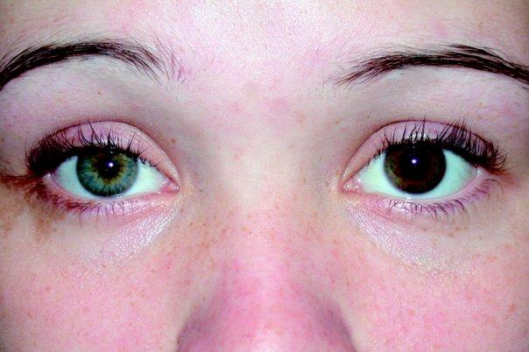
Slide #28
Q: This a picture of a patient who’s using eye drops to treat her condition “Glaucoma”, what is the Latin name of this side effect?
A: Heterochromia iridis (change in color of one iris= gets darker)
Q: Name another side effect cause by the same drug?
A:
Longer & darker Lashes
Periorbital Skin Hyperpigmentation
Conjunctival hyperemia
They didn’t mention that its prostaglandin you should know from the side effect + glaucoma therapy,,
Mechanism of action: increase uveoscleral outflow
*Not same pic but similar the effected eye is the left one

Slide 30
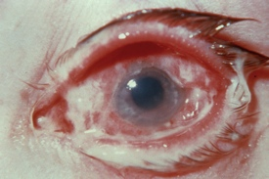
Slide #29
Q: A man came to the ER with a Hx of redness and pain in one eye for one day, from the picture, what is the most likely diagnosis?
A: Some answered corneal ulcer complicated by bacterial conjunctivitis, most likely psuedomonas ‘since less than 24h’
Q: How would you manage such a case?
A:
Take off the contact lenses if he’s using them
Topical broad spectrum antibiotics
Cycloplegics
Topical analgesic NSAID’s
Not sure of the answer

Slide 31
Slide #30
Q: This patient came to
A:
Q: how would you manage her?
A:

