Slide 1
Q. What is this instrument : A. Pinhole Q. What is it the value ? A. Central vision testing to re-correct refraction if necessary .

Slide 2
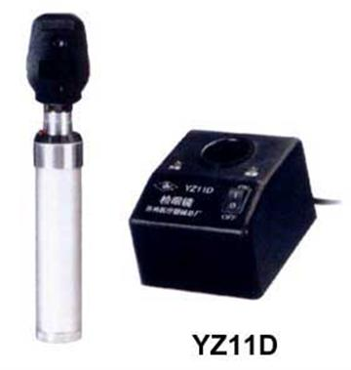
Direct Opthlamoscope Q. What is the magnification? A. x15 Q. Mention 2 characteristics of the image produced. A. Right image (not inverted), mono-ocular vision, high magnification, narrow area.

Slide 3
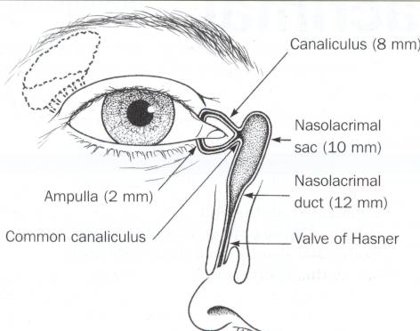
Q. Identify the organ (A) A. Superior canaliculus. Q. Identify the organ (B) A. Nasolacrimal sac.
A
B

Slide 4
1- Dx = nasolacrimal duct obstruction 2- Rx = recanalization or massage
صورة طفل وضع له صبغة الاختبار وكأنه يبكي الصبغة ؟؟

Slide 5
1- INSTRUMENT ? Prism 2- value ? Test eye deviation (measure strabismus)
إذا حابين تشوفونها تلقونها بالعيادات

Slide 6
Dx ?Neurofibromatosis associated symptoms in eyes? -Sphenoidal dysplsia -Optic Glioma -Nearofibrosarcoma -Iris Hamartoma

Slide 7
Q. What is the diagnosis? Vitreous Hemorrhage Q. Name 3 causes; Trauma, HTN , DM

Slide 8
Dx? Sublaxated lens (SuperoTemporally) associated with ? → Marfan’s Syndrome

Slide 9
Dx? Posterior synechia risk factor? -trauma -iritis -iridocyclitis -syphilis -leprosy -herpes -toxoplasmosis -Parasites -tuberculosis -hypermature cataract TTT: Atropine Mydriatics Topical steroids CAUTION ! NEVER give steroids if: (1) There are signs of infection. (2) He has a corneal ulcer.

Slide 10
Dx? Iridodialysis causes: - Blunt & penetrating trauma - iatrogenic ( cataract surgery) TTT: -Patch & Observe -Surgical

Slide 11
Dx? Xanthelasma lab test ? - lipid profile

Slide 12
This was a bilateral finding in a young obese woman with 120/80 BP. CT scan imaging was negative. Q. What is the most likely diagnosis? -papilledema -Brain tumor -Pseudotumor crebri -HTN Q. How would you manage her? 1.Medical: weight reduction & carbonic-anhydrase inhibitors (e.g. acetazolamide) 2.Surgical: CSF shunt.

Slide 13
Dx? Pusdoesotropia. What is the cause? Large epicanthal fold. You can see the symmetrical light reflex

Slide 14
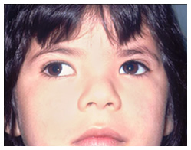
Dx? Rt eye exotropia. Type of surgery. Lateral rectus weakening. Medial rectus strengthening

Slide 15
Name the instrument? Exophthalmometer. uses ? Measure Exopthalmos

Slide 16
Q. What is the diagnosis? A. Right facial (7th) nerve palsy (LMNL). Q. Mention 2 ocular manifestations: Exposure keratitis epiphoria (excessive tearing) ectropion.

Slide 17
Identify 1- Optic Tract 2- Optic Radiation

Slide 18
Q. What is the diagnosis? A. Accommodative esotropia in the right eye. Q. Which type of refractive error is associated with this condition? A. Hyperopia.

Slide 19
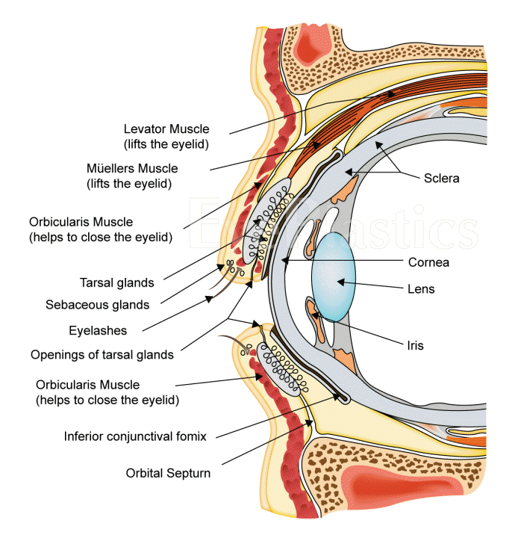
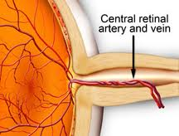
2
1
1- Ciliary Body
2- Central retinal artery

Slide 20
Q. DIAGNOSIS ? PROLIFERATIVE DIABETIC RETINOPATHY Q. What is the sign ? Fan shaped neovascularization on optic disc (NVD) Q. How would you manage this patient? A. Pan-retinal photocoagulation (PRP) & control blood sugar

Slide 21
Q. What is this sign? A. Leucokoria in the right eye. Q. Mention 2 differential diagnoses. -Congenital cataract -Retinoblastoma -Premature Retinopathy

Slide 22
Q. What is the diagnosis? A. Subconjuctival hemorrhage. Q. Mention 2 causes: -Trauma -blood diseases -anti-coagulants -OCP -cough -Valsalva maneuver -old age -idiopathic.

Slide 23
A patient with a history of glaucoma Q. Dx? A. Open angle glaucoma Q. What is this sign? A. Cupping (increased cup:disk). Q. Which type of visual field defect is associated with this condition? Peripheral visual field defect Nasal Step Arcuate Scatoma

Slide 24
Tunnel Vision Glucoma

Slide 25
A 25 year old patient with a history of sinusitis & fever Q. What is the diagnosis? A. Orbital cellulitis. Q. How would you manage her? Admission, temperature chart, culture and sensitivity, IV antibiotics, CT scan. Q. SYMPTOMS ? - PROPTOSIS - RESTRICTED EYE MOVEMENT -Distorted vision -Optic nerve injury Complications: Brain Abscess Cavernous sinus thrombosis Meningitis Optic Neuritis Vision loss

Slide 26
SLE butterfly rash Retinopath & Keratopathy Cotton wool appearance

Slide 27
Congenital ptosis will develop ambylopia

Slide 28
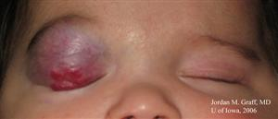
Capillary Hemangioma of the eye Treat by steroids

Slide 29
A patient with a history of wearing contact lenses Q. What is the diagnosis? A. Corneal ulcer. Q. How would you manage this patient? A. Remove the contact lenses & topical antibiotics

Slide 30
Q. What is the diagnosis? A. Herpitic keratitis. Q. What is the name of the stain that was used? A. Fluorescein dye. Q. Rx? acyclovir

Slide 31
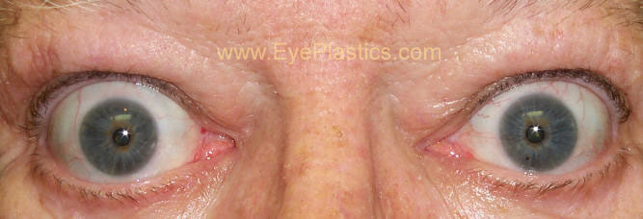
Proptosis Lid Retraction Causes: -Sinusitis -Trauma -Glucoma -Graves complications: Optic neuropathy Restricted eye movements

Slide 32
Q. What is the diagnosis? A. Senile cataract. Mention 2 postoperative complications: -Endophthalmitis -hemorrhage -IOL dislocation -Retinal Detachment -Cornea swelling -↑ IOP -Ptosis

Slide 33
A patient with a history of cataract surgery Q. What is the diagnosis? Endophthalmitis. Q. How would you manage this patient? intravitreal antibiotics.

Slide 34
Q. What is this procedure called? A. Peripheral iridotomy. Q. What is the indication of this procedure?. -Acute closed angle glaucoma -narrow angle glaucoma.

Slide 35
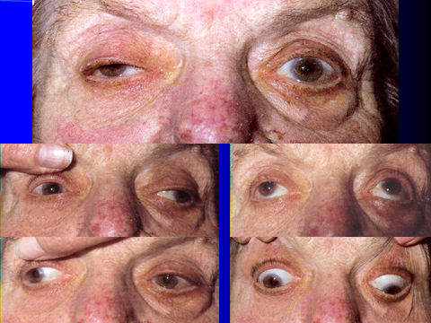
Q. What is the diagnosis?
A. Right oculomotor (3rd) nerve palsy.
Q. If patient has a history of nausea, vomiting & dizziness.
What will be the most likely diagnosis?
Neoplasm (brain tumor).

Slide 36
Hx of corneal abrasion 1- Rx ? Patch & cover 2- complication? -recurrent corneal erosions -Scar -Blepharospasm -Eye red -Eye pain -Photophobia
مو نفس الصورة

Slide 37
Hyphema TTT: Bed rest & prevent bleeding Cycloplegics Steroids Antifibrinolytics

Slide 38
Hx: Redness itching FB sensation Acute Blepharitis TTT: Hygine Antibiotic ointment hot compressor

Slide 39
Viterous hemorhage with Crescent shaped pool Symptoms: blurry vision • light flashes • floaters Causes: -DM -HTN -Sickle cell anemia -Carotid artery disease TTT: vitrectomy

Slide 40
CRAO -Cherry Red spot sign -Marcus Gunn Pupil Causes: -HTN -DM Giant Cell Arteritis -Emboli -Carotid Artery disease -Atherosclerosis Blood diseases TTT: -Restore blood flow in the 1st 2 days -supine position -ocular massage -IV acetazolamide & topical beta blockers

Slide 41
Q. What is the diagnosis? A. Central retinal vein obstruction (CRVO), sudden visual loss Investigations: fluroscien angiography Q. Mention 2 predisposing factors. -HTN & DM -Cardiovascular disorders -Bleeding or clotting disorders -Vasculitis -Autoimmune disorders -OCP -Trauma -Alcohol -Glucoma

Slide 42
Dx ? Chalazion Rx ? -warm compress - antibiotics - incision

Slide 43
Dacrocystitis Systemic Antibiotics Inscision & drainage

Slide 44
1- Dx ? Foreign body in eye 2- Rx? - anesthesis - remove FB - topical antibiotics

Slide 45
1- Dx ? Herpes zoster ophthalmus (involving 5th nerve) Hutchinson’s sign (nasocilliary nerve) 2- Rx?Acyclovir 3- associated symptoms? -Headache -Fever -Malaise - eye pain -red eye (usually unilateral) -decreased vision -skin/eyelid rash -tearing

Slide 46
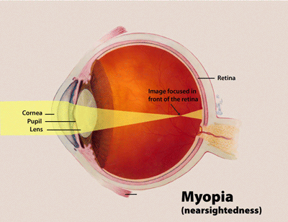
The Error : Myopia
Correction by : Concave Lens or –ve lense

Slide 47
What is the refractive error illustrated in the diagram? A. Hyperopia Q. What type of lenses could be used to correct it? Convex lenses +ve lens

Slide 48
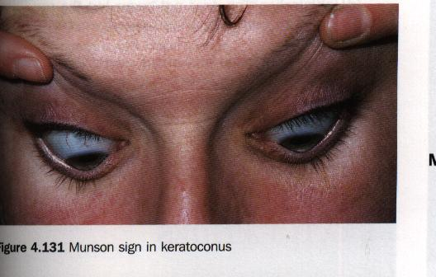
Q. What is the diagnosis? A. Keratoconus. Q. What is this sign? A. Munson’s sign.

Slide 49
Non proliferative DRP TTT: Focal or Grid photocoagulation

Slide 50
Hx: glucome and medication that decrease iris pigmentation Prostaglandin Analogue

Slide 51
U shaped tear Rhuegmatougenous Detachment

Slide 52
Dx? Retinal detachment Risk factor? -Myopia -cataract surgery -Glaucoma -Injru -Previous retinal detachment in the other eye -Family history

