Slide 1
Neuro-ophthalmology Review Second Hour
Thomas M. Bosley, MD
Professor of Ophthalmology
King Saud University

Slide 2
Neuro-ophthalmology
Afferent
Efferent
Other
Anatomy
Examination
Diagnoses
Tests

Slide 3
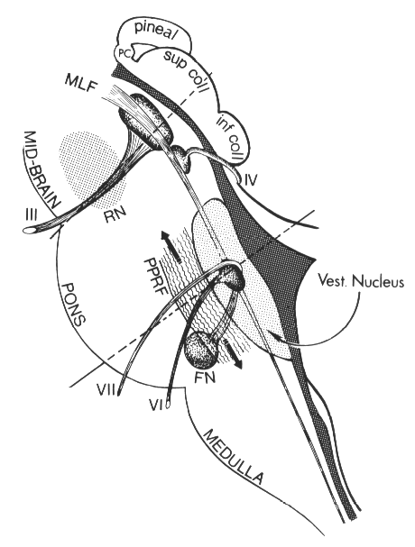
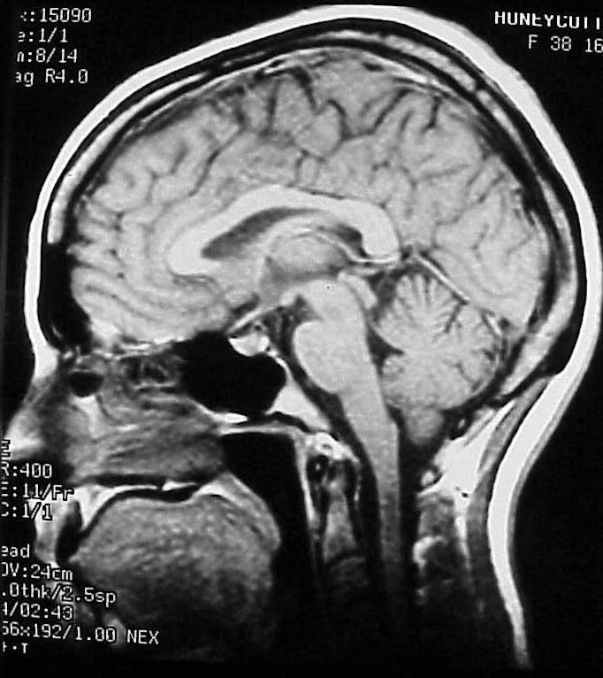
Efferent Neuro-anatomy

Slide 4
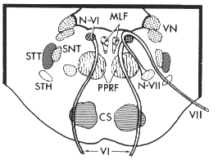
Efferent Neuro-anatomy

Slide 5
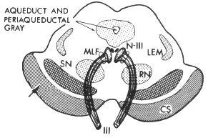
Efferent Neuro-anatomy

Slide 6
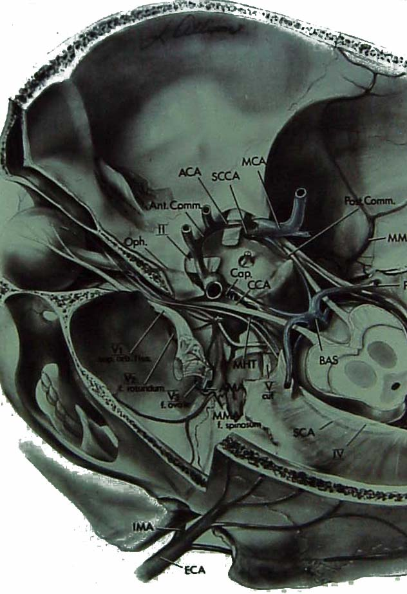
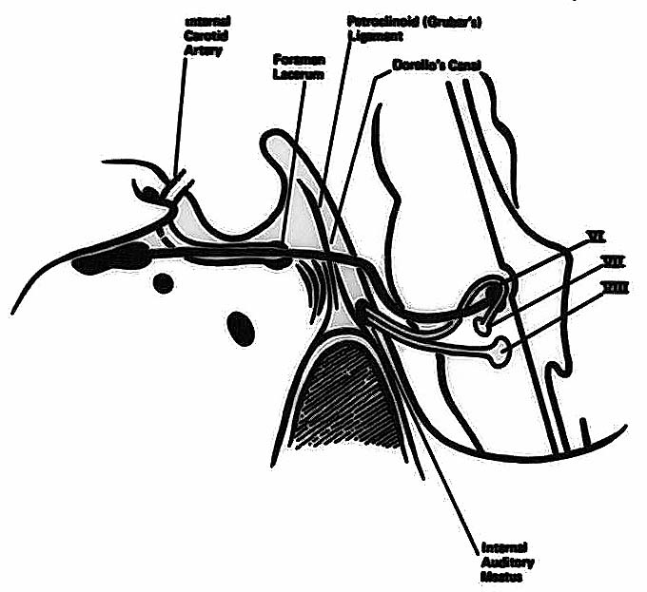
Efferent Skull Anatomy

Slide 7
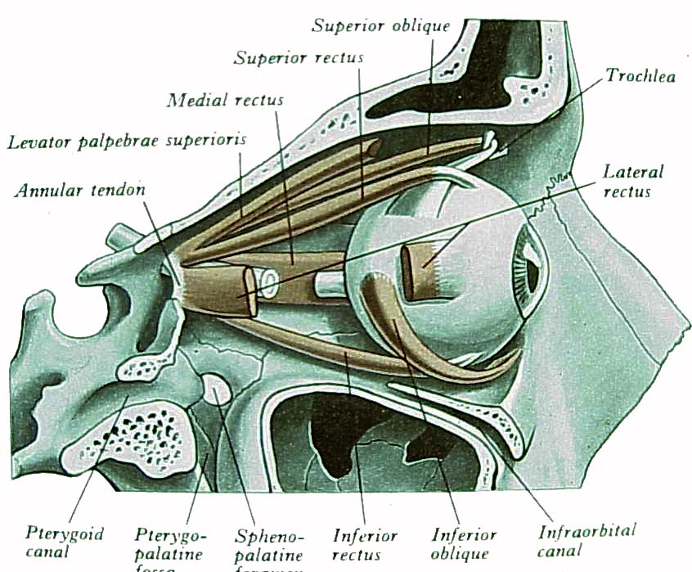
Efferent Skull Anatomy

Slide 8
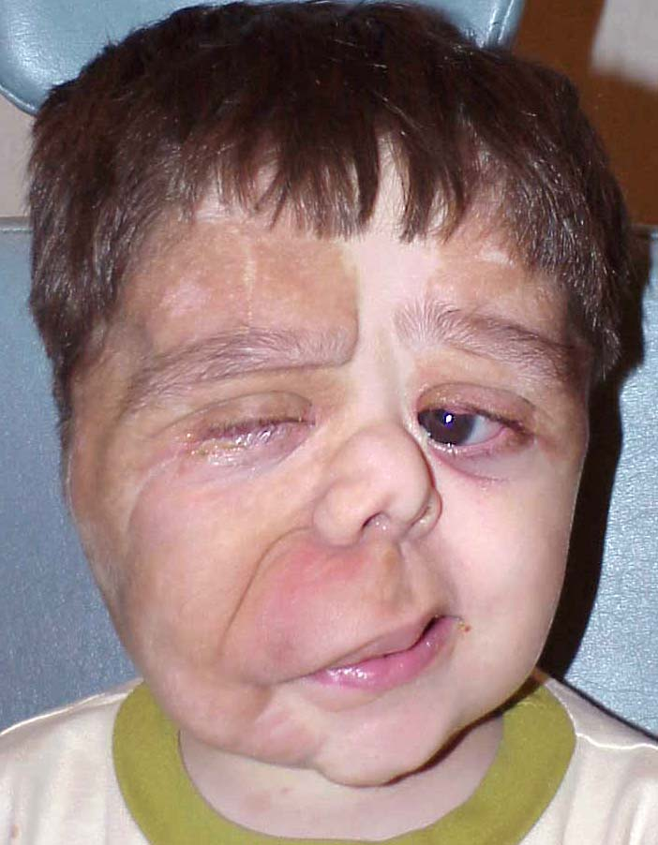
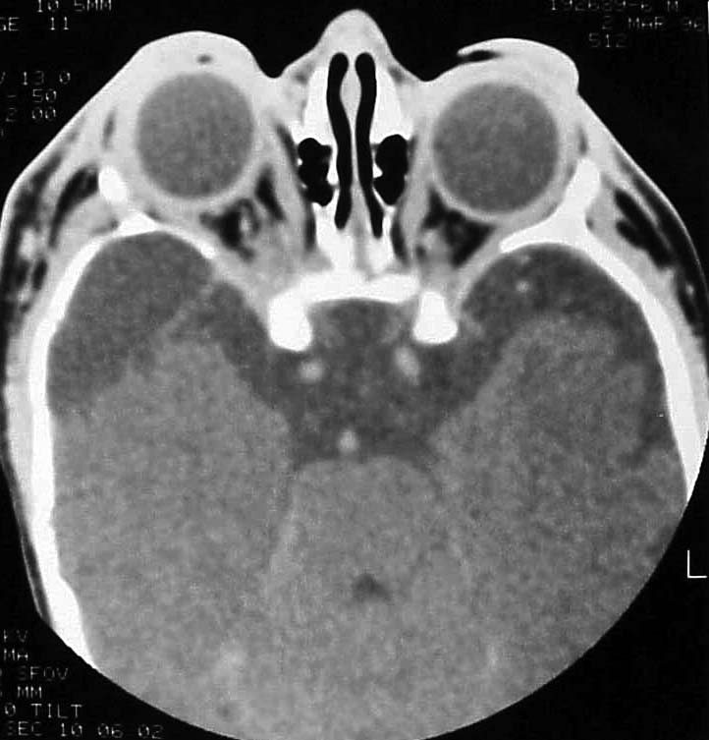
Orbit Pathology
192689-6

Slide 9
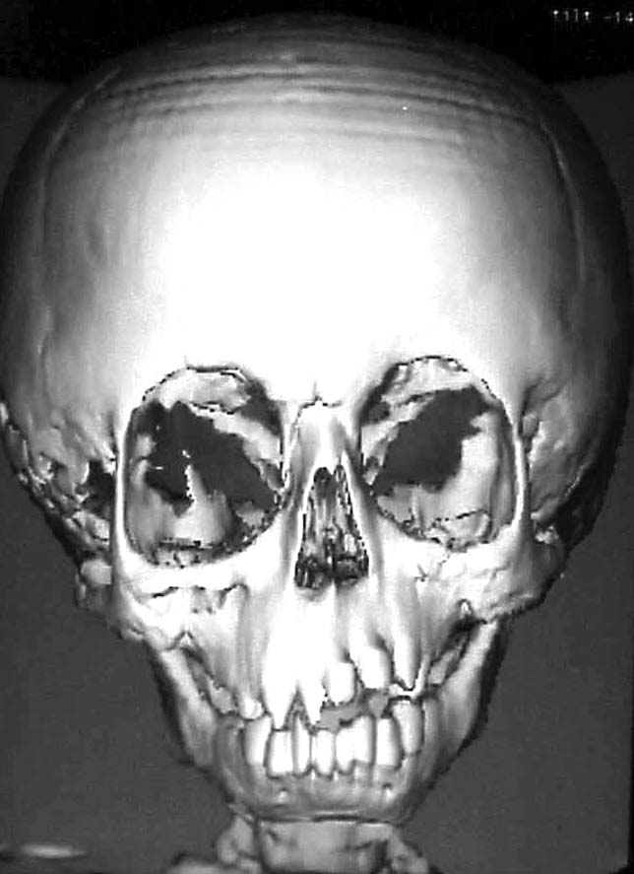
Orbit Pathology
192689-6

Slide 10
Efferent Examination
Just look at patient
Movements of both eyes in all directions
Smooth pursuit
Saccades

Slide 11
Efferent Examination
Just look at patient
Movements of both eyes in all directions
Smooth pursuit
Saccades
Are eyes straight?
What are the lid positions?
Are the eyes proptotic?
Are there any spontaneous eye movements

Slide 12
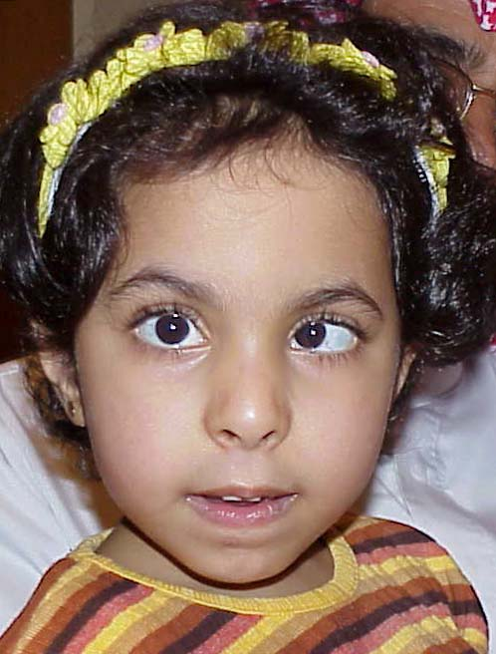
Efferent Examination
Are eyes straight?
What are the lid positions?
Are the eyes proptotic?
Are there any spontaneous eye movements
194568-8

Slide 13
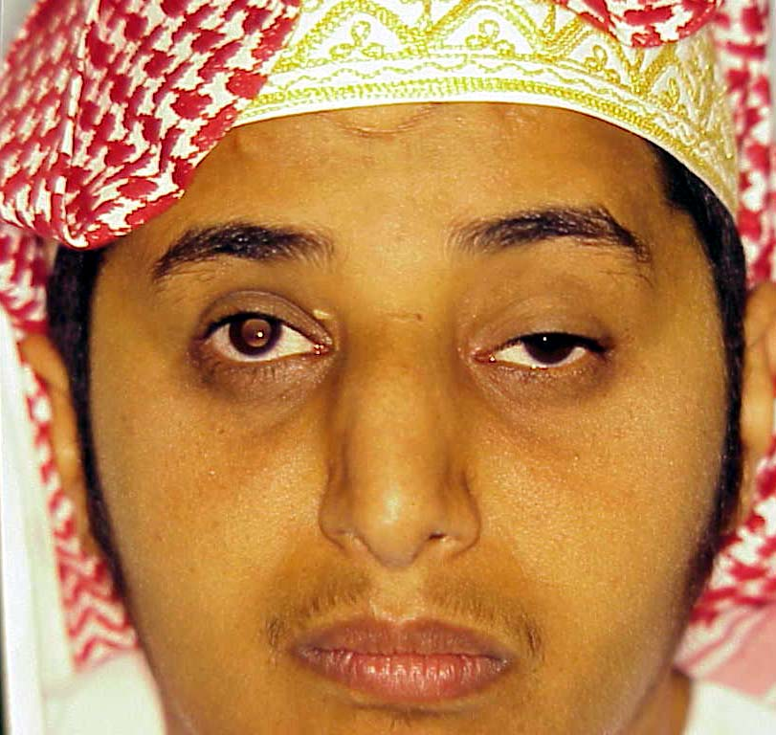
Efferent Examination
Are eyes straight?
What are the lid positions?
Are the eyes proptotic?
Are there any spontaneous eye movements
163331-7

Slide 14
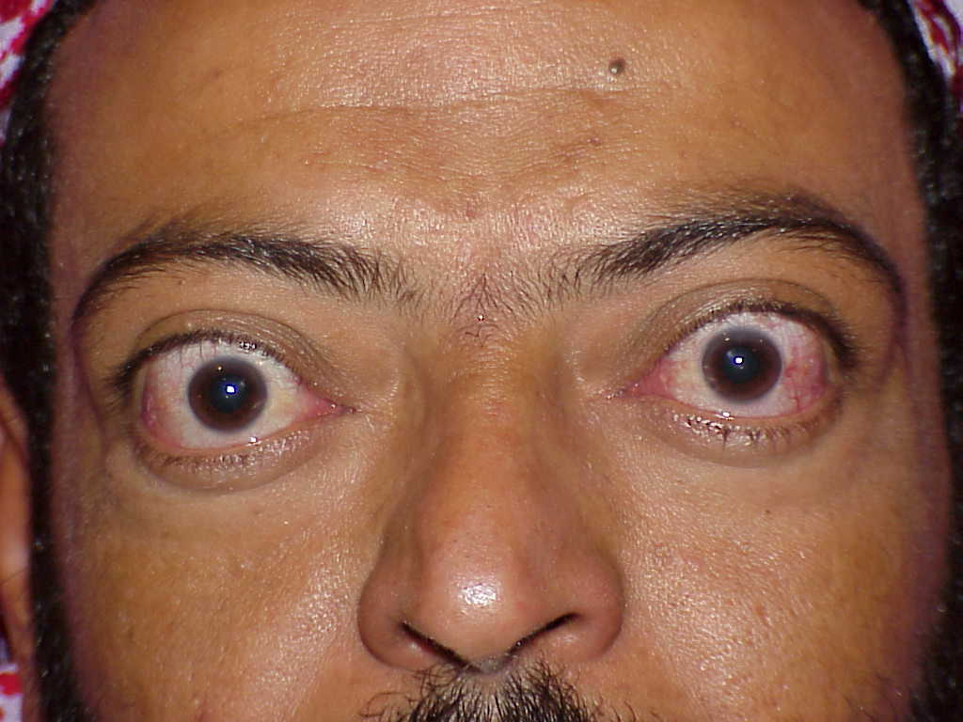
Efferent Examination
Are eyes straight?
What are the lid positions?
Are the eyes proptotic?
Are there any spontaneous eye movements

Slide 15
Efferent Examination
Are eyes straight?
What are the lid positions?
Are the eyes proptotic?
Are there any spontaneous eye movements
194568-8

Slide 16
Efferent Examination
Just look at patient
Movements of both eyes in all directions
Smooth pursuit
Saccades
Have the patient move eyes in all directions, not just the direction where you think there is a problem.
Hold lids if necessary (only after looking first without holding lids)
Examine each eye separately if necessary

Slide 17
Efferent Examination
Have the patient move eyes in all directions, not just the direction where you think there is a problem.
Hold lids if necessary (only after looking first without holding lids)
Examine each eye separately if necessary
260007-2

Slide 18
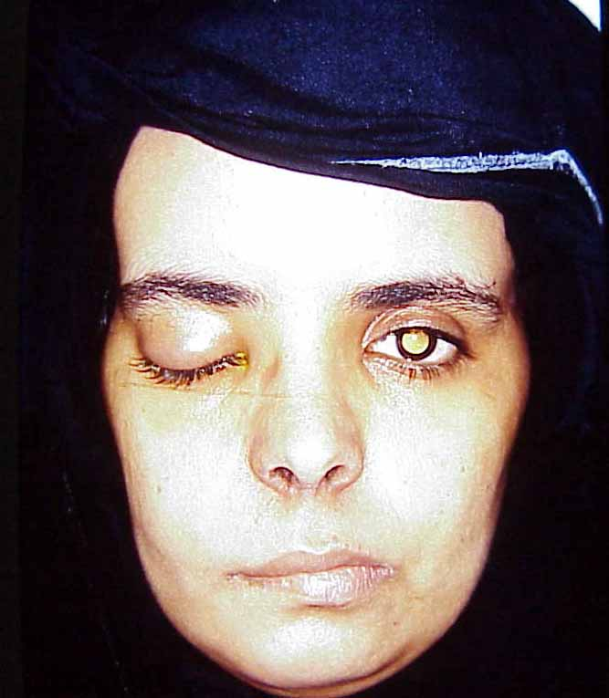
Efferent Examination
Have the patient move eyes in all directions, not just the direction where you think there is a problem.
Hold lids if necessary (only after looking first without holding lids)
Examine each eye separately if necessary
210439-3

Slide 19
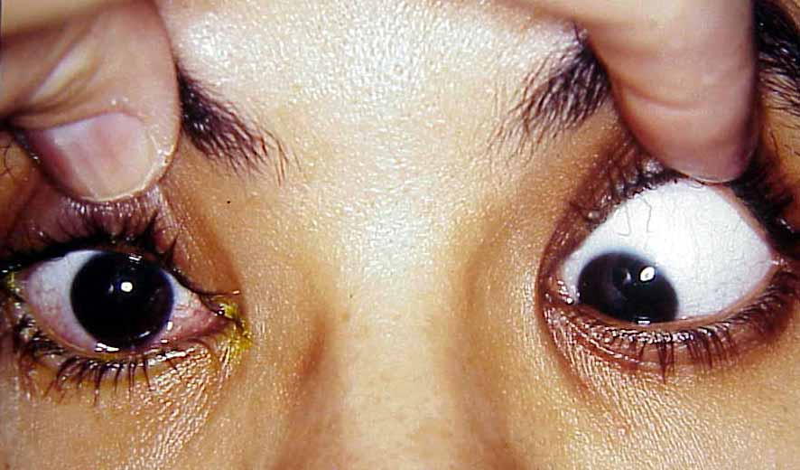
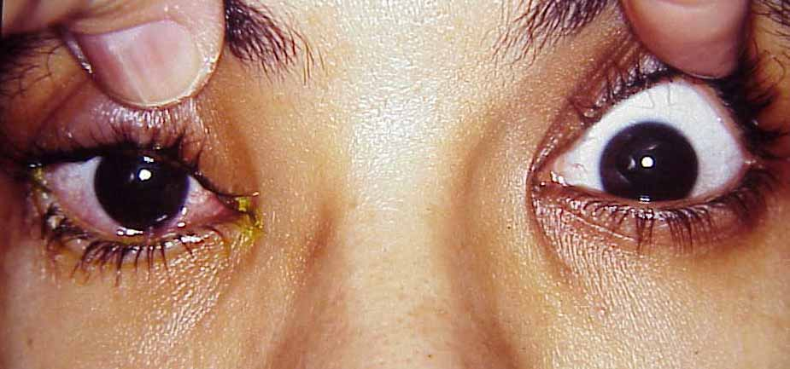
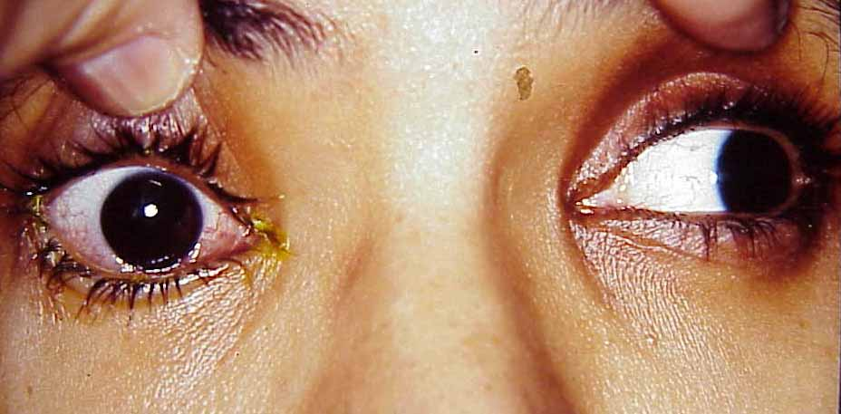
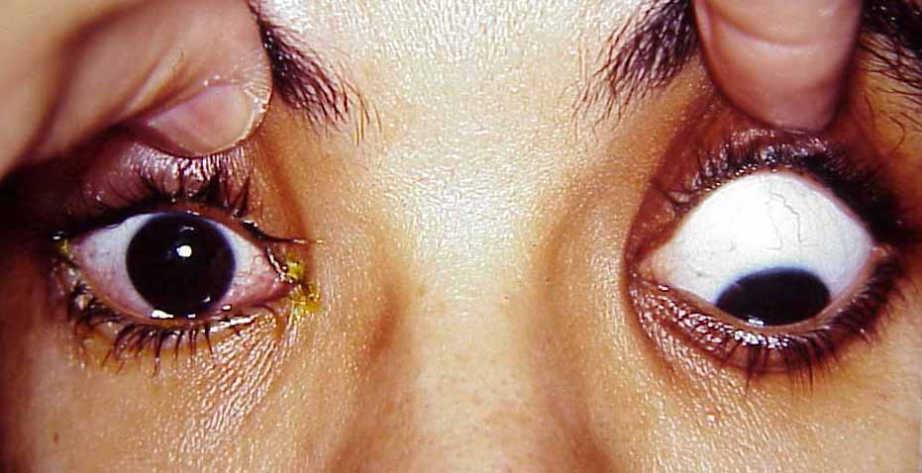
Efferent Examination
210439-3

Slide 20
Efferent Examination
210439-3

Slide 21
10 yo girl
Born with weakness of the face
Parents noticed unusual eye movements at early age
No family history
154333-4

Slide 22
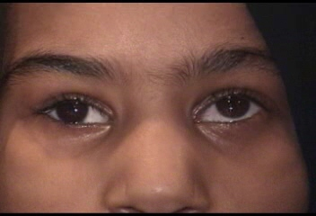
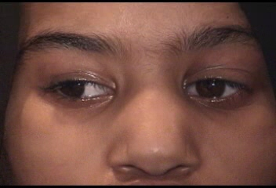
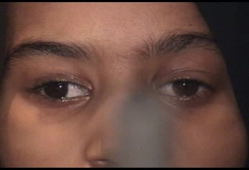
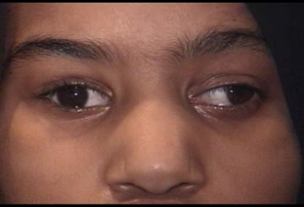
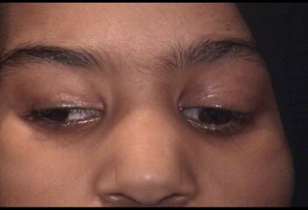
154333-4

Slide 23
10 yo girl
Bilateral Mobius syndrome, L>R
Possible congenital injury to 3rd CN OD
154333-4

Slide 24
Efferent Examination
Just look at patient
Movements of both eyes in all directions
Smooth pursuit
Saccades
The reflex that helps to maintain fixation on an object in motion in the visual world while the head is stable
Also the reflex that inhibits the vestibulo-ocular reflex

Slide 25
Efferent Examination
Just look at patient
Movements of both eyes in all directions
Smooth pursuit
Saccades
The reflex that permits a rapid refixation from one point in the visual field to another.

Slide 26
Efferent
Orbit
Extraocular muscles
Trauma
Mass
Neuromuscular junction
Single cranial nerves
Multiple cranial nerves
Intraparenchymal problem
INO
Gaze palsy
Anatomy
Examination
Diagnoses
Tests

Slide 27
Efferent Diagnoses
Orbit
Extraocular muscles
Trauma
Mass
Neuromuscular junction
Single cranial nerves
Multiple cranial nerves
Intraparenchymal problem
INO
Gaze palsy

Slide 28
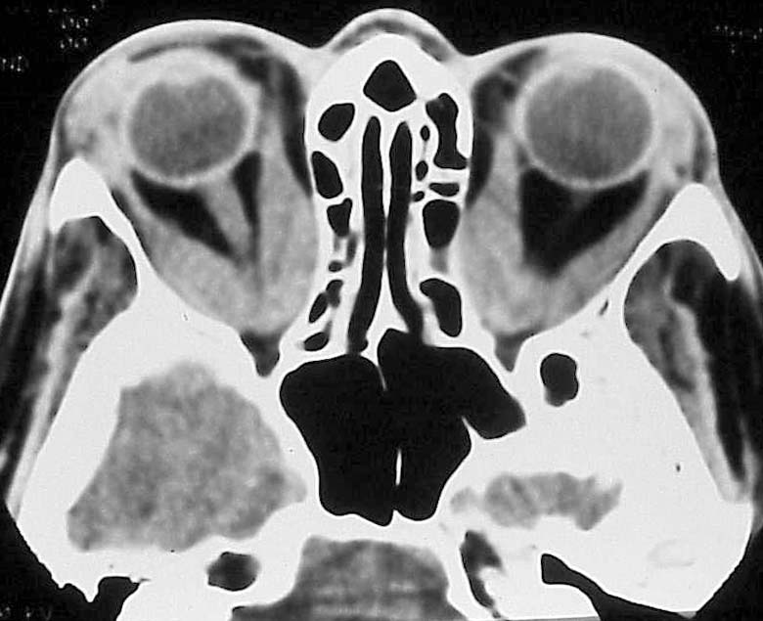
Efferent Diagnoses
Orbit
Extraocular muscles
Trauma
Mass
Neuromuscular junction
Single cranial nerves
Multiple cranial nerves
Intraparenchymal problem
INO
Gaze palsy

Slide 29
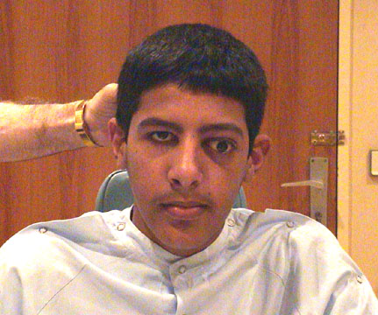
Efferent Diagnoses
Orbit
Extraocular muscles
Trauma
Mass
Neuromuscular junction
Single cranial nerves
Multiple cranial nerves
Intraparenchymal problem
INO
Gaze palsy
253324-3

Slide 30
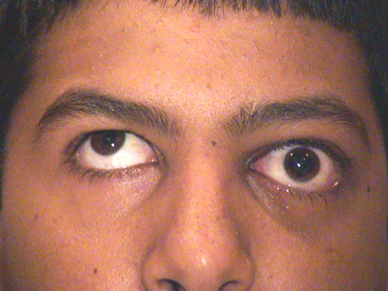
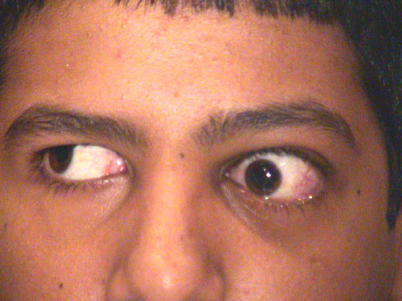
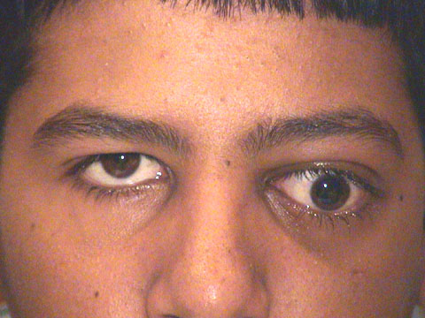
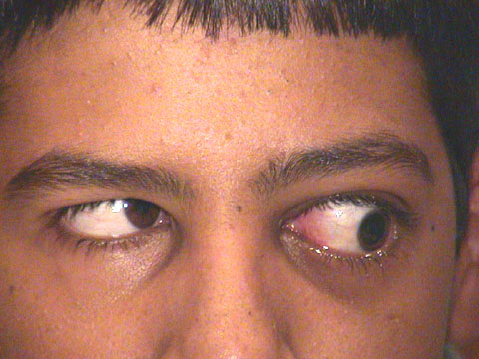
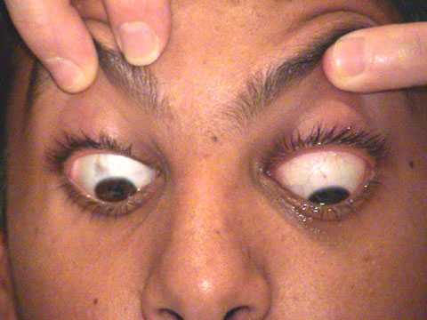
14 yo boy
253324-3

Slide 31
Efferent Diagnoses
Orbit
Extraocular muscles
Trauma
Mass
Neuromuscular junction
Single cranial nerves
Multiple cranial nerves
Intraparenchymal problem
INO
Gaze palsy

Slide 32
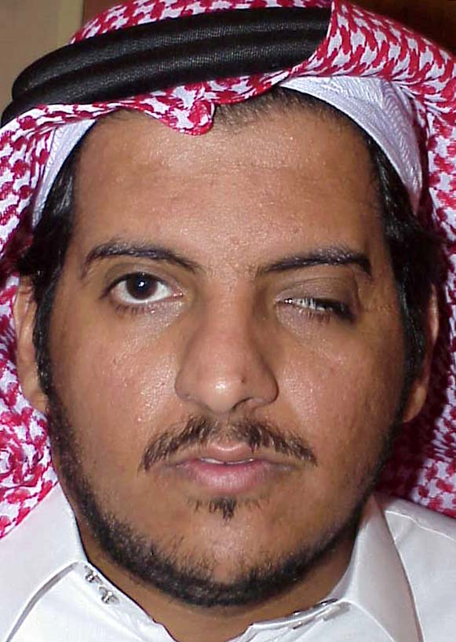
29 yo man
Left optic nerve sheath meningioma resected in 1988
Developed progressive ptosis in 1993 with pain, treated as sinusitis and resolved
Syndrome recurred in 9/00
067170-3

Slide 33
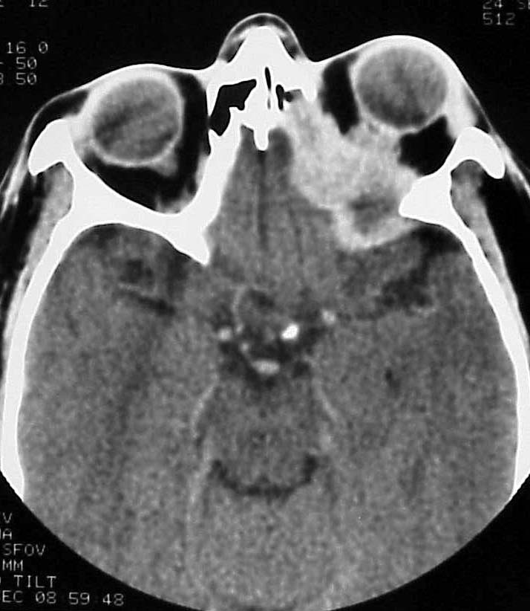
29 yo man
067170-3

Slide 34
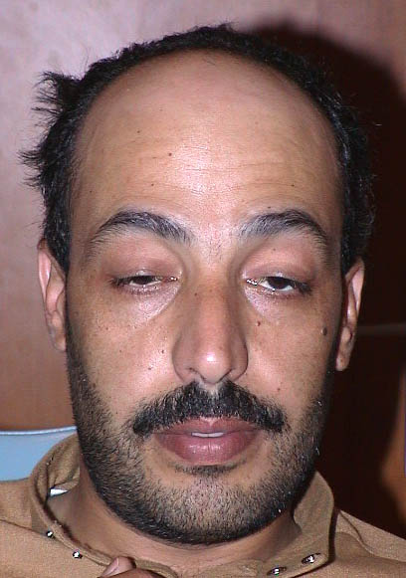
Efferent Diagnoses
Orbit
Extraocular muscles
Trauma
Mass
Neuromuscular junction
Single cranial nerves
Multiple cranial nerves
Intraparenchymal problem
INO
Gaze palsy
260007-2

Slide 35
Efferent Diagnoses
Orbit
Extraocular muscles
Trauma
Mass
Neuromuscular junction
Single cranial nerves
Multiple cranial nerves
Intraparenchymal problem
INO
Gaze palsy
Oculomotor nerve (3)
Trochlear nerve (4)
Abducens nerve (6)

Slide 36
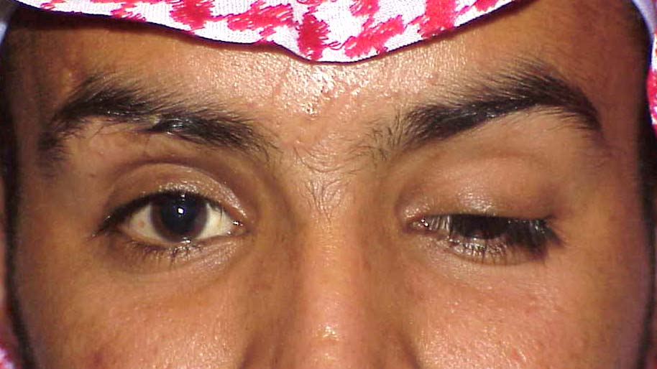
Efferent Diagnoses
Oculomotor nerve (3)
Trochlear nerve (4)
Abducens nerve (6)

Slide 37
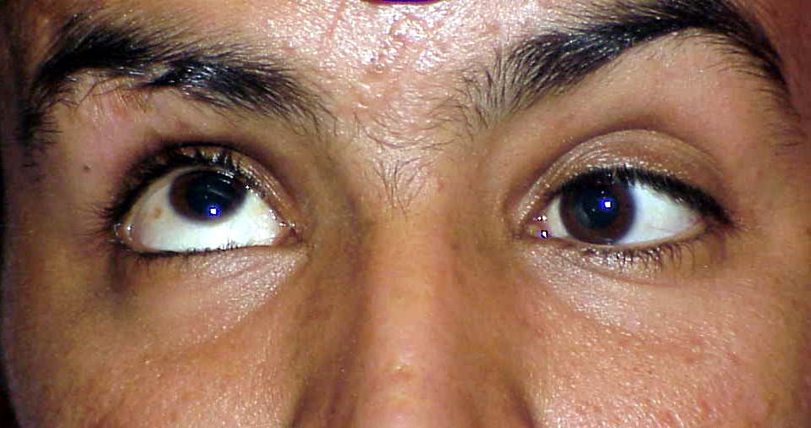
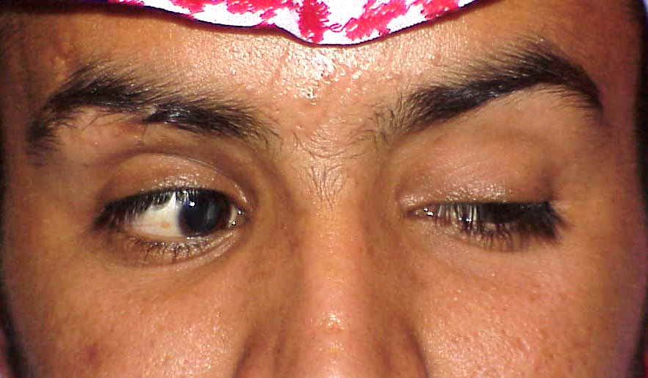
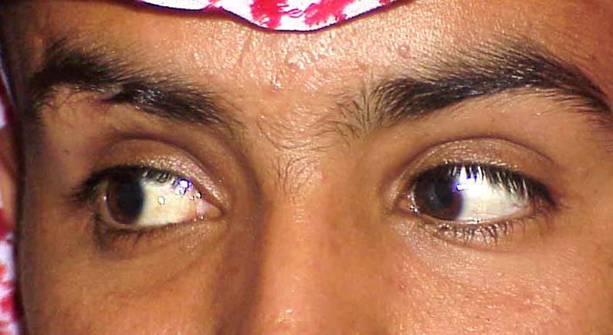
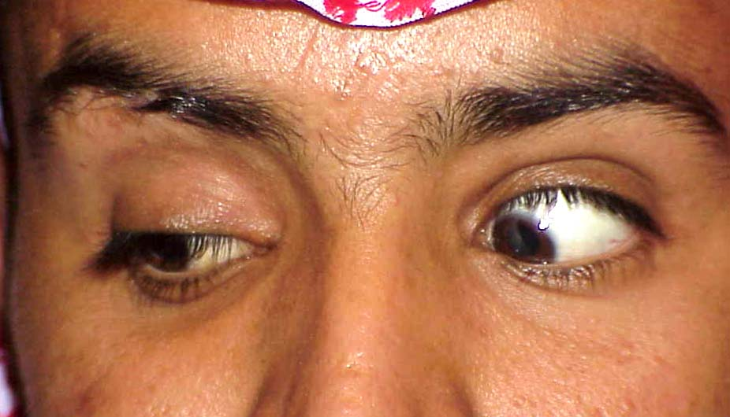
Oculomotor CN Palsy
(Note elevation of left lid on gaze down and right – aberrant regeneration of the levator muscle.)

Slide 38
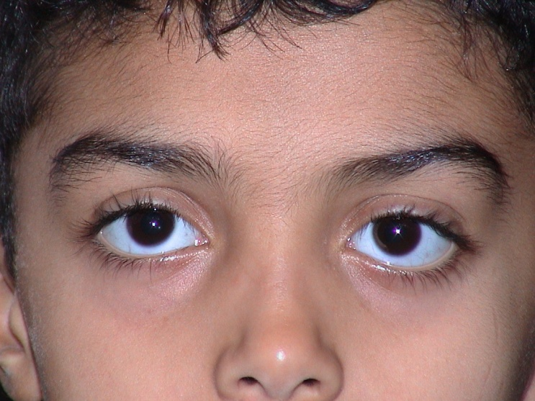
Efferent Diagnoses
Oculomotor nerve (3)
Trochlear nerve (4)
Abducens nerve (6)

Slide 39
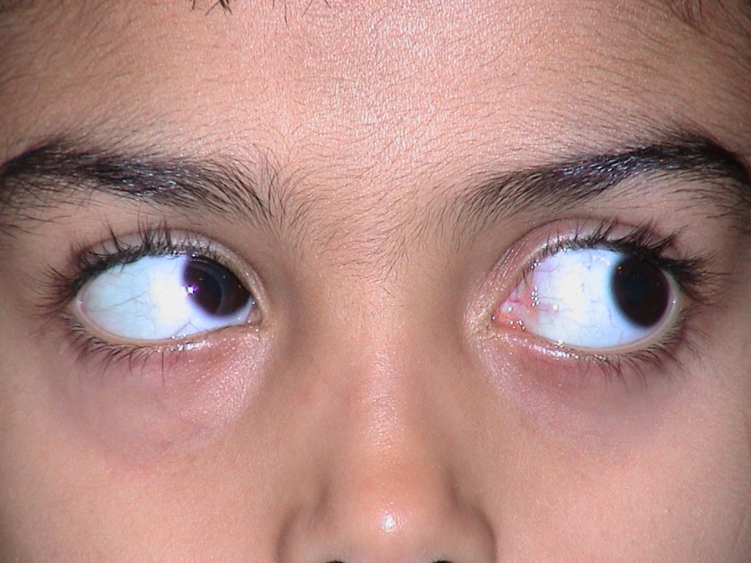
Efferent Diagnoses
Oculomotor nerve (3)
Trochlear nerve (4)
Abducens nerve (6)

Slide 40
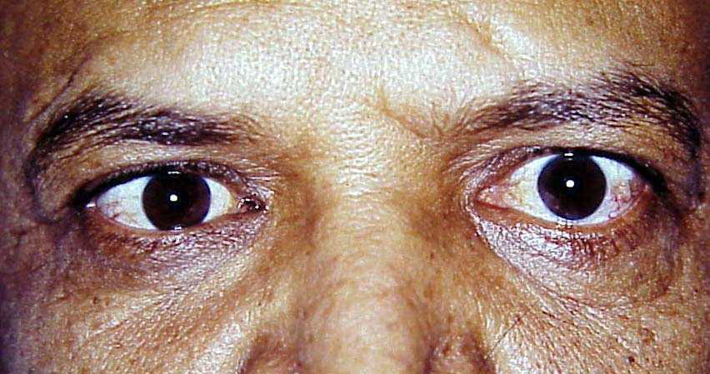
Efferent Diagnoses
Oculomotor nerve (3)
Trochlear nerve (4)
Abducens nerve (6)

Slide 41
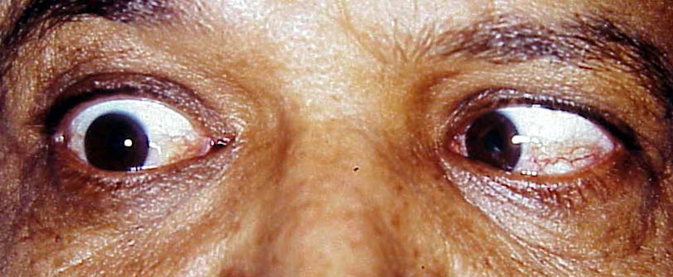
Efferent Diagnoses
Oculomotor nerve (3)
Trochlear nerve (4)
Abducens nerve (6)

Slide 42
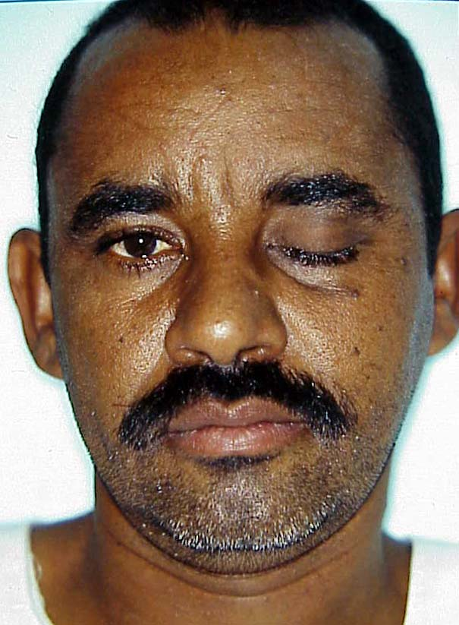
Efferent Diagnoses
Orbit
Extraocular muscles
Trauma
Mass
Neuromuscular junction
Single cranial nerves
Multiple cranial nerves
Intraparenchymal problem
INO
Gaze palsy

Slide 43
Efferent Diagnoses
Orbit
Extraocular muscles
Trauma
Mass
Neuromuscular junction
Single cranial nerves
Multiple cranial nerves
Intraparenchymal problem
INO
Gaze palsy

Slide 44
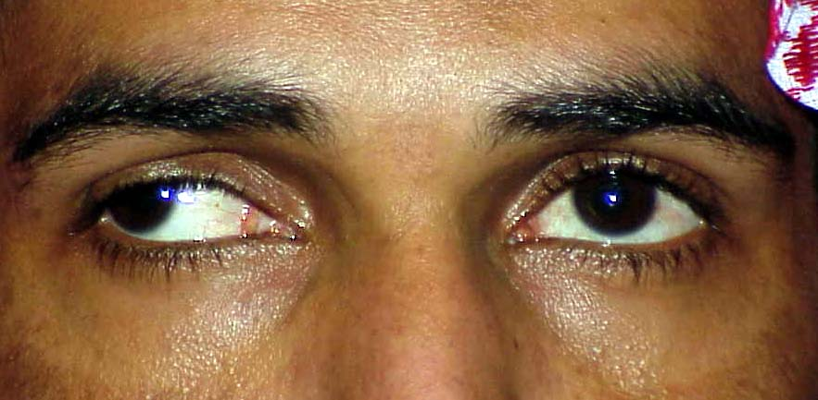
Efferent Diagnoses
Orbit
Extraocular muscles
Trauma
Mass
Neuromuscular junction
Single cranial nerves
Multiple cranial nerves
Intraparenchymal problem
INO
Gaze palsy

Slide 45
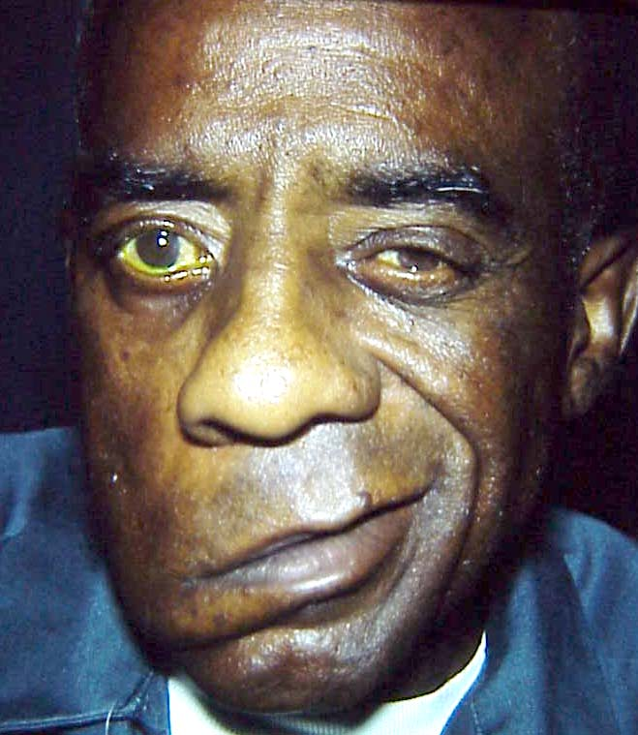
Efferent Diagnoses
Orbit
Extraocular muscles
Trauma
Mass
Neuromuscular junction
Single cranial nerves
Multiple cranial nerves
Intraparenchymal problem
INO
Gaze palsy

Slide 46
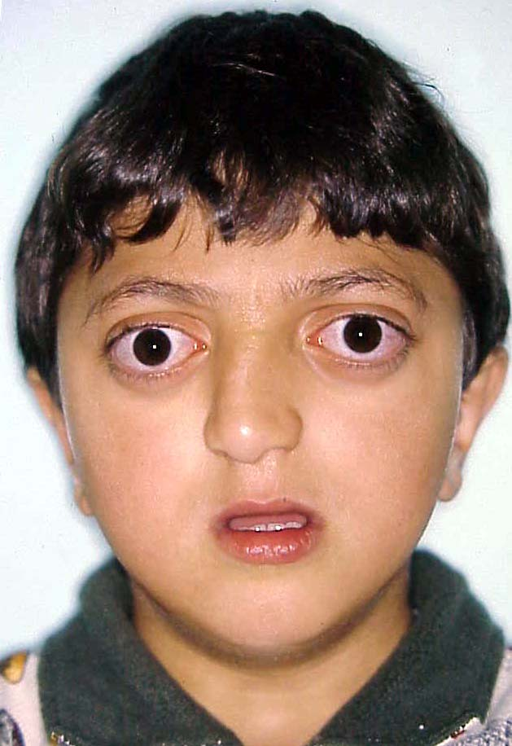
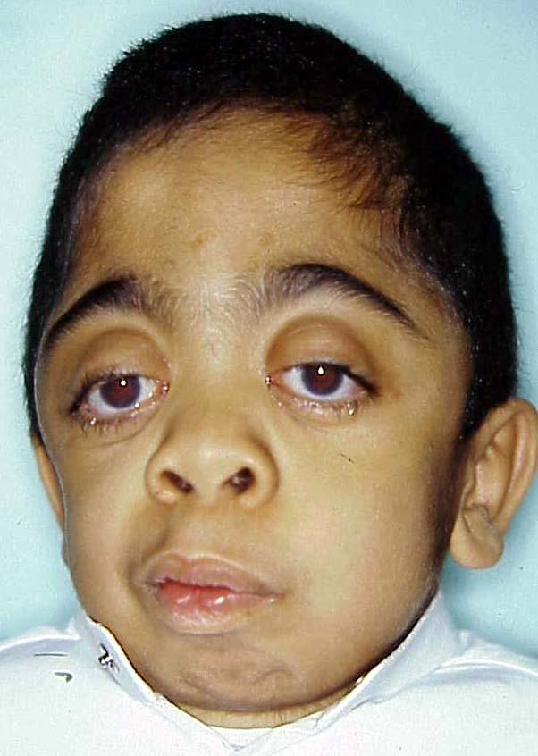
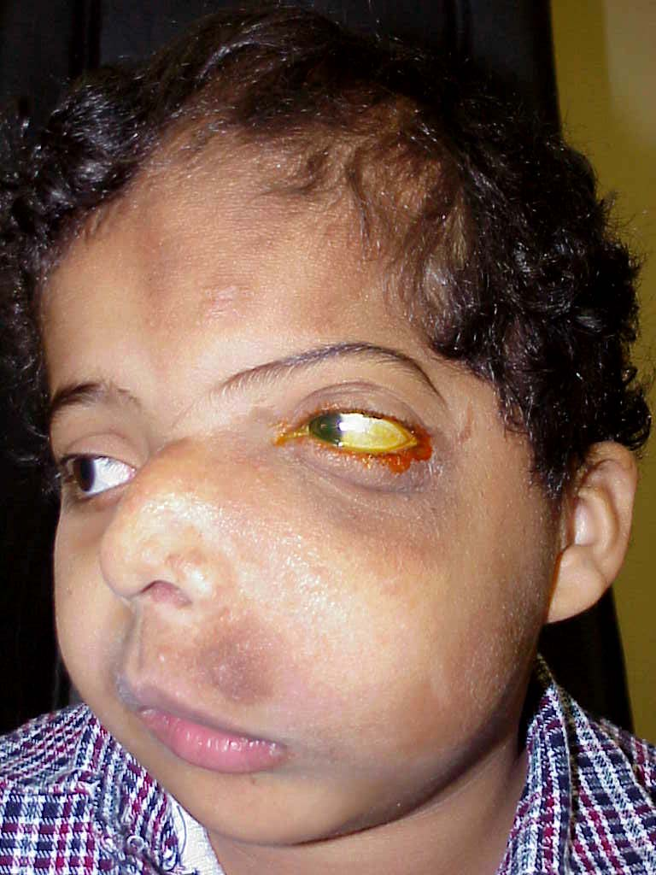
Neuro-ophthalmology
Unusual faces
Afferent
Efferent
Other

Slide 47
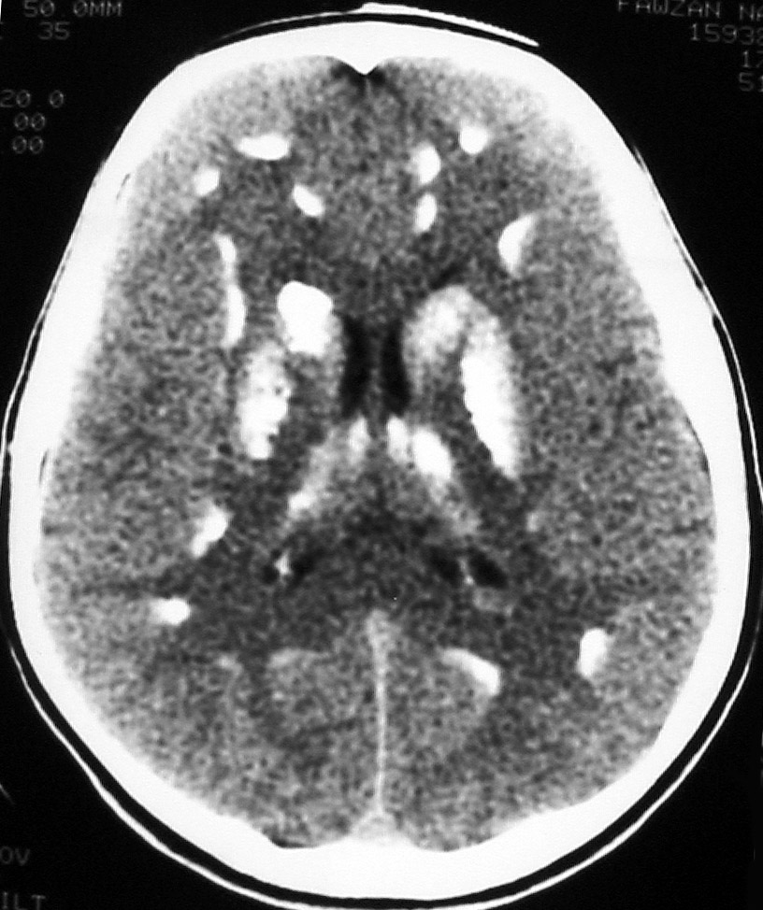
Neuro-ophthalmology
Unusual scans
Afferent
Efferent
Other

Slide 48
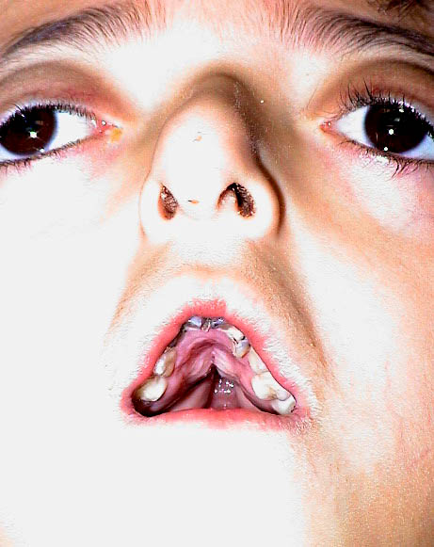
Neuro-ophthalmology
Unusual teeth
Afferent
Efferent
Other

Slide 49
Neuro-ophthalmology
Unusual skin lesions
Afferent
Efferent
Other

Slide 50
Neuro-ophthalmology
Unusual postures
Afferent
Efferent
Other

Slide 51
Neuro-ophthalmology
Afferent
Efferent
Other
And much, much more …

