Slide 1

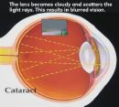
CHRONIC VISUAL LOSS
ESSAM OSMAN
Associate Professor
Chief Glaucoma unit
Email:eosman@ksu.edu.sa
www.ksu.edu.sa/68905

Slide 2
CHRONIC VISUAL LOSS
Causes of slowly progressive visual loss in an adult patient
1. Glaucoma.
2. Cataract.
3. Macular degeneration.
4. Diabetic retinopathy .

Slide 3
CHRONIC VISUAL LOSS
1. Measure intraocular pressure with a tonometer
2. Evaluate the nerve head, classifying it as normal, or abnormal
3. Evaluate the clarity of the lens
4. Evaluate the function and appearance of the macula.

Slide 4
The Visual Pathway
Cornea
Anterior Chamber
Lens
Vitreous
Retina
Iris
Notes:
Let us recall the visual pathway. Light enters the eye via the refractive media, namely the cornea, anterior chamber, lens, and vitreous, and stimulates the retina posteriorly.

Slide 5
The Visual Pathway
RGCs
*Phototransduction:By photoreceptors (rods and cones)
*Image processing:
By horizontal, bipolar, amacrine and RGCs
*Output to optic nerve:
Via RGCs and
nerve fiber layer
Nerve Fibers
Notes:
Light stimulates the photoreceptors, ie., the rods and cones. Through a series of other retinal nerve cells, the end result is that the RGC is stimulated. The RGC sends its axon, or fiber, in the nerve fiber layer to the optic disc and then down the optic nerve.

Slide 6
The Visual Pathway
Retina
Optic Nerve
Optic Chiasm
Visual Pathway
Lateral Geniculate
Nucleus
Primary Visual Cortex
Notes:
From the optic nerve, about half of the fibers cross over at the chiasm to the opposite optic tract, and the other half remain on the same side. The fibers in the optic tract synapse in the lateral geniculate nucleus of the thalamus. Neurons in the lateral geniculate nucleus then project to the occipital lobe, to the primary visual cortex. From there, there is further processing with projections to other cells in the visual cortex and elsewhere, resulting in conscious visual perception.
Now that we know how visual information is normally transmitted to the brain, what happens with a disease like glaucoma?

Slide 7
GLAUCOMA
*A major cause of blindness.
*Often A symptomatic; in early stage.
*Damage is irreversible.
*Effective treatment is available.

Slide 8
TYPES OF GLAUCOMA
Acute glaucoma
Chronic glaucoma
Congenital glaucoma

Slide 9
GLAUCOMA
Risk factor
Family history
Black
Age
Myopia
DM
HTN

Slide 10
GLAUCOMA
Diagnosis 2 of 3
IOP
Disc
Visual field defect(respect horizontal midline)

Slide 11
GLAUCOMA
Painless
Gradual increase in IOP
Central vision is affected late

Slide 12
GLAUCOMA
Normal IOP
10mmHg -21
21-31 ocular hypertension

Slide 13
GLAUCOMA
Disc
Normally cupping 0.3 to 0.4
More than 2 of population C/D ratio more than 0.6

Slide 14
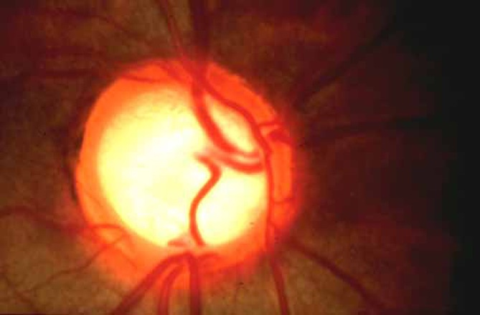
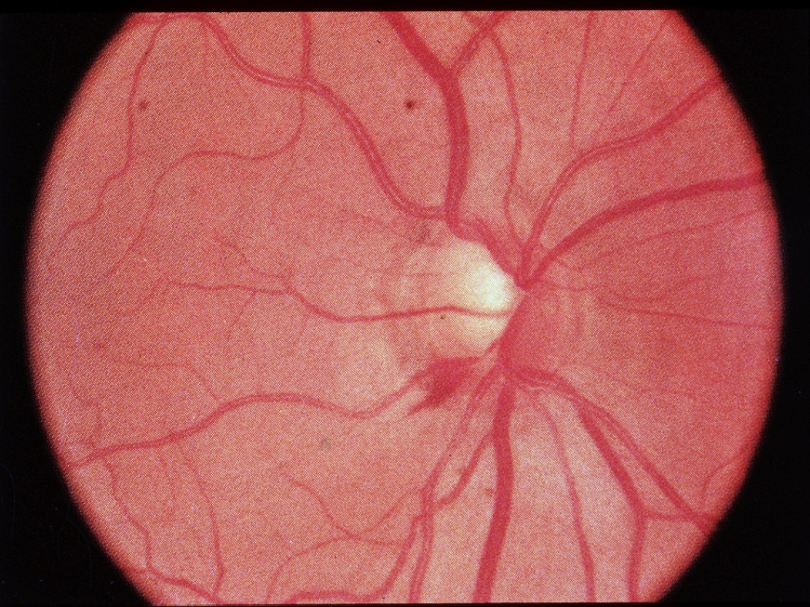

Slide 15
GLAUCOMA
IOP measurement
Schiotz
Applanation
Tonopen
Pulsair
Air puff
paskal

Slide 16
GLAUCOMA
Primary or secondary
Primary by exclusion
Pseudoexfoliation
Pigmentary
Steriod induced
Uveitic

Slide 17
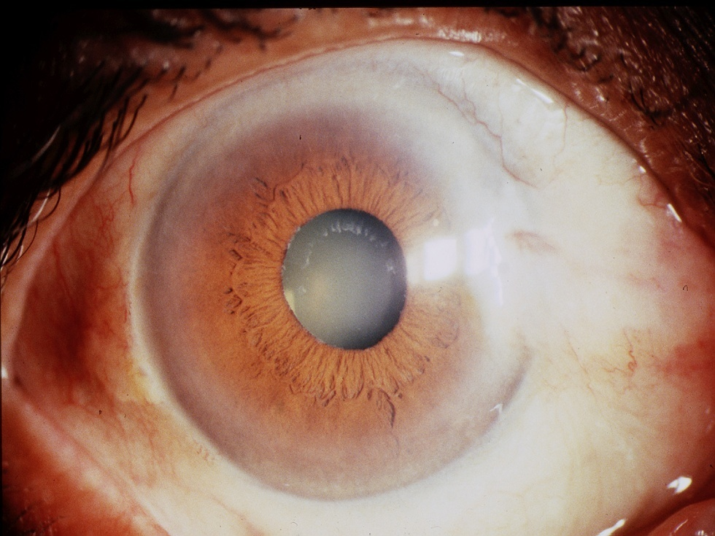
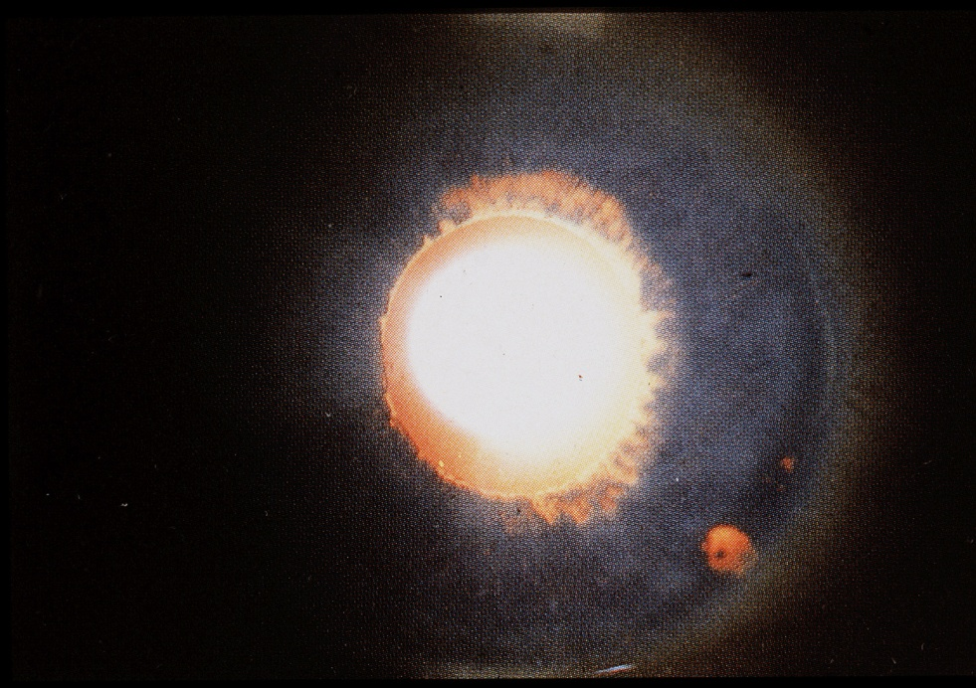

Slide 18
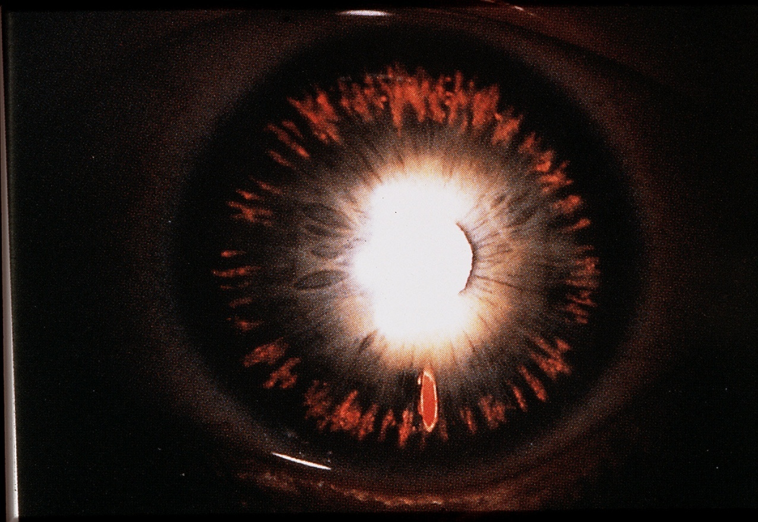

Slide 19
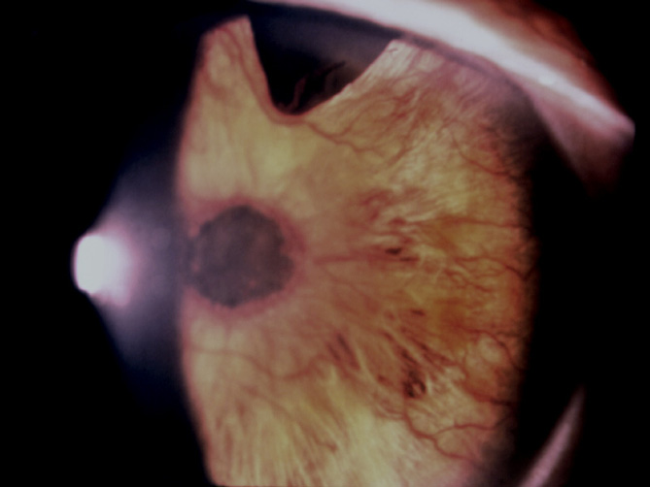

Slide 20
GLAUCOMA
Management
Medical school
Surgical school

Slide 21
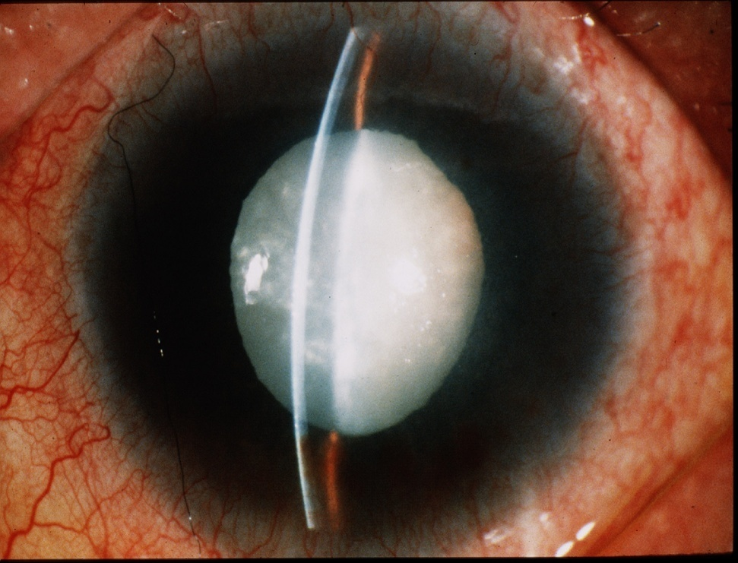
CATARACT
Opacity of the lens

Slide 22

CATARACT
Causes
Age related
subcapsular
Nuclear
cortical
Traumatic

Slide 23
CATARACT
Metabolic
diabetic
galactosemia
Glacokinase defiency
Mannosidosis
Fabrys disease
Lowes syndrome
Hypocacemic syndrome

Slide 24
CATARACT
Cataratogenic drugs
Chlorpromazine
Miotics
Myleran
Amiodarone
gold

Slide 25
CATARACT
Complicated cataract
Uveitis
Retinal dystrophy,retinitis pigmentosa
High myopia
Acute glaucoma
Intrauterine causes
rubellatoxo,cmv
Syndroms
dowen syndrome,wernerrothman
Heredetary 1/3

Slide 26
CATARACT
Classification
1-morphologic
nuclear,subcapsular,cortical
2-maturity
immature,mature,itumescent,hypermature
3-age of onset
cong,infantile,presenile.senile

Slide 27
CATARACT
Management
Congenital lens aspiration±IOL
Aquired
ICCE
ECCE
ECCE IOL
PHACO IOL

Slide 28
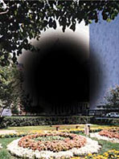
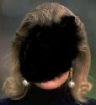
Macular Degeneration
RELEVANCE
In the United States, age-related macular degeneration is the leading cause of irreversible central visual loss (20/200 or worse) among people aged 52 or older.
Because certain types of macular degeneration are treated effectively with laser, it is important to recognize this entity and to refer for appropriate care.
It is important to distinguish between the possible causes of visual loss, whether cataract (surgically correctable), glaucoma (medically or surgically treatable), or macular
degeneration (potentially laser treatable).

Slide 29
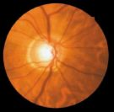
Macular degeneration
Macular Anatomy
The macula is an oval area situated about 2 disc diameters temporal to the optic disc. The macula is composed of both rods and cones and is the area responsible for detailed, fine central vision.
The central macula is a vascular and appears darker than the surrounding retina. The fovea is an oval depression in the center of the macula.there is a high density of cones but no rods are present.
The central depressionof the fovea may act like a concave mirror during ophthalmoscopy, producing a light reflection (i.e., foveal reflex).

Slide 30
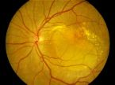
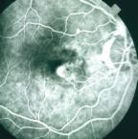
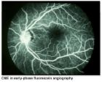
Macular degeneration
Test for macular function
V/A
Pupillary light reaction
Color vision
Ophthalmoscopy
Amsilar grid
Phtosterss test
Laser inferometry
Flourescine angiography

Slide 31
Macular degeneration
Age related
Some degree of visual loss
associated with drusen&atrophy of RPE
subretinal neovascularization
Types
Dry type 90% slow progressive atrophy of RPE and photoreceptors
Wet type 10% RPE detachment and choroidal neovas.

Slide 32
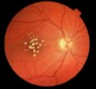
Macular Degeneration
Drusen are hyaline nodules (or colloid bodies) deposited in Bruch's membrane, whichseparates the inner choroidal vessels from the retinal pigment epithelium. Drusen maybe small and discrete or larger, with irregular shapes and indistinct edges. Patientswith drusen alone tend to have normal or near normal visualacuity ,with minimal metamorphopsa

Slide 33
Macular degeneration
As the most common cause of vision loss among people over the age of 60, macular degeneration impacts millions of older adults every year. The disease affects central vision and can sometimes make it difficult to read, drive or perform other activities requiring fine, detailed vision.

Slide 34
macular degeneration
What Risk Factors You Can't Control
Age
Race
Gender
Genetics

Slide 35
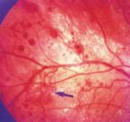
Macular Degeneration
Risk Factors You Can Control
Smoking
High Blood Pressure
High Cholesterol
Poor Nutrition
Unprotected Exposure to Sunlight
Ultraviolet (UV) light has been
Excessive Sugar Intake
Obesity
Sedentary Lifestyle

Slide 36
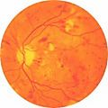
Diabetic retinopathy
Risk factors
Duration of the disease
Good metamolic controll
Pregnancy,hypertemsion,renal disease,anaemia

Slide 37
Diabetic retinopathy
Pathogenesis
Microvascular occlusion
Microvascular leakage

Slide 38
Diabetic retinopathy
Microvascular occlusion
Thikened capillary basement membrane
Capilary endothelial cell damage
Changes in RBC
Retinal ischemia
AV SHUNT
NEOVASCULARIZATIONJ

Slide 39

Diabetic retinopathy
Microvascular leakage
Loss of pericyte cells between endothelial cells
Leakage of plasma conistitute in the retina(exudate)

Slide 40
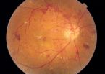

Diabetic retinopathy
Types
Non proliferative
Proliferative
Macular oedema

Slide 41

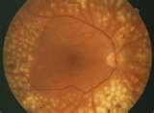
Diabetic retinopathy
Management
NPDR OBSERVATION
PDR PRP
MACULAR OEDEMA FOCAL&GRID LASER

