Slide 1
SPINAL DEFORMITIES
Dr. ABDULMONEM ALSIDDIKY , MD , SSCO.
Assistant Professor & Consultant
pediatric Ortho.& Spinal Deformities
The Director of Research Chair of Spinal Deformities
KSU,KKUH
Riyadh , Saudi Arabia

Slide 2
NORMAL SPINE ALLIGNMENT
FRONTAL PLANE
STRAIGHT
LATERAL PLANE
20-40 DEGREE THORACIC KYPHOSIS
30-60 DEGREE
LUMBAR LORDOSIS

Slide 3
SCOLIOSIS
Def.
Lat. deviation of the spine from midline with rotation

Slide 4
Rotation in scoliosis

Slide 5
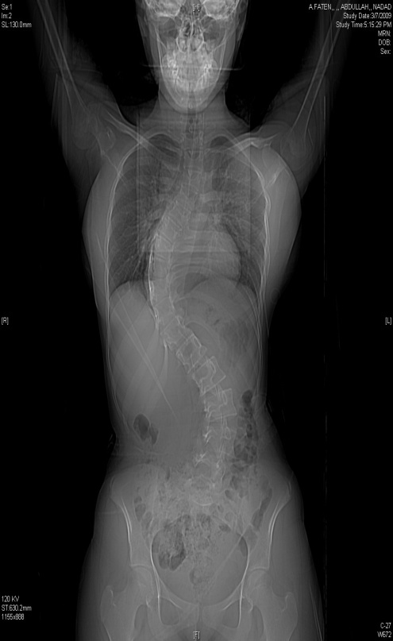
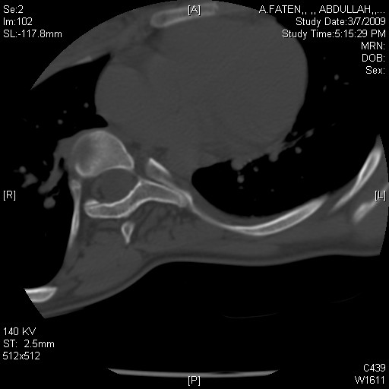
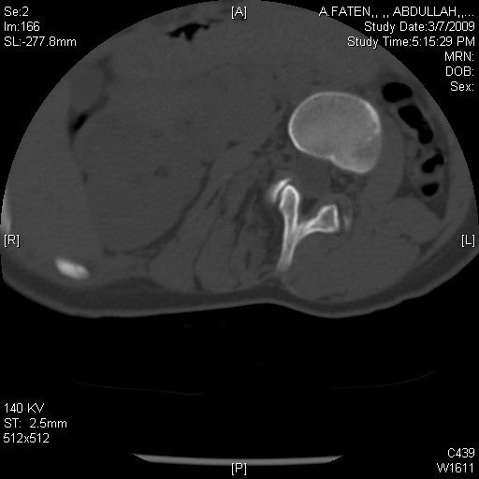

Slide 6
Rotation in scoliosis

Slide 7
SCOLIOSIS
Types :
Congenital (structural abn. In vertebrae or ribs )
Neuromuscular (eg. cp,mmc,sma…)
Idiopathic (most common )
Others

Slide 8
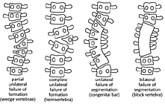
CONGENITAL CLASSIFICATION
Wedge
vertebrae
Hemi-
vertebrae
Unilateral
Bar vertebrae
Block
vertebrae

Slide 10
IDIOPATHIC SCOLIOSIS
Spinal deformity in a spine which was normal
Causes
? Properioception disorders
Brain stem
Melatonin hormones
UNKNOWN

Slide 11
IDIOPATHIC SCOLIOSIS
TYPES
Infantile (0-4 yrs )
Juvenile (4-9 yrs )
Adolescent (> 10 yrs ) [most common]

Slide 12
IDIOPATHIC SCOLIOSIS
Incidence
More in female
Rt thoracic curve is the most common
? Family Hx
More in twins

Slide 13
IDIOPATHIC SCOLIOSIS
C/O :
Loss of self image
Family observation
Pain
Early fatigue
Cardio-pulmonary dysfunction ( if curve > 90 )

Slide 14
IDIOPATHIC SCOLIOSIS
O/E :
Shoulder level inequality
Waist line asymmetry
Spinal deformity
Rib hump
Adam foreword flexion test
Full neurological exam

Slide 15
clinically

Slide 16
IDIOPATHIC SCOLIOSIS
Radiological exam :
X-rays :
AP – LAT standing long film
AP Pelvis

Slide 17
IDIOPATHIC SCOLIOSIS
MRI :
If abnormal curve suspected ( any curve other than rt. thoracic curve in young female )
Ct scan :
If congenital scoliosis suspected

Slide 18
X-ray
71ْ
53ْ

Slide 19
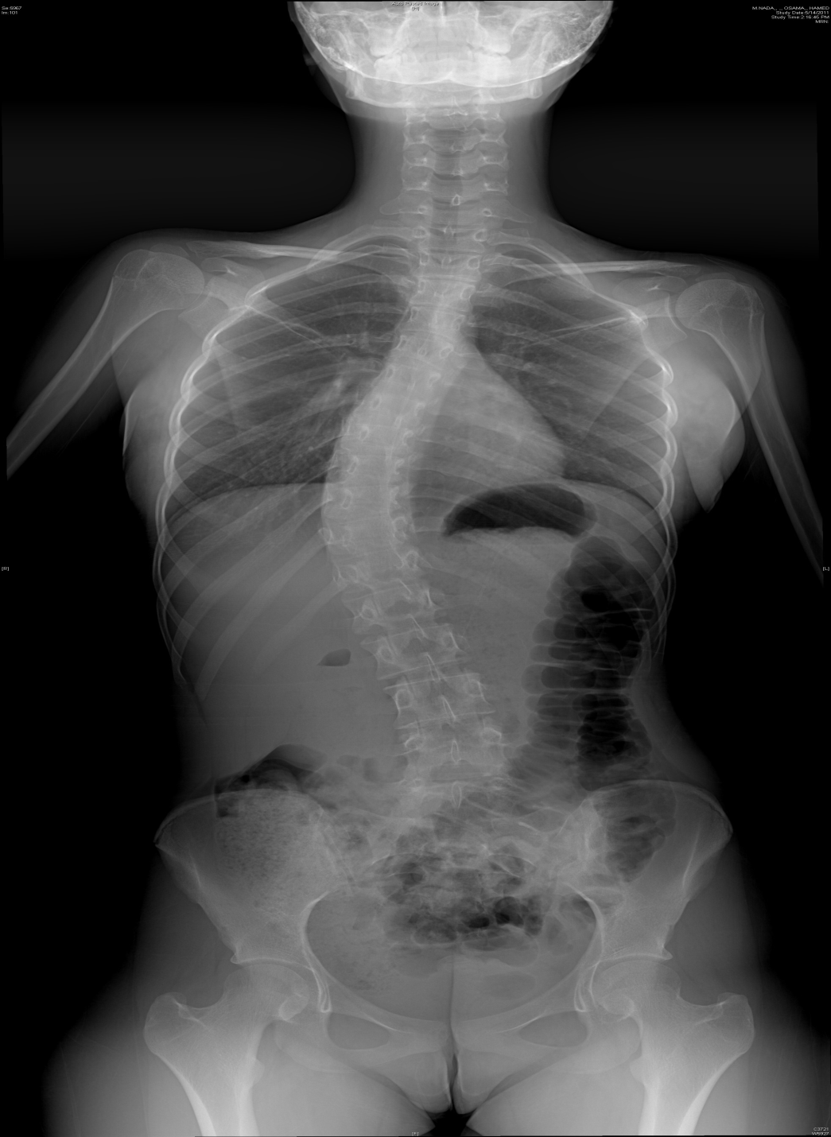

Slide 20
Cobb and Lippmann
Determine end vertebrae
Those most tilted from horizontal
Line along upper end plate prox. & lower endplate distally
Measure formed angle
Transitional
vertebrae
Notes:
-for double curves the lower end vertebrae of the upper curve= upper end vertebrae of the lower curve (transition vertebrae)

Slide 21
Treatment
Based on :
Maturity of the pt.
Menarche
Rissor’s stage
Magnitude of deformity
Curve progression

Slide 22
Risser’s stage eg.

Slide 24
Treatment
Options
Observation
Bracing
Surgery
? Physical therapy & exercise

Slide 25
Treatment ( protocol )
Mature pt.
< 40º observation
progression ~ 1º / year
> 40º surgery
Immature pt.
0-25º Observation every 4-6 months
clinically & radiologically
25-40º Bracing
> 40º Surgery

Slide 26
Braces eg.

Slide 27
Treatment
Braces :
Did not correct the deformity
Might stop the progression of the curve
(or slow it down)
Effect is dose related (more worn better effect)
Best 23 hours / day
If curve apex above T7 Milwaukee brace
If curve apex bellow T8 Boston brace

Slide 29
Treatment
Surgery :
Anterior spinal fusion
severe curve
young pt. < 10 years
Post spinal fusion & instrumentation
The gold standard treatment for most of cases
Both
For selected cases

Slide 30
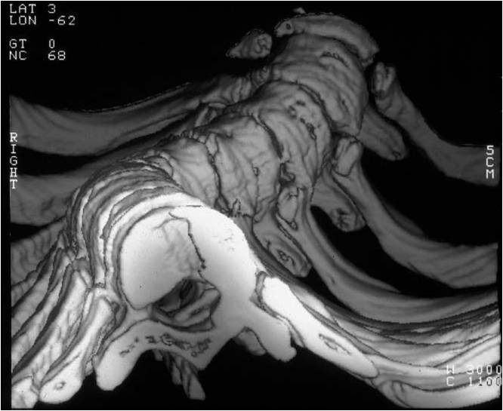
Treatment
Complications of surgery
Neurological deficit
Bleeding
Infection
Implant dislodgment

Slide 31
Examples

Slide 41
Research Chair of Spinal Deformities
كرسي أبحاث انحرافات العمود الفقري

Slide 42
الحملة الوطنية للتعريف بانحرافات العمود الفقري (جنـــــف) SAUDI SCOLIOSIS

Slide 43
THANKS

Slide 44
0545531933 riyadh

