Slide 1
Soft Tissue Injury Around The Knee
Ahmad Bin Nasser MBBS, FRCSC
Assistant Professor
Course 451
KSU

Slide 2
Lecture Outline
Soft Tissue injury:
Static stabilzers:
Meniscus
Ligaments:
Collaterals
Cruciates
Knee Dislocation
Dynamic stabilizers:
Extensor Mechanism injury
Muscle injury

Slide 3
Stability
Joint stability:
Bony stability
Soft Tissue :
Dynamic stabilizer: Tendons/Muscles
Static stabilizer: Ligaments ± meniscus/labrum
Complex synergy leading to a FUNCTIONAL and STABLE joint

Slide 4
Meniscus
Definition
Location:
Function:
Pathology:
Congenital
Traumatic
degenerative

Slide 5
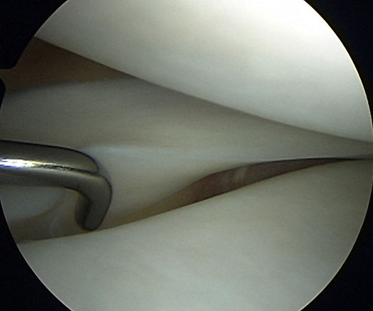
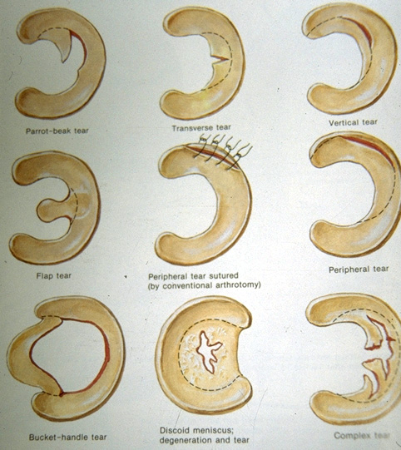
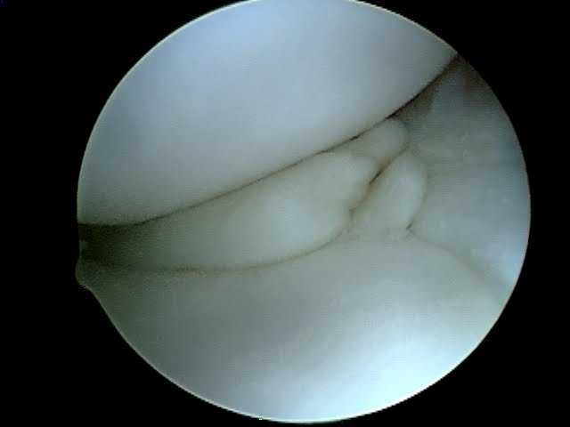

Slide 6
Ligaments
Complex ligamentous structures supporting the knee
Four major:
MCL/LCL
ACL/PCL
Pathology may be chronic or traumatic
Injury can occur to one or more at the same time.

Slide 7
Type of Acute Ligament Injury
Partial/complete
Avulsion/ midsubstance
Grade:
1: partial (0-5mm, tender, no loss of function, common)
2:almost complete (5-10mm, partial loss of function)
3:complete (10-15mm, complete loss of function,instability)

Slide 8
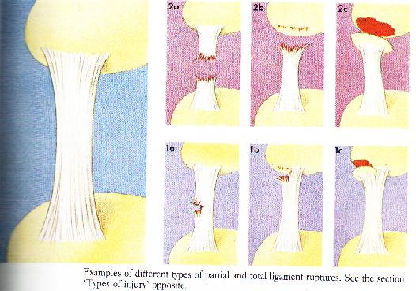

Slide 9
General Management
Acute
RICE:
R: Rest
I: Ice
C: Compression
E: Elevation
Analgesia
Support
Physiotherapy

Slide 10
Chronic Ligament Pathology
Usually secondary to Malalignment
Results in gradual stretching/ failure of ligament
If malalignment exists, then correction of alignment is necessary ±ligament reconstruction/repair

Slide 11
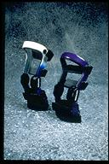
General Management
Chronic (good alignment):
Physiotherapy
Bracing
Restriction of activity
Surgery

Slide 12
MCL
Deep/Superficial
Valgus strain
Common injury
Associated with ACL/ Meniscus
Isolated
Good potential of healing
Femoral sided avulsion may heal with calcification of ligament (Pellegrini-steida )

Slide 13
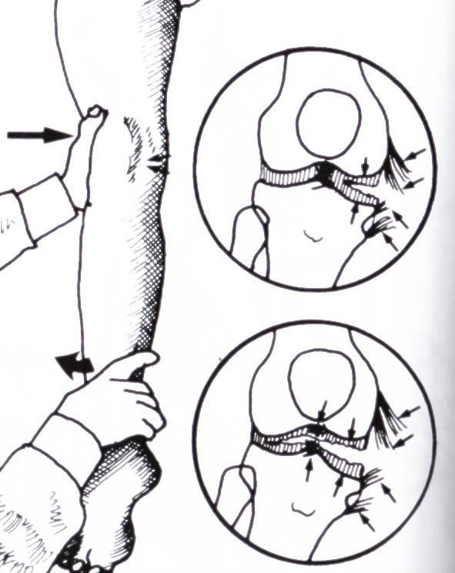

Slide 14
LCL
Complex structures stabilize the lateral and posterolateral knee
LCL is a major ligament in this complex constraint
Varus strain
Less common
Fair potential of healing

Slide 15
ACL
Two bundles
Anterior translation/ Pivot (rotation)
Usually complete midsubstance tear in adults
Usually tibial sided fracture/avulsion in children
Acute (early) heamoarthrosis
Surgery needed if unstable during activities
Cast and/or fixation in children
Reconstruction in adults (no potential of healing)

Slide 16
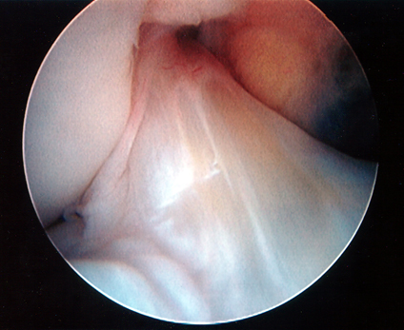
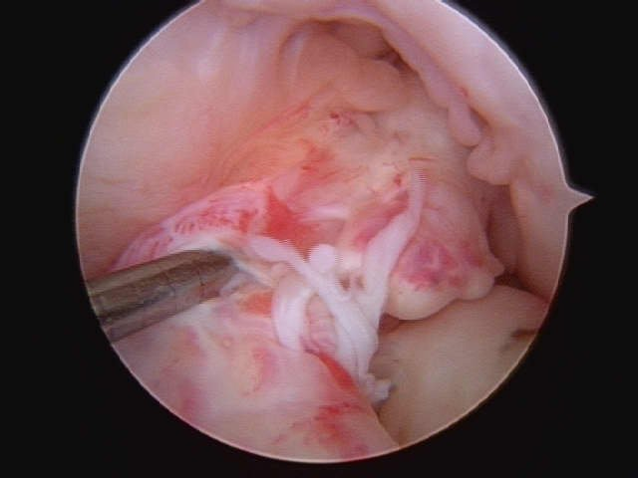

Slide 17
PCL
Two bundles
Less common
Posterior translation
Surgery in Avulsion/Fracture type
Otherwise surgery for isolated PCL is rare

Slide 18
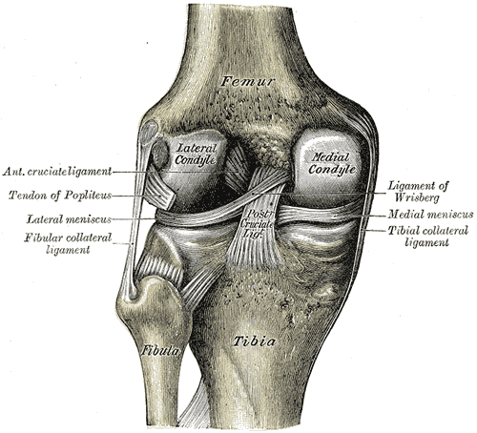

Slide 19
Knee Dislocation
Three or more ligaments
Severe (high energy) trauma
May be associated with popletial artery injury---- Limb threatening
Very serious emergency
Needs accurate vascular assessment
May be associate with peroneal nerve injury
May be associated with fracture/ compartment syndrome
Most require surgery either early or late or both

Slide 20
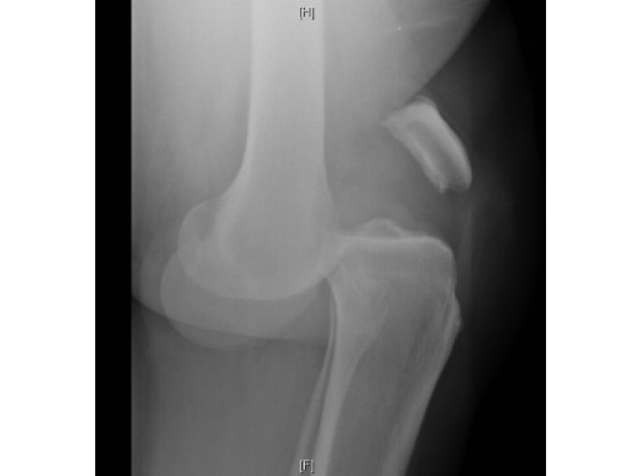
Knee Dislocation

Slide 21
Dynamic Stabilizers
Muscles and Tendons
Tendons have poor potential of healing if completely transected and need repair
Tendon avulsions have better chance of healing without surgery
Muscles have good potential of healing but with weak fibrous tissue
Rest then physiotherapy are essential for better muscle healing

Slide 22
Extensor Mechanism
Quadriceps muscle
Quad’s tendon
Patella
Patellar tendon
Tibial tubercle
Disruption of the mechanism leads to loss of active extension
Requires early surgical correction (except quadriceps muscle tear)

Slide 23
Muscle Injury
muscle injury is amongst the commonest most misunderstood and inadequately treated conditions in sport medicine.
It account 30% of all injuries in sports.
30% of all soccer players will have a muscle injury.
Muscle can be damaged by direct trauma(impact) or indirect ( overload).
The result injury can be either partial rupture/ strain or complete.

Slide 24
Muscle Injury
Distraction rupture :
caused by over stretching or overload, it occur in the superficial part of the muscle or at its origin or insertion. It occur more in muscles the mobilize 2 joints (quadriceps, gastrocnemius)
Compression rupture :
result from direct impact to the muscle, the muscle is pressed against the underlying bone

Slide 25
2 way of classification :
Rupture :
partial or total.
Strain:
1st & 2nd degree (partial rupture)
3rd degree (total rupture)

Slide 26
Muscle Injury
Sharp or stabbing pain at the moment of injury, and pain can be reproduced by muscle contraction.
In partial rupture pain inhibit muscle contraction, in total rupture muscle can’t contract for mechanical reasons.
Can feel defect in part of muscle.
Localized swelling and tenderness.
After 24 hours bruising and discoloration.

Slide 27
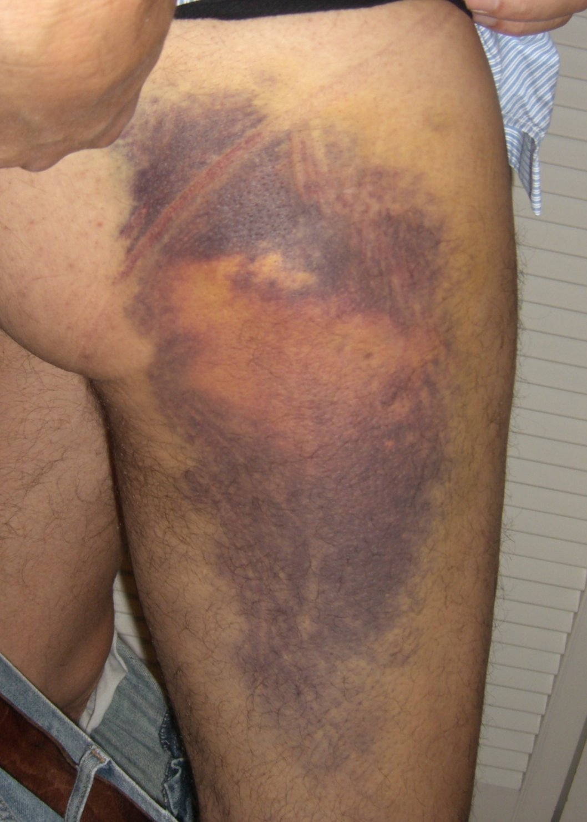

Slide 28
Treatment
R.I.C.E.
Relieving load on the limb.( using crutches or arm sling).
After 72 hours to start physiotherapy.
Surgery (rarely)

Slide 29
Complications
I. Scar tissue formation :
the space between ruptured muscle fibers fills with blood which clots and gradually converted into connective tissue, which converted into scar tissue. This leaves the muscle with areas of varying elasticity, and further injury may occur if too hard and too soon.
In some cases this scar tissue may need surgical excision.

Slide 30
Complications
II .Heterotopic Bone Formation ( Myositis Ossificans ) :
Direct impact causes intermuscular and intramuscular hematoma, if immediate treatment is inadequate, the hematoma become ossified and calcified.
Ossification may continue as long as healing is disrupted by repeated impact or contraction.

Slide 31
Continued
Ossification is a lengthy inflammatory process for which doctors hesitate to recommend active treatment for long period of time.
X-ray will reveal signs of ossification.
Bone scan will reveal active ossification
May need surgical excision (late)
Much higher risk if associated with head injury

Slide 32
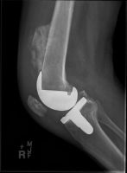

Slide 33
Complications
3. Compartment Syndrome:
Types:
Acute (fracture or soft tissue injury)
Chronic (activity related)
Limb threatening
Orthopedic emergency
Keep high index of suspicion

Slide 34
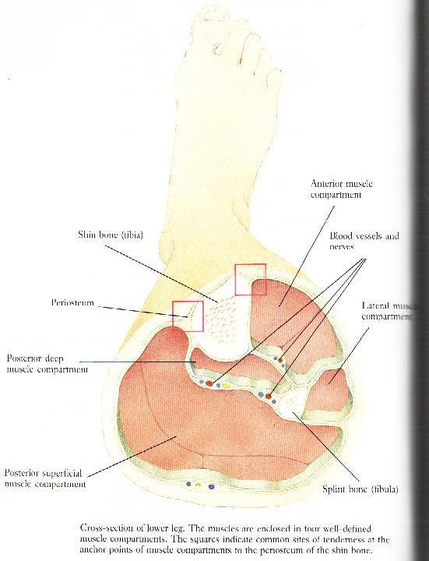
Compartment Syndrome
Can occur anywhere
Most common in leg and forearm
Leg has 4 compartments:
Anterior
Lateral
Superficial posterior
Deep posterior

Slide 35
Compartment syndrome
Swelling/injury/hematoma/injection
Increased interstitial compartment pressure
Obstruction of capillary perfusion
Direct transfer of oxygenated blood from arterial to venous system without oxygenation of the tissues
Ischemia and necrosis of the compartment structures

Slide 36
Compartment Syndrome
Diagnosis:
High Index of suspicion
Pain at rest
Pain with active and passive stretch
Pain not responding to conservative measures
Hard/tight compartment
Compartment pressure >30mmgh
Numbness/ weakness
Paralysis (late)

Slide 37
Compartment syndrome
Management:
Slight elevation (at heart level) and rest
Release of bandage/ cast
Monitor kidney function
Surgical release (fasciotomy):
Not responding
Presents early within first 48-72 hours from symptoms
The sooner the better
If late will loose function of the involved compartment

Slide 38
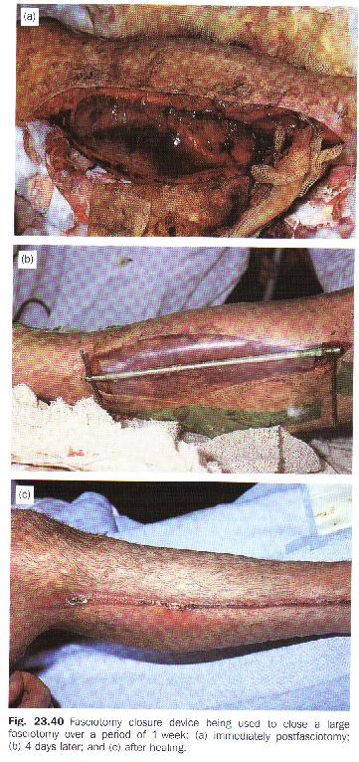
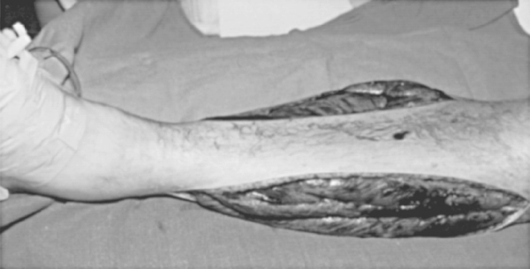

Slide 39
Q&A
THANK YOU,,

