Slide 1
INTRODUCTION TO COURSE 452
Dr.KHOLOUD ALZAIN
Assistant Professor of Orthopedic Surgery
Consultant, Pediatric Orthopedic Surgeon
Course Organizer (Course 452) Females

Slide 2
WILL COVER
Course objectives.
What is expected of you.
Deference between orthopedics and other subjects.
Explain the tables.
Reading sources.
Exams.

Slide 3
ORTHOPEDICS
Orthopedic = study of musclo.skeletal system
(bone diseases & trauma)

Slide 4
OBJECTIVES
Knowledge:
Ortho → important & common problems, especially those related to our community.
Trauma → emphasize on basic aspects in trauma & how to deal with them.

Slide 5
OBJECTIVES
To acquire the skills:
Good H/O taking of trauma and elective cases.
Perform O/E of limbs & joints.
The ability to read (XR) radiological images.

Slide 6
IT IS EXPECTED FROM YOU
5 week course.
Study & prepare from the beginning.

Slide 7
IT IS EXPECTED FROM YOU
Be on time for lectures & clinical sessions.
Do not sign attendance for someone else.
Notes:
You should never enter the class if you arrived ≥ 15 min.

Slide 8
IT IS EXPECTED FROM YOU
Each student must attend at least 75% of lectures.
If this is not achieved ➔ not be allowed to attend the FINAL EXAM.

Slide 9
HISTORY
Orthopedics:
Present C/O.
Ask for daily functions:
UL: reach & use (can reach mouth).
LL: weight bearing (gait in knees O.A).
Any previous Rx:
Medical (Brufen vs. Mobic).
Immobilization (splints).
Surgical.
Traditional medicine.

Slide 10
HISTORY
Ped.Orthopedic ➔ perinatal period.
Trauma ➔ ATLS:
ABCD.
Mechanism of injury (calcenium #).
Force of injury (pathological #).
Initial & definite treatment.

Slide 11
CLINICAL EXAMINATION
Patient’s position (in bed / walk in OPD).
Limb’s attitude.

Slide 12
CLINICAL EXAMINATION
The system we are going to use is:
Inspection = Look
Palpation = Feel
Movement = Move (active / passive)
Do:
Special tests.
Measurements.
Gait.
Neurovascular assessment.
Always compare.

Slide 13
THE TABLES

Slide 14
THE TABLES

Slide 15
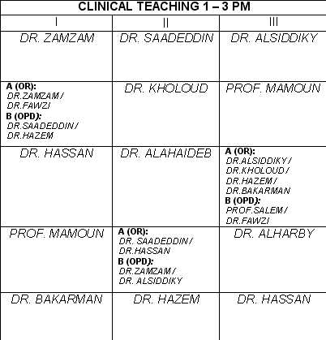
THE TABLES

Slide 16
THE TABLES

Slide 17
THE TABLES
40 marks
30 marks
30 marks

Slide 18
CLINICAL TEACHING
In 34B/22B cases prepared to be interviewed.
In the OPD.
In the OR.

Slide 19
BOOKS
“Appley’s system of Orthopedics”.
“Orthopedic Examination” by McRae.

Slide 20
BOOKS
“Appley’s system of Orthopedics”.
“Orthopedic Examination” by McRae.
“Fractures and Dislocations” by Bader and Shaheen.

Slide 21
KEEP IN MINDE
Dr.’s office hours.
If:
A lecture not given → tell me the same day.
Clinical teaching 15 min’s with no idea → page me.
My pager 0073
(please only by leaders, care on Sat & Mon)

Slide 22
YOUR GROUP
You are 74 Dr.’s, with 1 leader.
3 gp (25, 25, 24) each with a leader.
Each gp (A & B).

Slide 23
Any Question ? Dr.Kholoud P-0073

