Slide 1
Operative Treatment of Fractures &instrumentation
Dr.Khalid. A. Bakarman ,MD,SSC(Ortho)
Assistant Prof. pediatric Orthopedic Consultant
Orthopedic trauma Surgeon
ِ

Slide 3
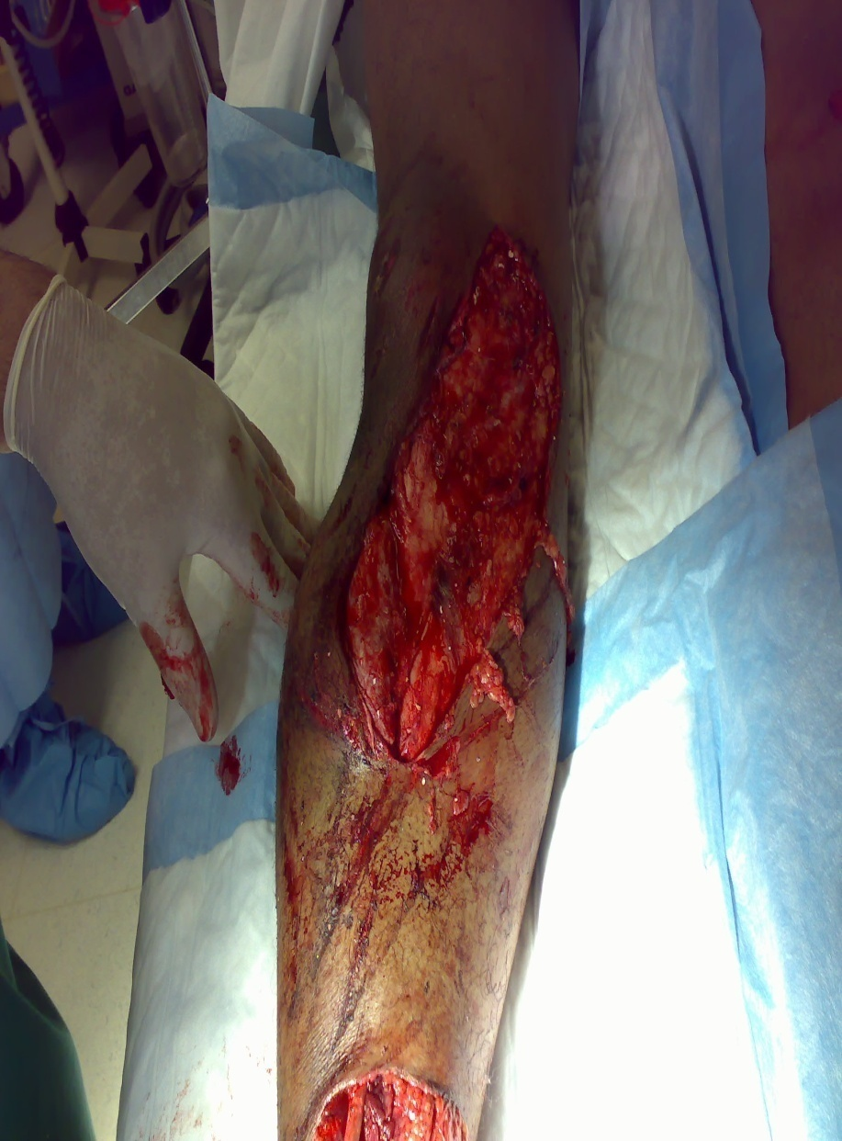

Slide 4
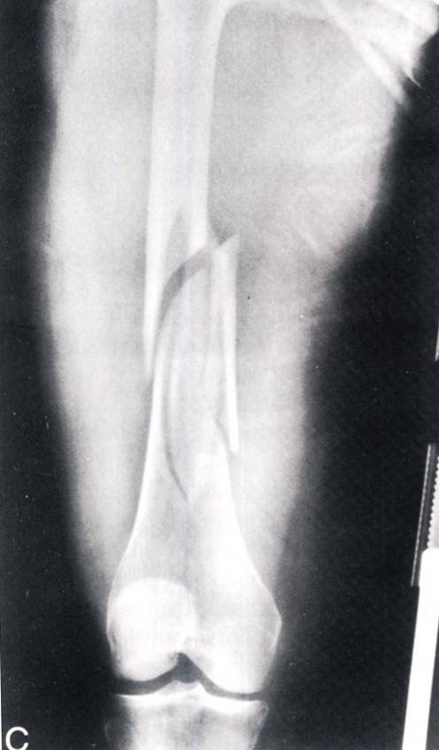
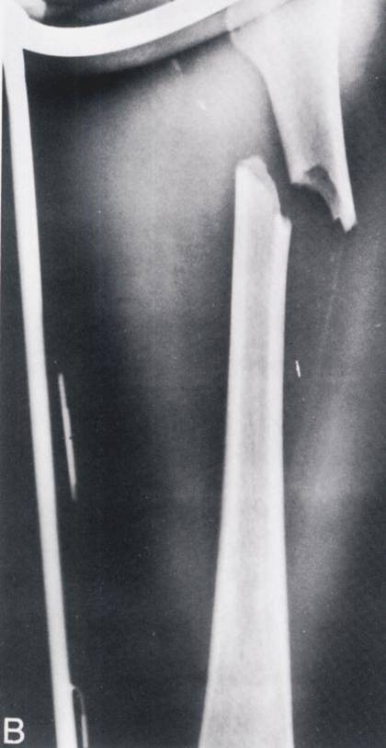

Slide 5
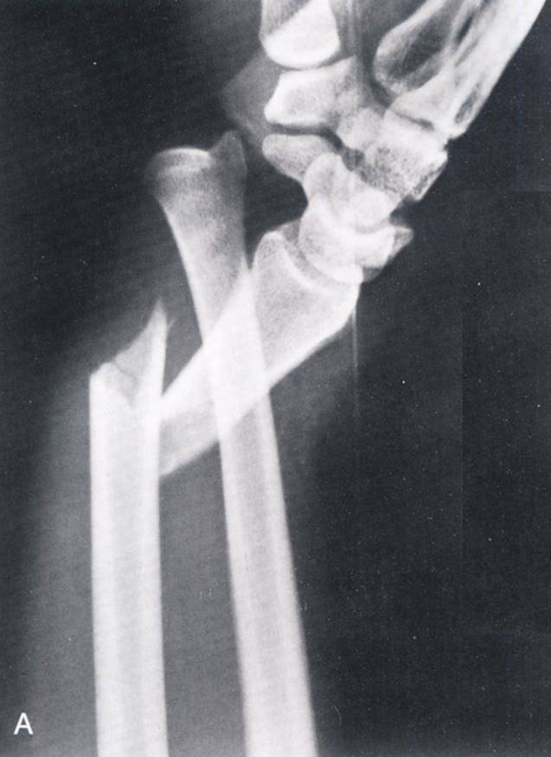
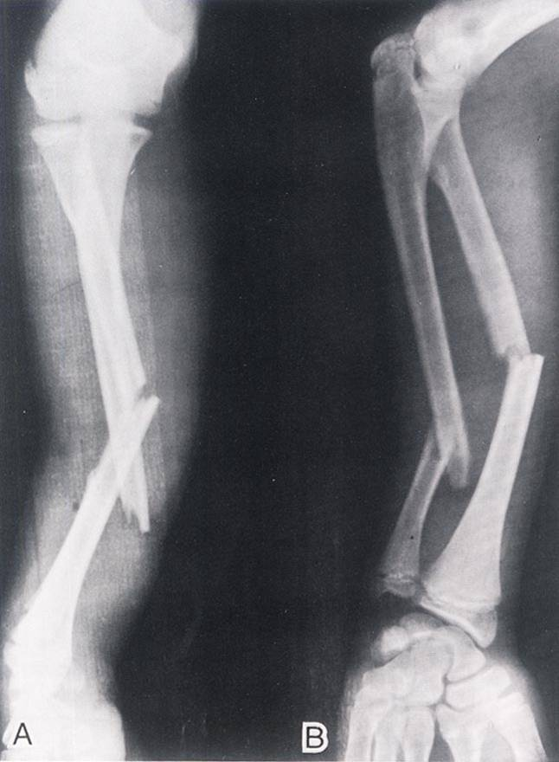

Slide 7
Principles
Surgical indications
Timing for Surgical intervention .
Principles of Surgical treatment .
Methods of fixation

Slide 8
Surgical Indications
1.Displace intraarticular #
2.unstable # with failed N.O.R
3.Major Avulsion #.
4. Pathological #
5.Fractues of necessity
6. Displaced physeal injuries
7. Fractures with Compartment Syndrome

Slide 9
8. Fractures with vascular injury
9. Fractures with neurological deterioration
10. Polytrauma patients

Slide 10
Timing for intervention
The timing of the surgical intervention
Emergency
Urgent
Elective

Slide 11
Principles of Surgical Treatment
anatomical reduction of the fracture fragments, especially in joint fractures
stable internal fixation to fulfill the local biomechanical demands
preservation of blood supply to the injured area of the extremity
active, pain-free mobilization of adjacent muscles and joints to prevent the development of fracture disease

Slide 12
Methods of Fixation
1 K- wires fixation
2 External Fixation
3 plate & Screws
4 Intramedullar Nail

Slide 13
Kirschner wire
A. Indications
- pediatric fractures
B. Advantages
- less traumatic to soft tissue
C. Disadvantages
- it gives relative stability

Slide 14
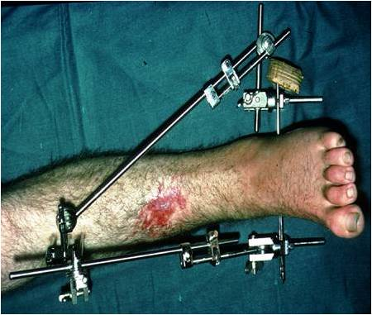
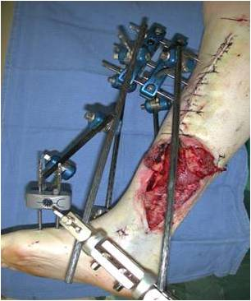
External fixation
A. Indications
B. complications

Slide 15
Plate and screw
A. Indications
- long bone Fractures,. intraarticular Fracture
B. Advantages.
- absolute stability. early ROM, Less stiffness
C. Disadvantages
- soft tissue dissection, infection,healing,NWB,
bone necrosis

Slide 16
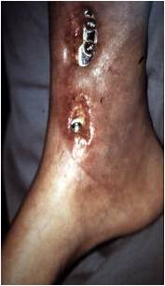
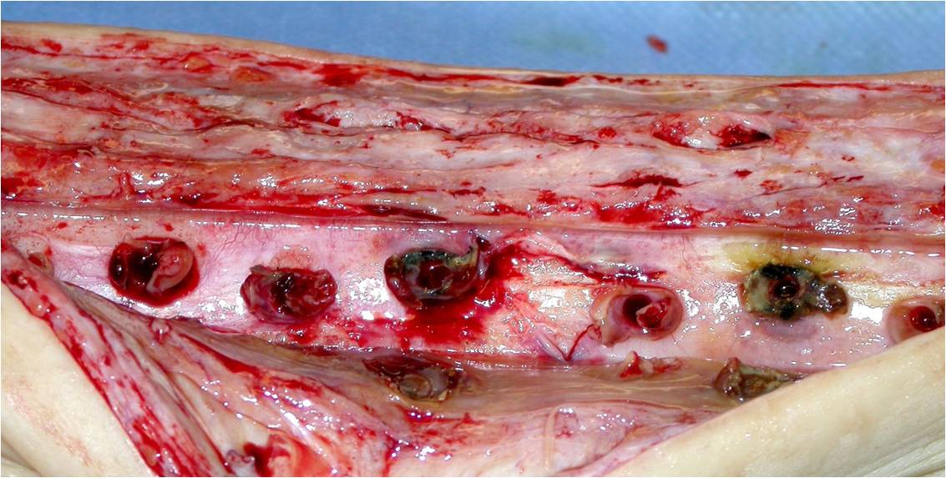

Slide 17
Intramedullar Nail
A. indications.
- long bone fractures
B. Advantages
- Early WB, restore L,R,
C. Disadvantages.
-

Slide 19
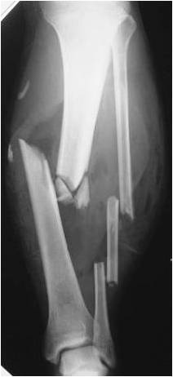
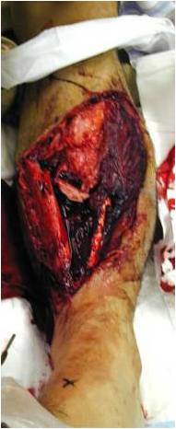
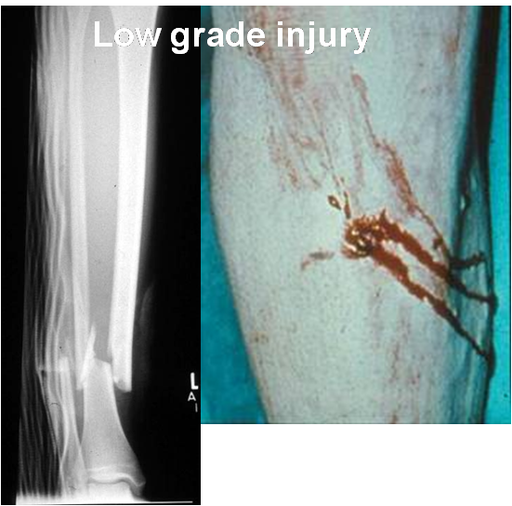
Practices

Slide 20
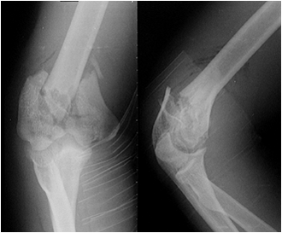
Cont.

Slide 22
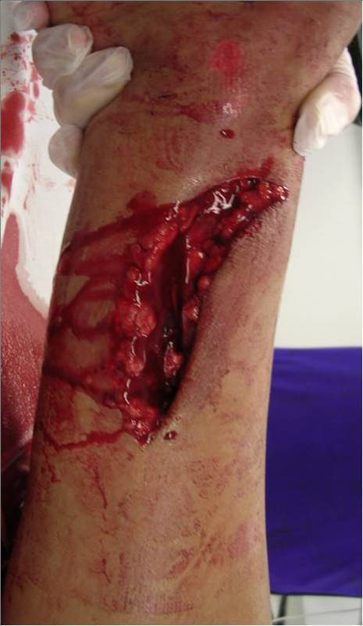

Slide 23
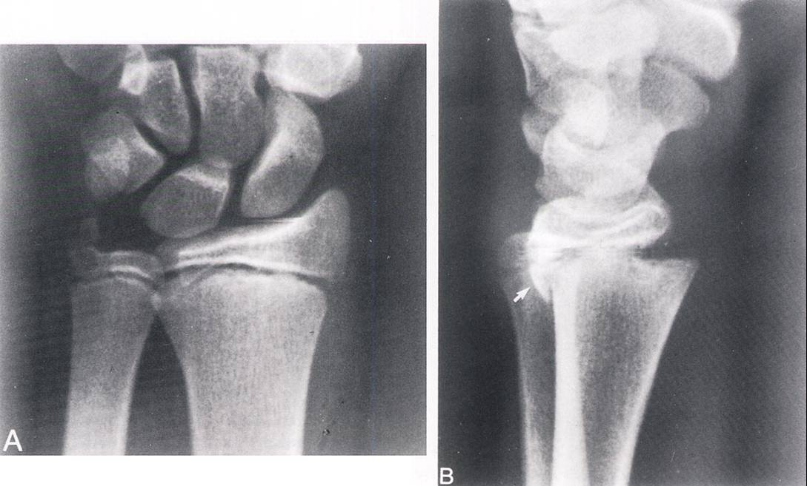

Slide 24
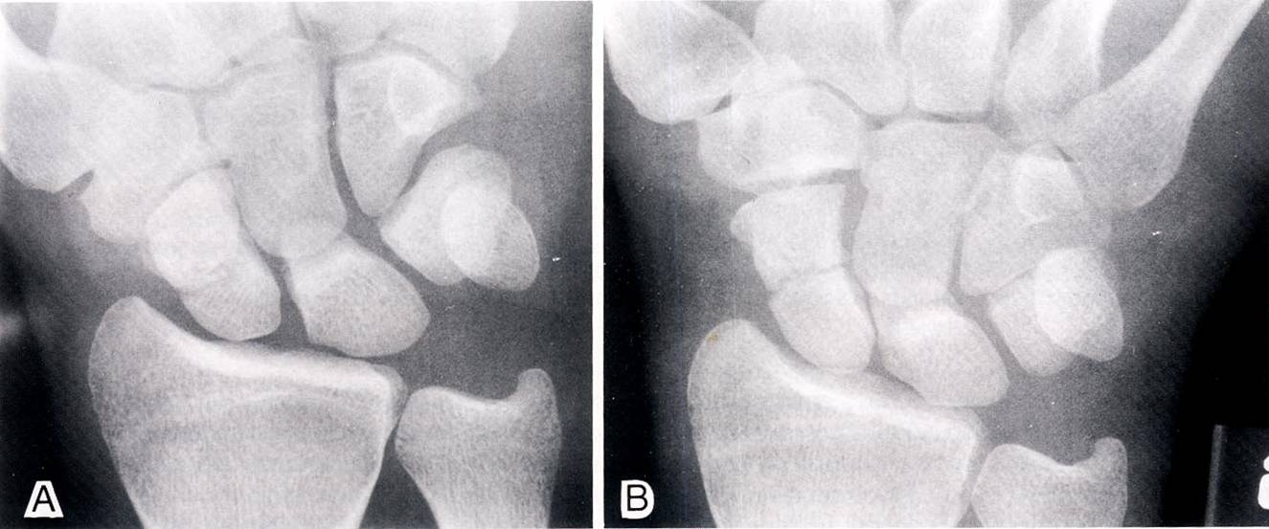

Slide 25
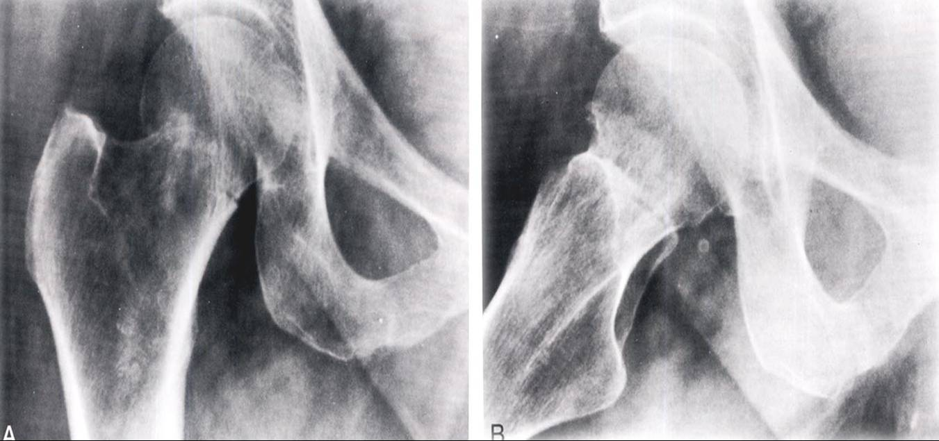

Slide 26
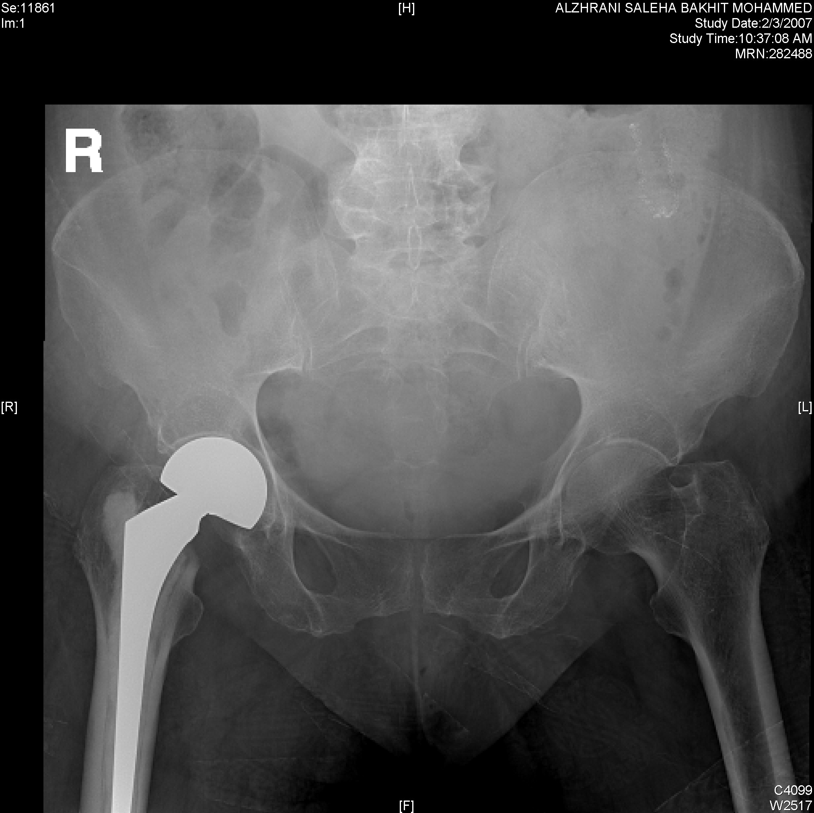

Slide 27
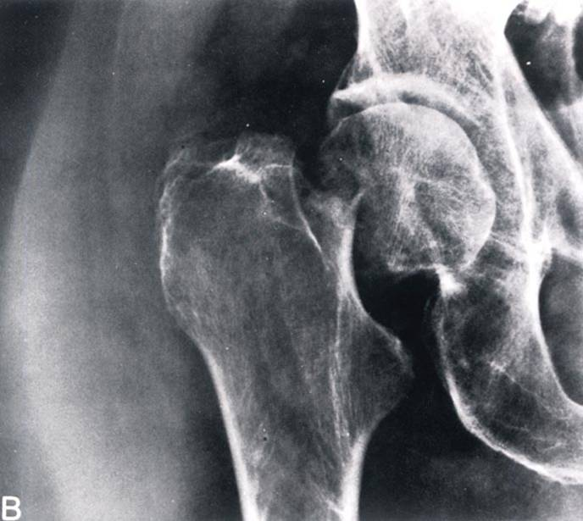

Slide 28
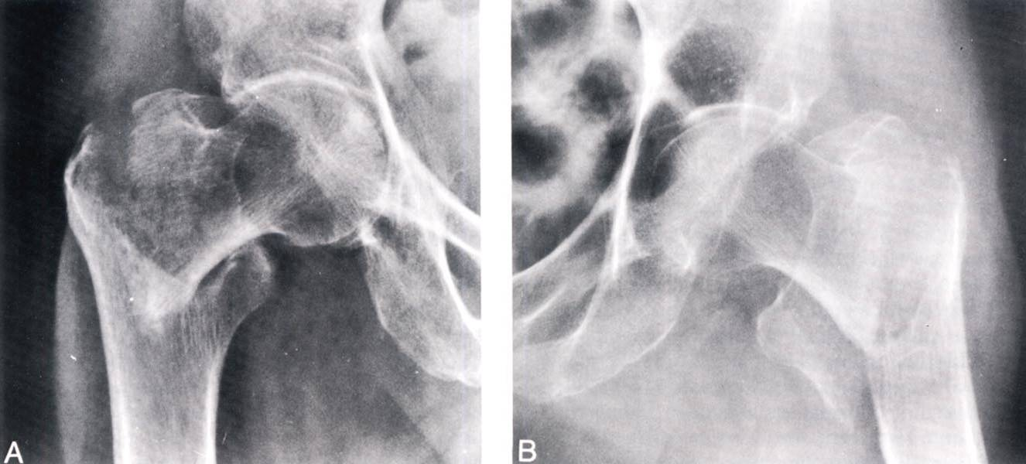

Slide 29
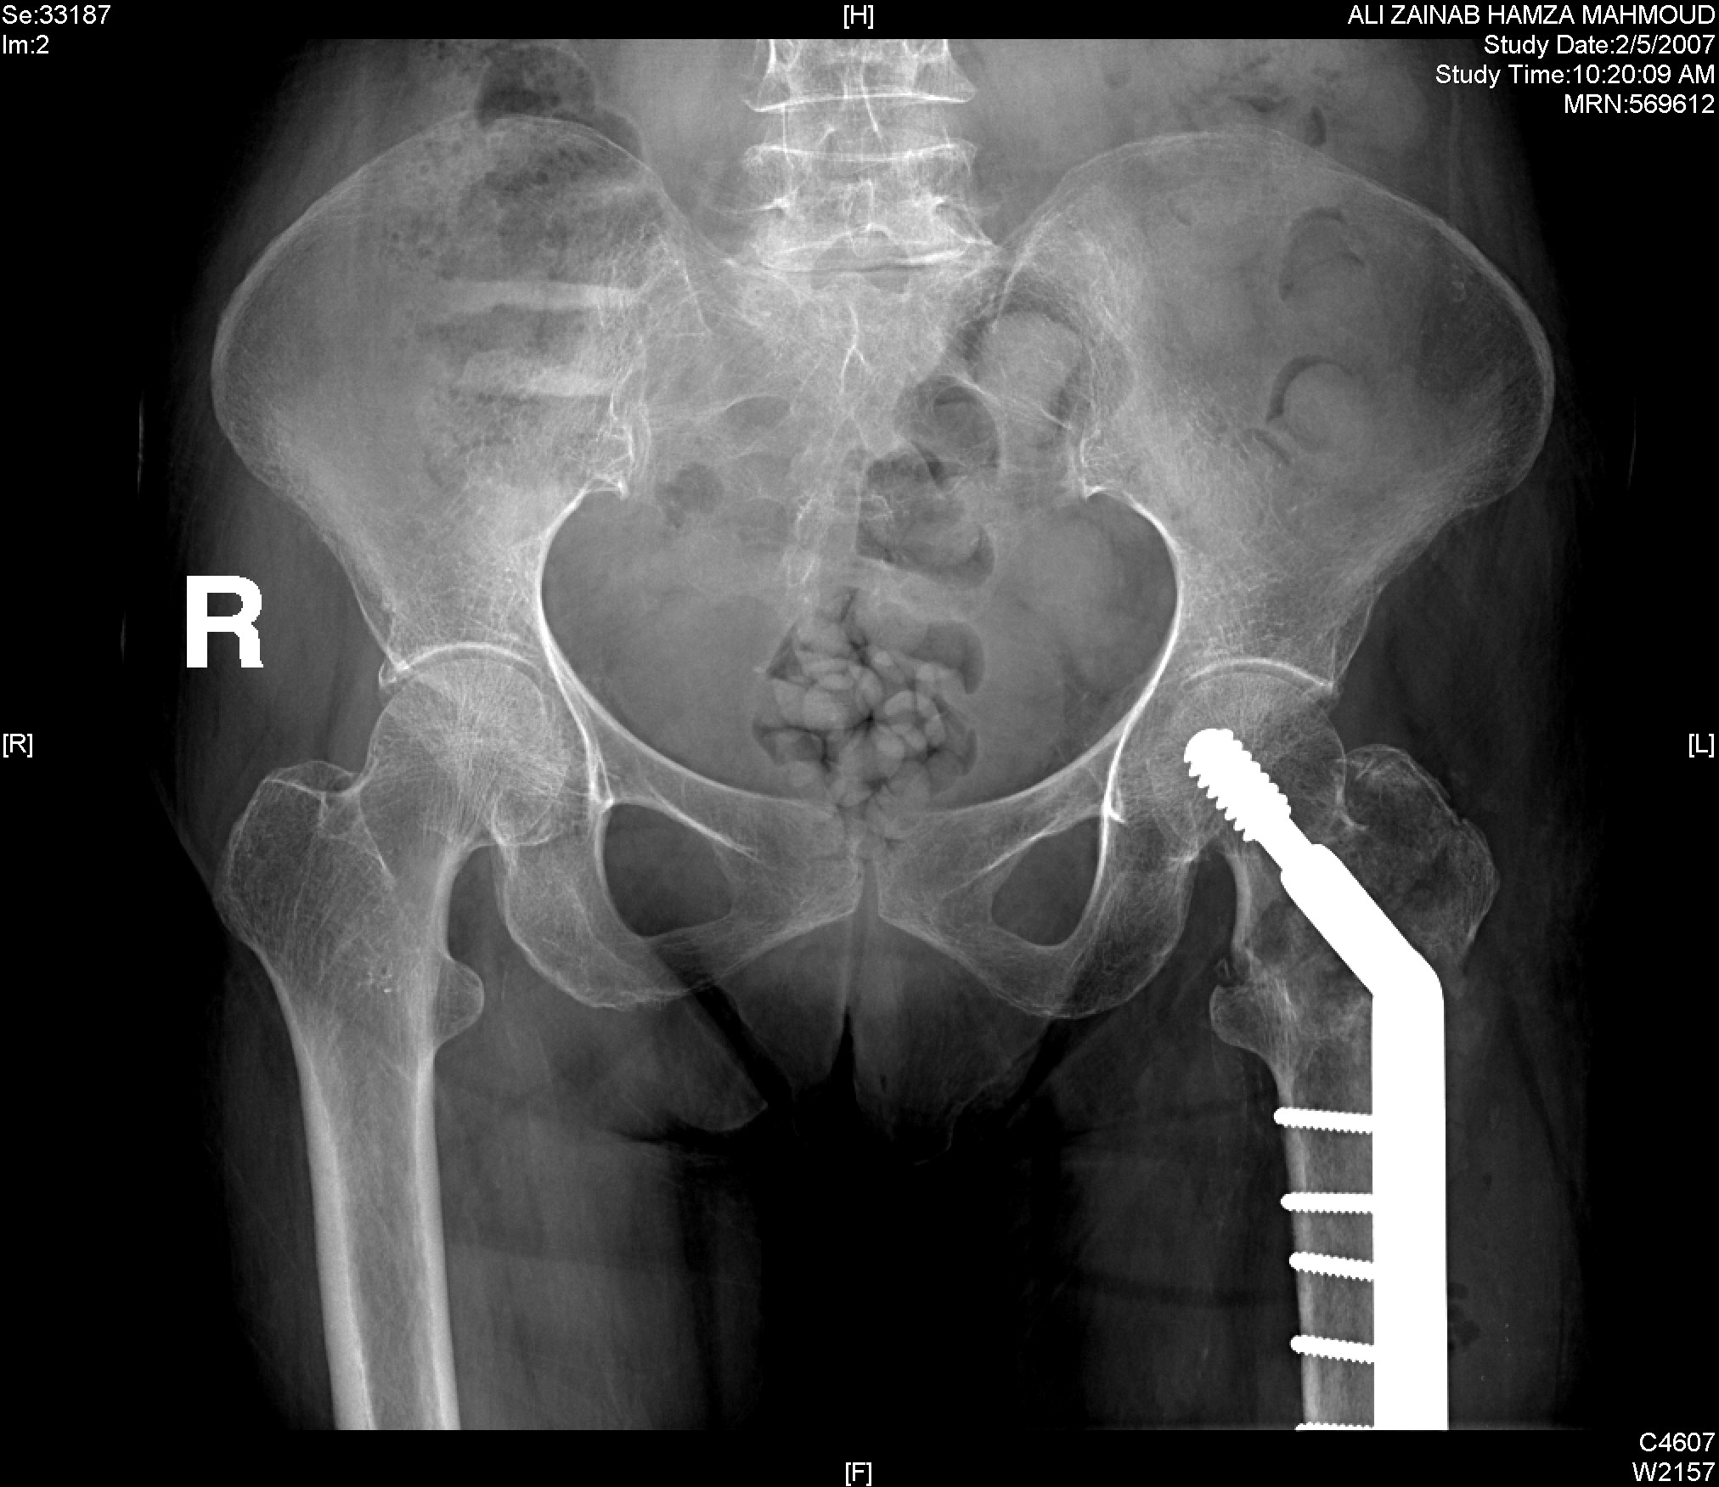

Slide 30
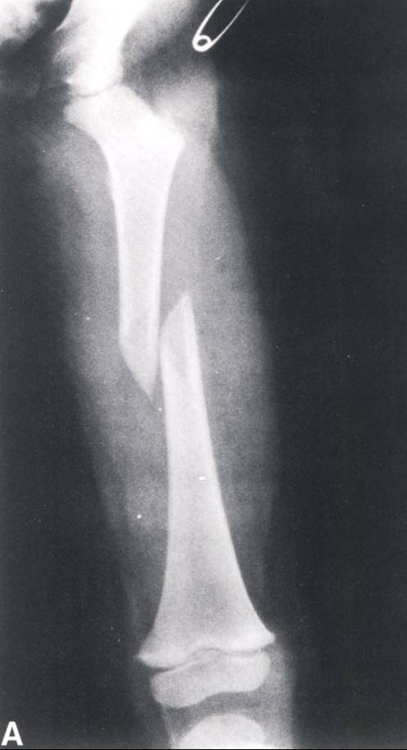
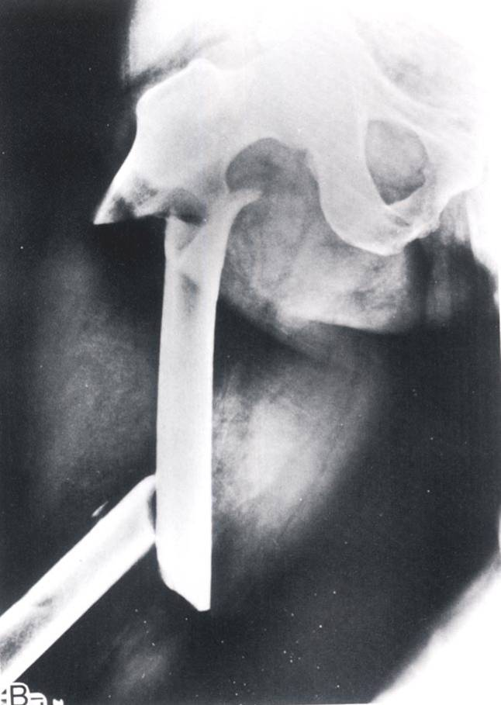

Slide 31
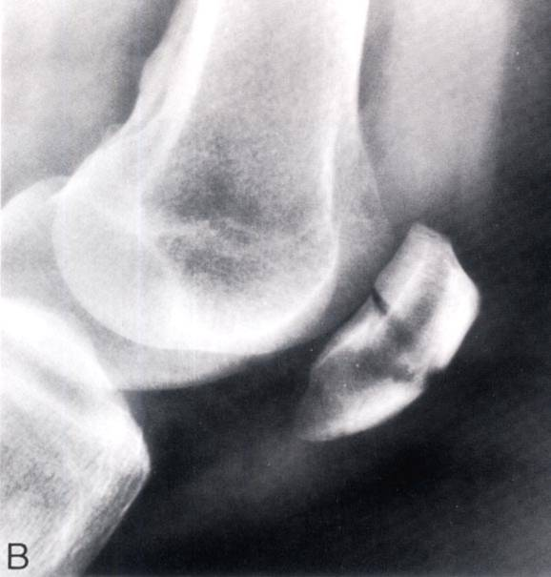
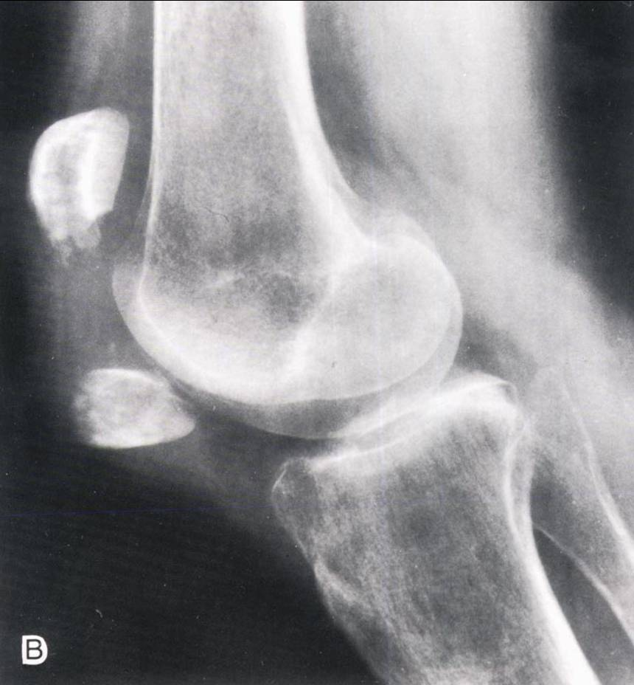

Slide 32
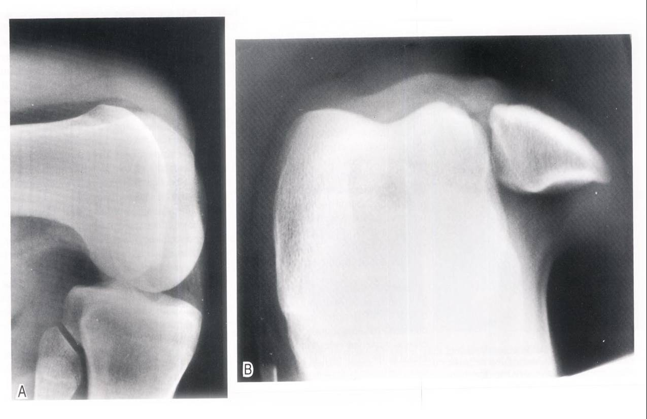

Slide 33
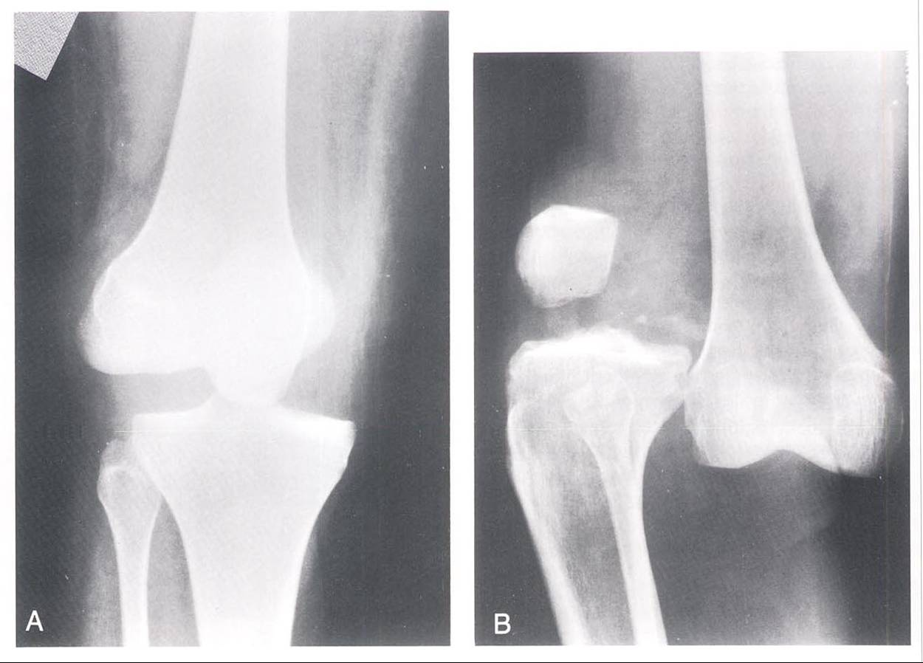

Slide 34
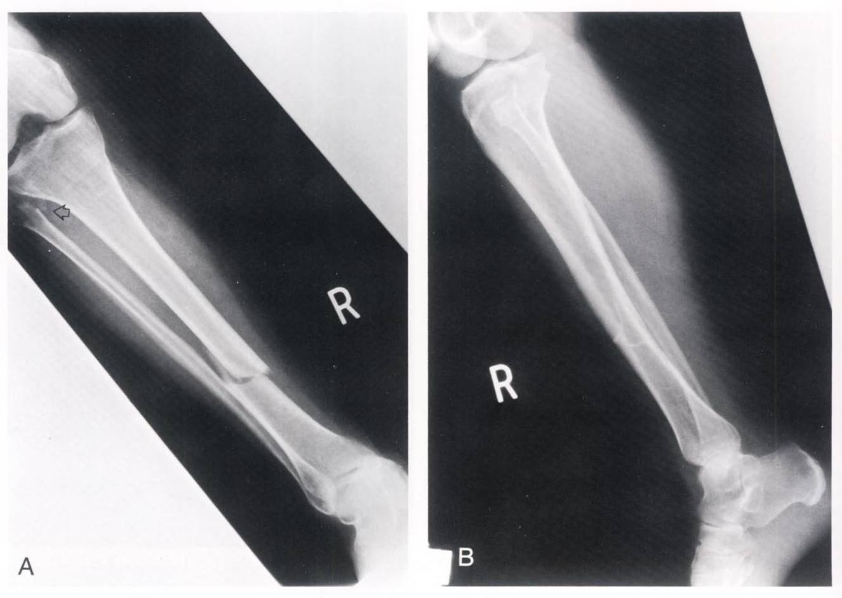

Slide 35
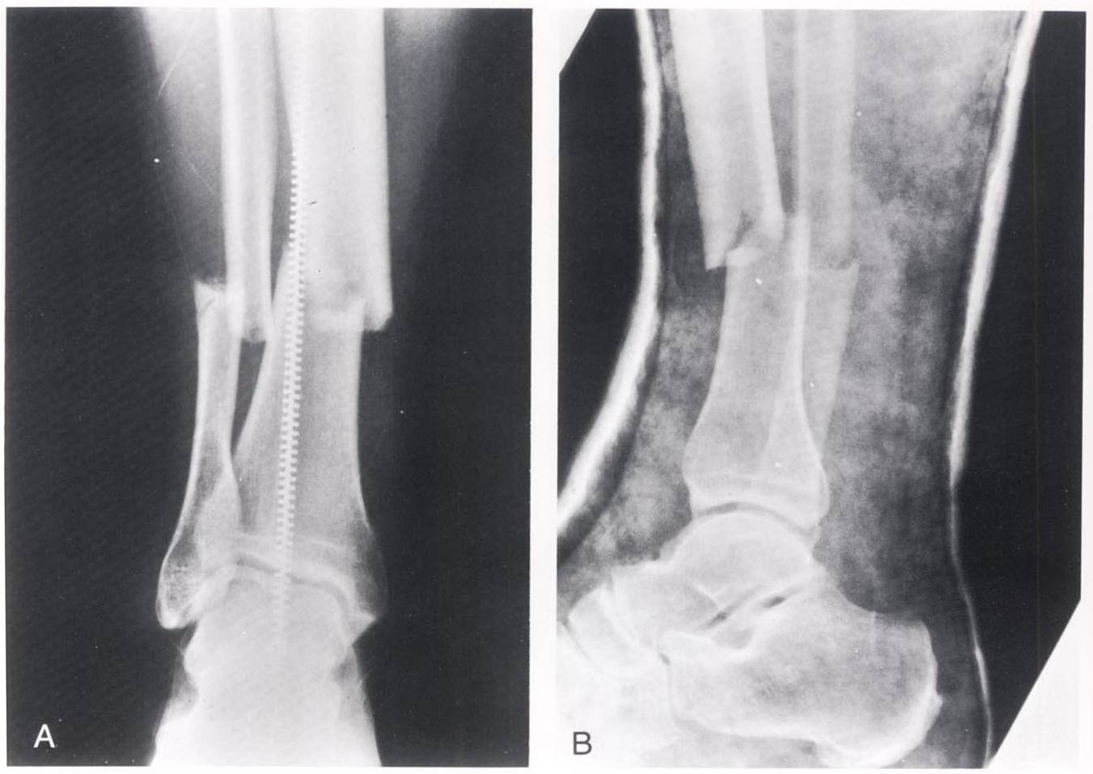

Slide 36
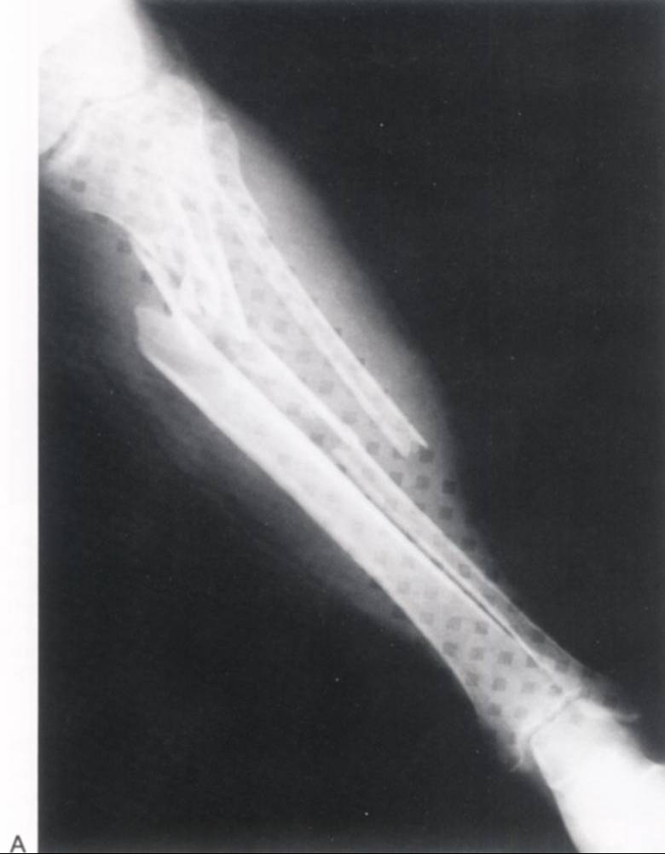

Slide 37
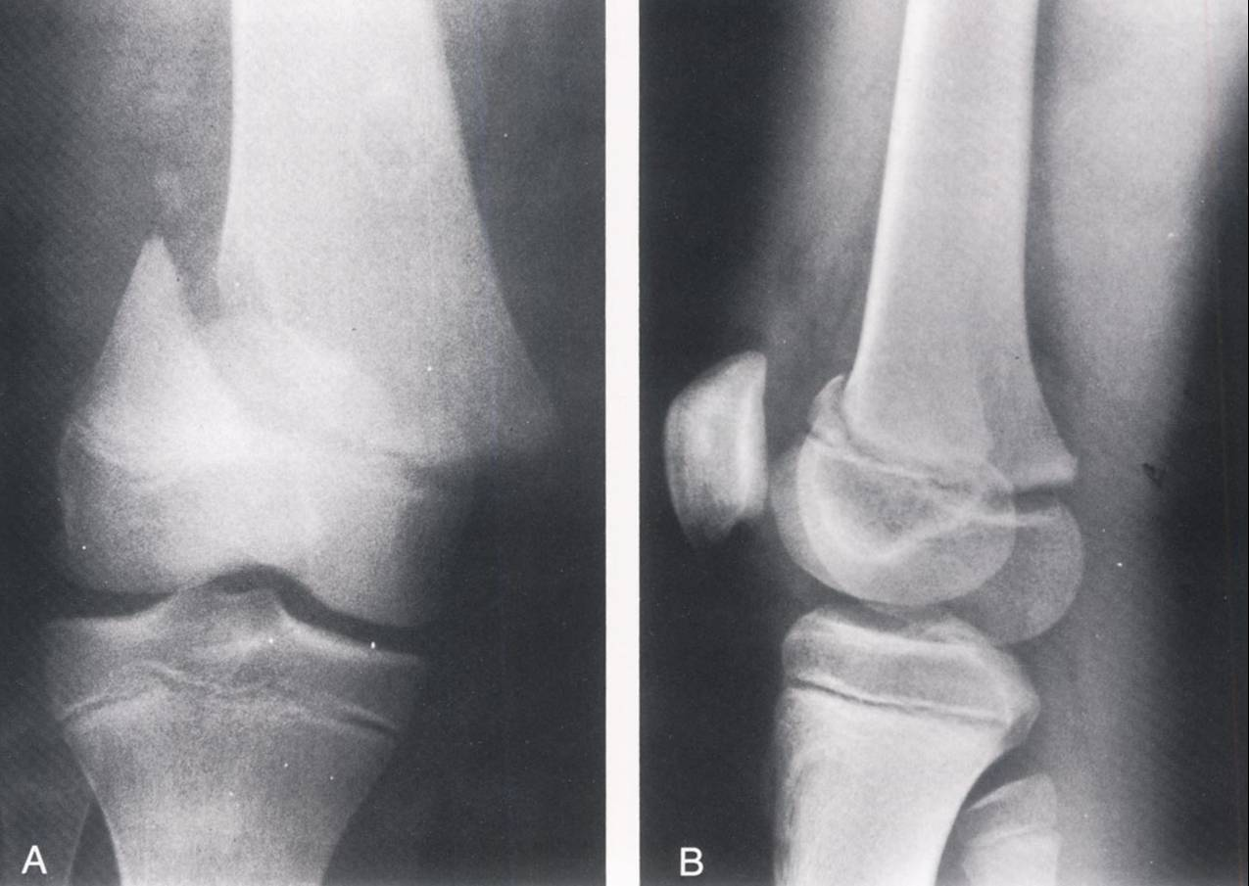

Slide 38
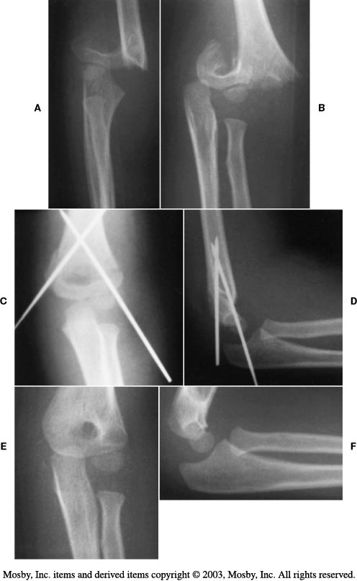

Slide 39
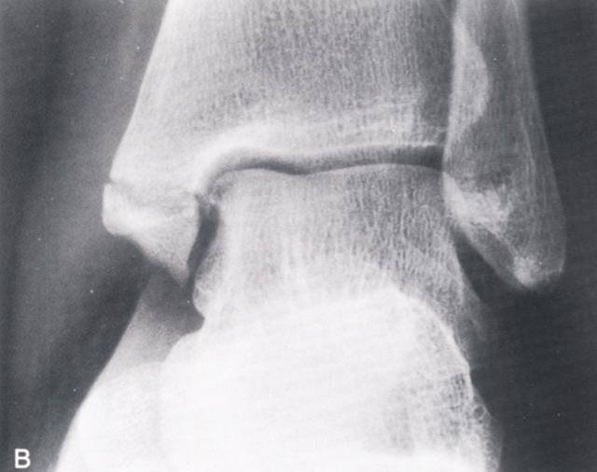
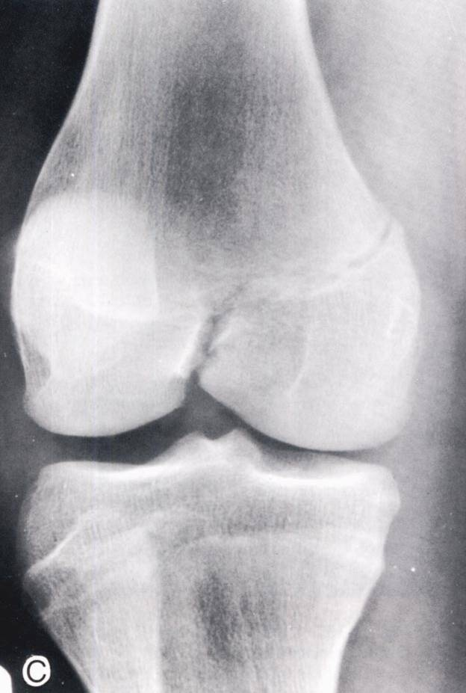

Slide 40
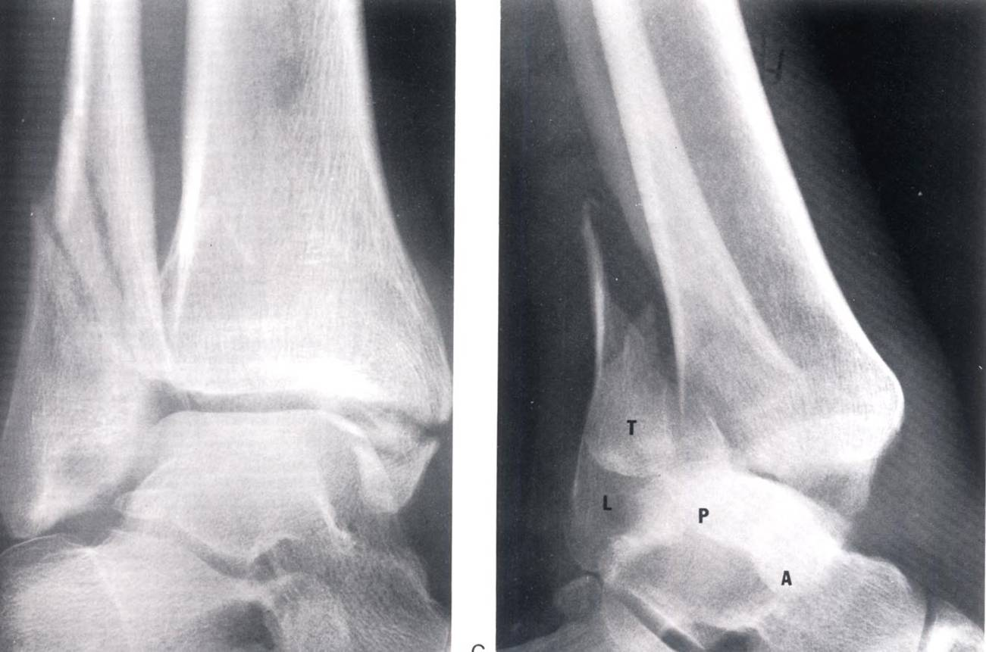

Slide 41
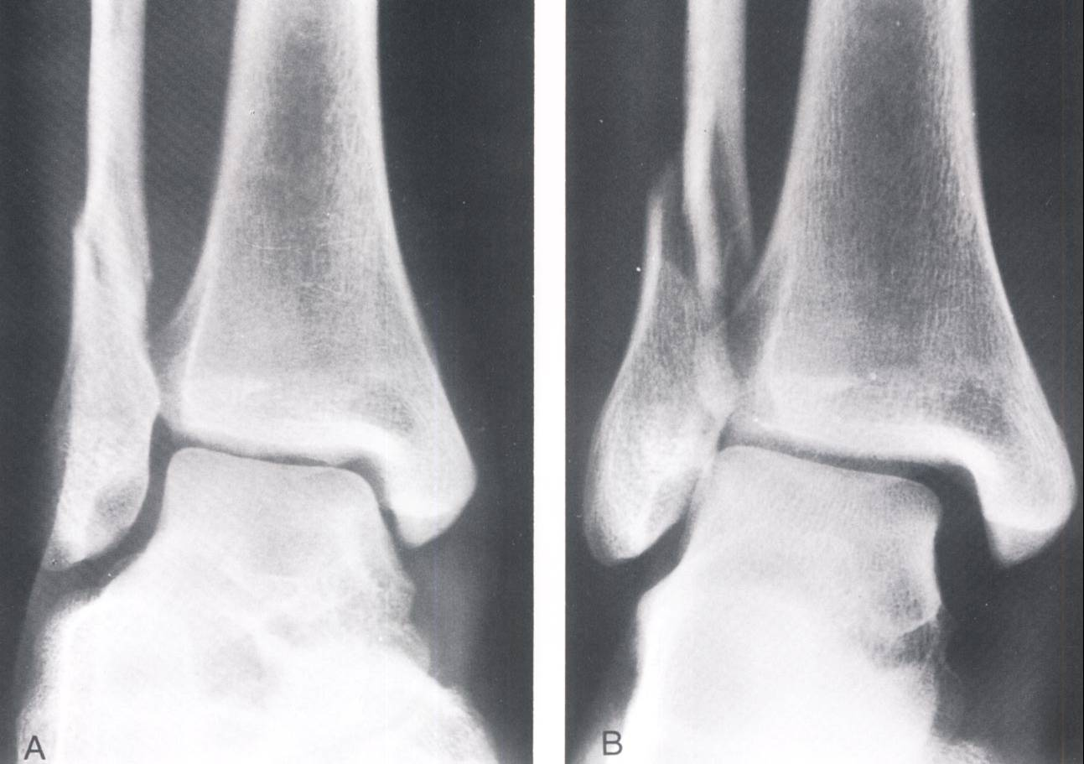

Slide 42
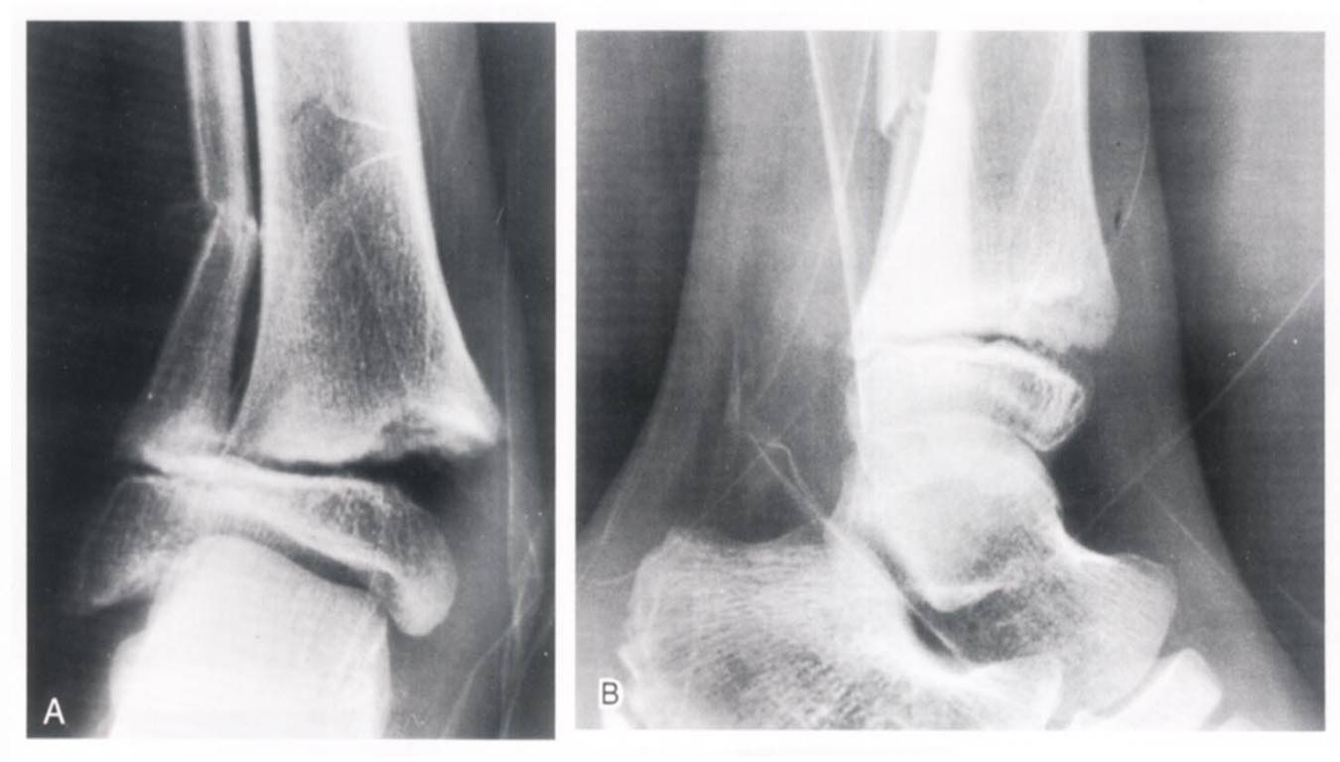

Slide 45
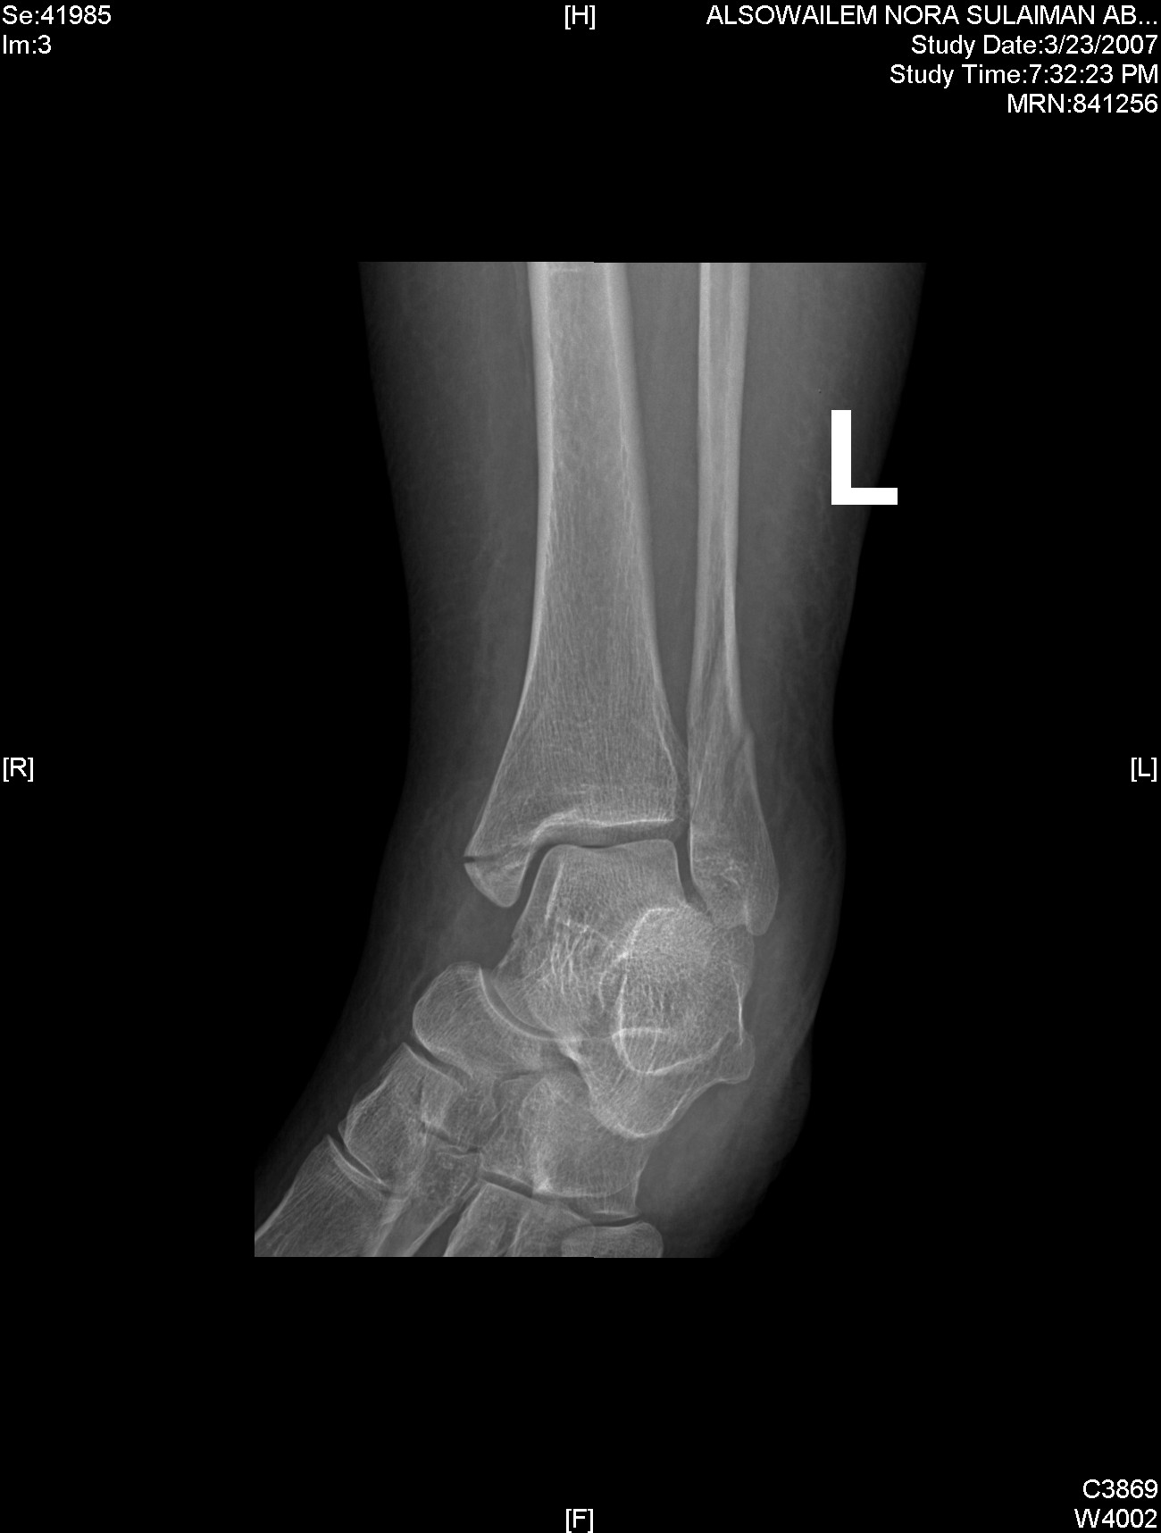

Slide 46
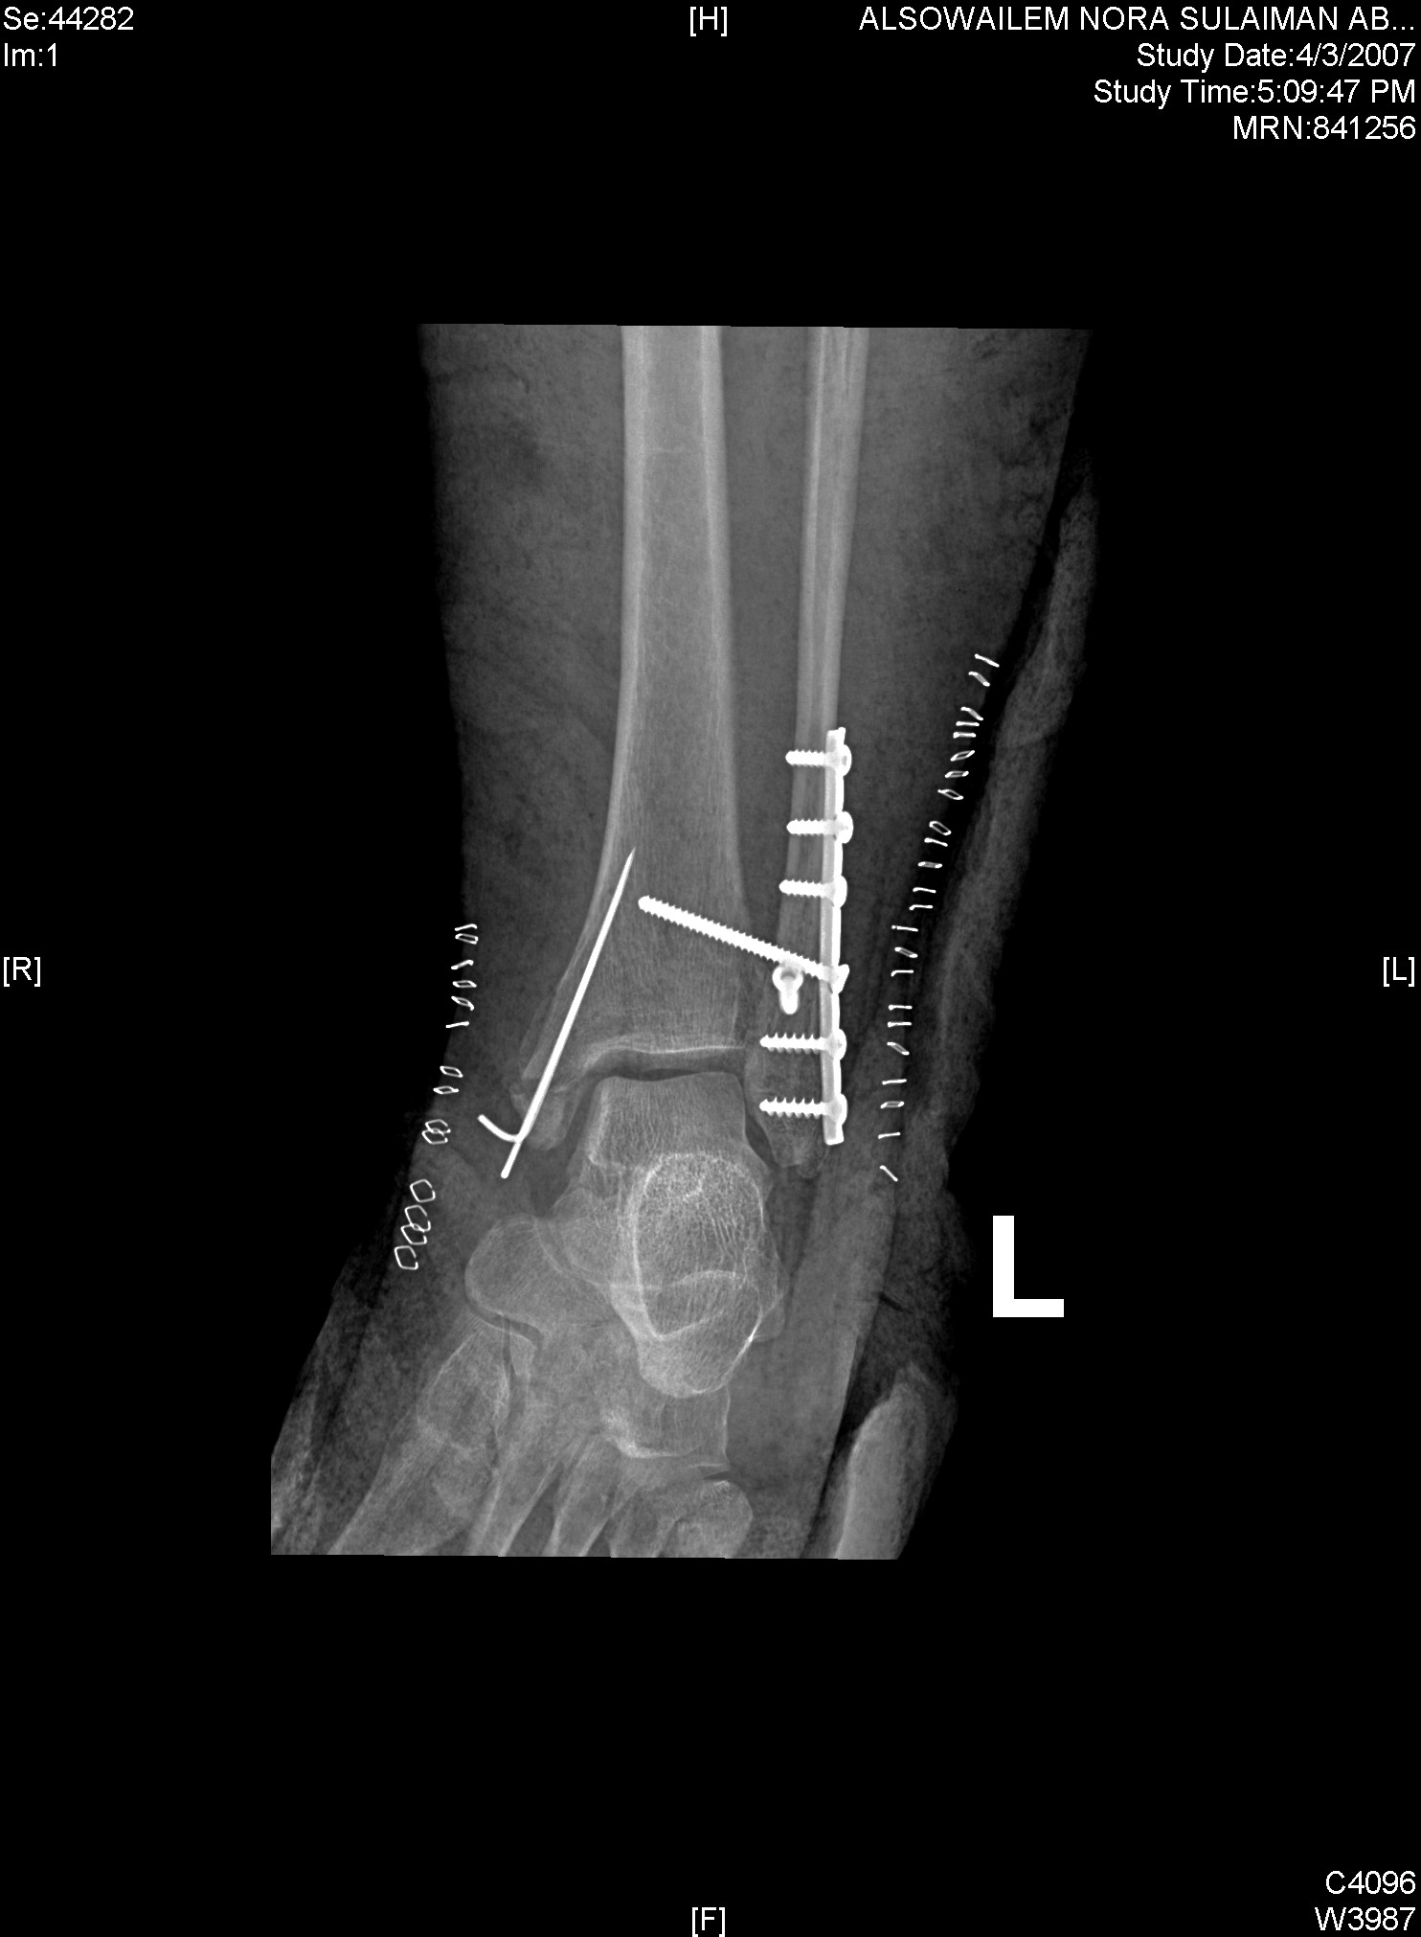

Slide 47
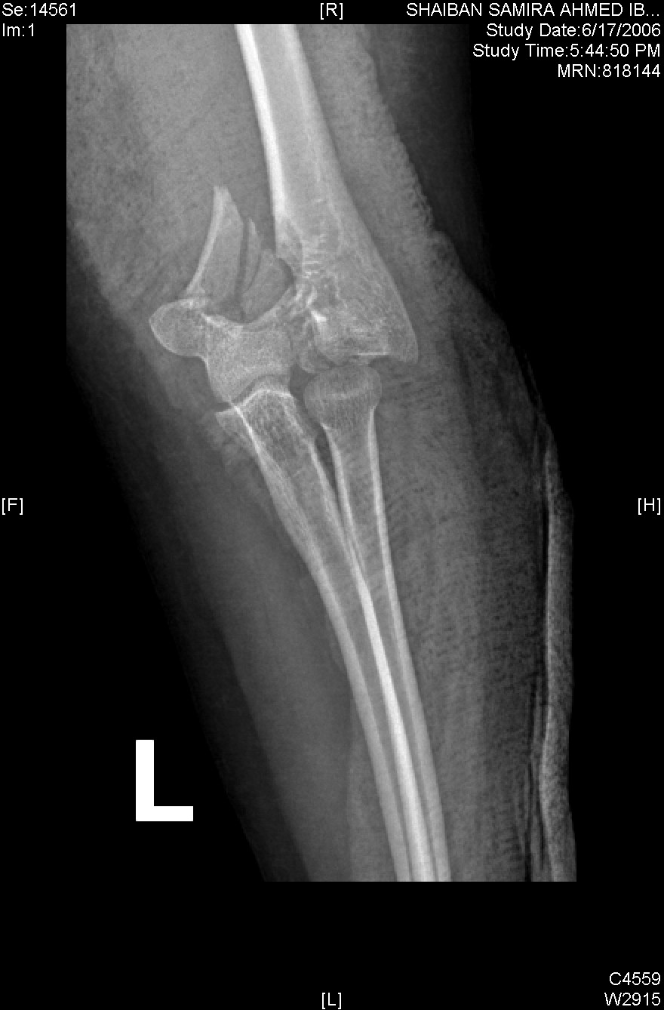

Slide 48
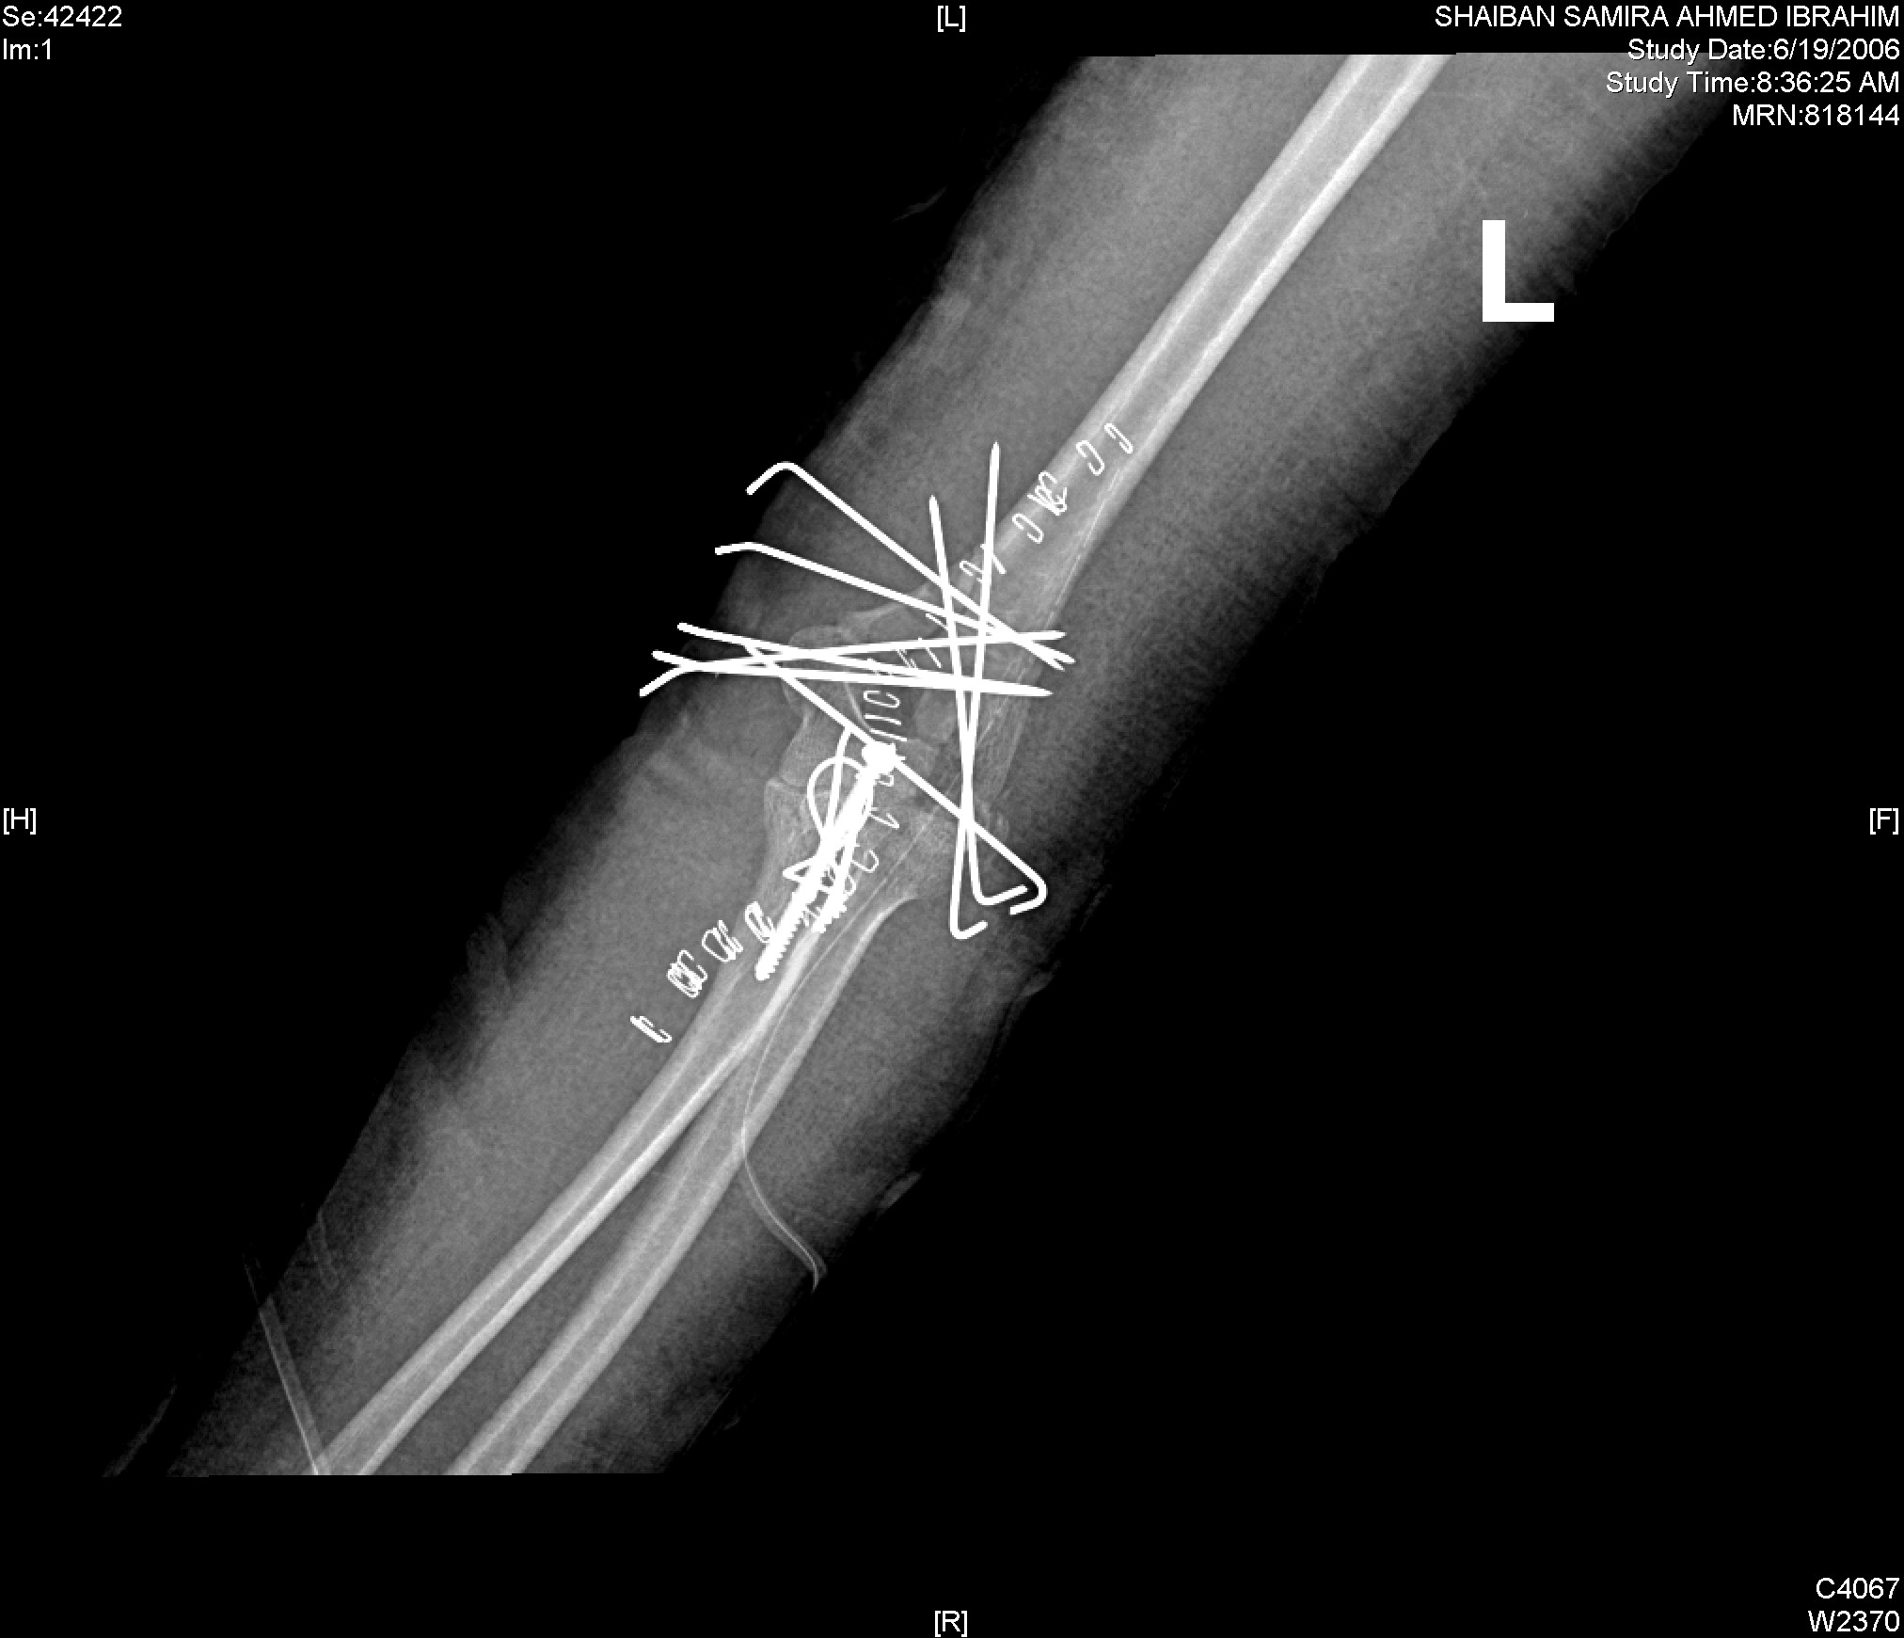
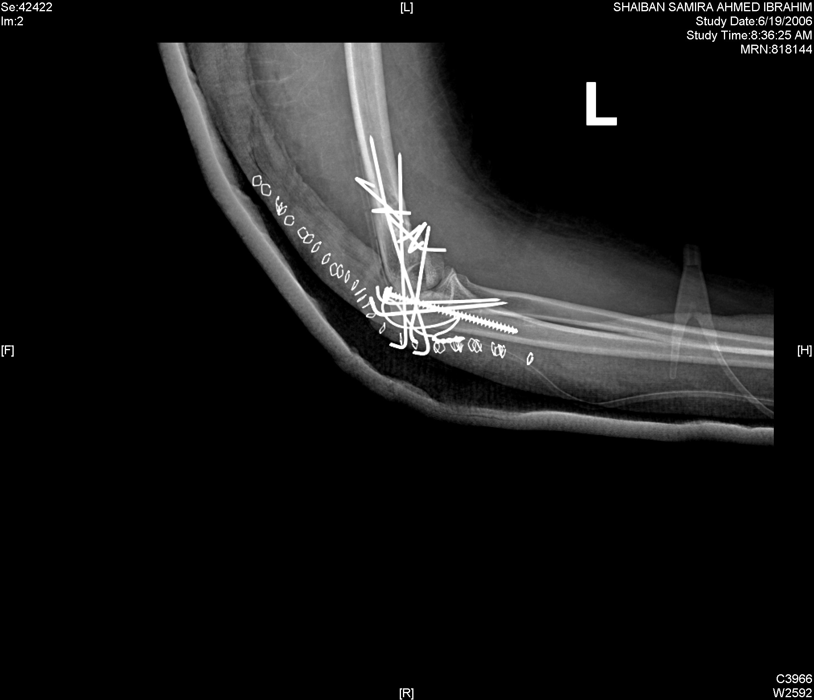

Slide 49
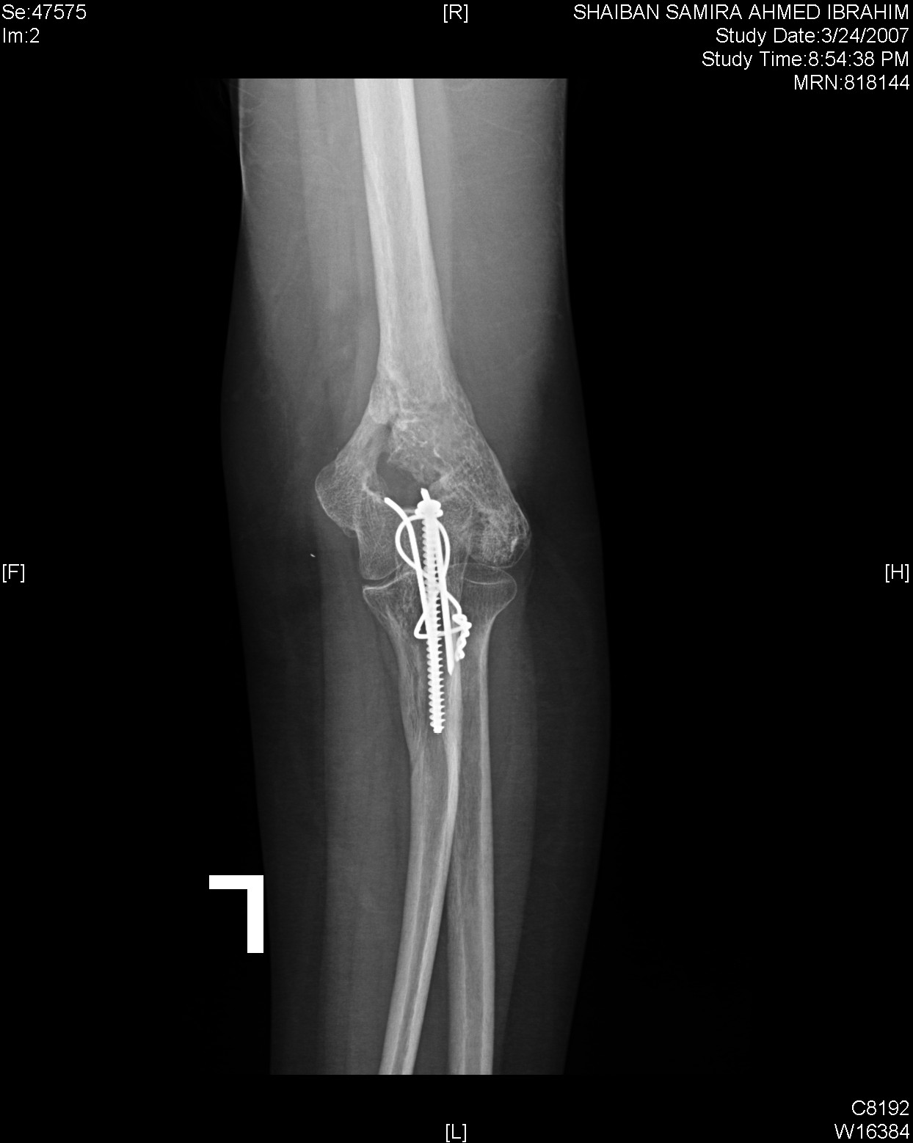

Slide 50
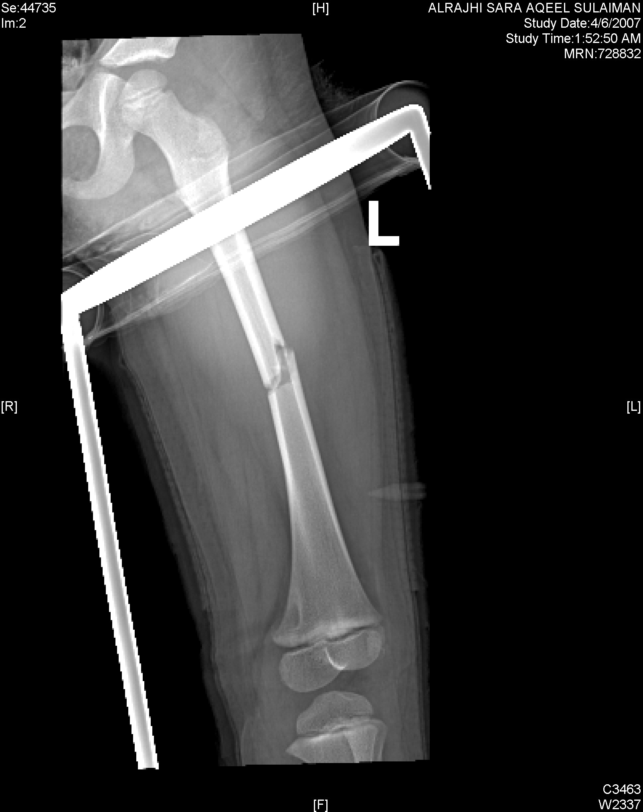

Slide 51
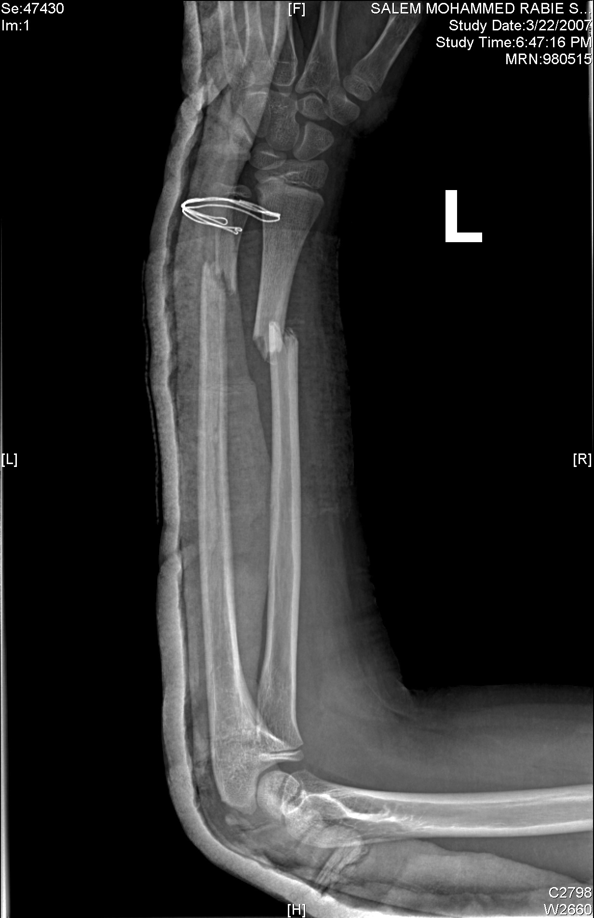
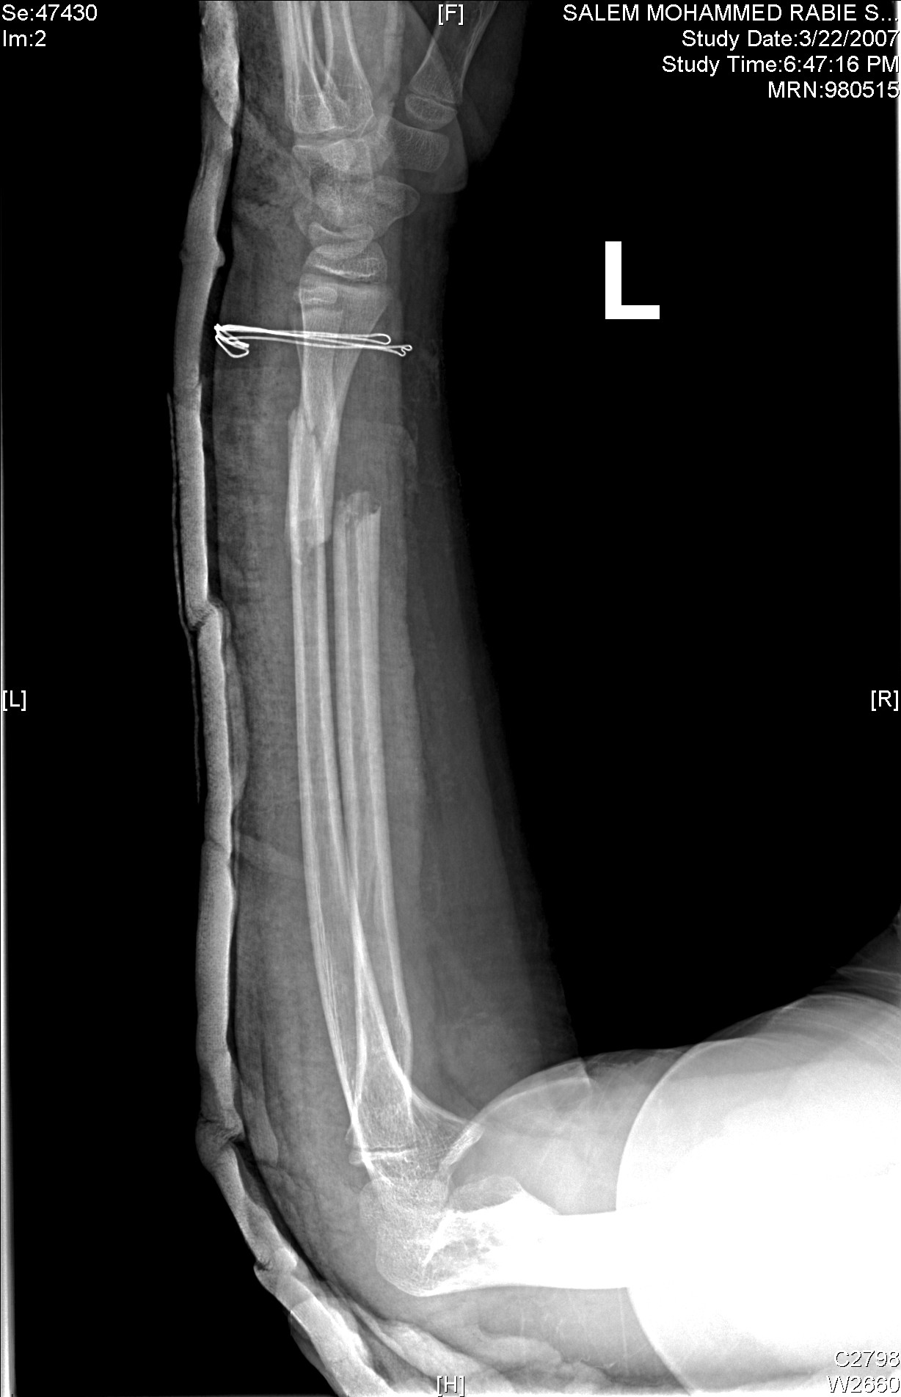

Slide 52
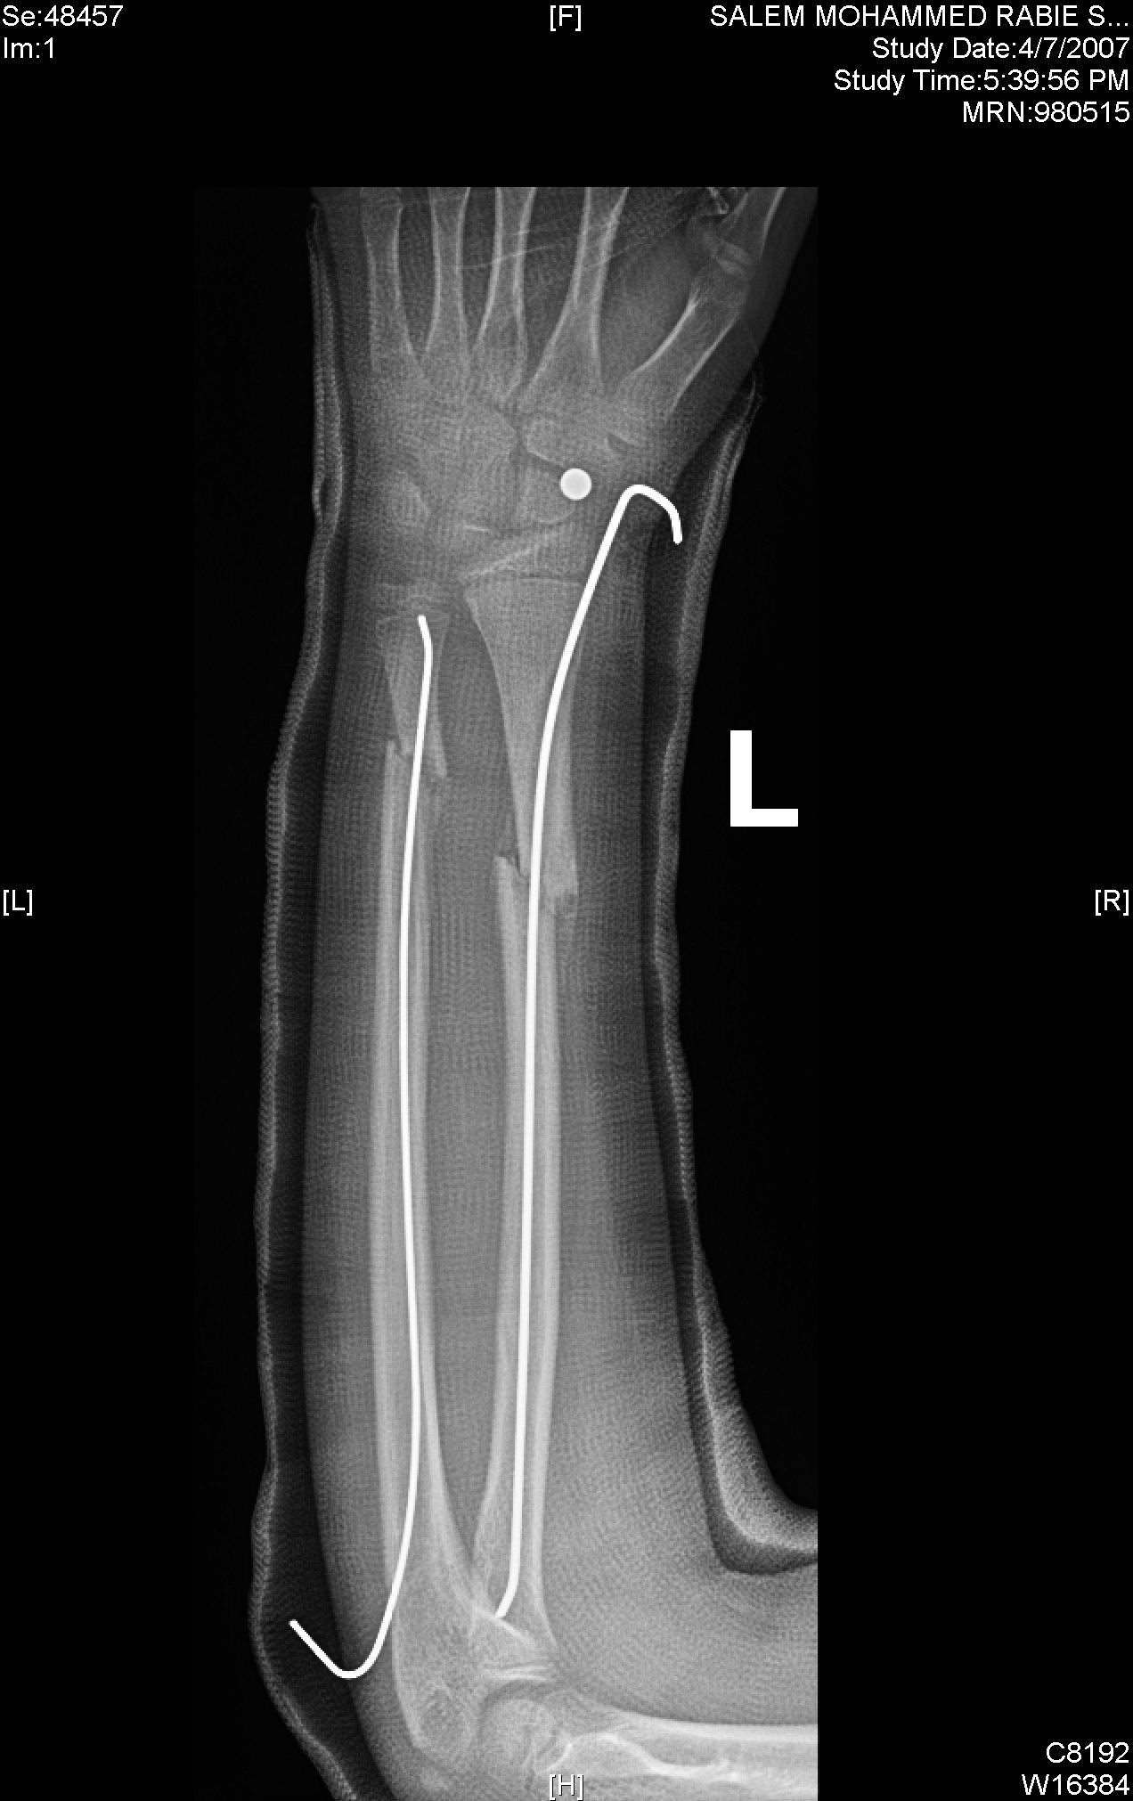

Slide 53
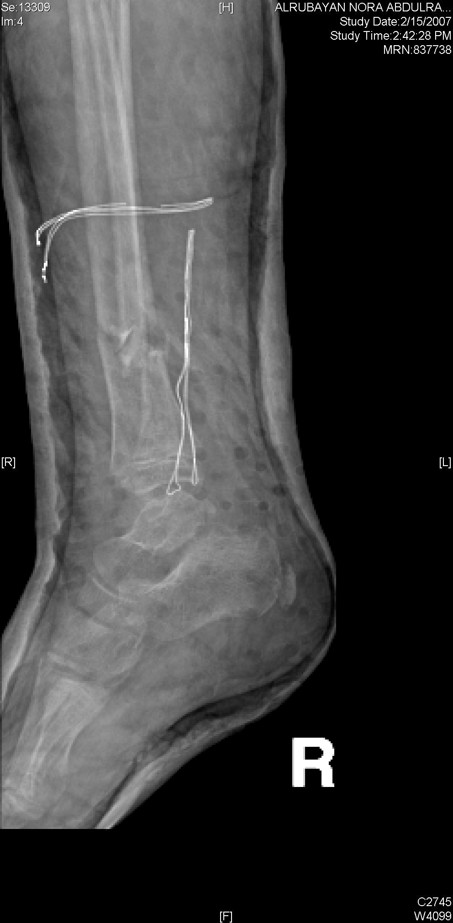

Slide 54
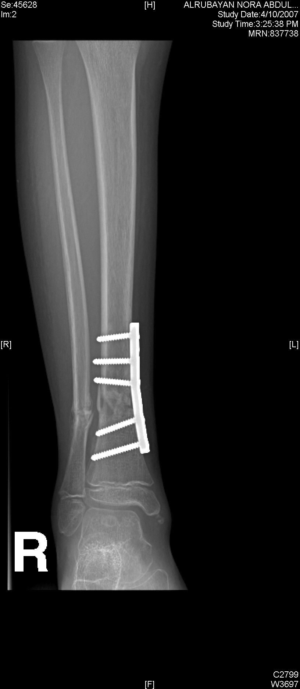

Slide 55
