Slide 1
Common Hip Disorders In Children
Dr.Kholoud Al-Zain
Assistant Prof.
Ped. Orthopedic Consultant
April 2012
(Acknowledgment to 5th cycle students 2010)

Slide 2
Will Cover
Slipped capital femoral epiphysis (SCFE).
Legg-Calf-Perth’s disease.

Slide 3
Slipped Capital Femoral Epiphysis (SCFE)

Slide 4
Objectives
Definition.
Types & severity.
Clinical picture.
Diagnosis.
Treatment.

Slide 5
Definition
It is anterior displacement of the femoral neck and shaft relative to the femoral epiphysis.

Slide 6
Types
Onset:
Acute → < 3w of complain (30% of patients).
Chronic → > 3w.
Acute on top of chronic.

Slide 7
Types
Severity of slip:
Mild → < 30% slippage
Moderate → 30 – 60%
Severe → > 60%

Slide 8
Epidemiology
2M : 1F
11 – 15 y old.
Around puberty time.
Usually:
Over weight (or tall & thin).
Dark skin.
30% have hormonal imbalance → thyroid, parathyriod, GH, & gonadal.
30% bilateral hips affection.

Slide 9
Clinical Picture
Pain:
Acute pain with a minor trauma.
Or had mild pains that suddenly increased.
At the groin ± thigh.
Could be only knee pain.
↑ with activity.
Painful (antalgic) gait.

Slide 10
Clinical Picture
O/E of the affected L.L:
Is externally rotated.
Loss of internal rotation.
May be (1-2 cm) shorter.
With passive hip flexion → it involuntarily goes into external rotation.
Depending on the type → can he/she walk on it.

Slide 11
Clinical Picture

Slide 12
Work Up
Hormonal studies.
X-ray:
AP.
Frog lateral.

Slide 13
X-Ray

Slide 14
X-Ray

Slide 15
X-Ray

Slide 16
X-ray Klein’s Line

Slide 17
Work Up
We rarely ask for:
MRI → early detection of SCFE & complications.
C.T → pre operatively to plan the osteotomy.
Bone scan → early detection of complications.

Slide 18
Differential Diagnosis
Salter Harris fracture type-1 of the physis.

Slide 19
Treatment
Once diagnosed we treat.
No role for:
Observation, or
Attempts at closed reduction.
Aim → prevent further slip → fix with pins.
NSAID, temporary skin traction.
Medical referral & hormonal treatment.

Slide 20
Treatment- Acute Slip

Slide 21
Treatment- Chronic Slip

Slide 22
Complications
If the slip progress → leads to early O.A
If the pins are put too deep → chondrolysis.
If not treated properly → higher rates of AVN.

Slide 23
Complication- Chondrolysis

Slide 24
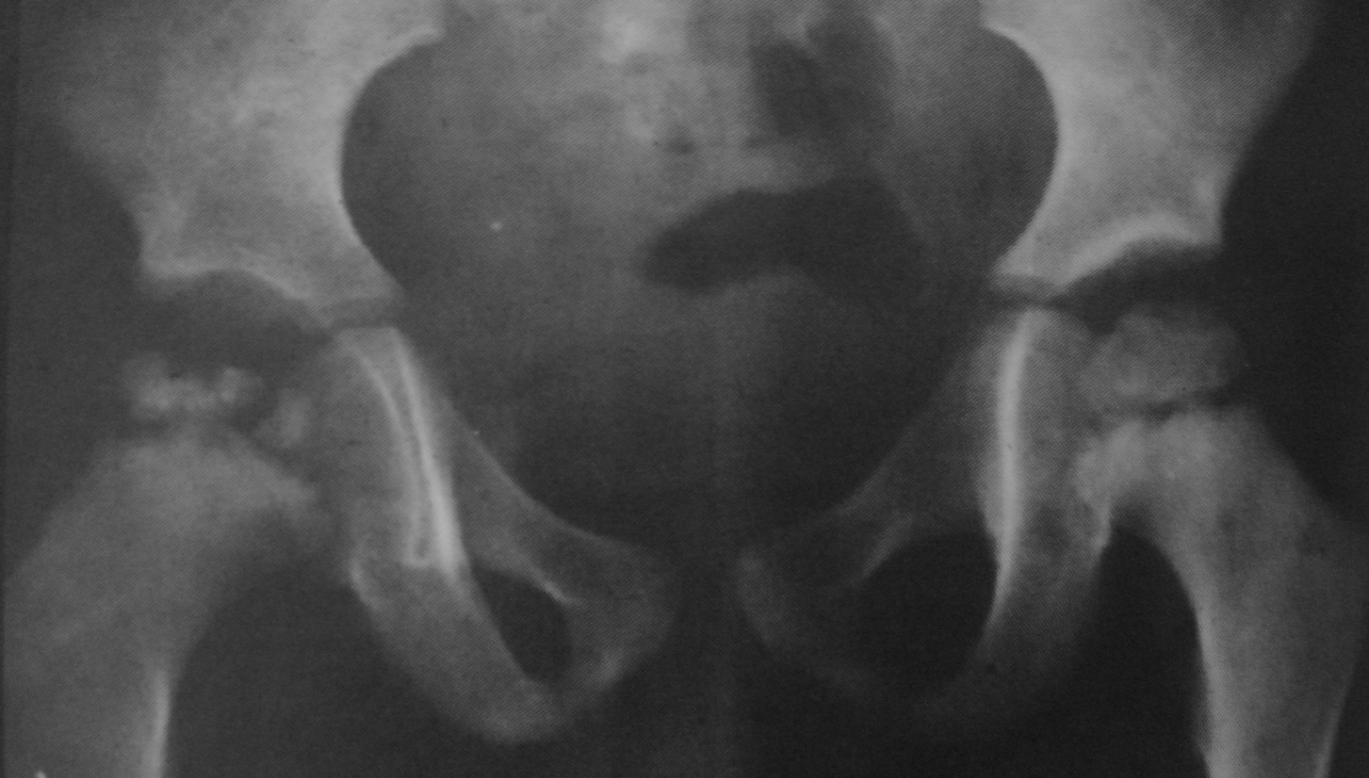
Legg-Calve-Perth's Disease

Slide 25
Objectives
Definition.
Epidemiology.
Clinical picture.
Stages & Grades.
Treatment.

Slide 26
Definition
It is idiopathic avascular necrosis of the femoral head.

Slide 27
Causes
Idiopathic.
Multiple theories → most accepted is multifactorial, including a combination of:
A.V malformation.
Hyperactive child.
Minor repeated trauma.
± Viral infection.

Slide 30
Epidemiology
M5 : F1
1 : 10,000
Age 4-10 y.
Bilateral affection of hips:
20% affected on presentation.
40% of the other hip by 12-18m will be affected.

Slide 31
Clinical Picture
Pain:
Acute pain (moderate-sever).
That is fluctuating & persistent.
Some parents relate it to a minor trauma.
At the groin ± anterior thigh.
Could be only knee pain.
Painful (antalgic) gait.
Patient’s activity affected.
↑ with activity, especially jumping.

Slide 32
Clinical Picture
Leg length discrepancy.
Affected L.L → muscle atrophy (due to disuse).
Hip:
Tender groin.
↓ range of motion (ROM):
In all directions.
Particularly: internal rotation & abduction.
Knee → Normal exam.

Slide 33
Stages
Synovitis.
Fragmentation stage.
Reossification (remodeling) stage.
Healed stage.

Slide 34
Grades
I → ¼ of the head only involved.
II → ½
III → ¾
IV → all involved (worst).

Slide 35
Work Up
X-ray:
AP.
Frog lateral.

Slide 36
AP

Slide 37
Frog-leg view

Slide 38
AP

Slide 39
Stage 1- Vasculitis Subchondral #, metaphysial changes

Slide 40
Stage 2- Fragmentation Loss of epiphysial height

Slide 41
Stage 3- Reossification & remodeling

Slide 42
Stage 4- Healed

Slide 43
Work Up
MRI:
Early detection of AVN.
Follow up of revascularization pattern.
Bone Scan:
Extent of avascular changes before evident X-ray.

Slide 44
Bone Scan- Synovitis Stage

Slide 45
Treatment
The primary goal:
Containing the femoral head within the acetabulum.
Femoral head recover & grow to a normal shape.
The healing process can take several years.

Slide 46
Treatment
Usually:
Children < 6y do well, need observation mainly.
Children > 9y generally have bad results, need operation(s).

Slide 47
Treatment
Non-surgical:
NSAID to control pain.
Bed rest.
Skin traction, of few days.
Abduction stretching.
Abduction splints.
No jumping.

Slide 49
Abduction splint

Slide 50
Treatment
Surgical:
Pelvic → usually Salter.
Femoral → varus osteotomy.

Slide 51
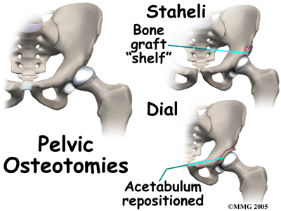

Slide 52
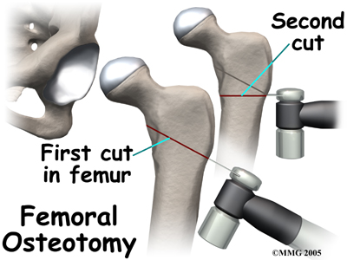

Slide 53
Follow up
Vary closely to monitor:
Symptoms,
Hip mobility,
Healing process,
In unilateral affection we need to observe the other hip.

Slide 54
Prognosis
Most patients do well early in their life.
By 50-60 y of age → 50% will develop O.A .
The end result → most patients will require THR at some point in the future.

Slide 55
Summary (SCFE & Perth’s)

Slide 56
Summary
Both are diseases of an unknown etiology.
M > F
Insidious in onset.
Always examine the hip in patients with knee pain.
2 X-ray views are necessary to make the diagnosis.
Bilateral affection 20-40%.
SCFE → mainly surgical.
LCPD → medical & surgical depending on the age & stage of presentation.

