Slide 1
Common Hip Disorders In Children
Dr.Kholoud Al-Zain
Assistant Prof.
Ped. Orthopedic Consultant
April 2012
(Acknowledgment to 5th cycle students 2010)
428 C2 Notes

Slide 2
Will Cover
Slipped capital femoral epiphysis (SCFE).other name(femoral capital epiphysiolysis)
Legg-Calf-Perth’s disease.
Hip dislocation is very common

Slide 3
Slipped Capital Femoral Epiphysis (SCFE)

Slide 4
Objectives
Definition.
Types & severity.
Clinical picture.
Diagnosis.
Treatment.

Slide 5
Definition
It is anterior displacement of the femoral neck and shaft relative to the femoral epiphysis.
It is the actual slipping of the femoral neck on the epiphysis anteriorly; the neck is displaced anteriorly and the epiphysis stays in the acetabular socket.(see picture in the next slide)
It is similar to the salter harris type 1 fracture.
There is a also a posterior displacement of the posterior neck of the femur but it is a rare entity.

Slide 7
Types
Onset:
Acute → < 3w of complain (30% of patients).
Chronic → > 3w.
Acute on top of chronic (if the pain lasted for months and suddenly developed sudden acute pain.

Slide 8
Types
Severity of slip i.e degree of displacement:
Think of it as a rule of 30’s
Mild → < 30% slippage
Moderate → 30 – 60%
Severe → > 60%

Slide 9
Epidemiology
2M : 1F
11 – 15 y old (pre-puberty and puberty usually doesn’t come in toddlers) .
Around puberty time.
Usually:
Over weight (or tall & thin).
Dark skin.
30% have hormonal imbalance → thyroid, parathyriod, GH, & gonadal they displaced due to the imbalance found in their hormones .
30% bilateral hips affection.
(boys affected more than girls,and left hip is affected more than the right)

Slide 10
Clinical Picture
Pain:
Usually Acute pain with a minor trauma same as salter harris fractures.
Or had mild pains that suddenly increased.
At the groin ± thigh because this is where the innervation ends for the hip joint once we say groin we mean hip.
Occasionally and not rarely could be only knee pain and is often neglected in the ER; and they are not oriented to the north pathology (hip) and this is a very common presentation. Pudendal nerve is affected.
↑ with activity.
Painful (antalgic) gait.

Slide 11
Clinical Picture
O/E of the affected L.L:
Is externally rotated.
Loss of internal rotation.
May be (1-2 cm) shorter from the external rotation.
With passive hip flexion → it involuntarily goes into external rotation. This test is so pathognomonic so characteristic to the disease. It is the most specific test.
Test is done when the patient is in supine position and the hip is passively flexed the leg spontaneously goes into external rotation.
Depending on the type → can he/she walk on it. Usually in acute setting their condition is so devastating and they cannot walk on their feet.
.

Slide 12
Clinical Picture; typical presentation over weight boys

Slide 13
Work Up
Hormonal studies.
X-ray:
AP.
Frog lateral not lateral pelvis. The hips will be flexed, abducted and externally rotated in order to assess the entire femoral head

Slide 14
Slipped femur X-Ray normal hip

Slide 15
X-Ray radiological line that when passed along the neck should cross the tip of the epiphysis in AP and lateral view

Slide 16
X-Ray (trethowan's sign) normal

Slide 17
X-ray Klein’s Line

Slide 18
Work Up
We rarely ask for:
MRI → early detection of SCFE & complications.(AVN)
C.T → pre operatively to plan the osteotomy.
Bone scan → early detection of complications.

Slide 19
Differential Diagnosis
Salter Harris fracture type-1 of the physis.

Slide 20
Treatment
Once diagnosed we treat no observation the more we delay the worse the slip. The worse the slip the more osteoarthritis in the future.
Admit and put on the emergency list.
No role for:
Observation, or
Attempts at closed reduction. If you attempt to reduce you will crush the growth plate
Aim (surgery) → prevent further slip → fix with pins.
NSAID, temporary skin traction it is not life threating or limb threating so if you get a patient at midnight you can wait till the morning and control by skin traction and immobilization and non-oral analgesia.
Medical referral & hormonal treatment must do hormonal assay but do not wait for results to operate because it can take a week. But if hormonal assay comes positive it must be treated to prevent the slipping of the other hip or the pathology in the same hip can re-slip when patch removed.

Slide 21
Treatment- Acute Slip AP Fixed prophylactically lateral

Slide 22
Treatment- Chronic Slip

Slide 23
Complications
If the slip progress → leads to early O.A
If the pins are put too deep → chondrolysis. Articular surface of the femoral head will dissolve.
If not treated properly → higher rates of AVN. The vessels infront are compressed and the one behind are being stretched and lead to ischemia.

Slide 24
Complication- Chondrolysis patient was operated. The blood supply of the chondrom can be affected due to complication of surgery during screw insertion

Slide 25
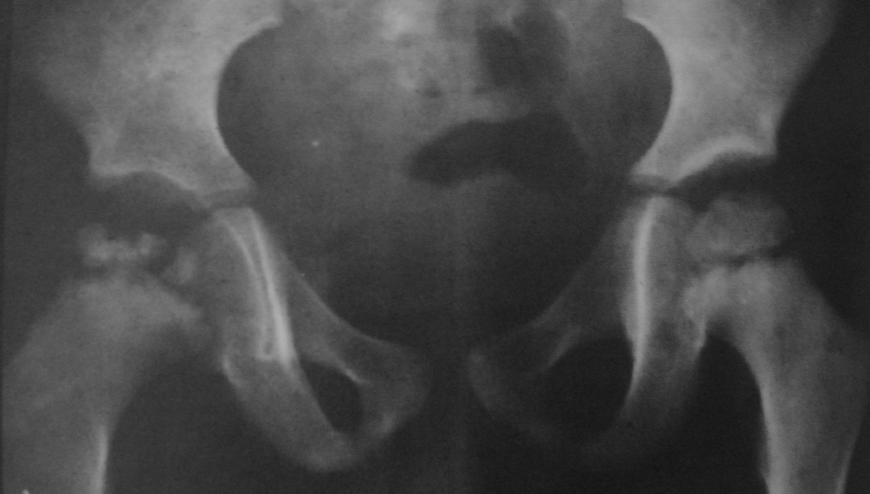
Legg-Calve-Perth's Disease

Slide 26
Objectives
Definition.
Epidemiology.
Clinical picture.
Stages & Grades.
Treatment.

Slide 27
Definition
It is idiopathic avascular necrosis of the femoral head.
(painful disorder of childhood characterized by avascular necrosis of the femoral head)
The role of surgery plays 50:50 percent chance. If the patient has sickle cell anemia we don’t call it perth’s same goes for fracture and dislocation. They get AVN but it is not perth’s disease; it is a traumatic AVN.
Idiopathic AVN is a diagnosis of exclusion.

Slide 28
Causes
Idiopathic.
Multiple theories → most accepted is multifactorial, including a combination of:
A.V malformation.
in
Hyperactive child.
With
Minor repeated trauma.
± Viral infection.

Slide 29
Loss of calcium which will lead to collapse on the femoral head and ends as an oval mushrom shaped head.

Slide 31
Epidemiology
M5 : F1
1 : 10,000 it is seen commonly
Age 4-10 y.
Bilateral affection of hips:
20% affected on presentation.
40% of the other hip by 12-18m will be affected.
Most unilateral cases untreated tend to be bilateral within 1 to 1.5 years if you don’t have close observation

Slide 32
Clinical Picture
Pain:
Acute pain dull aching pain (moderate-sever).
That is fluctuating & persistent; never goes.
Parents feel there is a change in movement and relate it to a simple trauma. They mention that their child has less pain but he is limping. … typical presentation.
Some parents relate it to a minor trauma.
At the groin ± anterior thigh.
Could be only knee pain.
Painful (antalgic) gait.
Patient’s activity affected.
↑ with activity, especially jumping they tend to be hyperactive children. Try to restrict jumping because once the collapse happens there is a deformity and even if the blood supply is restored it will supply an distorted structure.

Slide 33
Clinical Picture
Leg length discrepancy because the epiphysis collapsed.
Affected L.L → muscle atrophy (due to disuse).
Hip:
Tender groin.
↓ range of motion (ROM due to the oval shaped femoral head):
In all directions.
Particularly: internal rotation & abduction.
Knee → Normal exam. Have to examine the knee

Slide 34
Stages; clinical and radiological
Synovitis.
Fragmentation stage.
Reossification (remodeling) stage collapse has stopped and blood supply is restored.
Healed stage the disease has finished its course and it takes years to reach this stage.

Slide 35
Grades; how much of the femoral head is involved
I → ¼ of the head only involved.
II → ½
III → ¾
IV → all involved (worst).

Slide 36
Work Up
X-ray:
AP.
Frog lateral.

Slide 37
Normal AP affected

Slide 38
Frog-leg view

Slide 39
AP

Slide 40
Stage 1- Synovitis Subchondral #, metaphysial changes cysitc formation. Early stage. The earliest sign is subchondral fracture but not always seen.

Slide 41
Stage 2- Fragmentation Loss of epiphysial height

Slide 42
Stage 3- Reossification & remodeling

Slide 43
Stage 4- Healed; greater trochanter is higher than the femoral head and this is what we should avoid or prevent in our patients. They have limited abduction and the leg shorter

Slide 44
Work Up
MRI:
Early detection of AVN; at an unusual age and history is not typical. For ex: 3 year old child
Mostly x-ray is more than enough
The children do MRI under GA. But done only when needed
Follow up of revascularization pattern.
Bone Scan:
Extent of avascular changes before evident X-ray.

Slide 45
Bone Scan- Synovitis Stage in the fragmentation stage we will get a cold picture of bone scan. This early stage shows hyperemia

Slide 46
Treatment
The primary goal:
Contain femoral head in the acetabulum. Mobility and painlessness
Containing the femoral head within the acetabulum.
Femoral head recover & grow to a normal shape.
The healing process can take several years.

Slide 47
Treatment
Usually:
Children < 6y do well, need observation mainly. They tend to model well and gain spherical shape of the head. (symptomatic treatment ;pain control+gentle exercise)
Children > 9y generally have bad results, need operation(s). At least one surgery but may have many.
Between 6 and 9 we don’t know they can go both ways depending on the age of onset. When did the pain start with the patient.

Slide 48
Treatment
Non-surgical:
NSAID to control pain.
Bed rest.
Skin traction, of few days.
Abduction stretching physiotherapy even though all other movements are affected. You can operate without full range of motion
Abduction splints.
No jumping.
Must have a very close follow up to make sure to operate once patient gains full range of motion

Slide 50
Abduction splint

Slide 51
Treatment
Surgical:
Pelvic → usually Salter.
Femoral → varus osteotomy.

Slide 52
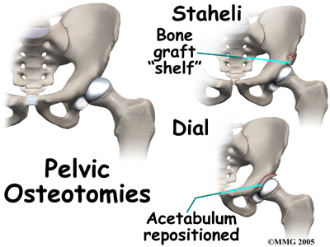

Slide 53
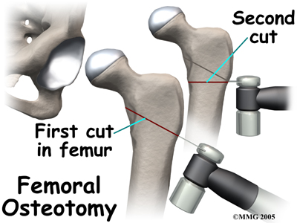

Slide 54
Follow up
Vary closely to monitor:
Symptoms,
Hip mobility,
Healing process,
In unilateral affection we need to observe the other hip.

Slide 55
Prognosis
Most patients do well early in their life.(Age is the most important prognostic factor; children under 6 good prognosis,older the child the less good is the prognosis)
poorer prognosis for female.
By 50-60 y of age → 50% will develop O.A .
The end result → most patients will require THR at some point in the future.
Recurrence is not common when the head is in the acetabulum.
AVN affects bone not joint

Slide 56
Summary (SCFE & Perth’s)

Slide 57
Summary
Both are diseases of an unknown etiology.
M > F
Insidious in onset.
Always examine the hip in patients with knee pain.
2 X-ray views are necessary to make the diagnosis.
Bilateral affection 20-40%.
SCFE → mainly surgical.
LCPD → medical & surgical depending on the age & stage of presentation.

