Slide 1
Degenerative Disease of the Spine
Khalid A. AlSaleh, FRCSC
Assistant Professor
Dept. of Orthopedic Surgery
428 C2 NOTES
done by:
Rahmah AL-ariyani
Maha ALamri

Slide 2
Degenerative spine disease is a general term that refers to any disease of the spinal column that results from the aging process and wear and tear that occurs to the bone and soft tissues of the spine. While some of this type of spinal disease is normal with the normal aging process, some people appear to be more prone to the development of this type of spine disease than others. Additionally, people who put increased strain on their necks and backs can increase the rate at which this wear and tear occurs.

Slide 3
Post traumatic arthritis and back pain are both complications of degenerativespinal diseases.
Disc degeneration is a disease of young while facet joint diseases are more common in middle aged or old population.
Neural canal (nerve roots) is near the disc, therefore any disc disease will compress it leading to neural foramen stenosis not spinal stenosis.
Sacrum is completely fused and not mobile, therefore rarely affected.
When the disc degenerates it will overload the facet joints and they will start being painful and arthritic.

Slide 4
disc Herniation usually affects one side while disc bulge involves more than one side.

Slide 5
Spinal Instability: Normally, the spine and all its ligaments and muscular support are stable. It moves only in certain ways and other types of movement is limited. Smooth bending and turning of the column keeps the spinal cord and spinal nerves happy and safe. However, with severe degenerative spine disease, this normal stability can become lax and lead to abnormal weakness in certain areas. This is spinal instability. Instability can both lead to pain as well as injury to the spinal cord or spinal nerves, both of which can cause neurological symptoms. Instability can also occur acutely as the result of a trauma which tears supportive soft tissues or breaks bones of the spine.

Slide 6
What Types of Symptoms Are Typical in degenerative spine disease?
Pain, both in the back or neck and in the arms or legs, is a common finding.
neurological symptoms due to compression of spinal nerves or even the spinal cord itself can occur →sensory symptoms (such as numbness, tingling, pain, etc.) ..→motor symptoms (weakness or paralysis, muscle wasting, abnormal reflexes, etc.).
In general, lumbar (low back) disease will lead to low back and leg symptoms while cervical (neck) disease can lead to neck and arm symptoms.

Slide 7
How Is The Diagnosis Typically Made?
history of symptoms
neurological examination.
imaging studies of the spine ; plain x-rays of the spine, CT scans (is good for defining bony anatomy and any fractures or dislocations of bone structures in the spine)and MRI scans( gives the best resolution of soft tissues so that fine detail can be seen, It can easily demonstrate herniated discs, stenosis, nerve compression and other more subtle findings).Rarely, a myelogram (uses the injection of a contrast dye into the cerebrospinal fluid in the spine to help elucidate some pathologies of the spine on x-ray or CT scan).

Slide 8
What Are Some Common Treatments?
Treatment for degenerative spine disease varies considerably depending on the specifics of each case. Some patients benefit from conservative therapy with rest and physical therapy. Others benefit from injections of the spine. Some cases require surgical intervention.

Slide 9
Introduction
Degeneration:
“deterioration of a tissue or an organ in which its function is diminished or its structure is impaired”
Other terms:
“Spondylosis”
“Degenerative disc disease”
“Facet osteoarthrosis”

Slide 10
-Spondylosis is degenerative arthritis of the vertebra and related tissues. It's normal, to some degree, as people age. -Spondylolysis is a defect in the transverse plane of the vertebra - typically caused by a stress fracture of the bone. This can be due to over activity or injury. -Spondylolysthesis is the anterior displacement of a vertebra in relation to the vertebra below.

Slide 11
Etiology
Multi-factorial
Genetic predisposition
Age-related
Some environmental factors:
Smoking
Obesity
Previous injury, fracture or subluxation
Deformity
Operating heavy machinery, such as a tractor

Slide 12
Anatomy
Anterior elements:
Vertebral body
Inter-vertebral disc
Degeneration occurs at the the disc ..its commonly in young pt
Posterior elements
Pedicles, laminae, spinous process, transverse process, facet joints (2 in each level)
Osteoarthrosis occurs at the facet joints

Slide 13
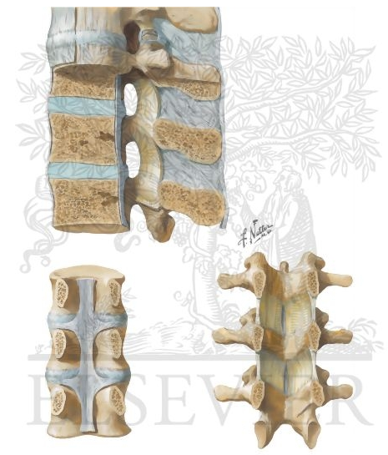
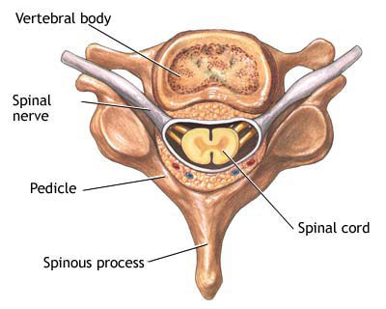
Anatomy, cont.
Neurologic elements:
Spinal cord
Nerve roots
Cauda equina

Slide 14
The Cervical vertebrae obtain: - Bifid (meaning double) spinous processes - Foramina transversarium for passage of nerves root and vessels - The body is a more oval shape - Do not articuate with the ribs The Thoracic vertebrae obtain: - Spinous process (singular) - No foramina transversarium - The body is a small semi-circular shape - Articulate with the ribs -Have demifacets for articulation with the ribs The Lumbar vertebrae obtain: - Spinous process (singular) - No Foramina transversarium - The body is a large circular shape - Does not articulate with the ribs - Demonstrates a "Scotty Dog" when positioned for a left/right anterior/posterior oblique radiograph.

Slide 15
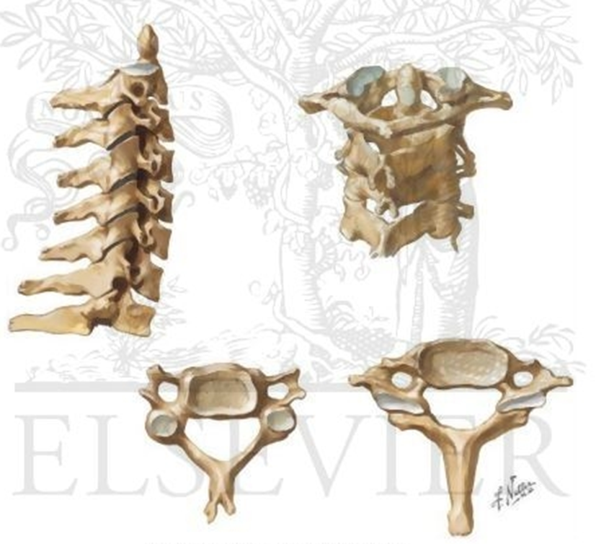
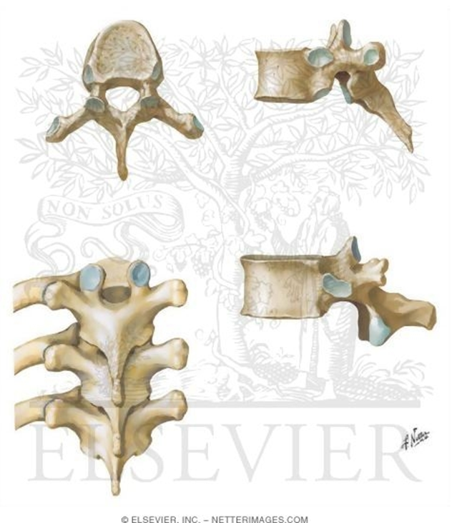
Cervical and Thoracic Spine Anatomy

Slide 16
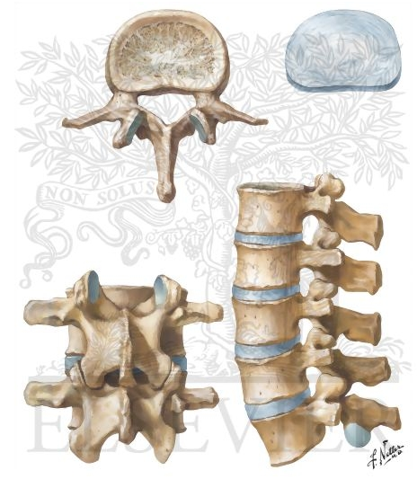
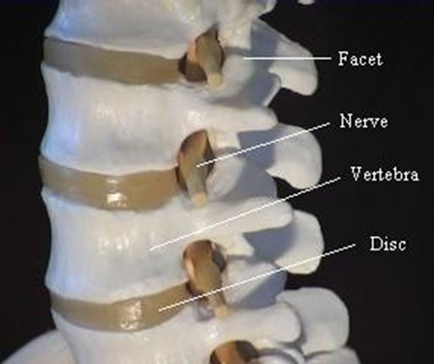
Lumbar Spine Anatomy

Slide 17
Pathology: The inter-vertebral disc
The first component of the 3 joint complex present in each vertebral segment from C2 to S1
It is primarily loaded in FLEXION→ because its located anteriory (flexion pain or sitting pain or discogenic pain that indicate disc problem)
Composed of annulus fibrosus and nucleus pulposus
Degeneration of the nucleus causes loss of cellular material and loss of hydration, the vertebra will flatten and might lead to spinal stenosis.
Movement is impaired-painful- and could become unstable

Slide 18
The inter-vertebral disc, cont.
Disc degeneration will also cause
Loss of disc height→
Abnormal loading of facet joints (disc compression(flatting compression) may lead to posterior facet joint problem )
Stenosis in the inter-vertebral foramen → then compression the nerve root (usually one side but may effect both side)
Bulging of the disc into the spinal canal
Contributing to spinal stenosis
Herniation of the nucleus into spinal canal
Causing radiculopathy (e.g. sciatica in the lumbar spine)

Slide 19
Pathology: The facet joints
Scientific name: “zy-gapo-physial joints”
Synovial joints
2 in each segment
Together with the disc, form the 3 joint complex
Are primarily loaded in EXTENSION → because its located posteriory(extension pain or standing pain or working pain or fascicular pain → that indicate facet syndrom)
Pattern of degeneration similar to other synovial joints
Loss of hyaline cartilage, formation of osteophytes, laxity in the joint capsule
-Its common in old pt

Slide 20
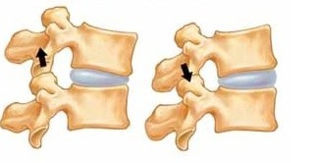
The facet joints, cont.
Facet degeneration will cause:
Hypertrophy, osteophyte formation
Contributing to spinal stenosis or foraminal stenosis
Laxity in the joint capsule
Leading to instability (degenerative spondylolisthesis)
Degenerative spondylolisthesis →Loss of hyaline cartilage, formation of osteophytes , subsclerosis laxity and relaxation in the joint capsule→ Leading to instability not all of time but in certain position and standing

Slide 21
As Facet joint arthritis advances cartilage will be lost, osteophytes start to accumulate and the capsule will be redundant and loose. At this stage the spine will be unstable and more prone to spindolisthesis when bending forward.
In flexion the discs are compressed, therefore flexion pain (when sitting) is discogenic in origin.
In extention the facet joints are compressed but discs are relieved, therefore extention pain (when standing or walking) is facetogenic.

Slide 22
Presentation
Falls into 2 catagories:
Mechanical pain: due to joint degeneration or instability
“Axial pain” in the neck or back
Activity related (and related to certain position)-not present at rest
A pain that is not related to activity is an alarming sign. It indicates a tumor or infection.
Neurologic symptoms: due to neurologic impingement
Spinal cord
Presents as myelopathy its an upper motor neuron lesion (loss of power, loss of propioception leading to loss of balance,loss of fine movements and function due to loss of propioception)
We test it by hoffmens reflex and ramborgs sign
Cauda equina & Nerve roots
Presents as radiculopathy (e.g. sciatica- lower limb pain, brachialgia-upper limb pain, or neurogenic claudication)
Sciatica is pain in the coarse of the sciatic nerve, its not a sciatic nerve injury its due to nerve root compression (S2,S3,S4 roots)

Slide 23
Presentation, cont.
Mechanical pain
Associated with movement
Sitting, bending forward (flexion):
originating from the disc
“discogenic pain”
Standing, bending backward (extension) :
originating from the facet joints
“Facet syndrome”
Instability-e.g. spondylolisthesis- also causes mechanical pain

Slide 24
Presentation, cont.
Neurologic symptoms
Spinal cord
Myelopathy:
Loss of motor power and balance
Loss of dexterity براعة يدوية
Objects slipping from hands
UMN deficit (rigidity and Spasticity, hyper-reflexia, positive Babinski. increase deep tendon reflex (DTR),rumburg)
Slowly progressive “step-wise” deterioration.
Spinal cord injury
With Spinal stenosis, there is a higher risk of spinal cord injury
Complete or incomplete

Slide 25
Presentation, cont.
Cauda equina & Nerve roots
Radiculopathy
LMN deficit→ flaccid paralysis, muscle atrophy, anesthesia
Commonest is sciatica, but cervical root impingement causes similar complaints in the upper limb(trachalgia)
*sciatic pain →is the pain over the course of sciatic nerve L4-L5-L5-S1
Neurogenic claudication
Pain in both legs caused by walking
Must be differentiated from vascular claudication(ischemic pain)

Slide 26
What's the difference between neurogenic and vascular claudication?
Both neurogenic and vascular claudication can cause pain in the legs when walking. However, beyond this, these two entities are very different.
Pathophysiology Neurogenic claudication is caused by lumbar stenosis (pain from back to leg). Vascular claudication is caused by narrowing of arteries which results in decreased blood flow to the legs.(the pain only in the leg) ischemic pain that is relieved by rest. Symptoms Pain secondary to neurogenic claudication gets better when bending forward because this position widens the spinal canal (leaning on shopping cart/cane, walking up hill, biking, bicycle) and the pain gets more in extention. This position does not improve the symptoms of vascular claudication. Physical Exam Neurogenic claudication - neuro exam is often normal when sitting but can reveal single or multiple lumbosacral radiculopathies after walking it will lead to weakness. Cauda equina and myelopathy can be rare but serious complications. Vascular claudication - decreased peripheral pulses there is always an abnormal examination. Treatment Neurogenic claudication - unless symtoms severe, initial treatment is conservative with physical therapy, pain medications, and epidural injections. Spinal surgery can be considered if symtoms do not improve with conservative approach. Vascular claudication - physical therapy, antiplatelet medications and surgery depending on severity.

Slide 27
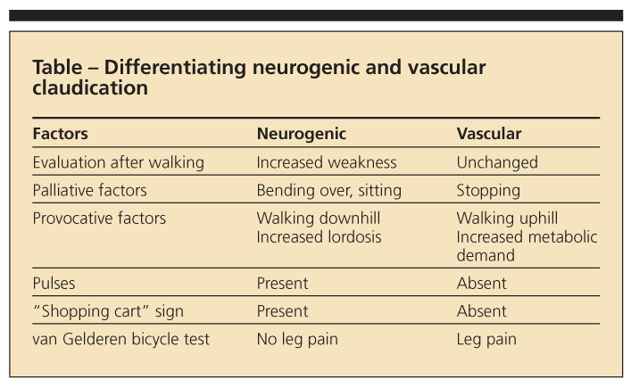
Vascular vs. Neurogenic claudication

Slide 28
Red flag
History →is not cause Mechanical pain
Cancer→Unexplained weight loss
Immunosuppression→Prolonged use of steroids , Intravenous drug use
Pain that is increased or unrelieved by rest
Fever
Significant trauma related to age (e.g., fall from a height or motor vehicle accident in a young patient, minor fall or heavy lifting in a potentially osteoporotic or older patient or a person with possible osteoporosis)
Urinary tract infection
Bladder or bowel incontinence
Urinary retention (with overflow incontinence)
Physical examination
Saddle anesthesia
Loss of anal sphincter tone
Major motor weakness in lower extremities
Fever
Vertebral tenderness
Limited spinal range of motion
Neurologic findings persisting beyond one month

Slide 29
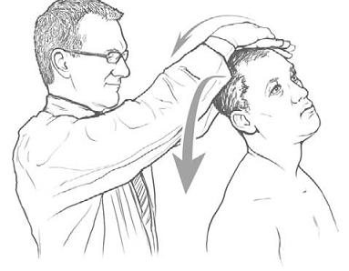
The Cervical spine: introduction
Degenerative changes typically occur in C3-C7
Presents with axial pain, myelopathy, radiculopathy
Physical examination:
Stiffness (loss of ROM)→in
one side because stretching
of nerve root of other side
Neurologic exam
Weakness
Loss of sensation
Hyper-reflexia (in myelopathy), hypertonia
Special tests: Spurling’s sign: its designed for radiculopathy: you provoke the pain, it will only be +ve if the cause was nerve compression

Slide 30
Spurling’s test
Axial compression of the spine and rotation to the ipsilateral side of symptoms reproduces/worsens cervical radiculopathy.
Description
This is a common manoeuvre performed by neurosurgeons. Axial compression of the spine and rotation to the ipsilateral side of symptoms reproduces/worsens cervical radiculopathy. Pain to the side of rotation is usually indicative of foraminal stenosis and nerve root irritation.

Slide 31
The Cervical spine: Management →most of cervical and back pain treated conservatively
Conservative treatment
First line of treatment for axial neck pain and mild neurologic symptoms (e.g. mild radiculopathy without any motor deficit)
Physiotherapy:
Focus on ROM and muscle strengthening
Non-steroidal anti-inflammatory medications (NSAID)
E.g. Diclofenac, ibuprofen, naproxen
Neuropathic medication: for radiculopathy pain
E.g. Gabapentin or pregabalin (the pt can use these drugs for long time because less side effect →does not cause increase blood pressure or renal or liver toxicity)

Slide 32
The Cervical spine: Management
Surgical management
Indicated for:
Spinal stenosis causing myelopathy
Disc herniation causing severe radiculopathy and weakness
Failure of conservative treatment of axial neck pain or mild radiculopathy
Procedures:
Anterior discectomy and fusion
Posterior laminectomy

Slide 33
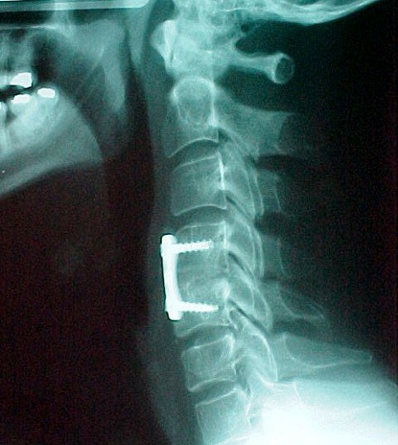
Anterior Discectomy and fusion

Slide 34
The Lumbar spine
Degenerative changes typically occur in L3-S1 (L3-L4,L4-L5,L5-S1)
Presents with axial pain, Sciatica, neurogenic claudication
Physical examination:
Stiffness (loss of ROM)
Neurologic exam
Weakness
Loss of sensation
Hypo-reflexia, hypo-tonia
Special tests: SLRT→ stright leg raising test

Slide 35
The Lumbar spine: management →MRI is very sensitive especialy in early case
Axial low back pain
Conservative treatment if first-line and mainstay of treatment
Physiotherapy: core muscle strengthening, posture training
NSAID
Surgical treatment
indicated for:
Instability or deformity
e.g. high-grade spondylolisthesis
Failure of conservative treatment

Slide 36
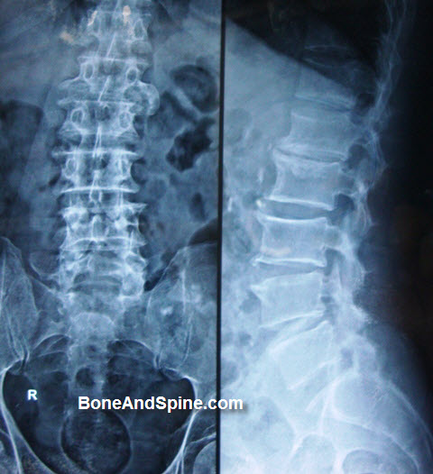
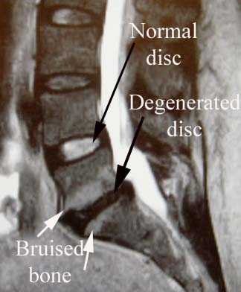
Lumbar spondylosis -degenerated disc and bruised bone
Bulging of disc
Normal disc → bright and oval
Abnormal disc → black-bulging-bruised bone

Slide 37
The Lumbar spine: management
Spinal stenosis
Conservative treatment is first line of treatment
Activity modification, analgesics, epidural cortico-steroid injections
Surgical treatment
Indicated for
Motor weakness e.g. drop foot
failure of –minimum- 6 months of conservative treatment
Spinal decompression (laminectomy) is the commonest procedure

Slide 38
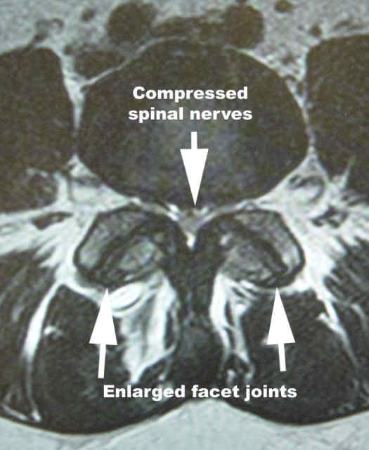
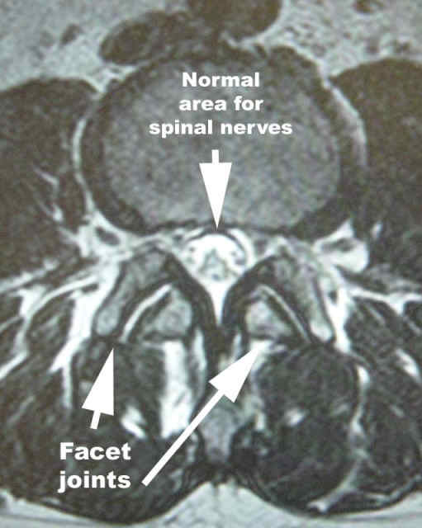
Spinal Stenosis

Slide 39
Spinal Stenosis: Stenosis is a term that describes narrowing of a structure. In this case, it is narrowing of the spinal canal, in which the spinal cord sits. Over time, as this narrows from build up of tissue around the spine, it can start to cause symptoms by compressing the nerves and spinal cord. Stenosis occurs most commonly as lumbar stenosis and cervical stenosis. In addition, stenosis is sometimes used to refer to Foraminal Stenosis, which is narrowing of one or more foramen, the holes that the spinal nerves(nerve root ) go through to exit from the spinal column.

Slide 40
The Lumbar spine: management
Disc herniation
→in L5-S1:Decrease planter flexion and ankle jerk
→ In L4-L5:decrease dorsiflexion and big toe extension
Conservative treatment is first line of treatment for mild sciatica without motor deficit
Short (2-3 day) period of rest, NSAID, physiotherapy, epidural cortico-steroid injection
95% of sciatica resolves within the first 3 months without surgery
Surgical treatment:
Indicated for cauda-equina syndrome (cause by large disc hearniation need surgical immediately), motor deficit, failure of 3 months of conservative treatment
Procedure: Discectomy (only the herniated part)

Slide 41
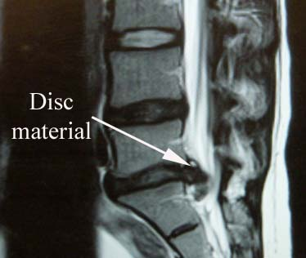
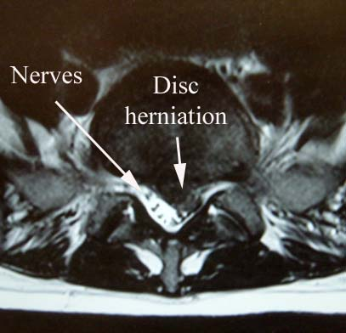
Disc Herniation

Slide 42
Herniated Discs or "slipped disc": A herniated disc is a protrusion of an intervertebral disc, the "cushion" that sits between each vetebral bone of the spine. It can happen suddenly with a trauma, but more commonly occurs over years. It can cause pain and also compress nerves in the area, leading to sensory or motor symptoms in the arm or leg, depending on the location of the herniation. The most common sites are lumbar herniated discs (low back) and cervical herniated discs (neck). Thoracic herniated discs (mid-back) are much less common.

Slide 43
The Lumbar spine: management
Degenerative Spondylolisthesis
Typically at L4-5
Causes spinal stenosis
Conservative treatment first,
Surgery if Grade 3 or more or failed conservative managment.
Other spondylolisthesis types:
Isthmic: →common in our society
Usually at L5-S1, →vertebral forward but no spinal stenosis(may cause foramina stenosis)—not sure
Has par inter-articularis defect

Slide 44
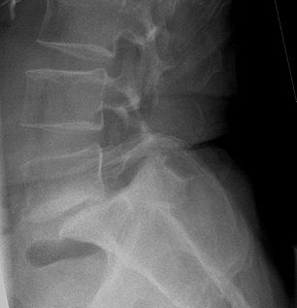
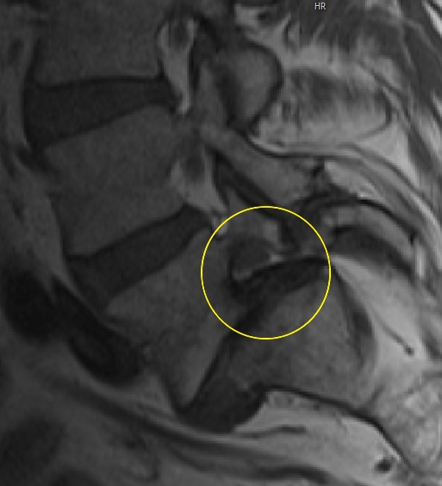
Spondylolisthesis, foramenal stenosis

Slide 45
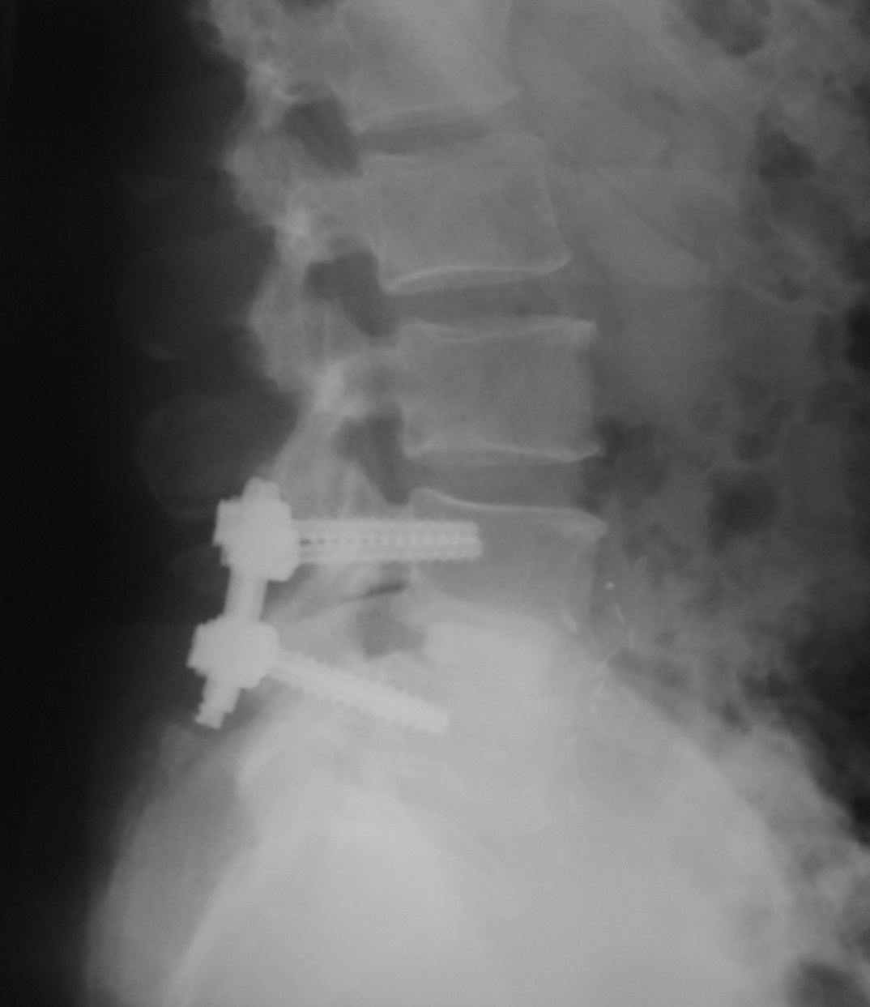
Spinal Fusion

Slide 46
The Lumbar spine: management
Degenerative scoliosis
Mechanical or neurological (mylopathy or radiculopathy )
Combination of elements from the prior conditions
Deformity, Instability
Spinal stenosis, Disc herniation
Also treated conservatively first, unless severe neurologic deficit or instability present
Surgery :Usually requires multi-level instrumentation, fusion and decompression

Slide 47
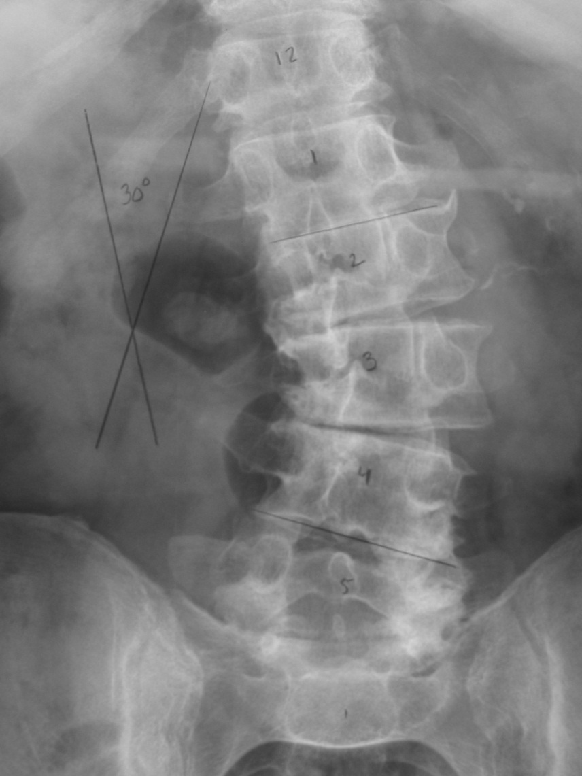
Degenerative scoliosis

Slide 48
Any pt come with spinal symptoms should be exclude present of:
trauma –neurological claudicating –wt loss –night pain –night sweating

Slide 49
Thank you

