Slide 1
OSTEOARTHROSIS
Dr .Hazem Alkhawashki
Associate professor
College of Medicine,KSU

Slide 2
OSTEOARTHROSIS
Definition
A non-inflammatory (DEGENERATIVE) disease affecting articular cartilage of joints

Slide 3
OSTEOARTHROSIS
Primary
Intrinsic defect (mechanical,vascular,cartilage,HEREDITARY-generalised O.A)
Secondary
Sec. to local or systemic disease

Slide 4
OSTEOARTHROSIS
Increased load eg;obesity(hips&knees take 3-4 body wt. with each step)
Trauma ;osteochondral,malunion,sport injury
Congenital/developmental;CDH,multiple epiphyseal dysplasia
Infection
Necrosis;Perth`s disease,osteonecrosis,steroids
Haematologic;SCD,haemophaelia
Endocrine;DM,acromegaly

Slide 5
OSTEOARTHROSIS
Metabolic; crystaline deposition disease(gout,CPPD)paget disease
Inflamatory joint disease
Neuropathic;DM,tabes dorsalis
Occupation

Slide 6
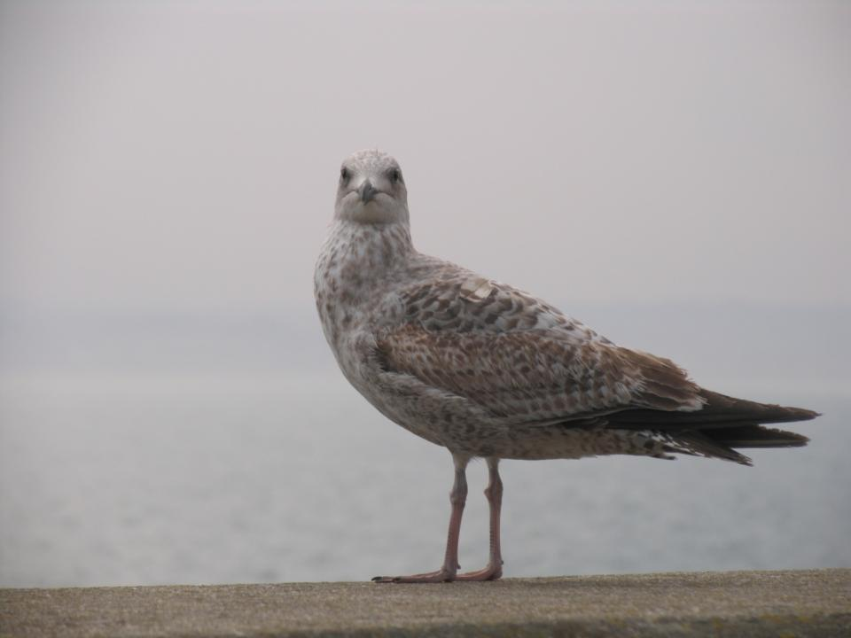

Slide 7
OSTEOARTHROSIS
Epidemiology
Common in our community esp.knees
Much more in females ;esp.Obese
Presents earlier than West
About 90% of those over 40 have asymptomatic degeneration of wt.bearing joints
Commonest joints are;knee,hip,C.S&L.S,1st CMJ,1st MTPJ,IPJ

Slide 8
OSTEOARTHROSIS
Pathophysiology
Increased water content;swelling&softening of cartilage
Deplition of Proteoglycan
Chondrocyte damage& synovitis › proteolytic enzymes›collagen disruption
FIBRILATION on wt. bearing surfaces
LOSS OF CARTILAGE HIGHT &exposed bone› DEC.JOINT SPACE

Slide 9
OSTEOARTHROSIS
Attempts of repair;
SUBCHONDRAL SCLEROSIS
eburnation (ivory like bone)
Fissuring (cracks);
synovial fluid pumped into subchondral
bone ›SUBCHONDRAL CYST
Hypervas. of synovium & subchon. bone
›proliferation of adjacent cartilage › enchondral ossification› OSTEOPHYTE

Slide 10
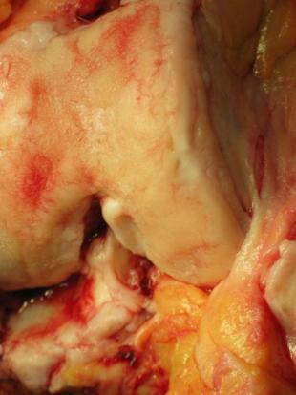
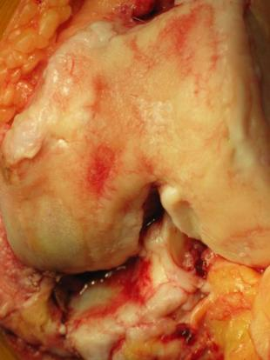
fissuring
Osteophytes & eburnation

Slide 11
OSTEOARTHROSIS
Synovial &capsular thickening
Progressive bone erosion› BONE COLLAPSE
Fragmented osteophyte› LOOSE BODIES
Loss of hight&lig.laxity› MALALIGNMENT

Slide 12
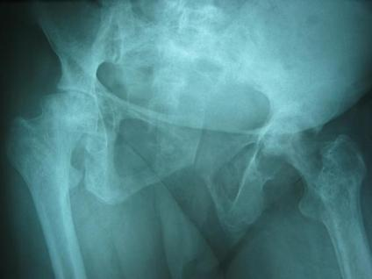
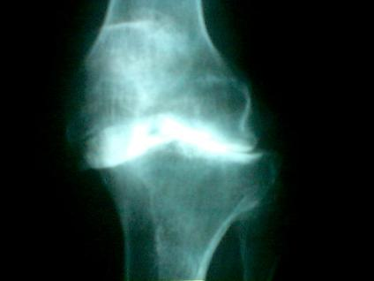
Cysts&sclerosis
Loss of bone&deformity

Slide 13
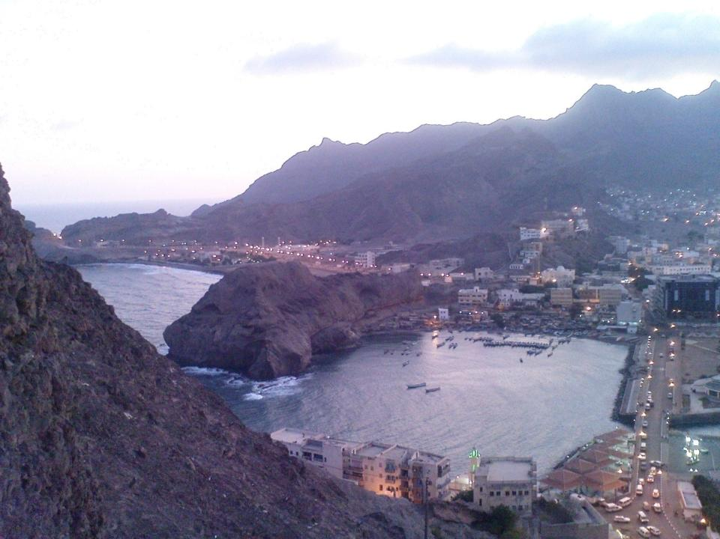

Slide 14
OSTEOARTHROSIS
Clinical picture
SYMPTOMS
P ,I ,N ,S ,D
SIGNS
E ,M ,T ,I ,C ,D ,N

Slide 15
OSTEOARTHROSIS
INVESTIGATIONS
x-ray (STANDING in L.L)
osteophytes
cysts
sclerosis
loss of space
malalignment
sulux.
erosion
loose bodies
synovial analysis (in diff.diag.)

Slide 16
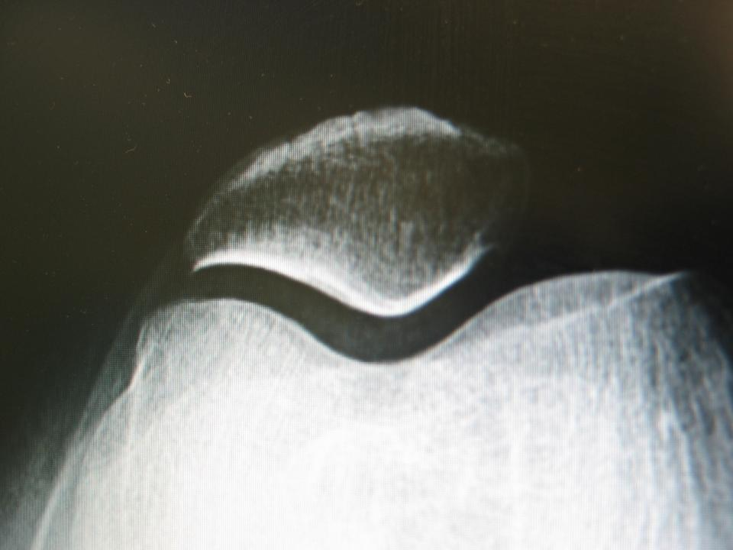

Slide 17
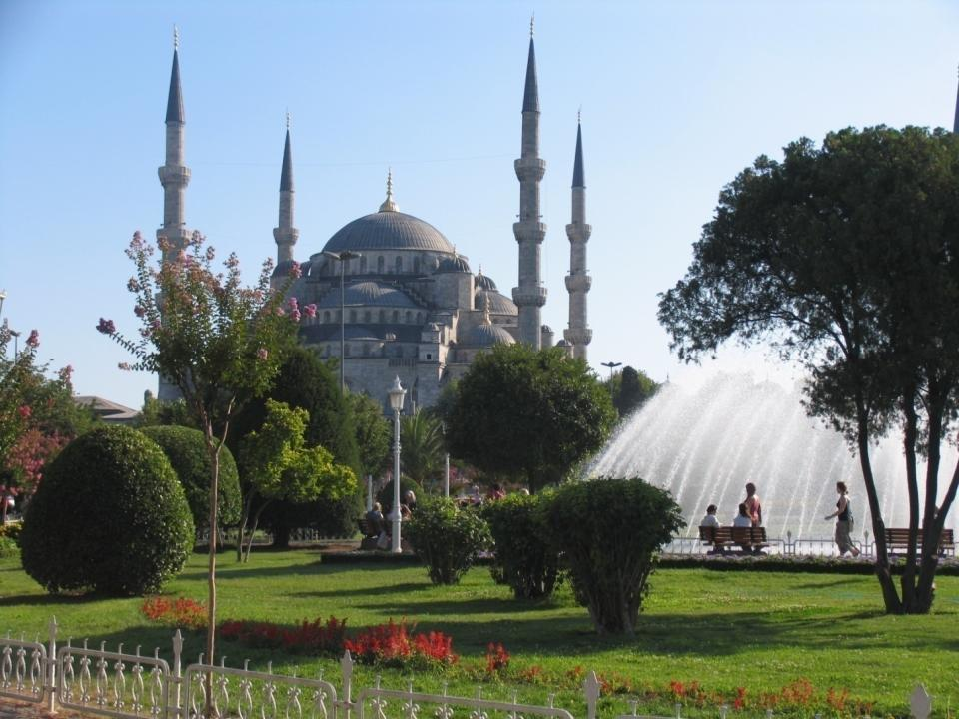

Slide 18
OSTEOARTHROSIS
Management
History
Examination
Investigations

Slide 19
OSTEOARTHROSIS
Conservative treatment
decrease load (wt.,stick,rest)
modify activity
physiotherapy
prevent contractures
muscle strengthening
ROM
medications
systemic
local

Slide 20
OSTEOARTHROSIS
Surgical treatment
1. Joint Debridement
2. Corrective Osteotomy
what?
varus/valgus.abd./add.
why?
realign axis&redistribute wt.
which joint?
knee/hip

Slide 21
OSTEOARTHROSIS
what joint
mobile,stable,minimaly deformed
which patient
young,thin,active

Slide 22
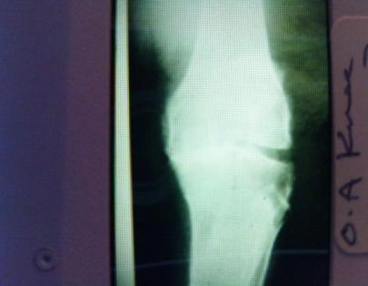
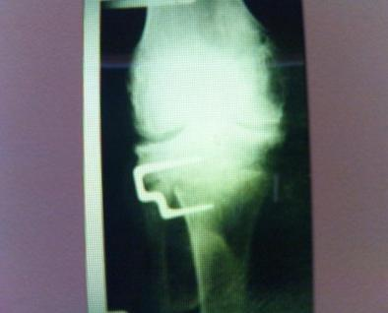
PREOPERATIVE
POST OSTEOTOMY

Slide 23
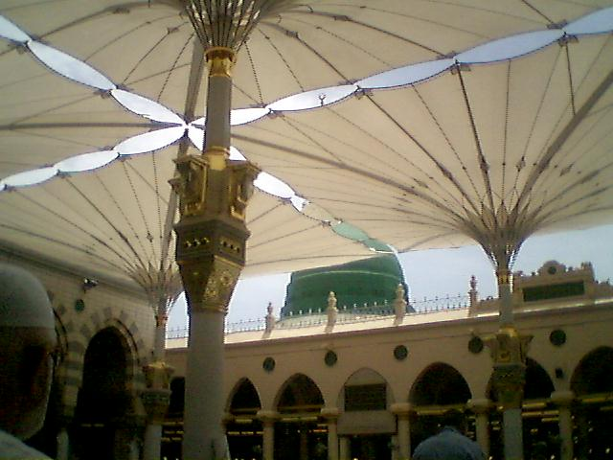

Slide 24
OSTEOARTHROSIS
3. Arthrodesis
why;
transfer painfull stiff into painless stiff
joint
stabelise njoint
which joint;
wrist,ankle,CS,LS,hand
hips&knees (LESS COMMON)

Slide 25
OSTEOARTHROSIS
when?
failed TKR(infection)
neuropathic
paralitic(flail)
loss of quad.
stiff in young

Slide 26
OSTEOARTHROSIS
when NOT;
epsilateral disease
contralateral hip disease
bilateral j.disease
LS./OA
TRANSFER LOAD TO DISTAL&CONTRALATERAL JOINTS

Slide 27
OSTEOARTHROSIS
4.Arthroplasty
Excision
what?
remove part of joint to allow
movement
disadvantage;
weakness
shortening
walking aid

Slide 28
OSTEOARTHROSIS
which joint?
hip ;post infection(girdle stone)
1st.MTPJ
1st.MPJ
Joint replacement
PARTIAL
which joint;
hip (fracture)
knee
shoulder(SCD,RA)

Slide 29
OSTEOARTHROSIS
when;
necrosis
degenerative
trauma
inflmatory(ONLY SHOULDER)
when NOT
infection
young
inflamatory

Slide 30
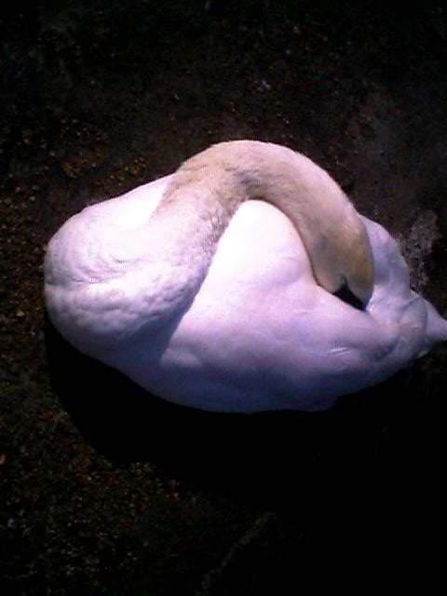

Slide 31
OSTEOARTHROSIS
TOTAL REPLACEMENT
which?
knees , hips, shoulders, ankles,
elbow
when?
painful, deformed stiff joint
old patient!!

Slide 32
OSTEOARTHROSIS
when NOT;
neuropathic
infection
paralytic
young, active(RELATIVE)

Slide 33
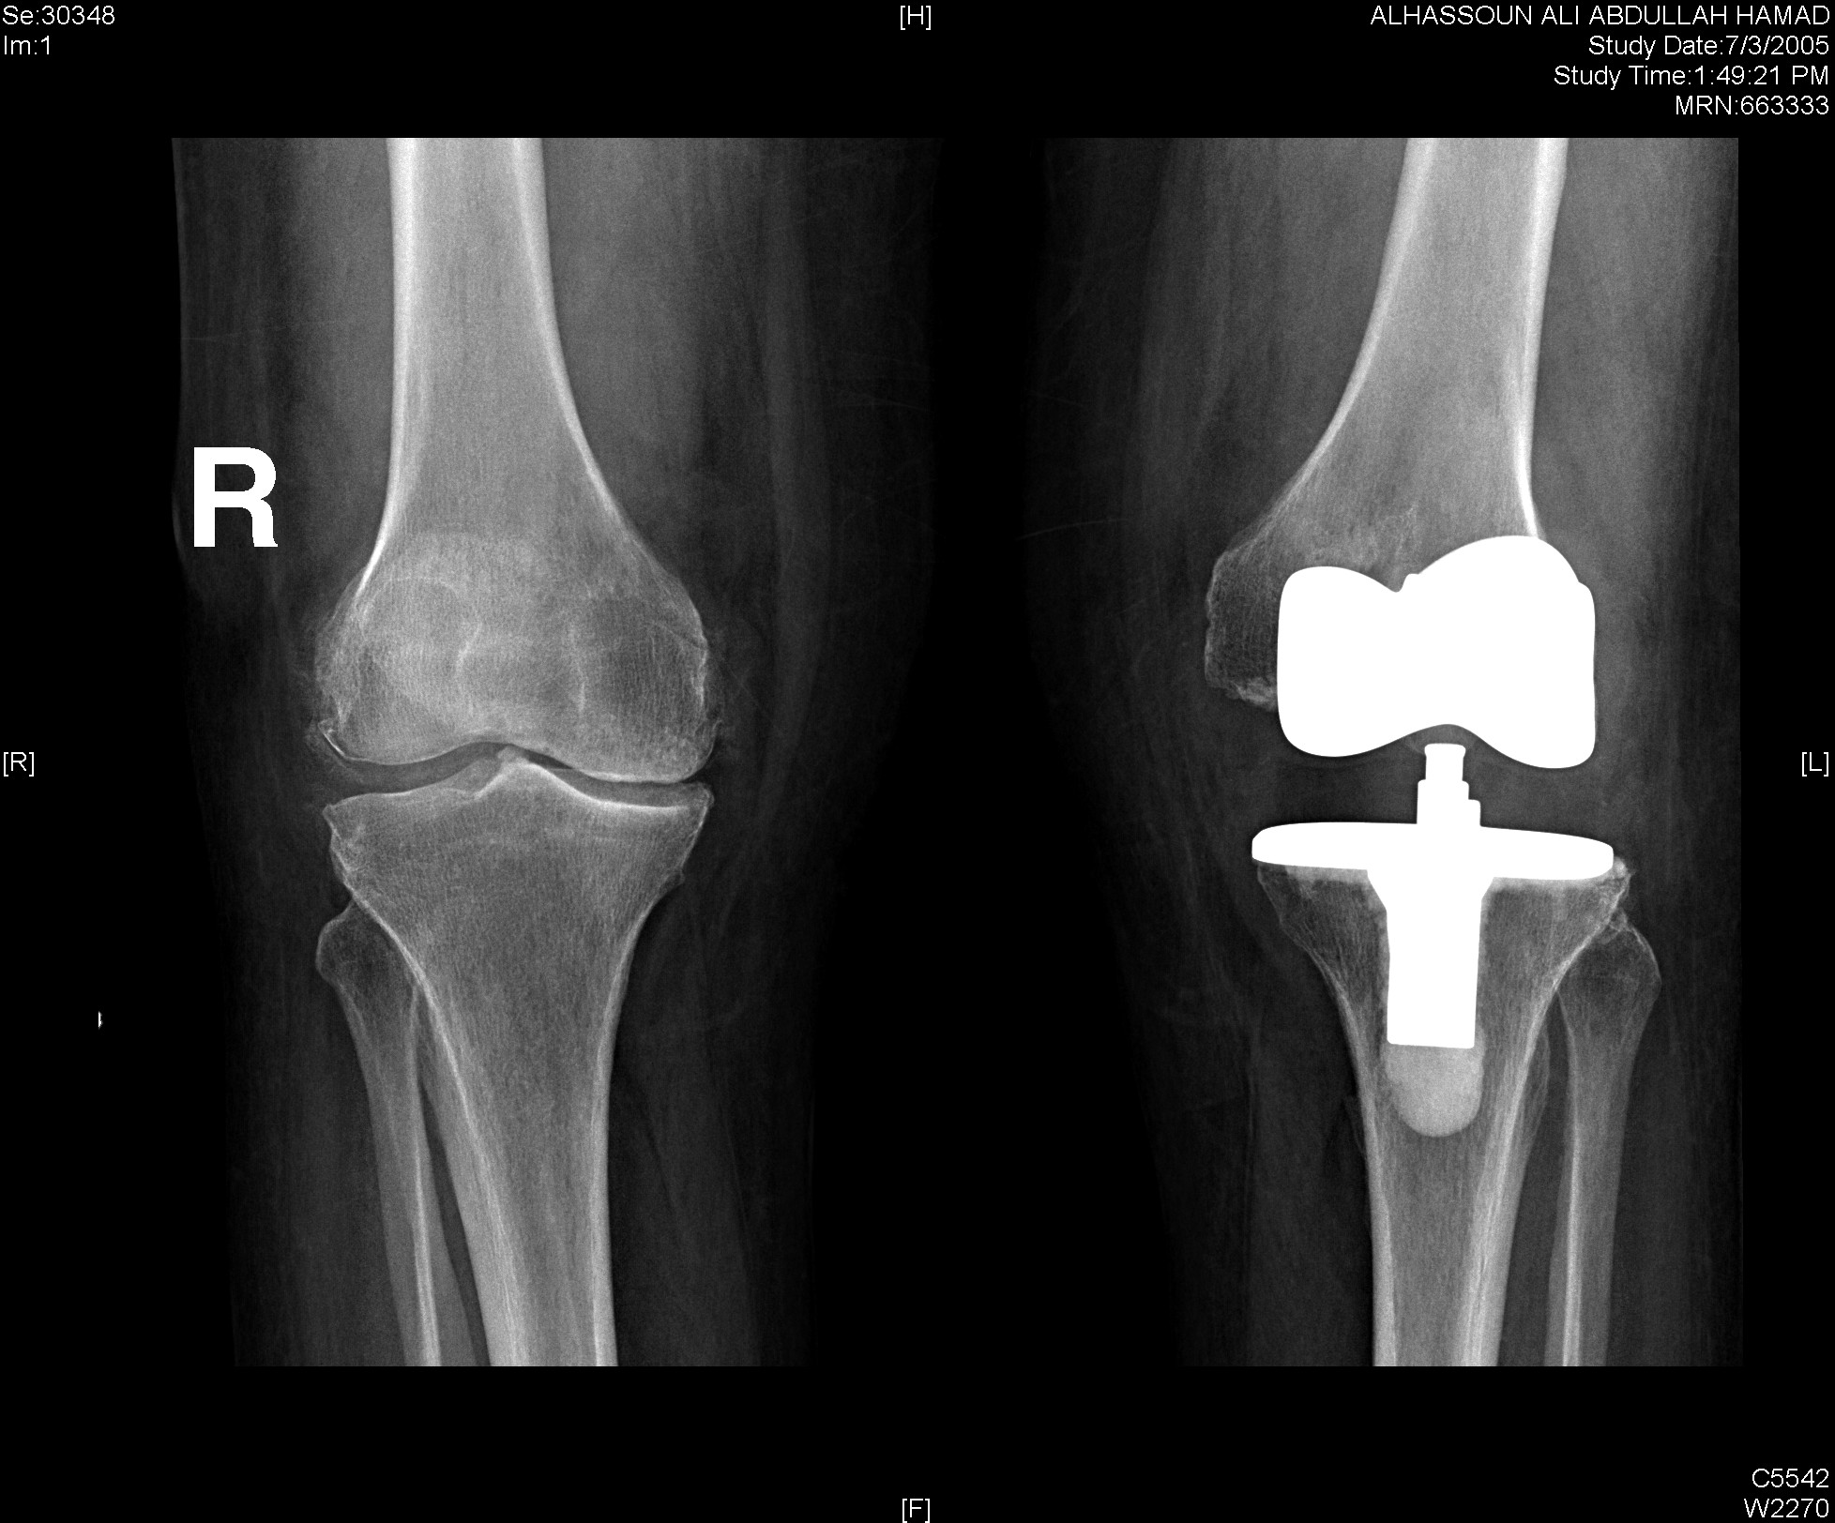
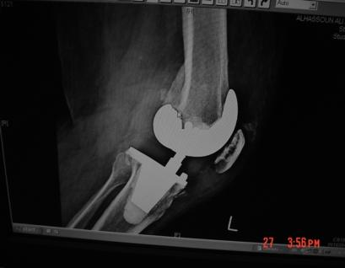

Slide 34
