Slide 1
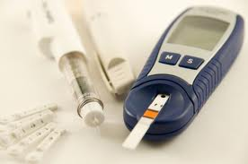
Diabetes Mellitus
Done by:
Abdulaziz sagga – Ahmad Al-ahmari
Bander alsubaie – Firas Almansour
Majid Alroiedy
Supervised by:
Dr. HUSSEIN SAAD

Slide 2
Diabetes Mellitus
is metabolic disease in which a person has high blood sugar, either because the body does not produce enough insulin, or because cells do not respond to the insulin that is produced.

Slide 3
Why it is important!!!
Can be predictable
We can prevent complication
Economic burden
Increase prevalence

Slide 4
Epidemiology of diabetes in the world
In 2000, according to the World Health Organization, 2.8% of the population.
Its incidence is increasing rapidly, and it is estimated that by 2030, this number will almost double.
Wild S, Roglic G, Green A, Sicree R, King H (May 2004). "Global prevalence of diabetes: estimates for 2000 and projections for 2030". Diabetes Care 27 (5): 1047–53

Slide 5
Epidemiology of diabetes in Saudi Arabia

Slide 6
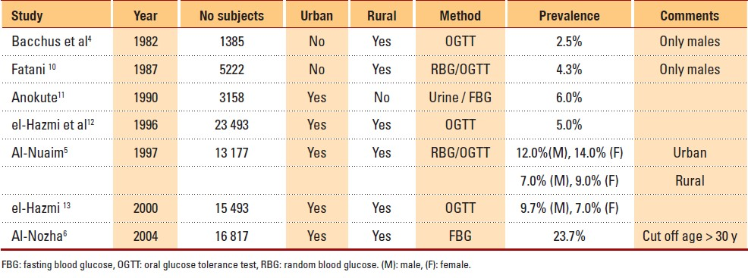
Year : 2007 | Volume : 27 | Issue : 4 | Page : 241-250 Epidemiology, clinical and complications profile of diabetes in Saudi Arabia : A review Tarik A Elhadd¹, Abdallah A Al-Amoudi¹, Ali S Alzahrani²
Notes:
the various epidemiological studies that were published in Medline between 1982 and 2004
The next study, a single authored study published

Slide 7
The next study was also a single authored study by Anukote 1990
Its main advantage is that it confirmed the trend of a rising diabetes prevalence (6%).

Slide 8
Year : 2007 | Volume : 27 | Issue : 4 | Page : 241-250 Epidemiology, clinical and complications profile of diabetes in Saudi Arabia : A review Tarik A Elhadd¹, Abdallah A Al-Amoudi¹, Ali S Alzahrani²
Notes:
the various epidemiological studies that were published in Medline between 1982 and 2004
The next study, a single authored study published

Slide 9
The study by eliHazmi et al (1996) was devoid of the many limitations of the previous studies. It involved a large number of subjects (23 493)
They also showed that there was a parallel rise in obesity rates with a higher rate in females (20%) vs males (13%).
Notes:
However, at the time of the study WHO recommended using the random blood glucose as the tool for use in epidemiological studies

Slide 10
The study confirmed a higher prevalence of obesity among urban females.
The main limitation of this study (by today's standard) is that it used random blood glucose as a screening method so a significant number of subjects with diabetes might have been missed.

Slide 11
Year : 2007 | Volume : 27 | Issue : 4 | Page : 241-250 Epidemiology, clinical and complications profile of diabetes in Saudi Arabia : A review Tarik A Elhadd¹, Abdallah A Al-Amoudi¹, Ali S Alzahrani²
Notes:
the various epidemiological studies that were published in Medline between 1982 and 2004
The next study, a single authored study published

Slide 12
The latest national epidemiological survey by Ali Nozha et al (2004)
in addition to using a lower cut off value for fasting blood glucose as the screening method
However, its major weakness is that it only screened subjects older than 30 years of age, so the quoted overall prevalence rate (23.7%) may have been artifactually increased.
Notes:
according to latest ADA/WHO diagnostic criteria.

Slide 13
Year : 2007 | Volume : 27 | Issue : 4 | Page : 241-250 Epidemiology, clinical and complications profile of diabetes in Saudi Arabia : A review Tarik A Elhadd¹, Abdallah A Al-Amoudi¹, Ali S Alzahrani²

Slide 14
several of studies confirmed the effects of:
urbanization
obesity
in the rise in diabetes prevalence.

Slide 15
Main Types of Diabetes
gestational diabetes
Type 2 Diabetes
Type 1 Diabetes
is usually first diagnosed in children, teenagers, and young adults.
is diabetes that first occurs during pregnancy
the most common form of Diabetes
usually goes away after the baby is born
more likely to develop type 2 diabetes later in life
People can develop type 2 diabetes at any age
results from β-cell destruction (absolute insulin deficiency)
results from a progressive insulin secretory defect on the background of insulin resistance
Other types of diabetes
genetic defects in β-cell function, genetic defects in insulin action, diseases of the exocrine pancreas and drug- or chemical-induced

Slide 16
Former Name | Preferred Names
Type I juvenile diabetes insulin-dependent diabetes mellitus (IDDM) | type 1 diabetes
Type II adult-onset diabetes noninsulin-dependent diabetes mellitus (NIDDM) | type 2 diabetes

Slide 17
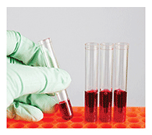
Diagnosis of diabetes
For decades, the diagnosis of diabetes was based on plasma glucose criteria :
Used to diagnose | Instructions | Test
diabetes pre-diabetes | Fasting for at least 8 hours
Diabetes pre-diabetes | person fasts at least 8 hours and 2 hours after drinks a glucose-containing beverage containing 75 gm of glucose dissolved in water
diabetes but not pre-diabetes | Need an assessment of symptoms
fasting plasma glucose
(FPG)
oral glucose tolerance test (OGTT)
random plasma glucose

Slide 18
FPG test
Plasma Glucose Result (mg/dL) | Diagnosis
99 or below (≥ 5.5) | Normal
100 to 125 (5.6 to 6.94) | Pre-diabetes (impaired fasting glucose)
126 or above (≥ 7) | Diabetes*
OGTT
2-Hour Plasma Glucose Result (mg/dL) | Diagnosis
139 and below (≥7.6 ) | Normal
140 to 199 (7.78 to 11.05 mmol/l ) | Pre-diabetes (impaired glucose tolerance)
200 and above (≥ 11.1 mmol/l ) | Diabetes*
Random Plasma Glucose Test
mg/dl = 18 × mmol/l
If blood glucose level of 200 mg/dL(11.1 mmol/l) or higher, plus the presence of the following symptoms, can mean a person has diabetes:
increased urination
increased thirst
unexplained weight loss

Slide 19
HB A1C
In 2009, an International Expert Committee recommended the use of the A1C test to diagnose diabetes, with a threshold of ≥6.5%
ADA( American Diabetes Association) adopted this criterion in 2010
* (American Diabetes Association: Diagnosis and Classification of Diabetes Mellitus. Diabetes Care 2010; 33( Suppl. 1): S62–S69 )
HB A1C is :
Glycated hemoglobin ( hemoglobin A1c, HbA_{1c}, A1C, or Hb_{1c}; sometimes also HbA1c) is a form of hemoglobin which is measured primarily to identify the average plasma glucose concentration over prolonged periods of time
Epidemiologic datasets show a similar relationship between A1C and risk of retinopathy as has been shown for the corresponding FPG and 2-h plasma glucose thresholds.

Slide 20
The HB A1C has several advantages to the FPG and OGTT :
greater convenience, since fasting is not required
evidence to suggest greater preanalytical stability
less day-to-day perturbations during periods of stress and illness.
Disadvantages:
greater cost,
the limited availability of A1C testing
the incomplete correlation between A1C and average glucose in certain individuals
A1C levels can vary with patients' ethnicity as well as with certain anemias and hemoglobinopathies
**Ziemer DC ,Kolm ,Weintraub WS, Vaccarino V, Rhee MK, Twombly JG,Narayan KM, Koch DD, Phillips LS. Glucose-independent, black-white differences in hemoglobin A1c levels: a cross-sectional analysis of 2 studies. Ann Intern Med 2010;152: 770–777
For conditions with abnormal red cell turnover, such as
pregnancy, recent blood loss or transfusion, or some anemias
the diagnosis of diabetes must employ glucose criteria exclusively.

Slide 21
As with most diagnostic tests, a test result diagnostic of diabetes should be repeated to rule out laboratory error, unless the diagnosis is clear on clinical grounds, such as a patient with a hyperglycemic crisis or classic symptoms of hyperglycemia and a random plasma glucose ≥200 mg/dl.
if two different tests (such as A1C and FPG) are both above the diagnostic thresholds
the diagnosis of diabetes is confirmed.

Slide 22
What is pre-diabetes?
In pre-diabetes, blood glucose levels are higher than normal but not high enough for a diagnosis of diabetes.
Pre-diabetes is defined as:
having impaired fasting glucose (IFG) (FPG levels 100–125 mg/dl [5.6–6.9 mmol/l])
or
impaired glucose tolerance (IGT) (2-h PG values in the OGTT of 140–199 mg/dl [7.8–11.0 mmol/l]).
** the World Health Organization (WHO) and a number of other diabetes organizations define the cutoff for IFG at 110 mg/dl (6.1 mmol/l).
However, many people with pre-diabetes develop type 2 diabetes within 10 years.
Individuals with pre-diabetes have an increased risk of heart disease and stroke.

Slide 23
In a systematic review of 44,203 individuals from 16 cohort studies with a follow-up interval averaging 5.6 years (range 2.8–12 years)
those with an A1C between 5.5 and 6.0% had a substantially increased risk of diabetes with 5-year incidences ranging from 9–25%.
An A1C range of 6.0–6.5% had a 5-year risk of developing diabetes between 25–50% and relative risk 20 times higher compared with an A1C of 5.0%.
**Zhang X, Gregg EW, Williamson DF, Barker LE, Thomas W, Bullard KM,Imperatore G, Williams DE, Albright AL A1C level and future risk of diabetes: a systematic review. Diabetes Care 2010; 33: 1665–1673
Other analyses suggest that an A1C of 5.7% is associated with diabetes risk similar to that of the high-risk participants in the Diabetes Prevention Program (DPP).
Hence, it is reasonable to consider an A1C range of 5.7–6.4% as identifying individuals with high risk for future diabetes, a state that may be referred to as prediabetes As is the case for individuals found to have IFG and IGT, individuals with an A1C of 5.7–6.4% should be informed of their increased risk for diabetes as well as CVD and counseled about effective strategies to lower their risks
**American Diabetes Association: Diagnosis and Classification of Diabetes Mellitus.Diabetes Care 2010; 33( Suppl. 1): S62–S69

Slide 24
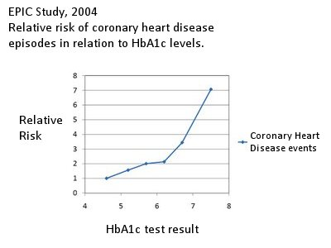

Slide 25
Is it possible to prevent development diabetes in pre-diabetic patient ??

Slide 26
Is it possible to prevent development diabetes in pre-diabetic patient ??

Slide 27
Diabetes Prevention Program(DPP)
Is a program developed by National Institute of Diabetes ,Digestive and Kidney Diseases (NIDDK) and National Institutes of Health (NIH)
losing weight through regular physical activity
The DPP also suggests that metformin can help delay the onset of diabetes.
a diet low in fat and calories
DPP suggest :

Slide 28
reduced their risk of developing diabetes | Strategy
by 58 percent | effective diet, exercise, and behavior modification *improving the body's ability to use insulin and process glucose.
by 71 percent. | Lifestyle changes for people aged 60 and older
by 31 percent | taking metformin *least effective in people aged 45 and older.
**National Institute of Diabetes ,Digestive and Kidney Diseases (NIDDK) and National Institutes of Health (NIH) http://diabetes.niddk.nih.gov/dm/pubs/preventionprogram

Slide 29
How to appraoch ??

Slide 30
In both types of diabetes, high blood glucose levels can damage the eyes, nerves, kidneys and major blood vessels. Damage to the heart and arteries is a particular problem in people with Type 2 diabetes, although it also occurs in middle age in those with Type 1 diabetes.
So…. Who do we need For management.. ???

Slide 31
Management Team
Physician .
Nutrition .
Educator .
++ ophthalmologist .
And in need we can consult :
Vascular .
Nephrologist .
Neurologist .

Slide 32
DSME:
Diabetes self-management education (DSME) is the ongoing process of facilitating the knowledge, skill, and ability necessary for diabetes self-care. (1).

Slide 33
General examination & essential investigation

Slide 34
The physical examination
The physical examination of a diabetes patient should include:
General: height, weight, waist:hip ratio, body mass index (BMI).
Vitals: heart rate, blood pressure.
Chest: routine examination.
Cardiovascular: examination for signs of congestive heart failure (CHF) such as crackles, S3, peripheral pulses, bruits

Slide 35
Abdominal examination: routine examination.
Genitourinary: examination for fungal infections such as jock itch and yeast infections in women.
Musculoskeletal: examination of feet and joint mobility and laxity for arthropathy.
Neurological examiantion: examine for vibration sense, proprioception and reflexes.
Skin examination: look for skin infections and signs of hyperlipidemia

Slide 36
General inspection:
well-lit room should
removed shoes and socks.
inappropriate footwear and foot deformities
“Are these shoes appropriate for these feet?” excessively worn or are too small for the person's feet (too narrow, too short, toe box too low), resulting in rubbing, erythema, blister, or callus.

Slide 37
The dermatological assessment
global inspection, including interdigitally,nail deformity. Focal or global skin temperature differences (vascular disease or ulceration and could also prompt referral for specialty foot care) .

Slide 38
The musculoskeletal assessment :
should include evaluation for any gross deformity. Rigidity deformities are defined as any contractures that cannot easily be manually reduced and are most frequently found in the digits.
Common forefoot deformities that are known to increase plantar pressures and are associated with skin breakdown include metatarsal phalangeal joint hyperextension with interphalangeal flexion (claw toe) or distal phalangeal extension (hammer toe)

Slide 39
Neurological assessment:
ankle reflexes absence is associated with increased risk of foot ulceration .
Similarly, the inability of a subject to perceive pinprick sensation is associated with an increased risk of ulceration . A disposable pin should be applied just proximal to the toenail dorsally with just enough pressure to deform the skin

Slide 40
Monofilaments (Semmes-Weinstein monofilaments), were originally used to diagnose sensory loss in leprosy. studies confirmed that loss of pressure sensation using the 10-g monofilament is highly predictive of subsequent ulceration.
128-Hz tuning forks is an easy ,inexpensive, and widely used test of vibratory sensation. Vibratory sensation should be tested over the tip of the great toe bilaterally. An abnormal response can be defined as when the patient loses vibratory sensation and the examiner still perceives it while holding the fork on the tip of the toe

Slide 41
Peripheral arterial disease (PAD) assessment: is a component cause in approximately one-third of foot ulcers and is often a significant risk factor associated with recurrent wounds .Therefore, the assessment of PAD is important in defining overall lower-extremity risk status. Vascular examination should include palpation of the posterior tibial and dorsalis pedis pulses ,which should be characterized as either “present” or “absent”.

Slide 42
An important and often overlooked or misdiagnosed condition is Charcot arthropathy. This occurs in the neuropathic foot and most often affects the midfoot. This may present as a unilateral red, hot, swollen, flat foot with profound deformity (18–20). A patient with suspected Charcot arthropathy should be immediately referred to a specialist for further assessment and care.

Slide 43
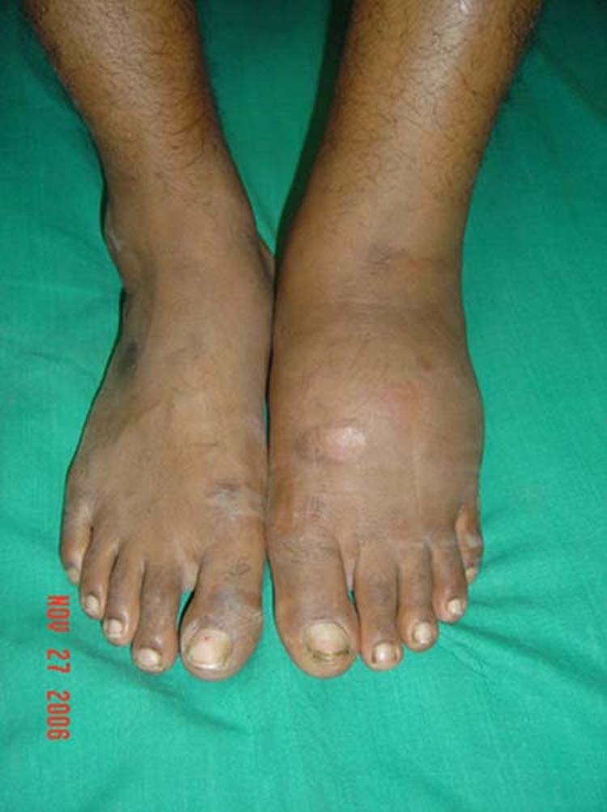
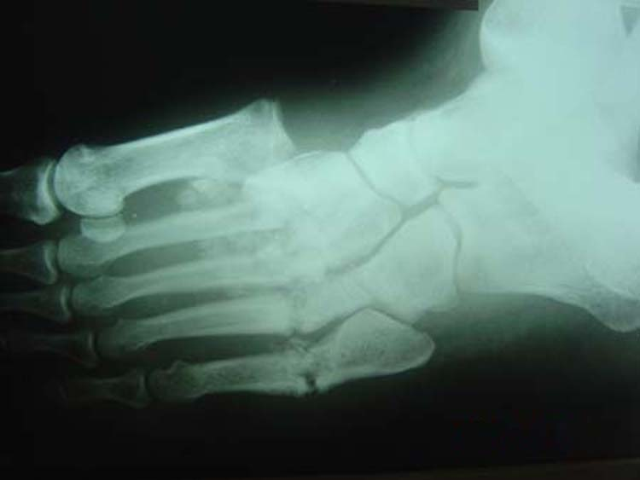

Slide 44
Laboratory Investigations:
HbA1c.
BUN.
Creatinine
TSH
ECG
Chest x-ray
Fasting Glucose.
Fasting Lipid Profile.
Routine and macroscopic urinalysis for protein glucose.
ketones and microalbumin.

Slide 45
Treatment Goals
Lowering Blood glucose, Measuring HBa1C
What’s the magic Number?
Is there any risk of intensive Rx?
Decreasing long-term complications.
MacroVascular
MicroVascular
Improving the quality of life.
Decreasing Acute complications and side effect( hypoglycemia, ketoacidosis, Hyperglycemic Hyperosmolar State)
Decreasing Morbidity

Slide 46
New ADA/EASD treatment algorithm for Type 2 diabetes
Tier 1: Well validated core therapies
Lifestyle + Metformin
+
Basal insulin
Lifestyle + Metformin
+
Intensive insulin
At diagnosis:
Lifestyle
+
Metformin
Lifestyle + Metformin
+
Sulfonylureaª
STEP 1
STEP 2
STEP 3
Tier 2: Less well validated therapies
Lifestyle + Metformin
+
Pioglitazone
No hypoglycaemia
Oedema/CHF
Bone loss
Lifestyle + Metformin
+
Pioglitazone
+
Sulfonylureaª
Lifestyle + Metformin
+
GLP-1 agonist^{b}
No hypoglycaemia
Weight loss
Nausea/vomiting
Lifestyle + Metformin
+
Basal insulin
Reinforce lifestyle interventions at every visit and check HbA_{1c} every 3 months until HbA_{1c} is <7 % and then at least every 6 months. The interventions should be changed if HbA_{1c} is ≥7 %
ªSulfonylureas other than glibenclamide (glyburide) or chlorpropamide ^{b}Insufficient clinical use to be confident regarding safety

Slide 47
Treatment of type I Diabetes
Traditional Treatment
Intensive Insulin Therapy (Multiple daily insulin injections)
Continuous insulin infusion

Slide 48
Pharmacological Treatment
Insulin Therapy:
Types of insulin injections:
Ultra-short-acting ( e.g. insulin lispro, insulin aspart)
Short-acting -Regular- (e.g. Novolin R, Humulin R)
Intermediate-acting (NPH, Lente insulin)
4. Long-acting (Glargine ,Ultralente )

Slide 49
What’s the use of ultra short acting insulin
Patient can eat immediately after injections
No risk of hypoglycemia caused by long acting
Can be used for CSII because of its fast onset of action.

Slide 50
Comparison of insulin lispro protamine suspension versus insulin glargine once daily in basal-bolus therapies with insulin lispro in type 2 diabetes patients: a prospective randomized open-label trial.
In a recent study comparing intermediate acting insulin with long acting insulin in type II diabetes, there was no significant difference in the blood glucose level between the two regimen.
So, ILPS ( Insulin lispro promatine suspension) can be considered as an alternative to basal-bolus regimen with insulin Glasgine for T2DM patient.
http://www.ncbi.nlm.nih.gov/pubmed/21819517

Slide 51
Recent studies compared CSII with intensive insulin therapy (multiple daily insulin injections) in children suggested that that there’s no significant difference between the two in reducing HBa1C, but CSII has less hypoglycemic attacks compared to MDI)
http://pediatrics.aappublications.org/content/112/3/559.short
http://www.pediatricsdigest.mobi/content/107/2/351.short

Slide 52
Insulin is the most effective of diabetes medications in lowering glycemia, and it’s the only medication that can reduce the Hba1C to its therapeutic level.
Insulin therapy is mainly used to treat type I diabetes.

Slide 53
In type II, initially it’s used to overcome the insulin resistance, but within time it will become a hormone-replacement therapy.
Insulin has a benefit over antihyperglycemic agents that it has an effect on reducing the cholesterol TAG.
In the other hand it’s associated with an increase in wieght gain, and has more risk for causing hypoglycemia.

Slide 54
Life style modification
The major risk factor of aquiring type II diabetes is obesity and sedentry lifestyle.
According to the American Diabetic Association, weight reduction and exercise can significantly control blood glucose in T2DM.

Slide 55
Oral hypoglycemics
When levels of glycemia are high (e.g., A1C >8.5%), classes with greater and more rapid glucose-lowering effectiveness, or potentially earlier initiation of combination therapy, are recommended; conversely, when glycemic levels are closer to the target levels (e.g., A1C <7.5%), medications with lesser potential to lower glycemia and/or a slower onset of action may be considered.

Slide 56
According to the American association of diabetes, type 2 diabetes is a progressive disease with worsening glycemia over time. Therefore, addition of medications is the rule, not the exception, if treatment goals are to be met over time.

Slide 57
Pharmacological Treatment
Sulfonylureas
Meglitinides
Biguanides
Thiazolidinediones
Alpha-glucosidase inhibitors
DPP-4 inhibitors

Slide 58
SulfanylUrea
Eg: Chlorpropamide
Old Drug (1950’s)
glipizide (Glucotrol and Glucotrol XL), glyburide (Micronase, Glynase, and Diabeta), and glimepiride (Amaryl)
Sensitize B-cells to release more insulin.
Can cause Hypoglycemia as a side effect (b/c it increases insulin level)
Alcohol is not recommended while taking Sulfonylureas

Slide 59
Biguanides
Eg: metformin
Increase peripheral tissue sensitivity for glucose and cause more utilization
Inhibits gluconeogenesis in the liver
Doesn’t cause hypoglycemia if used as monotherapy, because it doesn’t increase the level of insulin in plasma.

Slide 60
In another recent study, metformin was suggested to be the first line treatment for type 2 diabetics, and there was no clear clinical evidence that the combination of two more drugs can reduce the level HBa1C.
http://www.ncbi.nlm.nih.gov/pubmed/21735563

Slide 61
In a recent meta-analysis of randomized clinical trials, there was no evidence that a patient already receiving metformin and sulfanylureas will have signficant benifet if we added a third anthyperglycemic
http://www.annals.org/content/154/10/672.abstract

Slide 62
Meglitinides
Repaglinide (Prandin) and nateglinide (Starlix)
Rapid onset of action
Also B-Cell sensitizers to release more insulin (can cause hypoglycemia)
Good for post-prandial hyperglycemia

Slide 63
Alpha glucosidase inhibitors
Acarbose
Delays the absorption of carbohydrates from GI, So blood glucose level doesn’t elevate significantly after meals.
Non convenient side effects, and must not be used as monotherapy.

Slide 64
Thiozolidinediones
Rssiglitazone, Pioglitazone
Reduces insulin resistance by promoting glucose uptake in sketeletal muscle and adipose tissue.
Also inhibits gluconeogenesis
Not given in patient with Heart failure, and causes hepatotoxicity
Not used in patients with liver or renal imapirment.

Slide 65
Incretins
Incretins are group of gastrointestinal hormoes that are secreted after meal, they cause increase in the release of insulin from B-cells of pancrease and decrease in the synthesis of glucagon.

Slide 66
Incretins are degraded rapidly by an enzyme called Dipeptidyl peptidase-4 (DPP-4)
Incretins are impaired in patients with type 2 DM, which causes more postprandial hyperglycemia.

Slide 67
We used drugs that inhibit the action of DPP-4, so inhibition of the inhibition…
Example of DPP-4 inhibitors e.g. Sitagliptin, vildagliptin

Slide 68
Recent studies mentioned that using Vildagliptin (DD4I) can significantly increase the release of insulin from b-Cells,
http://aasproxy.museglobal.com/MuseSessionID=b0a417b20aecbfa41ea97b4799d6db/MuseHost=web.ebscohost.com/MusePath/ehost/detail?vid=4&hid=113&sid=f789bd18-267d-4221-9464-ec879013a217%40sessionmgr104&bdata=JnNpdGU9ZWhvc3QtbGl2ZQ%3d%3d#db=cmedm&AN=21239518

Slide 69
Other studies also suggested that it has beneficial action in patients with hemodyalsis, and it’s safe on the liver.
http://www.ncbi.nlm.nih.gov/pubmed/21921362

Slide 70
Surgery
When do we do pancreatic transplant for patients with type I diabetes?

Slide 71
Studies suggested successful pancreas transplantation is associated with significantly less severe diabetic glomerulopathy in kidneys previously transplanted into diabetic patients.
Others mentioned that there’s no significant delay in retinopathy in compared groups
http://www.nejm.org/doi/pdf/10.1056/NEJM198907133210204
http://www.nejm.org/doi/pdf/10.1056/NEJM198801283180403

Slide 72
Another study implied that the progression of diabetic polyneuropathy may be halted through the restoration of a normoglycemia state by successful pancreatic transplantation.
http://www.nejm.org/doi/full/10.1056/NEJM199004123221503

Slide 73
Pancreas transplantation can also reverse the lesions of diabetic nephropathy, but reversal requires more than five years of normoglycemia.
http://www.nejm.org/doi/full/10.1056/NEJM199807093390202

Slide 74
Annual Check Up
Annual check is important to rule out and manage any complication the patient may have, and to have an overview of the patient compliance and implication o f treatment.

Slide 75
Investigations of the check up:
HBa1C
Urea and Creatinine
Lipid profile
Albumin to creatinine ratio

Slide 76
Examine :
Eye Fundus
Feet

Slide 77
Diabetic Education
Public education about diabetes is important to increase the conscious about the diseases, and to change the risk behavior that maybe involved in causing type II diabetes (Obesity, sedentary lifestyle…)

Slide 78
Diabetic education of the diabetic patients are part of the management that should be provided along with the physician visits and dietitian control.
It can increase the compliance of the patient to take treatment and decrease the long term complications and acute side effects.

Slide 79
Screening for Diabetes
The chronic hyperglycemia of diabetes is associated with long-term dysfunction, damage, and failure of various organs…
So early detection and prompt treatment may reduce the burden of diabetes and its complications….
Screening is only for type 2 ---- preclinical .

Slide 80
There is no role of screening for type 1 diabetes or gestational diabetes mellitus (GDM).
Screening of asymptomatic individuals for the presence of autoantibodies related to type 1 diabetes….why??
1) no cutoff values for some of the immune marker assays.
2) there is no known action should be taken when a autoantibody test positive.
3) because the incidence of type 1 diabetes is low
Notes:
). Because of the acute onset of symptoms

Slide 81
community screening outside a health care setting may be less effective because of :
the failure of people with a positive screening test to seek and obtain appropriate follow-up testing and care
to ensure appropriate repeat testing for individuals who screen negative.

Slide 82
Tests
The best screening test for diabetes, the fasting plasma glucose (FPG), is also a component of diagnostic testing.
the FPG test is preferred in clinical settings
easier
faster to perform
more convenient
acceptable to patients
less expensive.

Slide 83
TheHb A1C test
Random blood glucose level .
better used for self-monitoring rather than as a screening tool.

Slide 84
Cases And Roleplay

Slide 85
A 40 year old smoker gentleman diagnosed with type II diabetes presented for regular check up :
FBG: 200 mg\dl
BMI: 32
HbA1c: 9.3

Slide 86
Case
A 44 year old woman presents to your office with 2 months H/O lose of weight and polyurea.
BMI = 20 , RBS= 24.4 mmol / L
Urine dipstick = glucose 4+
Ketones = nil
What is your diagnosis?
What is your management ?

Slide 87
What is new ??

Slide 88
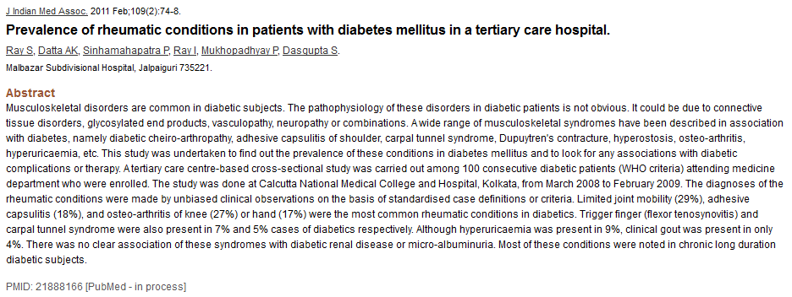
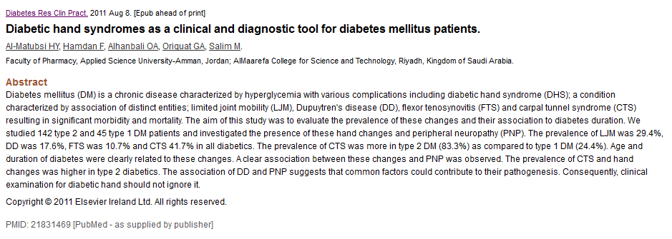

Slide 89
Diabetic Hand Syndrome… 2011
diabetic hand syndrome (DHS); a condition characterized by association of distinct entities; limited joint mobility (LJM), Dupuytren's disease (DD), flexor tenosynovitis (FTS) and carpal tunnel syndrome (CTS) .
LJM was 29.4%.
DD was 17.6%
FTS was 10.7%.
CTS 41.7% in all types ..(more in type 2 DM).

Slide 90
(1)MARTHA M. FUNNELL, TAMMY L. BROWN, BELINDA P. CHILDS, et al . National Standards for Diabetes Self-Management Education : American Diabetes Association: DIABETES CARE, VOLUME 32, SUPPLEMENT 1, JANUARY 2009 : s87:s94.
(4) Abbott CA, Carrington AL, Ashe H, Bath S, Every LC, Griffiths J, Hann AW, Hussain A, Jackson N, Johnson KE, Ryder CH, Torkington R, Van Ross ER, Whalley AM, Widdows P, Williamson S, Boulton AJ: The North-West Diabetes Foot Care Study: incidence of, and risk factors for, new diabetic foot ulceration in a community-based patient cohort. Diabet Med 19:377–384, 2002
14 Frykberg RG, Zgonis T, Armstrong DG, Driver VR, Giurini JM, Kravitz SR, Landsman AS, Lavery LA, Moore JC, Schuberth JM, Wukich DK, Andersen C, Vanore JV: Diabetic foot disorders: a clinical practice guideline (2006 revision). J Foot Ankle Surg 45(Suppl. 5):S1–S66, 2006
(15) Young MJ, Breddy JL, Veves A, Boulton AJ: The prediction of diabetic neuropathic foot ulceration using vibration perception thresholds: a prospective study. Diabetes Care 17:557–560, 199
(9) Bristow I: Non-ulcerative skin pathologies of the diabetic foot. Diabetes Metab Res Rev 24(Suppl. 1):S84–S89, 2008

