Slide 1
Hypertension
Ahmed Al-Malki
Bilal Marwa
Zaid Al-Kahtani
Hassan Al-Dossari

Slide 2
Outlines
Why hypertension?
Epidemiology.
Measurement.
Diagnosis.
Guidelines
In the clinic.

Slide 3
Why Hypertension?
Hypertension raises your risk for heart disease the first leading causes of death in the world.
Called the "silent killer" because many people don't realize they have it.

Slide 4
Epidemiology
The National Health and Nutrition Examination Survey (NHANES) data shows that the prevalence of hypertension in USA is 29 – 31 % in ages of 18 years and older.(1)
The prevalence is higher in older individuals, non-Hispanic blacks, and women.(2)
Another study shows that hypertension is more in 6 European countries than in USA with 44%.(3)

Slide 5
Epidemiology
The study sample: 17,230
The prevalence of hypertension was 26.1%
28.6% of males, 23.9% of females.
Higher prevalence in urban population (27.9%) compared to rural population (22.4%).
The prevalence of CAD among hypertensive patient was 8.2%, and 4.5% among normotensive subjects.
Al-Nozha MM, Abdullah M, Arafah MR, et al. Hypertension in Saudi Arabia. Saudi Med J. 2007 Jan;28(1):77-84.

Slide 6
Epidemiology
4758 subjects participated in recent study.
51% was female.
The prevalence was 25.5%.
27.1% males, 23.9% females.
55.3% of the patients were unaware of their disease.(5)
Abdalla A. Saeed, Nasser A. Al-Hamdan, Ahmed A. Bahnassy, et al. Prevalence, Awareness, Treatment, and Control of Hypertension among Saudi Adult Population: A National Survey. International Journal of Hypertension. Volume 2011 (2011): 8.

Slide 7
Diagnosis
To take a blood pressure reading, the patient need to be:
Relaxed and comfortably seated.
His arm well supported.
Measurement should begin after at least 5 mins of rest.

Slide 8
Two or more elevated readings are obtained on each visit, for at least two visits over a period of one to several weeks.
3 types of measurements:
Clinic Measurement.
Ambulatory Measurement.
Home measurement.

Slide 9
Cautions !
“White coat” effect.
Isolated ambulatory hypertension.
Other methods of measuring BP.

Slide 10
Diagnosis
JNC-VII. Hypertension. 2003;42:1206–1252

Slide 11
Diagnosis
2007 ESC/ESH Guidelines for the management of Arterial Hypertension. J Hypertens. 2007;25:1105-1187.

Slide 12
Guidelines
BHS 2004, JNC 7 and ESH/ESC 2007:
All people with high blood pressure, borderline or high normal blood pressure should be advised on lifestyle modifications.
All support combination therapy.
Initiation of therapy with combination drugs.
Fixed-dose combination.

Slide 13
In the Clinic
History
Examination
Investigations
Management
Follow-up

Slide 14
History
Presentation:
Usually asymptomatic, routine check-up.
Late:
Dull headache, dizzy spells.
Recurrent Epistaxis.

Slide 15
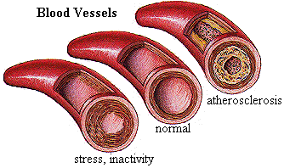
History
Assess severity:
Duration
Previous levels
History of chronic diseases
HTN and CVS disease
Dyslipidemia
Atherosclerosis
DM
Obesity
Exclude secondary causes
Drug history.
Specific associated symptoms
Renal: previous renal disease or symptoms
Polyuria, polydypsia, hematuria, etc..
Episodes of sweating, palpitations, anxiety (pheochromocytoma)
Muslce weakness and tetany (aldosteronism)
Notes:
Smoking: immediately due to its action.. And chronically due to disturbance of blood flow

Slide 16
History
3. Risk factors
Age
> 55 for men, > 65 for women
Obesity
Race
Family history:
HTN
CVS disease
DM
Renal disease
Social History
Smoking
Diet
physical exercise, sedentery life style
Personality
Snoring (sleep apnea)
Stress
Alcohol

Slide 17
History
4. Symptoms of organ damage (complications)
headache, vertigo,
impaired vision, TIA, sensory or motor deﬁcit
Palpitations, chest pain, SOB, leg edema
Renal
Peripheral coolness, intermettint claudication
5. Previous Treatment.

Slide 18
Examination
Measure BP (as mentioned above)
Pulse
HR, rhythm, character, volume
Additional risk factors
Exclude Secondary Causes
Recognize Organ damage and complications

Slide 19
Signs of organ damage
Fundoscopy.
CVS examination:
Carotid bruits.
Apical impulses, cardiac rhythm.
Pulmonary rales.
Peripheral edema.
Peripheral vascular signs.

Slide 20
Secondary Hypertension signs
Cushingoid appearance
Skin markings of Neurofibromatosis (pheochromocytoma)
Auscultation for murmers (renovascular)
Signs of aortic coarctation or aortic disease:
Auscultation of precordial or chest murmurs
Diminished and delayed femoral pulses and reduced femoral BP

Slide 21
”Essential investigations“

Slide 22
Laboratory Tests
Routine laboratory tests(for all patients):
Urinalysis.
Blood chemistry( K, Na, creatinine).
Fasting blood glucose.
Fasting total cholesterol and HDL , LDL and triglycerides.
Standard 12-lead electrocardiography.

Slide 23
Laboratory Tests
Optional laboratory tests:
Urinary albumin excretion in patients with diabetes.
Captopril-enhanced radioisotope renal scan, Doppler sonography, magnetic resonance angiography, and computed tomographic angiography for patient with Renovascular hypertension.

Slide 24
Laboratory Tests
Hyperaldosteronism(endocrine hypertension):
hypertensive patients with spontaneous hypokalemia (potassium < 3.5mmol/L).
hypertensive patients with marked diuretic-induced hypokalemia. (potassium < 3.0 mmol/L).
Plasma aldosterone and plasma renin activity.

Slide 25
”Treatment Guidelines“

Slide 26
Objectives of the Guidelines
1.Promote the primary prevention of hypertension and cardiovascular disease.
2.Increase the detection and treatment of undiagnosed hypertension by routine screening .
3.Ensure that patients taking antihypertensive drugs are controlled.
4.Reduce the risk of cardiovascular disease of treated hypertensive patients by non-pharmacological measures.
5. Increase the identification and treatment of patients with mild hypertension who are at high risk of cardiovascular disease.
6.Promote continued adherence to drug treatment, by optimising the choice and use of drugs, minimising side effects, and increasing information and choice for patients.

Slide 27
The ultimate public health goal of antihypertensive therapy is the reduction of cardiovascular and renal morbidity and mortality.
Goals of Therapy

Slide 28
Goals of Therapy
The primary goal of treatment in patients with hypertension is to achieve maximum reduction in the long-term total risk of CVD. This requires the treatment of both raised BP and all associated reversible risk factors.

Slide 29
BP Targets
BP targets are (systolic/diastolic):
≤140/90 mmHg in all patients with hypertension.
≤130/80 mmHg in patients with diabetes and in high-risk.
It may be difficult to achieve BP targets, especially in elderly and diabetic patients, and in patients with CV damage.

Slide 30
Non-pharmacological Management
Adoption of healthy lifestyles by all persons is critical for the prevention of
high BP and is an indispensable part of the management of those with hypertension.

Slide 31
Lifestyle Modifications
Approximate SBP Reduction (Range) | Recommendation | Modification
5–20 mmHg/10 kg weight loss 23,24 | Maintain normal body weight | Weight reduction
8–14 mmHg 25,26 | Consume a diet rich in fruits, vegetables, and lowfat dairy products with a reduced content of saturated and total fat. | Adopt DASH eating plan
2–8 mmHg 25–27 | Reduce dietary sodium intake to no more than 100 mmol per day (2.4 g sodium or 6 g sodium chloride). | Dietary sodium reduction
4–9 mmHg 28,29 | Engage in regular aerobic physical activity such as brisk walking (at least 30 min per day, most days of the week). | Physical activity
2–4 mmHg 30 | Limit consumption to no more than 2 drinks (1 oz or 30 mL ethanol; e.g., 24 oz beer, 10 oz wine, or 3 oz 80-proof whiskey) per day in most men and to no more than 1 drink per day in women and lighter weight persons | Moderation of alcohol consumption

Slide 32
Pharmacological Management

Slide 33
There are five major classes of such agents licensed for initiation or maintenance of hypertension, alone or in combination:
thiazide diuretics; calcium antagonists (CA); ACE inhibitors (ACEI); agiotensin receptor antagonists (ARB), and β-blockers (BB).

Slide 34
The choice of a specific drug or combination should take into account the following:
Previous patient exposure to, and history with, a class of compounds.
CV risk associated with agent and the patient’s CV risk profile.
Presence of other disorders and conditions.
Possible drug interactions.
Cost considerations (although these should not predominate over efficacy, tolerability and patient protection).
Side-effects and their potential impact on compliance.
Duration of antihypertensive effect – once-daily administration should be preferred .

Slide 35
Drug of choice
Patients aged 55 or older and black patients of any age:
First choice for initial therapy should be either calcium-channel blocker or thiazide-type diuretic.
if a third drug is needed an ACE inhibitor or ARB is achoice.

Slide 36
Drug of choice
For patients younger than 55 years initial therapy should be:
ACE inhibitor or ARB if ACE inhibitor is not tolerated.
Adding ACE inhibitor t a calcium-channel blocker or a diuretic.
Beta-blockers may be consedered in younger people.

Slide 37
Possible contraindications | Compelling contraindications | Conditions favoring use | Drug Class
metabolic syndrome glucose intolerance pregnancy | gout | isolated systolic hypertension (elderly) heart failure hypertension in blacks | Thiazide diuretics
 | renal failure hyperkalemia | heart failure post-MI | Diuretics (antialdosterone)
 |  | end stage renal disease heart failure | Loop diuretics
peripheral arterial disease metabolic syndrome glucose intolerance athletes and physically active patients chronic obstructive pulmonary disease | asthma A-V block (grade 2 or 3) | angina pectoris post-MI heart failure tachyarrhythmias glaucoma pregnancy | Beta blockers
tachyarrhythmias heart failure |  | isolated systolic hypertension (elderly) angina pectoris LV hypertrophy carotid/coronary atherosclerosis pregnancy hypertension in blacks | Calcium antagonists (dihydropyridines)
 | pregnancy angioneurotic edema hyperkalemia bilateral renal artery stenosis | heart failure LV dysfunction post-MI diabetic nephropathy LV hypertrophy carotid atherosclerosis proteinuria/mircroalbuminuria atrial fibrillation metabolic syndrome | ACE inhibitors
 | pregnancy hyperkalemia bilateral renal artery stenosis | heart failure post-MI diabetic nephropathy proteinuria/mircroalbuminuria LV hypertrophy atrial fibrillation metabolic syndrome ACEI-induced cough | Angiotensin receptor antagonists

Slide 38
Combination therapy
Antihypertensive agents can be combined if they have different and complementary mechanisms of action and where their combined use either offers greater efficacy than that of either of the combination components, or a favorable tolerability profile, or both.

Slide 39
The following two-drug combinations have been found to be effective and well tolerated, and have been favorably used in randomized efficacy trials:
Thiazide diuretic and ACEI
Thiazide diuretic and ARB
Thiazide diuretic and BB (although this should be avoided in patients with metabolic syndrome or high risk of incident diabetes because of dysmetabolic effects)
CA and ACEI
CA and ARB
CA and thiazide diuretic
BB and CA (dihydropiridine)

Slide 40
HTN and Diabetes
The coexistence of hypertension and either type 1 or type 2 diabetes substantially increases risk of developing renal and other organ damage, leading to increased incidence of stroke, CHD, congestive heart failure, PAD and CV mortality

Slide 41
Combinations of two or more drugs are usually needed to achieve the target
goal of <130/80 mmHg.
Thiazide diuretics, BBs, ACEIs, ARBs, and CCBs
are beneficial in reducing CVD and stroke incidence in patients with diabetes.

Slide 42
ACEI- or ARB-based treatments favorably affect the progression of diabetic nephropathy and reduce albuminuria.
ARBs have been shown to reduce progression to macroalbuminuria.
Lifestyle interventions (especially caloric intake and increased physical activity) are also strongly encouraged

Slide 43
HTN and Chronic Kidney Disease
Hypertension appears in the majority of
these patients, and they should receive aggressive BP management, often with
three or more drugs to reach target BP values of <130/80 mmHg

Slide 44
ACEIs and ARBs have demonstrated favorable effects on the progression of diabetic and nondiabetic renal disease.
A limited rise in serum creatinine of as much as 35 percent above baseline with ACEIs or ARBs is acceptable and is not a reason to withhold treatment unless hyperkalemia develops.

Slide 45
HTN and IHD
Ischemic heart disease (IHD) is the most common form of target organ damage
associated with hypertension.

Slide 46
In patients with hypertension and stable angina pectoris, the first drug of choice is usually a BB.
In patients with acute coronary syndromes (unstable angina or myocardial infarction), hypertension should be treated initially with BBs and ACEIs.

Slide 47
In patients with postmyocardial infarction, ACEIs, BBs, and aldosterone antagonists have proven to be most beneficial.

Slide 48
HTN and heart failure
Heart failure (HF), in the form of systolic or diastolic ventricular dysfunction,
results primarily from systolic hypertension and IHD.

Slide 49
Fastidious BP and cholesterol control are the primary preventive measures for those at high risk for HF.
In asymptomatic individuals with demonstrable ventricular dysfunction,ACEIs and BBs are recommended.
For those with symptomatic ventricular dysfunction or end-stage heart disease, ACEIs, BBs, ARBs and aldosterone blockers are recommended along with loop diuretics.

Slide 50
HTN and Cerebrovascular Disease
For patients with cerebrovascular disease, a treatment goal of BP <130/80 mmHg is recommended and pharmacological interventions should be initiated when BP is in the high-normal range.

Slide 51
The risks and benefits of acute lowering of BP during an acute stroke are still unclear.
control of BP at intermediate levels (approximately 160/100 mmHg) is appropriate until the condition has stabilized or improved.
Recurrent stroke rates are lowered by the combination of an ACEI and thiazide-type diuretics.

Slide 52
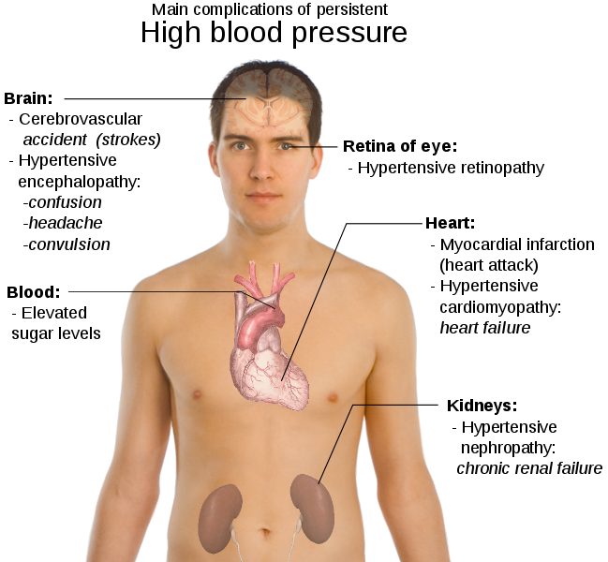
Follow up to prevent complications

Slide 53
The frequency of follow up depends on factors including:
Severity and variability of blood pressure.
Complexity of the treatment regimen.
Compliance.
Six monthly review is probably sufficient when treatment and blood pressure are stable.

Slide 54
Patients on non-pharmacological interventions require frequent follow-up visits to
Maximize compliance.
To reinforce the treatment approach.
To monitor BP.
Allowing a prompt and timely switch to pharmacological interventions if necessary.

Slide 55
During the titration phase of pharmacological therapy, patients should receive regular checkups (eg, every 2–4 weeks) in order to optimize the treatment regimen.
The Guidelines advise an added benefit of instructing patients to self-measure BP at home during this phase.

Slide 56
FOLLOW-UP VISITS
The timing of additional visits will depend on:
Blood pressure control and the.
Existence of complications or other diseases.

Slide 57
Every Visit:
Measure and record BP.
Measure weight for BMI calculation.
Elicit information on adherence to treatment, including taking medication the morning of visit.
Ask about symptoms/changes since last visit, and any adverse drug effects.
Stress importance of healthy lifestyle evaluating the Patient.

Slide 58
Annual Visit:
Update medical history.
Measure and record BP.
Measure weight for BMI calculation.
Ask about lifestyle - diet, physical activity, tobacco and alcohol use.
Stress importance of healthy lifestyle.
Do lab. investigations :
plasma creatinine, electrolytes, fasting lipid profile and full blood.
count (FBC) and fasting blood sugar.
Do an ECG.

Slide 59
Patients should be referred to consultative specialty services when:
BP remains uncontrolled even aggressive therapy with a minimum trial of 3 or 4 medications.
A dramatic failure to respond to medications
Unusually young patient.

Slide 60
Refer patients to:
Consultative Internal Medicine, unless there is a clear element of renal failure.
Nephrology if there is a clear element of renal failure (creatinine > 2 or rising creatinine with proteinuria).
Cardiology only if the patient is currently under the active management of a cardiologist.

Slide 61
When to decide start of medication ?
or

Slide 62
The decision to start antihypertensive treatment should be based on two criteria:
The level of systolic and diastolic blood pressure.
The level of total cardiovascular risk.

Slide 63
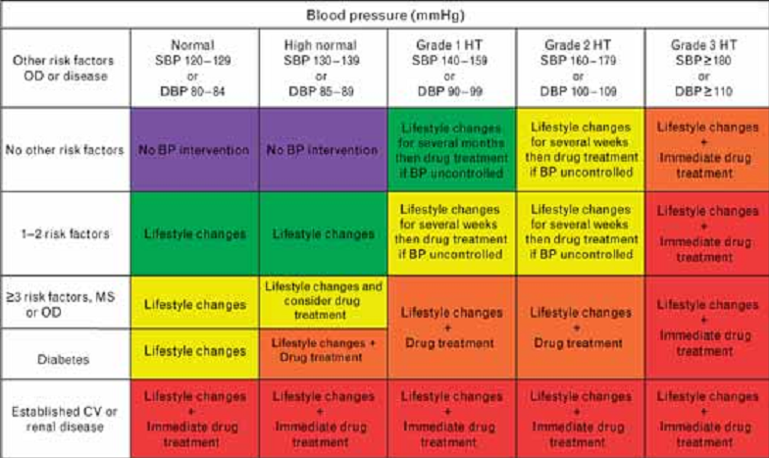

Slide 64
References
Burt VL, Whelton P, Roccella EJ, et al. Prevalence of hypertension in the US adult population. Results from the Third National Health and Nutrition Examination Survey, 1988-1991. Hypertension 1995; 25:305.
Centers for Disease Control and Prevention (CDC). Racial/ethnic disparities in prevalence, treatment, and control of hypertension--United States, 1999-2002. MMWR Morb Mortal Wkly Rep 2005; 54:7.
Katharina Wolf-Maier, Richard S. Cooper, Jose´ R. Banegas, et al. Hypertension Prevalence and Blood Pressure Levels in 6 European Countries, Canada, and the United State. JAMA, May 14, 2003; 289 (1): 2363-2369.

