Slide 1
Risk Assessment of Cardiovascular Diseases
Presented by:
Abdussalam Al-Ahmari
Abdulelah Al-Asiri
Faisal Al-Ghosen
Abdussalam Al-Wabel
Mohammed Al-Shayie
Ahmad Al-Watban

Slide 2
Risk factors of CVD

Slide 3
Non-Modifiable risks :-
Age
In many epidemiologic surveys, age remains one of the strongest predictors of disease. More than half of those who have heart attacks are 65 or older, and about four out of five who die of such attacks are over age 65.
GENDER
Men are more likely than women to develop cardiovascular events
HEREDITY
some people have a significantly greater likelihood of having a heart attack or stroke because they have inherited a tendency from their parents.
→this is because male hormones—androgens—increase risk or because female hormones—estrogens—protect against atherosclerosis is not completely understood

Slide 4
Modifiable risks :-
HIGH BLOOD PRESSURE
both systolic and diastolic blood pressures determine an individual’s risk. Hypertension often occurs together with other cardiovascular risk factors.
HIGH BLOOD CHOLESTEROL AND RELATED LIPID PROBLEMS
The impact of Lp(a) levels on the risk of coronary heart disease is as strong as that seen with total cholesterol levels or reduced high-density lipoprotein (HDL) levels . (HDL,LDL,TAG,total cholesterol)
CIGARETTE SMOKING
Evidence from the Framingham Heart Study shows that the risk of suddendeath increases more than tenfold in men and almost fivefold in women who smoke.
Lp (a)
has the opposite effect with the normal process of clot lysis .

Slide 5
Cont. Modifiable risks :-
OBESITY
One recent study that examined more than 100,000 women age 30 to 55 showed that the risk for heart disease was
DIABETES MELLITUS
Individuals with diabetes mellitus, especially those whose diabetes occurs in adult life, have an increased incidence of coronary heart disease and stroke
more than three times higher among the most obese
group than among the leanest group.
Type A , stress . Type A individuals tend to become upset easily, often for little cause, and are always in a hurry,
BEHAVIORAL FACTORS

Slide 6
Risk Factors Assessment

Slide 7
Why is it important to do risk assessment ?
Any major risk factor, if left untreated for many years, has the potential to produce cardiovascular disease .
So , an assessment of total risk based on the summation of all major risk factors can be clinically useful for 3 purposes :
(1) identification of high-risk patients who deserve immediate attention and Intervention
(2) motivation of patients to adhere to risk-reduction therapies
(3) modification of intensity of risk-reduction efforts based on the total risk estimate

Slide 8
How to do risk assessment ?
We have a number of scoring systems used to determine an individual's chances of developing cardiovascular disease .
Framingham Risk Score (FRS) , Prospective Cardiovascular Münster (PROCAM) , Systematic Coronary Risk Evaluation (SCORE) and The Reynolds Risk Score (RRS) are all cardiovascular risk assessment tools .
anyway , The FRS is now recommended .

Slide 9
FRAMINGHAM RISK SCORE
What is Framingham risk score ?
It is risk assessment tool to predict a person’s chance of having a heart attack or dying from heart disease in the next 10 years
What does the Framingham risk score mean?
Your Framingham risk score is your risk of having a heart attack or dying from heart disease within 10 years
Low risk = less than 10% Intermediate risk = 10% to 20% High risk = more than 20%

Slide 10
What factors are included in FRS ?
1- Age
2- Sex
3- Total cholesterol
4- HDL cholesterol
5- Smoking
6- Blood pressure

Slide 11
Who can use the Framingham risk calculator?
Anyone who have not already had a heart attack or been diagnosed with heart disease In addition, if you have any of the following conditions, the risk score does not apply to you :
- Stroke or transient ischemic attack
- Bypass surgery or balloon angioplasty
- Type 2 diabetes
- Kidney disease
- Abdominal aortic aneurysm
- Familial hypercholesterolemia
- Peripheral artery disease
- Carotid artery disease
Why?

Slide 12
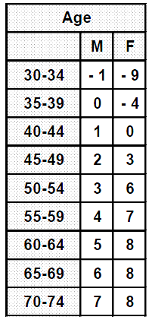
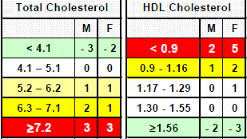
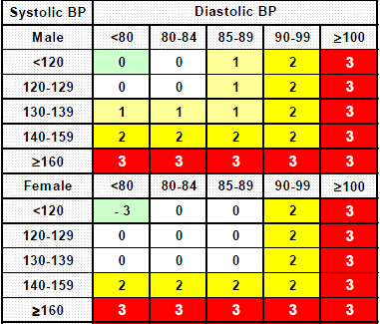
How to calculate your Framingham score ?
Step one : Add scores by sex for Age, Total Cholesterol, HDL-Cholesterol, BP and Smoking.

Slide 13
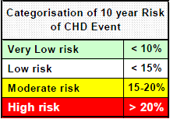
Step two : Use total score to determine Predicted 10 year Absolute Risk of CHD Event (Coronary Death, Myocardial Infarction, Angina) by sex
Categorization :

Slide 14
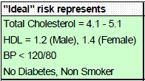
Step three : Compare Predicted 10 year Absolute Risk with "Average" and "Ideal" 10 year Risks, to give Relative Risks

Slide 15
Example : a 62-year-old male who does not smoke. His current blood pressure is 135/95, his total cholesterol reading is 220 mg/dL(5.6892 mmol/l), while his HDL reading is 50 mg/dL(1.293 mmol/l) .
What is his score??
What does it mean??
According to the tables for each predictor, his risk factor scores are:
5 for Age,
0 for Smoking,
2 for Blood pressure,
1 for LDL or total cholesterol, and
0 for HDL choleste
His total scores is 8 , so his 10 year risk is 16% to develop CVD

Slide 16
Primary OR Secondary prevention ?
FRAMINGHAM RISK SCORE only applies to assessment for PRIMARY PREVENTION of CHD, in people who do not have evidence of established vascular disease.
Patients who already have evidence of vascular disease usually have a >20% risk of further events of over 10 years, and require vigorous SECONDARY PREVENTION.

Slide 17
Primary prevention of CVD

Slide 18
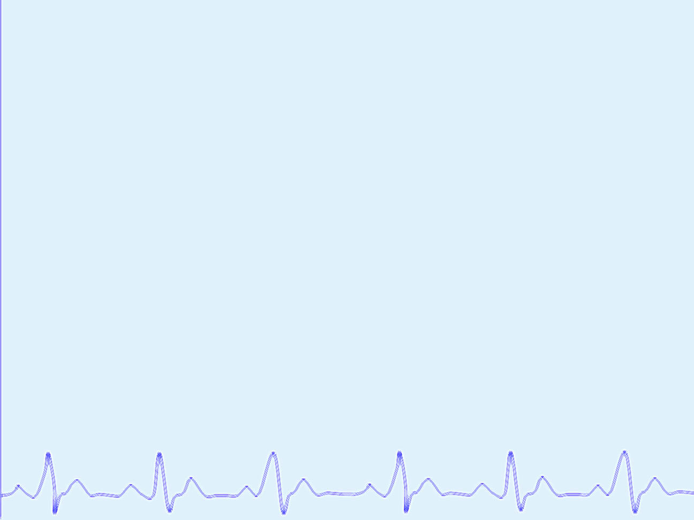
WHAT IS PRIMARY PREVENTION?
Primary prevention is the strategies that intend to avoid the development of disease.
Most population-based health promotion activities are primary preventive measures.

Slide 19
THE MAIN OBJECT OF PRIMARY PREVENTION
Reduce the risk of the occurrence of CVD (heart attack, stroke, peripheral vascular disease, heart failure and kidney disease) by providing a summary of strategies for the assessment of RISK factors that increase the occurrence of cardiovascular disease.

Slide 20
PRIMARY PREVENTION SRATAGIES
Heart disease and stroke are often caused by modifiable risk factors related to diet and lifestyle. These factors include smoking, lack of physical activity, unhealthy eating habits and excess body weight.
These strategies Prevent heart disease through lifestyle management, including smoking cessation increased physical activity, maintenance of a healthy weight and healthy eating habits.

Slide 21
Lifestyle Recommendations
Smoking cessation
Cigarette smoking is responsible for approximately 30% of CHD deaths in North America. Complete cessation of smoking and exposure to second hand smoke is recommended.
Physical activity
Moderate intensity activity (such as walking 3 km in 30 minutes once per day) is beneficial for cardiac health and has been shown to reduce hypertension, prevent diabetes and improve survival.
Weight reduction
A body-mass index (BMI) greater than 27 kg/m² is associated with increased risk of hypertension, type 2 diabetes and dyslipidemia.
Dietary recommendations
Recommend a diet that emphasizes fruits, vegetables, low-fat dairy products, fiber, whole grains, and protein sources that are low in trans-fat, saturated fat and cholesterol. In addition to, a reduced dietary sodium intake of As well, increased consumption of fish that are high in omega-3 fatty acids decreases cardiovascular risk.

Slide 23
How to reduce incidence of development CVD ?
Those patients already have the risk factors , but now we are trying to prevent them to be a known cases of CVD .
What can we do for them ?
We are going to divide them upon risk factors into two groups: High risk patients and highest risk patients

Slide 24
: First: The high risk group are
Diabetes Mellitus
Preipheral arterial disease
Abdominal aortic aneurism .
Symptomatic carotid artery disease
Those with 2 or more major risk factors) but with no DM or CHD(
The overall goal remains on LDL_C less than 100 mg/dl .

Slide 25
: Second: The highest risk group are
Diabetes with one or more major risk factors other than
dyslipidaemia , e.g : smoking , metabolic syndrome and
hypertension .
These highest risk individual be treated to :
_ LDL_C goal less than 70 mg/dl .
_ Non_HDL cholesterol goal less than 100 mg/dl

Slide 26
MANAGEMENT

Slide 27
*Cardiovascular disease (CVD) is a leading cause of mortality and is responsible for one-third of all global death.
*50% of death and disability from CVD can be reduced by reduce major cardiovascular risk factors.

Slide 28
Diet
Most authorities agree that reducing saturated fats and refined sugars in the diet, while
increasing fruits, vegetables and fibres, is associated with increased health.
Most important is the restriction of caloric intake to achieve and maintain a healthy body weight. In Caucasians, a BMI of less than 25 kg/m2 is considered optimal.

Slide 29
Exercise
Physical activity is another important component of prevention.Many studies have shown the benefits of regular exercise in maintaining health and preventing CVD. for 30 min to 60 min most (preferably all) days of the week.

Slide 30
Smoking
Smoking cessation: Smoking cessation is probably the most important health behaviour intervention for the prevention of CVD. There is a
linear and dose-dependent association between the
number of cigarettes smoked per day and CVD risk
.Pharmacological therapy is associated with an increased likelihood of smoking.

Slide 31
Dyslipidemia
*Highest risk group(known clincal CVD OR Diabetic with one or more other risk factor)
LDL-C goal < 70 mg/dl
Non-HDL colesterol < 100 mg/dl
* High risk group(Diabetic but no other risk factor OR two or more major risk factor)
LDL-C goal < 100mg/dl
Non-HDL colesterol < 130 mg/dl

Slide 32
*The majority of patients will be able to achieve target LDL-C levels on statin monotherapy. However, a significant minority of patients may require combination therapy with an agent that inhibits cholesterol absorption (ezetimibe) or bile acid reabsorption (cholestyramine,colestipol).
*But if the TAG is over 500 mg you should treat it first by fibrate.

Slide 33
Hypertension
1- β-blockers(reduce HR and contractility).
2- ACE inhibitors.
3- Diuretics(increase K excretion and decrease Na reabsorpiton).

Slide 34
DM
1- Oral hypoglycemic.
2-Insulin.

Slide 35
References
1- Ockene IS, Miller NH. Cigarette smoking, cardiovascular disease, and stroke: A statement for healthcare professionals from the American Heart Association. American Heart Association Task Force on Risk Reduction. Circulation 1997;96(9):3243-47.
2- Shaw K, Gennat H, O'Rourke P, et al. Exercise for overweight or obesity. Cochrane Database Syst. Rev. 2006(4):CD003817
3- Lau DCW, Douketis JD, Morrison KM, et al. 2006 Canadian clinical practice guidelines on the management and prevention of obesity in adults and children [summary]. CMAJ 2007;176(8):s1-s13.
4- Stevens VJ, Obarzanek E, Cook NR, et al. Long-term weight loss and changes in blood pressure: Results of the trials of hypertension prevention, phase II. Ann Intern Med 2001;134(1):1-11.
5- Dattilo AM, Kris-Etherton PM. Effects of weight reduction on blood lipids and lipoproteins: A meta-analysis. Am J Clin Nutr 1992;56(2):320-28.
6- Canada's Food Guide. www.hc-sc.gc.ca/fn-an/food-guide-aliment/index_e.html. Accessed January 30, 2008.
7- Lichtenstein AH, Appel LJ, Brands M, et al. Diet and lifestyle recommendations revision 2006: A scientific statement from the American Heart Association Nutrition Committee. Circulation 2006;114:82-96.

