Slide 1
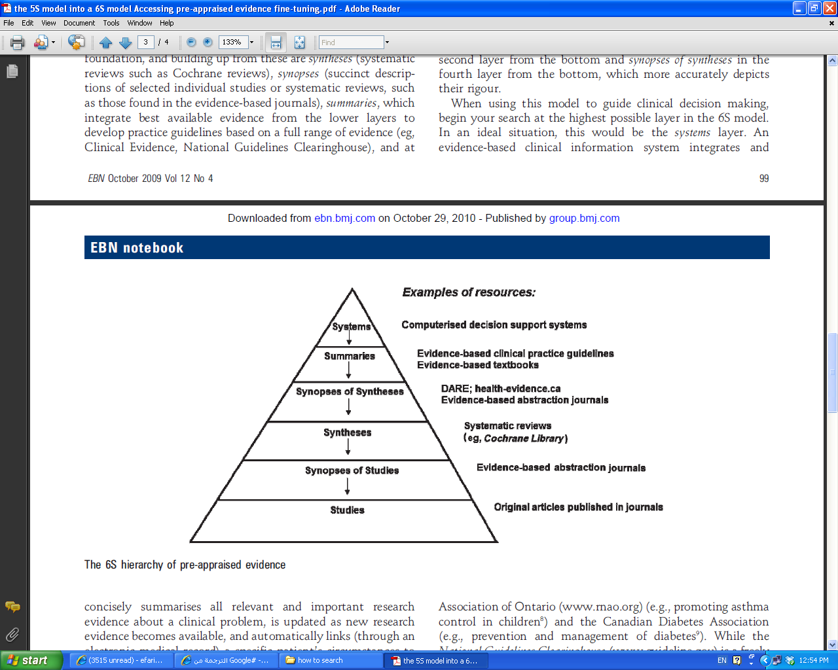

Slide 2
Systems
Summaries
Synopsis of Syntheses
Syntheses
Synopsis of Studies
Studies

Slide 3
Systems
Decision support systems (CDSSs),
detailed individual patient data are entered into a computer program
matched to programs or algorithms in a computerised knowledge base
The generation of patient-specific assessments or recommendations
for clinicians.
For example, CDSSs exist to manage oral anticoagulation in nurse-led primary care clinics in the UK
To increase inpatient influenza vaccination.
Few such systems are currently available.

Slide 4
Summaries
Clinical Evidence www.clinicalevidence.com
Dynamed www.ebscohost.com/dynamed/default.php
Physicians Information and Education Resource (PIER) pier.acponline.org
UpToDate www.uptodate.com
Clinical Practice Guidelines
National Guidelines Clearinghouse www.guideline.gov

Slide 5
Synopses of Syntheses
Evidence Based Abstraction Journals e.g.
ACP Journal Club www.acpjc.org
Evidence Based Medicine ebm.bmj.com
Evidence Based mental health ebmh.bmj.com
The database of abstracts of reviews of effects (DARE) www.crd.york.ac.uk

Slide 6
Syntheses
ACPJC plus (plus.mcmaster.ca/acpjc)
EvidenceUpDates http://plus.mcmaster.ca/evidenceupdates
The Cochrane Library www.thecochranelibrary.com

Slide 7
Synopsis of Studies
Evidence-Based Abstraction Journals

Slide 8
Studies
www.pubmed.gov
Clinical queries
Special queries: for health services and qualitative research www.nlm.nih.gov/bsd/special_queries.html

Slide 9
Federated Search Engines
SUMSearch sumsearch.uthsca.edu
TRIP Turning Research Into Practice
www.tripdatabase.com

