Slide 1
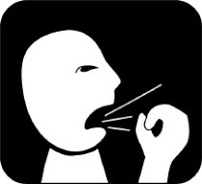
Upper respiratory tract infections
Done by :
Meshal al-tamimi
Mohsen al-anzi
Mohannad al-shaya
Yusuf alghamdi
Abdullah al-shahrani

Slide 2
Objectives
How can we differentiate between viral and bacterial infection
Update in Management and role of anibiotics
Sore throat
Sinusitis
Otitis media in children
How can we modify help seeking behavior of patients with flu illness ?

Slide 3
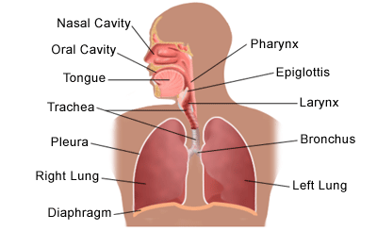
Introduction
Anatomy :

Slide 4
Upper respiratory tract
Nose, nasal cavity, and paranasal sinus
Pharynx
Nasopharynx
Oropharynx
Laryngopharynx
Larynx
Middle Ear (auditory tube) !

Slide 5
auditory tube and otitis Media
auditory tube drains mucus from the middle ear to nasopharynx
Upper airway infections or allergies → the auditory tube to become swollen, trapping bacteria and causing ear infection
Pseudoephedrine
otitis Media are more common in children >>Why ?

Slide 6
The upper respiratory tract is the most common site of infection by pathogens >>>Why ?
Children :2-5 URTI/year
Adults: 1-2 URTI /year

Slide 7
URTI & LRTI
URTI
LRTI
commonly include Dry cough, sore throat, runny nose, nasal congestion, headache, low grade fever, facial pressure and sneezing.
Productive cough, shortness of breath, Chest pain, fever, Wheezing, Hemoptysis, sore throat , sneezing .
Examination : Cyanosis, chest expansion, dullness hyperresonance, Crackles , bronchial breath sounds in periphery…

Slide 8
Common Cold
Etiology :
Rhinoviruses
coronaviruses,
respiratory syncytial virus (RSV)
others

Slide 9
Epidemiology
The common cold is the most frequent infectious disease in humans
Young children have an average of 6-8 colds per year but 10-15 % of children have at least 12 infections per year.
It is common in the winter

Slide 10
Why sometime we get 2 or more common cold per year ?

Slide 11
Clinical manifestations
Sore throat or “ scratchy” throat
Nasal obstruction and rhinorrhea .
Cough (30%)
Sometimes: fever, headache, muscle pain, fatigue, chills, loss of appetite
Incubation : about 3 days
Duration : 7-10 days in adults and more in children
Symptoms peak :2–3 days after symptom onset,

Slide 12
What is the difference between a cold and the flu?
Common Cold
The Flu
More localised
Runny nose and nasal obstruction and sneezing
Colds generally do not result in serious health problems
Colds are usually milder than the flu.
Duration : 7-10 days
More systemic
Fever, chills, headache, Fatigue and weakness, muscle pain,
May develop life-threatening complications
Duration : 1-2 weeks

Slide 13
Diagnosis:-
By excluding the differential diagnosis that are more serious

Slide 14
Conditions that can mimic the common cold:-
1- Allergic rhinitis. ( sneezing).
2- Foreign body in the nose.( Unilateral, foul-smelling secretions, bloody nasal secretions).
3- Sinusitis. (presence of fever, headache, or facial pain, persistence of rhinorrhea or cough for >14 days).
4- Pertussis.(Onset of persistent severe cough).
5- Congenital syphilis. ( Persistent rhinorrhea in the 1st 3 mo of life).

Slide 15
Prevention
Keep your hands away from your eyes and nose
Avoid being close to people who have colds
If You sneeze or cough, cover your nose or mouth

Slide 16
Treatment
There is no antiviral drug
Rest and deep sleep
symptomatic treatment : paracetamol
Zinc supplements : an somewhat reduce the severity and duration of common cold symptoms when taken by otherwise healthy adults within 24 hours of onset of symptoms.
Vitamin C : Vitamin C does not prevent the common cold, however, it may reduce the duration of symptoms during treatment .

Slide 17
Increasing fluid intake, or "drinking plenty of fluids" during a cold is not supported by medical evidence, according to a literature review published in the British Medical Journal

Slide 18
Complications of the common cold
Otitis media
Sinusitis.
Exacerbation of asthma
pneumonia

Slide 19
Prescribing of antibiotics for self-limiting respiratory tract infections in adults and children in primary care

Slide 20
NICE clinical guideline
No antibiotic strategy
Delayed antibiotic strategy
Immediate antibiotic prescribing strategy

Slide 21
Mosby's Color Atlas and Text of Infectious Diseases by Christopher P. Conlon and David R. Snydman. pp. 53-67
National Institute for Health and Clinical Excellence - Respiratory tract infections – antibiotic prescribing 2008
zink and health: the common colds Office of Dietary Supplements, National Institute of health. Retrieved 2010-05-01. ^ Singh M, Das RR. (2011). Singh, Meenu. ed. "Zinc for the common cold". Cochrane Database of Systematic Reviews (2): CD001364.
BMJ. 2004;328:499-500

Slide 22
SORE THROAT
MOHANAD AL-SHAYA

Slide 24
Sore Throat
What causes a sore throat?
Sore throats can be caused by many things. Viruses and bacteria can cause a sore throat, and so can smoking, breathing dirty air, drinking alcohol, allergies,
Sore throat also may be caused by other conditions, such as gastroesophageal reflux, postnasal drip secondary to rhinitis, persistent cough, thyroiditis and a foreign body .
Sore throat is one of the most common reasons for visits to family physicians.
While most patients with sore throat have an infectious cause (pharyngitis), fewer than 20 percent have a clear indication for antibiotic therapy (i.e., group A beta-hemolytic streptococcal infection).

Slide 25
Useful, well-validated clinical decision rules are available to help family physicians care for patients who present with pharyngitis.
rapid streptococcal antigen tests, throat culture can be reserved for patients whose symptoms do not improve over time or who do not respond to antibiotics.

Slide 26
Pharyngitis
Pharyngitis is one of the most common conditions encountered by the family physician.
Viral :
Viral pharyngitis, the most common cause of sore throat, has a wide differential.
Furthermore, different viruses are more prevalent during certain seasons. Coryza, conjunctivitis, malaise or fatigue, hoarseness, and low-grade fever suggest the presence of viral pharyngitis.
Children with viral pharyngitis also can present with atypical symptoms, such as mouth-breathing, vomiting, abdominal pain, and diarrhea.

Slide 27
Bacterial :
Patients with bacterial pharyngitis generally do not have rhinorrhea, cough, or conjunctivitis. The incidence of bacterial pharyngitis is increased in temperate climates during winter and early spring. There is often a history of streptococcal throat infection (strep throat) within the past year.
GABHS is the most common bacterial cause of pharyngitis.
GABHS pharyngitis accounts for 15 to 30 percent of cases in children and 5 to 15 percent of cases in adults.

Slide 28
Identifying the cause of pharyngitis, especially group A beta-hemolytic streptococcus (GABHS), is important to prevent potential life-threatening complications.
GABHS Infection:
Symptoms of strep throat may include pharyngeal erythema and swelling, tonsillar exudate, edematous uvula, palatine petechiae, and anterior cervical lymphadenopathy .
GABHS pharyngitis is self-limited and resolves within a few days, even without treatmentm but Effective antibiotic therapy shortens the infectious period to 24 hours, reduces the duration of symptoms by about one day, and prevents most complications.

Slide 29
Complications of GABHS Infection:
Rheumatic fever :
This illness should be suspected in any patient with joint swelling and pain, subcutaneous nodules, erythema marginatum or heart murmur, and a confirmed streptococcal infection during the preceding month.
Patients will have an elevated antistreptolysin-O titer and erthrocyte sedimentation rate.
Scarlet fever is associated with GABHS pharyngitis and usually presents as a punctate, erythematous, blanchable, sandpaper-like exanthem.

Slide 30
Complications of GABHS Pharyngitis
Suppurative | Nonsuppurative
Bacteremia | Poststreptococcal glomerulonephritis Rheumatic fever
Cervical lymphadenitis
Endocarditis
Mastoiditis
Meningitis
Otitis media
Peritonsillar/retropharyngeal abscess
Pneumonia

Slide 31
Other Bacterial Causes of Pharyngitis
Gonococcal pharyngitis occurs in sexually active patients and presents with fever, severe sore throat, dysuria, and a characteristic greenish exudate.
Chlamydia pneumoniae and Mycoplasma pneumoniae as causes of acute pharyngitis, particularly in the absence of lower respiratory tract disease, but still remains somewhat uncertain .
Diphtheria is an acute upper respiratory tract illness that is characterized by sore throat, low-grade fever, and an adherent grayish membrane with surrounding inflammation of the tonsils, pharynx, or nasal passages.

Slide 32
Other Causes of Sore Throat
Tonsillitis:
Tonsillitis is when your tonsils get swollen. This can cause a sore throat. Strep throat and tonsillitis can feel the same. Tonsillitis is usually caused by bacteria, but sometimes a virus may be the cause.
mononucleosis:
Mononucleosis is an infection caused by a virus. Mono can cause a sore throat that lasts for up to four weeks. It also can cause fever and chills, headache, feeling tired, and swollen glands in your neck, armpits, and groin.

Slide 33
Diagnosis
GENERAL APPROACH:
When a patient presents with sore throat, the family physician must consider a wide range of illnesses. Infectious causes range from generally benign viruses to GABHS. Inflammatory presentations may be the result of allergy, reflux disease or, rarely, neoplasm.
GABHS :
Important historical elements include the onset, duration, progression, and severity of the associated symptoms (e.g., fever, cough, respiratory difficulty, swollen lymph nodes); exposure to infections; and presence of comorbid conditions (e.g., diabetes). The pharynx should be examined for erythema, hypertrophy, foreign body, exudates, masses, petechiae, and adenopathy. It also is important to assess the patient for fever, rash, cervical adenopathy, and coryza.

Slide 34
Selected Laboratory Tests for Identifying the Cause of Pharyngitis
Name of test | Type of test | Sensitivity and specificity
Throat culture | Specimen obtained by throat swab of posterior tonsillopharyngeal area and inoculated onto 5 percent sheep-blood agar plate to which a bacitracin disk is applied; results in 24 to 48 hours | Sensitivity: 97 percent; specificity: 99 percent; results dependent on the technique, medium, and incubation
Rapid antigen detection test or rapid streptococcal antigen test | Detects presence of group A streptococcal carbohydrate on a throat swab (change in color indicates a positive result); results available within minutes; in-office test | Specificity: > 95 percent; sensitivity: 80 to 97 percent, depending on the test
Monospot test | Rapid slide agglutination test for mononucleosis | Overall sensitivity: 86 percent; overall specificity: 99 percent
 |  | First week sensitivity: 69 percent; specificity: 88 percent
 |  | Second week: sensitivity: 81 percent; specificity: 88 percent

Slide 35
A systematic review of the clinical diagnosis of pharyngitis identified large, blinded, prospective studies using throat cultures as a reference standard.
The presence of tonsillar or pharyngeal exudate and a history of exposure to streptococcus in the previous two weeks were the most useful clinical features in predicting current GABHS infection.
The absence of tender anterior cervical adenopathy, tonsillar enlargement, and tonsillar or pharyngeal exudate was most useful in ruling out GABHS.
However, no single element in the history or physical examination is sensitive or specific enough to exclude or diagnose strep throat.

Slide 36
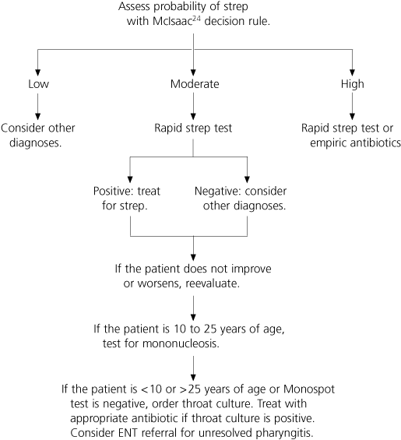
Suggested Approach to the Evaluation of Patients with Sore Throat

Slide 37
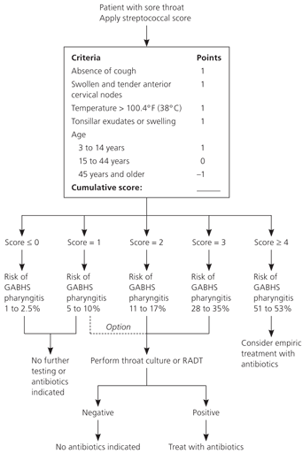
Clinical Decision Rule for Management of Sore Throat

Slide 38
ANTIBIOTIC SELECTION
Effectiveness, spectrum of activity, safety, dosing schedule, cost, and compliance issues all require consideration. Penicillin, penicillin congeners (ampicillin or amoxicillin), clindamycin (Cleocin), and certain cephalosporins and macrolides are effective against GABHS.
penicillin is recommended.
Oral amoxicillin suspension is often substituted for penicillin because it tastes better.

Slide 39
Treatment for patients with penicillin allergy (recommended by current guidelines)
Erythromycin ethylsuccinate | Macrolide | Oral | Children: 30 to 50 mg per kg per day in two to four divided doses | 10 days | $4
 |  |  | Adults: 50 mg per kg per day in three to four divided doses
Erythromycin estolate | Macrolide | Oral | Children: 20 to 40 mg per kg per day in two to four divided doses | 10 days | $4
 |  |  | Adults: not recommended‡
Cefadroxil (Duricef; brand no longer available in the United States) | Cephalosporin (first generation) | Oral | Children: 30 mg per kg per day in two divided doses | 10 days | $45
 |  |  | Adults: 1 g one to two times per day
Cephalexin (Keflex) | Cephalosporin (first generation) | Oral | Children: 25 to 50 mg per kg per day in two to four divided doses | 10 days | $4
 |  |  | Adults: 500 mg two times per day

Slide 40
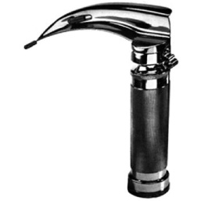
Laryngoscopy is recommended when sore throat is chronic and recurrent, cultures and heterophil antibody tests are negative, and the diagnosis remains uncertain. Additional evaluation is required to investigate for the presence of a foreign body, neoplastic lesions, and other unusual causes of sore throat.

Slide 41
Sinusitis
Mohsen nazal

Slide 42
What is sinusitis ?
Sinusitis refers to inflammation of the sinuses that occurs with a viral, bacterial, or fungal infection.

Slide 43
Causes
The sinuses are air-filled spaces in the skull (behind the forehead, nasal bones, cheeks, and eyes) that are lined with mucus membranes. Healthy sinuses contain no bacteria or other germs. Usually, mucus is able to drain out and air is able to circulate.
When the sinus openings become blocked or too much mucus builds up, bacteria and other germs can grow more easily.
Sinusitis can occur from one of these conditions:
Small hairs (cilia) in the sinuses, which help move mucus out, do not work properly due to some medical conditions.
Colds and allergies may cause too much mucus to be made or block the opening of the sinuses.
A deviated nasal septum, nasal bone spur, or nasal polyps may block the opening of the sinuses.

Slide 44
Sinusitis can be:
Acute -- symptoms last up to 4 weeks
Sub-acute -- symptoms last 4 - 12 weeks
Chronic -- symptoms last 3 months or longer
Acute sinusitis is usually caused by a bacterial infection in the sinuses that results from an upper respiratory tract infection. Chronic sinusitis refers to long-term swelling and inflammation of the sinuses that may be caused by bacteria or a fungus.

Slide 45
SIGN/ SYMPTOM | SINUSITIS | ALLERGY | COLD
Facial Pressure /Pain | Yes | Sometimes | Sometimes
Duration of Illness | Over 10-14 days | Varies | Under 10 days
Nasal Discharge | Whitish or colored | Clear, thin, watery | Thick, whitish or thin
Fever | Sometimes | No | Sometimes
Headache | Often | Sometimes | Sometimes
Pain in Upper Teeth | Sometimes | No | No
Bad Breath | Sometimes | No | No
Coughing | Sometimes | Sometimes | Yes
Nasal Congestion | Yes | Sometimes | Yes
Sneezing | No | Sometimes | Yes

Slide 46
Risk factors for sinusitis:
Allergic rhinitis or hay fever
Cystic fibrosis
Day care
Diseases that prevent the cilia from working properly, such as Kartagener syndrome and immotile cilia syndrome.
Changes in altitude (flying or scuba diving)
Large adenoids
Smoking
Tooth infections (rare)
Weakened immune system from HIV or chemotherapy

Slide 47
Symptoms
The classic symptoms of acute sinusitis in adults usually follow a cold that does not improve, or one that worsens after 5 - 7 days of symptoms. Symptoms include:
Bad breath or loss of smell
Cough, often worse at night
Fatigue and generally not feeling well
Fever
Headache -- pressure-like pain, pain behind the eyes, toothache, or facial tenderness
Nasal congestion and discharge
Sore throat and postnasal drip

Slide 48
Examination of sinusitis
Looking in the nose for signs of polyps
Shining a light against the sinus (transillumination) for signs of inflammation
Tapping over a sinus area to find infection
Regular x-rays of the sinuses are not very accurate for diagnosing sinusitis.
Viewing the sinuses through a fiberoptic scope (called nasal endoscopy or rhinoscopy) may help diagnose sinusitis.
A CT scan of the sinuses may also be used to help diagnose. if thought to involve a tumor or fungal infection, an MRI of the sinuses may be necessary.

Slide 49
In case of chronic or recurrent sinusitis, other tests may include:
Allergy testing
Blood tests for HIV or other tests for poor immune function
Ciliary function tests
Nasal cytology
Sweat chloride tests for cystic fibrosis

Slide 50
treatment of sinusitis
Antibiotics are usually not needed for acute sinusitis. Most of these infections go away on their own. Even when antibiotics do help, they may only slightly reduce the time. Antibiotics may be prescribed sooner for:
Children with nasal discharge, possibly with a cough, that is not getting better after 2 - 3 weeks
Fever higher than 102.2° Fahrenheit (39° Celsius)
Headache or pain in the face
Severe swelling around the eyes

Slide 51
Chronic sinusitis should be treated for 3 - 4 weeks. Some people with chronic bsinusitis may need special medicines to treat fungal infections. Surgery to clean and drain the sinuses may also be necessary, especially in patients whose symptoms fail to go away after 3 months, despite medical treatment, or in patients who have more than two or three episodes of acute sinusitis each year.

Slide 52
Possible Complications
Although very rare, complications may include:
Abscess
Bone infection (osteomyelitis)
Meningitis
Skin infection around the eye (orbital cellulitis)

Slide 53
References
Cincinnati Children's Hospital Medical Center. Evidence-based care guideline for management of acute bacterial sinusitis in children 1 to 18 years of age. Cincinnati (OH): Cincinnati Children's Hospital Medical Center; 2006.
Slavin RG, et al. The diagnosis and management of sinusitis: a practice parameter update. J Allergy Clin Immunol. 2005;116:S13-S47.
Rosenfeld RM, Singer M, Jones S. Systematic review of antimicrobial therapy in patients with acute rhinosinusitis. Otolaryngol Head Neck Surg. 2007;137:S32-S45.
Rosenfeld RM, Andes D, Bhattacharyya N, Cheung D, Eisenberg S, Ganiats TG, et al. Clinical practice guideline: adult sinusitis. Otolaryngol Head Neck Surg. 2007;137:S1-S31.

Slide 54
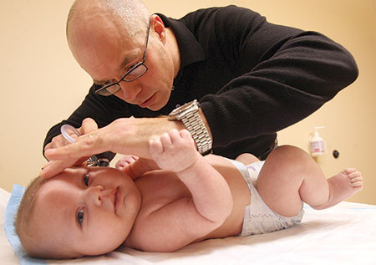
OTITIS MEDIA
YUSUF AL-GHAMDI

Slide 55
What’s otitis media ?
Acute otitis media (AOM) is defined by the presence of fluid in the middle ear accompanied by acute signs of illness and signs or symptoms of middle ear inflammation. Bulging of the tympanic membrane (TM) is considered the most important sign that distinguishes AOM from otitis media with effusion and a normal TM.

Slide 56
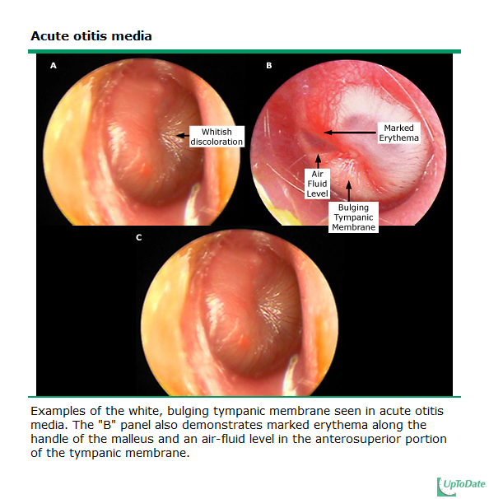

Slide 57
EPIDEMIOLOGY
Acute otitis media (AOM) is the most frequent diagnosis in sick children visiting clinicians’ offices and the most common reason for administration of antibiotics. AOM occurs at all ages but is most prevalent in infancy.
Between 60 and 80 percent of children have at least one episode of AOM by one year of age, and 80 to 90 percent by two to three years. AOM is slightly more common in boys than girls.

Slide 58
Risk factors of AOM
Age : The age-specific attack rate for AOM peaks between 6 and 18 months of age. After that, the incidence declines with age.
Family history: Pooled analysis of three studies (1240 children) found that the risk of AOM was increased if any other member of the family had history of AOM
Day care : The spread of bacterial and viral pathogens is common in day care centers. Multiple observational studies indicate that children attending day care centers, especially with four or more other children, have a higher incidence of AOM than children who receive care at home.

Slide 59
Risk factors of AOM
Lack of breastfeeding : Lack of or limited breastfeeding is associated with an increased risk of AOM, the risk of AOM was decreased among children who were breastfed for at least three months.
Tobacco smoke and air pollution : Exposure to tobacco smoke and ambient air pollution increases the risk of AOM. The mechanism for this association is not entirely clear but may be related to increased nasopharyngeal and oropharyngeal carriage of streptococcus pneumoniae
Developing areas : Lack of access to medical care and local environmental factors lead to severe suppurative episodes of otitis media in children living in developing areas.
Social and economic conditions : poverty and household crowding increase the risk)
Season (increased incidence during the fall and winter months)
Altered host defenses and underlying disease (eg, cleft palate, Down syndrome, allergic rhinitis.

Slide 60
Microbiology
Bacteria :Three species of bacteria account for most of the bacterial isolates from middle ear fluid: Streptococcus pneumoniae, nontypeable Haemophilus influenzae, and Moraxella catarrhalis . This continues to be true even after the introduction of the conjugate pneumococcal vaccines to the routine childhood immunization schedule. In clinical trials, the 7-valent pneumococcal conjugate vaccine (PCV7) reduced the incidence of pneumococcal AOM by 34 percent, although the overall incidence of AOM declined by only 6 to 7 percent
S. pneumoniae — S. pneumoniae accounts for approximately 50 percent of bacterial isolates from the middle ear fluid of young children with severe, persistent, or refractory AOM . The proportion of pneumococcal isolates resistant to penicillin varies worldwide, but resistance is more likely to be found in children with recurrent and/or persistent AOM .

Slide 61
H. influenzae : H. influenzae accounts for approximately 45 percent of bacterial isolates from the middle ear fluid of young children with severe, persistent, or refractory AOM . H. influenzae AOM is more often bilateral than unilateral. Most H. influenzae isolates from the middle ear are nontypeable. Approximately one-third to one-half of strains of H. influenzae recovered from middle ear fluids produce beta-lactamase .
M. catarrhalis : M. catarrhalis accounts for approximately 10 percent of bacterial middle ear isolates in children with AOM in the United States, a percentage that has been little affected by universal immunization of infants with pneumococcal conjugate vaccine . More than 90 percent of strains produce beta-lactamase.

Slide 62
Group A streptococcus : Group A streptococcus occasionally causes AOM (2 to 10 percent of isolates) . Group A streptococcal AOM tends to occur in older children and to be more frequently associated with local complications (eg, tympanic membrane perforation, mastoiditis) and less frequently associated with fever and systemic or respiratory symptoms than AOM caused by other organisms.
Staphylococcus aureus : Staphylococcus aureus is an uncommon cause of AOM, but its prevalence appears to have increased after licensure of the 7-valent pneumococcal conjugate vaccine. It is found often as a cause of acute otorrhea in children with tympanostomy tubes in place.
Other bacteria: Anaerobic bacteria infrequently cause AOM. Enteric gram-negative bacilli such as Escherichia coli may cause AOM in the first months of life . Pseudomonas aeruginosa has a special role in chronic suppurative otitis media.

Slide 63
Viruses : Microbiologic and epidemiologic data suggest that viral infection is frequently associated with AOM. With advances in microbiologic techniques, including reverse transcriptase PCR, viruses are increasingly detected in the middle ear fluid of children with AOM. The most frequently isolated viruses are respiratory syncytial virus, picornaviruses (eg, rhinovirus, enterovirus), coronaviruses, influenza viruses, adenoviruses, and human metapneumovirus.
Other pathogens : Mycoplasma pneumoniae rarely has been isolated from middle ear fluids of children with AOM. Chlamydia trachomatis has been associated with otitis media in infants younger than six months of age. C. pneumoniae has been isolated from some patients with acute and chronic otitis media .

Slide 64
Symptoms and signs
Children with AOM, particularly infants, may present with nonspecific symptoms and signs, including fever, irritability, headache, apathy, anorexia, vomiting, and diarrhea. Fever occurs in one- to two-thirds of children with AOM, though temperature >40°C (104°F) is unusual unless accompanied by bacteremia or other focus of infection. The lack of specificity of symptoms of AOM in young children, particularly in infants, makes the diagnosis challenging.
Ear pain (otalgia) is the most common complaint in children with AOM and the best predictor of AOM. However, ear pain and other ear-related symptoms (eg, ear rubbing) are not always present

Slide 65
DIAGNOSIS
The diagnosis of AOM requires all of the following:
Evidence of an acute history (eg, fever, irritability)
Signs and symptoms of middle ear inflammation (eg, distinct erythema of the tympanic membrane or otalgia, fever)
Middle ear effusion (eg, tympanic membrane bulging, decreased or absent tympanic membrane mobility, presence of an air-fluid level, or otorrhea)

Slide 66
Intratemporal complications
Intratemporal (extracranial) complications of AOM include:
Hearing loss (secondary to middle ear fluid, ossicular fixation or disruption, or involvement of the eighth cranial nerve)
Balance and motor problems
Tympanic membrane perforation, tympanosclerosis (asymptomatic whitish plaques)
Middle ear atelectasis (retraction or collapse of the tympanic membrane due to chronic or recurrent decreased pressure in the middle ear)
Cholesteatoma : is an abnormal growth of squamous epithelium in the middle ear .
Mastoiditis — Because the mastoid air cells are connected to the distal end of the middle ear through a small canal or antrum, most episodes of AOM are associated with some inflammation of the mastoid

Slide 67
Intracranial complication
Meningitis
Epidural abscess.
Brain abscess.
Lateral sinus thrombosis
Cavernous sinus thrombosis
Subdural empyema (collection of purulent material between the dura and the arachnoid membrane)
Carotid artery thrombosis.

Slide 68
Management of AOM
The systemic and local signs and symptoms of AOM usually resolve in 24 to 72 hours with appropriate antimicrobial therapy, and somewhat more slowly in children who are not treated initially with antibiotic therapy. Regardless, persistence of middle ear effusion (MEE) after the resolution of acute symptoms is common.

Slide 69
SYMPTOMATIC THERAPY
Pain remedies :
1. topical agent, Auralgan (combination of antipyrine, benzocaine, and glycerin)
2.topical aqueous lidocaine (lignocaine) ear drops .

Slide 70
Based upon the available data, the AAP/AAFP 2004 guideline suggests that observation without use of antibacterial therapy is an option for selected children with uncomplicated AOM based upon diagnostic certainty, age, illness severity, and assurance of follow-up.
The decision to treat children younger than two years who have a certain diagnosis of AOM that is made according to stringent criteria is supported by randomized trials. For children older than two years of age, clinicians can share with parents or caregivers that antibacterial therapy prescribed at the first visit may shorten symptoms but that the antibiotic may cause side effects in some patients.

Slide 71
Antibacterial therapy should be administered to any child younger than the age of six months, regardless of the degree of diagnostic certainty.
For children ages six months to two years, antibacterial therapy is recommended when the diagnosis of AOM is certain or if the diagnosis is uncertain, but illness is severe (moderate to severe otalgia or fever ≥39ºC in the previous 24 hours). Observation is an option only for children in whom the diagnosis is not certain and illness is not severe.
For children older than two years, antibacterial therapy is recommended if the diagnosis is certain and illness is severe. Observation is an option when the diagnosis is certain but illness is not severe, and in patients with an uncertain diagnosis.

Slide 72
First line therapy
The AAP/AAFP guideline recommends a dose of amoxicillin of 80 to 90 mg/kg per day. For heavier children, we suggest a maximum dose of 3 g/day, although diarrhea is a potential adverse effect at higher doses. Only S. pneumoniae that are highly resistant to penicillin will not respond to this regimen. As a result, more than 80 percent of children with pneumococcal AOM would respond to high-dose amoxicillin treatment. Review of data from a large group practice indicates that the proportion of AOM treated with high-dose amoxicillin increased from 1.7 to 41.9 percent between 1996 and 2004.

Slide 73
Amoxicillin should not be used as first-line therapy in children who are at high risk for AOM caused by an amoxicillin-resistant otopathogen. These include :
Children who were treated with antibiotics in the previous 30 days, particularly beta-lactam antibiotics.
Children with concurrent purulent conjunctivitis (otitis-conjunctivitis syndrome usually is caused by nontypeable H. influenzae, which is frequently resistant to beta-lactam antibiotics)
Children receiving amoxicillin for chemoprophylaxis of recurrent AOM (or urinary tract infection).
Children in the above categories should start therapy with an agent with activity against beta-lactamase-producing nontypeable H. influenzae, as well as S. pneumoniae, such as amoxicillin-clavulanate

Slide 74
Modification of Help Seeking Behavior of Patient with flu illness
Abdullah al-shahrani

Slide 75
Modification of Help Seeking Behavior of Patient with flu illness
Health Education.
80% of sore throat is virus origin.
Virus(no need antibiotics) .
The symptomes may take 1-2 weeks.
Self limited disease.
Rest and deep sleeping.

Slide 76
when to call family physician?
If the severity of symptomes increased you should call family physician .
Long duration of symptomes than usual.

Slide 77
22 years old man come to the clinic complaining of sore throat, mild fever, runny nose, and cough for the last 2 days . At the end of the consultation, he request antibiotic prescription. His BMI : 31
HOW YOU WILL PROCEED DURING THIS CONSULTATION?

Slide 78
Modify help seeking behavior + opportunistic health promotion

