Slide 1
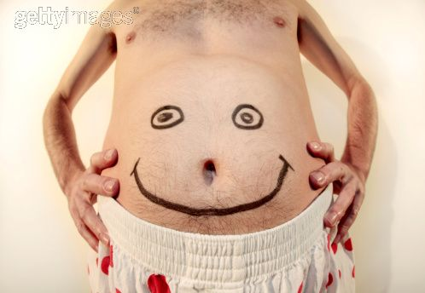
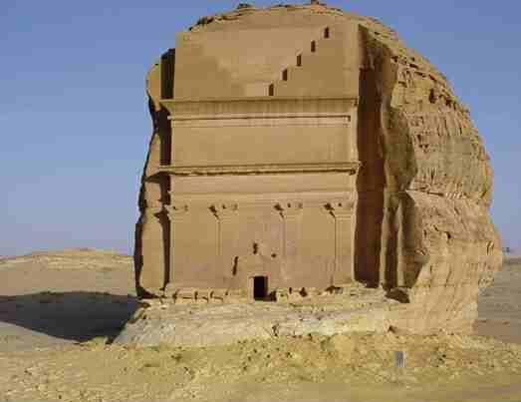

Slide 2
إشراف الدكتور : يوسف التركي
Approach To Obese Patient
محمد الشمراني
عامر الملوقي
منتصر المنصوري
عبدالباقي السبعي
وليد العنزي
عبدالعزيز السعران

Slide 3
Faisal is 42 year old male patient came to the clinic for follow up for HTN, DM and dyslipidemia, and his BMI = 40 :
Is this patient obese?
What is the benefits of reducing this patients weight?
What are the things you should advice him?

Slide 4
Definition of obesity
A disorder of body weight regulatory system characterized by accumulation of excess body fat.

Slide 5
Diagnosis
Obesity is usually diagnosed on the basis of calculation of
Body mass index
Measurement of waist-hip ratio

Slide 6
How to classify obesity?
through BMI

Slide 7
BMI calculation
BMI Calculation (kg/m2):
Weight ( Kg)
------------------------------
Height squared (meters)

Slide 8
Classification of obesity
Obesity is graded according to BMI as:
Healthy weight 18.5-24.9
Overweight 25-29.9
Obesity I 30-34.9
Obesity II 35-39.9
morbid obesity 40 or more

Slide 9
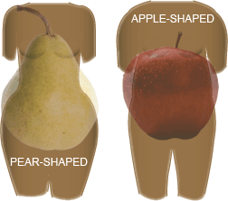
Anatomical difference in fat deposition
The anatomical difference of fat deposition has a great influence on associated health risk.
We use waist to hip ratio to calculate it.

Slide 10
Types
Android (or abdominal or central, mostly males)
Collection of fat mostly in the abdomen (above the waist)
Hip to waist ratio of more than 0.8 in female and more than 1 in male.
apple-shaped
Associated with insulin resistance , diabetes, dyslipidemia and coronary heart disease. due to access to liver circulation.

Slide 11
Gynoid (below the waist, females)
Collection of fat on hips and buttocks
Waist to hip ratio less than 0.8 in female and less than 1 for men
pear-shaped

Slide 12
Always remember
In some medical condition obesity is an associated feature e.g. hypothyroidism, Cushing syndrome and drug induce(corticosteroids).

Slide 14
Prevalence of obesity

Slide 15
Prevalence of obesity in Saudi Arabia
In study done 1996 by Dr. Alrobeaan et al.
Found that overweight (BMI 25-30) percentage :
Male : 29% Female : 27%
And obesity (> 30) percentage :
Male : 16% Female : 24%

Slide 16
In another study done in 2005 by Dr.Alnozha et al.
Found that overweight and obesity in kingdom is 35.5%

Slide 17
In USA 35% in female and 31% in male.
In Europe 22% in female and 15% in male.
And world wide approximately 7% are obese and two to three times are overweight .
from medscape.com

Slide 19
Causes of obesity

Slide 20
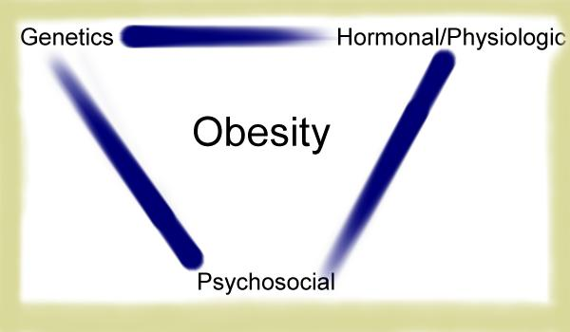

Slide 21
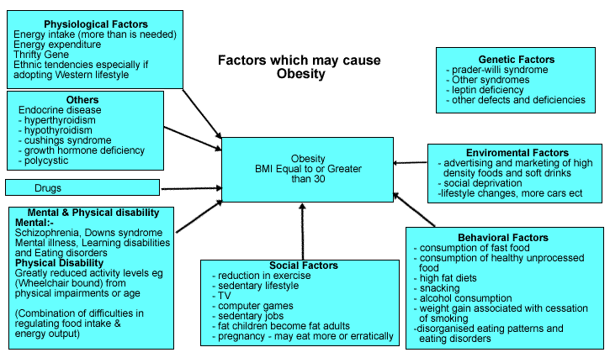

Slide 22
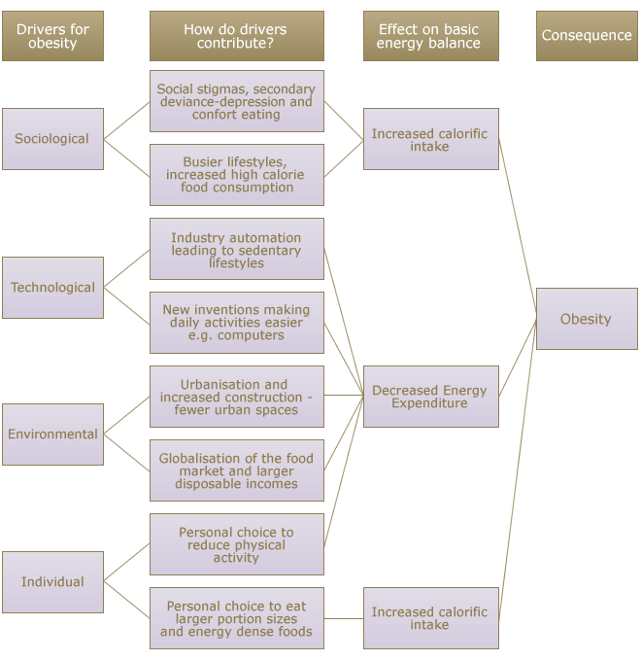

Slide 24
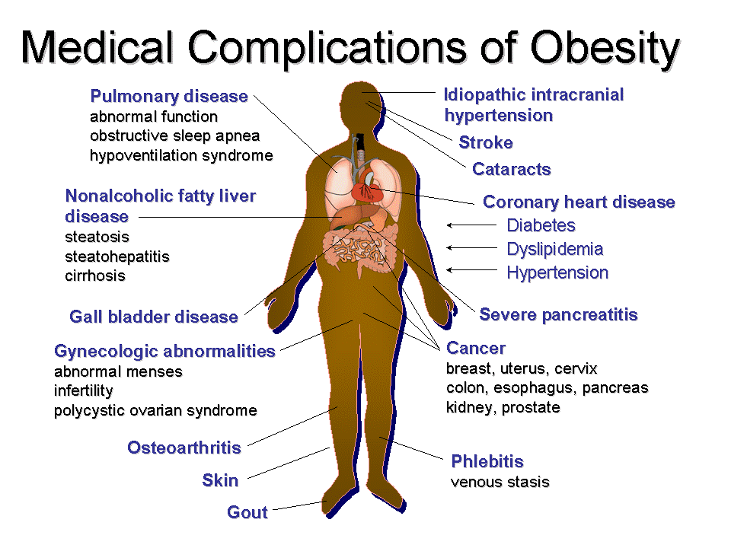

Slide 25
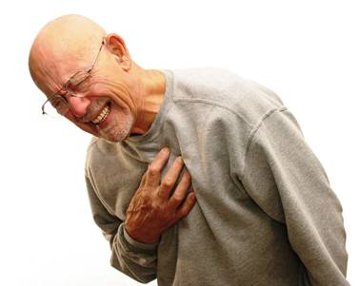
Complication of obesity
High cholesterol and triglycerides
Type 2 diabetes
High blood pressure
Metabolic syndrome — a combination of high blood sugar, high blood pressure, high triglycerides , high cholesterol and glucose intolerance
Heart disease

Slide 26
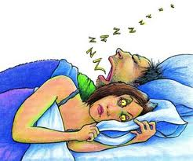
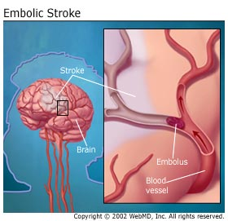
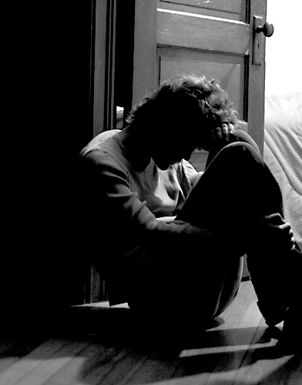
Complication of obesity
Stroke
Sleep apnea
Depression
Gallbladder disease
Nonalcoholic fatty liver disease
Osteoarthritis

Slide 27
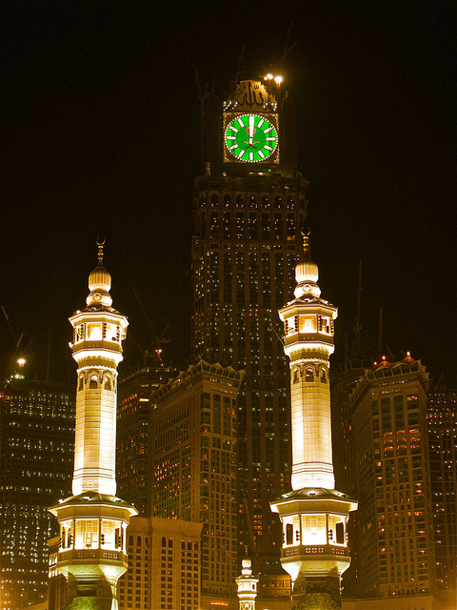

Slide 28
Health education of obese people

Slide 29
Why the health education is important?
1- Obesity is associated with increased risk of death
2- Obesity is a risk factor for many chronic diseases:
type 2 DM
hyperchlosterolemia
high plasma level of triacylglycerol
hypertension
coronary heart diseases
some cancers
gallstones
arthritis
gout
So we can prevent all these problems by health education

Slide 30
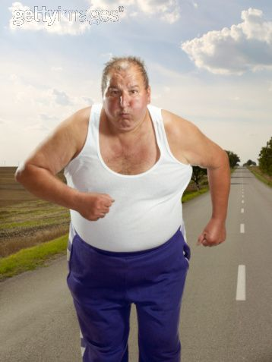
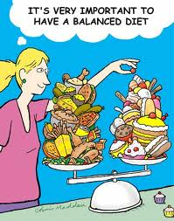
What is the main objectives for education?
1-Physical activity
2- balanced Diet
3-Enviromental
4-Behavioral

Slide 31
Physical activity
Increasing physical activity is an essential component of weight loss therapy.
The key to weight control is balancing our energy (food) intake with how much energy our body burns (physical activity). To lose weight, you must burn more calories than you eat.
The combination of exercise and diet is the best way to control your weight.

Slide 32
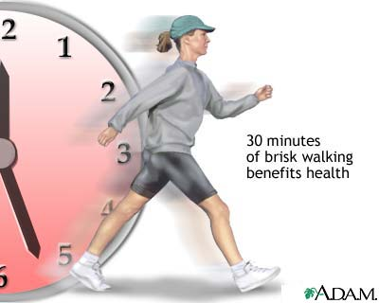
Start by increase the daily activity: e.g. take the stairs and parking far from a destination, should be encouraged.
A daily walk, for example, is something most people can manage. Initially, they can start by walking for 10 minutes, three times a week and gradually build up to 30-45 minutes on most days of the week .

Slide 33
AEROBIC EXERCISE
Aerobic exercise is exercise in which you are continuously moving a large muscle group such as in your arms legs and hips for a period of time. Your heart rate gets faster and your breathing becomes deeper and faster.

Slide 35
Diet
WHO recommendation :
. -achieve energy balance and a healthy weight
-limit energy intake from total fats and shift fat consumption away from saturated fats to unsaturated fats and towards the elimination of trans-fatty acids

Slide 36
-increase consumption of fruits and vegetables, and legumes, whole grains and nuts limit the intake of free sugars
-limit salt (sodium) consumption from all sources and ensure that salt is iodized

Slide 37
Environmental factors:
ready availability of palatable energy-dense foods .
sedentary life-style : TV watching for a long time .
wide dependency on cars .
computer using .
energy-sparing devices at home & at work .
decrease physical activity .

Slide 38
Eating behavioural factors:
snacking
portion size
individual`s unique food preferences
number of people with whom one eats
START NOW
Use small plate
Set a realistic objectives

Slide 39
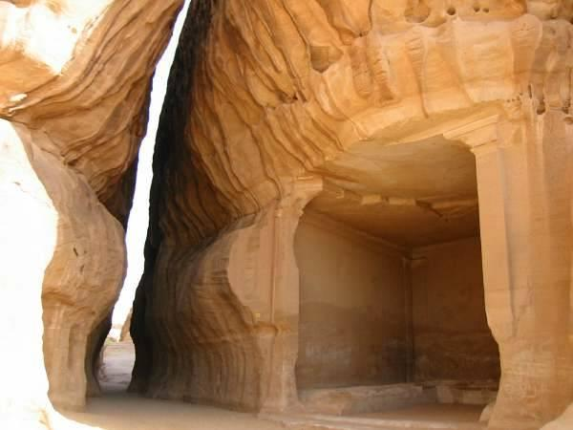

Slide 40
Management of Obesity

Slide 41
GOALS of weight management in obese patients:
To induce negative energy balance to reduce body weight .
decrease caloric intake and/or increase energy expenditure .
To maintain a lower body weight over a longer term .

Slide 42
Physical activity
increases cardiopulmonary fitness & reduces risk of cardiovascular diseases. (independent on weight loss)
Combination of caloric restriction & exercise with behavioural treatment may be expected to reduce 5 – 10 % of weight over a period of 4-6 months.
Essential for maintaining weight reduction .

Slide 43
Diet
1 pound of adipose tissue (~ 0.5 kg) corresponds to about 3500 Kcal.
Ineffective for a long term for many obese individuals.
More than 90% regain the lost weight after suspension of dieting.
Weight losses of 10% of body weight over a 6-month period often lead to :
reduces blood pressure
reduces lipid levels
enhance control of type 2 DM

Slide 44
1- Pharmacological treatment
For BMI 30 or more:
1- sibutramine:
appetite suppressant
inhibits serotonin & norepinephrine reuptake
2- orlistat:
lipase inhibitor that inhibits gastric & pancreatic lipase.

Slide 45
1- Surgical treatment
To reduce food consumption
For severely obese patients

Slide 46
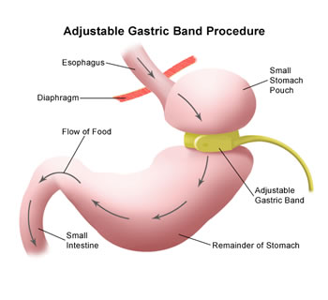
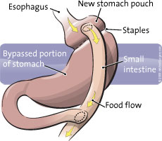
Types of surgical treatment
1-Roux-en Y gastric bypass (RYGB)
2-Adjustable gastric banding (Lap-Band®)
(1)
(2)

Slide 47
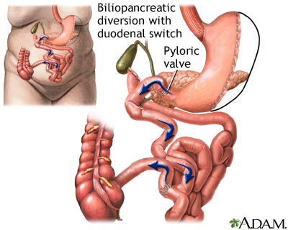
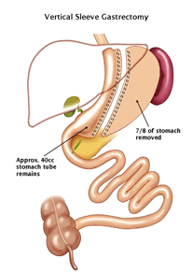
3-Biliopancreatic diversion with duodenal switch (DS)
4-Vertical Sleeve Gastrectomy (VSG)
(3)
(4)

Slide 49
