Slide 1
Back Pain

Slide 2
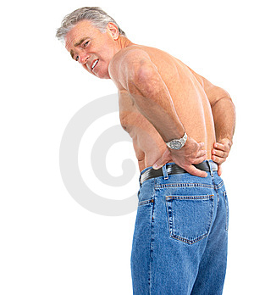

Slide 3
The back pain
If you've ever groaned, "Oh, my aching back!", you are not alone. Back pain is one of the most common medical problems, affecting 8 out of 10 people at some point during their lives

Slide 4
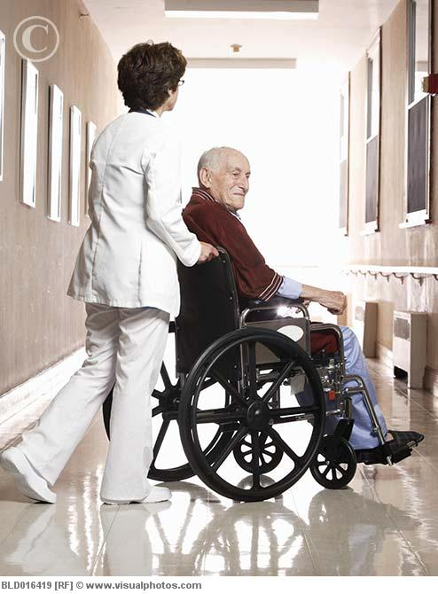
If not taken seriously ,back pain can last for a long of time,and can become disabling

Slide 5
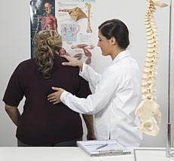
5% of cases in general practice
Backache is second only to the common cold as a cause of lost days at work
A practitioner will typically see at least one PT with Bp/day

Slide 6
The pain can be divided into neck pain, upper back pain, lower back pain or tailbone pain.

Slide 7
Usually originates from

Slide 8
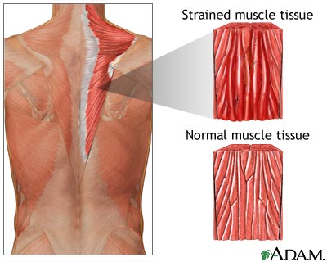

Slide 9
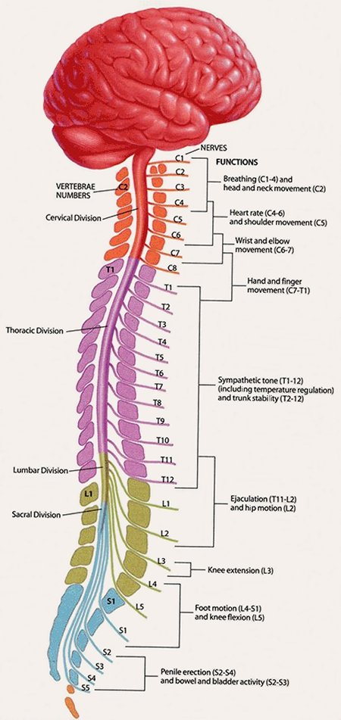

Slide 10
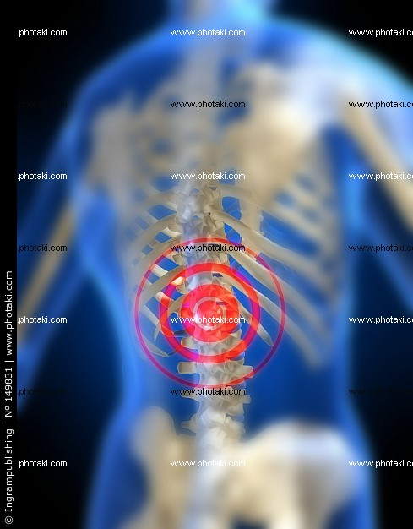

Slide 11
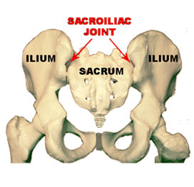

Slide 12
Back pain can range from a dull, constant ache to a sudden, sharp pain.
Acute back pain on suddenly and usually lasts from a few days tocomes a few weeks. Back pain is called chronic if it lasts for more than three months.

Slide 13
It is important to understand that back pain is a symptom of a medical condition, not a diagnosis itself.

Slide 14

Causes of Back Pain
MECHANICAL
Injuries
Acquired conditions and diseases
Infections and tumors

Slide 15
Mechanical problems
A mechanical problem is a problem with the way your spine moves or the way you feel when you move your spine in certain ways
The most common mechanical cause of back pain is a condition called intervertebral disk degeneration, which simply means that the disks located between the vertebrae of the spine are breaking down with age.(NIAMS)

Slide 16
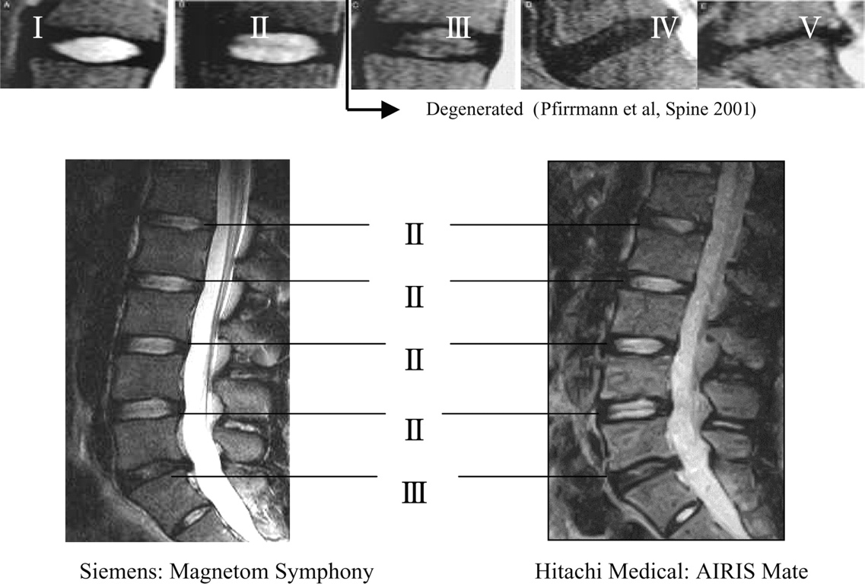

Slide 17
Other mechanical causes of back pain
Spasms
Muscle tension
Ruptured disks, which are also called herniated disks.

Slide 18
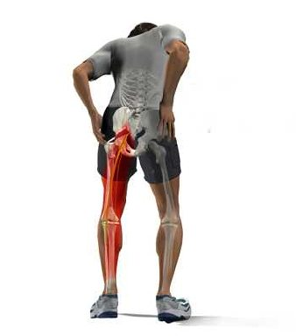

Slide 19
Sciatica
If a bulging or herniated disk presses on the main nerve that travels down your leg, it can cause sciatica sharp, shooting pain through the buttock and back of the leg.

Slide 20
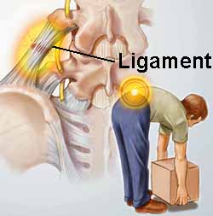
Injuries
Spine injuries such as sprains and fractures can cause either short-lived or chronic pain.
Sprains are tears in the ligaments that support the spine, and they can occur from twisting or lifting improperly.
Fractured vertebrae are often the result of osteoporosis. Less commonly, back pain may be caused by more severe injuries that result from accidents or falls.

Slide 21
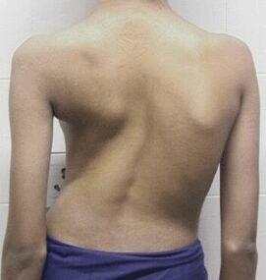

Slide 22
Acquired conditions and diseases
Many medical problems can cause or contribute to back pain. They include
scoliosis: a curvature of the spine that does not usually cause pain until middle age
spondylolisthesis (displacement)
various forms of arthritis, including osteoarthritis, rheumatoid arthritis, and ankylosing spondylitis
spinal stenosis, a narrowing of the spinal column that puts pressure on the spinal cord and nerves
* osteoporosis itself is not painful, it can lead to painful fractures of the vertebrae.

Slide 23
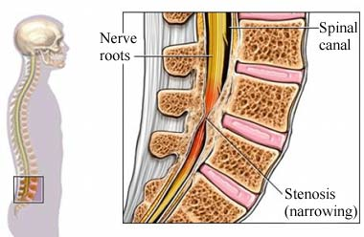

Slide 24
Other causes of back pain include pregnancy
kidney stones or infections
endometriosis( which is the buildup of uterine tissue in places outside the uterus)
fibromyalgia, a condition of widespread muscle pain and fatigue.

Slide 25
Infections and tumors
Although they are not common causes of back pain
Infections can cause pain when they involve the vertebrae, a condition called osteomyelitis, or when they involve the disks that cushion the vertebrae, which is called diskitis
Tumors also are relatively rare causes of back pain. Occasionally, tumors begin in the back, but more often they appear in the back as a result of cancer that has spread from elsewhere in the body.

Slide 26
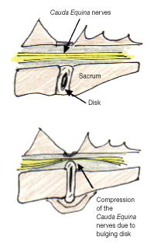
Rare but serious condition
Cauda equina syndrome.
This is a serious neurological problem affecting a bundle of nerve roots that serve your lower back and legs.
It can cause weakness in the legs, numbness in the "saddle" or groin area, and loss of bowel or bladder control.

Slide 27
Who Gets Back Pain?
Anyone can have back pain, but some things that increase your risk are:
Getting older. Back pain is more common the older you get. You may first have back pain when you are 30 to 40 years old.
Poor physical fitness. Back pain is more common in people who are not fit.

Slide 28
Being overweight. A diet high in calories and fat can make you gain weight. Too much weight can stress the back and cause pain.
Heredity. Some causes of back pain, such as ankylosing spondylitis, a form of arthritis that affects the spine, can have a genetic component

Slide 29
Your job. If you have to lift, push, or pull while twisting your spine, you may get back pain. If you work at a desk all day and do not sit up straight, you may also get back pain.
Smoking. Your body may not be able to get enough nutrients to the disks in your back if you smoke. Smoker’s cough may also cause back pain. People who smoke are slow to heal, so back pain may last longer.
Another factor is race. For example, black women are two to three times more likely than white women to have part of the lower spine slip out of place.

Slide 30
Diagnosis of back pain
History

Slide 31
Each type of back pain has it's own presentation but …
During taking history, you must cover the following:
the course of pain.
Is there evidence of a systemic disease.
Is there evidence of neurologic probloms.
Occupational history.
Red flags.
Yellow flags.

Slide 32

Red flags
Onset age either <20 or >55 years.
Bowel or bladder dysfunction.
Spinal deformity.
Wight loss.
Lymphadenopathy.
Neurological symptoms.
History of HIV, corticosteroid therapy.
Unexplained fever.
Duration more than 6 weeks.

Slide 33
Yellow Flags
If patient believe that the back pain is serious.
Fear avoidance behavior(apprehension about reactivation).
Depression.
Work related factor.
Prior episodes of back pain.
Extreme symptoms.

Slide 34
Functional impairment and
Occupational impact
Lifting , sitting.
Any other workers have similar symptoms???

Slide 35
Mechanical back pain
Deep dull pain
Moderate in nature.
Relieved by rest , and increase by activity.
Maybe because of injury and usually with previous episodes.
Diffuse and unilateral.
Intensity increase at the end of the day and after activity.
Postural back pain because of sitting in poorly design unsupportive chair.

Slide 36
Inflammatory back pain
Insidious onset??.
Throbbing in nature.
Morning stiffness.
Exacerbates by rest and relived by activity.
Intensity increase in night and early morning.
Examplse???:
Ankylosing spondoylitis , and Rh.arthritis.
It is chronic backache.

Slide 37
Nerve root compression
Intense sharp or stabbing pain.
Numbness and paraesthesia in same distribution
Radiation to dermatome like : foot or toe.

Slide 38
Examples
Spondylosis:
degenerative osteoarthritis due to aging or stress fracture , as a result the space b/w two adjacent vertebrae narrows, and compression of a nerve.
Symptoms: pain , heaviness ,muscle weakness and tingling.

Slide 39
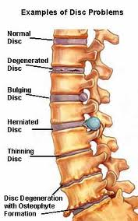

Slide 40
Sciatica:
pain is felt in the lower back, buttock, and/or various parts of the leg and foot.
There may be numbness, muscular weakness

Slide 41
Spondylolisthesis:
anterior displacement of a vertebra on the one beneath it.
Grade 1: 1-25
Grade 2: 26-50
Grade3: 51-75
Grade4:76-100
Pain usually worse when you stand and walk.

Slide 42
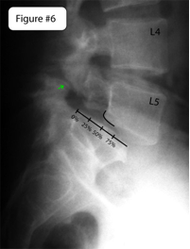
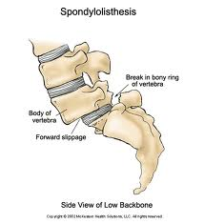

Slide 43
malignancy
Usually metastasize from primary site to spine to cuse Neoplastic epidural spinal cord compression (ESCC).
three must common cases are:
prostate cancer
breast cancer
lung cancer
each of which accounts for about 20 percent of cases.

Slide 44
It metastasize through:
1- Arterial seeding of bone probably accounts for most cases.
2- for pelvic tumors like prostate cancer.????
Through venous route especially When abdominal pressure is increased by the Valsalva maneuver, venous drainage from the abdomen and pelvis is shunted to the epidural venous plexus, which promotes vertebral metastases.

Slide 45
Symptoms are similar NRC, according to level of lesion.

Slide 46
Examination
by
بدر الهزاع

Slide 47
General :
  Permission
  Explain
  Privacy
Vital signs
Patient should be standing with the whole trunk exposed.

Slide 48
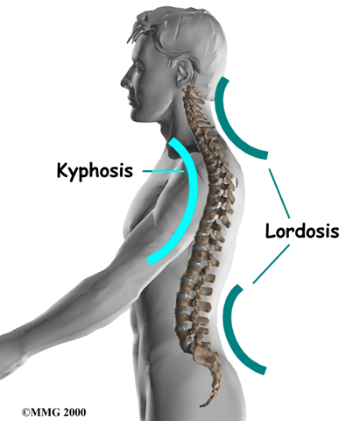
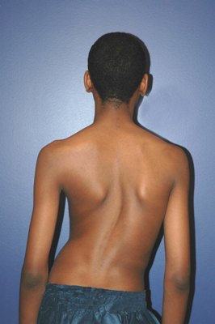
Look
look for deformity
Side:
  Normal kyphosis and lordosis
  Ankylosing spondylitis
Back:
  Scoliosis ( lateral curvature)

Slide 49
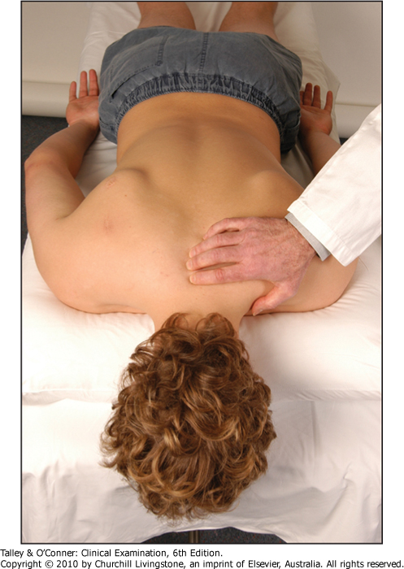
Feel
Feel each vertebral body for tenderness and palpate for muscle spasm .
Palpate over the SI joint.

Slide 50
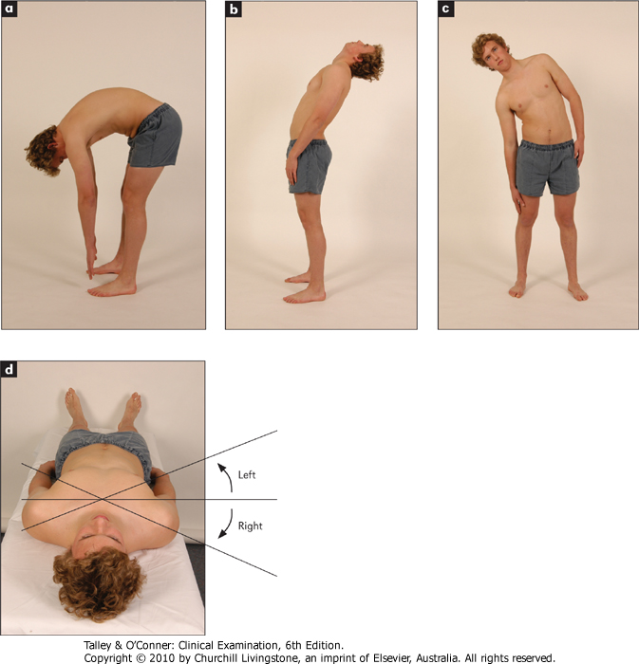
Movement
Flexion
Extension
Lateral bending
Rotation (sitting to fix the pelvis)

Slide 51
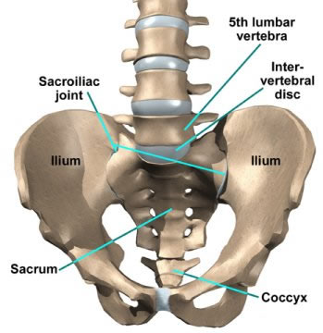
Sacroiliac joints
At supine position , press directly on the anterior superior iliac spines and apply lateral pressure → pain in the SI joint → sacroiliitis.
Firm palpation over the joint will elicit tenderness in patients with sacroiliitis.

Slide 52
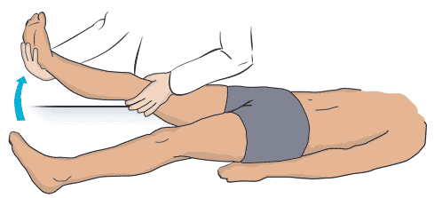
Straight leg raising (SLR)
raises the patient's extended leg with the ankle dorsiflexed.
Normally 80 – 90 degrees no pain
It will be limited by sciatica pain in lumbar disc prolapse. ( <60 )

Slide 53
Crossed SLR test
The test is positive when lifting the unaffected leg reproduces the sciatica in the affected leg.
specific | sensitive | Tests for herniated disc
no | Yes | SLR
90% | Less | Crossed SLR

Slide 54
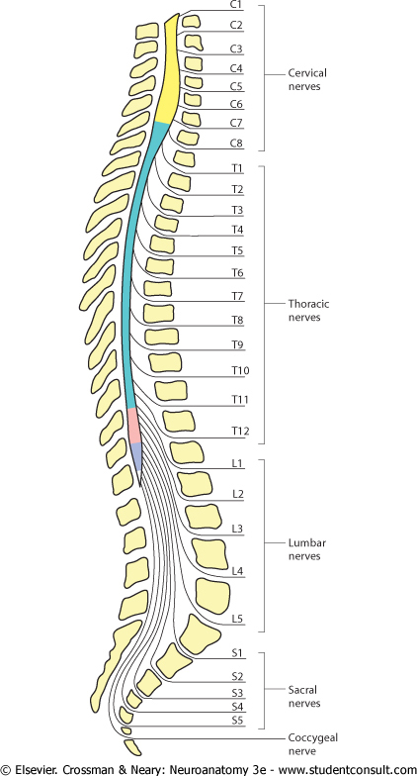
Neurologic testing
We should focus on the L5 and S1 nerve roots
98% of disc herniations occur at L4-5 and L5-S1
Reflexes
Motor
sensory

Slide 55
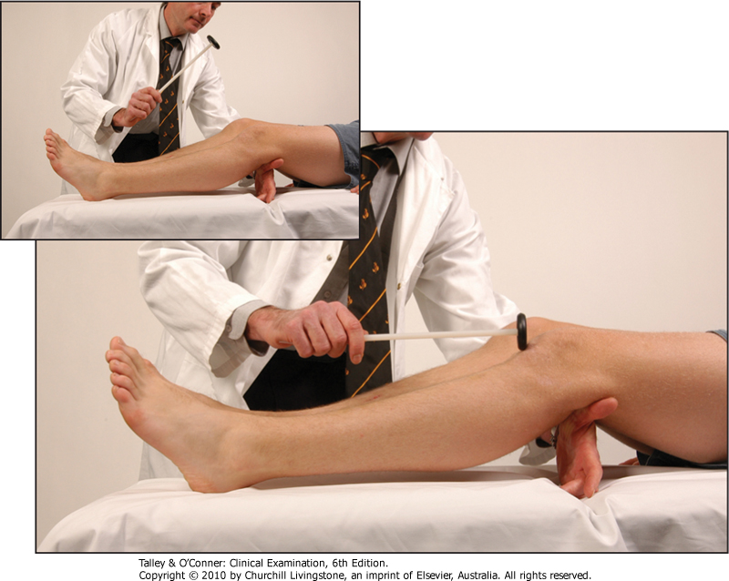
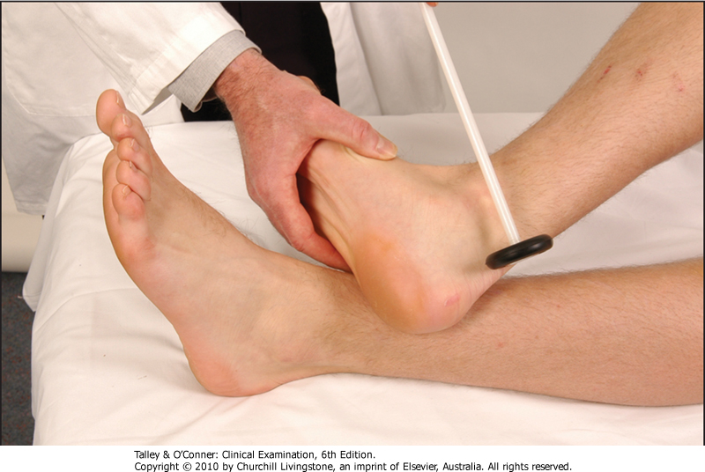
Reflexes
Knee (L3-4)
Ankle (S1-2)

Slide 56
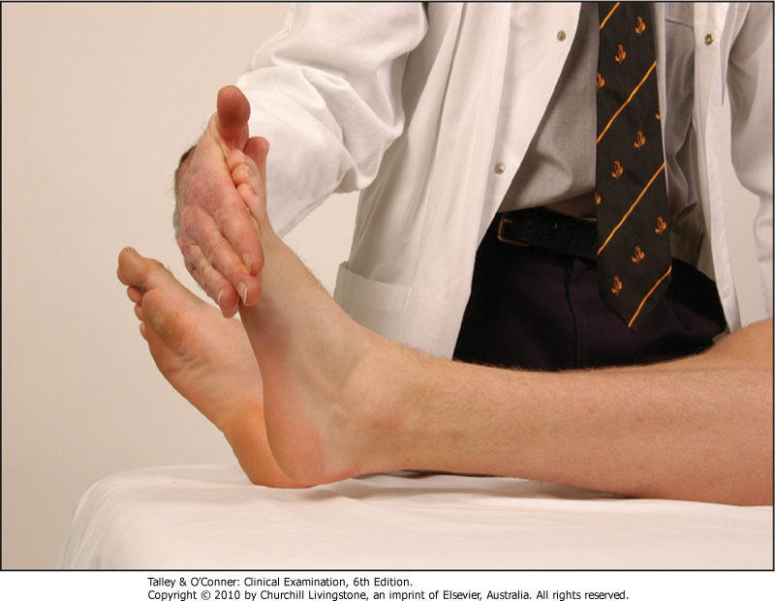
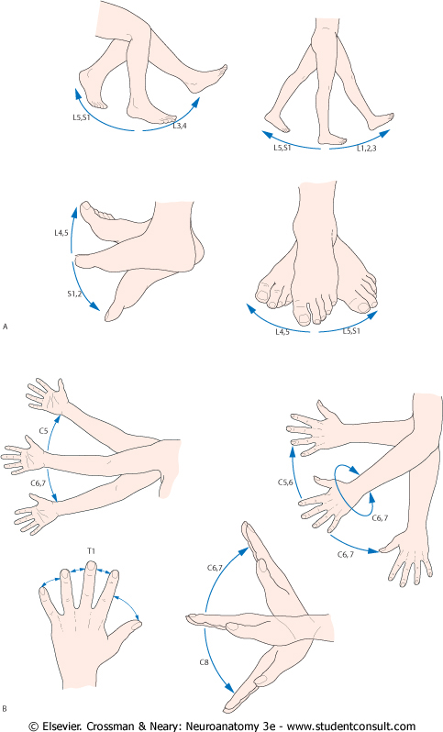
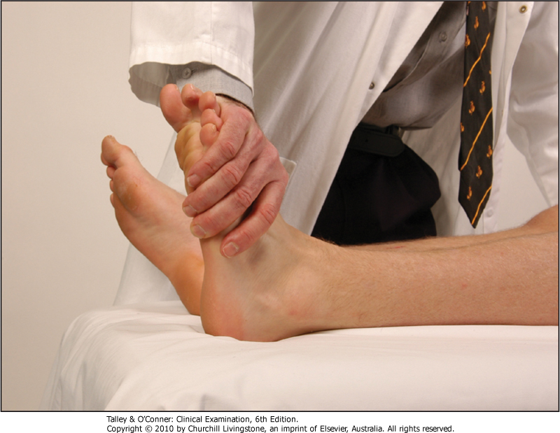
Motor
Ankle plantar flexion
Ankle dorsiflexion

Slide 57
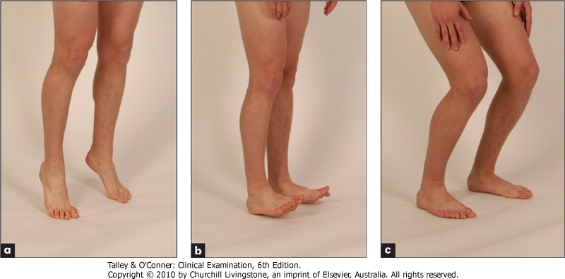
Motor
Walking on toes
Walking on heels
S1
L5

Slide 58
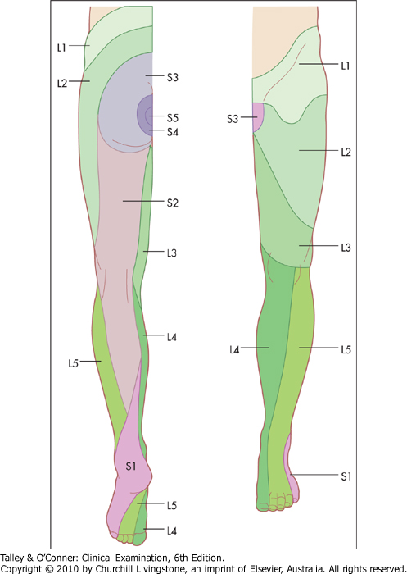
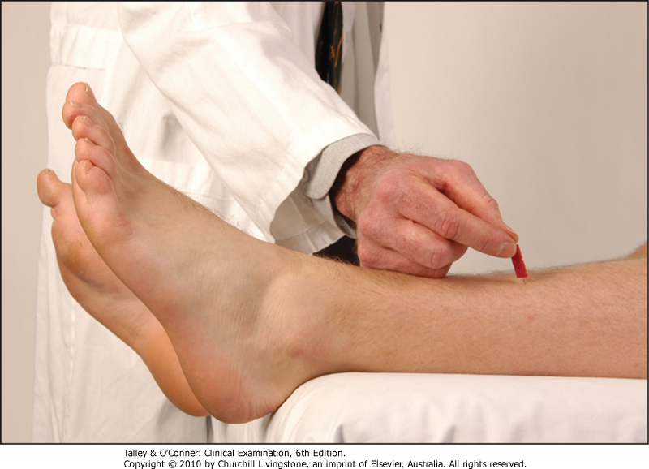
Sensory
Examine both legs with a pin in each dermatome.

Slide 59
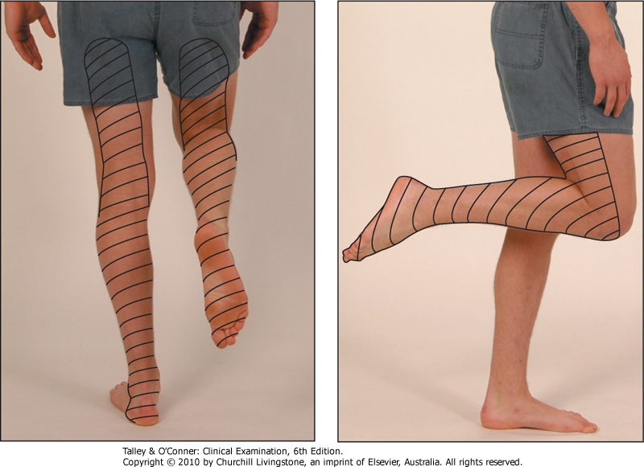
Sensory
Sciatic nerve (L4,5,S1,2)
Sensory distribution of the sciatic nerve

Slide 60
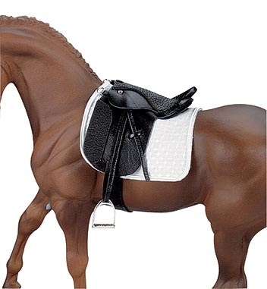
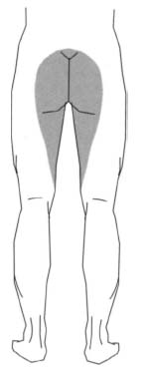
Sensory
Saddle anesthesia is loss of sensation restricted to the area of the buttocks and perineum.
Cauda equina syndrome

Slide 61
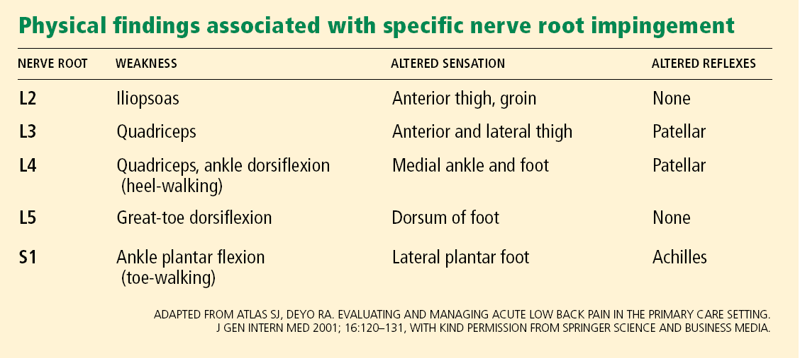
summary

Slide 62
Malignancy
We have to evaluate for malignancy (breast, prostate, lymph node exam) when persistent pain or history strongly suggests systemic disease.

Slide 63
Role of Primary Health Care in Management
MOHAMMAD ALSEMARI

Slide 64
Ability
Pain
GOALS
cope
chronic

Slide 65
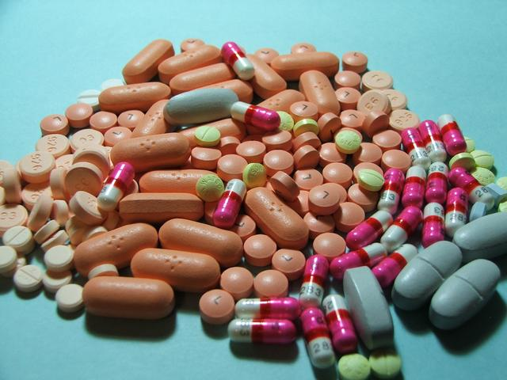
Note : Not all treatments work for all conditions or for all individuals with the same condition, and many find that they need to try several treatment options to determine what works best for them.

Slide 66

The management is according to the cause .. But first we have to assess the educational level of the patient ?!!

Slide 67
Principles of management :
Underlying systemic disease is rare.
Most episodes of back pain are unpreventable.
psychosocial issues are often important, and relevant.
Talking to the patient and explaining the issues involved are critical to successful management.

Slide 68

Evidence-Based Medicine Findings : http://www.aafp.org/afp/2002/0301/p925.html
Oral drugs
Analgesics
Antidepresant
Muscle relaxant
NSAIDS
Local injection
EPIDURAL STEROID
FACET JOINT
TRIGGER POINT AND LIGAMENTOUS
Nondrug
Heat therapy
physiotherapy
Acupuncture

Slide 69
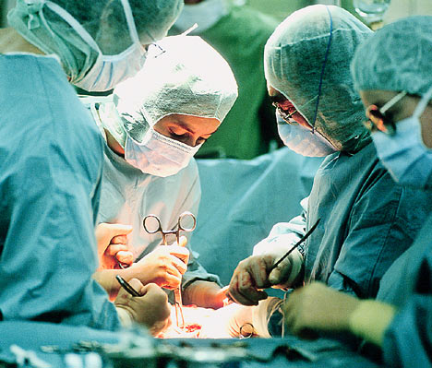
Cont..
Surgery :
Minimally invasive surgical procedures are often a solution for many causes of back pain.
Surgery may sometimes be appropriate for patients with:
Lumbar disc herniation
Lumbar spinal stenosis or spondylolisthesis
Scoliosis
Compression fracture

Slide 70
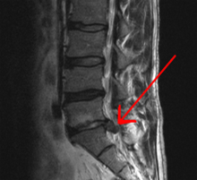
DISK PROLAPSE
The majority of herniated discs will heal themselves in about six weeks and do not require surgery ..

Slide 71
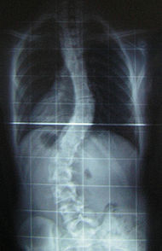
SCOLIOSIS
The traditional medical management of scoliosis is complex and is determined by the severity of the curvature ..
RX :
1- Observation .
2- Physiotherapy .
3- Bracing
4- Surgery .

Slide 72
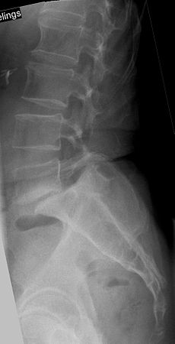
Spondylolisthesis
The appropriate treatment of patients with spondylolisthesis is just as controversial as the cause of symptoms.
Patients with symptomatic spondylolisthesis are initially offered conservative treatment :
1- Activity modification 2- Medications
3- Physiotherapy .
The last resort is surgery .

Slide 73
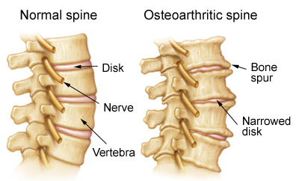
osteoarthritis
Lifestyle modification (such as weight loss and exercise) and analgesics are the mainstay of
treatment.

Slide 74
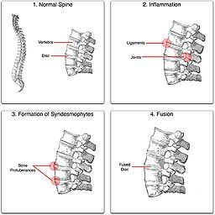
Ankylosing spondylitis
No cure is known for AS, although treatments and medications are available to reduce symptoms and pain .
Physical therapy and exercise, along with medication, are at the heart of therapy for ankylosing spondylitis.

Slide 75
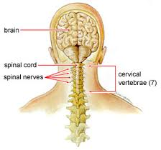
Rheumatoid arthritis
The goal of treatment is twofold:
1- alleviating the current symptoms
2- preventing the future destruction of the joints .
Treatment of RA can be divided into
(DMARDs), anti-inflammatory agents and analgesics. Treatment also includes rest and physical activity.

Slide 76
others
Treat underlying cause :
Tumor
Osteomylitis
Sciatica

Slide 77
When should patients be referred to a specialist?
By . IBRAHEM AL DEGHAITHER ☺

Slide 78
Patients should be referred to a neurologist, neurosurgeon, orthopedist, or other specialist if they have :-
Cauda equina syndrome ,
Severe or progressive neurologic deficits ,
Infections ,
Tumors ,
Fractures compressing the spinal cord ,
No response to conservative therapy for 4 to 6 weeks for patients with a herniated lumbar disk or 8 to 12 weeks for those with spinal stenosis.
Notes:
Cauda equina syndrome (CES) is a serious neurologic condition in which there is acute loss of function of the lumbar plexus, neurologic elements (nerve roots) of the spinal canal below the termination (conus) of the spinal cord.
After the conus medullaris, the canal contains a mass of nerves (the cauda equina or "horse-tail") that branches off the lower end of the spinal cord and contains the nerve roots from L1-5 and S1-5. The nerve roots from L4-S4 join in the sacral plexus which affects the sciatic nerve, which travels caudally (toward the feet).
Tumors and lesions
Trauma
Spinal stenosis
Inflammatory conditions
Signs
Signs include weakness of the muscles of the lower extremeties innervated by the compressed roots (often paraplegia), sphincter weaknesses causing urinary retention and post-void residual incontinence as assessed by catheterizing after the patient has urinated. Also, there may be decreased anal tone and consequent fecal incontinence; sexual dysfunction; saddle anesthesia; bilateral leg pain and weakness; and bilateral absence of ankle reflexes. Pain may, however, be wholly absent; the patient may complain only of lack of bladder control and of saddle-anaesthesia, and may walk into the consulting-room.
Diagnosis is usually confirmed by an MRI scan or CT scan, depending on availability. If cauda equina syndrome exists, surgery is an option depending on the etiology discovered and the patient's candidacy for major spine surgery.

Slide 79

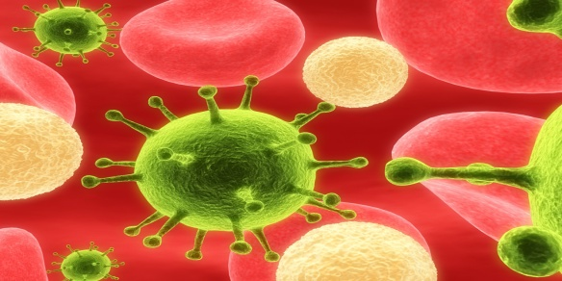
Red flags suggesting a serious back condition
Hx : Age ≥ 50 years ,Unexplained weight loss .
PE : Neurologic findings , Lymphadenopathy .
CANCER
Hx : Age ≥ 50 years (> 70 years is more specific) ,Significant trauma ,History of osteoporosis ,Corticosteroid use ,Substance abuse
PE : -VE
Compression fracture
Hx : Fever or chills ,Immunosuppression ,Injection drug use .
PE : Fever (temperature > 100°F or 38°C) Tenderness over spinous processes
INFICTION

Slide 80
CASE !!?
A 23 years old male karate player, student, non-smoker, come to the PHC clinic in the Security Force Hospital complaining of low back pain 3 days ago .

Slide 81
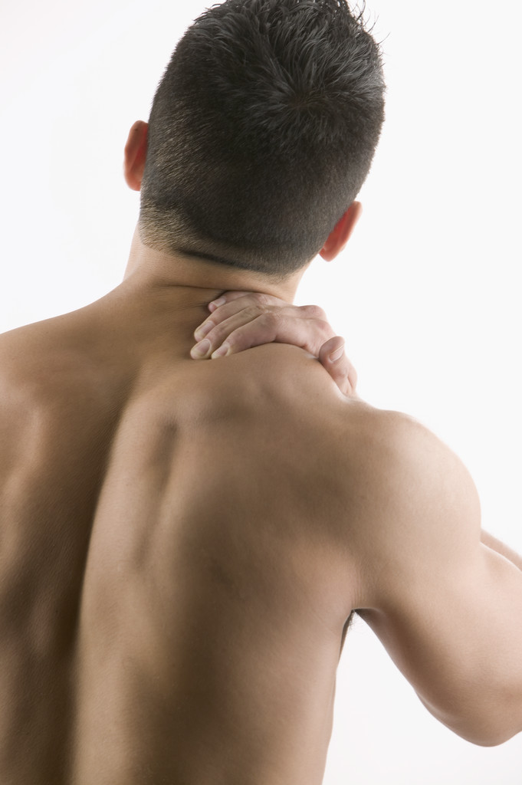
PAIN : in the low back around vertebral column, not referred & not radiating , stabbing in nature. Aggravated by movement & relieved spontaneously.
Duration of the attack was 10-15 min. no other attacks since this period .
The pain was so severe that the patient cannot move.

Slide 82
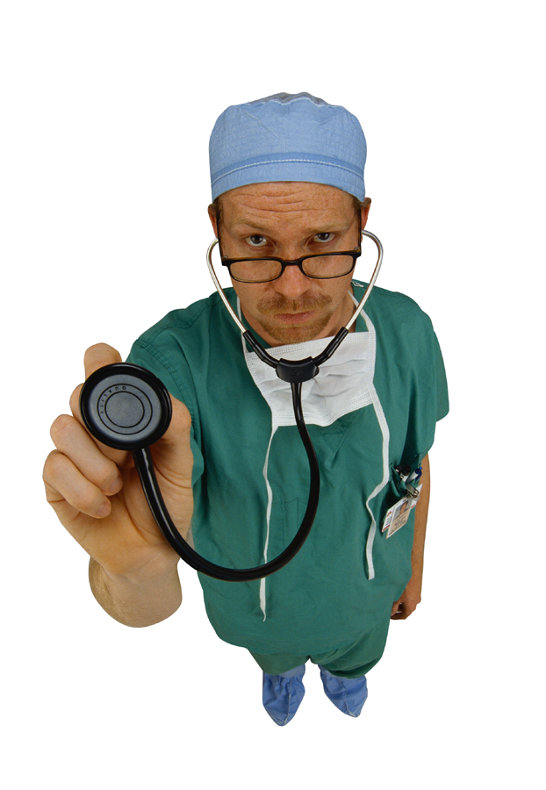
IMPORTANT –ve’s
NO associated symptoms.
NO problems in urination or defecation.
NO chronic illnesses.
NO history of recent trauma.

Slide 83
Physical Examination
The patient is generally well.
Inspection normal
Palpation mild paraspinal tenderness in lower back.
Movement normal
Neurological normal

Slide 84
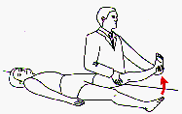
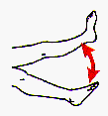
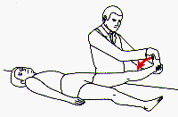
Strait leg raising test is negative.
one hand placed above the knee With the other hand cupped under the heel, slowly raise the straight limb
Estimate the degree of leg elevation that elicit complaint from the patient
Dorsiflex the ankle Note whether this aggravates the pain
Notes:
Ask the patient to lie as straight as possible on a table in the supine position. With one hand placed above the knee of the leg being examined (top figure), exert enough firm pressure to keep the knee fully extended. With the other hand cupped under the heel, slowly raise the straight limb. Tell the patient, "If this bothers you, let me know, and I will stop."
Estimate the degree of leg elevation that elicits complaint from the patient. Then determine the most distal area of discomfort: back, hip, thigh, knee, or below the knee
While holding the leg at the limit of straight leg raising, dorsiflex the ankle (bottom figure). Note whether this aggravates the pain. Internal rotation of the limb can also increase the tension on the sciatic nerve roots Pain below the knee at less than 70 degrees of straight leg raising, aggravated by dorsiflexion of the ankle and relieved by ankle plantar flexion or external limb rotation, is most suggestive of tension on the L5 or S1 nerve root related to disc herniation

Slide 85
Investigations
NO investigation was done for this patient (UK guidelines) .
Notes:
Current UK guidelines are clear that routine tests such as X-rays and scans should not be done if the diagnosis is made of non-specific low back pain.
Tests such as X-rays or scans may be advised in certain situations. This is mainly if there are symptoms, or signs during a doctors examination, to suggest that there may be a serious underlying cause for the back pain

Slide 86
SO ???
What is your diagnosis ?? Are you going to refarred him ??

Slide 87
The most likely diagnosis :
Back Strain
Management :
Non-pharmacological:
Continue with normal activities as much as possible.
Sleep in the most naturally comfortable position.
Get back to work as soon as possible .
Pharmacological:
Diclofenac gel
Lornoxican (NSAID) 8 mg 2 weeks
Tizanidine HCl (muscle relaxant) 4 mg

Slide 88
Prevention
of
Back Pain
By , ABDULAZIZ AL SYARI

Slide 89
Individuals may report that various strategies work for them
But in the absence of scientific evidence that does not mean they can be generally recommended for prevention
It is not known whether some of these strategies have disadvantageous long-term effects

Slide 90
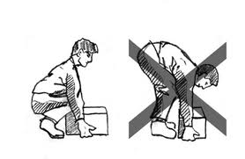

General
Posture.
Lifting.
Sitting on Chiar.
Studying on dask.

Slide 91


Slide 92


Slide 93
Recommendations for the General Population:
Physical exercise
It is recommended for prevention of sick leave due to LBP.
type of exercise ??
There is insufficient consistent evidence to recommend for or against any specific type , intensity or the frequency of the exercise.
Although , training.Water gymnastics may be recommended to reduce short-term back pain and extended work loss during and following pregnancy .

Slide 94

Mattresses :
There is insufficient strong evidence to recommend for or against any specific
mattresses for prevention in back pain .
Though existing persistent symptoms may reduce with a medium-firm rather than a hard mattress.

Slide 95

recommendations for School Age
Poor life style habits.
Prolonged static sitting during school age on unadjusted furniture .
may play a role in the origin of LBP.

Slide 96

also the physical cumulative load experience on the lumbar spine (e.g. from heavy book-bag , carrying or sitting on unadjusted furniture) during childhood and adolescence contributes to adult LBP.

Slide 97
The most promising approaches seem to involve physical activity/exercise and
appropriate (biopsychosocial) education, at least for adults.
But, no single intervention is likely to be effective to prevent the overall problem of
LBP, owing to its multidimensional nature

