Slide 2
BRONCIAL ASTHMA

Slide 3
khalid 14 year old come to clinic c/o shortness of breath for one day duration.
He is a known asthmatic patient for more than 8 years, he visited A/E frequently.
His school performance is below average, with frequent absence from school due to his illness.

Slide 4
HOW YOU WILL PROCEED DURING THIS CONSULTATION ?

Slide 5
Epidemiology of Asthma
It is one of the most common chronic diseases in Saudi Arabia, affecting more than 2 million
Saudis !
Although many asthma patients continue to be under-diagnosed, under-treated !

Slide 6
PREVALENCE IN SADIA ARABIA
The rate of growth of this disease is very alarming with its prevalence rates currently exceeding 20 percent of our population in certain regions of the Kingdom !!
(Dr. Majdy M. Idrees, chief of pulmonary medicine at Riyadh Military 2009)

Slide 7
World Allergy Organization Journal: Prevalence of bronchial asthma in children in Saudi Arabia, Al-Frayh, November 2007 - Volume - Issue - pp S167-S168

Slide 8
On average, 3 children in a classroom of 30
are likely to have asthma.*
*Epidemiology and Statistics Unit. Trends in Asthma Morbidity and Mortality. NYC: ALA, July 2006.
Notes:
8
On average, a typical classroom of 30 students is likely to have 3 with asthma.*
According to the 2004 National Health Interview Survey, parents reported that 9.6% (5.1 million) of their school-aged children (ages 5-17) had been told by a doctor that they have asthma (“lifetime asthma”) and still had asthma (“current asthma”).

Slide 9
Asthma cannot be cured but its symptoms can be controlled with proper environmental changes and medication !

Slide 10
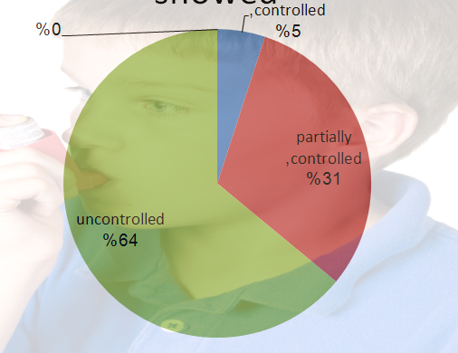
A recent asthma control survey showed

Slide 11
Causes
Poor knowledge,
fear of use of new drugs,
and lack of awareness of the importance
of control of the disease among primary
care physicians !!
A study by Al-Kabbaa and colleagues found that only 39% of primary care physicians meet the standards of the national guidelines in management of asthma. Furthermore, the overall level of awareness among physicians was low (52%).

Slide 12
WHAT IS ASTHMA ?
It’s a chronic disorder of the airways, characterized by variable reversible and recurring symptoms related
to airflow obstruction,bronchial hyperresponsiveness, and an underlying inflammation.

Slide 13
Pathology of Asthma
Inflammation
Airway Hyper-responsiveness
Airway Obstruction
Symptoms of Asthma
Notes:
13

Slide 14
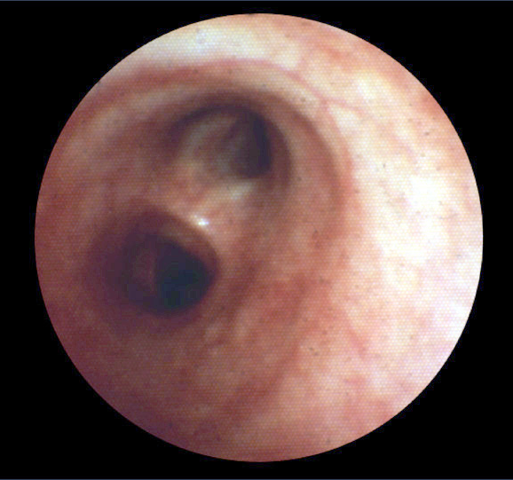
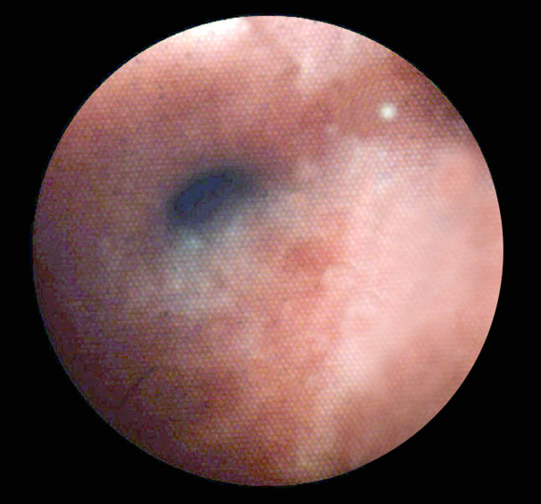
Bronchoconstriction
Before
10 Minutes After Allergen Challenge
Notes:
14

Slide 15
Pathophysiology
Airways inflammation:
Asthma is a complex syndrome characterized by a state of airways hyperresponsiveness and caused by a multi-cellular inflammatory reaction.
(mast cells, macrophages, antigen-presenting dendritic cells, neutrophils, eosinophils, and T lymphocytes, Type 2 T-helper cells)

Slide 16
Pathophysiology
Airways hyperresponsiveness:
To direct (histamine or methacholine) OR
indirect (exercise, cold air).
it’s give us a relatively good correlation between the severity of disease and the degree of Airways hyperresponsiveness.

Slide 17
Pathophysiology
Early and late responses
Airway remodeling:
epithelial damage, subepithelial fibrosis, increased airway vasculature, increases in proteoglycans, and increased smooth-muscle mass, increase number of secretory glands.

Slide 18
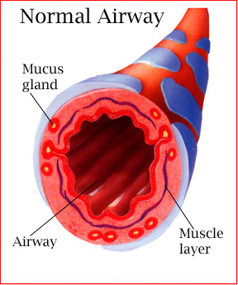
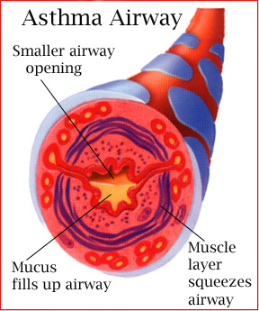
During an asthma attack…
Notes:
18
When exposed to an asthma trigger…
Bronchioles constrict to limit exposure to the trigger.
Mucous membrane becomes irritated and swells.
Mucous is produced to trap the irritant.
Coughing initiated to pop open bronchioles and expel the mucous build-up.
Air retention volume in alveolar sacs increases – can’t get air out or in.
CO2 build-up in alveolar sacs and in system tissues which can lead to acidosis.
The body attempts to blow off the excess CO2 – rapid shallow breathing. (hyperventilation)
Hungry for O2 and trying to get rid of CO2 at the same time.
Fatigued muscles in this effort.
If this continues, the person with asthma can die.
A person with asthma undergoes what is called “airway remodeling” – where there is permanent damage to the airways and decreased overall capacity….airway hyperactivity. A hyperactive airway is more susceptible to triggers.
Taking medication:
Rescue inhaler – dilates bronchioles, doesn’t alleviate mucous or congestion in any appreciable way
Daily corticosteroid –works to reduce airway hyperactivity

Slide 19
“Real Life” Variability in Asthma
Acute
inflammation
symptoms
subclinical
Chronic inflammation
Structural changes
TIME
Barnes PJ. Clin Exp Allergy 1996.
Notes:
19
Multimedia Slide 7
Asthma is a chronic inflammatory disease with a variable course characterized by episodic attacks of acute inflammation.¹ Acute inflammation in asthma is associated with bronchoconstriction, plasma exudation/edema, vasodilatation, and mucus hypersecretion. Chronic inflammation in asthma is associated with subepithelial fibrosis, smooth-muscle hyperplasia/hypertrophy, mucus gland hyperplasia, and new-vessel formation. If asthma remains uncontrolled or poorly controlled, the underlying chronic inflammation may lead to structural changes (remodelling) that reduce the extent of airway response to therapy.
1. Barnes PJ. New drugs for asthma. Clin Exp Allergy 1996;26:738-745.

Slide 20
http://kidshealth.org/misc/movie/cc/how-asthma-affects.html

Slide 21
khalid 14 year old come to clinic c/o shortness of breath for one day duration.
He is a known asthmatic patient for more than 8 years, he visited A/E frequently.
His school performance is below average, with frequent absence from school due to his illness.

Slide 22
What more would you want to know about your patient?

Slide 23
Obtain a detailed History
Does the patient or his/her family have a history of asthma or other atopic conditions, such as eczema or allergic rhinitis?
Does the patient have recurrent attacks of wheezing?
Does the patient have a troublesome cough at night?

Slide 24
Obtain a detailed History
Does the patient wheeze or cough after exercise?
Does the patient experience wheezing, chest tightness, or cough after exposure to pollens, dust, feathered or furry animals, exercise, viral infection, or environmental smoke (cigarettes, burning incense “Bukhoor”, or wood?

Slide 25
Obtain a detailed History
Does the patient experience worsening of symptoms after taking aspirin/ nonsteroidal inflammatory medication or use of B-blockers?
Does the patient’s cold “go to the chest” or take more than 10 days to clear up?
Are symptoms improved by appropriate asthma treatment?

Slide 26
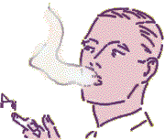
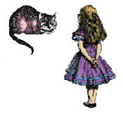
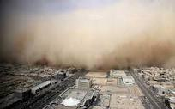
To rule out triggers !

Slide 27
Dust mites and mold spores, pollen
Animal dander,
Cockroaches,
Indoor and outdoor pollutants,
Irritants (e.g., tobacco smoke, smoke from wood-burning, perfumes, cleaning agents),

Slide 28
Pharmacologic triggers (e.g., aspirin or other nonsteroidal anti-inflammatory drugs, beta blockers and sulfites),
Physical triggers (e.g., exercise, hyperventilation,
cold air)
Physiologic factors (e.g., stress, gastroesophageal reflux (GERD), respiratory infection [viral, bacterial] and rhinitis).

Slide 29
Physical Examination
Wheeze /Rhonchi.
Tachypnea.
Use of accessory muscles of respiration.
paradoxical pulse (a pulse that is weaker during inhalation and stronger during exhalation).
Over-inflation of the chest.
Cyanosis of nails.
signs of allergy in skin, nose, eyes.

Slide 30
Special consideration for asthma in children younger than five years !
It’s challenge to diagnosing Asthma in children of five years and below, because Lung function testing, and assessment of airway hyperresponsiveness, are not very helpful in diagnosing it in this age group.
Also Skin prick testing is less reliable for confirming atopy in infants.

Slide 31
Three categories of wheezing have been described:
Transient early wheezing: It is often outgrown in the first three years, when symptoms begin and end before the age of three. This is often associated with prematurity and parental smoking.

Slide 32
Three categories of wheezing have been described:
Persistent early-onset wheezing: Children in this category begin to have symptoms before the age of three and continue beyond the age of six. These children typically have recurrent episodes of wheezing associated with acute viral respiratory infections and have no evidence of atopy.

Slide 33
Three categories of wheezing have been described:
Late-onset wheezing/asthma: Symptoms begin after the age of three and persist throughout childhood and into adult life. Typically, the patient has an atopic background, often with eczema, and his airway pathology shows characteristic features of asthma.

Slide 34
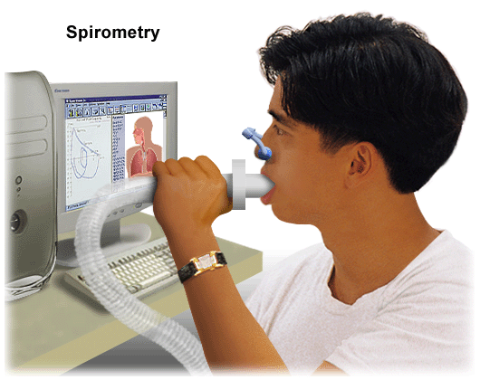
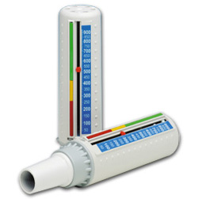
Investigation
There is currently not a precise physiologic, immunologic, or histologic test for diagnosing asthma. The diagnosis made based on the pattern of symptoms and response to therapy .
Pulmonary Function Tests
Peak flow meter

Slide 35
Spirometry Test
Recommend by STS for regular screening method because it is less variable than PEFT and completed in 10 to 15 min.
Measure (FEV1) and (FVC) volume-time curve
Normally FEV1/FVC ~ 75%
An obstructive pattern on spirometry is identified numerically by a reduction in the ratio of FEV1 to FVC.
Recommend spirometry at the time of initial diagnosis, after treatment is initiated and symptoms are stabilized

Slide 36
How spirometry test is done ?

Slide 37
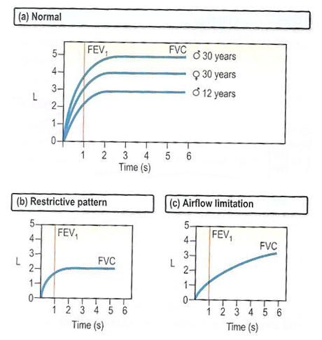
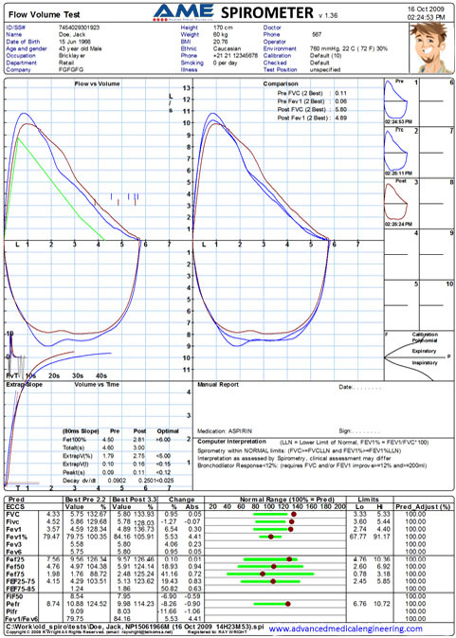
volume-time curve
If FEV1 or FVC ^ By 12% after bronchodilator obstruction considered reversible.

Slide 38
Limitations of Test
The maneuver is highly dependent on patient cooperation.
FVC can only be underestimated, never overestimated.
Only be used on children old enough to comprehend and follow the instructions given (6 years old or more(
Not suitable for patients who are unconscious, heavily sedated, or have limitations that would interfere with vigorous respiratory efforts.
Many intermittent or mild asthmatics have normal spirometry between acute exacerbation,

Slide 39
Peak Expiratory Flow
Recommend in monitoring and long term assessment of patient disease and response to treatment
on waking prior to taking a bronchodilator and before bed after bronchodilator.
Also in assessment of possible occupational asthma.
At least 4 time/daily
for 2weeks at work
And 2weeks off work
In acute setting when patient is SOB, PEF is quickest method of diagnosis

Slide 40
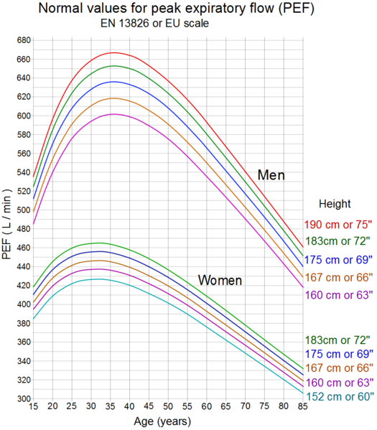
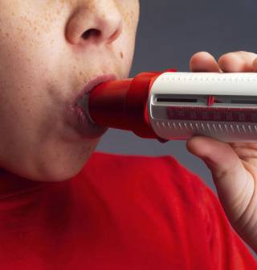
How PEF test is done?

Slide 41
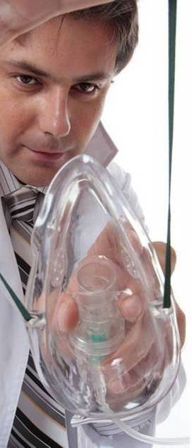
Bronchoprovocation Challenge Testing
It evaluate the airway narrowing in response to stimuli.
Not for everyone! only done when symptoms suggest asthma, but normal spirometry , it may cause a severe asthma attack .
Also used for diagnosis of occupational asthma
How is Bronchoprovocation Testing Preformed?
Perform a spirometry test.
Inhale a nebulized aerosol with methacholine or histamine.
Perform another spirometry after nebulized the aerosol.
See if there is decrease in FEV1.
Hyperresponsive will develop at lower doses

Slide 42
Chest X-ray
Not recommended as routine Investigation
Normal in mild cases.
Only Sever asthma reveals hyperinflation
Recommended in the evaluation of severe "difficult-to-control" asthma or in atypical symptoms
Used to exclude other condition (mass with tracheal compression ,pneumothorax)

Slide 43
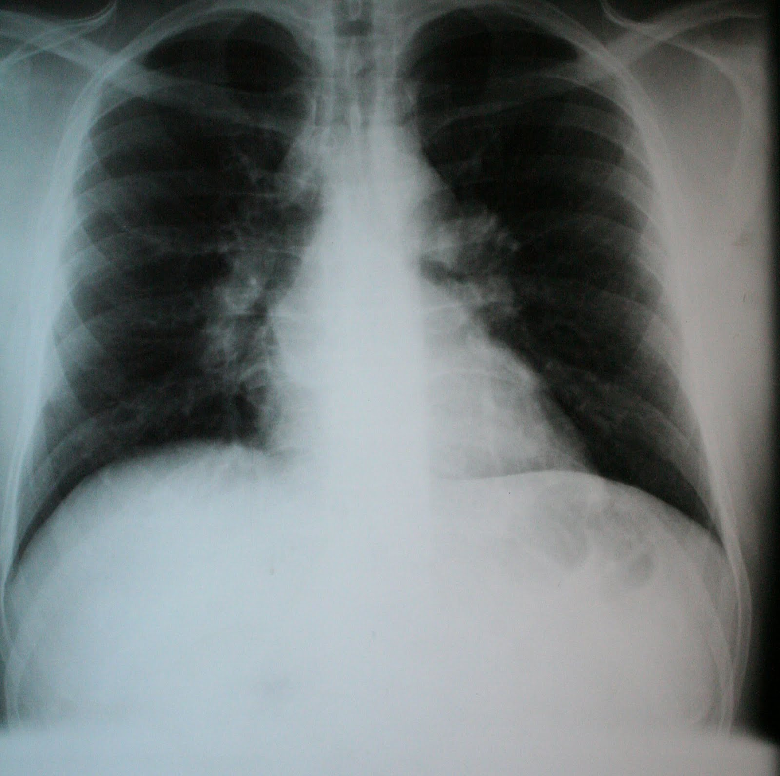
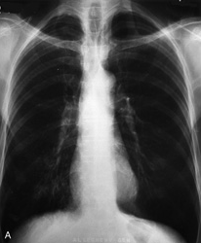
NORMAL
HYPERINFLATION

Slide 44
Other supportive tests

Slide 45
Arterial Blood Gases
Considered when
Severe respiratory distress (ASTHMA)
increased respiratory rate
Hypocarbia
Hypoxiemia may be present

Slide 46
Arterial Blood Gases
But
When Pco2 is normal or increased
Respiratory muscle fatigue or sever airway obstruction
The patient should be hospitalized and mechanical ventilation is considered

Slide 47
Other findings but are not routinely recommended
Peripheral eosinophilia on CBC
Signs of eosinophilic inflammation in the sputum
elevated IgE levels in the serum

Slide 48
Measurements of allergic status
Allergens can be Identifeined by :
Skin testing
Level of specific IgE in the serum
- Provocation of the air ways with a suspected allergen especially in the occupational asthma. (But rarely useful and dangerous )

Slide 49
Allergy Skin test
The primary diagnostic tool in determining allergic status. Simple, rapid, low coast, highly sensitive

Slide 50
Special situation
Asthma

Slide 51
Exercise induced Asthma
A different type of asthma .
It can induce an asthmatic attack in people who have no other triggering factors .
People with exercise-induced asthma are believed to be more sensitive to changes in the temperature and humidity of the air.

Slide 52
Exercise induced Asthma
Main Point
When you are at rest, you breathe through your nose, which serves to warm, humidify, and cleanse the air you inhale to make it more like the air in the lungs.
But
When you are exercising, you breathe through your mouth, and the air that hits your lungs is colder and drier. The contrast between the warm air in the lungs and the cold inhaled air or the dry inhaled air and moist air in the lungs can trigger an attack.

Slide 53
Exercise induced Asthma
Symptoms usually begin about 5- 10min after finishing to exercise.
Rarely starts during the exercise .
Typically gone within an hour, but they may last longer.
It can happen under any weather but cold and dry weather is the most common .

Slide 54
Why It Is Important ?
When asthma is left untreated and the inflammation persists, permanent narrowing of the airways can occur then this chronic asthma can also be referred to as chronic obstructive pulmonary disease (COPD), like emphysema and chronic bronchitis.

Slide 55
Education
If patient think he may have exercise-induced asthma, he should promptly make an appointment with your health-care professional.
This plan should include instructions on
how to prevent an attack while exercising
what to do when an asthma attack occurs,
when to call the health-care professional,
and when to go to a hospital emergency

Slide 56
Assessment of severity of asthma
divided into 4 levels

Slide 57
Mild Intermittent Asthma
Symptoms
Symptoms < 2 X/wk
Asymptomatic and normal PEF between exacerbations
Exacerbations brief (few hrs - few days); intensity may vary
Nighttime symptoms < 2 X/mo
Lung Function
FEV₁ or PEF > 80% predicted
PEF variability < 20%

Slide 58
Mild Persistent Asthma
Symptoms
Symptoms > 2 X/wk but <1 X/day
Exacerbations may affect activity
Nighttime symptoms > 2 X/mo
Lung Function
FEV₁ or PEF > 80% predicted
PEF variability 20-30%

Slide 59
Moderate Persistent Asthma
Symptoms
Daily symptoms
Daily use of inhaled short-acting
beta₂ agonist
Exacerbations affect activity; > 2 X/wk; may last days
Nighttime symptoms >1 time/wk
Lung Function
FEV₁ or PEF
> 60% - < 80% predicted
PEF variability >30%

Slide 60
Severe Persistent Asthma
Symptoms
Continual
Limited physical activity
Frequent exacerbations
Frequent nighttime symptoms
Lung Function
FEV₁ or PEF < 60% of predicted
PEF variability >30%

Slide 61
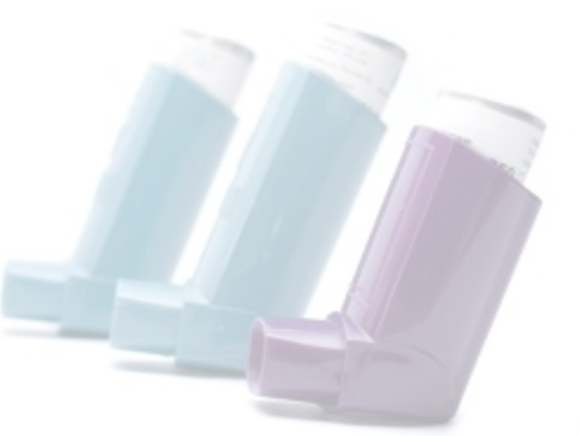
Treatment of Asthma
Global Initiative for Asthma (GINA) 6-point plan:
Educate patients to develop a partnership in asthma management
Provide regular follow-up care
Avoid exposure to risk factors
Assess and monitor asthma severity with symptom reports and measures of lung function as much as possible
Establish medication plans for chronic management in children and adults
Establish individual plans for managing exacerbations

Slide 62
Asthma treatment: 2 steps to better asthma control
1. Track your symptoms
Write down your symptoms in an asthma diary each day. Recording symptoms can help you recognize when you need to make treatment adjustments according to your asthma action plan. Use your asthma diary to record:
Shortness of breath or whistling sounds when you exhale (wheezing)
Disturbed sleep caused by shortness of breath, coughing or wheezing
Chest tightness or pain
Quick-relief (rescue) inhaler use — record when you need to use your quick-relief inhaler (such as albuterol) and write down how many puffs you take
Disruptions to work, school, exercise or other day-to-day activities caused by asthma symptoms
Asthma symptoms during exercise
Changes in color of phlegm you cough up
Hay fever symptoms such as sneezing and runny nose
Anything that seems to trigger asthma flare-ups

Slide 63
2. Record how well your lungs are working:
Peak flow.
Spirometry

Slide 64
Stepwise approach ( children)
classification | mild Intermittent | Mild persistent | Moderate persistent | Severe persistent
Minor symptoms | < 1/week | 1-3 /week | 4-5/week | Continuous
exacerbation/ nocturnal | < 1/month | 1 /month | 2-3/month | > 4 /month
PEF between attacks | >80% | >80% | 60-80% | < 60%
 | Step 1 | Step 2 | Step 3 | Step 4

Slide 65
Stepwise approach ( adult)
classification | mild Intermittent | Mild persistent | Moderate persistent | Severe persistent
Minor symptoms | < 2 /week | 2-3 /week | 4-5 /week | Continuous
exacerbation/ nocturnal | < 2 /month | 2-3 /month | 4-5 /month | > 5 /month
PEF between attacks | >80% | >80% | 60-80% | < 60%
 | Step 1 | Step 2 | Step 3 | Step 4

Slide 66
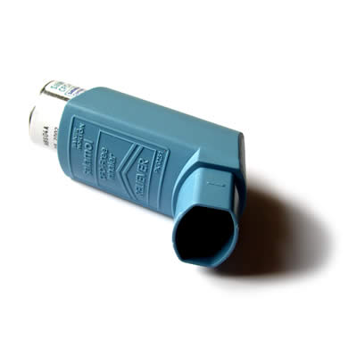
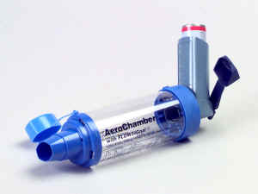
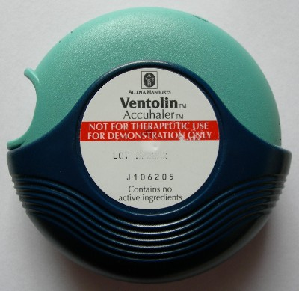
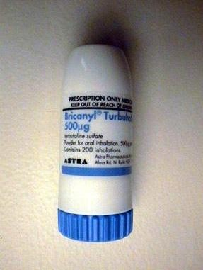
Types of asthma inhalers include:
Metered dose inhalers.
Metered dose inhaler with a spacer
Dry powder inhaler

Slide 67
Medications to control Asthma
Quick relievers :
1- Short-acting beta₂-agonists.
2- Anti-muscarinic.
Long-term controllers :
1- Corticosteroids.
2- Long-acting beta₂-agonists
3- Leukotriene modifiers
4-theophylline.

Slide 68
Quick reliefers :
SABA(ventolin):
MOA:
increasing airflow through your lungs and relax the smooth muscle lining the airways of the lung and your airways open up.
Uses:
before the onset of exercise
exercise-induced asthma.

Slide 69
Ipratropium bromide
MOA:
anticholinergic agent that inhibits vagally-mediated reflexes by antagonizing the action of acetylcholine at the cholinergic receptor.
Uses:
COPD
Acute Asthma Exacerbations

Slide 70
Long-term controllers
ICS
There are many drugs such as :
Flunisolide.
Fluticasone propionate.
Beclometasone dipropionate.
MOA:
Steroids and other anti-inflammatory drugs work by reducing swelling and mucus production in the airways of a person with asthma. As a result, the airways are less sensitive and less likely to react to asthma triggers, allowing people with symptoms of asthma to have better control over their condition.

Slide 71
ICS
USES:
Note that while inhaled steroids prevent asthma symptoms, they do not relieve asthma symptoms during and attack
What Are the Side Effects of Inhaled Steroids?
higher doses, thrust (a yeast infection) in the mouth) and hoarseness may occur

Slide 72
(adviar) LABA
A LABA is a type of bronchodilator whose effects last for 12 hours or more. LABA is associated with the following benefits when added in patients who are inadequately controlled on an inhaled corticosteroid to:
Improved lung function
Decreased asthma symptoms
Increased number of symptom-free days
Reduction in number of asthma attacks
Decreased recue inhaler use.
prevention of exercise induce asthma .

Slide 73
LABA (adviar , Symbicort)
MOA:
LABA relaxes smooth muscle lining the airways of your lung and causes your airways to open up. As a result, you begin to experience less symptoms.
Uses : for moderate, severe persistent asthma.
Side effect :
You should not be taking a LABA if you are not also taking an inhaled steroid.

Slide 74
Theophylline
Theophylline is part of a class of asthma medicines called methylxanthines.
MOA:
A muscle relaxant to open up narrowed airways, and it may have mild anti-inflammatory qualities as well.
USES:
For persistent asthma, theophylline is not considered the preferred first treatment because it has not been shown to be as effective as ICS. However, in some cases it may be prescribed as an additional medication if sufficient control is not achieved with steroids alone.

Slide 75
(LTRA( montileukast
MOA:
Leukotrienes are released from mast cell, eosinophil and basophil and lead to increased inflammation so Monteleukast (singulair) antagonize it.
Uses:
Mild persistent asthma
Adjunctive therapy in combination with inhaled steroids.
prevention of exercise induce asthma.

Slide 76
INTERACTIVE
Asthma Control Test

Slide 77
Pharmacotherapy for Adults and Children Over the Age of 5 Years
Step 1 (ACT ≤20):
No daily medication needed.
PRN short-acting beta₂-agonists (albuterol) MDI.
Although the overall diagnosis is “mild intermittent” the exacerbations themselves can still be severe.
Severe exacerbations may require systemic corticosteroids.

Slide 78
Pharmacotherapy for Adults and Children Over the Age of 5 Years
Step 2 (ACT 16-19):
Preferred Treatment
Low-dose inhaled corticosteroid
Alternative Treatment (no particular order)
Leukotriene receptor antagonist (LTRA)
Cromolyn
Nedocromil
Sustained release theophylline to maintain a blood level of 5-15 mcg/mL

Slide 79
Pharmacotherapy for Adults and Children Over the Age of 5 Years
Step 3 (ACT <16):
Preferred Treatment
Low-to-medium dose inhaled corticosteroids
WITH long-acting beta₂-agonist
Alternative Treatment
Increase inhaled corticosteroids within the medium dose range
Add leukotriene receptor antagonist or theophylline to the inhaled corticosteroid

Slide 80
Pharmacotherapy for Adults and Children Over the Age of 5 Years
Step 4 (Severe persistent):
Preferred Treatment, in adults:
High-dose inhaled corticosteroids
AND long-acting beta₂-agonist
AND (if needed) LTRA or Theophylline
Consider Omalizumab in allergic asthma
In children above 5 years:
Medium to high dose ICS + LABA and LTRA if needed

Slide 81
Pharmacotherapy for Adults and Children Over the Age of 5 Years
Step 5:
In adults:
Step 4 options + omalizumab in allergic asthma AND/OR long-term oral corticosteroids
In children above 5 years:
Medium to high dose ICS AND daily lowest dose of oral corticosteroids providing control

Slide 84
Step up & Step down
If asthma is not controlled on the current treatment regimen, step up treatment. But befor stepping up treatment, you have to review the patient’s compliance, inhaler technique, and avoidance of risk factors. Generally, improvement should be seen within 1 month.
If control is maintained for at least 3 months, step down gradually. The goal is to decrease treatment to the least medication necessary to maintain control.

Slide 85
Pharmacotherapy for Infants and Young Children (<5 years)
The most effective bronchodilator available is SABA that can be delivered as needed by MDI and spacer.
If control is not achieved ➔ lowest dose of ICS
If control is not achieved ➔ double the initial dose of ICS
If further control is needed ➔ ICS dose can be increased to the maximum, AND/OR adding LTRA or theophylline.

Slide 86
cont.
Low dose of oral corticosteroids for a few weeks to achieve control should be limited to sever uncontrolled cases to avoid their side effects.
For children with seasonal symptoms, daily controller therapy may be discontinued after the season, with the advice for a follow-up visit within 3-6 weeks.

Slide 87
Monitoring to maintain control
Ongoing monitoring is essensial to maintain control and establish the lowest step and dose of treatment to minimize cost and maximize safety.
Typically, patients should be seen one to three months after the initial visit, and every three months thereafter.
After an exacerbation, follow-up should be offered within 2 weeks to 1 month.

Slide 89
Management of Acute severe asthma

Slide 92
Special situations
Asthma and pregnancy: identifying and avoiding triggering factors should be the first step of therapy in a pregnant woman. Treatment should take the same stepwise approach an in the non-pregnant patient.
Cough-variant asthma: follow the same stepwise approach for the long-term management of asthma (ICS).

Slide 93
Special situations
Aspirin-induced asthma: up to 28% of adults with asthma suffer from exacerbations in response to aspirin.
Within minutes to 1 or 2 hours, an acute, sever attack develops, and is usually accompanied by: rhinorrhea, nasal obstruction, conjunctival irritation, and scarlet flush of the head and neck.
Typical history is considered adequate for diagnosis.

Slide 94
Cont.
Patients known to have AIA should avoid all aspirin-containing products.
However, patients for whom aspirin is considered essential, they should be referred to an allergy specialist for aspirin desensitization.

Slide 95
Special situations
GERD-triggered asthma:
The mechanisms include vagal mediated reflex and reflux secondary to micro-aspiration of gastric contents into the upper airways.
All patients with asthma should be asked about symptoms of GERD.
Treatment: treat GERD with proton pump inhibitor.

Slide 96
Special situations
Rhinitis and asthma: share several risk factors, so they often coexist. Treatment of rhinitis (e.g. H₁-receptor antagonists) usually improve asthma symptoms.
Occupational asthma: same drugs mentioned + avoid the relevant exposure.
Obesity and asthma: same drugs mentioned + weight loss which will improve asthma control

Slide 97
How to use different types of inhalers

Slide 98
inhaler
An inhaler or puffer is a medical device used for delivering medication into the lungs
It is mainly used in the treatment of asthma and Chronic Obstructive Pulmonary Disease (COPD).

Slide 99
types of inhalers
Metered-dose inhalers
Dry powder inhalers
Nebulizers

Slide 100
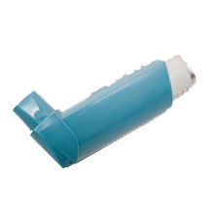
Metered-dose inhalers
Is the most common type of inhaler
the medication is most commonly stored in solution in a pressurized canister

Slide 101
Metered-dose inhalers
How to use it
first fully exhale, place the mouth-piece of the device into the mouth, and having just started to inhale at a moderate rate, depress the canister to release the medicine. The aerosolized medication is drawn into the lungs by continuing to inhale deeply before holding the breath for 10 seconds to allow the aerosol to settle onto the walls of the bronchial and other airways of the lung.

Slide 103
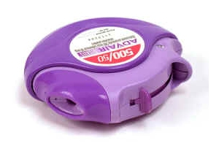
Dry powder inhalers
is a device that delivers medication to the lungs in the form of a dry powder.
It is an alternative to the metered-dose inhaler
The medication is commonly held either in a capsule for manual loading or a proprietary form from inside the inhaler.

Slide 104
Dry powder inhalers
How to use it
Once loaded or actuated, the operator puts the mouthpiece of the inhaler into their mouth and takes a deep inhalation, holding their breath for 5-10 seconds.

Slide 106
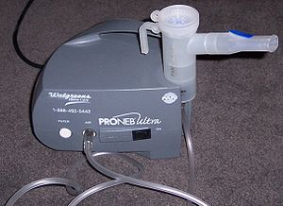
Nebulizers
a device used to administer medication in the form of a mist that inhaled into the lungs.
It use oxygen, compressed air or ultrasonic power to break up medical solutions/suspensions into small aerosol droplets that can be direclty inhaled from the mouthpiece of the device.
aerosol is a mixture of gas and liquid particles

Slide 107
spacer
is an add-on device used to increase the ease of administering aerosolized medication from a metered-dose inhaler
The spacer adds space in the form of a tube or “chamber” between the canister of medication and the patient’s mouth, allowing the patient to inhale the medication by breathing in slowly and deeply for five to 10 breaths.

Slide 108
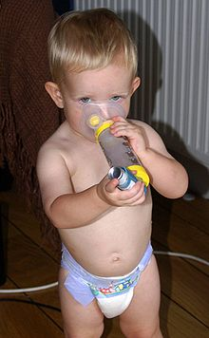
Benefits
In order to properly use an inhaler without a spacer, one has to coordinate a certain number of actions in a set order and not all patients are able to master this sequence.
Use of a spacer avoids such timing issues and make it easier.

Slide 109
Benefits
It reduce deposition in the mouth and throat

Slide 110
Disadvantages
A spacer can be bulky, limiting portability. This portability issue is small when one considers the fact that an asthma drug, such as albuterol MDI used with a spacer, is more effective than nebulizers used by EMS and emergency rooms.

Slide 111
EDUCATION

Slide 112
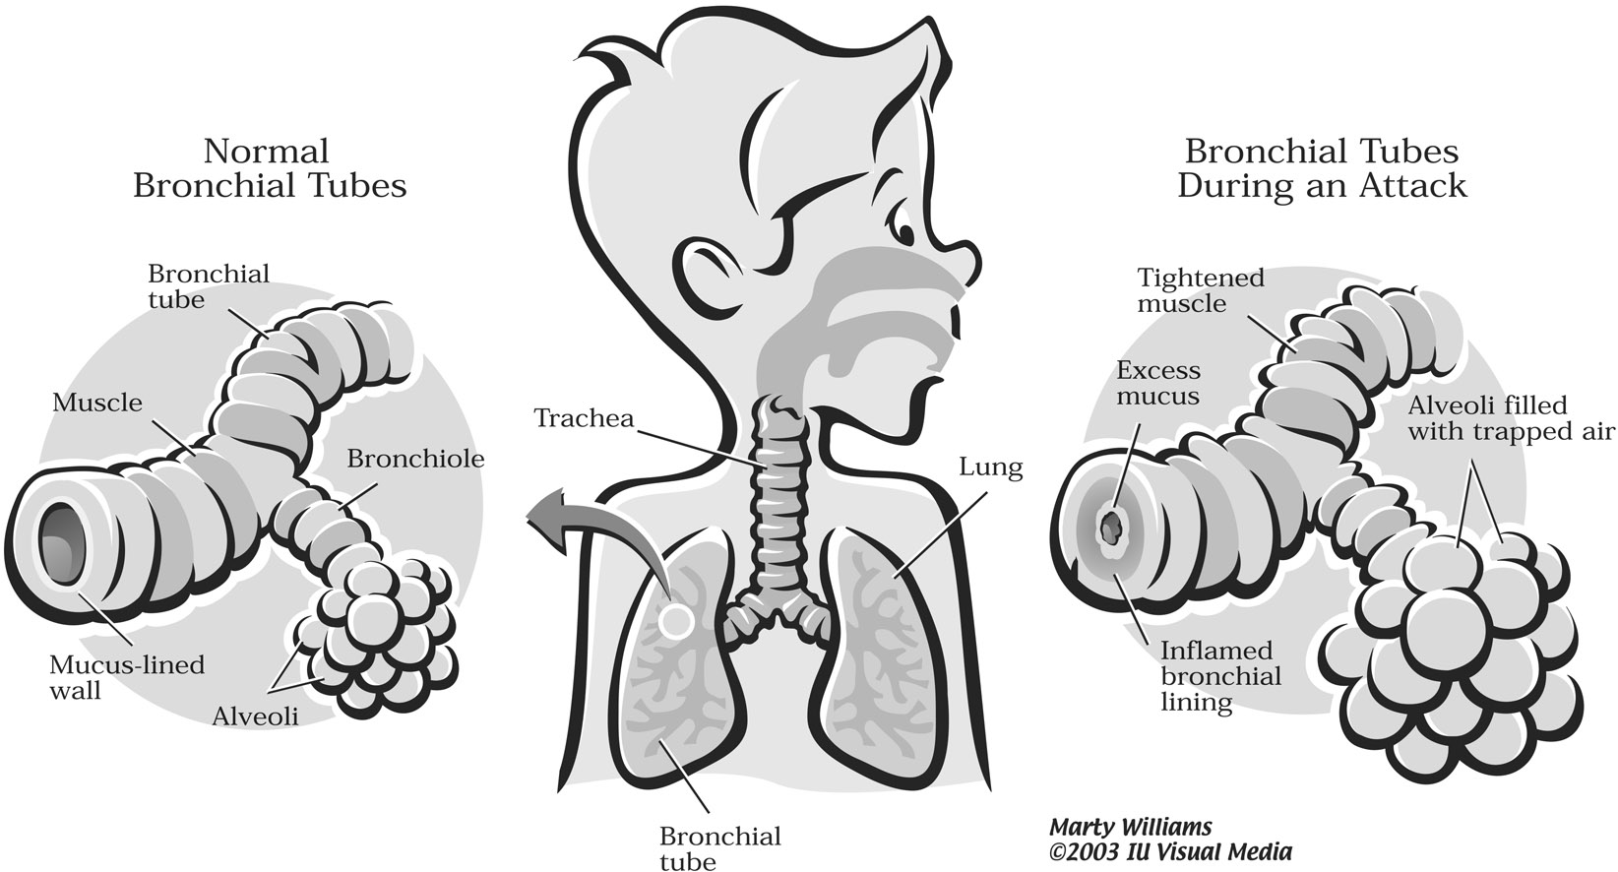

Slide 113
EDUCATION
Asthma self-management education is essential to provide patients with the skills necessary to control asthma and improve outcomes
self-management education requires repetition and reinforcement.

Slide 114
Asthma education category
Education to the Patient
Education to the family

Slide 115
Education to the Patient
What is asthma?
What are triggers?
How to use the medication?
What is the benefit from the medication?
What are the goals of asthma treatment?

Slide 116
What is asthma?
Asthma is a disease of the airways or breathing tubes in the lungs. These airways carry air to the lungs. Airways get smaller and smaller like branches of a tree. When asthma is under control, the airways are clear and air flows easily in and out of the lungs.

Slide 117
What are triggers?
Because you have asthma, your airways are very sensitive. They may react to things called triggers (things that can cause asthma episodes). When you are around triggers, your breathing tubes may become swollen, tighten up, and make a lot of mucus. This will make it harder for you to breathe.
It is important to find out what your asthma triggers are and learn ways to avoid them.

Slide 118
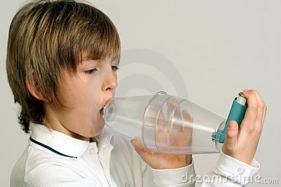
How to use the medication?

Slide 119
What is the benefit from the medication?
Acute
inflammation
symptoms
subclinical
Chronic inflammation
Structural changes
TIME
Barnes PJ. Clin Exp Allergy 1996.
Notes:
Multimedia Slide 7
Asthma is a chronic inflammatory disease with a variable course characterized by episodic attacks of acute inflammation.¹ Acute inflammation in asthma is associated with bronchoconstriction, plasma exudation/edema, vasodilatation, and mucus hypersecretion. Chronic inflammation in asthma is associated with subepithelial fibrosis, smooth-muscle hyperplasia/hypertrophy, mucus gland hyperplasia, and new-vessel formation. If asthma remains uncontrolled or poorly controlled, the underlying chronic inflammation may lead to structural changes (remodelling) that reduce the extent of airway response to therapy.
1. Barnes PJ. New drugs for asthma. Clin Exp Allergy 1996;26:738-745.

Slide 120
What are the goals of asthma treatment?
Prevent hospitalization and emergency room visits.
Prevent school absences.
Prevent disturbed sleep.
Allow full participation in activities such as playing, exercise, and sports.

Slide 121
Education to the family
How can I encourage the patient on compliance?
How can I reduce the triggers?
when we need to tack the patient to the ER ?

Slide 122
Reference
Global initiative for asthma guidelines
http://www.ginasthma.org/pdf/GINA_Report_2010.pdf
Saudi Thoracic committee
http://www.sinagroup.org/download/book_asthma_final.pdf

