Slide 1


Slide 2
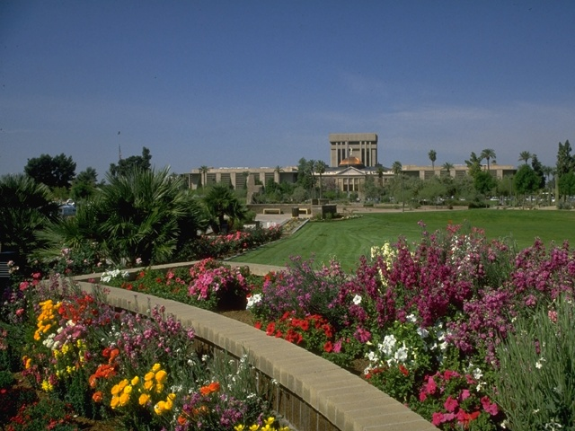
Please write the most imp three points you learned

Slide 3


Slide 4
Learning
It is a relatively permanent change in behavior and in the content of a course, is brought about by a planned learning experience.

Slide 5
Aim and Objectives
Enable you to manage your learning through certain study skills and time management
List five facilitators and five obstacles for learning.
List the the educational activities that you can do while in the HC ?

Slide 6
Aim and Objectives
Increase and develop awareness of the principles of learning
Describe the differences between mature and immature learners
Be able explain the reading for understanding method.

Slide 7
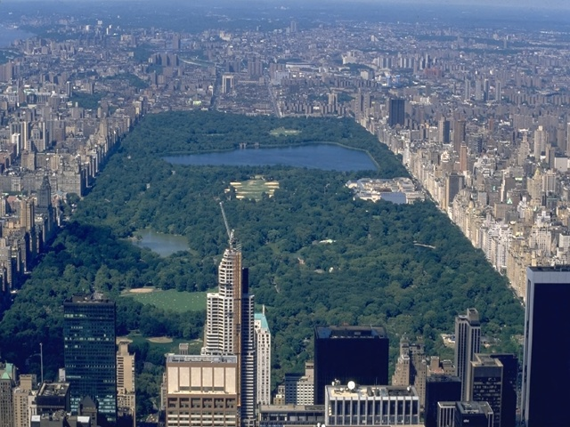

Slide 8
If adult learning is to be achieved…...
Learning has to be deep and active learning as opposed to superficial and passive learning
Why is deep/active learning important?
Superficial learning is easily and very quickly forgotten
With superficial learning you will not be able to apply or use it in practical situations
Deep learning accommodates varying learning styles

Slide 9
How can deep /active learning be achieved?
Do not be a passive receiver of information. Try to interact with information and try to apply it and try to do different things with that information.

Slide 10
What do we remember?
20% of what we read
30% of what we hear
40% of what we see
50% of what we say
60% of what we do
90% of what we read, hear, see, say and do

Slide 11
Learn actively and deeply
Don’t just read and close the book
Try to do different things with what you have read immediately after writing
draw flow charts
draw diagrams using colour
write a summary
attempt answering pass papers
In short, interact with what you have learned

Slide 12
How to shift information from short term to long tern memory?
1. Learn actively & deeply
2. Revisit, repeat & revise
Important points about revisiting & revision
There is no special place or time to revise.
Try to revisit and repeat at every given opportunity.
Do not wait until you finish studying to revise.

Slide 13
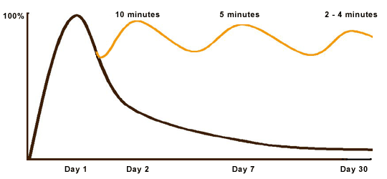
Forgetting curve

Slide 14
Two students read same time and same IQ, one score higher why
Read before lecture
Reading for understanding
Luck
Read after lecture
Use other methods e.g. video, virtual hospital

Slide 15
differences in Learning from one person to another

Slide 16
Your learning style =
How you perceive information
+
How you process information

Slide 17
Learning styles I
Visual learner
Auditory learner
Reading/writing
Kinaesthetic learner

Slide 18
Learning styles II
Thinkers
Reflector
Theorist
Activist
Pragmatist
Action-oriented

Slide 19
WHAT IS LEARING STYLE?
The way in which each individual learner begins to concentrate on, process, absorb, and retain new and difficult information.
Learning styles are the most important tool for us when we construct knowledge.
The right way of studying does not exist.

Slide 20
WHAT IS LEARING STYLE?
Everybody learns in his individual way, but without knowing this way, you can’t learn efficiently – sometimes you can’t learn at all. SO
Learning styles are strategies or regular mental behaviors that are habitually applied by an individual to learning.

Slide 21
EXPERIMENTAL LEARNING
Learning Cycle
Concrete experience: perception of the objective world.
Active experimentation: testing theory in new situations
Observation and reflection: the beginning of internalization
Abstract conceptualisation: step back and draw conclusions or make generalisations
Kolb et al (1984)

Slide 22
Kolb’s Experiential Cycle

Slide 23
 | MATURE READERS | IMMATURE
BEFORE READING | Activate prior knowledge Understand task and set purpose Choose appropriate strategies Focus attention Anticipate and predict | Start reading without preparation Read without knowing why Are easily distracted Read without considering how to approach the material

Slide 24
 | MATURE READERS | IMMATURE READERS
DURING READING | Use fix-up strategies when lack of understanding Use contextual analysis to understand new terms Use text structure to assist comprehension | Read to get done Do not know what to do when lack of understanding occurs Do not recognize important vocabulary

Slide 25
 | GOOD OR MATURE READERS | POOR OR IMMATURE READERS
DURING READING | Organize and integrate new information Self-monitor comprehension by ... knowing comprehension is occurring knowing what is being understood | Are easily distracted Read to get done Do not know what to do when lack of understanding occurs Do not recognize important vocabulary

Slide 26
 | GOOD OR MATURE READERS | POOR OR IMMATURE READERS
AFTER READING | Reflect on what was read Feel success is a result of effort Summarize major ideas Seek additional information from outside sources | Stop reading and thinking Feel success is a result of luck

Slide 27

How can I learn Better?

Slide 28
SQW3R S = Survey
  The whole reading/ chapter. scanning:
  title(s) and subheadings
  summaries or abstracts
  the introduction and conclusion
  visual materials (pictures, charts, graphs or tables) and their captions
  the first and last sentences in paragraphs
  the conclusion
  any focus questions

Slide 29
SQW3R Q = Question
Your reading will be more memorable
Writing down questions keeps you alert and focused on your work.
Ask yourself:
What is this chapter/ article about?
What did my lecturer/ tutor say about this chapter or subject?
What do I already know about this subject?
How does this reading relate to what I already know/ have read?

Slide 30
Devise questions that will guide your reading:
Think about specific questions
Read any focus questions at the end
Turn the title, headings and subheadings into questions. For example, if the heading is Qualitative and Quantitative Research, your question might be: …...?’

Slide 31
Make a list of your questions for consideration. You will use during revision

Slide 32
R1 = Read
Be prepared to READ material twice.
First, read without making notes:
Decrease your pace and read actively. Active reading requires concentration, so take your time and find a quiet place.
As you read, look for answers to the earlier Qs
Question the author’s reasoning. Is each point justified?
Compare diagrams and illustrations with the written text.

Slide 33
Make sure you understand what you are reading. Reduce your reading speed for difficult passages.
If you have difficulty understanding a text, look up difficult words in the dictionary or glossary of terms and reread. If the meaning of a word or passage still evades you, leave it and read on.

Slide 34
Use reflection to increase your understanding of what you read. When the author makes a claim, reflect on your prior knowledge to support or disprove it. If this raises more questions, note them down.

Slide 35
SQW3R W • (Read) + Write
On your second reading, begin to take notes:
Take notes from the text, but write information in your own words.
Read one section at a time (a section might be divided up by headings or subheadings)
After you read a section, try to sum up the main point in one sentence.
Note down the main idea(s) of each paragraph in a section. They are often found in the first or last sentence.

Slide 36
Examples and illustrations can further your understanding and be good cues for memory. Look for important details (supporting evidence, written illustrations of points, provisions or alternatives ).
In your notes, underline or highlight the important points. Why?
Refer to the list of questions you made earlier and try to answer them.

Slide 37
SQW3R R2 = Recall
RECALL straight after you finish taking notes.
You should now try to recall and write your thinking about what you have read.
Close the book and cover your notes.
Make notes of what you remember about the main thesis and points of the reading.
Check their accuracy against the notes you made

Slide 38
SQW3R R2 = Recall
RECALL straight after you finish taking notes.
Return to the reading. Read one section at a time and try to recall what you have read. Reread the section that you could not recall to clarify it further.
It can also be helpful to RECITE ideas aloud to help you remember. Sum up the main points verbally.

Slide 39
SQW3R R3 = Review
Now REVIEW what you have read.
At the end of your study period:
Check the accuracy of your notes against the original material (if you have underlined the main points, this should be simple). This is an important part of the process because it can really help you clarify and remember what you have read.

Slide 40
The next day:
Read through your notes to reacquaint yourself with the main thesis and key points.
Now read through the questions you noted down and try to answer them from memory.
Try doing the same thing after a few days.
If you are reading for a course, periodically reviewing notes will help you at exam time. The more you revise throughout semester, the less you will need to cram during exam study periods.

Slide 41
Is Your Reading Relevant?
Select a book or article: Ask yourself what it is you must find out.
Use the contents page first. Is the information you are looking for listed?
Go to the index at the back. Locate key words.

Slide 42
Skim through the first chapter.
If the chapter is relevant,
read the first and last paragraphs.
Ask yourself what the author is saying.
From this, you can gain an overall view of the content, enabling you to decide on the relevance of the book to your topic.

Slide 43
BUILDING ON THE PRINCIPLES OF ADULT LEARNING
Adult Learners are most successful when: | The Tutor should therefore: Remember in EBM
There is a high degree of personal motivation | Use the learners’ enthusiasm
The learning is within their capacity to learn | Avoid excessive jargon and/or showing off his/her own knowledge Ensure the learner is not over-tired
The learning experience is meaningful | Clearly relate the learning experience to practice

Slide 44
Adult Learners are most successful when: | The Tutor should therefore: Remember in EBM
There is active involvement | Involve the learners
The learning is experience-centered The learner can reflect on the experience | Clearly relate the learners’ experience requiring them to ask and answer questions (discuss)
Clear goals are set | Identify the expectations of each learning experience
Regular feedback is provided | Provide regular, timely feedback which is specific both for positive features and suggestions for improvement

Slide 45
What are the educational activities that you can do while in the HC ?

Slide 46
Observation and discussion with the PHC physician while consulting their patients. Make notes about what you observe.
Interviewing certain selected patients alone.
Discussion with different team members (one session each(
Lecturing in the centre.
Design a health education material for the practice.

Slide 47
Free time in your schedule should be made use of e.g. by reading in the library or discussion with colleagues or any other useful activity.
A good deal of learning in the practice is one to one. However you are strongly recommended to attend the continuing medical education activities of the family medicine clinics

Slide 48
Read the whole curriculum guidelines
Don t read
Read some
Read all but next week

Slide 49

Adult Learning theory
Malcolm Knowles

Slide 50
Adult Learners are most successful when:
There is a high degree of personal motivation
The learning is within their capacity to learn
The learning experience is meaningful

Slide 51
Adult Learners are most successful when:
There is active involvement
The learning is experience-centered
The learner can reflect on the experience
Clear goals are set
Regular feedback is provided

Slide 52
Five assumptions on how adults learn:
  Independent and self directing
  Accumulated a great deal of learning
  Value learning relevant with everyday demands
  Immediate problem centered approach
  Motivated by internal drives

Slide 53
شكــــــراً
THANKS

Slide 54
LEARNING HOW TO LEARN
Eiad A. Al-faris
Professor and consultant of family medicine

Slide 55
Introduction

Slide 56
Exercise 1: Two minutes
What is your definition of learning?
Please answer the questions first alone and then with your neighbour:-
Your ideas!
Notes:
Three minutes for the answer

Slide 57
Exercise 2: Two minutes
Think of a good learning incidence:
What factors helped your learning with that incidence?
Please write your name in the answer sheet
keep a copy of your answer
Only one point in each paper
You can write as much points as you like

Slide 58
Principles to guide teaching practice
A-Effective and safe learning climate

Slide 59
Principles to guide teaching practice
A-Effective and safe learning climate
Active contributor

Slide 60
Principles to guide teaching practice cont
Active contributor
Learning close to understanding and solving real life problems
Current knowledge and experience are critical in new learning situations
Learners should be supported to use self direction in their learning.

Slide 61
Principles to guide teaching practice cont
Learners should be supported to use practice accompanied by self assessment and constructive feedback.
Learners should be given opportunities to reflect on their practice.
The use of role models by medical educators has a major impact on learners.

Slide 63
Learning
It is a relatively permanent change in behavior and in the content of a course, is brought about by a planned learning experience.

Slide 64
Please write the most imp three points you learned

Slide 65

Exercise 3
Answer true or false

Slide 66
The main purpose (s) of teaching are to:
Answer true or false
The transmission of information T/F
To help students to Establish habits. T/F
To make students Develop attitudes and skills. T/F

Slide 67
The main purpose (s) of teaching are to:
To help students to Understand, analyze, synthesize and evaluate. T/F
Telling students what to do. T/F

Slide 68
Exercise 4
The most appropriate
response

Slide 69

Some learning theories

Slide 70
The six theories
Characteristics of adult learners (Knowles)
Constructivist Theory (J. Bruner)
Self-directed learning
Social cognitive theory
Reflective practice
Experiential learning
Adult learning principles

Slide 71
Adult Learning theory
Malcolm Knowles

Slide 72
Characteristics of adult learners “Andragogy’’ By Knowles
Five assumptions on how adults learn:
  Independent and self directing
  Accumulated a great deal of learning
  Value learning relevant with everyday demands
  Immediate problem centered approach
  Motivated by internal drives

Slide 73
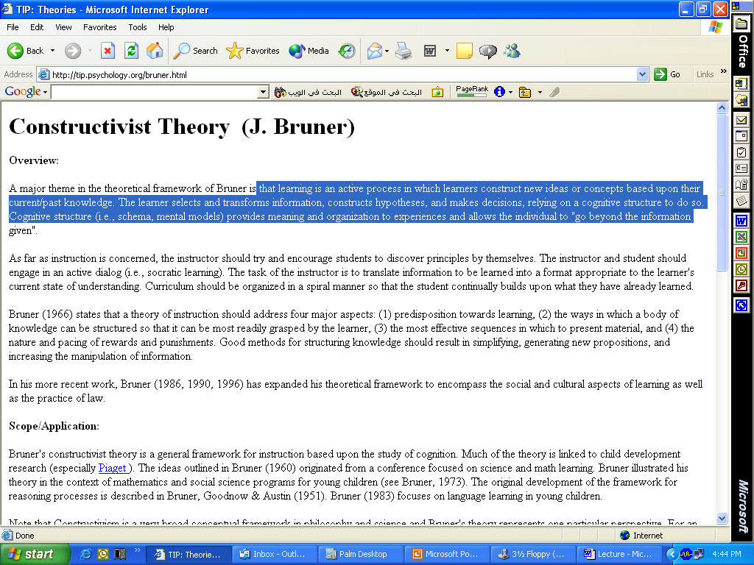

Slide 74
Constructivist Theory (J. Bruner)
Overview:
Bruner: learning is an active process in which learners construct new ideas or concepts based upon their current/past knowledge.
The learner selects and transforms information, constructs hypotheses, and makes decisions, relying on a cognitive structure to do so.
Notes:
Cognitive structure (i.e., schema, mental models) provides meaning and organization to experiences and allows the individual to "go beyond the information given".

Slide 75
Constructivist Theory (J. Bruner)
Implication:
Teacher transmitter of information
Inconsistency: learning experiences
Active engagement
Sufficient time for in-depth examination of new experiences
Notes:
Cognitive structure (i.e., schema, mental models) provides meaning and organization to experiences and allows the individual to "go beyond the information given".

Slide 77
Self directed learning (cont)
Implications on the curriculum
Requires supportive environment

Slide 78
المعلم لا أدري لما لا يدري جزء من العلم قول
سئل رجل النبي  أي البقاع خير؟ قال لا أدري ثم سئل أي البقاع شر؟ قال لا أدري ، فأوحى الله لرسوله بأن خير البقاع المساجد وشر البقاع الاسواق .

Slide 79
Self directed learning
Learners task are within the learner control
Learners accept responsibility

Slide 80
Skills that directly improve Self directed learning
Requires supportive environment
Critically appraise new information
Reflecting critically on their learning process and outcome
Self assessment
Assessment promotes self-direction

Slide 81
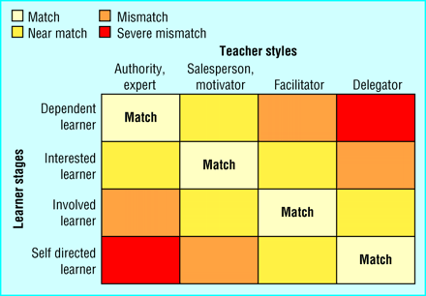

Slide 82
Self efficacy Albert Bandura
People judgment of their ability to deal with different situations is central to their actions.
Four main sources
  Performance attainment
  Observation of other people (vicarious experience)
  Verbal persuasion from a credible source
  Physiological state

Slide 83
What are the application?
Guided practice of new skills to experience success
Avoid failure in the early crucial learning period.
Demonstration of the desired process
Encouragement
Relaxation and optimism

Slide 84
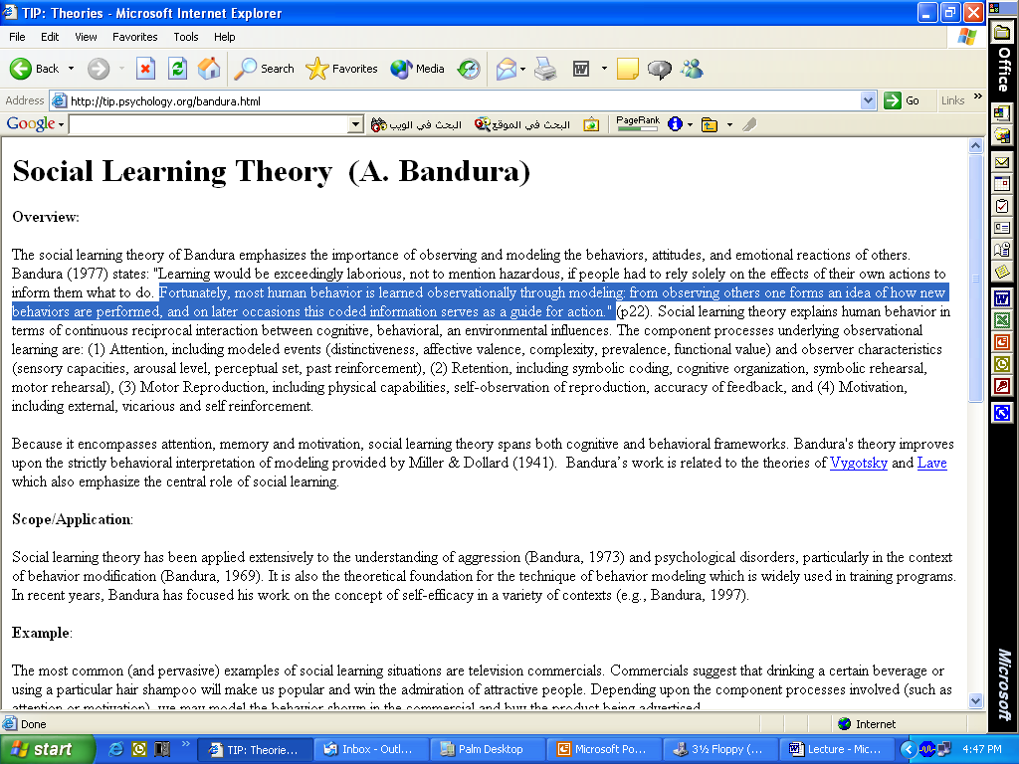

Slide 85
Social Learning Theory
(A. Bandura)Overview:
Fortunately, most human behavior is learned observationally through modeling: from observing others one forms an idea of how new behaviors are performed, and on later occasions this coded information serves as a guide for action." (p22).

Slide 86
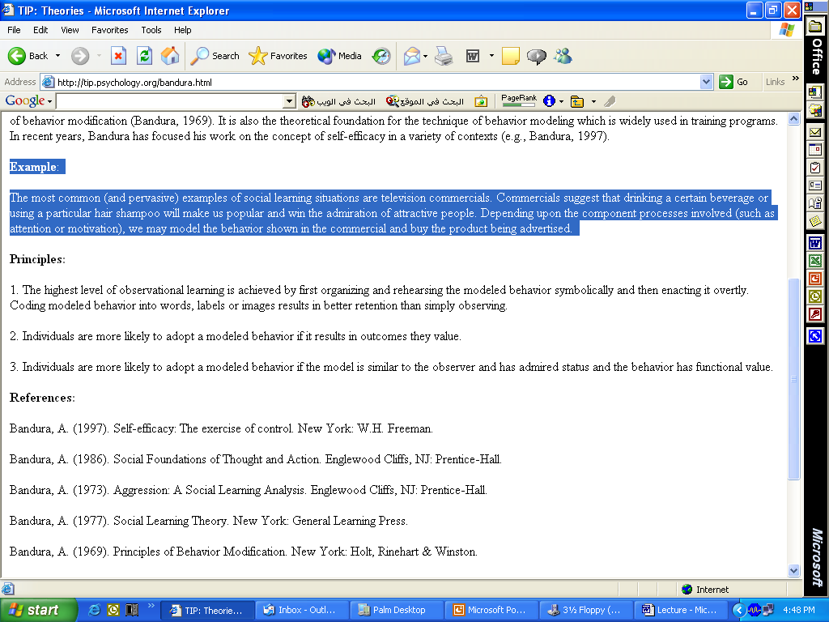

Slide 87
Scope/Application: Example:
The most common examples of social learning situations are T.V commercials which suggest that drinking a certain beverage will make us popular and win the admiration of attractive people. We may model the behavior shown in the commercial and buy the product being advertised.

Slide 88
Reflective practice by Schon
Reflection in action
Reflection on action
  Self awareness
  Description
  Analysis
  Synthesis
  Evaluation
Wisdom in practice (debriefing, feedback, learning diary)

Slide 89
Kolb’s Experiential Cycle

Slide 90
a-During the classroom
  There will be fewer lectures and more discussions and tutorials, which will be based on your participation and active involvement. This system encourages you to participate more actively in your learning and take more responsibility for your learning. Your involvement in the lectures is welcomed and encouraged.

Slide 91
The style of teaching is a mixture of interactive lectures, large group tutorials, students’ group presentation whose topics were selected based on your learning needs, single student EBM presentation and small group discussions.

Slide 92
Self assessment questions
The self assessment questions in a similar way to the exam questions. The topic that you encounter difficulty with requires from you a plan to learn re are better

Slide 93
Some teachers will give you a patient scenario and an article or a suggested reading reference; make sure to answer the questions about the scenario before attending the session

Slide 94
Reflection
Clinical and non-clinical materials faced in the centre will raise certain learning issues and needs. You are expected to respond by careful and critical thinking, reading or discussion with clinical tutors, colleagues or teachers during the tutorials.

Slide 96
The exercise result
Please read the attached paper

Slide 97
Aim and Objectives
Increase and develop awareness of the principles of learning
List the names of at least two learning theories
Be able to provide two examples in which theories inform practice

Slide 98
Further Practice
Exercise 3
Visit and utilise the attached learning resources
http:/tip.psychology.org
Portfolios
  Educational portfolios BMJ
  PC diary learning portfolio software
http://gacguidelines.ca

Slide 99
Further Practice
Exercise 3
Visit and utilise the attached learning resources
Design a lecture using the Gagne’ events of instruction
Apply some of the principles of adult learning principles to solve some of your learning difficulties

Slide 100
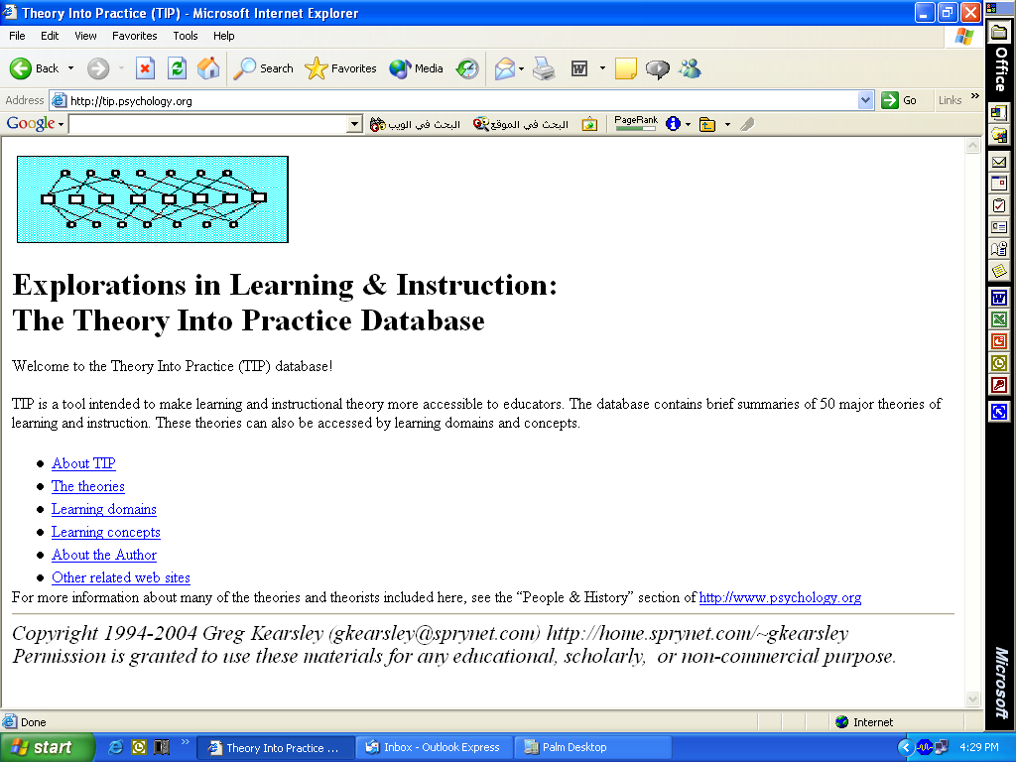

Slide 101
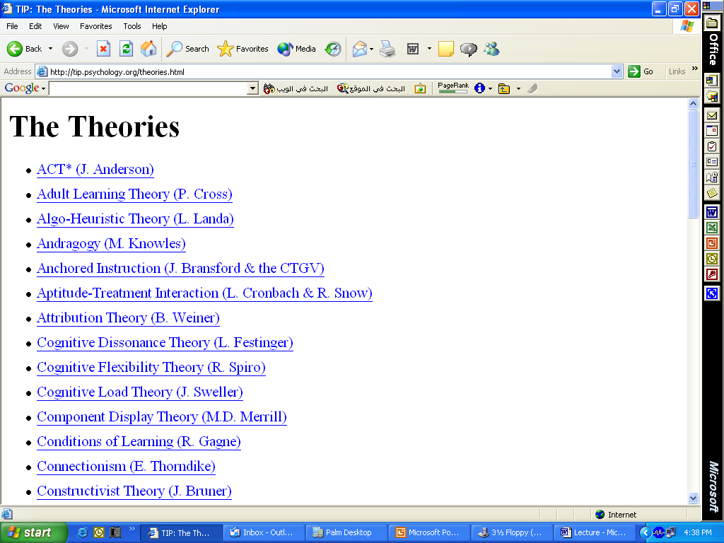

Slide 102
Learning management
Portfolios
  Educational portfolios BMJ
  PC diary learning portfolio software

Slide 103
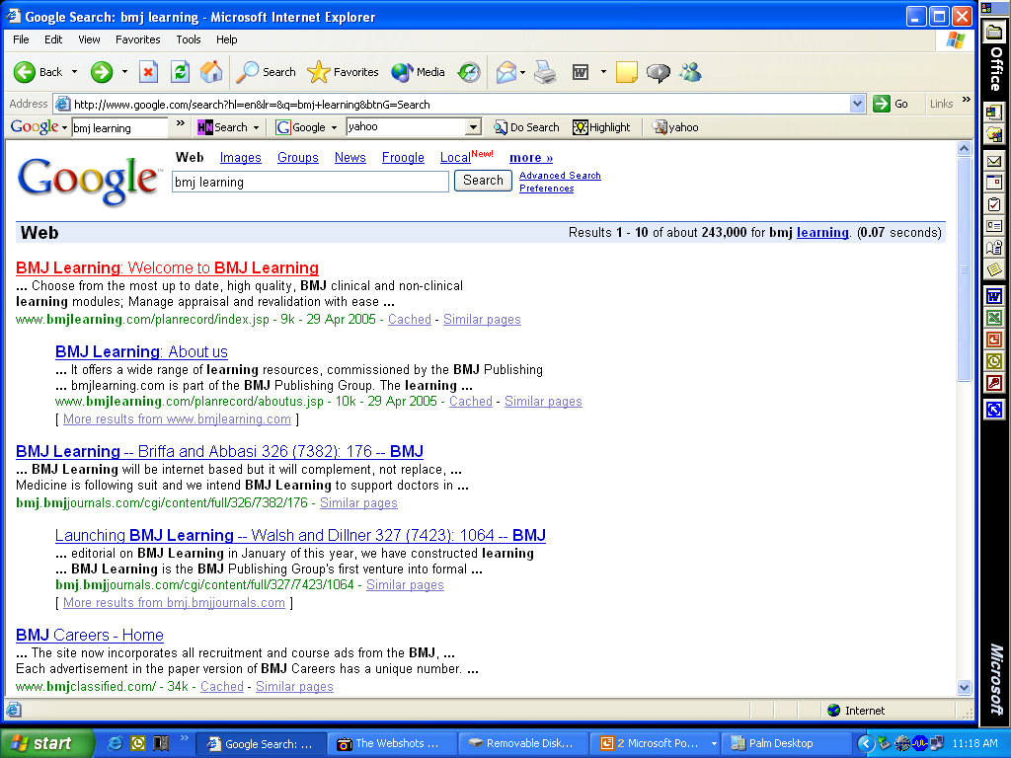

Slide 104
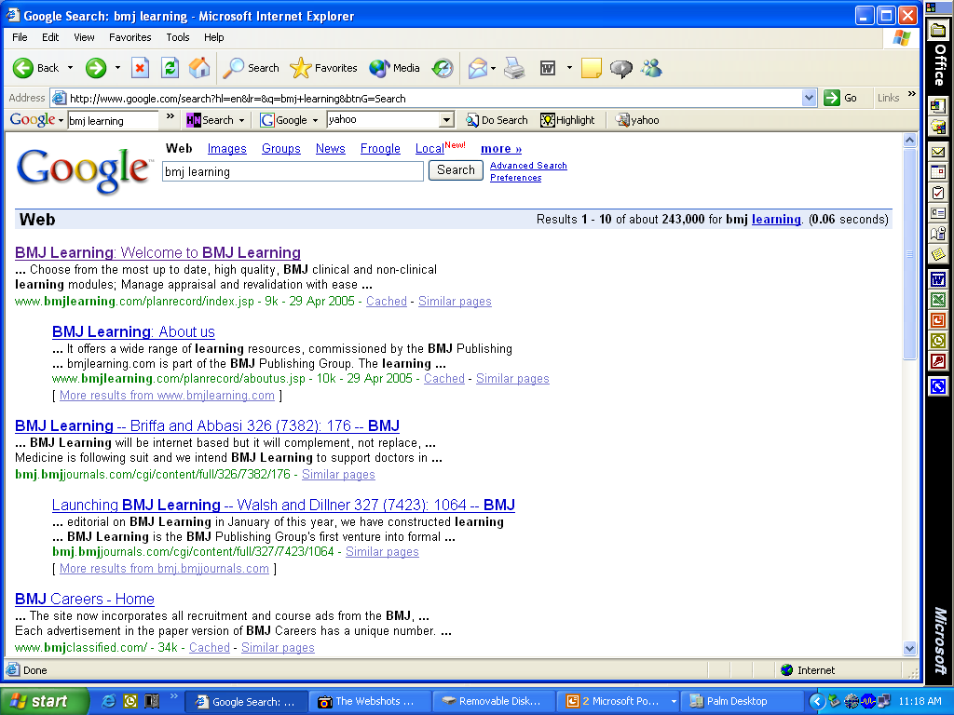

Slide 105
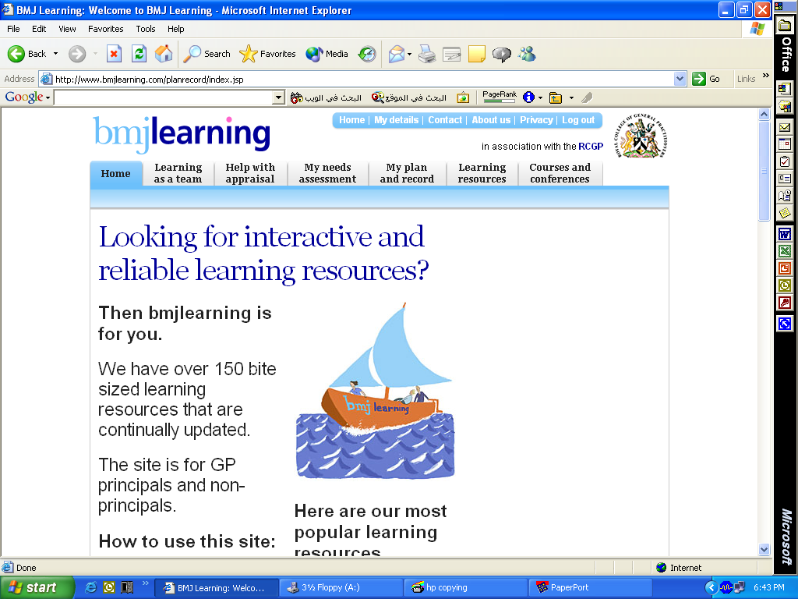

Slide 106
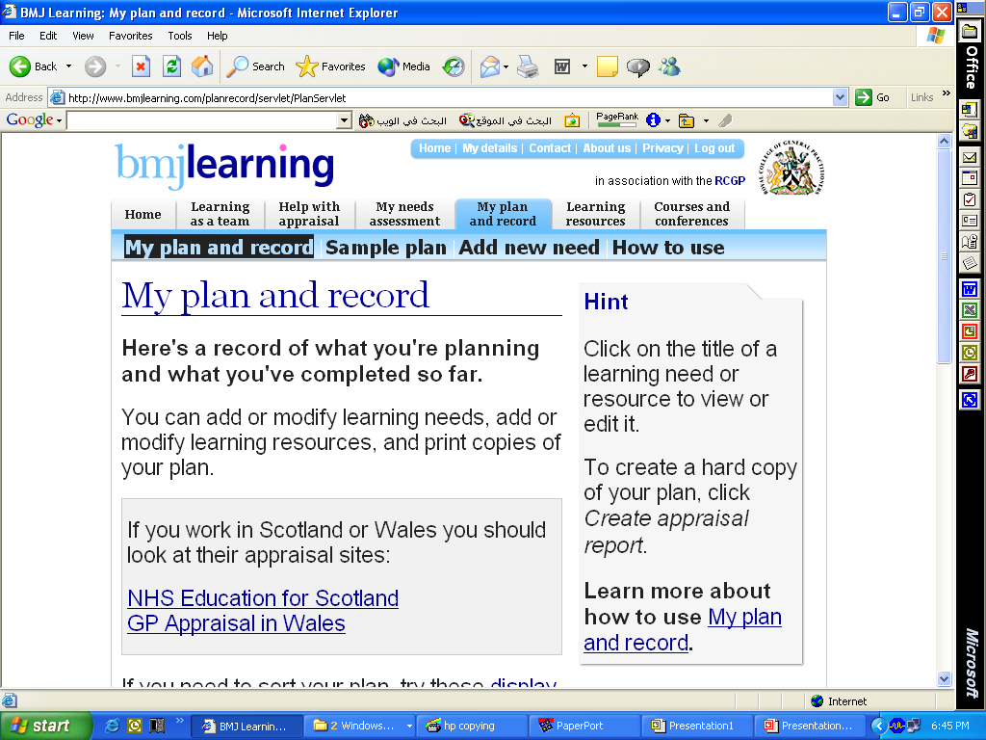

Slide 107
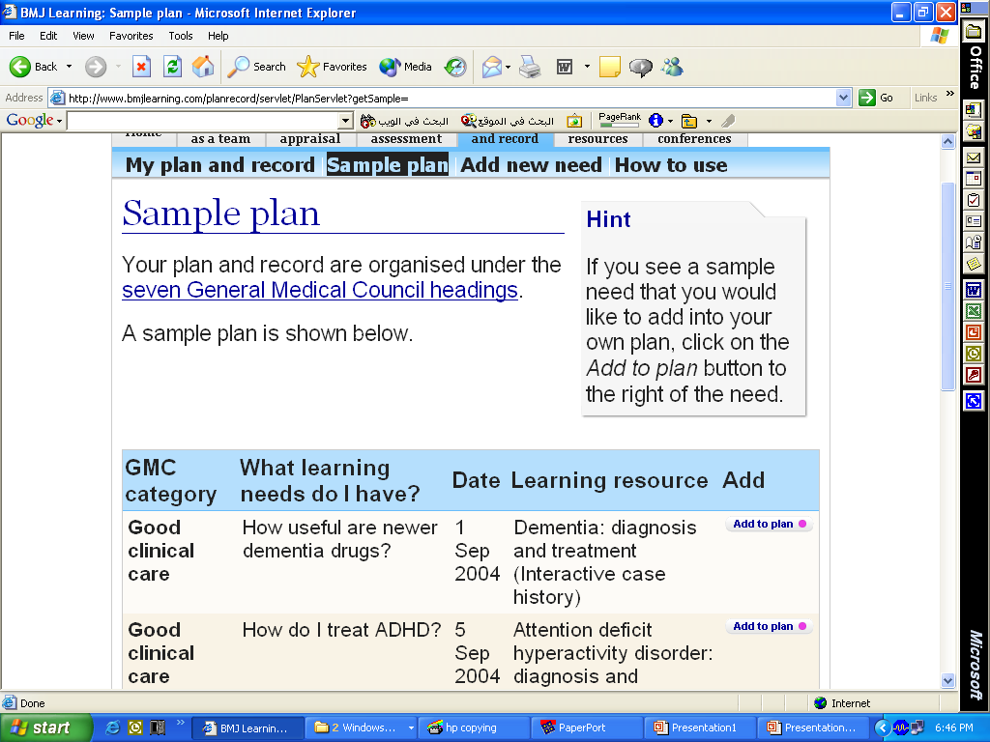

Slide 108


Slide 109
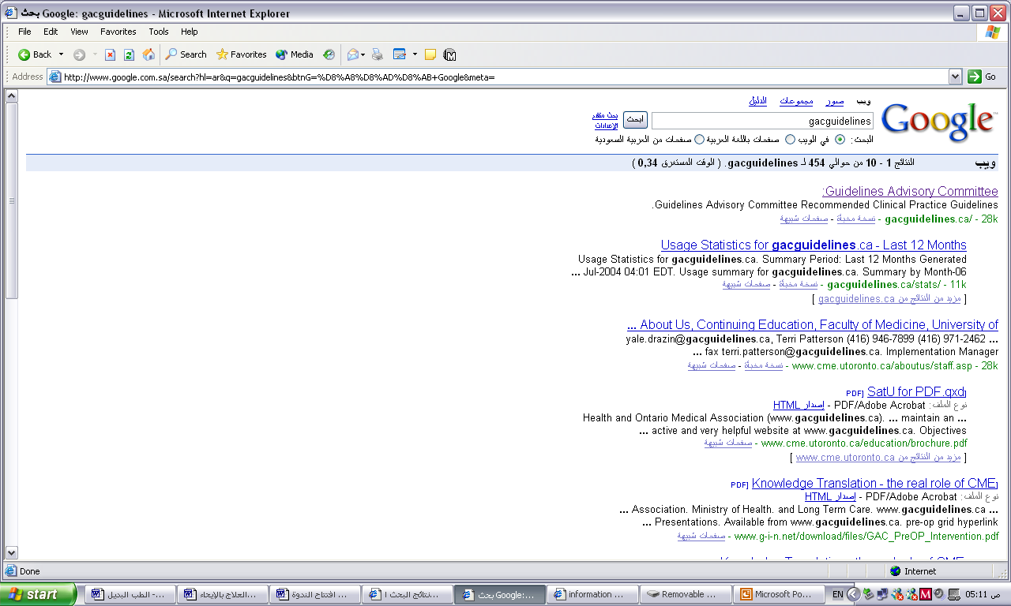

Slide 110


Slide 111
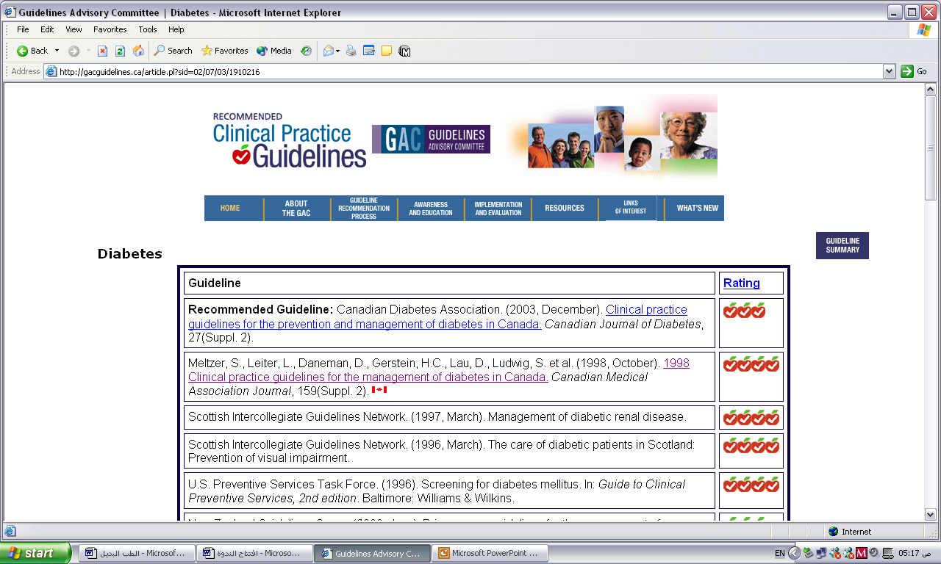

Slide 112
SUMMARY

Slide 113
Please write the most imp three points you learned

Slide 114
References
Kaufman DM, KV Mann, Jennett PA. Teaching and Learning in Medical Education: How Theory can inform practice. Association for the Study of Medical Education, 2000. ASME Office.
Hesketh EA, Laidlaw. Developing the teaching instinct 3: Facilitating Learning. Medical Teacher, Vol. 24, No 5, 2002, pp. 479-482.
Kaufman M David. ABC of learning and teaching in medicine applying educational theory in practice. BMJ vol. 326, 2003.
Newman Panny, Peile Ed. Valuing learners’ experience and supporting further growth: educational models to help experienced adult learners in medicine. BMJ vol. 325, 2002.
Al-Faris EA. Students’ Evaluation of a Traditional and Innovative curriculum in a Saudi Medical School. Education for health 2002
tip.psychology.org

Slide 115
Feedback from students & myself
Distribute scenarios before hand
Make it shorter with break
A,b,c choices if written it is better
Make it in the form of 3 scenarios for students who have difficulty learning or study ( ask naghma to prepare)
  barriers and facilitators
  Reading for understanding
  Time management

Slide 116
Feedback from students & myself
Remove the exercise on definition of learning
Prepare in writing the references
Tell where to find the curric guidelines in the bookshop
Bring some material to be read

Slide 117
Feedback from students & myself
Take the best of learning theories and put in the form of scenario
Read from the English booklet
Show internet resources
Hutchison and PDA
Distribute slides 22-25 and lolo

Slide 118
Ways of varying student activity in lectures
Rest
Show a video clip
Demonstrate a task
Set a brief MCQ
Use Buzz groups
Red and green cards
Read some material or Notes

Slide 119
Ways of varying student activity in lectures Cont.
Solve a problem collectively
Ask the students to
  discuss briefly a research design
  frame questions in relation to data.
  invent examples and compare
  Advantage and disadvantages of a procedure or theory

Slide 120
Classical classification of Learning styles:
Visual (prefer to learn by seeing)
Auditory (prefer to learn by sound)
Kinesthetic (prefer to learn by doing)
Verbal (linguistic) learning style
Logical (mathematical) learning style
Social (interpersonal) learning style

