Slide 1
Rational use of drugs & compliance
Dr Rajab Ali Khawaja FCPS, MRCGP
Clinical Assistant Professor & Consultant
family Medicine

Slide 2
Learning Objectives
Definition of rational Use of Drugs
Rationale behind rational use of drugs
Reasons of irrational use of drugs
Dangers of irrational use of drugs
Steps to be taken for rational use of drugs
Compliance of drugs-
- Definition and benefits
- Burden of poor compliance, its reasons and hazard
- Strategies to improve compliance

Slide 3
Rational use of drugs
Definition:
In simplest words rational use means “prescribing right drug, in
adequate dose for the sufficient duration & appropriate to the
Clinical needs of the patient at lowest cost
World Health Organization

Slide 4
Rational use of drugs
Rational use of drugs is based on “Rule of Right”
The right medicine at the right time with the right dosages.
It should fulfill the SANE criteria:
Safety
Affordability
Need
Efficacy

Slide 5
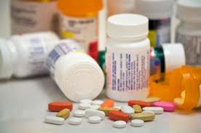
Criteria for rational prescribing
Specific diagnosis
Appropriate indication
Appropriate medicines
Appropriate patient
Appropriate dosage
Appropriate duration
Appropriate Route of administration
Appropriate Information & monitoring
WHO, Dept. Essential Drugs and Medicines Policy

Slide 6
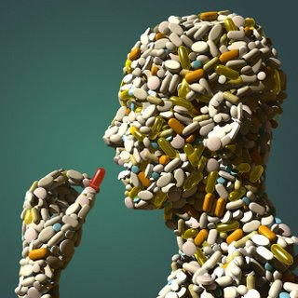
Rationale behind rationale use of drugs (Factors that have led sudden realization for rational drug use)
Drug explosion
Efforts to prevent the
development of resistance
Growing awareness
Increased cost of the treatment
Consumer protection Act. (CPA)

Slide 7
Irrational Prescribing (common patterns)
Use of medicines when no medicine is indicated
Use of wrong medicine
Use of medicine with doubtful efficacy
Use of medicine having uncertain safety status
Failure to provide available safe & effective drug
Use of correct medicine with incorrect administration, dose & duration
Prescribing new costly medicine when cheaper alternative is available
Indiscriminate use of injections
Over use & misuse of drugs especially antibiotics
inadequate treatment of serious illness

Slide 8
REASONS FOR IRRATIONAL USE OF DRUGS (OBSTACLES IN RATIONAL DRUG USE)
Lack of information
Faulty & inadequate training & education of medical graduates
Poor communication between health professional & patient
Lack of diagnostic facilities/Uncertainty of diagnosis
Demand from the patient
Defective drug supply system & ineffective drug regulation
Promotional activities of pharmaceutical industries

Slide 9
HAZARDS OF IRRATIONAL USE OF DRUGS
Ineffective & unsafe treatment
Exacerbation or prolongation of illness.
Distress & harm to patient
Increase the cost of treatment

Slide 10
Problem of irrational use
Worldwide more than 50% of all medicines are prescribed,
dispensed, or sold inappropriately, while 50% of patients fail to
take them correctly. Moreover, about one-third of the world's
population lacks access to essential medicines
World health organization

Slide 11
Adverse drug events
4-6th leading cause of death in the USA
Estimated costs from drug-related morbidity & mortality 30 million-130 billion US$ in the USA
4-6% of hospitalisations in the USA & Australia
commonest, costliest events include bleeding, cardiac arrhythmia, confusion, diarrhoea, fever, hypotension, itching, vomiting, rash, renal failure
Review by White et al, Pharmacoeconomics, 1999, 15(5):445-458

Slide 12
Cycle to improve Rational use of drugs
1. EXAMINE
Measure Existing
Practices
(Descriptive
Quantitative Studies)
4. FOLLOW UP
improve
diagnosis
2. DIAGNOSE
Measure Changes
Identify Specific
in Outcomes
Problems and Causes
(Quantitative and Qualitative
(In-depth Quantitative
Evaluation)
and Qualitative Studies)
improve
intervention
3. TREAT
Design and Implement
Interventions
(Collect Data to
Measure Outcomes)

Slide 13
Rational use of drugs
Intrinsic
Prior Knowledge
Scientific Information
Habits
Information
Influence of Drug
Industry
Social & Cultural
Factors
Treatment Choices
Societal
Workload & Staffing
Economic &
Legal Factors
Workplace
Infra- structure
Authority & Supervision
Relationships
With Peers
Workgroup

Slide 14
Strategies to Improve Use of Drugs
Educational:
Inform or persuade
Health providers
Consumers
Economic:
Offer incentives
Institutions
Providers and patients
Managerial:
Guide clinical practice
Information systems/STGs
Drug supply / lab capacity
Regulatory:
Restrict choices
Market or practice controls
Enforcement

Slide 15
Educational Strategies Goal: to inform or persuade
Training for Providers
Undergraduate education
Continuing in-service medical education e.g. seminars, workshops
Face-to-face persuasive outreach e.g. academic detailing
Clinical supervision or consultation
Printed Materials
Clinical literature and newsletters
Formularies or therapeutics manuals
Persuasive print materials
Media-Based Approaches
Posters
Audio tapes, plays
Radio, television

Slide 16
Managerial strategies Goal: to structure or guide decisions
Changes in selection, procurement, distribution to ensure availability of essential drugs
Essential Drug Lists, morbidity-based quantification, kit systems
Strategies aimed at prescribers
targeted face-to-face supervision with audit, peer group monitoring, structured order forms, evidence-based standard treatment guidelines
Dispensing strategies
course of treatment packaging, labelling, generic substitution
Avoidance of perverse financial incentives
prescribers’ salaries from drug sales, flat prescription fees,
insurance policies that reimburse non-essential drugs or incorrect doses

Slide 17
Regulatory strategies Goal: to restrict or limit decisions
Drug registration
Banning unsafe drugs - but beware unexpected results
substitution of a second inappropriate drug after banning a first inappropriate or unsafe drug
Regulating the use of different drugs to different levels of the health sector e.g.
licensing prescribers and drug outlets
scheduling drugs into prescription-only & over-the-counter
Regulating pharmaceutical promotional activities

Slide 18
Choosing an Intervention
A single educational strategy is often not effective and does not have a sustainable impact
Printed materials alone are not effective
Combination of strategies, particularly of different types (e.g. educational + managerial) always produces better results than a single strategy
Focused small groups and face to face interactive workshops have been shown to the effective
Audit and feedback, peer review, are very effective
Economic strategies are very powerful strategies to change drug use but may be difficult to introduce

Slide 19
strategies to promote Rational Use of Drugs (world health organization)
1. Evidence-based standard treatment guidelines
2. Essential Drug Lists based on treatments of choice
3. Drug & Therapeutic Committees in hospitals
4. Problem-based training in pharmacotherapy in Under Graduate training
5. Continuing medical education as a licensure requirement
6. Independent drug information e.g bulletins, formularies
7. Supervision, audit and feedback
8. Public education about drugs
9. Avoidance of perverse financial incentives
10. Appropriate and enforced drug regulation

Slide 20
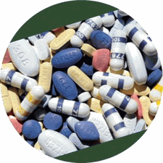
COMPLIANCE

Slide 21
COMPLIANCE (adherence, concordance or capacitance, Alliance, Fidelity)
Definition:
The extent to which a person’s behaviour (in terms of taking
medications, following diets or executing lifestyle changes)
coincides with medical or health advice

Slide 22
Average of expert’s preferred definition
Compliant Patient misses < 25% of medication
Partially compliant Patient misses 25%–65% of medication
Noncompliant Patient misses > 65% of medication

Slide 23
Compliance (The pot of gold)
Better Health for Patients
Reduced Cost to Insurance, Individuals, Society
Better Care Management
Less Stress
Overall Increased Effectiveness of Drugs
Many, many more benefits!

Slide 24
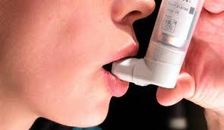
Partial or Non-compliance
Over or under use, wrong time
Taking the wrong medicine
Administration error
Using another patient’s medication
Using old, possibly expired medication

Slide 25
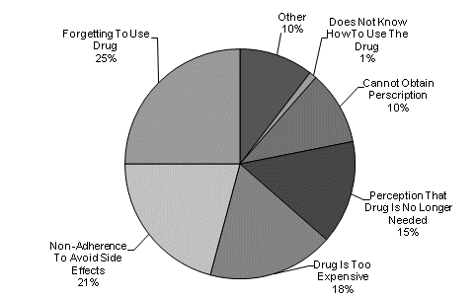
Leading Reasons for Medication Noncompliance
Forgetfulness/Wasn't reminded to take medication
Disbelief that drug is necessary or is helping
Fear of side effects
Experiencing actual side effects
Belief that medication would have a negative impact on performance of daily activities
Desire to save money
Felt symptoms had disappeared so drug was no longer necessary
Confused by instructions
Overwhelmed by number of drugs prescribed
Difficulty opening medication container
Difficulty swallowing medication

Slide 26
Patients at higher risk
Multiple daily dosing
Complex regimen (polypharmacy)
Patient perceptions (effectiveness, side effect, cost)
Poor communication
Psychiatric illness
Asymptomatic conditions (hypertension)
Chronic conditions (DM, HTN, Arthritis)
Cognitive impairment (dementia, Alzheimer)

Slide 27
Harms of Non-Compliance Noncompliance is dangerous and costly as many illnesses Increases the cost of healthcare as a result of adverse outcomes
Health effects
Economic effects
Increased morbidity
Treatment failure
Exacerbation of disease
More frequent physician visits
Increased hospitalizations
Death
Increased absenteeism
Lost productivity at work
Lost revenues to pharmacies
Lost revenue to pharmaceutical manufacturers

Slide 28
Medication Non-Compliance
In the United States, 50-70% of patients do not properly take their medications
Costs of patient non-compliance are estimated at over $100 billion annually
125000 unnecessary deaths
10% (more than 1 million) of all hospitalizations may be due to non-compliance

Slide 29
Strategies to improve compliance
Clinicians should actively discuss compliance issues with patients (e.g. comprehension, adverse effects and acceptance of illness etc)
Use simple dosing regimens (e.g. agents requiring less frequent dosing or long acting formulations)
Engage family members/significant others to support adherence
Pair pill-taking with a routine daily activity (e.g. eating Breakfast)
Multimedia educational campaigns
Patient education, counseling, written information, special labels
Teaching methods for self monitoring
Devices, reminders, special packaging
Follow up

Slide 30
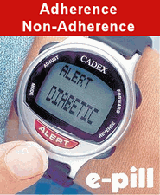
Devices to improve compliance

Slide 31
Benefits of improved compliance
Patients - better outcomes and quality of life
Practitioners - healthier, more loyal patients
Pharmaceutical industry- increased sales
Managed care - lower total health care expenditures

Slide 32
CONCLUSION
Drug use is the end point of the therapeutic consultation
Prescribers have the responsibility to ensure that the right drug is prescribed, dispensed, and taken
Methods exist to measure drug use and to change practices
Improving drug use improves the quality of care and lowers costs
Better compliance is associated with improved health outcome
Promoting the rational use of drugs will finally results in improved quality, increased accessibility and better quality of life for the community

