Slide 1
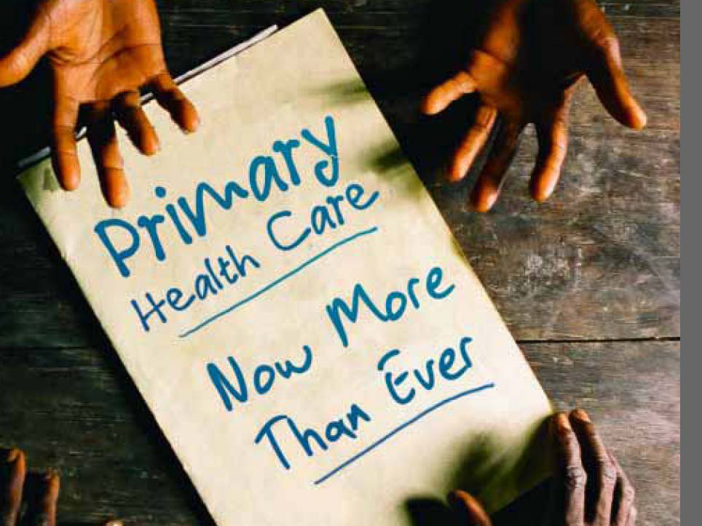
Concepts of PHC Dr. Nada AlYousefi

Slide 2
Objectives
At the end of this session you will be able to:
Discuss the roots of family medicine
Explain the need for primary care
Explain the terminology used in PC
Discus family medicine as a distinct specialty
Discuss the features of family physicians

Slide 3
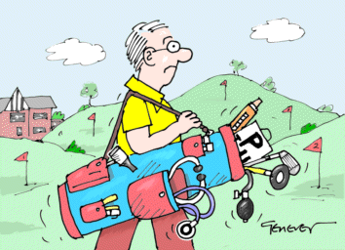
What is a GP?
Golfing Practitioner?
http://www.cartoondoc.co.uk

Slide 4
What names and terms are used related with family medicine?
General practitioner (GP)
General practice (GP)
Family physician (FP)
Family medicine (FM)
Family doctor
First contact physician
Primary doctor
Comprehensive care
Primary care
Primary care physician

Slide 5
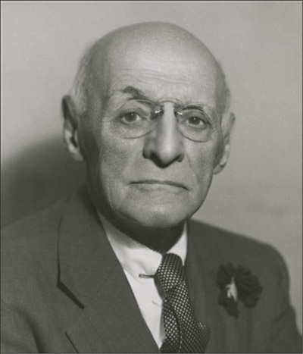
Flexner 1910
By 1910, there were 155 ‘medical schools’. There were no standards or guidelines for curricula.
He suggested that medical education should be conducted solely at university-affiliated centers located in urban areas with a curricular focus on specialized care.

Slide 6
GP/specialist ratio: USA

Slide 7
The result of excessive specialization
Fragmentation
Coordination problem between specialists
Comprehensive care not available
Continuous care not available
Problems in medical education

Slide 8
The popularity issue
Less income
No respect
Not taught at school
Practice conditions not good
Not suitable for political investment

Slide 9
USA 1960’s
35% of GP’s practice badly
Medicine and technology advanced but patients not satisfied
No connection between undergraduate and postgraduate education
Specialization routine
No interest in preventive medicine
Most of the population living in city centers

Slide 10
Flexner’s mistake
“Specialization = good doctors”
“Generalism is bad”

Slide 11
In fact…
PC physician is aware of all specialties; he can recognize rare diseases.
Common diseases are best known by GPs.
Specialization doesn’t prevent uncertainty; it only isolates the problem from its environment, which hinders to see the whole picture.
As science advances, knowledge increases but the knowledge load decreases.
Malpractice arises from less concern, not less knowledge.

Slide 12
Specialist
Family Physician
Phase of symptoms
Pre-symptomatic Phase
Health

Slide 13
Self –care 75%
Taken to GP 25%
Hospital

Slide 14
1000 persons
800 report symptoms
327 consider seeking medial care
217 visit a physician's office (113 visit a primary care physician's office)
65 visit a complementary or alternative medial care provider
21 visit a hospital outpatient clinic
14 receive home health care
13 visit an emergency department
8 are hospitalized
<1 is hospitalized in an academic medical center
N Engl J Med, Vol. 344, No. 26 – June 28, 2001 – www.nejm.org

Slide 15
What will happen without GPs?
Admission to hospitals and emergency units increases
Specialists can’t perform their real work
Preventive medicine is not applied
Has economic consequences
Patients’ do not have a responsible care
Decide by their own
Pharmacy, friend…
Self treatment
Alternative treatments

Slide 16
From the Millis report (1962)
“A peptic ulcer patient may need a surgeon, a psychiatrist or a pharmacy. There is a need for somebody who understands from all of these branches. We can’t force a patient to a resource who is not aware of the others!”

Slide 17
The primary care doctor looks at the whole movie, not the first picture!

Slide 21
Comparison of PHC and hospital
Hospital - specialist Cares for a large unregistered population (500 000+) No registration system Access usually via GP Situated far from most patients’ homes Hospitals exhibit far less variability | General practice-practitioner small registered population (2000) Patients registered with individual doctor direct access Close Huge variability between practices (e.g. age, social class of patients, geographical distribution)

Slide 22
Comparison of PHC and hospital
Hospital - specialist Responsibility for specialty- related medical care Responsibility for specialty- related problems only: restricted by age (e.g. paediatrics) or sex (Obs.&Gynae). Presented with more organized disease Deals mainly with rare diseases or atypical versions of common diseases. | General practice-practitioner all health care for patient all presenting problems irrespective of age, sex or morbidity Presented with undifferentiated problems/ diseases Deals with common diseases and social problems

Slide 23
Comparison of PHC and hospital
Hospital – specialist Makes frequent and less selective use of ‘high technology’ Episodic responsibility for patients Fewer opportunities for anticipatory care | General practice-practitioner Makes infrequent and highly selective use of ‘high technology’ Continuing responsibility for patients Repeated opportunities for anticipatory care

Slide 24
Comparison of PHC and hospital
Hospital - specialist Disease oriented: usually either physical or psychological Little use of time as diagnostic tool (need to know) Doctor-patient relationship less well demonstrated or used If no cure, the patient is often discharged Less recognition of patient’s viewpoint and autonomy | General Practice-practitioner ‘Whole person’ oriented: uses ‘triple diagnosis’ Prepared to use time as diagnostic tool Importance of doctor-patient relationship and its uses recognized and valued If no cure, recognizes need for continuing care and support Patient’s viewpoint and autonomy recognized

Slide 25
Comparison of PHC and hospital
Specialist Practice Contact Is usually initiated by referral from another doctor. Accessibility Is often restricted, resulting in: | General Practice. Contact In 50 % or more of consultations contact is initiated by the patient. Accessibility Patient, relatives and doctor are readily accessible to each other, often over many years.

Slide 26
Complement!

Slide 27
Leuwenhorst definition (1974)
General practitioner is a medical graduate who provides personal and continuous primary care services to individuals, families and population connected to a health center, without differentiating of age, sex and type of health problem. He is distinguished by synthesizing these functions. A GP can give his service at a office, home, clinic, or hospital.

Slide 28
Wonca definition (2002)
Family medicine is a academic and scientific discipline and a primary care oriented clinical specialty with his own specific educational content, research, and base of evidence.
European definition of GP/FM, WONCA 2002

Slide 29
Is general practice really a distinct specialty?
Is this formula correct?: “Internal medicine + Pediatrics + Obs-Gyn + Psychiatry + Emergency = general practice”
If we subtract the competencies gained from rotations, is there anything unique for GP?

Slide 31
Basic components of GP/FM
Access to care
Continuity of care
Comprehensive care
Coordination of care
Contextual care
Saultz 2001

Slide 32
Basic principles of FM/GP
Point of first contact with the health system
Open and unlimited service opportunity
Independent of age, sex or any other feature of the person
Easily accessible
Geographically
Economic
Culturally
Rakel 2003

Slide 33
Integrated and coordinated service:
Preventive, curative, and rehabilitative
Coordination between different service levels
Consultation, referral, follow up
Continuous health care:
Time, person, place, records, and interdisciplinary

Slide 34
Comprehensive care:
All conditions related with health
Physical, psychological, social
Personal care:
Person centered

Slide 35
Family and population oriented:
Family and population aspects of problems
Health problems of the population
Coordination with other sectors, occupational groups and voluntary organizations

Slide 36
Privacy and closeness :
Spread over the life span, a continuous and close relationship
Advocacy:
In all health affairs and relationships between other members of the health team
Efficient use of health resources:
Prescription, referral, consultation, laboratory investigations, hospitalization

Slide 37
Specific communication and clinical decision making
Effective communication,
Undifferentiated health problems,
Specific decision making process defined by the incidence and prevalence of the disease in the population
Team work:
Other disciplines, other health personnel, social services, education services, employers…

Slide 38
THE FUNCTIONS OF PRIMARY HEALTH CARE
To provide continuous and comprehensive care
To refer to specialists and/or hospital services
To co-ordinate health services for the patient
To guide the patient within the network of social welfare and public health services
To provide the best possible health and social services in the light of economic considerations.

Slide 39
Principles of PHC
Equitable distribution
Appropriate technology
Multispectral approach
Community participation

Slide 40
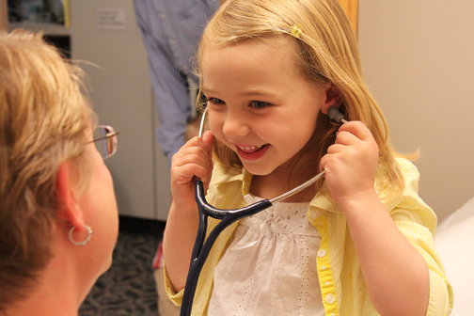
Family Physician
The family physician is a physician who is educated and trained in the discipline of family practice – a broadly encompassing medical specialty.
Family physicians possess unique attitudes, skills, and knowledge that qualify them to provide continuing and comprehensive medical care, health maintenance, and preventive services to each member of the family regardless of sex, age or type of problem, be it biological, behavioral, or social.
These specialists, because of their background and interactions with the family, are best qualified to serve as each patient’s advocate in all health-related matters, including the appropriate use of consultants, health services, and community resources.
(AAFP Congress, 1993)

Slide 41
Family Physician
A strong sense of responsibility for the total, ongoing care of the individual and the family during health, illness, and rehabilitation.
Compassion and empathy.
A curious attitude.
Enthusiasm for the undifferentiated medical problem and its resolution.
An interest in the broad spectrum of clinical medicine.
The ability to deal comfortably with multiple problems in one patient.
A desire for frequent and varied intellectual and technical challenges.
The ability to support children during growth and development.

Slide 42
Family Physician
The ability to assist patients in coping with everyday problems.
The capacity to act as coordinator of all health resources needed in the care of a patient.
A continuing enthusiasm for learning.
The ability to maintain composure in times of stress.
An appreciation for the complex mix of physical, emotional, and social elements in holistic and personalized patient care.
A feeling of personal satisfaction derived from intimate relationships with patients.
A skill for and commitment to educating patients and families about disease processes and the principles of good health.

Slide 43
DETERMINANTS OF HEALTH
Socioeconomic development
Education
Agriculture
Water/Sanitation
Housing
Health care
Resources
Organization and management
Delivery and accessibility
Quality, Use
Health
Wellbeing
Work
Environtment
Employment
Age
Gender
Genetics
Life-style
Social organizational networks
Living conditions
Family size
(Tarimo and Webster, 1994)

Slide 44
In Saudi Arabia

Slide 45
An overview
In 1949 there were 111 physicians & about 1,000 hospital beds in the whole kingdom of Saudi Arabia.
The country, however, has witnessed lately a spectacular development in health services &health manpower.
Notes:
What was the achievements of the past ?

Slide 46
History
In the early 1950 the 1st preventive programme for malaria control.
In 1977 the WHA decided that: the main targets government &WHO in the decades ahead should be the attainment of (health for all by the year 2000)
In 1978 the primary health care concept adopted by the Alma Ata meeting .

Slide 47
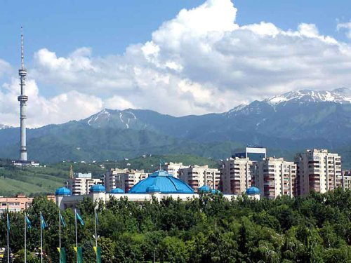
Al ma Ata Declaration(1978)
An international conference in Alma Ata (USSR).
Expressed the need for urgent action by all governments, health &development worker the world community to protect the health of all the people of the world.
Notes:
shot

Slide 48
In the 1980 s the primary health care concept was recognized by the MOH & became part of its policy.
In 1983 primary health care was totally implemented .

Slide 49
AlmaAta declaration
Primary health care is the key to achieve HFA, So people can attain a level of health that will permit them to lead socially & economically productive lives & that should be the main social target of governments ,international organization and the whole world community.

Slide 50
Alma Ata declaration
Concurrently , a few intermediate goals for HFA were defined :
1)Ensuring right kind of food for all by 1986.
2)Providing an adequate supply of drinking water &basic sanitation for all by 1990.
3)Immunizing children against 6 common diseases by 1990.

Slide 51
Achievements in health services
Indicators of good health development in the nations:
IMR = it is an imp. Indicator politically, it reflects ante-natal care ,pediatric care, nutritional status & pollution .
S.A.= 118/1000 1970(averag= 96)
Now, IMR =23/1000 2002(averag = 56)

Slide 52
Achievements in health services
Health services became available almost every where in the country &within the reach of almost every individual .
The quality of the services has also improved especially at the tertiary level.
Physician-population ratio which is a popular tool for assessing the quality of care1.62 /1000 people of health care in KSA is 1(1987),while in under developed country i.e..SRI LANKA 1:12,346 ,&in developed nation USA 1:500(1983).

Slide 53
Achievements in health services
Medical research has also increase in no. &quality(SMJ established 1979) helped in promoting research activities also KACST has supported >100 medical research projects since its establishment in 1977.

Slide 54
The Challenges of the present
The country is divided into 13 health regions each is headed by regional health director.
The physical development has outgrown the ability for proper planning & management.
Man power.
The health information system lags behind.
The cost of the health care delivery.
The system has become predominantly curative.

Slide 55
السنه | وزارة الصحة |  | الحكومية الاخرى |  |  | القطاع الخاص
 | اطباء | ممرضين | اطباء | ممرضين |  | اطباء | ممرضين
1416 | 15.266 | 34947 | 6.796 |  | 15679 | 8.482 | 10558
1417 | 14.717 | 34739 | 6.806 |  | 16447 | 8.891 | 10800
1418 | 14.407 | 36101 | 6.853 |  | 17080 | 9.021 | 11609
1419 | 14.786 | 36340 | 6.891 |  | 16920 | 9.825 | 12266
1420 | 14.970 | 37126 | 7.199 |  | 17212 | 9.053 | 12610
1421 | 14.950 | 36495 | 7.588 |  | 17664 | 9.445 | 13262
1422 | 15.945 | 36212 | 7.413 |  | 17255 | 9.312 | 13101
1423 | 16.477 | 366495 | 7.588 |  | 17664 | 9.445 | 13262
1424 | 17.448 | 36710 | 7.618 |  | 17813 | 9.529 | 13566
1425 | 18.621 | 41356 | 8.856 | 19421 |  | 15.498 | 17810

Slide 56
إجمالي المرافق والقوى العامه بالقطاع الصحي بالمملكه
2002 |  |  |  | 2003 |  |  |  | 2004
وزارة الصحة | الجهات الحكومية الأخرى | القطاع الخاص | المجموع | وزارة الصحة | الجهات الحكومية الأخرى | القطاع الخاص | المجموع | وزارة الصحة | الجهات الحكومية الأخرى | القطاع الخاص | المجموع
1804 | ---- | ---- | 1804 | 1809 | ---- | ---- | 1809 | 1824 | ---- | ---- | 1824
---- | ---- | 744 | 744 | --- | ---- | 750 | 750 | ---- | ---- | 990 | 990
194 | 40 | 101 | 335 | 196 | 41 | 103 | 340 | 200 | 40 | 105 | 545
28410 | 9576 | 9834 | 47820 | 28531 | 9618 | 9893 | 48042 | 28751 | 10300 | 10121 | 49172
16477 | 7588 | 9445 | 33510 | 17448 | 7618 | 9529 | 34595 | 17623 | 9331 | 9713 | 36667
36495 | 17664 | 13262 | 67421 | 36710 | 17813 | 13566 | 68089 | 38019 | 20368 | 14118 | 72505
18665 | 11012 | 9923 | 39600 | 18723 | 11322 | 9980 | 40025 | 23369 | 14041 | 6855 | 44265
المراكز الصحيه
المستوصفات الأهليه
المستشفيات
الأسرة
الأطباء
التمريض
الفئات الطبية المساعده

Slide 57
ميزانية الصحة في السنوات 1999 إلى 2005
( بملايين الريالات )
السنة | ميزانية الصحة
1999 | 15152
2000 | 16381
2001 | 18089
2002 | 18970
2003 | 16767
2004 | 17971
2005 | 23057

Slide 58
توزيع اعتمادات ميزانية العام المالي 1425 / 1426 هـ ( 2005 ) حسب القطاعات الرئيسية

Slide 59
The promises of future
There is a positive political commitment of primary health care is equally important ,according to the seventh development plane(1420-1425).
There is a strong emphasis on health services provided through PHC (preventive as well as curative) to be accessible to every individual.
open 250 health centers in different health regions.
start building 500 primary care centers (project of the custodian of holy mosques).
keep up the high vaccination rate not <95%.

Slide 60
References
Abdul- Rahman F.ALswailem Assessing health care delivery in SA.Annals of Saudi med. .vol10.number 1.1990.
Yagob Al mazrou etal,Principles & practice of primary health care ,1990.
Zuhair AL sebai,Primary health care,Saudi med j ,vol9 No.2 MARCH 1988.
MOH, Annual health report ,1997.
The seventh development plan (ministry of planning).
Barbara Starfield ,Is primary care essential ?.The lancet ,Vol 344.October 22,1994.
Fred Abbatt &Rosemary MCmMahoon,2nd edition. Teaching Health care Workers ,1993.
دليل الندوة الختامية لدراسة صحة الأسرة الخليجية ،المكتب التنفيذي لمجلس وزراء الصحة لدول مجلس التعاون لدول الخليج العربي 2000م.

Slide 61
