Slide 1
Searching Skills
Dr. Nada AlYousefi
March 21, 2012

Slide 2
http://ksu.edu.sa/Deanships/library/Pages/Home.aspx

Slide 4
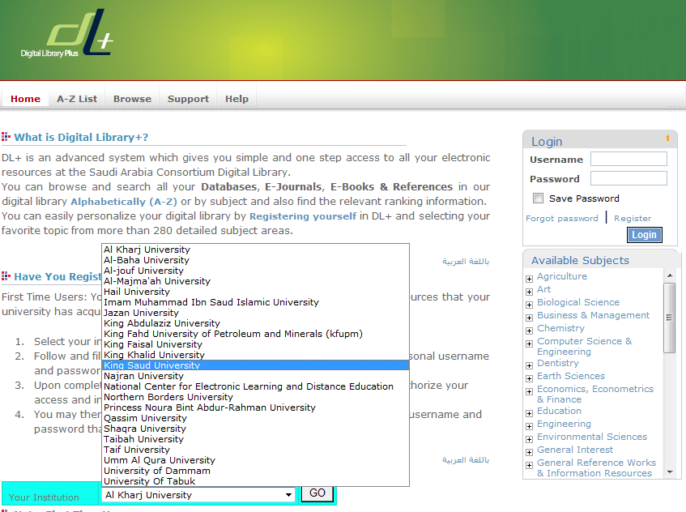
http://saudi.digitallibraryplus.com

Slide 5
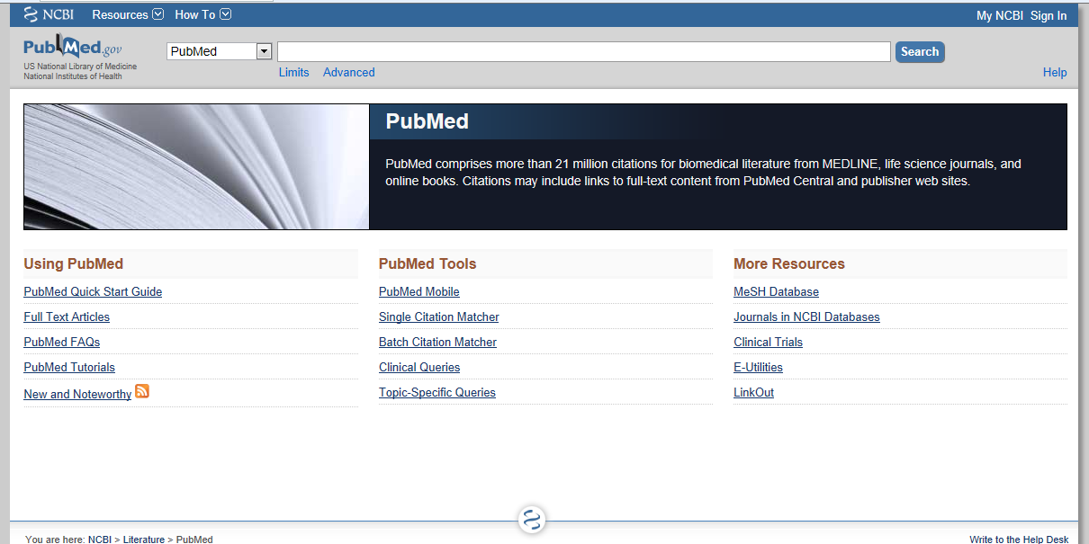
www.ncbi.nlm.nih.gov/pubmed

Slide 6
Key concepts!
Auther

Slide 7
Stopwords

Slide 8
MeSH(The Medical Subject Headings )
Notes:
It imposes uniformity and consistency to the indexing of biomedical literature. MeSH terms are arranged in a hierarchical categorized manner called MeSH Tree Structures and are updated annually.

Slide 9
Exercise
Use the MeSH Database to build a strategy that will find citations to references discussing the economics of community-acquired pneumonia.

Slide 10
Exercise
Use the NLM Catalog Journal search page to see if PubMed includes the journal, Molecular Microbiology. If so, retrieve all PubMed citations from this journal.

Slide 11
Exercise
Use the Clinical Queries to find systematic reviews for accidents caused by sleep deprivation.

Slide 12
Search
What role does pain have in sleep disorders?

Slide 13
Search
To search for citations to articles written by Bonnie W. Ramsey about gene therapy for cystic fibrosis

Slide 14
Search
To search for citations to articles about drosophila in the journal Molecular Biology of the Cell

Slide 15
Exercise
Find citations to articles about the ethics of liver transplantation. Check Details to see how the terms are mapped. Filter to review articles. Select a few items and add them to the Clipboard. Go to the Clipboard and view the selected items in Abstract format to see the assigned MeSH terms.

Slide 16
Exercise
Use the MeSH Database to build a strategy that will find citations to articles about schizophrenia resulting from prenatal exposure to influenza. Schizophrenia and influenza should be the major topics of the articles.

