Slide 1
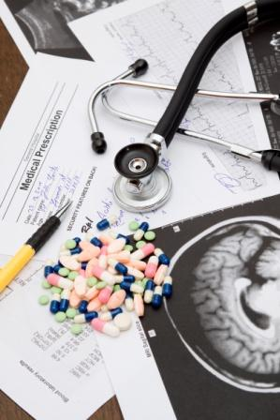
RATIONAL USE OF MEDICATIONS
Dr. Abeer Al Shahrani
MBBS, SBFM, ABFM
Assistant Trainer
Department of FM & PHC
National Guard Hospital

Slide 2
CONTENT
DEFINITION
ELEMENTS
CONSEQUENCES
FACTORS
STRATIGIES FOR IMPROVEMENT
MEDICATION ERROR

Slide 3
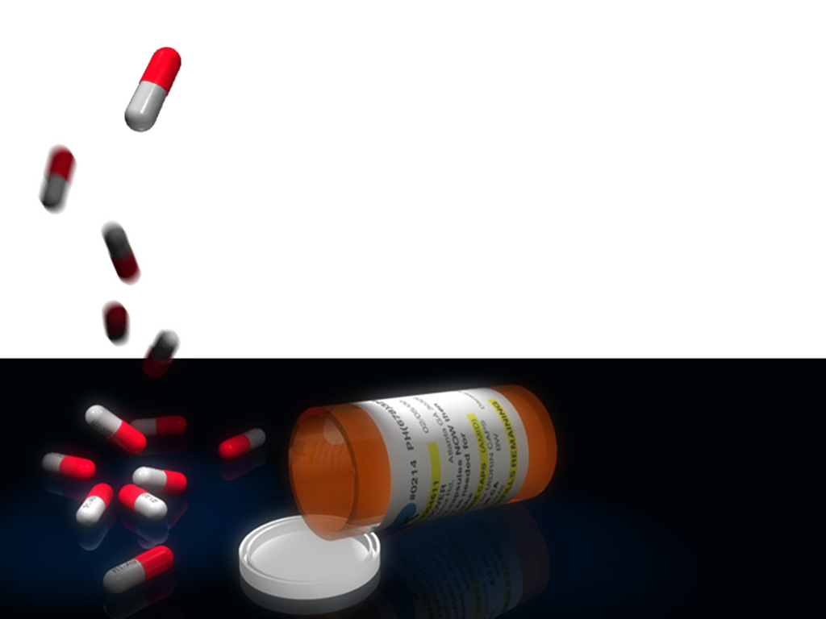

Definition
Prescribing right Drug, in adequate Dose for the sufficient Duration & appropriate to the Clinical Needs of the patient at lowest Cost
(WHO 1985)

Slide 4
Appropriate indication: The decision to prescribe drug(s) is entirely based on medical rationale & that drug therapy is effective & safe treatment
Appropriate drug. The selection of drugs is based on efficacy, safety, suitability & cost considerations.
Appropriate patient. No contra-indications exist & the likelihood of adverse reactions is minimal & the drug is acceptable to the patient.
Appropriate information. Patients should be provided with relevant, accurate, important & clear information regarding his / her condition & the medication(s) that are prescribed.
Appropriate monitoring. The anticipated & unexpected effects of medications should be appropriately monitored.

Slide 5
BACKGROUND
Appropriate use of drugs is essential element in achieving quality of health & medical care .
Medically inappropriate, ineffective & inefficient use of medication is commonly observed in health care systems.

Slide 6
BACKGROUND
More than 50% of all medicines worldwide are prescribed, dispensed, or sold inappropriately .
50% of patients fail to take them correctly.
Conversely, about 1/3 of the world’s population lacks access to essential medicines.

Slide 7

CONSEQUENCES
Reduction in the quality of drug therapy leading to increased morbidity& mortality.
Waste of resources leading to reduced availability of other vital drugs & increased costs.
Increased risk of unwanted effects such as adverse drug reactions & the emergence of drug resistance.

Slide 8

CONSEQUENCES
Can stimulate inappropriate patient demand which will lead to reduced access , attendance rates and loss of patient confidence in the health system.

Slide 9
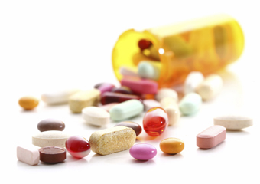
Common Examples of Irrational Use of Medicine
Use of too many medicines /patient (Poly-pharmacy)
Inappropriate use of antibiotics, often in inadequate dosage, for non-bacterial infections.
Over-use of injections when oral formulations would be more appropriate.
Failure to prescribe in accordance with clinical guidelines.
Inappropriate self-medication, often of prescription-only medicines.

Slide 10

Towards Rational Use of Medicines
Type
Strategies can be targeted towards changing specific problems.
Amount
Size of problem is known & Impact of the strategies can be monitored.
Causes
Appropriate, effective & feasible strategies can be chosen.

Slide 11
FACTORS INFLUENCING DRUG USE
Policy, Legal & Regulatory framework
Prescriber, Dispenser & workplaces
Patient & community
Rational Drug Use
Drug Supply System
Notes:
Patient& Community
Beliefs and (mis)information available in the Community including cultural values on therapy, patient demands& expectations,
Prescriber, Dispenser
Lack of drug information, limited experience and skills, fear induced prescribing (uncertain diagnosis)
Incorrect generalization from experience, inability to read or interpret prescriptions, inadequately trained dispensers, poor attitude about dispensing and packaging
Workplace
Lack of equipment, facilities, packaging materials, lab capacity, continuing education, pressure to prescribe and dispense, insufficient staffing, inadequate supervision of practitioners.
Drug Supply System:
Drug Quality Problems
unreliable suppliers
Bad forecasting/bad quantifications
Bad Inventory Management (expired drugs, Shortages, etc.)
Pressure and lobbying from Industry (promotional activities and misleading claims)
Drug Regulation
non-essential drugs available:
non-formal prescribers
lack of regulation enforcement

Slide 12
INFORMATIONAL
Knowledge Deficit
PERSONAL
Unbiased Information
Acquired Habits
Influence of Industry
Cultural Beliefs
DRUG USE
Workload & Staffing
INTEREPERSONAL
Patient Demand
Infra-structure
Authority & Supervision
WORKPLACE
Relation with peers
WORKGROUP

Slide 13

Important Factors
Lack of information
Faulty & inadequate training
Poor communication between health professional & patient
Lack of diagnostic facilities/Uncertainty of Diagnosis
Demand from the patient
Defective drug supply system & ineffective drug regulation
Promotional activities of pharmaceutical industries
Notes:
13

Slide 14
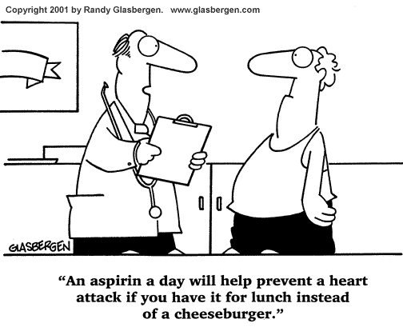

Slide 15
STEPS TO IMPROVE RATIONAL DRUG USE
Diagnosis of the disease.
Identify underlying cause & motivating factor
STEP III
List possible intervention or treatment.
STEP I
Recognize the need for action.
Identify the patient’s problem
STEP II

Slide 16
STEPS TO IMPROVE RATIONAL DRUG USE
STEP IV
STEP V
Given proper information instruction & warning regarding the treatment given
STEP VI
Monitor the treatment & check response
Start treatment by writing an accurate & complete prescription

Slide 17

PRESCRIPTION WRITING

Slide 18
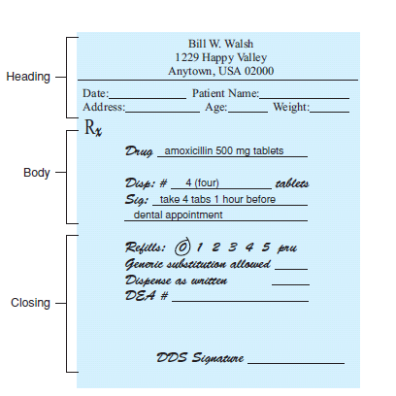
Parts of Prescription

Slide 19
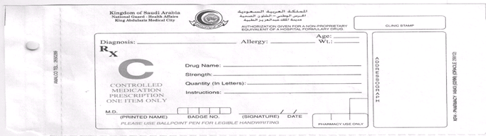
Parts of Prescription

Slide 20
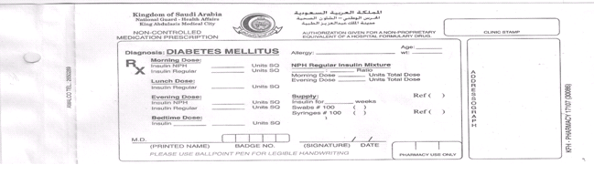
Parts of Prescription

Slide 21
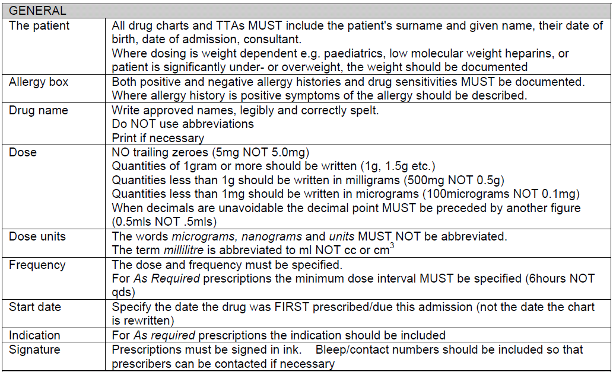

Slide 22

AVOID Abbreviations

Slide 23
Abbreviation | Potential Problem | Preferred Term
U (unit) | Mistaken as zero, four, or cc | Write “unit”
IU (international unit) | Mistaken as IV or 10 | Write “international unit”
Q.D., Q.O.D. | Mistaken for each other. Period after Q and O after Q can be mistaken for “I” | Write “daily” and “every other day”
Trailing zero and lack of leading zero | Decimal point missed | Never write a zero by itself after a decimal point, and always use a zero before a decimal point
MS, MSO4, MgSO4 | Confused for one another | Write “morphine sulfate” or “magnesium sulfate”

Slide 24
Abbreviation | Potential Problems | Preferred Term
µg (microgram) | Mistaken for mg (milligram) | Write “mcg”
H.S. (at bedtime or half – strength) | Mistaken for either meaning: Also mistaken for every hour | Write out “half – strength” or “at bedtime”
T.I.W (three times a week) | Mistaken for three times a day or twice weekly | Write “three times weekly” or “3 times weekly”
S.C. or S.Q. (subcutaneous) | Mistaken for SL for sublingual or “5 every” | Write “Sub-Q” or “subQ” or “subcutaneously”
D/C | Interpreted as discontinue whatever medication follows (typically discharge meds) | Write “discharge”
c.c. | Mistaken for U (units) when poorly written | Write “ml” for milliliters

Slide 25
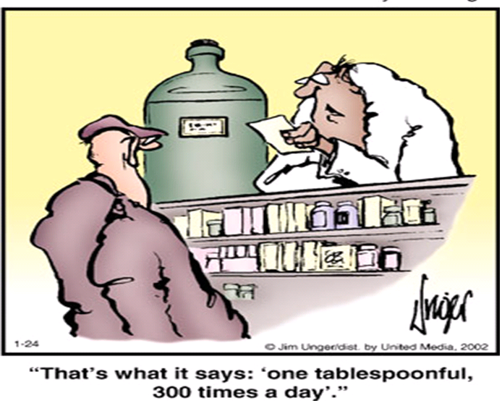

Slide 26
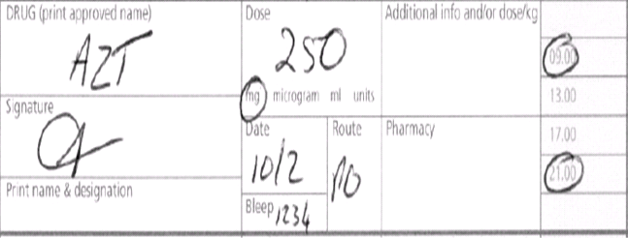
Exercise I
Comment on the prescription :
AZT 250 mg PO twice daily

Slide 27
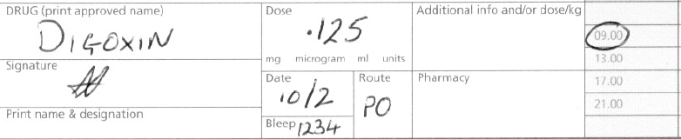
Exercise II
Comment on the prescription :
Digoxin .125 PO Once daily

Slide 28
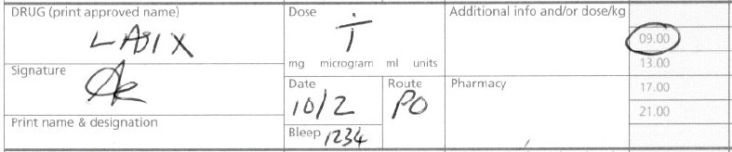
Exercise III
Comment on the prescription :
LASIX T PO once daily

Slide 29
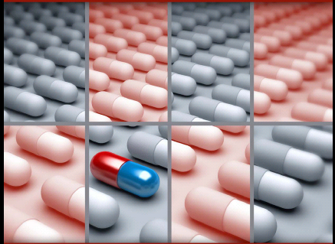
Medication Error
Any preventable event that may cause or lead to inappropriate medication use or patient harm while the medication is in the control of the health care professional, patient, or consumer.

Slide 30
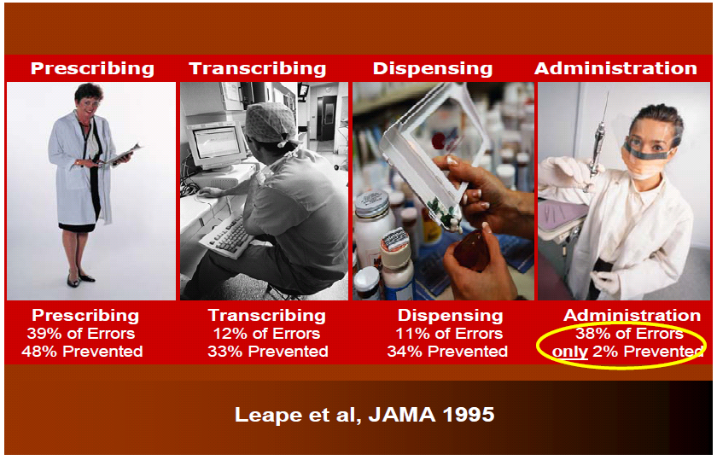
Types of Medication Errors

Slide 31
CONCLUSION
Irrational use of drugs not only waste resources, but also leads to drug induced disease.
The drug control authority, the teaching institutes, drug industries, HC providers & the patient himself are helpful for rational drug use.

Slide 32
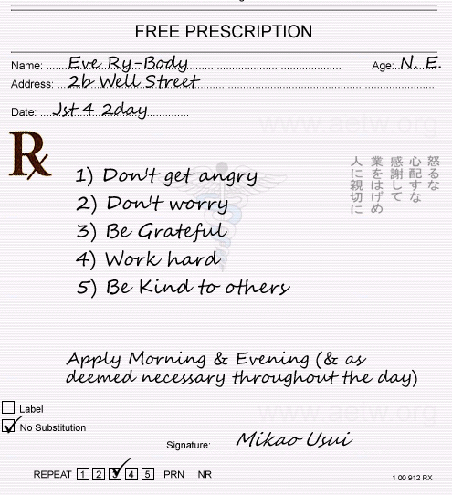


Slide 33
ADHERANCE TO MEDICATIONS

Slide 34

CONTENT
DEFINITION / TERMINOLOGY
IMPORTANCE
TYPES
DIMENSIONS
STRATIGIES FOR IMPROVEMENT
CONCLUSION

Slide 35
DEFINITIONS
Adherence:
Synonym for compliance
The extent to which a patient’s behavior (in terms of taking medication, following a diet, modifying habits, or attending clinics) coincides with medical or health advice.
Compliance:
The patient is PASSIVELY following the doctor’s orders & that treatment plan is not based on a therapeutic alliance / contract established between patient & physician.

Slide 36
DEFINITIONS
Concordance:
The extent to which patients & their providers agree on Whether, When, How a medication should be taken.
Persistence
The duration of time from initiation to discontinuation of therapy.

Slide 37
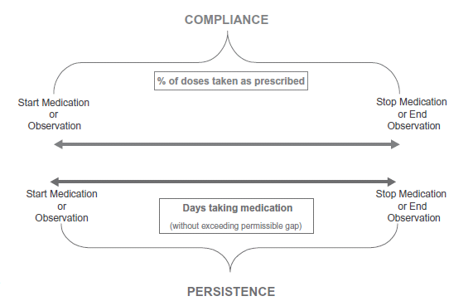
DEFINITIONS

Slide 38
DEFINITIONS
Non-Adherence:
Wide range of behaviors , both intentional & unintentional, that leads to either underuse or overuse of prescription medications.

Slide 39
BACKGROUND
Adherence is the key mediator between medical practice & patient outcomes.
Rates of adherence have not changed much in last 3 decades, despite WHO & IOM improvement goals.
WHO , describes patient non-adherence with prescribed medication as worldwide problem of striking magnitude.

Slide 40
BACKGROUND
Non-adherence to medications is estimated to cause 125,000 deaths annually.
Overall, about 20% to 50% of patients are non-adherent to medical therapy.
People with chronic conditions only take about half of their prescribed medicine.

Slide 41
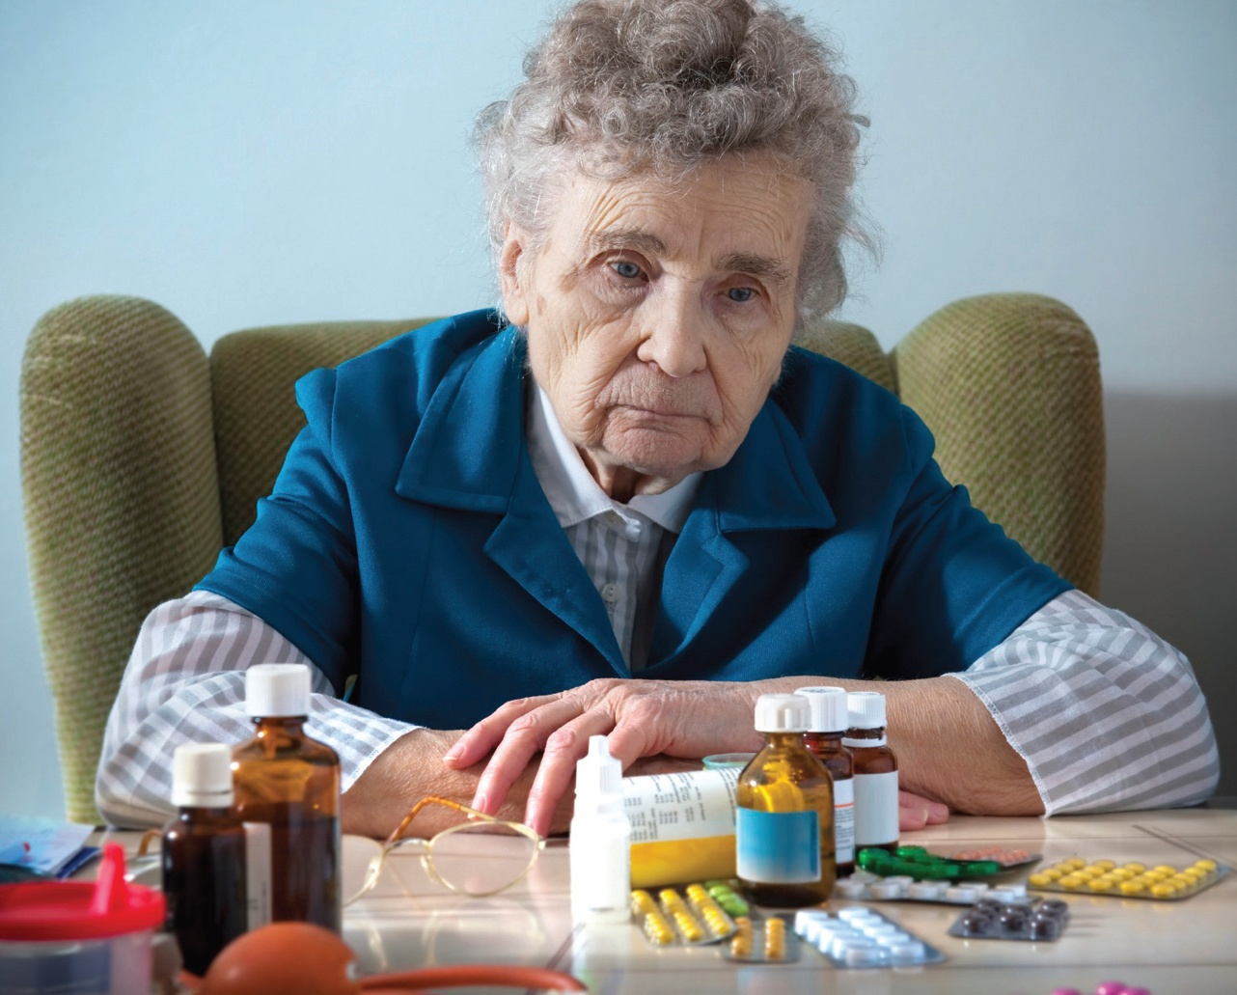
40% of all admissions are due to medication problems.
About half of older people do not take their medicines as instructed

Slide 42
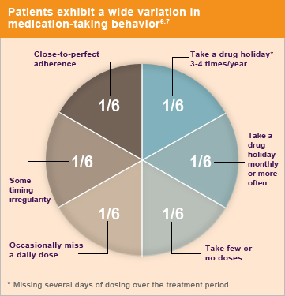

Slide 43
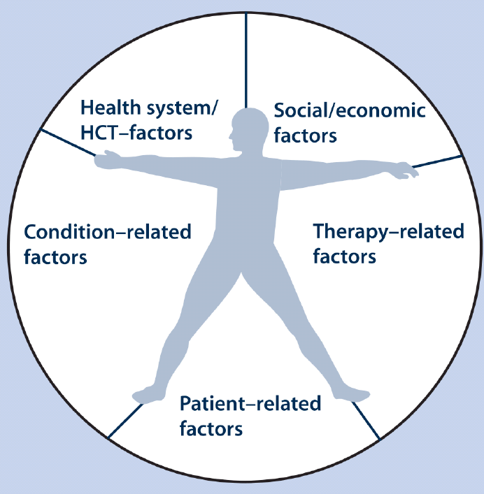
DIMENSION OF PATIENT ADHERANCE

Slide 44
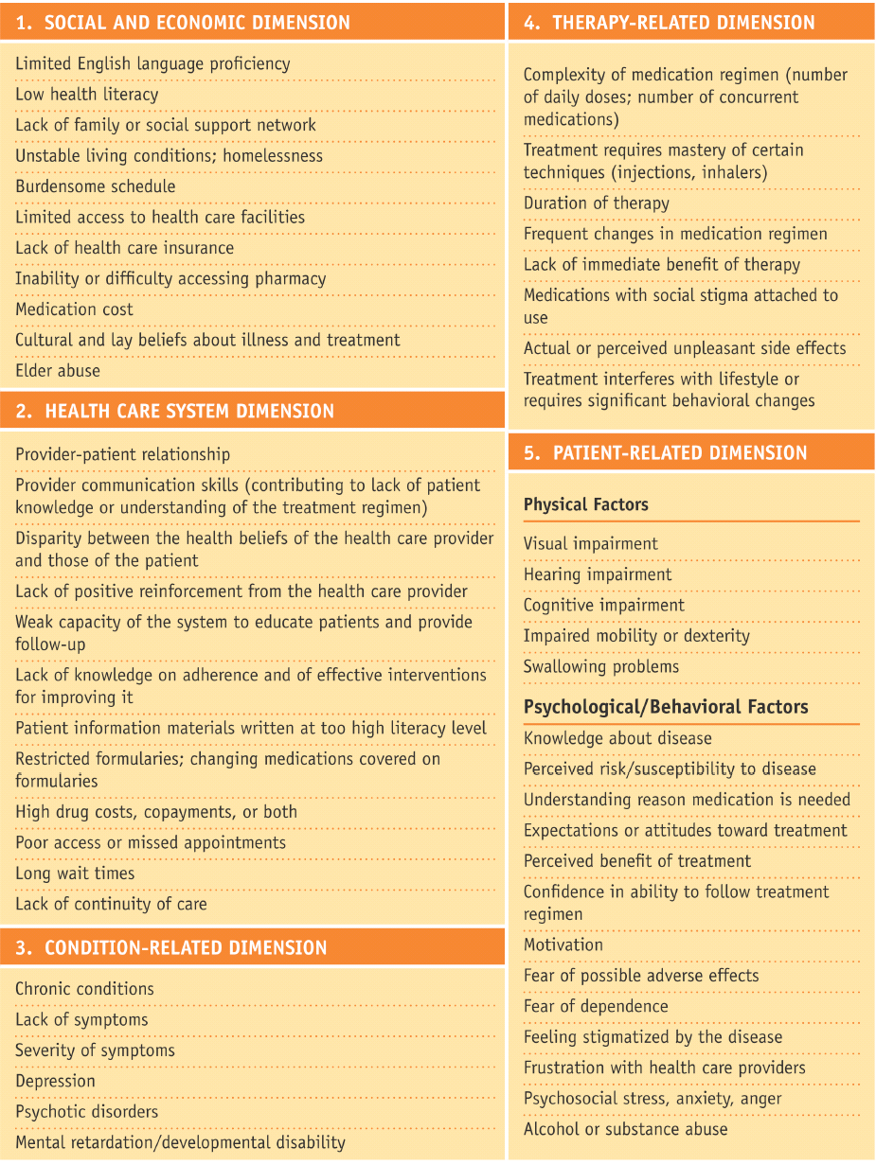
Health Care System
Provider – Patient relationship
Provider communication skills
Disparity between health beliefs
Poor access or missed appointments
Week capacity for patient education & FU.
Long waiting time
High cost

Slide 45
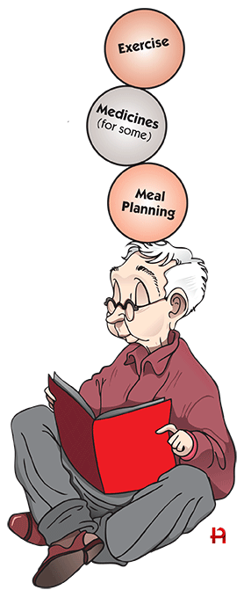
Patient
Physical Factors :
Cognitive impairment
Visual / hearing problems
Impaired mobility
Swallowing problems
Psychological / Behavioral:
Knowledge & understanding ( Dx & Rx )
Motivation
Perceived benefits of Rx
Fear / Frustration
Psychosocial stress / Anxiety
Alcohol or substance abuse

Slide 46
Therapy
Complexity / Frequent changes
Duration
Actual or perceived side effects
Treatments requires technique
Treatments interferes with lifestyle
Lack of immediate benefits

Slide 47
Social / Economic
Lack of family / social support
Low health literacy
Culture / health beliefs
Unstable living condition
Lack of health care insurance

Slide 48
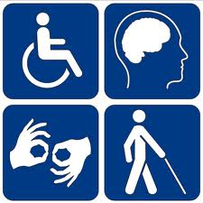
Condition / disease
Chronic vs. Acute
A symptomatic
Severity
Psychiatric illness
Mental / cognitive impairment

Slide 49
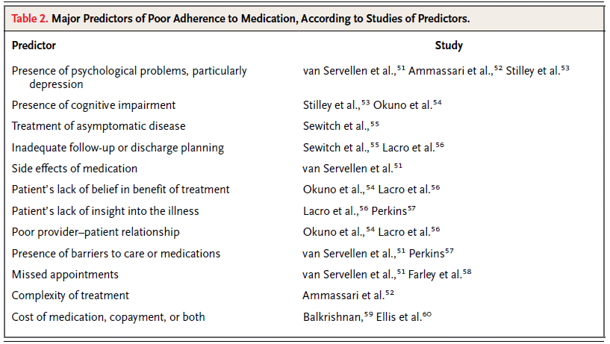
PREDICTORS OF NON-ADHERANCE

Slide 50
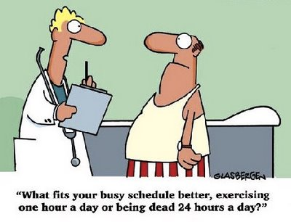

Slide 51
STRATEGIES TO IMPROVE ADHERENCE

Slide 52
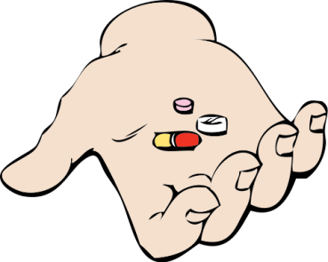

SIMPLE !!
S implify regimen
I mpart knowledge
M odify patient beliefs & human behavior
P rovide communication & trust
L eave the bias
E valuate adherence

Slide 53

Simplify Regimen
Adjust timing, frequency, amount, and dosage.
Match regimen to patients’ activities.
Recommend all medications be taken at same time of day .
Encourage use of adherence aids.

Slide 54

Impart knowledge
Patient-Provider shared decision.
Provide clear instructions (written & verbal)
Reinforce all discussions often, especially for low-literacy patients.
Involve family & friends in the discussion when appropriate.

Slide 55

Modify Patient Beliefs & Behavior
Empower patients to self-manage their condition.
Address fears & concerns of taking the medication.
Provide rewards for adherence.

Slide 56

Provide Communication & Trust
FACTS
50% of patients leave the office not understanding what they have been told !!
Physicians interrupt patients on average of 22 sec.
54% patient problems & 45% patient concerns are neither elicited by physician nor disclosed by patient

Slide 57
Provide Communication & Trust
Improve interviewing skills.
Practice active listening.
Provide emotional support.
Provide clear, direct, & thorough information.
Elicit patient’s input in treatment decisions.
Allow adequate time for patients to ask questions.
Build trust.

Slide 58
Leave the Bias
Examine self-efficacy
Acknowledge biases in medical decision-making
Review communication style to see if it is patient-centered

Slide 59
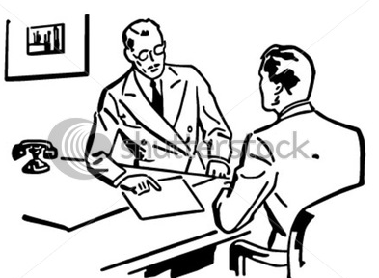
Evaluating Adherence
Self-reports are the most commonly used tool in measuring adherence.
Review patient’s medication containers, noting renewal dates

Slide 60
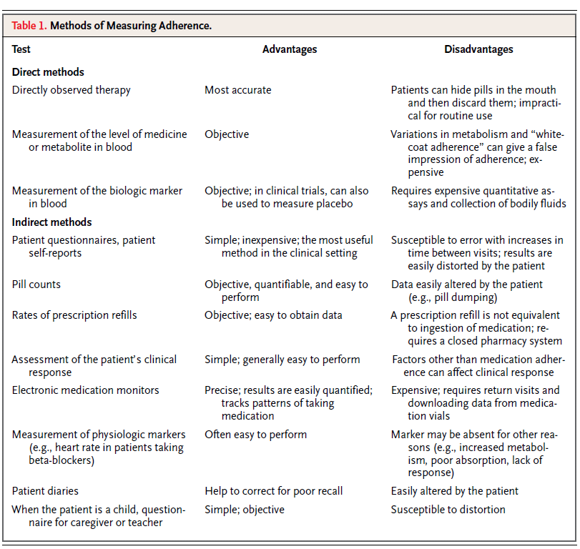

Slide 61
CONCLUSION
Adherence to prescribed medication regimens is critical to patient outcomes
Non-adherence is a multidimensional problem
Provider should focus on communication skills, cultural sensitivity, & patient-centered care.
SIMPLE approach

Slide 62

THANK YOU ☺

