Slide 1
Done By : AlAnood AlSolaihim
Beshayr AlOtaibi
Bushra Bin Hussain
Deemah AlAteeq
Leila AL-Enazy
Rana Badghesh
Rowyeda Mishddi
Supervised By : Dr. Nada AlYousefi

Slide 2
Pre – test ☺

Slide 3
People smoke World wide …
People World wide 2012 !!!
7 billion
1,35 billion
1,35
000
000
000
000

Slide 4
Smoking epidemic is one of the biggest public health threats the world has ever faced.
It is the leading preventable cause of death in many countries
Every Day
13,000 people die .
Every Year
6 000 000 people die
More than 5 million are users and ex users and more than 600.000 are nonsmokers exposed to second-hand smoke.

Slide 5
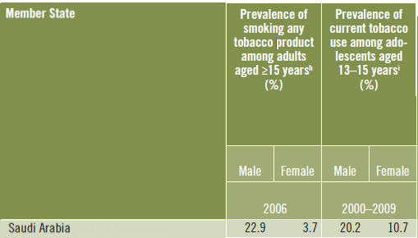
WHO statistics :

Slide 6
Prevalence of smoking in Saudi Arabia:
The prevalence of current smoking in Saudi Arabia ranges from
2.4-52.3% (median = 17.5%).
The prevalence of smoking in males up to 38% , while in females its
up to 16%.
63.8% started shisha smoking at ages of 16 to 18 years.
Results revealed that occurrence of smoking among female college
students was 8.6%.
The mean age at which smoking started was 16 ± 2. years, More than half of the students who smoked were cigarette smokers, while 43.2% were shisha smokers.

Slide 7
Overall smoking prevalence among KSU students was estimated at
14.5%, prevalence among male students (32.7%), and females (5.9%).

Slide 8
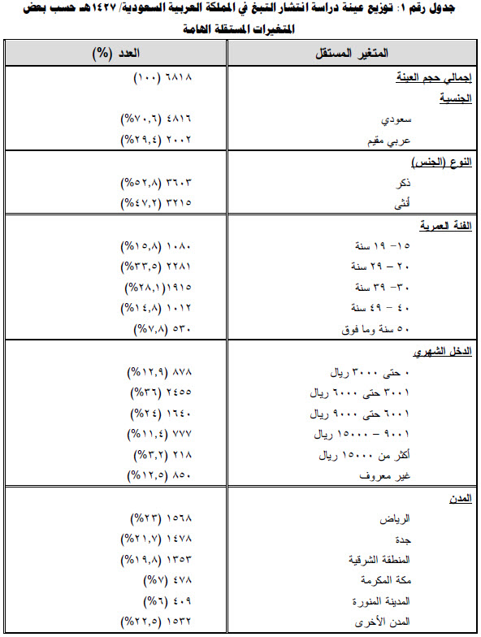

Slide 11
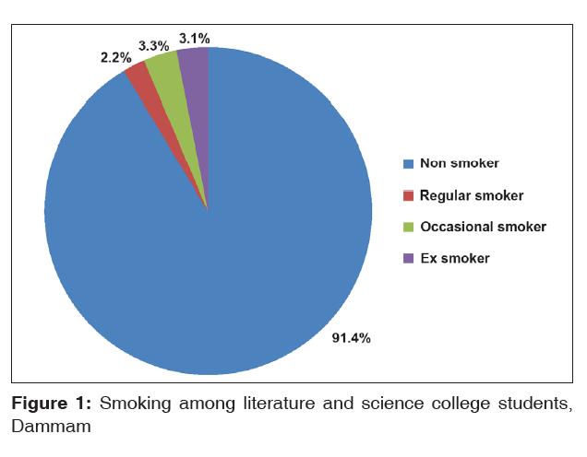

Slide 12
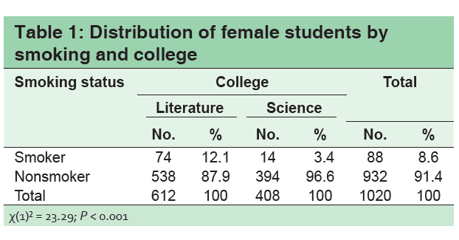
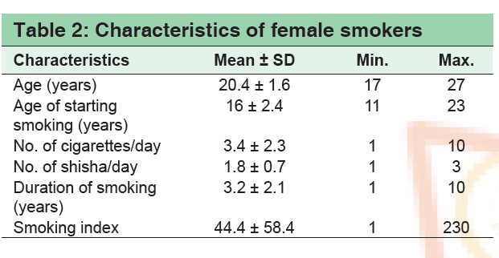

Slide 14
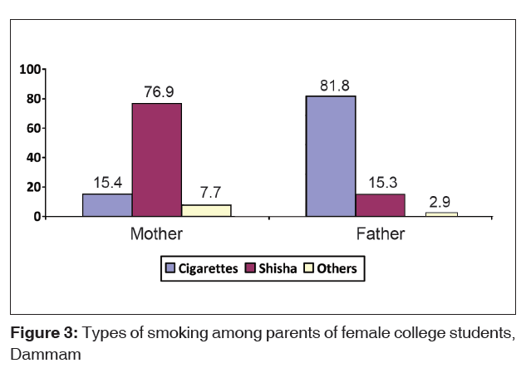

Slide 15
Smoking habits among medical students in Central Saudi Arabia.
The study shows that
13%
currently active smokers
5.3%
of male medical students were
ex-smokers
38.2%
passive smokers

Slide 16
The types of smoking
sheesha
44.1%
cigarette
32.2%
both
23.7%
The common reason given for the smoking behavior was the influence of friends (35.6%).
The study shows that 57.1% of current smokers were motivated to stop smoking.

Slide 17
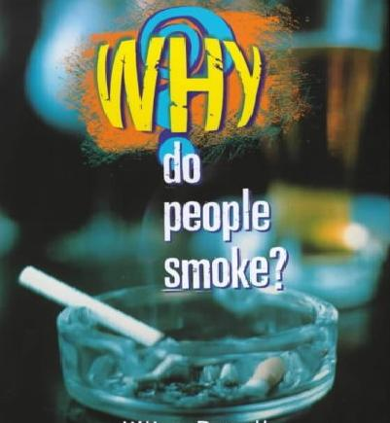

Slide 18
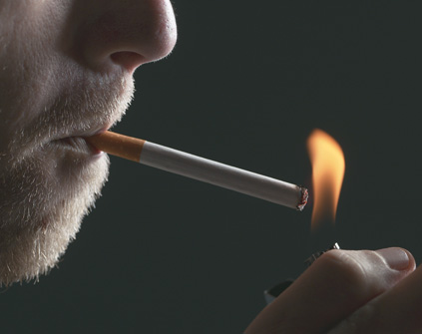
There’s no single reason why people begin to smoke.
It Has been estimated that 80% of Adult smokers start smoking as children, and 30% of children have tried smoking by the age of 11.
Knowing about risk factors is useful
because they can help identify which people might be at greatest risk for smoking and in greatest need of support to resist smoking.

Slide 19
Social Factors
Parental influences
Individual influence
Wrong personal beliefs and values about smoking
Environmental influence
friendship groups
Influence of peer
Low socioeconomic status
Self esteem
Curiosity
Availability
Accessibility
Price
Media
The need to fit In.
It looks cool.

Slide 20
The health risks of smoking
The causal link between smoking and increased morbidity and mortality is now firmly established.
Approximately 4000 chemical compounds have been identified in cigarette smoke, of which over 40 are known to cause cancer.
On an individual level this means that long-term regular smokers can expect to lose, on average, ten years of life.

Slide 22
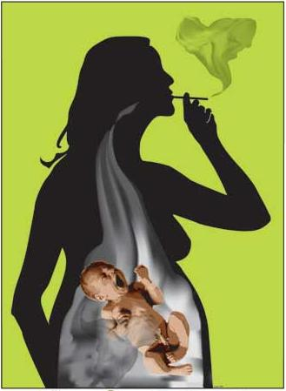
Smoking and Pregnancy
The effects of cigarettes on the pregnant woman and developing fetus are numerous with a wide range of effects that will remain with the fetus for the rest of her life.
It Can Cause:
1- Spontaneous Abortion
2- Placental Problems.
3- Premature birth
4- Low birth weight infant
5- reduced lung function in infants
6- sudden infant death syndrome (SIDS)

Slide 23
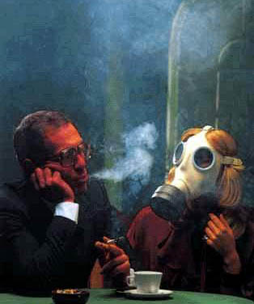
Secondhand Tobacco Smoke
Is a significant health risk for nonsmokers, especially those with pre-existing respiratory and cardiac conditions.
Is now a recognized carcinogen .
Concentrations of many harmful chemicals are higher in secondhand smoke than in that inhaled by smokers.

Slide 24
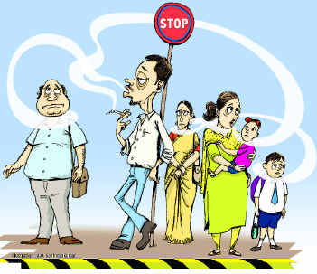
Exposure to secondhand smoke increases the risk of :
1- Heart disease among non-smokers by as much as 60%.
2- The Risk of lung cancer by as much as 20% to 30%.
It Can decrease :
1- Heart rate variability.
2- Coronary flow
Some research: also suggests that secondhand smoke may increase the risk of breast cancer, nasal sinus cavity cancer, and nasopharyngeal cancer in adults and the risk of leukemia, lymphoma, and brain tumors in children..

Slide 25
Serious Health Risks to Children:
Exposure to secondhand smoke can cause asthma.
Exposure to secondhand smoke increases the risk for Sudden Infant Death Syndrome .
Infants and children younger than 6 who are regularly exposed to secondhand smoke are at increased risk of lower respiratory track infections, such as pneumonia and bronchitis .
Children who regularly breathe secondhand smoke are at increased risk for middle ear infections .

Slide 26
There is no safe level of exposure to secondhand smoke.
restricting smoking in public places should be done to decrease the exposure.
Mechanical ventilation or separation of smokers does not fully eliminate the risk.
Air cleaning systems leave behind small particles.
Heating and cooling systems may distribute smoke throughout a building.

Slide 27
“The only 'safer' cigarette is your last one”

Slide 28
Know we will start our trip to manage any smoking people ☺

Slide 29
Screening :
smoking cessation guidelines recommend that all health professionals should check on the smoking status of their clients at least once a year and advise smokers to stop whether or not they are seeking help with stopping smoking, because: 1-Brief advice (up to five minutes) 2-This advice appears to have its effect primarily by triggering a quit attempt rather than by increasing the chances of success of quit attempts

Slide 30
(1) Ask if the person smokes
(2) Advise smokers to quit
(3) If they would like help refer them to the NHS Stop Smoking
Service, and we apply to him 5A’s approch
or if they do not want to attend the service, then possible offer an alternative

Slide 31
Not Thinking About Quitting:
objective: to help the patient reflect on his – her smoking .
-Ask about and discuss the impact of smoking on the patient's life .
- Link every smoking – related illness in the patient to his - her smoking .
- Provide a strong personalized message .
-Encourage patient to make his L her house and car smoke free .
- Provide relevant education materials

Slide 32
Thinking About Quitting :
Objective: to increase patient's motivation to quit .
- Offer to help your patient .
- Ask about your patient's concerns about quitting and discuss ways of dealing with them
- Provide patient materials
- Suggest a follow-up visit .

Slide 33
5 A’s appraoch :
Ask
Advise
Assess
Assist
Arrange for follow-up

Slide 34
Clinical Visit of such smoker we have to follow some points :
. problem identification :
. introduction and referral information :
Why he – she want to quit ?
Client who like smoking but feel pressured to quit smoking → less committed to change
Clients who want to quit smoking →high committed to change
Why ???
They are disgusted by their habit and are concerned about their own health .
So ,, the motivation for change if it come from within the person more better than if it come from outside the person

Slide 35
What the client want to achieve ? what brings you here ?
Pattern and context of cigarette smoking

Slide 36
Onset of smoking ?
This provides insight into how chronic the problem is . secondary function smoking may have served in the past. Fit in .. to cope with a stressful life event .. feel glamorous
Why ??

Slide 37
Quantify the extent of nicotine use ?
Pack size ?
Why ??
Indicate the severity of smoking .
Serves two function : first, many clients use this as a " benchmark" to keep track of their cigarette use in given day . second, it will reveal if client buy cigarettes in dulk to save mony .
Why ?

Slide 38
We have to check for any compensatory smoking:
. reducing their nicotine intake by reducing the number of cigarettes they smoke per day
. lower nicotine intake by smoking the fewer cigarettes more intensely.
. some newer cigarettes use genetically modified tobacco to provide a nicotine step down by varying the nicotine content from high to very low while delivering equivalent level of tar .

Slide 39
How soon after you wake up do you smoke your first cigarette ?
To measure nicotine dependence . time to first cigarette of the day is the strongest behavioral predictor of nicotine dependence .
Why ??

Slide 40
Ask about recent and past smoke – free periods ?
. longest time without cigarette
. previous use of nicotin-replacement treatment or drug
. strategies previously found helpful by the client
. duration of current level of smoking

Slide 41
How likely do you think it is that you will be a non-smoker in six month's time ?
Assesses readiness for change , this provides an indication of how committed the client is to work hard to make the switch from being a smoker to being a non-smoker .
Identify source of environmental barriers and social support for becoming smoke free ??

Slide 42
Assess the level of ambivalence toward change :
First explain the simple metaphor of ' two voices' :
One that says ' I want to not smoke anymore ' / and one that says , ' I really want a cigarette right now'

Slide 43
Ask about health or medical issues relevant to smoking and about co morbid substance use other than nicotine .
Ask about medication the client is currently taking .

Slide 44
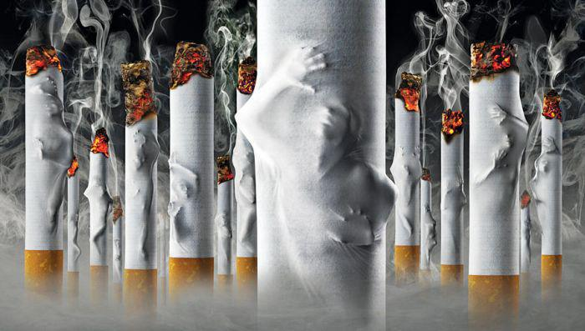
“Take your life back from the tobacco companies. They don't own you anymore”

Slide 45
Why quitting can seem so hard?
Smoking tobacco is both a psychological habit and a physical addiction. The act of smoking is ingrained as a daily ritual and, at the same time, the nicotine from cigarettes provides a temporary, and addictive, high. Eliminating that regular fix of nicotine will cause your body to experience physical withdrawal symptoms and cravings. To successfully quit smoking, you’ll need to address both the habit and the addiction by changing your behavior and dealing with nicotine withdrawal symptoms.

Slide 46
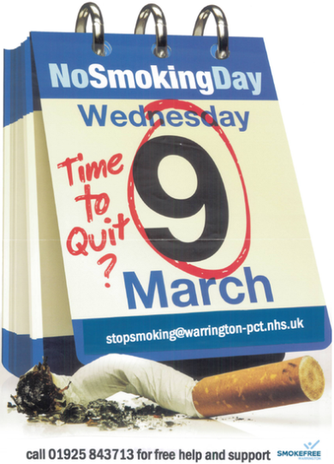
Start your stop smoking plan with START
S = Set a quit date.
T = Tell family, friends, and co-workers that you plan to quit.
A = Anticipate and plan for the challenges you'll face while quitting.
R = Remove cigarettes and other tobacco products from your home, car, and work.
T = Talk to your doctor about getting help to quit.

Slide 47
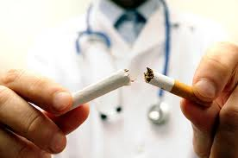
Role of the primary care physician
It recommend that you visit your primary care physician for a full physical at the beginning of your stop smoking effort. He or she can identify what physical health problems may have already begun within you, along with personalized changes needed to begin correcting them. These changes may include proper diet, exercise, medication, and other lifestyle changes for your particular situation. Your primary care physician should also let you know which, if any, food, activity, or medications you should avoid taking or engage in moderation.

Slide 48
Exercise Regularly:
regular exercise will manage your weight and dealing better with difficult feelings, such as depression, anxiety, stress boredom , and overall improve cardiovascular health-some of the main casualties from smoking that will probably require improvement.
Change Your Diet:
eat more of the healthy foods that will lessen your smoking cravings, It also make sense to avoid those foods and substances that will only increase your cravings.
Keep Your Mouth and Hands Busy:
it may be helpful to keep your hands and mouth busy in other ways-at least for the first 6 months or so until your cravings lessen considerably.
Dealing with Family and Friends that Smoke.

Slide 49
Changing Old Triggers and Cues to Smoke:
it can be helpful to identify these old triggers and cues to smoke, and then come up with alternative plans of what you can do in these instances.
Confidence Statements:
Confidence statements are positive, true statements that you can repeat to yourself daily to stay focused, motivated.
Remembering Reasons to Quit:
it can be helpful to write out and repeat a number of "why I am quitting statements" about yourself and your goal to stop smoking.

Slide 50
What can we do for patient Not Ready to Make a Quit Attempt ?
Relevance :
Tie tobacco use to current health, or social and economic costs of tobacco use ,motivation level, and/or the impact of smoking on children and others in the home. For example ,“ Your child’s asthma flare is certainly related to your smoking habit. It would be in your child’s best interest for you to set a quit date in the near future.”
Risks :
Ask patient to identify potential negative consequences of tobacco us:
Acute risks —shortness of breath, exacerbation of asthma, impotence, infertility.
• Long term risks — heart attacks, strokes, gum disease, tooth loss, COPD, lung and other cancers
• Environmental risks — increased risk of lung cancer in spouse and children; higher rates of smoking by children; increased risk for SIDS, asthma, middle ear disease and respiratory infection in children

Slide 51
Rewards :
ask patient to identify 1) Any positive benefits they currently derive from tobacco use. Discuss alternative methods for filling the potential void after cessation. 2) The potential rewards of quitting ,including improved health, improved taste, money saved, healthier children, freedom from addiction.
Roadblocks :
Ask patient to think about what are the barriers to quitting tobacco use (e.g., partner ,or co-worker who smokes, fears about quitting smoking, etc.).
Repetition:
Repeat above strategies every time an unmotivated patient has a visit

Slide 52
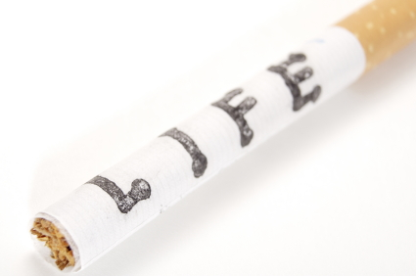
A majority of cigarette smokers, 70% report that they would like to stop smoking and indeed they attempt to stop many times.
Results from a national survey of smokers and ex-smokers revealed that in a 12-month period 32% of smokers had made a quit
Attempt and 33% had tried to cut down.

Slide 53
Many smokers are uncomfortable with their continued smoking and report a variety of reasons for why they would like to stop

Slide 54
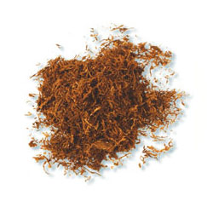
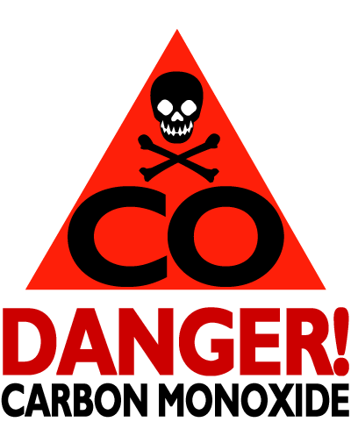
Health Benefits of Stopping Smoking
12 hours
• almost all the nicotine has been metabolised
24 hours
• blood levels of carbon monoxide have dropped dramatically
5 days
• most nicotine by-products have been removed
• sense of taste and smell improve
Notes:
Most people who smoke are aware that smoking damages health. They may not be aware that most
adverse health effects from smoking decline dramatically after quitting.

Slide 55
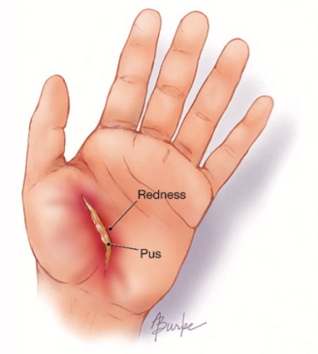
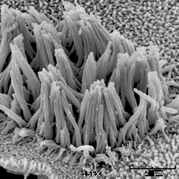
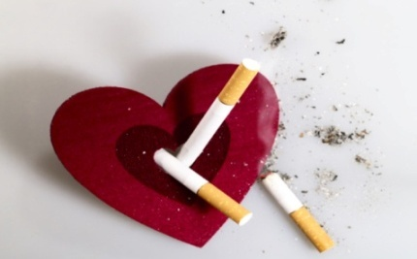
6 weeks
• risk of wound infection after surgery substantially reduced.
3 months
• cilia begin to recover and lung function improves
1 year
• risk of coronary heart disease is halved after one year compared to continuing smokers

Slide 56
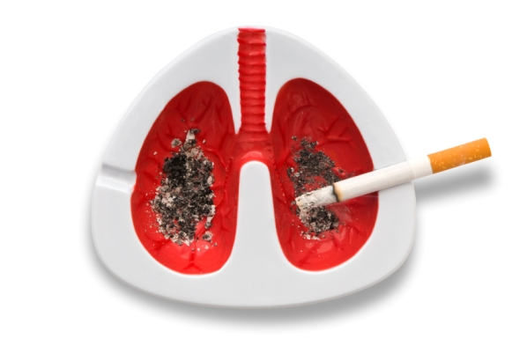
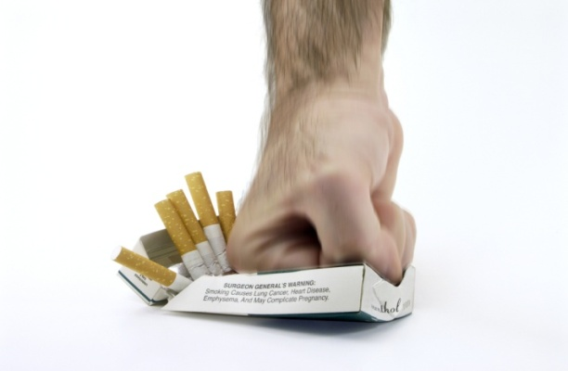
10 years
• risk of lung cancer is less than half that of a continuing smoker and continues to decline
15 years
.• risk of coronary heart disease the same as a non-smoker
• 10 to 15 years after quitting the all-cause mortality in former smokers declines to the same level as people who have never smoked.

Slide 57
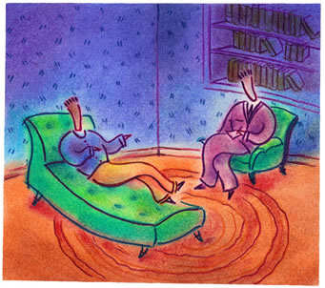
Psychotherapy

Slide 59
How Can Psychotherapy Help You Quit Smoking?
Whether delivered one-on-one, in a group, or as part of a self-help approach, psychotherapy provides a powerful tool to quit smoking.
Since smokers are more likely than nonsmokers to also have depression or other mental-health concerns, psychotherapy can assist in resolving these contributing underlying issues as well.
Psychotherapy can help correct misconceptions about smoking
change behaviors that encourage smoking
provide the support needed to undertake the process of quitting.

Slide 60
According to the American Cancer Society (ACS), the more intense the psychotherapy intervention is,
the better the chance for success.
In one-on-one or group therapy sessions, ACS recommends programs of :
four to seven sessions over at least two weeks, with at least 20 to 30 minutes per session.

Slide 61
Most conventional approaches to quitting smoking use a combination of
cognitive- behavioral therapy

Slide 62
When a person uses cognitive-behavioral therapy to help quit smoking, the focus is on:
Increasing the patient’s confidence in their ability to quit smoking
Exploring any ambivalence about quitting
Learning ways of coping with stress and urges to smoke
You’ll be taught to be on the alert for negative thoughts like, "I'll never be able to quit smoking" or "What's the use of quitting now?" The therapist will work with you to develop responses to these thoughts, and have you practice them so that they become almost automatic. The goal is to change thought patterns so that new, healthy patterns replace older, destructive ones.

Slide 63
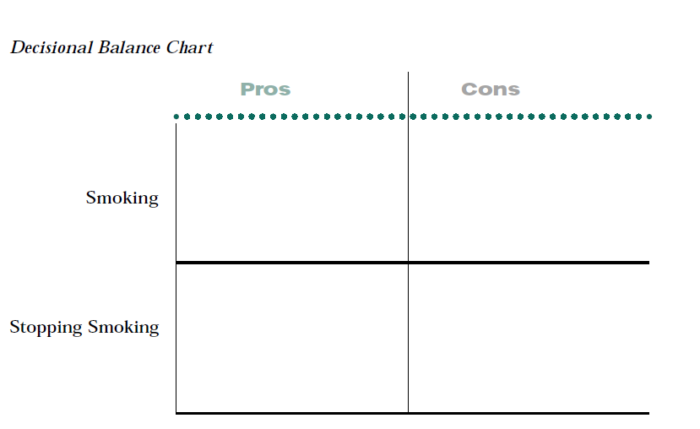
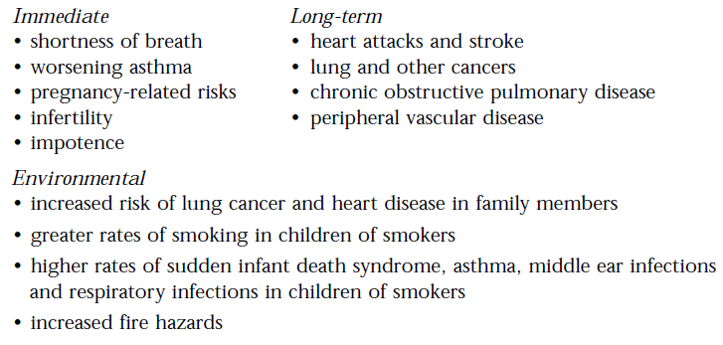
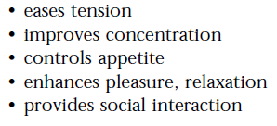
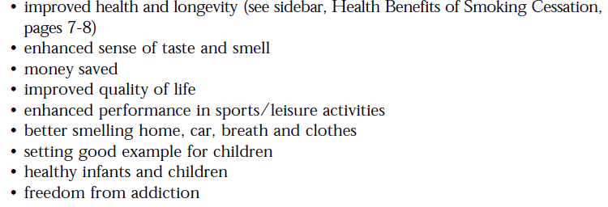
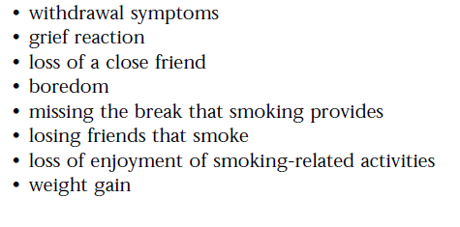
Notes:
ask the patient to identify both the
pros and cons of smoking and quitting. The following are possibilities only.
Each patient needs to be asked to identify his/her own pros and cons as they
will be highly personal.

Slide 64
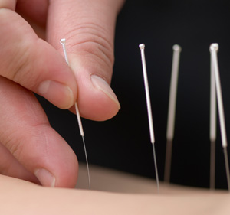
Acupuncture & Hypnotherapy
While acupuncture and hypnotherapy are popular, there is insufficient evidence to
support their effectiveness beyond a placebo effect. However, if the patient has
faith in acupuncture or hypnotherapy, they may benefit from the counselling that
these approaches offer.

Slide 65
Your Role as a Friend/mother/wife/sister
1) Don’t nag, insult, or try to shame the smoker into quitting.
2) Let the smoker know that he is valued as a person.
3) Listen non-judgmentally, Try to see the problem through the smokers’ eyes.
4) Praise the smoker for even the smallest
efforts to quit.

Slide 66
“Nicotine patches are great. Stick one over each eye and you can't find your cigarettes” ~Author Unknown

Slide 67
Physiology and action of Nicotine Nicotine dependence Nicotine withdrawal Nicotine pharmacotherapy

Slide 68
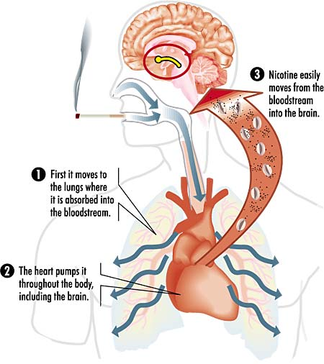
Nicotine physiology and action
natural compound
“alkaloid “ .
Nicotine can gain entry to the bloodstream by several routes → brain !
Notes:
* An alkaloid is an organic compound made up of carbon, hydrogen, nitrogen, and sometimes oxygen (nicotine lacks oxygen). Another example of an alkaloid
is caffeine. Both caffeine and nicotine are similar in that they provide stimulation upon ingestion, a factor that encourages their habitual use.
* Tobacco can also be applied as a wad to the inside of the mouth, enabling nicotine to diffuse across the mucous membranes of the gums to the bloodstream. As a component of a cigarette, nicotine can be inhaled into the lungs. There, it encounters the alveoli, diffuses across the alveolar membrane, and enters the bloodstream

Slide 69
Nicotine physiology and action
Nicotine reaches the brain within 10-15 seconds of entering the bloodstream. Initially, it causes the rapid release of adrenaline.
Adrenaline
heart rate and blood pressure → increase
breathing → rapid and shallow.
glucose → released into the blood and, at the same time, the release of insulin can be blocked.

Slide 70
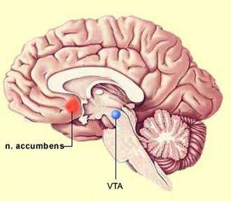
Nicotine physiology and action
The target of nicotine in the brain
are neurons !
Nicotine acts by occupying
Acetylcholine binding site to create an
action potential .
The global stimulation of brain activity produces an alert feeling. Also, the "reward center" of the brain is stimulated producing a pleasant and happy feeling.
Notes:
Key structures in the reward system are the ventral tegmental area (VTA), the nucleus accumbens and the circuit of nerve cells linking these two areas of the brain. Drugs of abuse cause a marked increase in the level of the neurotransmitter dopamine in the VTA. The prefrontal cortex is another area of the brain that is part of the brain's reward system, and is affected by addictive drugs. Brain structures involved in learning and memory also play a role in addiction.

Slide 71
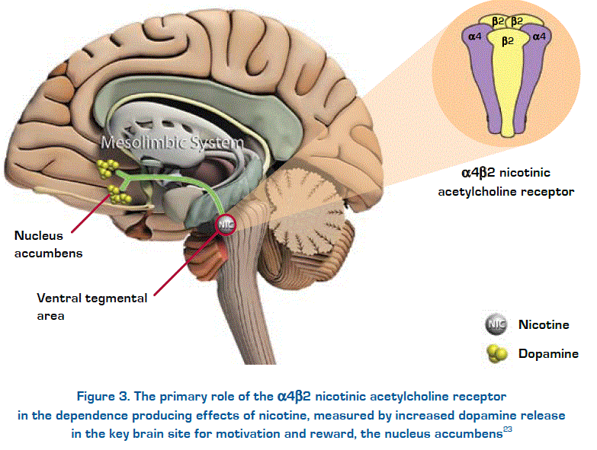
Nicotine physiology and action
Cell bodies are in the midbrain region called the ventral tegmental area (VTA), whose ﬁbres project forward to a region called the nucleus accumbens (NAcc)

Slide 72
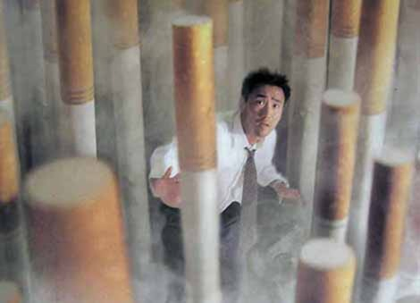
the hormone endorphin is released in greater quantity, producing the euphoric "runner's high"
that encourages the repeating of the behavior that invoked the response.
The need to take in
nicotine can become
Addictive !

Slide 73
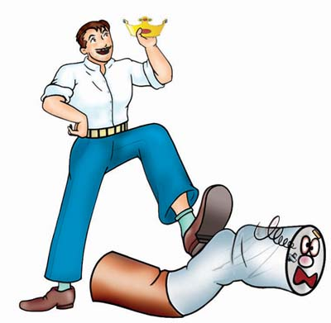
Nicotine dependence
‘People smoke for nicotine but die of smoke’.
Dependence would not occur without nicotine – but nicotine is not responsible for the harmful effects of smoking.
Notes:
If cigarettes did not deliver nicotine, they would not be smoked and smokers would not ﬁnd it so hard to stop.
Nerve cells communicate with each other by means of these chemical messengers – they are released from one cell and attach to a specially designed ‘receptor’ in the other cell, rather like a key ﬁtting into a lock. Once they have attached to that receptor they can do a number of things, including causing the nerve cell hosting the receptor to become activated.

Slide 74
Nicotine doesn’t cause cancer;
it is the tar and carbon monoxide in cigarette smoke that are harmful.
Notes:
NRT will not give you any of the tar and carbon monoxide that you get from cigarettes,
but will give you some nicotine to reduce the withdrawal symptoms that many smokers experience when they stop smoking.

Slide 75
Nicotine dependence
continued presence of nicotine !!
the neurons increase the number of neuroreceptors for nicotine.
nicotine abruptly stopped, these physiological adaptations remain.
As a result, the body cannot function in the same way it did in the presence of the drug.

Slide 76
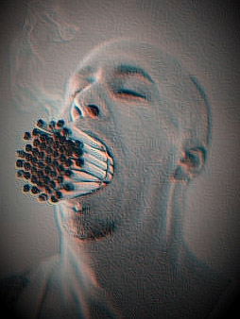
Nicotine dependence
For about a month, until the neuroreceptors readjust, feelings of irritability, anxiety, depression and craving for nicotine will be present.
Indeed, of the millions of people who try and stop smoking each year, only 10% are successful .

Slide 77
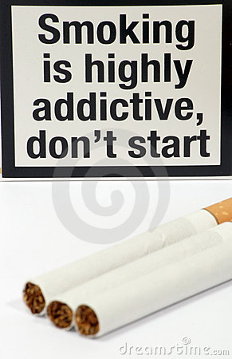
I don’t feel like an addict, smoking is just a habit isn’t it?
Nicotine is an addictive .
withdrawal symptoms occures when you stop smoking .
Of course, having a cigarette will make these unpleasant withdrawal symptoms go away .
Notes:
Nicotine is an addictive drug and most regular smokers will be dependent upon it – whether they feel that way or not. Try going without a cigarette for a while; the levels of nicotine in your blood will drop, you will experience some withdrawal symptoms (especially the urge to smoke) and you might start to feel more like an ‘addict’. Of course, having a cigarette will make these unpleasant withdrawal symptoms go away – which is what most smokers do in order to avoid feeling like this.

Slide 78
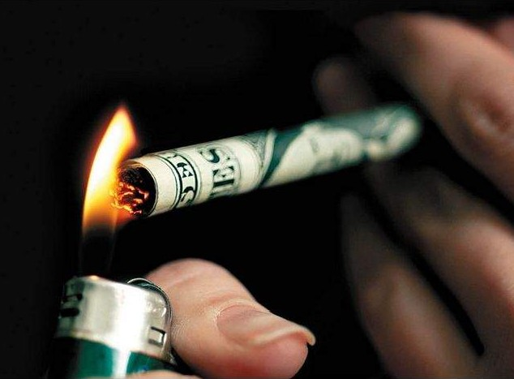
things can make it more difficult for a smoker to stop
Psychological and social forces , combined with the effects of nicotine.
Smokers think that smoking helps them control stress.
They often ﬁnd the identity of being a smoker more attractive than that of a nonsmoker.
Notes:
It is also thought that another effect of nicotine on the NAcc is to
make the activity of smoking, and the stimuli that accompany it, more
rewarding and pleasant, so that smokers come to like the feeling of
smoke going into the throat and lungs and places and situations
that usually accompany smoking – and they become attached to the
particular look and taste of the brand that they smoke.

Slide 79
Tobacco withdrawal syndrome
Physical and mental changes that occur following interruption, reduction or termination of tobacco use.
They are temporary and are a product of physical or psychological adaptation to long-term tobacco use.
Notes:
(in other words the smoker’s mind and body gets used to having nicotine in their system), requiring a period of readjustment when tobacco is no longer used.

Slide 80
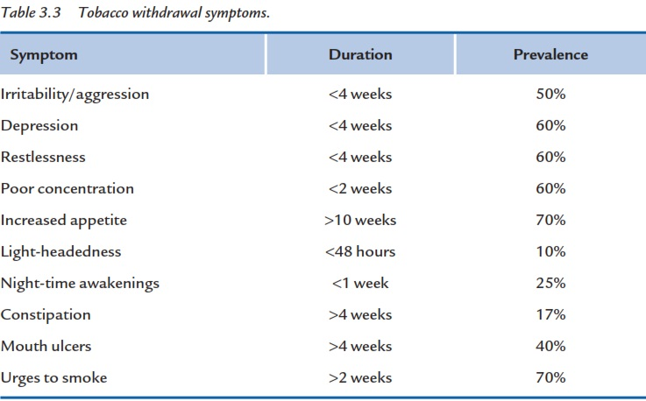
Tobacco withdrawal syndrome
Stopping smoking usually brings on a withdrawal syndrome, comprising a range of symptoms:
assisting smokers through the ﬁrst 4 weeks is important.
greater risk of relapse
Notes:
I am ﬁnding it difﬁcult to concentrate, how long will this last?
It is fairly common for people to report this when they stop smoking.
Difﬁculty in concentrating is a withdrawal symptom and as long as you do not smoke it typically gets better in a couple of weeks.
most withdrawal symptoms last no longer than 2–4 weeks and therefore assisting smokers through the ﬁrst 4 weeks is important.
Urges to smoke may go on for a much longer time, but, as long as you do not smoke, they will become less frequent.
Clients can be informed that withdrawal symptoms are due to them stopping smoking and not to any NRT that they may be using; and they can be reassured that these symptoms will pass, as long as they do not smoke.
More severe urges to smoke and depression are associated with a greater risk of relapse.
There is no evidence that greater weight gain is associated with greater risk of relapse
in fact greater weight gain is related to lower risk of relapse.

Slide 81
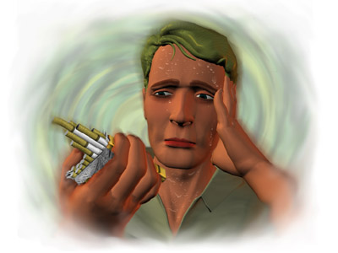
Tobacco withdrawal syndrome
feeling physically worse.
increased coughing,
throat soreness,
chest problems.
Notes:
Smokers expect to feel physically better when they stop, but many report feeling physically worse.
Many smokers report increased coughing, throat soreness, chest problems and mouth ulcers.
The short-term decrease in salivary immunoglobulin A (part of the body’s immune system), probably as a result of the stress involved with stopping smoking, may explain an increase in respiratory tract infections and mouth ulcers.

Slide 82
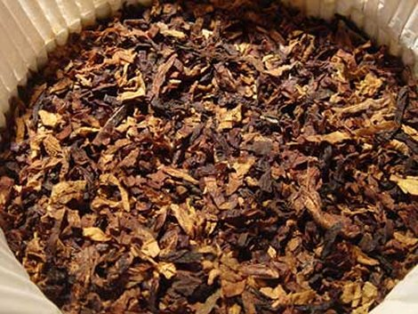
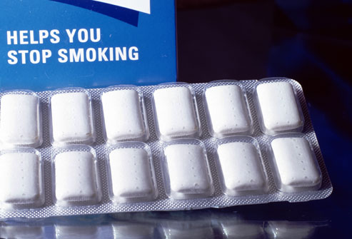
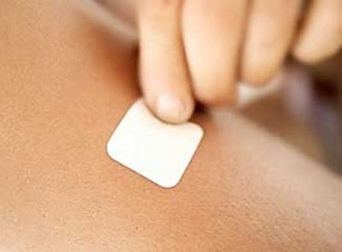
Tobacco withdrawal syndrome
Withdrawal symptoms from chewing tobacco are broadly similar to those from cigarettes, but probably less severe.
Withdrawal symptoms from nicotine nasal spray, gum or other oral nicotine replacement products appear to be much less severe than from cigarettes.
There is no evidence of withdrawal symptoms after cessation of nicotine patch use.

Slide 83
Pharmacotherapy of smoking ..
First-Line Agents ..
Nicotine replacement therapy (NRT)
Bupropion (Zyban®)
Varenicline (Champix®)
Second Line Agents ..
Clonidine
Nortriptyline
Notes:
Smoking cessation pharmacotherapy
Pharmacotherapy with either Nicotine Replacement Therapy (NRT) or bupropion slow release is an effective aid to
assisting motivated smokers to quit and in the absence of contraindications should be offered to all motivated
smokers who have evidence of nicotine dependence. In general, pharmacotherapy is not offered to people
smoking less than 10 cigarettes per day, as there is a lack of evidence for effectiveness below
this level of smoking. The choice of therapy is based on clinical suitability and patient preference. Special
consideration is needed in those with contraindications such as recent cardiovascular events, pregnant and breastfeeding
women and adolescent smokers.

Slide 84
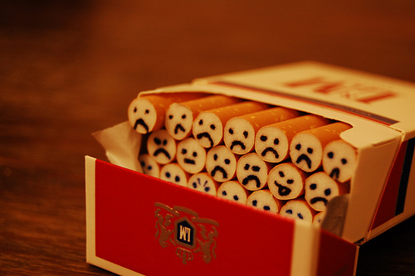
Nicotine Replacement Therapy
What is Nicotine Replacement Therapy?
How does it work ?
forms of NRT.
Contraindications .
Adverse effects .

Slide 85
Nicotine Replacement Therapy
NRT replaces some of the nicotine from cigarettes without the patient being exposed to the harmful constituents of tobacco smoke.
It is recommended that all products be used for 8–12 weeks.
Notes:
NRT increases quit rates approximately two-fold at 12 months compared to placebo.

Slide 86
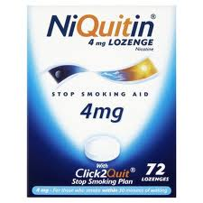
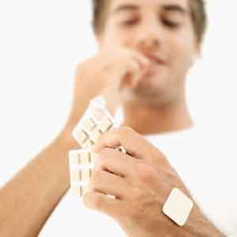
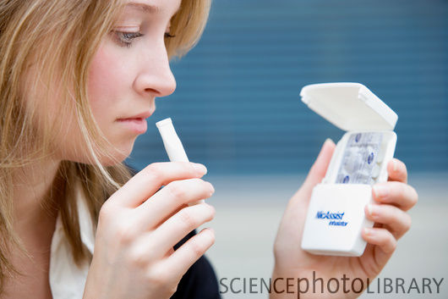
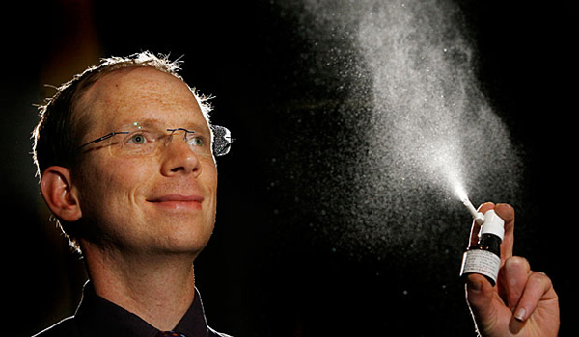
Nicotine Replacement Therapy
A number of forms of NRT are available (patch, gum, inhaler, lozenge & sublingual tablet)
there are no significant differences in effectiveness between forms.

Slide 87
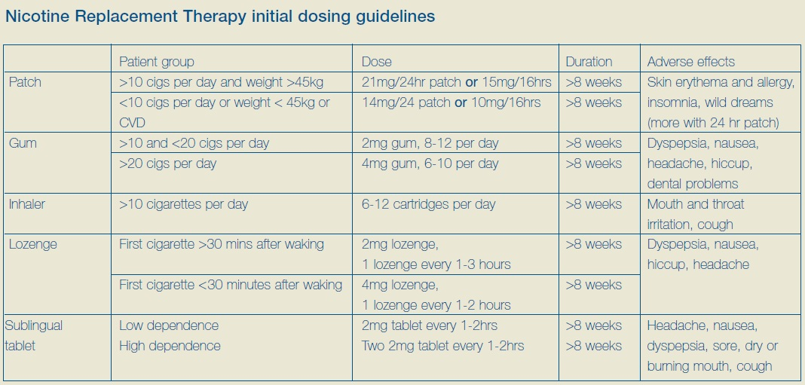

Slide 88
Adverse effects
Patch :
- Skin erythema , allergy ,insomnia, wild dreams
Gum :
- Dyspepsia, nausea, headache, hiccup,dental problems
Inhaler :
- Mouth and throat , irritation, cough
Lozenge :
- Dyspepsia, nausea, hiccup, headache
Sublingual Tablet:
- Headache, nausea, dyspepsia, sore, dry or burning mouth, cough

Slide 89
Contraindications of NRT
Pregnancy ,
recent myocardial infarction,
recent cerebrovascular event
severe arrhythmia
Patients with generalised skin disease should avoid use of patches.
Patients with dentures should avoid using nicotine gum
Notes:
the clinicians and patient involved may make an informed choice to use NRT if the benefits are assessed to out-weigh the risk.

Slide 90
Bupropion (Zyban®)
What is Bupropion (Zyban®)?
How does it work ?
Dosage .
Contraindications .
Adverse effects .

Slide 91
Bupropion sustained release (Zyban®)
Bupropion (trade name Zyban) is an atypical antidepressant type medication that was also found by chance to help people stop smoking.
(note: at the doses at which it is prescribed for smoking cessation, and because of the length of time it is taken, bupropion does not act as an antidepressant).
Notes:
Bupropion approximately doubles cessation rates at 12 months compared to placebo.

Slide 92
Bupropion
Bupropion is an oral non-nicotine therapy to assist cessation
It affects neuronal re-uptake of noradrenalin and dopamine.
It reduces cravings and other symptoms of nicotine withdrawal.
It is available only on prescription.

Slide 93
How does Zyban work?
Exactly , not particularly clear,
but we do know that it acts on parts of the brain where smoking has an effect.
This helps by reducing the urges to smoke and other withdrawal symptoms, making quitting smoking a little easier.

Slide 94
Bupropion Dosage
The initial dose is 150mg daily for 3 days,
increasing to 150mg twice a day on day four.
Bupropion is initiated while the patient is still smoking
The quit date is set within the second week of treatment.

Slide 95
Contraindications
Allergy to bupropion,
past or current seizures,
known CNS tumours,
abrupt withdrawal from alcohol or benzodiazepines,
current or previous bulimia or anorexia nervosa,

Slide 96
Adverse effects
insomnia (42%),
headache (26%),
dry mouth (11%),
nausea (10%),
dizziness (11%)
anxiety (9%),
Hypersensitivity reactions (3%)
seizures 0.1% (1/1000)
Notes:
The most common reaction is pruritis, urticaria and/or
angioedema. Serum-sickness-like reactions of arthralgia, myalgia and fever can occur in
association with skin rash and these can be delayed 10-20 days after starting bupropion.

Slide 97
Varenicline (Champix®)
What is Varenicline (Champix®) ?
How does it work ?
Dosage .
Contraindications .
Side effects .

Slide 98
Varenicline (Champix®)
new class of drug for first line pharmacotherapy.
It was developed specifically for smoking cessation by targeting the nicotinic acetylcholine (ACh) receptor in the reward centres in the brain.

Slide 99
How Does Varenicline Work ?
Varenicline binds with high affinity at the α4β2 nicotinic ACh receptor
It acts as a partial agonist to alleviate symptoms of craving and withdrawal.
At the same time, if a cigarette is smoked, the drug prevents inhaled nicotine from activating the α4β2 receptor sufficiently to cause the pleasure and reward response

Slide 100
varenicline Dosage
The first script is a starter pack lasting 4 weeks,
followed by a maintenance batch for the remainder of the 12 week course.
The patient should set a quit date 1–2 weeks .
The medicine can be taken whole with water and food to help reduce nausea.

Slide 101
varenicline Dosage
The recommended dose of varenicline is 1 mg twice per day following a 1 week titration as follows:
Days 1–3 ( 0.5 mg once per day )
Days 4–7 ( 0.5 mg twice per day )
Day 8 ( 1 mg twice per day )

Slide 102
Contraindications
Psychiatric problems:
(There have been reports of depressed mood, agitation, hallucinations, changes in behaviour, suicidal ideation and suicides in patients attempting to quit smoking using varenicline )

Slide 103
adverse effects
Nausea (30%) of smokers.
Abnormal dreams were also more common in the varenicline group (13.1%) than either the bupropion (5.9%) or placebo groups (3.5%).
No clinically meaningful drug interactions have been identified

Slide 104
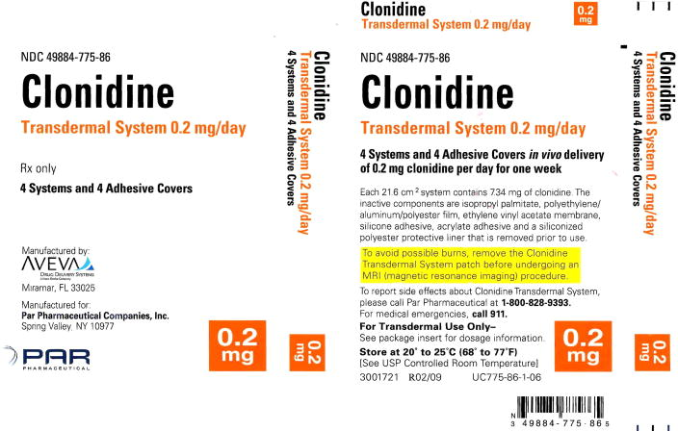
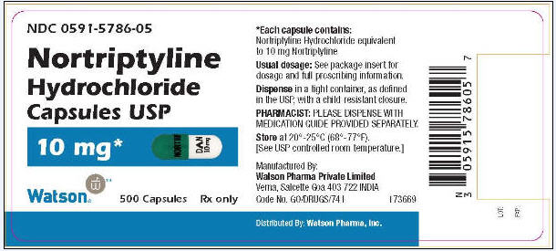
Second-line agents ..
Clonidine
Nortriptyline

Slide 105
Pharmacotherapy in special populations

Slide 106
“Quitting smoking is easy. I’ve done it hundreds of times.”

Slide 107
And lapse Relapse

Slide 108
What is the difference between a lapse and a relapse?
Relapse | lapse
When you’re unable to stop yourself because you make a negative judgment of your abilities or culpability. | It’s when you take two or three puffs of a cigarette but are able to stop yourself.
A return to an addictive lifestyle | A one-time return to addictive behavior

Slide 109
Approximately 80% of all smoking cessation attempts result in relapse.
Lapses are highly predictive of relapse; more than 90% of lapses lead to a relapse.
Quitting is not nearly as difficult as staying quit, i.e. the maintenance of change.

Slide 110
High-risk relapse situations
Arguments with partners/family
When the pressure is on at work
Vacations
Under the influence of alcohol
In the company of smokers.
prolonged withdrawal symptoms.
lack of support
Problems with pharmacotherapy

Slide 111
Relapse Prevention Therapy (RPT)
It’s a cognitive-behavioral approach to the treatment of addictive behaviors.
This Therapy suggests coping with cravings to smoke and ways to reduce the risk of relapse.
Cravings are most frequent in the first few days after quitting.

Slide 112
Remember the 4Ds:
Delay
Deep breathe
Drink water
Do something

Slide 113
Delay :
Every time you get the urge to puff, try to delay it..Delay it for a few minutes, to half an hour, to an hour, to a day….as long as you can.This will help you strengthen your threshold against the cravings you are going through.
Deep breathe:
It has been proven to effectively help smokers kick the habit.
It’s a perfect aid especially when you're going through withdrawal symptoms by taking a long slow breath in and slowly release it out again..Repeat three times

Slide 114
Drink water:
Water refreshes the body and flushes out toxins.
It doesn't give the same effects as nicotine but it can help to calm you down.
Do something:
Exercise, work out in the gym, paint, dance, do some gardening and you can always bake cookies.
Do anything that keeps your hands full and your mind preoccupied.

Slide 115
Remember
Thinking ‘I can have just one’ is the way most people go back to regular smoking.
The longer you go without a smoke the sooner you'll be able to overcome withdrawal symptoms.
Combine these methods and you'll be amazed at just how quickly you can become a healthy non smoker.

Slide 116
References
http://kickit.quitsa.org.au/cms_resources/Why%20do%20people%20smoke.pdf
http://www.bpac.org.nz/magazine/2009/february/docs/bpj19_smoking_pages_48-55.pdf
http://med.stanford.edu/medicalreview/smrp14-16.pdf
http://www.cancer.gov/cancertopics/factsheet/Tobacco/Fs10_18.pdf
http://www.epa.gov/smokefree/healtheffects.html
McEwen, A. & West, R. (1999). Tobacco use amongst black and minority ethnic groups in England. In: Black and Minority Ethnic Groups
Tobacco Use in England. A Practical Resource for Health Professionals. London: Health Education Agency.
http://www.everydayhealth.com/smoking-cessation/living/coping-with-the-urge-behaviorally-and-mentally.aspx
The Smoking Cessation Clinical Practice Guidelines Panel and Staff. The Agency for Health Care
Policy and Research smoking cessation clinical practice guideline. JAMA 1996; 275:1270-80.
Office for National Statistics (1997). Living in Britain: Results from the
1996 General Household Survey. London: The Stationery Office.
http://onlinelibrary.wiley.com/doi/10.1002/14651858.CD006886/pdf

Slide 117
References
http://www.altmd.com/Articles/Psychotherapy-for-Quitting-Smoking
Smoking Cessation Guidelines FOR AUSTRALIAN GENERAL PRACTICE
Nicotine Actions and the Physiology of Smoking from World of Anatomy and Physiology. ©2005-2006 Thomson Gale, a part of the Thomson Corporation.
Smoking Cessation Guidelines FOR AUSTRALIAN GENERAL PRACTICE
Manual of Smoking Cessation.A guide for counsellors and Practitioners . Andy McEwen,Peter Hajek,Hayden McRobbie,Robert West.
Smoking cessation pharmacotherapy an update for health professionals. © The Royal Australian College of General Practitioners 2007 .Reviewed and updated April 2009
TCS tobacco consultation services( how to help your patiant to quite tobacco use 2012.
http://www.helpguide.org How to Quit Smoking
A Guide to Kicking the Habit for Good.
http://www.tricountycessation.org/helping_patient_quit/motivating.htm Motivating Your Patient to Quit. PHS-Clinical Practice Guideline
7 Tips to Help You Stop Smoking
Exercise, Dite, and Keeping Busy from dr. Randy Gilchrist.

