Slide 1
Medical Records
Dr. Nada Al-Yousefi

Slide 2
Medical record
Health record
Medical chart

Slide 3
A systematic documentation of a single patient's long-term individual medical history and care.

Slide 4
Medical record
Physical folder for each individual patient
Body of information which comprises the total of each patient's health history
Notes:
The term is used both for the physical folder for each individual patient and for the body of information which comprises the total of each patient's health history

Slide 5
Medical records are intensely personal documents and there are many ethical and legal issues surrounding them such as the degree of third-party access and appropriate storage and disposal.

Slide 6
Purpose?

Slide 7
Continuity of care to individual patients.
Serves as a basis for planning patient care, documenting Communication between patient, the health care provider and any other health professional contributing to the patient's care.
Assists in Protecting the Medical needs and the Legal interest of the patient and the health care providers responsible for the patient's care, and Documenting the care and services provided to the patient.

Slide 8
Educate medical students/resident physicians.
Provide data for internal hospital auditing and quality assurance.
Provide data for medical research.
Notes:
In addition, the individual medical record anonymised may serve as

Slide 9
Contents?

Slide 10
Contents?
Medical history
Surgical history
Obstetric
Medications and medical allergies
Family History ?pedigree chart
Social history
Habits
Immunization history
Growth chart and developmental history
Notes:
Medical history
The medical history is a longitudinal record of what has happened to the patient since birth. It chronicles diseases, major and minor illnesses, as well as growth landmarks. It gives the clinician a feel for what has happened before to the patient. As a result, it may often give clues to current disease states. It includes several subsets detailed below.
Surgical history The surgical history is a chronicle of surgery performed for the patient. It may have dates of operations, operative reports, and/or the detailed narrative of what the surgeon did. Obstetric history The obstetric history lists prior pregnancies and their outcomes. It also includes any complications of these pregnancies. Medications and medical allergies The medical record may contain a summary of the patient's current and previous medications as well as any medical allergies. Family history The family history lists the health status of immediate family members as well as their causes of death (if known)^{[8]}. It may also list diseases common in the family or found only in one sex or the other. It may also include a pedigree chart. It is a valuable asset in predicting some outcomes for the patient. Social history The social history is a chronicle of human interactions. It tells of the relationships of the patient, his/her careers and trainings, schooling and religious training. It is helpful for the physician to know what sorts of community support the patient might expect during a major illness. It may explain the behavior of the patient in relation to illness or loss. It may also give clues as to the cause of an illness (e.g. occupational exposure to asbestos). Habits Various habits which impact health, such as tobacco use, alcohol intake, exercise, and diet are chronicled, often as part of the social history. This section may also include more intimate details such as sexual habits and sexual orientation. Immunization history The history of vaccination is included. Any blood tests proving immunity will also be included in this section. Growth chart and developmental history For children and teenagers, charts documenting growth as it compares to other children of the same age is included, so that health-care providers can follow the child's growth over time. Many diseases and social stresses can affect growth and longitudinal charting and can thus provide a clue to underlying illness. Additionally, a child's behavior (such as timing of talking, walking, etc.) as it compares to other children of the same age is documented within the medical record for much the same reasons as growth.

Slide 11
Hospital admission documentation
Routine visits (problem-oriented medical record (POMR), which includes a problem list of diagnoses or a "SOAP" )

Slide 12
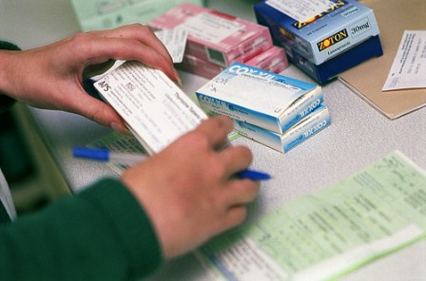
Orders and Prescriptions

Slide 13
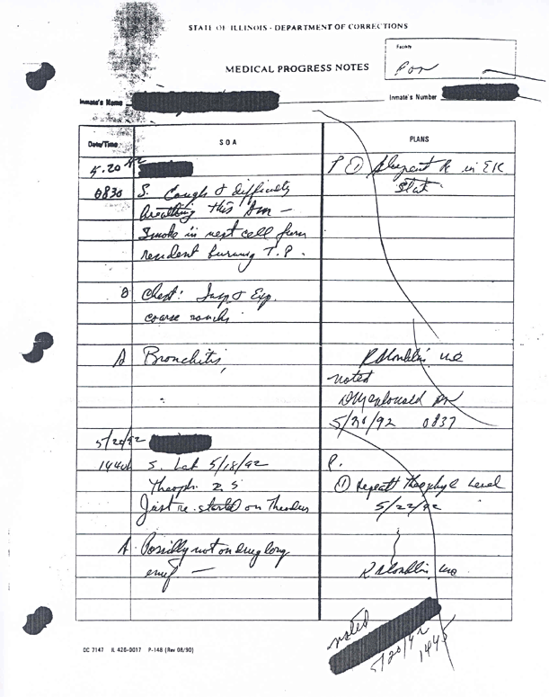
Progress notes

Slide 14
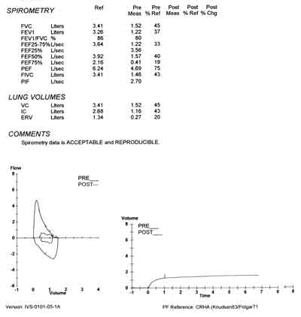
Test results

Slide 15
Other information
Many other items are variably kept within the medical record.
Digital images of the patient, flowsheets from operations/intensive care units, informed consent forms, EKG tracings, outputs from medical devices (such as pacemakers), chemotherapy protocols .. etc.
Notes:
and numerous other important pieces of information form part of the record depending on the patient and his or her set of illnesses/treatments.

Slide 16
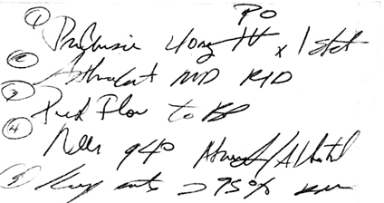

Slide 17
Not recorded = Not done !
Legal issues

Slide 18
Medical records are legal documents, and are subject to the laws of the country in which they are produced.

Slide 19
To prevent legal problems
Record everything you do (including phone consultations)
Apply guidelines (e.g. NCQA)
Don't use erasable pencils
Don’t use humiliating expressions
Do not use vague expressions such as “the patient feels well”
If you need to make changes just strike through and record also the date of change
If you stated that the patient is not cooperative give the reason
If patient rejects a procedure or test, mention it and give the reason why you requested it

Slide 20
Disadvantage of medical records
Time consuming
Cost
Loss of confidentiality
Loss of records

Slide 21
Abuses
The outsourcing of medical record transcription and storage has the potential to violate patient-physician confidentiality by possibly allowing unaccountable persons access to patient data.

Slide 22
Rules in keeping medical records (NCQA)
Each page in the record contains the patient’s name or ID number.
Personal biographical data include the address, employer, home and work telephone numbers and marital status.
All entries in the medical record contain the author’s identification.
All entries are dated.
The record is legible to someone other than the writer.
Significant illnesses and medical conditions are indicated on the problem list.
Medication allergies and adverse reactions are prominently noted in the record.
Notes:
The National Committee for Quality Assurance
If the patient has no known allergies or history of adverse reactions, this is appropriately noted in the record.Author identification may be a handwritten signature, unique electronic identifier or initials.

Slide 23
Rules in keeping medical records (NCQA)
Past medical history
?cigarettes, alcohol and substances
The history and physical examination
Laboratory and other studies are ordered, as appropriate.
Working diagnoses are consistent with findings.
Treatment plans are consistent with diagnoses.
Encounter forms or notes have a notation, regarding follow-up care, calls or visits, when indicated. The specific time of return is noted in weeks, months or as needed.

Slide 24
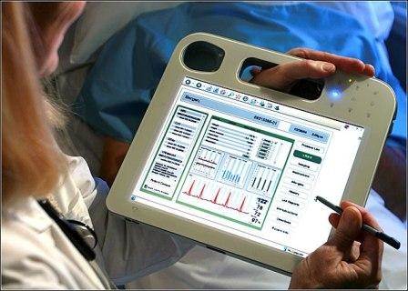

Slide 25
electronic medical record (EMR)
A computerized medical record created in an organization that delivers care, such as a hospital and doctor's clinic.
Tend to be a part of a local stand-alone health information system that allows storage, retrieval and modification of records.

Slide 26
MEDICATION MANAGER
Patient Name : CURRENT DRUG HISTPORT
I.D. No. :
DIAGNOSIS :
Urinary Tract Infection
OTHER ACTIVE PROBLEMS
ASTHMA
Drugs Available for Diagnostic Profile :
CODE
AMPICILLIN
AMPICILLIN-SODIUM
SELECT CANCEL
Consultant :
CURRENT DRUG HISTORY
Include : All current and expired drugs.
DRUG DOSE
Becotide 250 2/day
Drug Allergies :
NONE KNOWN
PRESCRIBE
RESULTS....

Slide 27
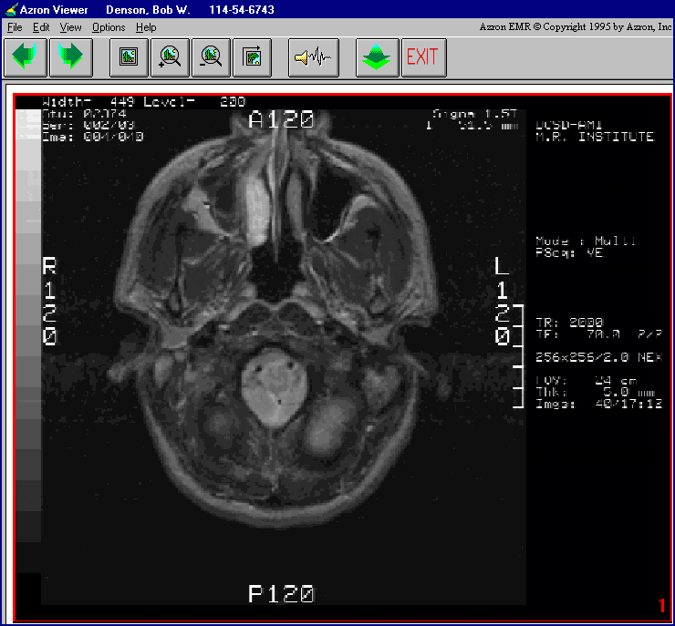

Slide 28
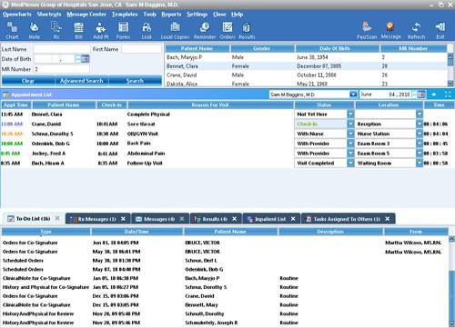

Slide 29
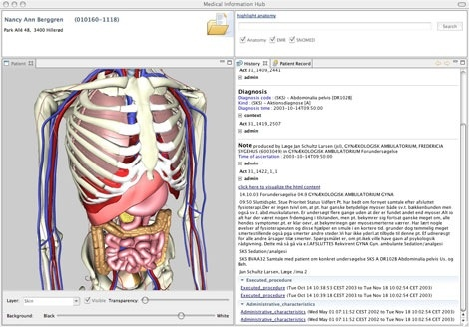

Slide 31
Advantages
Legible text
Information easily accessible and confidential
Staff time saved from filing
Encounter date and time entered
Accurate record of drugs prescribed
Easy display of results and blood pressure readings that can be in tabulated or graph form

Slide 32
Advantages
Patients' reports easily produced.
Back-up techniques made records more secure
Complex investigation for fraud or malpractice possible
Electronic information is more easily transferable by email, patient card or disc
Quality of record can be high
Patient summaries and drugs' warnings can be easily displayed, leading to safer prescribing

Slide 36
Disadvantages
Typing skills required
Passwords can be troublesome, abused or swapped
More time taken in scanning and entry of data
Print-outs often of poor quality and obscure essential information
Results can sometimes only be found by many screen changes and much mouse activity
Notes:
which inhibits some doctors, and many are using yet more abbreviations and acronyms.

Slide 37
Disadvantages
Only the information requested is provided
Paper still has to be kept
Screen viewing generally takes longer than scanning visually
Technicians skilled needed
Information fatigue easily occurs in busy clinics
Quality depends on the software and the skills of the user
Illness does not conform to codes and many codes are meaningless
Patients see the doctor as computer-centered and not patient-centered
Notes:
which inhibits some doctors, and many are using yet more abbreviations and acronyms.

Slide 38
Referrals

Slide 39
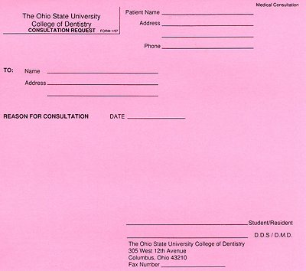

Slide 41
instructions
Fill in the header of the report or the address elements in a letter. These will identify the consulting physician, the referring physician, the date the consultation took place and the patient's identifying information.
Begin the report or body of the letter with the headings "Patient Identification" and "Reason for Referral" or with an introductory paragraph giving this information. For example, "The patient is a 32-year-old diabetic woman referred for shortness of breath."

Slide 42
instructions
Delineate the patient's history. Use several headings, such as "History of Present Illness," "Past Medical History," "Past Surgical History," "Medications," "Allergies," "Family History," "Social History" and "Review of Systems." Under "Review of Systems," list further subheadings of the body's systems (e.g., head; eyes; ears, nose, and throat; respiratory; cardiac; gastrointestinal; endocrine) and any pertinent symptoms the patient is experiencing for each system.
Describe the patient's exam under the heading "Physical Examination." A physician may also choose to leave out information that is not pertinent to the consultation. For example, an orthopedist consulted for a possible leg fracture might not include an ear exam in her evaluation of the patient.

Slide 43
instructions
Describe any results of pertinent tests available for review with the headings "Laboratory Studies" and "Diagnostic Studies."
Use the heading "Assessment" or "Impression" to express a professional opinion of the patient's condition.
Explain the steps needed to address the patient's condition with the heading "Plan" or "Recommendations."
Conclude the consultation report or letter with a sentence that thanks the referring physician for involving the consulting physician in the patient's care.
Contact information should also be given in the section, if needed. If the report is an in-patient consultation, the consultant should indicate whether she will continue following the patient along with the referring physician.

