Slide 1
Psychological Treatments
Dr. Ahmad AlHadi
Consultant, Psychiatrist and Psychotherapist
King Saud University
College of Medicine
Department of Psychiatry

Slide 2
introduction
What is Psychotherapy?
Psychodynamic
CBT
Discussion

Slide 3
Treatments in Psychiatry
Psychopharmacology
Psychotherapy
ECT
DBS
rTMS
VNS
Psychosurgery

Slide 4
Psychotherapy
?

Slide 5
Psychotherapy is defined as the establishment of a helping relationship between a patient and a trained professional who applies psychological principles to the treatment of emotional or behavioral problems.

Slide 6
What is psychotherapy?
Can be conducted with individual, couple, family or group of unrelated members who share common issues.
Also known as talk therapy, counseling, psychosocial therapy or, simply, therapy.
Can be combined with other types of treatment, such as medications.

Slide 7
Psychotherapy
Psychodynamic
Freudian
Ego
Object-relations
Self
IPT
Humanistic
CBT
Gestalt
Client-centered
CBT
MBCT
DBT
ACT
Family
&
Couple
Supportive
IPT
ISRT
Counseling

Slide 8
Does Therapy Work?
Meta-analysis
Number of
persons
Average
untreated
person
Average
psychotherapy
client
Poor outcome
Good outcome
80% of untreated people have poorer
outcomes than average treated person

Slide 9
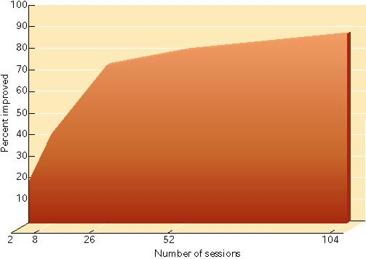
The dose-improvement relationship in psychotherapy. This graph shows the percentage of patients who improved after varying numbers of therapy sessions. Notice that the most rapid improvement took place during the first 6 months of once-a-week sessions. (From Howard et al., 1986.)
For How Long?

Slide 10
Therapeutic relationship
No matter what therapeutic technique or model is used, it is not likely to be effective if there is not a strong client-therapist relationship.

Slide 11
Myths of Psychotherapy
There is one best therapy
Therapy simply does not work
Therapists can “read minds”
People who go to therapists are crazy or just weak
Only the rich can afford therapy

Slide 12
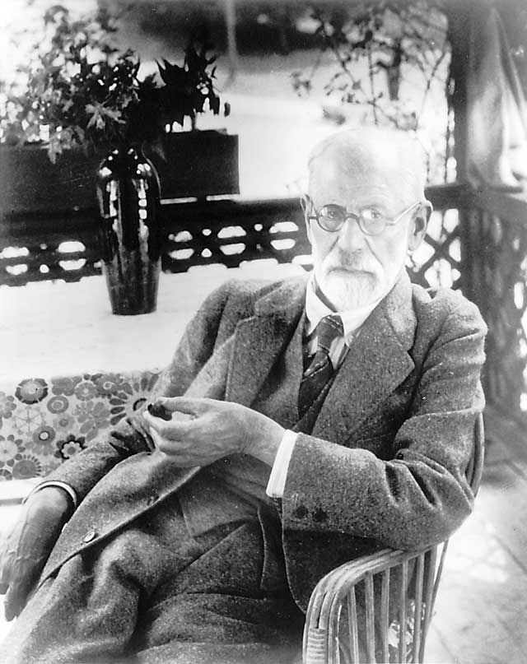
Sigmund
Freud

Slide 13
Psychoanalysis
Freud’s Topographical Model
Conscious
Preconscious
Unconscious
Freud’s Structural Model
Id
Ego
Superego
The interplay between these structures is referred to as “the psychodynamics of the personality”.

Slide 14
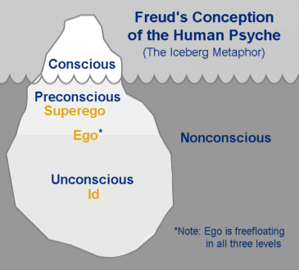

Slide 16
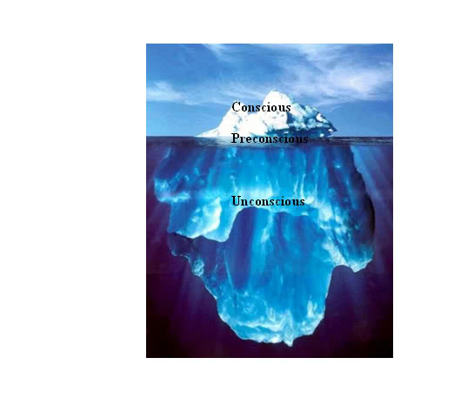

Slide 17
Defense mechanisms (DSM-IVTR, 2000)
Defense mechanisms (or coping styles) are automatic psychological processes that protect the individual against anxiety and from the awareness of internal or external dangers or stressors.
Individuals are often unaware of these processes as they operate.
Defense mechanisms mediate the individual’s reaction to emotional conflicts and to internal and external stressors.

Slide 18
DEFENSE MECHANISMS
They are divided into:
Mature: altruism, anticipation, asceticism, humor, sublimation, suppression.
Immature: acting out, blocking, hypochondriasis, identification, introjection, passive-aggressive behavior, projection, regression, schizoid fantasy, somatization.

Slide 19
DEFENSE MECHANISM
Neurotic: controlling, displacement, dissociation, externalization, inhibition, intellectualization, isolation, rationalization, reaction formation, repression, sexualization.
Narcissistic: denial, distortion, primitive idealization, projection, projective identification, splitting.

Slide 20
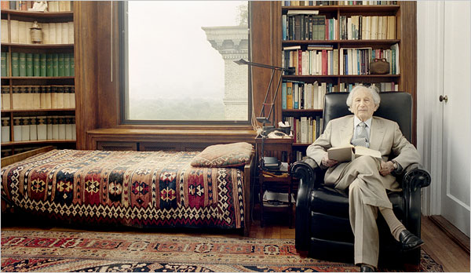
Psychoanalysis
Traditional
50 minute sessions
5 times per week
Duration of several years

Slide 21
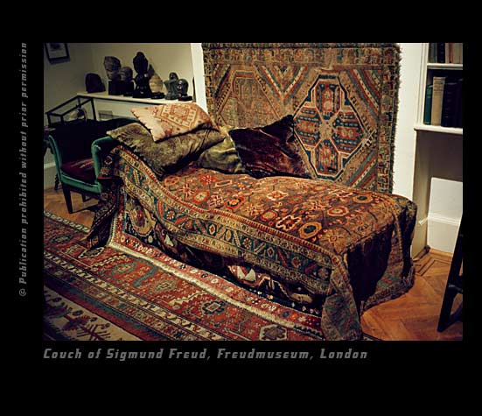

Slide 22
Psychoanalytic Techniques
Transference
Identifying resistance
Free association
Dream interpretation
Psychopathology of everyday life

Slide 23
Psychoanalytic Therapy
EX: young female client projects very negatively onto an older male therapist; does not trust or like therapist and is afraid of becoming attached to therapist.
INTERPRETATION: young female has repressed negative events in childhood; father left at an early age, so female, while wanting acceptance and love from father, is also afraid of being hurt.

Slide 24
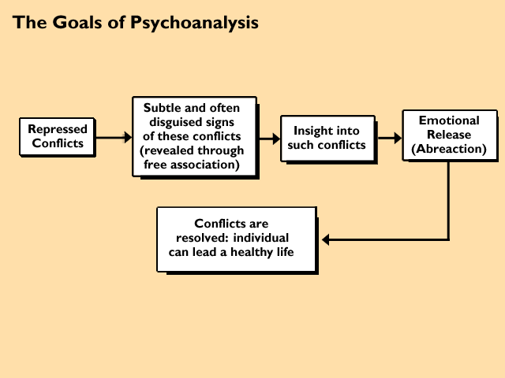
Goals of psychoanalysis

Slide 25
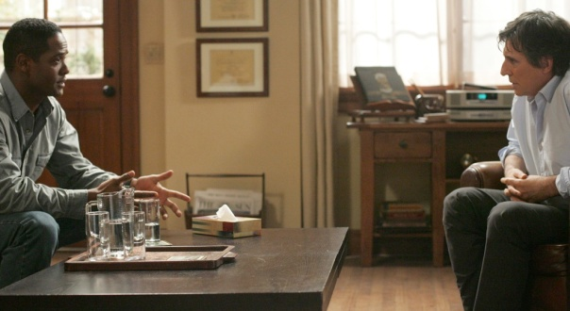
Psychoanalytic Therapy
MODERN PSYCHOANALYTICALLY ORIENTED THERAPISTS
No couch
Fewer sessions
More self-disclosure by therapist
More work with ‘real’ issues than projected material and dreams

Slide 26
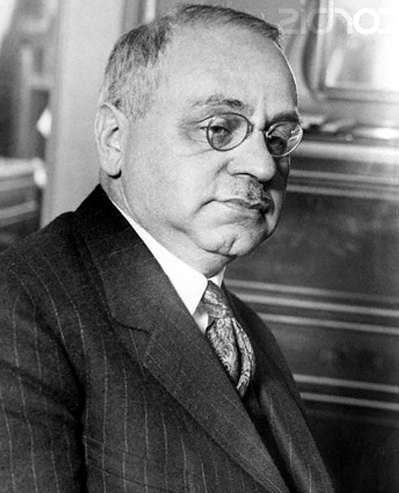
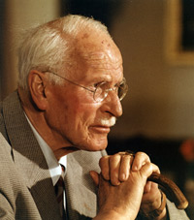
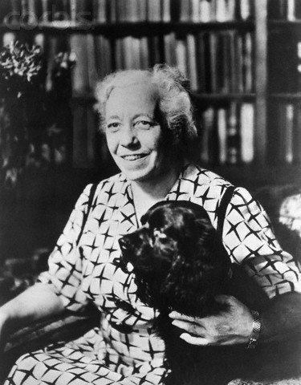
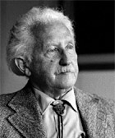
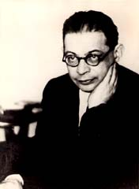
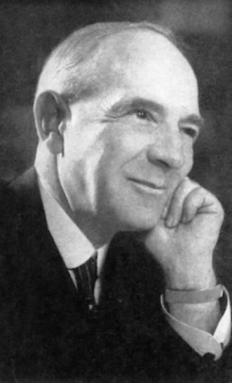
Psychoanalysis: Post Freud
Alfred Adler
Carl Jung
Karen Horney
Erik Erikson
Otto Rank
Ernest Jones

Slide 27
psychoanalytic theory
Object Relations
Melanie Klein, W.R.D. Fairbairn, D.W. Winnicott, and Harry Guntrip
Self Psychology
Heinz Kohut
Ego Psychology
Freudian psychology
Sigmund Freud
Hartmann, Loewenstein, and Kris.
Later Leo Bellak

Slide 28
Psychodynamic Therapies

Slide 29
Illustration of self-reflection needed for psychoanalytic therapy
“Whenever two people meet, there are really six people present:
There is each man as he sees himself,
each man as the other person sees him,
and each man as he really is”.
William James

Slide 30
Summary
Psychotherapy
Psychoanalysis/Psychodynamic

Slide 31
Questions

Slide 32
You are what you think, Know CBT
Ahmad AlHadi, Mbbs, ssc-Psych, ACT
Department of Psychiatry

Slide 33
Agenda
Welcome & Mood Checking
History of CBT
Model of CBT
Therapeutic Relationship
Therapy Structure
Who can benefit from CBT?
Summary
Feedback

Slide 34
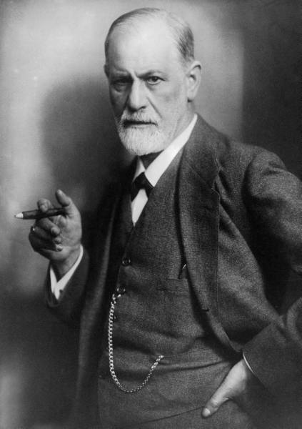
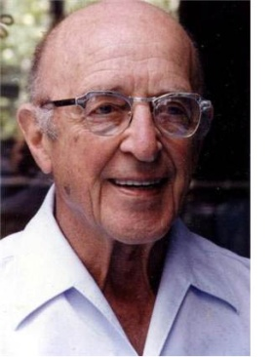
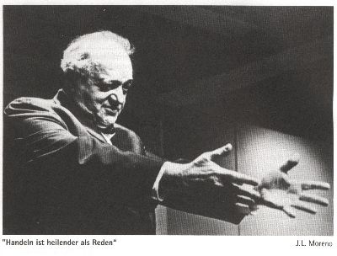
Psychotherapy
1900: Psychoanalysis
Freud
1921: Psychodrama by Moreno
1951:
Client-Centered Therapy
Carl Rogers
1951:
Gestalt Therapy by Perls, Goodman, and Hefferline
1953: behavioral therapy Skinner

Slide 35
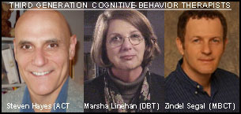
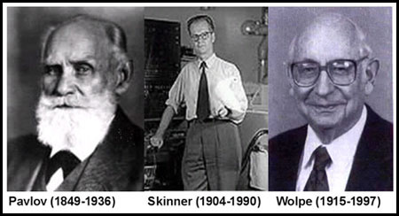
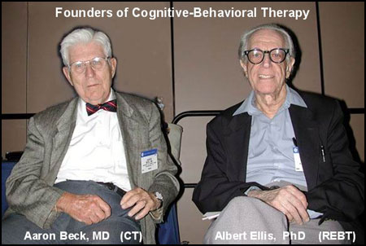
CBT
1st wave: Behavioral
2nd wave: Cognitive
3rd wave:
MBCT
DBT
ACT

Slide 36
CBT types
Behavioral Therapy
Cognitive Therapy
Cognitive Behavioral Therapy
Rational Emotive Behavioral Therapy
Metacognitive Therapy
Cognitive Behavioral Analysis System of Psychotherapy (CBASP)
Multimodal Cognitive Therapy
Emotion Focused Cognitive Therapy
Trauma Focused Cognitive Behavioral Therapy
Acceptance and Commitment Therapy (ACT)
Mindfulness Based Cognitive Therapy (MBCT)
Dialectical Behavior Therapy (DBT)
Behavioral Activation (BA)
Functional Analytic Psychotherapy (FAP)
Integrative Couple Therapy (ICT)

Slide 37
What is CBT?
Def
How can I be a CBT therapist?

Slide 38
Basic Cognitive Model

Slide 39
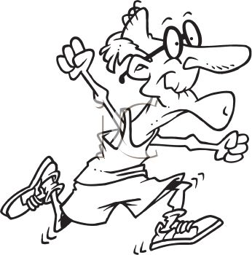
Situation
Exercise
Thought
Emotion
Behavior

Slide 40
Cognitive Model
Perception of event
Automatic thoughts
Behaviour
Emotions

Slide 41
Cognitive Model II
Perception of event
How we think ->
Altered information processing
What we think ->
Automatic thoughts
Behaviour
Emotions

Slide 42
Cognitive Processing Errors
Black/white thinking
Selective abstraction
Discounting the +
Overgeneralizing
Fortunetelling
Catastrophizing
Arbitrary inference
Labeling
Mind reading
Shoulds & musts
Personalizing
Magnification/ minimization
Emotional reasoning

Slide 43
Cognitive Errors
1. Overgeneralizing: You perceive a global pattern of negatives on the basis of a single incident.
“This generally happens to me. I seem to fail at a lot of things.”
2. Fortunetelling: You predict the future negatively: Things will get worse, or there is danger ahead.
“I’ll fail that exam,” or “I won’t get the job.”

Slide 44
Cognitive Model II
Perception of event
How we think ->
Altered information processing
What we think ->
Automatic thoughts
Behaviour
Emotions

Slide 45
Cognitive Model III
Perception of event
Underlying Schemas ->
Activated Core beliefs/ assumptions
How we think ->
Altered information processing
What we think ->
Automatic thoughts
Behaviour
Emotions

Slide 47
Automatic Thoughts
Occur rapidly in response to a situation
Are not subjected to systematic, logical analysis
A person may be unaware of their presence or significance
Nothing I do ever works out, so why bother?
He thinks I’m an idiot.
This depression is all my fault.
What if this is cancer?
They’re laughing at me.

Slide 48
Assumptions
Rules for living:
If I don’t do a great job, then I’m a failure.
If I’m depressed, people will think I’m weak.
If others don’t value me, I have no worth.
Anything worth doing should be done perfectly.
If I express my feelings, others will reject me.

Slide 49
Schemas – Core Beliefs
Organizing principles that govern perceptions, predictions, and actions
Rules used to evaluate the significance of events
Necessary to manage information inputs
Sets of schemas determine personal identity, values, and meaning
May be adaptive or maladaptive

Slide 50
Examples of Maladaptive Schemas
I will never succeed.
The world is a frightening place – I must always be on guard.
Others can’t be trusted.
I must be perfect to be accepted.
I am unlovable.
I am certain to fail.

Slide 51
CBT Principles
Present & future focus
Therapy goal-oriented
Time-limited
Sessions structured
Targets of therapy chosen based on shared case conceptualization
Guided discovery
Generalization promoted through HW
Notes:
1.
2. Phenomenological approach
- world seen through pt’s eyes
- pt = expert
- relies heavily on pt’s self-report of experience
- explore pt’s construal of events rather than interpret
3. Collaborative
- pt takes an active role in exploring and testing out beliefs & expectations
- e.g. HW exercises
4. Pt’s own construal of the world subject of intense scrutiny, data gathering,
experiments
5. T active in exploring pt’s cog & affective processes; designing exp’ts
6. Beliefs discovered in rx topics for self-monitoring & experimentation between
sessions (HW predicts success)

Slide 52
Session Structure
Set agenda (5 min)
What like to accomplish today?
How fit in with therapy goals? Prioritize.
Review learning since last session (5-10 min)
including HW review
New ideas and skills (Agenda) (20-30 min)
Setting of new HW (5-10 min)
Feedback on today’s session (2-5 min)
What will you take away from today’s session? How do you think the session went? Anything you would have preferred? etc.

Slide 53
CBT Treatment Phases:
Phase I.
Assessment
Case formulation
Socialization of Pt to Rx
Psychoeducation
Introduction to Rx procedures
Development of therapeutic alliance
Notes:
1.
2. Phenomenological approach
- world seen through pt’s eyes
- pt = expert
- relies heavily on pt’s self-report of experience
- explore pt’s construal of events rather than interpret
3. Collaborative
- pt takes an active role in exploring and testing out beliefs & expectations
- e.g. HW exercises
4. T active in exploring pt’s cog & affective processes; designing exp’ts
5. Pt’s own construal of the world subject of intense scrutiny, data gathering,
experiments
6. Beliefs discovered in rx topics for self-monitoring & experimentation between
sessions (HW predicts success)

Slide 54
CBT Treatment Phases:
Phase II.
Sequential application & mastery of cognitive and behavioral Rx strategies, skills training.
Phase III.
Preparation for termination
Relapse prevention.
Notes:
1.
2. Phenomenological approach
- world seen through pt’s eyes
- pt = expert
- relies heavily on pt’s self-report of experience
- explore pt’s construal of events rather than interpret
3. Collaborative
- pt takes an active role in exploring and testing out beliefs & expectations
- e.g. HW exercises
4. T active in exploring pt’s cog & affective processes; designing exp’ts
5. Pt’s own construal of the world subject of intense scrutiny, data gathering,
experiments
6. Beliefs discovered in rx topics for self-monitoring & experimentation between
sessions (HW predicts success)

Slide 55
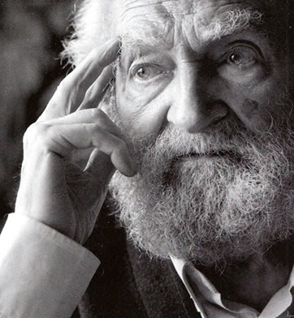
Thoughts Levels
Automatic Thoughts
Transient, superficial, unaware
Assumptions
Rules
Core Beliefs / Schemas
Absolute

Slide 56
Catch
Check
Correct
Problem Solving

Slide 57
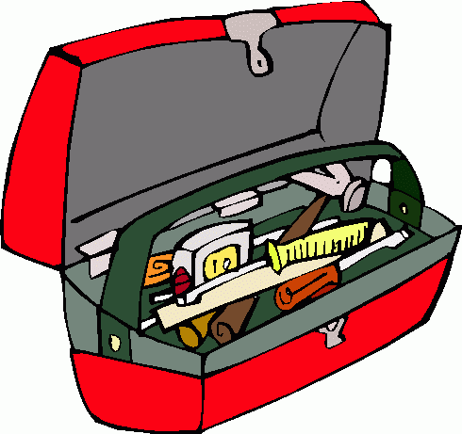
CBT techniques
Eliciting Thoughts
Differentiate emotions
Downward arrow
Pie chart
Continuum
Socratic questioning
Examining the evidence
Costs and benefits
Double standard
Problem solving
Behavioral activation
Exposure and response prevention
Role plays
Relaxation training
Behavioral experiment

Slide 58
Who Can Benefit from CBT?
Empirical Results

Slide 59
CBT empirically supported for
ADHD
Conduct disorder
Dementia
Substance abuse (including alcohol)
Schizophrenia
Depression
Bipolar disorder
Panic disorder
Phobias (eg Social Phobia)
Generalised anxiety disorder
Obsessive-compulsive disorder
Posttraumatic stress disorder
Somatoform & factitious disorders
Dissociative disorder
Sexual disorders
Eating disorders
Some sleep disorders
Personality disorders
Marital, family and parenting problems
Pain
Health-related behaviours
> 370 RCT

Slide 60
Health-related behaviours
Smoking
Over-weight
Compliance to Treatment
Migraine
Irritable-bowel syndrome
Stress

Slide 61
Conditions/Situations Where CBT May Not Be Helpful
Antisocial personality disorder
Memory impairment and other cognitive disorders
Medical conditions which interfere with participation in CBT
Strong attitudes that psychotherapy is not useful or is to be avoided

Slide 62
Suitability for Short Term CT Rating Scales (SRS) (Safran, Segal, Shaw & Vallis,1990)
1. Accessibility of automatic thoughts
2. Awareness & differentiation of emotion
3. Acceptance of personal responsibility for change
4. Compatibility with cognitive rationale
5. Alliance potential (in-session evidence)
6. Alliance potential (out-of-session evidence)
7. Chronicity
8. Security operations
9. Focality
10. General optimism/pessimism about therapy

Slide 63
Empirical results
Depression:
Chan 06 Meta-analysis: 57 studies, n=10,000
CBT vs no rx (ES =.83)*
Meds vs no rx (ES = .41) (no sig diff)
Combined vs CBT or meds (ES = .53)
Cuijpers et al 08: 53 studies, n=2,757
Compared CBT with 6 other psychological rx (IPT, supportive counselling, problem solving, behavioural activation, psychodynamic, social skills training)
All about the same (IPT better, SC worse)
*Small ES .2 Medium ES .5 Large ES .8

Slide 64
Anxiety Disorders: Effect Size (compared to placebo)
Disorder
OCD
Acute Stress Disorder
Social anxiety Disorder
PTSD
GAD
Panic Disorder
Hedge’s G (CI)*
1.37 (.64-2.2)
1.31 (.93-1.69)
.62 (.39-.86)
.62 (.28-.96)
.51 (.05-.97)
.35 (.04-.65)
*Small ES .2
Medium ES .5
Large ES .8
Hofman & Smits 08

Slide 65
Empirical results (cont.)
As adjunct to pharmacological or other psychological treatment
Schizophrenia
Bipolar disorder
Bulimia
Chronic pain
NB. Personality disorders: DBT, and other psychologically complex approaches have moderate results on some symptoms.

Slide 66
Guidelines
APA
NICE
CPA

Slide 67
video

Slide 68
Summary
CBT is a problem-focused, structured approach
Rx of choice for depression and anxiety disorders
Important adjunct for many disorders
Emotionally prominent situations chosen to explore the link between thought, emotion & behavior
Cognitive & behavioral interventions modify
what we think (content: automatic thoughts, assumptions & core beliefs)
how we think (cognitive distortions)

Slide 69
Feedback

Slide 70
THANK YOU

