Slide 1
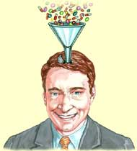
PSYCHOPHARMACOLOGY UNDERGRADUATE COURSE
ABDULLAH AL-SUBAIE, MBBS, FRCP (C) PROFESSOR OF PSYCHIATRY
Twitter: @prof_subaie

Slide 2
DRUGS IN PSYCHIATRY PSYCHOACTIVE DRUGS
ANTIPSYCHTIC DRUGS
ANTIDEPRESSANT DRUGS
MOOD STABILIZING DRUGS
ANTIANXIETY DRUGS
ELECTROCONVULSIVE THERAPY (ECT)

Slide 3
ANTIPSYCHOTIC DRUGS NEUROLEPTICS / MAJOR TRANQUILIZERS
Treat all psychoses & psychotic symptoms e.g. in autism, organic brain syndrome...
Block D2 receptors in the mesolimbic system
Not addictive

Slide 4
Antipsychotics
Atypical
Others
Phenothiazines
Thioxanthines
Diphenylbutyl
Pipiridines
Dihydroindolones
Dibenzoxazipines
Buterophenones
Olanzepine (10-30mg)
Risperidone (4-12mg)
Clozepine (100-800mg)
Sulpride (200-800mg)
Amisulpride (200-800mg)
Haloperidole (5-100mg)
Aliphatic e.g. Chlorpromazine (300-1500mg)
Pipiridine e.g. Thioridazine (300-800mg)
Piperazine
Loxapine (25-100mg)
Alipathic e.g. Chlorprothexine (75-600mg)
Piperazine e.g. Thiothexine (5-60mg)
Fluanoxol (3-10 mg)
Molindone (50-250mg)
Pimozide (2-12 mg)

Slide 5
ANTIPSYCHOTIC DRUGS NEUROLEPTICS / MAJOR TRANQUILIZERS
Mechanism of action
In typical antipsychotics
Blockage of D2 – receptors in:
Nigro-strial (psychiatric tract)
Substantia Nigra (Neurological tract)
Tubero-infundibular tract (Endocrine tract)
In atypical antipsychotics:
Blockage of 5HT2A/D2 receptors

Slide 6
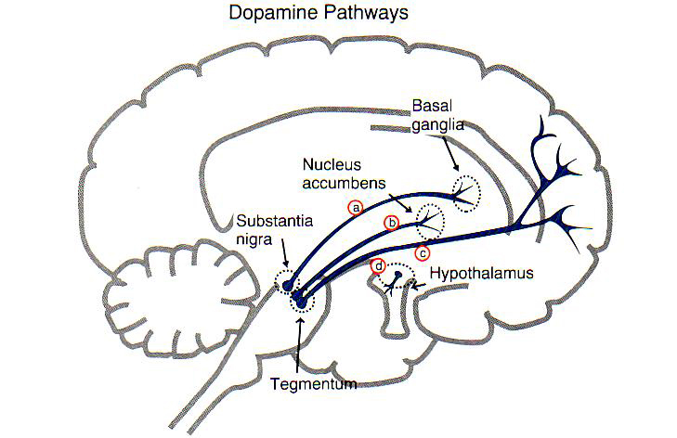
ANTIPSYCHOTIC DRUGS NEUROLEPTICS / MAJOR TRANQUILIZERS
Meso-limbic (Psychiaitrc tract)
Nigro-strial (Neurologic tract)
Meso-cortical (Psychiatric tract)
Tubero-infundibular (Endocrine tract)

Slide 7
ANTIPSYCHOTIC DRUGS Side effects (hint)
High Potency typical antipsychotics: Neurological side effects
Low Potency typical antipsychotics: other side effects

Slide 8
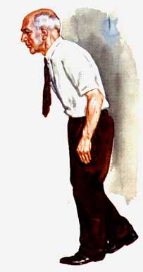
ANTIPSYCHOTIC DRUGS Neurologic Side effects
Due to D2 blockade
Parkinsonian syndrome
How to manage?
Position & gait
Apathy
Drooling
Fine tremor
Staring eyes

Slide 9
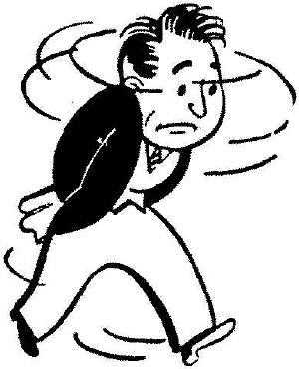
ANTIPSYCHOTIC DRUGS Neurologic Side effects
Due to D2 blockade
Parkinsonian syndrome
Akathesia (Motor restlessness)
D.Dx
How to manage?
Subjective feelings of restlessness
Objective signs of restlessness
Feelings of anxiety, inability to relax, jitteriness, pacing, rocking motions while sitting, rapid alterations of position.
More in middle aged women

Slide 10
ANTIPSYCHOTIC DRUGS Neurologic Side effects
How to manage?
Due to D2 blockade
Parkinsonian syndrome
Akathesia (Motor restlessness)
Acute dystonia
Brief or prolonged muscle contraction leading to abnormal movements or postures e.g. Occulogyric crises, tongue protrusion, torticollis, laryngeal pharyngeal dystonias and dystonic Postures
-
Early onset, more in young men and high doses of typical neurosleptics

Slide 11
ANTIPSYCHOTIC DRUGS Neurologic Side effects
Due to D2 blockade
Parkinsonian syndrome
Akathesia (Motor restlessness)
Acute dystonia
Tardive Dykinesia
Why?
How to manage?
Involuntary choreiform, athetoid or rhythmic movements of the tongue, jaw, trunk or extremities
More with long term typical neuroleptic treatment, old age, female sex, mood disorder, cognitive disorders.

Slide 12
ANTIPSYCHOTIC DRUGS Neurologic Side effects
Due to D2 blockade
Parkinsonian syndrome
Akathesia (Motor restlessness)
Acute dystonia
Tardive Dyskinesia
Neuroleptic malignant syndrome
How to manage?
Muscular rigidity, akinesia, mutism, obtundation & agitation, hyper-thermia, swaeting, tachycardia, Hypertension.
Increased wBC, incraesed CPK, liver enzymes, and plasma myoglobulin. Myoglobulinuria, may occur and may lead to renal failure.
Symptoms evolve in 1-3 days & may last 10-14 days.
May occur at any time
More common in young men
Mortality: 20% - 30%( higher with depot)

Slide 13
ANTIPSYCHOTIC DRUGS Other Side effects
Muscarenic (anti-cholenergic):
dry mouth
Constipation
Blurred vision, urinary retention
Precipitation of narow angle glucoma
Alpha–1–adrenergic blockade:
Orthostatic hypotension
Impotence
Impaired ejaculation

Slide 14
ANTIPSYCHOTIC DRUGS Other Side effects
CNS Side effects:
Sedation
Metabolic / Endocrine Side effects:
weight gain
Increased BS & lipids
Galactorrhea
Amenorrhea
Allergic Side effects
Cholestatic jaundice
Agranulostasis
Cardiac side effects:
EKG changes
Arrythmias
Occular Side effects:
Corneal Opacities
Retinitis pigmentoza
Dermatological Side effects:
Photosensitivities
Metallic discoloration
Contact dermatitis

Slide 15
ANTIDEPRESSANTS
Treat: Major depression, dysthymic disorder, nocturnal enuresis, chronic pain, panic disorder, OCD, ADHD, school phobia, other phobias, generalized anxiety disorder, insomnia…
Work through: Serotonin, Norepinephrine, Dopamine
Not addictive

Slide 16
ANTIDEPRESSANTS
Antidepressants
Heterocyclic Antidepressants
(HCAs)
Serotonin Specific Reuptake
Inhibitors
(SSRIs)
Serotonin/Norepinephrine
Reuptake Inhibitors
(NSRIs)
Mono-amine oxidaze
Inhibitors
(MAOI)
Reversible Inhibitors
of Mono-amines
(RIMA)
Imipramine, Amitriptyline, Chlomipramine (150–300mg)
Moclobemide (300– 600 mg)
Flouxetine, Paroxetine, citalopram (20-80mg)
Venlafaxine (75-300mg), Mertazepine 30-60mg)
Phenelzine (15-60mg), Tranycypramine (10-30mg)

Slide 17
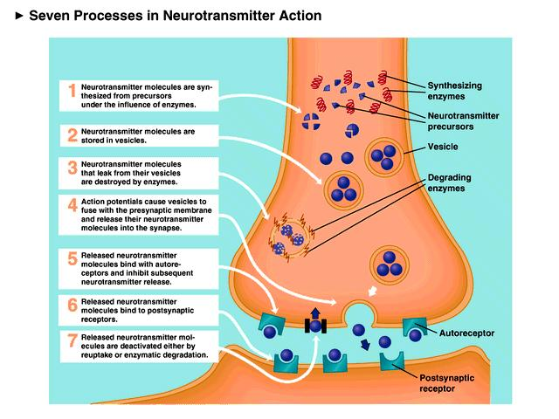
ANTIDEPRESSANTS Mechanism of action
Inhibition of reuptake
Inhibition of mono-amaine oxidaze enzyme
Inhibition of auto-receptors
Down regulation of beta-adrenergic post-synaptic receptors

Slide 18
ANTIDEPRESSANT DRUGS Side effects
HETEROCYCLICS:
Muscarenic (anti-cholenergic):
dry mouth
Constipation
Blurred vision, urinary retention
Precipitation of narow angle glucoma
Alpha–1–adrenergic blockade:
Orthostatic hypotension
Impotence
Impaired ejaculation

Slide 19
ANTIDEPRESSANT DRUGS Side effects
Central anti-cholenergic syndrome:
Management
Stop HCA immediately
Physostigmine (anticholinesterase inhibitor) 1-2 mg IV or IM every 20 – 60 minutes, until improvement occurs
Cardiac monitoring and life support (physostigmine may lead to severe BP drop and bronchial constriction)
Benzodiazepines may be used.
Delirium
Coma seizures
Agitation
Hallucinations
Severe hypotension
Supra-ventricular tachycardia
Flushing
Mydriasis
Dry skin
Hyperthermia
Decreased bowel sounds.

Slide 20
ANTIDEPRESSANTS Side effects
HETEROCYCLICS:
SSRI:
have a much better side effect profile:
Agitation
Sexual problems
Stomach upset
Hypersomnia/insomnia

Slide 21
ANTIDEPRESSANTS Side effects
HETEROCYCLICS:
SSRIs
MAOI:
Hypertensive crisis (tyramine reaction)
Nifedipine (guard, against rapid BP drop)
(patient bites the capsule and swallows its contents in water)
Phentolamine (alpha-adrenergic antagonist)
Chlorpromazine (alpha-adrenergic Antagonist)

Slide 22
ANTIDEPRESSANTS Side effects
HETEROCYCLICS:
SSRI:
MAOI:
Cardiovascular (orthostatic hypotension, tyramine hypertensive crisis)
Sexual (Impotence & delayed ejaculation)
Neurologic (insomnia, seizure& euphoria)
Hepatic: (Cholestatic reaction).

Slide 23
ANTIDEPRESSANTS Side effects
HETEROCYCLICS:
SSRI:
MAOI:
Interaction:
Diet:
Amphetamines
Decongestants & nasal sprays (Ephedrine….)
Epinephrine (local anesthesia)
Aldomet
Aged cheese
Pickled herriag
Raisin
Alcohol
Chicken liver
Beans
Figs
Yeast products
Chocolate

Slide 24
TREATING DEPRESSION
Confirm diagnosis
Rule out contraindications
Make use of side effects
Start with a small dose and build it up
Side effects start sooner but therapeutic effects start only 2-3weeks later
When patient improves, maintain treatment for 9 months, then cut down gradually watching for re-emergence of symptoms

Slide 25
TREATING DEPRESSION
Vegetative symptoms
Motor symptoms
Psychological symptoms
SUICIDE

Slide 26
MOOD STABLIZERS
Lithium Carbonate
Sodium Valproate
Carbamazepine
Lamotrigine
Topiramate
Clozapine

Slide 27
MOOD STABLIZERS Indications
Acute mania
Prophylaxis against both mania and depression
Schizoaffective disorder.
Impulse control disorder

Slide 28
LITHIUM CARBONATE
PHARMACOLOGY
Rapidly absorbed
Peaks in 30-60 minutes
Completely absored in 8 hours
Water soluble, not protein bound
Steady state is reached in 7 days.
Excreted though the kidneys, not metabolized.
MECHANISM OF ACTION
Unknown exactly
? stabilizes cell membranes

Slide 29
LITHIUM CARBONATE Administration
Assess the kidney functions, thyroid functions, cardiac and CNS condition.
After starting treatment, periodically assess drug level and kidney & thyroid functions.
Aim at a blood level of of: 0.8 – 1.2 mEq/l (acute mania), 0.6 – 0.8 mEq/l (prophylaxis)
(12 hours after the last dose)

Slide 30
LITHIUM CARBONATE Side effects
Neurological: Tremor (50%), weakness, cog-wheeling
Renal: Occur in 10-50 % e.g. polyuria, polydipsia, nephrogenic D.I., nephrotic syndrome, (tubular changes with chronic use and high levels)
Cardiac: Similar to those of hypokalimia e.g. U-wave and T-wave depression
Endocrine: Goiter, hypothyroidism, abnormal thyroid functions (30-40%)
Dermatological: Acne, exacerbation of psoriasis ), hair loss.
Pregnancy and lactation: Teratogenicity (level in milk=30-100% of maternal blood level)
Toxicity: (seizures, delirium, cerebellar signs, coma) occurs in blood level= 1.2 – 2 mEq/l. Lethal levels above that.

Slide 31
CARBAMAZPINE
PHARMACOLOGY
Absorbed slowly from the G.I. tract
Peaks in plasma in 2-8 hours and steady state level is reached in 2-4 days
Induces liver enzymes
MECHANIZM OF ACTION
UNCLEAR: increase of hippocampal GABA receptor density

Slide 32
CARBAMAZEPINE Administration
Assess blood count and liver functions
Start with a small dose and use clinical condition & drug level as a guide
Assess liver functions, blood level and blood count periodically.
Aim at a blood level of 6-12 mg/l after 10-12 hours of last dose
(12 hours after the last dose)

Slide 33
CARBAMAZEPINE Side effects
CNS: drowsiness and in diplopia, dizziness, nausea, vomiting and ataxia(toxic doses)
Dermatological: skin rash, Steven–Johnson Syndrome, photosensitivity.
Hepatic: cholestatic jaundice.
Hematological: Leuckopenia, thrombocytopenic purpura, and bone marrow suppression.

Slide 34
CARBMAZEPINE Contra-indications
A-V heart block
Liver disease
Leuckopenia
Cerebellar lesions
Co-administration with Clozapine

Slide 35
SODIUM VALPROATE
PHARMACOLOGY
Completely absorbed from the stomach
Peaks in plasma in 1-2 hours
Metabolized by liver
MECHANIZM OF ACTION
UNCLEAR: increase of hippocampal GABA receptor density

Slide 36
SODIUM VALPROATE Administration
Assess liver functions
Start with a small dose and use clinical condition & drug level as a guide.
Assess liver functions and blood level periodically.
Aim at a blood level of 50-120 mg/l after 10-12 hours of last dose
(12 hours after the last dose)

Slide 37
SODIUM VALPROATE Side effects
Nausea & vomiting.
Impairment of liver enzymes
Liver toxicity (in toxic doses)
Hair loss
Weight gain
Sedation, ataxia and dyarthria
Ovarian cysts in young females ?

Slide 38
SODIUM VALPROATE Contra-indications
Liver disease.
Co-administration with hepato-toxic drugs such as pemoline.
Thrombocytopenia and platelet dysfunction

Slide 39
ANTI-ANXIETY DRUGS
Barbiturates
Benzodiazepines
Non-benzodiazepines, non-barbiturates: e.g. TCAs and antihistamine
Buspirone
SSRIs
Antipsychotics

Slide 40
BENZODIAZEPINES
CLASSIFICATION:
Very short acting e. g. Triazolam
Short acting: e. g. Oxazepam, Lorazepam, Alprazolam
Long acting : e.g. Diazepam, Chlordiazepoxide
PHARMACOLOGY:
Completely absorbed from the G.I. tract
Rapid action due to high lipid solubility
Peaks in plasma in 1-3 hours.
Metabolized in the liver
MECHANIZM OF ACTION:
Through its own receptors
Through increased affinity for GABA receptors

Slide 41
BENZODIAZEPINES Side-effects
Sedation
Dizziness and ataxia
CNS depression when used with sedative substances or alcohol
Disinhibition and aggression
Tolerance and withdrawal (dependence)

Slide 42
BENZODIAZEPINES Indications
Insomnia
Anxiety Symptoms
Panic Disorder
Social phobia and other phobias
Mania
Akathesia
Alcohol Withdrawal

Slide 43
BENZODIAZEPINES Contra-indications
Potential abuse
Compromised cardiovascular system functions
Caution in elderly
Driving & operating heavy machines

Slide 44
BUSPIRONE
PHARMACOLOGY:
Well absorbed from the G.I. tract
Metabolized by the liver
Peaks in plasma in 1-1.5 hours
MECHANISM OF ACTION:
Unlike benzodiazepines it has no effect on GABA neurotransmitter
It is an agonist of 5HT-1-A, reduces firing of the serotonegic neurones in the median raphe nuclei

Slide 45
BUSPIRONE Administration
Well tolerated & safe
Takes long time to work
Does not lead to dependence

Slide 46
Visit our website:
www.alnafsy.com

