Slide 1
Back Pain
Presented by :
Mohammed Al-Saweed
Mohammed Al-Kahlan
Supervised by :
Prof. Eiad Al-Faris

Slide 2
Back Pain
Back pain is second to the common cold as a cause of lost days at work .
About 80% of people have at least one episode of low back pain during their lifetime.
The most common age groups are the 30s, 40s and 50s.
The pain can be divided into neck pain, upper back pain, lower back pain or tailbone pain.
It usually feels like an ache, tension or stiffness in your back.

Slide 3
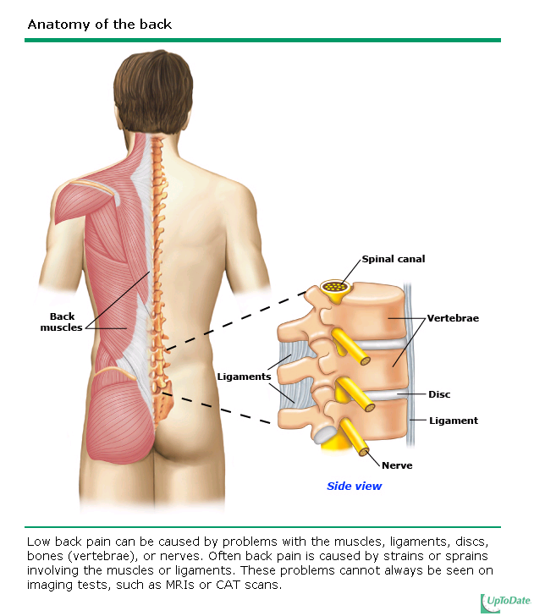

Slide 4
Back Pain = Symptom
≠ Diagnosis
80% to 90% of attacks of low back pain resolve in about 6 weeks.
Back pain can range from a dull, constant ache to a sudden, sharp pain.
Duration of pain:
acute (less than 4 weeks).
subacute (4 – 12 weeks).
chronic (greater than 12 weeks).

Slide 5
Causes of Back Pain
MECHANICAL
Non-MECHANICAL
Injury
inflammatory
Infections
Tumors
Psychological
“Malingering”

Slide 6
Mechanical problems
A mechanical problem is a problem with the way your spine moves or the way you feel when you move your spine in certain ways.
The most common mechanical cause of back pain is a condition called intervertebral disk degeneration, which simply means that the disks located between the vertebrae of the spine are breaking down with age.(NIAMS)

Slide 7
Mechanical problems (2)
Muscle tension:
happens when the muscle is over-stretched or torn, resulting in damage to the muscle fibers (also called a pulled muscle).
Ruptured disks “herniated disks”:
the inner core leaks out, The weak spot in the outer core of the disc is directly under the spinal nerve root, so a herniation in this area puts direct pressure on the nerve, which in turn can cause sciatica.

Slide 8
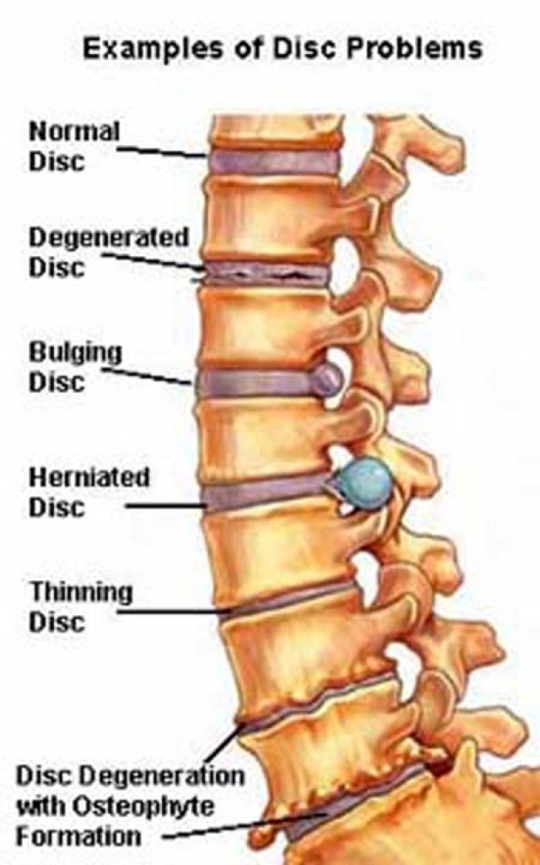

Slide 9
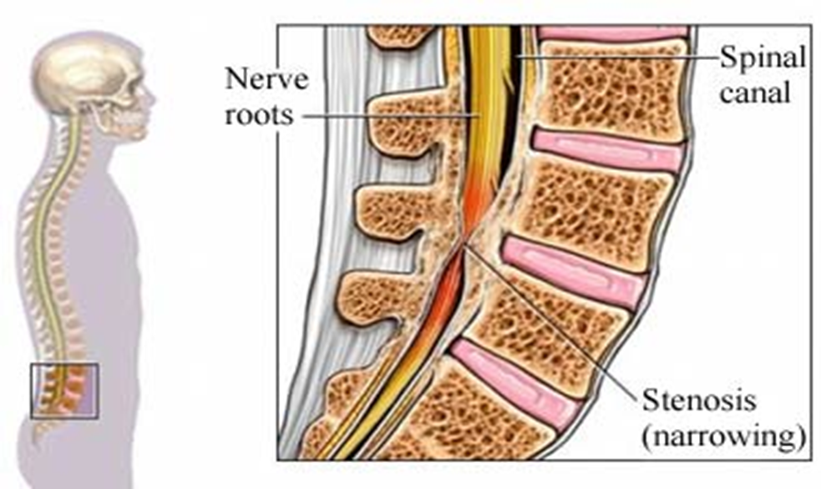
Mechanical problems (3)
spinal stenosis:
a narrowing of the spinal column that puts pressure on the spinal cord and nerves

Slide 10
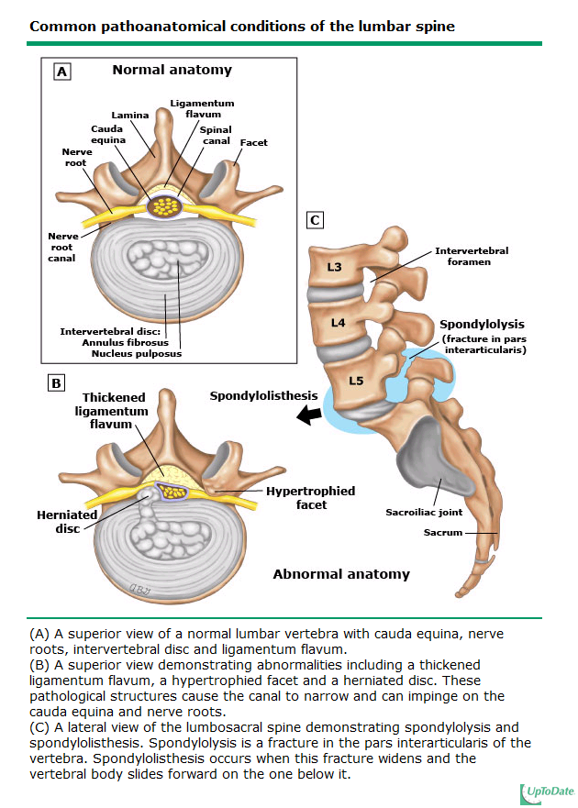
Mechanical problems (4)
spondylolisthesis (displacement):
is a condition in which one vertebra slip forward over the one below it.

Slide 11
Sciatica
If a bulging or herniated disk presses on the main nerve ( sciatic ) that travels down your leg, it can cause sciatica sharp, shooting pain through the buttock and back of the leg.
there may be numbness, muscular weakness, pins and needles or tingling and difficulty in moving or controlling the leg. Typically, the symptoms are only felt on one side of the body.

Slide 12
inflammatory problems
Rheumatoid arthritis
Noninfectious inflammation of the spine (Ankylosing spondylitis):
chronic inflammatory disorder characterized by the ossification of intervertebral discs, joints and ligaments leading to progressive rigidity of the spine.
can cause stiffness and pain in the spine that is particularly worse in the morning.
typically begins in adolescents and young adults.

Slide 13
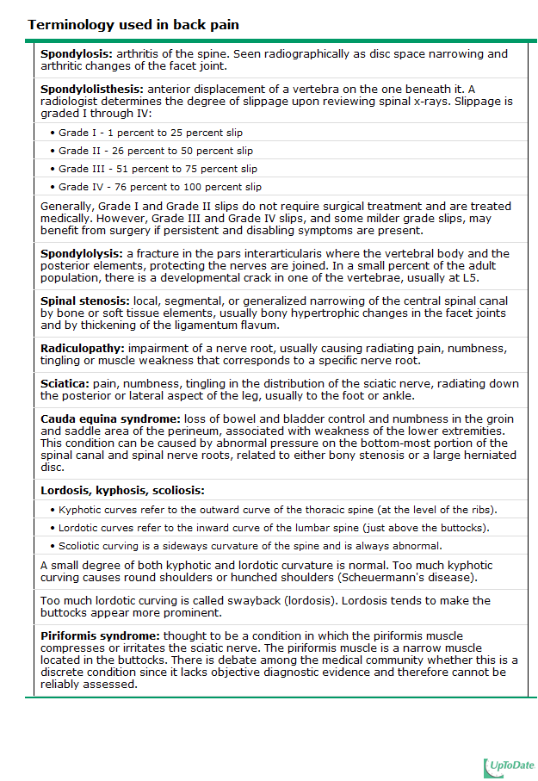

Slide 14
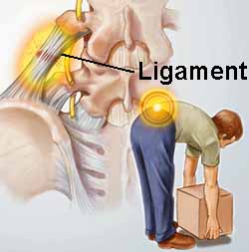
Injuries
Spine injuries such as sprains and fractures can cause either short-lived or chronic pain.
Sprains are tears in the ligaments that support the spine, and they can occur from twisting or lifting improperly.
Fractured vertebrae are often the result of osteoporosis. Less commonly, back pain may be caused by more severe injuries that result from accidents or falls.

Slide 15
Infections
Infections:
can cause pain when they involve the vertebrae, a condition called osteomyelitis (is an infection of the bone or bone marrow affecting the vertebral bodies of the spine).
Although they are not common causes of back pain.

Slide 16
Tumors
Tumors: (primary, metastatic)
also are relatively rare causes of back pain. Occasionally, tumors begin in the back, but more often they appear in the back as a result of cancer that has spread from elsewhere in the body.
three most common cases are:
prostate cancer
breast cancer
lung cancer

Slide 17
Other causes
Osteoporosis: is a disorder associated with reduction in bone mass, where the bones become weaker and more brittle. This leads to an increase in the risk of fracture. Osteoporosis can lead to spinal fractures, which causes back pain. If there are enough fractures within a vertebra, the entire vertebra may compress to a wedge shape, or collapse completely, which is known as a compression fracture.
pregnancy.
kidney stones or infections.
Endometriosis, which is the (buildup of uterine tissue in places outside the uterus).
fibromyalgia, a condition of (widespread muscle pain and fatigue

Slide 18
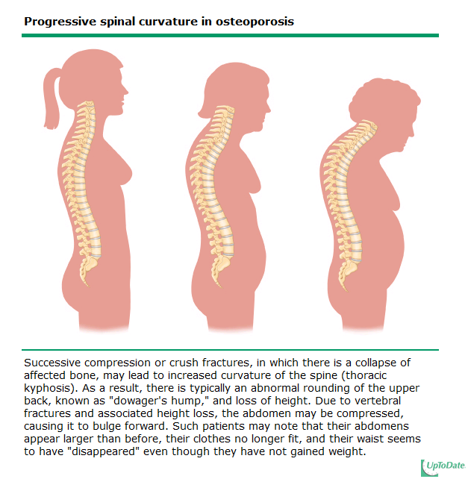

Slide 19
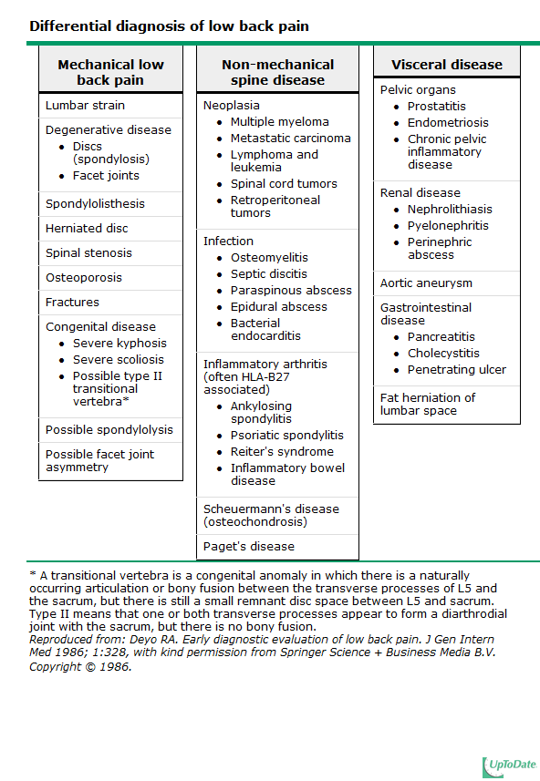

Slide 20
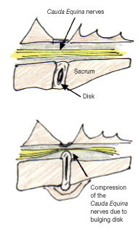
Cauda equina syndrome
Rare but serious condition
This is a serious neurological problem affecting a bundle of nerve roots that serve your lower back and legs due to compression or trauma .
It can cause weakness in the legs, numbness in the "saddle" or groin area, and loss of bowel or bladder control.

Slide 21
Diagnosis of back pain
(1)
History

Slide 22
History Elements:
During taking history, you must cover the following:
the course of pain.
Is there evidence of a systemic disease.
Is there evidence of neurologic probloms.
Occupational history.
Risk factors.
Red flags.
Yellow flags.

Slide 23
History Elements
Circumstances associated with pain onset.
Primary site of pain.
Radiation of pain.
Character of pain. (throbbing, sharp, aching)
Intensity of pain.
– At rest.
– On movement.
Factors altering pain (stiffness at rest or at night, decrease with movement)
– What makes it worse?
– What makes it better?
Is pain present continuously or otherwise?
Effect of pain on activities.
Effect of pain on sleep.

Slide 24
History Elements
Risk Factors:
It could be genetic or acquired:
Body-weight distribution (obesity).
Psychosocial risk factors, including high workload, low job control, job dissatisfaction, monotonous work, and low support from coworkers.
Occupational risk factor. 46% of adolescent athletes experienced low back pain as opposed to 18% nonathletes. Low back pain also appears to vary by sport.
Heavy physical work, nightshifts, lifting, bending, twisting, pulling, and pushing.
Psychological include stress/distress, mood and emotions, cognitive functioning, pain behavior, and depressive disorders.
Smoking.
Long-term use of medication that is known to weaken bones, such as corticosteroids.

Slide 25
Red flags
Onset age either <20 or >55 years.
Bowel or bladder dysfunction.
Spinal deformity.
Wight loss.
Lymphadenopathy.
Neurological symptoms.
History of HIV, corticosteroid therapy.
Unexplained fever.
Duration more than 6 weeks.

Slide 26
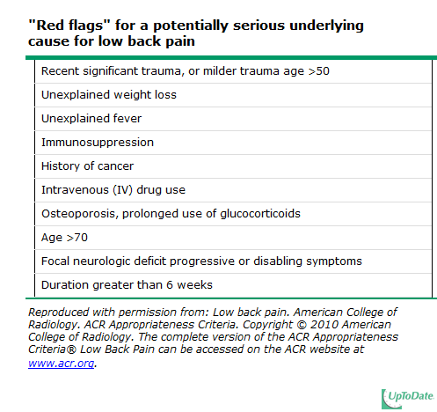

Slide 27
Yellow Flags
If patient believe that the back pain is serious.
Fear avoidance behavior(apprehension about reactivation).
Work related factor.
Prior episodes of back pain.
Extreme symptoms.

Slide 28
Mechanical back pain
Deep dull pain
Moderate in nature.
Relieved by rest , and increase by activity.
Maybe because of injury and usually with previous episodes.
Diffuse and unilateral.
Intensity increase at the end of the day and after activity.
Postural back pain because of sitting in poorly design unsupportive chair.

Slide 29
Inflammatory back pain
Gradually in onset.
Throbbing in nature.
Morning stiffness.
Exacerbates by rest and relived by activity.
Intensity increase in night and early morning.
It is chronic backache.

Slide 30
Nerve root compression
Intense sharp or stabbing pain.
Numbness and paraesthesia in same distribution
Radiation to dermatome like : foot or toe.

Slide 31
Examination
Video

Slide 32
Diagnosis of back pain
(2)
Examination

Slide 33
General :
  Permission
  Explain
  Privacy
Vital signs
Patient should be standing with the whole trunk exposed.

Slide 34
Examination Steps
look
feel
movement
Neurological test

Slide 35
1. Inspection:
Examination of any localized spinal disorder requires inspection of the entire spine. The patient should therefore undress to their underwear.
Look for any obvious swellings or surgical scars.
Assess for deformity: scoliosis, kyphosis, loss of lumbar lordosis or hyperlordosis of the lumbar spine. Look for shoulder asymmetry and pelvic tilt.
Observe the patient walking to assess for any abnormalities of gait.

Slide 36
2. Palpation:
Palpate for tenderness over bone and soft tissues.
Perform an abdominal examination to identify any masses, pain in the legs and unilateral or bilateral lower limb motor and/or sensory abnormality.

Slide 37
3. Movement:
Ensure The normal ranges of movements, with no limitation .
These movements are: Flexion, Extension, Lateral Bending and Rotation.

Slide 38
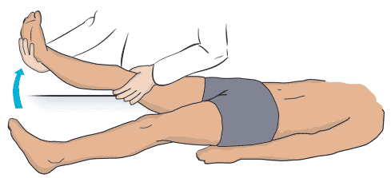
Straight leg raising (SLR)
raises the patient's extended leg with the ankle dorsiflexed.
Normally 80 – 90 degrees no pain
It will be limited by sciatica pain in lumbar disc prolapse. ( <70 ) → ( exactly from 30 to 70 )

Slide 39
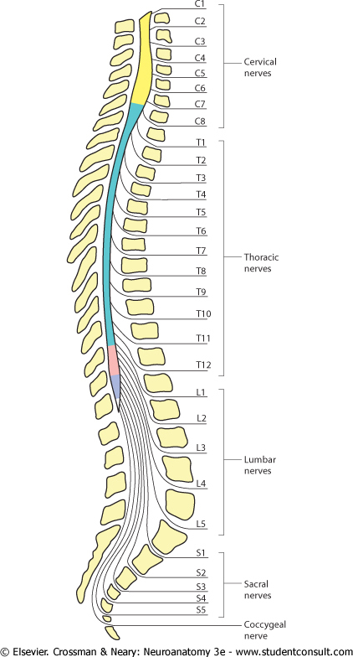
Neurologic testing
We should focus on the L5 and S1 nerve roots
98% of disc herniation occur at L4-5 and L5-S1
Then we test the Reflexes:
L4 – The knee reflex.
S1 – The ankle reflex.
Reflexes
Motor
sensory

Slide 40
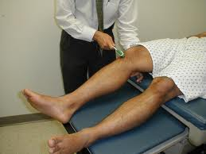
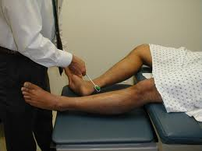
Reflexes
Knee (L3-4)
Ankle (S1-2)

Slide 41
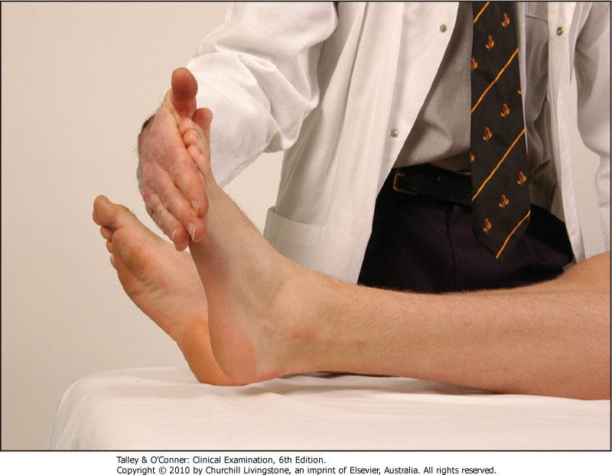
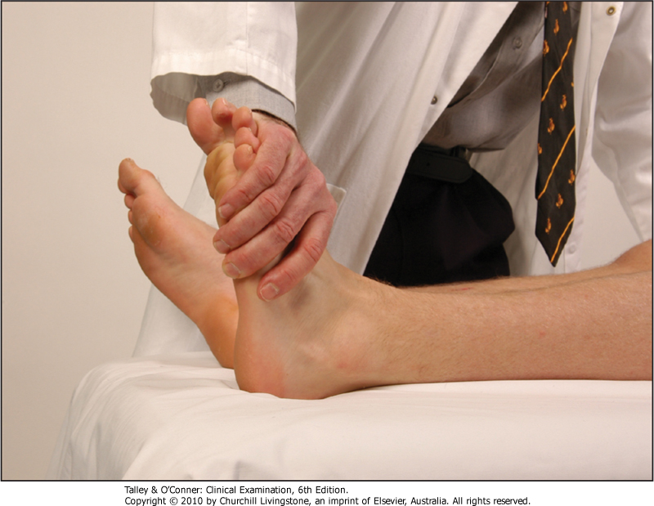
Motor
Ankle plantar flexion
Ankle dorsiflexion

Slide 42
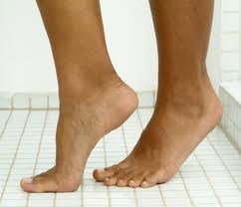
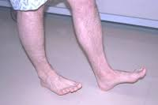
Motor
Walking on toes
Walking on heels
S1
L5

Slide 43
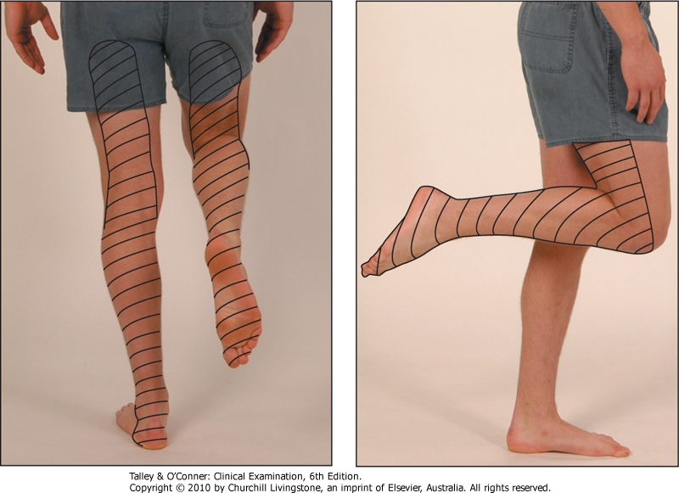
Sensory
Sciatic nerve (L4,5,S1,2)
Sensory distribution of the sciatic nerve

Slide 44
Role of Primary Health Care in Management

Slide 45
Goals for treatment :
Educate patient about the natural history of back pain.
Ask about and address the patient’s concerns and goals.
Explanation and education is very important to the patient: self-care at home.
Reduce pain.
Maximize functional status and increase quality of life.
Exercises: to help them return to normal activities and work. These exercises usually involve stretching maneuvers.
The management is according to the cause

Slide 46
Evidence based medicine (4)
We recommend NOT advising patients with acute low back pain to remain at bed rest. Patients who are treated for acute back pain with bed rest have more pain and slower recovery than ambulatory patients. Activity modification should generally be minimal, with patients returning to activities of daily living and to work as soon as possible.
Multiple randomized trials have now demonstrated that recovery from pain is equally rapid and complete without bed rest. A systematic review concluded that patients advised to rest in bed may even have slightly more pain and less functional recovery than those advised to remain ambulatory.
Randomized trials also suggest there is no advantage to bed rest for patients with sciatica. In one study, 183 patients with lumbosacral radicular symptoms were randomly assigned to bed rest or "watchful waiting" for two weeks. At two weeks, 70 percent of the bed rest and 65 percent of the watchful waiting group reported improvement (difference not statistically significant); at 12 weeks, 87 percent of both groups reported improvement, with no difference between the groups in pain intensity, functional status, or work absenteeism.

Slide 47
Pharmacological
Pharmacological
Oral drugs
Local injection
Non-drug
NSAID
“Ibuprofen”
Analgesics
Antidepresent
Muscle relaxant
Epidural Steroid
Trigger point and ligaments
Heat therapy
Physiotherapy
Acupuncture
Notes:
Heat therapy: it dilates the blood vessels of the muscles surrounding the lumbar spine. Heat application facilitates stretching the soft tissues around the spine, including muscles, connective tissue, and adhesions, decrease in stiffness as well as injury, with an increase in flexibility and overall feeling of comfort.
Acupuncture: For back pain, it involves inserting very thin needles to various depths into strategic points on the body. Acupuncture is generally recognized as safe if done by a competent, certified acupuncture practitioner. Possible side effects and complications can occur, which include soreness, bleeding, infection or bruising at the needle sites.

Slide 48
surgery
Minimally invasive surgical procedures are often a solution for many causes of back pain.
Surgery may sometimes be appropriate for patients with:
Lumbar disc herniation
Lumbar spinal stenosis or spondylolisthesis
Scoliosis
Compression fracture

Slide 49
DISK PROLAPSE
The majority of herniated discs will heal themselves in about six weeks and do not require surgery
we refer the pt, to surgery only if the pt, have Red flags symptoms – otherwise (education and physiotherapy is enough).

Slide 50
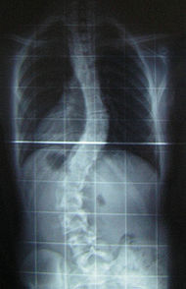
SCOLIOSIS
The traditional medical management of scoliosis is complex and is determined by the severity of the curvature .
RX :
Observation .
Physiotherapy .
Surgery .

Slide 51
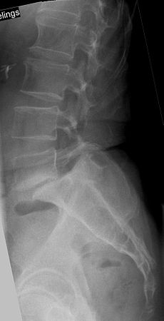
Spondylolisthesis
Patients with symptomatic spondylolisthesis are initially offered conservative treatment :
1- Activity modification
2- Medications
3- Physiotherapy .
The last resort is surgery .

Slide 52
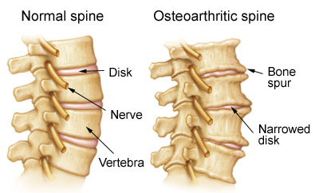
osteoarthritis
Lifestyle modification (such as weight loss and exercise) and analgesics are the mainstay of
treatment.

Slide 53
Ankylosing spondylitis
No cure is known for AS, although treatments and medications are available to reduce symptoms and pain .
Physical therapy and exercise, along with medication, are enough.

Slide 54
others
Treat underlying cause :
Tumor
Osteomylitis
Sciatica
Osteoprosis

Slide 55
When should patients be referred to a specialist?

Slide 56
Patients should be referred to a neurologist, neurosurgeon, orthopedist, or other specialist if they have :-
Cauda equina syndrome. (Immediate referral)
Severe or progressive neurologic deficits.
Infections.
Tumors.
Fractures compressing the spinal cord.
No response to conservative therapy for 4 to 6 weeks for patients with a herniated lumbar disk or 8 to 12 weeks for those with spinal stenosis.

Slide 57
Red flags suggesting a serious back condition
Hx : Age ≥ 50 years ,Unexplained weight loss
PE : Neurologic findings , Lymphadenopathy
CANCER
Hx : Age ≥ 55 years, Housewife , History of osteoporosis, Corticosteroid use
PE : -VE
Compression fracture
Hx : Fever or chills, Immunocompromised, IV drug use
PE : Fever (temperature > 100°F or 38°C) Tenderness over spinous processes
INFECTION

Slide 58
Prevention
of
Back Pain

Slide 59
Recommendations for the General Population:
Explain to your patient about non specific causes of low back pain. Encourage active life style and to make exercise a regular thing in their daily schedule, such as, walking, jogging, swimming… etc.
Occupational health must be emphasized on to prevent lots of diseases and one of them is back pain.

Slide 60
Tips and advice on how to protect your back:
In sitting position: always support your back against a hard chair. Make sure your hips level is higher than your knees.
In standing position: Never lean forward without bending your knees. When it comes to shoes (i.e. heels) preferably wear a moderate one to avoid straining on your back and avoid platform “flat” shoes.
Sleeping: Don’t sleep on your stomach. If your sleeping on your back use two pillows one to support your neck and the other one behind your knees. As our prophet Mohammad (PBUH) taught us to sleep on our right side and if so bend your knees.
Lifting: especially in manual workers or house wives. Avoid sudden movements. Bend both knees with leg muscles to lift them up. Keep the load closer to your body and try not to lift anything higher than your waist.

Slide 61
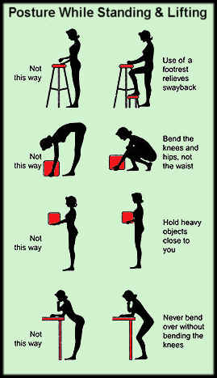
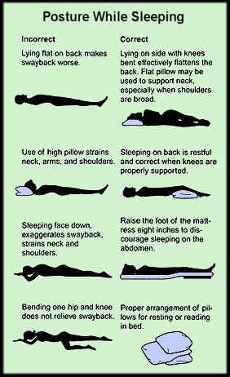

Slide 62
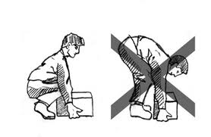
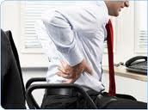
General
Posture.
Lifting.
Sitting on Chair.
Studying on desk.

Slide 63
References
http://www.emedicinehealth.com/back_pain/article_em.htm
http://www.nice.org.uk/nicemedia/live/11887/44334/44334.pdf
http://www.nhs.uk/Conditions/Back-pain/Pages/Introduction.aspx
http://www.ncbi.nlm.nih.gov/pmc/articles/PMC2153869/
http://www.uptodate.com/contents/treatment-of-acute-low-back-pain/abstract/23

Slide 64
POST TEST

Slide 65
Which of the following is not a risk factor for back pain:
Obesity.
Heavy physical work.
Ethnicity.
Stress and distress.

Slide 66
A patient came with lower back pain with morning stiffness exacerbates by rest and relived by activity :
Mechanical back pain
Inflammatory back pain
Tumor
Nerve root compression

Slide 67
All of the following is a red flag signs of back pain except :
Onset age either <20 or >55 years.
Duration less than 6 weeks.
Bowel or bladder dysfunction.
Spinal deformity.

Slide 68
30 year old women had low backache 3 days ago, while taking further history, she said that they were moving to a new house and she was lifting heavy objects, the most probable diagnosis is:
Spinal stenosis.
Prolapsed disc.
Rheumatoid arthritis.
Fracture.

Slide 69
Most common site for disk prolapsed is:
L4 and L5
S1 and S2
C4
L1 and L2

Slide 70
Which One of the following cancers, the spine is not a common site for metastasis:
Prostate cancer
Breast cancer
Liver cancer
Lung cancer

Slide 71
Thank you

