Slide 1
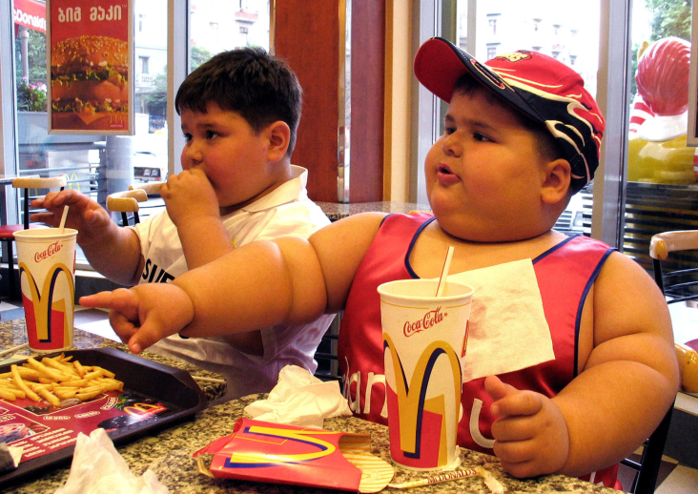
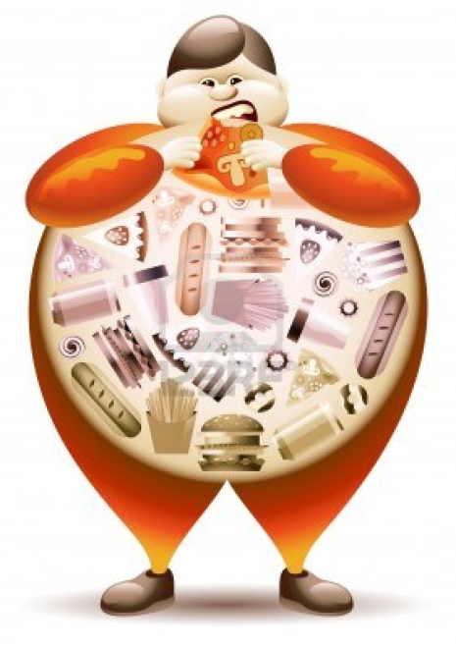
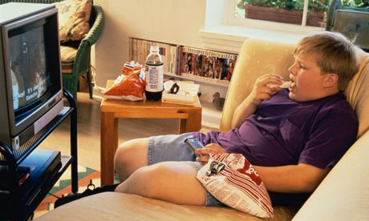
Approach to obese patients

Slide 2
Topics
Definition and Importance.
Diagnosis and Classification.
Prevalence (local and worldwide).
Common causes of obesity in the community.
Prevention of obesity in the community.
Evidence based approach to decrease weight
Role of health team, medical students, and school health in dealing with obesity in the community.

Slide 3
Definition

Slide 4
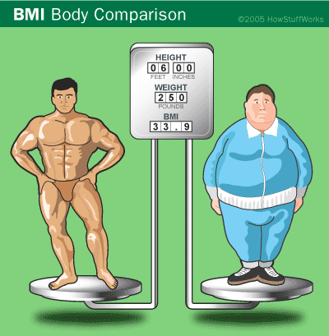
Obesity means having too much body fat (it is not the same as being overweight, which means weighing too much).
A person may be overweight from extra muscle, bone, or water, as well as from having too much fat.
Both terms mean that a person's weight is higher than what is thought to be healthy for his or her height.

Slide 5
WHO
Overweight and obesity are defined as abnormal or excessive fat accumulation that presents a risk to health.
a BMI greater than or equal to 25 is overweight.
a BMI greater than or equal to 30 is obesity.

Slide 6
Importance

Slide 7
Overweight and obesity are the 5th leading risk for global deaths.
At least 2.8 million adults die each year as a result of being overweight or obese.
In addition, 44% of the diabetes burden, 23% of the ischemic heart disease burden and between 7% and 41% of certain cancer burdens are attributable to overweight and obesity.

Slide 8
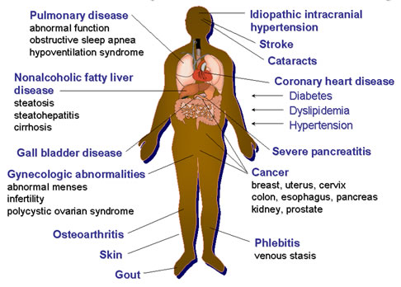
Overweight and obesity are major risk factors for a number of chronic diseases:
Diabetes
CV diseases.
Cancer.
Gallstones.
Osteoarthritis.
Sleep apnea.

Slide 9
Diagnosis & Classifications

Slide 10
The two most common ways to assess weight and measure health risks related to weight are:
Body mass index (BMI).
Waist circumference and Waist/Hip ratio.

Slide 11
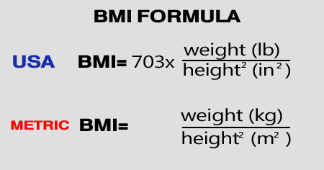
BMI
Body Mass Index (BMI) is a number calculated from a person's weight and height.
BMI is a fairly reliable indicator of body fatness for most people.

Slide 12
Classification according to BMI
Classification | BMI from | Till BMI of
Underweight | <18.5
Healthy weight | 18.5 | 24.9
Overweight | 25 | 29.9
Obesity I | 30 | 34.9
Obesity II | 35 | 39.9
Obesity III | 40<

Slide 13
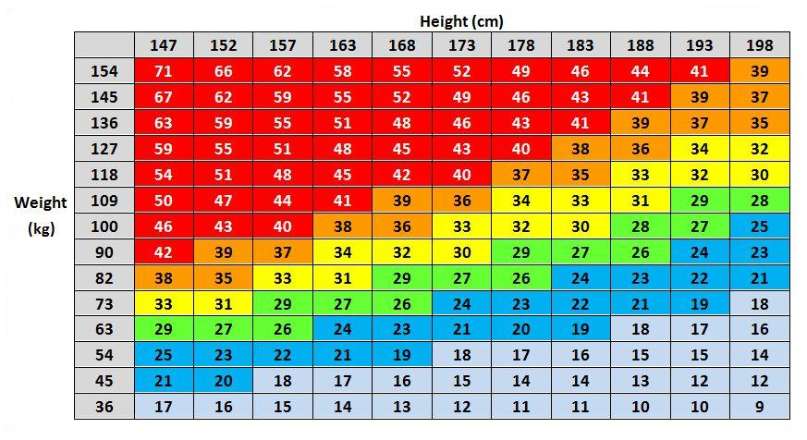
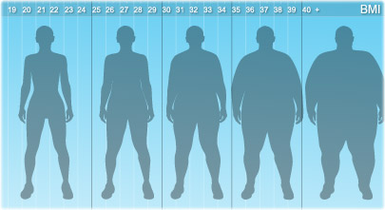
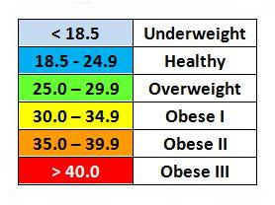

Slide 14
Waist circumference
Gender | Waist circumference | Complications
Men | 94cm < | Increased risk
 | 102cm < | Highly increased risk
Women | 80cm < | Increased risk
 | 88cm < | Highly increased risk

Slide 15
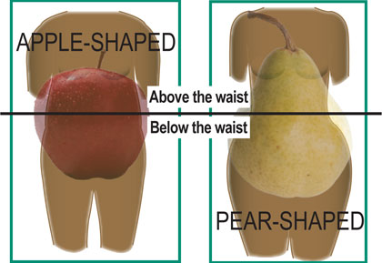
Classification according to Waist/Hip ratio
Gender | Android | Gynoid
Male | W/H ratio >1 | W/H ratio <1
Female | W/H ratio >.8 | W/H ratio <.8

Slide 16
Prevalence
Worldwide

Slide 17
WHO
In 2008, 35% of adults aged 20+ were overweight (BMI ≥ 25 kg/m2).
In 2008, 10% of men and 14% of women in the world were obese (BMI ≥30 kg/m2).
An estimated 205 million men and 297 million women over the age of 20 were obese worldwide.

Slide 18
Obesity
Over weight

Slide 19
CDC
In 2009–2010:
35.7% of U.S. adults were obese.
16.9% of U.S. children and adolescents were obese.

Slide 20
Prevalence
In KSA

Slide 21
WHO

Slide 22
Local study
17,232 Saudi subjects from selected households who participated in the study.
The prevalence of overweight was 36.9%. Overweight is significantly more prevalent in males (42.4%) compared to(31.8%)in females.
The overall prevalence of obesity was 35.5% (Females are 44% and males 26.4%).
Severe (gross) obesity was 3.2%.
 | Males | Females | Total
Overweight | 42.4% | 34.8% | 36.9%
Obese | 26.4% | 44% | 35.5%

Slide 23
Topics
Definition and Importance.
Diagnosis and Classification.
Prevalence (local and worldwide).
Common causes of obesity in the community.
Prevention of obesity in the community.
Evidence based approach to decrease weight
Role of health team, medical students, and school health in dealing with obesity in the community.

Slide 24
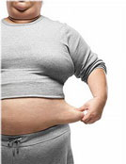
Causes

Slide 25
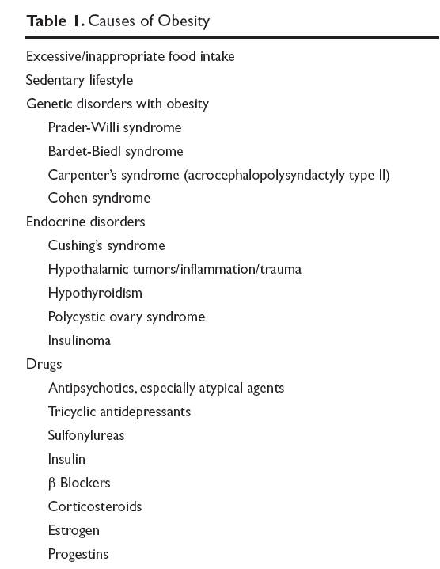
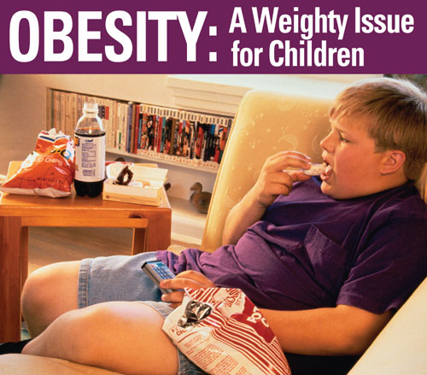

Slide 26
The fundamental cause of obesity and overweight is an energy imbalance between calories consumed and calories expended. Globally, there has been:
an increased intake of energy-dense foods that are high in fat, salt and sugars but low in vitamins, minerals and other micronutrients; and
a decrease in physical activity due to the increasingly sedentary nature of many forms of work, changing modes of transportation, and increasing urbanization.

Slide 27
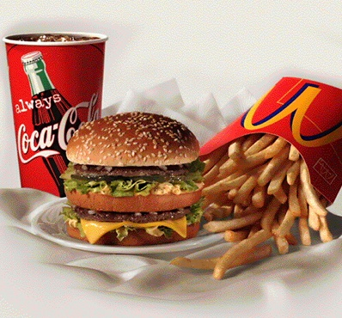
1- Diet
From the early 1970s to the late 1990s the average calories available per person per day increased in all parts of the world except Eastern Europe. The United States had the highest availability with 3,654 calories per person in 1996. This increased further in 2003 to 3,754.
During the late 1990s Europeans had 3,394 calories per person, in the developing areas of Asia there were 2,648 calories per person, and in sub-Saharan Africa people had 2,176 calories per person. Total calorie consumption has been found to be related to obesity.

Slide 29
Sedentary lifestyle
Worldwide there has been a large shift towards less physically demanding work, and currently at least 60% of the world's population gets insufficient exercise. This is primarily due to increasing use of mechanized transportation and a greater prevalence of labor-saving technology in the home.
In children, there appear to be declines in levels of physical activity due to less walking and physical education.
The World Health Organization indicates people worldwide are taking up less active recreational pursuits.

Slide 30
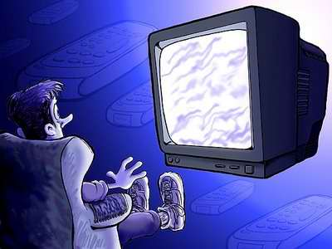
In both children and adults, there is an association between television viewing time and the risk of obesity.
A review found 63 of 73 studies (86%) showed an increased rate of childhood obesity with increased media exposure, with rates increasing proportionally to time spent watching television.
TV

Slide 31
Genetics
Like many other medical conditions, obesity is the result of an interplay between genetic and environmental factors. Polymorphisms in various genes controlling appetite and metabolism predispose to obesity when sufficient food energy present.
People with two copies of the FTO gene (fat mass and obesity associated gene) has been found on average to weigh 3–4 kg more and have a 1.67-fold greater risk of obesity compared to normal people.

Slide 32
Genetics
Obesity is a major feature in several syndromes, such as Prader-Willi syndrome, Bardet-Biedl syndrome, Cohen syndrome, and MOMO syndrome. (The term "non-syndromic obesity" is sometimes used to exclude these conditions.)

Slide 33
Prader–Willi syndrome
low muscle tone, short stature, incomplete sexual development, cognitive disabilities, problem behaviors, and a chronic feeling of hunger that can lead to excessive eating and life-threatening obesity.
Prader–Willi syndrome patients have high ghrelin levels.

Slide 34
Other causes
Hypothyroidism, Cushing's syndrome, growth hormone deficiency.
Eating disorders: binge eating disorder and night eating syndrome.

Slide 35
Binge eating disorder
Periodically does not exercise control over consumption of food.
Feels loss of control over eating during binge.
Eats an unusually large amount of food at one time, far more than an average person would eat.
Eats much more quickly during binge episodes than during normal eating episodes.
Eats until physically uncomfortable and nauseated.
Eats when depressed or bored.
Eats large amounts of food even when not really hungry.
Feels disgusted, depressed, or guilty after binge eating.
Experiences rapid weight gain/sudden onset of obesity.

Slide 36
Binge eating disorder: cause
The root of such behavior might be linked to rigid dieting practices. Binge eating may begin when individuals recover from an adoption of rigid eating habits. When under a strict diet that mimics the effects of starvation, the body may be preparing for a new type of behavior pattern, one that consumes a large amount of food in a relatively short period of time.

Slide 37
Prevention
The steps to prevent weight gain are the same as the steps to lose weight:
Daily exercise
Healthy diet, and a long-term commitment to watch what you eat and drink

Slide 38
Exercise regularly
According to the American College of Sports Medicine, you need to get 150 to 250 minutes of moderate-intensity activity a week to prevent weight gain.
Moderately intense physical activities include fast walking and swimming

Slide 39
Eat healthy meals and snacks
Focus on
Avoid
low-calorie, nutrient-dense foods, such as fruits, vegetables and whole grains.
saturated fat, alcohol and limit sweets.

Slide 40
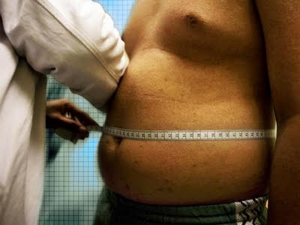
Monitor your weight regularly
Monitoring your weight can tell you whether your efforts are working and can help you detect small weight gains before they become big problems.

Slide 41
Infants
According to the American Academy of Pediatrics and the CDC, breastfed babies are less likely to become overweight.
The CDC also reports that the longer babies are breastfed, the less likely they are to become overweight as they grow older.

Slide 42
Children
Be a role model. Parents who eat healthy foods and participate in physical activity set an example so that a child is more likely to do the same.
Encourage physical activity.
Reduce "screen" time in front of TV and computer to less than two hours daily.
Avoid using food as a reward.
Encourage children to drink water rather than beverages with added sugar, such as soft drinks.

Slide 43
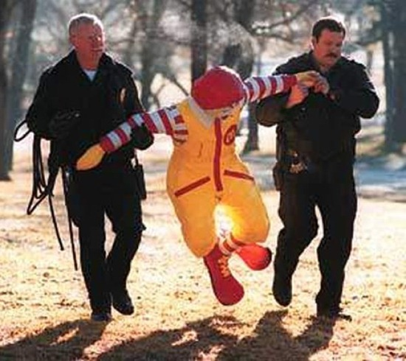
If the FDA really did their job...

Slide 44
Topics
Definition and Importance.
Diagnosis and Classification.
Prevalence (local and worldwide).
Common causes of obesity in the community.
Prevention of obesity in the community.
Evidence based approach to decrease weight
Role of health team, medical students, and school health in dealing with obesity in the community.

Slide 45
Role of health team, medical students, and school health in dealing with obesity in the community

Slide 46
Health team:
prevention of weight gain offer the only effective way to control obesity
Efforts amongst individuals and whole community was not that effective
How to make it effective ???

Slide 47
We need comprehensive range of strategies that target those with:
existing weight problems
at high risk
whole community

Slide 48
Before:
Primary: less incidence.
Secondary: less rates.
Tertiary: less disability.

Slide 49
Confusion?!!

Slide 50
US institute of medicine classification system

Slide 51
3 levels of prevention efforts:
universal or public
selective(for sub groups above average risk of developing obesity)
indicated: high risk individuals.

Slide 52
Role of schools:
health education
physical education
health services
nutrition services
staff health promotion
health educations for family

Slide 53
EBM
P: Metabolic complications of obesity in children.
I: Medical intervention.
C: Surgical intervention.

Slide 54
There is now accumulating evidence, generally of poor quality that surgical interventions (laparoscopic adjustable gastric banding and Roux-en-Y gastric bypass) provide excellent sustained weight loss and improvement in comorbidity and quality of life in selected older children.
Their benefits in adults are well demonstrated.
Surgery comes with risk, both immediate and in the future, as does severe obesity. Carefully weighing risk and benefit is challenging for the individual and for health service providers.
Careful health outcomes research with registries and well-conducted trials will provide better direction in the future.
In the meantime, we should move forward ethically and cautiously in providing more intensive obesity management in children.

Slide 55
References

Slide 56
World Health Organization. “Obesity and overweight - fact sheet”
Centers of Disease Control and Prevention “Prevalence of Obesity in the United States, 2009–2010”
Al-Nozha MM, Al-Mazrou YY, Al-Maatouq MA, Arafah MR, Khalil MZ, Khan NB, Al-Marzouki K, Abdullah MA, Al-Khadra AH, Al-Harthi SS, Al-Shahid MS, Al-Mobeireek A, Nouh MS. Obesity in Saudi Arabia. Saudi Med J. 2005 May;26(5):824-9.
"Why Extreme Dieting Sometimes Leads To Eating Disorder Treatment" http://www.casapalmera.com/articles/relationship-between-dieting-and-eating-disorders
“Questions and Answers on Prader-Willi Syndrome". Prader-Willi Syndrome Association. Retrieved February 2, 2012.
http://www.mayoclinic.com/health/obesity/DS00314/DSECTION=prevention
http://www.stjohnprovidence.org/HealthInfoLib/swArticle.aspx?85,P07863
"EarthTrends: Nutrition: Calorie supply per capita". World Resources Institute. Retrieved Oct. 18, 2009
Rosenheck R (November 2008). "Fast food consumption and increased caloric intake: a systematic review of a trajectory towards weight gain and obesity risk". Obes Rev 9 (6): 535–47. doi:10.1111/j.1467-789X.2008.00477.x. PMID 18346099.
"WHO | Physical Inactivity: A Global Public Health Problem". World Health Organization. Retrieved February 22, 2009.
Dixon JB, Jones K, Dixon M. Medical versus surgical interventions for the metabolic complications of obesity in children. Semin Pediatr Surg. 2009. Aug;18(3):168-75. PubMed PMID: 19573759.

