Slide 1
Bronchial Asthma
Mohammed Bahkali
Mohammed Al-Obayli
2012

Slide 2
WHAT IS ASTHMA ?
It’s a chronic inflammatory disorder of the airways, characterized by variable reversible and recurring symptoms related to airflow obstruction, bronchial hyperresponsiveness, and an underlying inflammation.

Slide 3
Asthma cannot be cured but its symptoms can be controlled with proper environmental changes and medication !

Slide 4
Epidemiology of Asthma
It is one of the most common chronic diseases in Saudi Arabia, affecting more than 2 million Saudis !
Although many asthma patients continue to be under-diagnosed, under-treated !

Slide 5
PREVALENCE IN SAUDI ARABIA
The rate of growth of this disease is very alarming with its prevalence rates currently exceeding 20 % of our population in certain regions of the Kingdom !!
(Dr. Majdy M. Idrees, chief of pulmonary medicine at Riyadh Military 2009)

Slide 6
World Allergy Organization Journal: Prevalence of bronchial asthma in children in Saudi Arabia, Al-Frayh, November 2007 - Volume - Issue - pp S167-S168

Slide 7
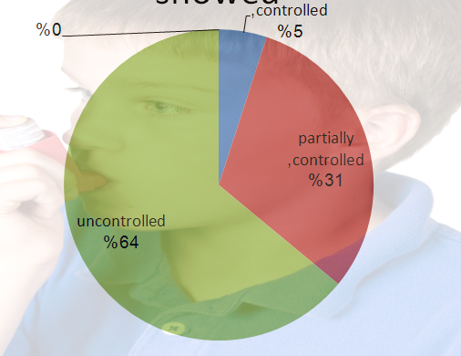
A recent asthma control survey showed:

Slide 8
Causes of poor control
Poor knowledge,
Fear of use of new drugs,
and lack of awareness of the importance of control of the disease among primary
care physicians !!
A study found that only 39% of primary care physicians meet the standards of the national guidelines in management of asthma.

Slide 9
Pathology of Asthma
Inflammation
Airway Hyper-responsiveness
Airway Obstruction
Symptoms of Asthma
Notes:
9

Slide 10
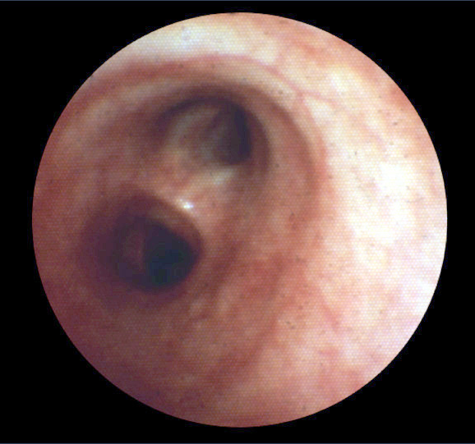
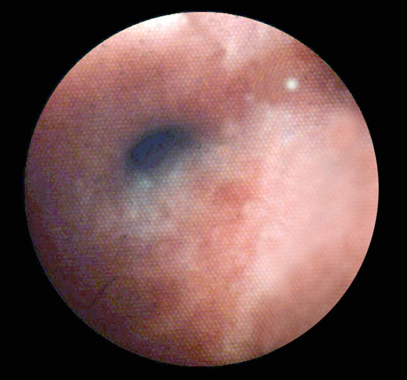
Bronchoconstriction
Before
10 Minutes
After
10 Minutes of Allergen Challenge
Notes:
10

Slide 11
Pathophysiology
Airways inflammation:
Asthma is a complex syndrome characterized by a state of airways hyperresponsiveness and caused by a multi-cellular inflammatory reaction.
Airways hyperresponsiveness:
Direct (histamine or methacholine) OR
Indirect (exercise, cold air).

Slide 12
Pathophysiology
Early and late responses
Airway remodeling:
epithelial damage, subepithelial fibrosis, increased airway vasculature and increased smooth-muscle mass, increase number of secretory glands.

Slide 13
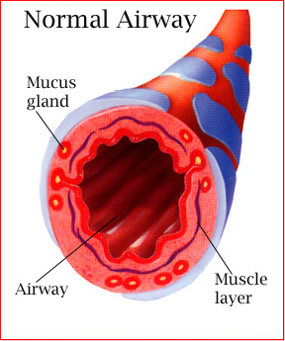
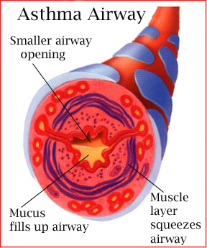
During an asthma attack…
Notes:
13
When exposed to an asthma trigger…
Bronchioles constrict to limit exposure to the trigger.
Mucous membrane becomes irritated and swells.
Mucous is produced to trap the irritant.
Coughing initiated to pop open bronchioles and expel the mucous build-up.
Air retention volume in alveolar sacs increases – can’t get air out or in.
CO2 build-up in alveolar sacs and in system tissues which can lead to acidosis.
The body attempts to blow off the excess CO2 – rapid shallow breathing. (hyperventilation)
Hungry for O2 and trying to get rid of CO2 at the same time.
Fatigued muscles in this effort.
If this continues, the person with asthma can die.
A person with asthma undergoes what is called “airway remodeling” – where there is permanent damage to the airways and decreased overall capacity….airway hyperactivity. A hyperactive airway is more susceptible to triggers.
Taking medication:
Rescue inhaler – dilates bronchioles, doesn’t alleviate mucous or congestion in any appreciable way
Daily corticosteroid –works to reduce airway hyperactivity

Slide 14
“Real Life” Variability in Asthma
Acute
inflammation
symptoms
subclinical
Chronic inflammation
Structural changes
TIME
Barnes PJ. Clin Exp Allergy 1996.
Notes:
14
Multimedia Slide 7
Asthma is a chronic inflammatory disease with a variable course characterized by episodic attacks of acute inflammation.¹ Acute inflammation in asthma is associated with bronchoconstriction, plasma exudation/edema, vasodilatation, and mucus hypersecretion. Chronic inflammation in asthma is associated with subepithelial fibrosis, smooth-muscle hyperplasia/hypertrophy, mucus gland hyperplasia, and new-vessel formation. If asthma remains uncontrolled or poorly controlled, the underlying chronic inflammation may lead to structural changes (remodelling) that reduce the extent of airway response to therapy.
1. Barnes PJ. New drugs for asthma. Clin Exp Allergy 1996;26:738-745.

Slide 15
The four major recognized asthma symptoms:
Shortness of breath, especially with exertion or at night
Wheezing is a whistling or hissing sound when breathing out
Coughing may be chronic, is usually worse at night and early morning, and may occur after exercise or when exposed to cold, dry air
Chest tightness may occur with or without the above symptoms

Slide 16
symptoms of a severe asthma attack
Persistent shortness of breath.
The inability to speak in full sentences.
Breathlessness even while lying down.
Chest that feels closed.
Bluish tint to your lips.
Agitation, confusion, or an inability to concentrate.
Hunched shoulders and strained abdominal and neck muscles.
A need to sit or stand up to breathe more easily.
A severe asthma attack often occurs with few warning signs. It can happen quickly and progress rapidly to asphyxiation.

Slide 17
How to approach asthmatic patient?

Slide 18
Obtain a detailed History
Does the patient or his/her family have a history of asthma or other atopic conditions, such as eczema or allergic rhinitis?
Does the patient have recurrent attacks of wheezing?
Has the patient ever been hospitalized due to asthma or other lung diseases?
Does the patient have a troublesome cough at night?

Slide 19
Cont, Obtain a detailed History
- Has the patient ever been admitted to the intensive care unit for asthma?
- Has the patient ever been intubated?
- Does the patient have a neonatal history of lung disease?

Slide 20
Cont, Obtain a detailed History
Does the patient wheeze or cough after exercise?
Does the patient experience wheezing, chest tightness, or cough after exposure to pollens, dust, feathered or furry animals, exercise, viral infection, or environmental smoke.
Physiologic factors (e.g., stress, gastroesophageal reflux (GERD), respiratory infection [viral, bacterial] and rhinitis).

Slide 21
Cont, Obtain a detailed History
Does the patient experience worsening of symptoms after taking aspirin/ nonsteroidal inflammatory medication or use of B-blockers?
Does the patient’s cold “go to the chest” or take more than 10 days to clear up?
Are symptoms improved by appropriate asthma treatment?

Slide 22
Physical Examination
Wheeze /Rhonchi.
Tachypnea.
Use of accessory muscles of respiration.
paradoxical pulse (a pulse that is weaker during inhalation and stronger during exhalation).
Over-inflation of the chest.
Cyanosis of nails.
signs of allergy in skin, nose, eyes.

Slide 23
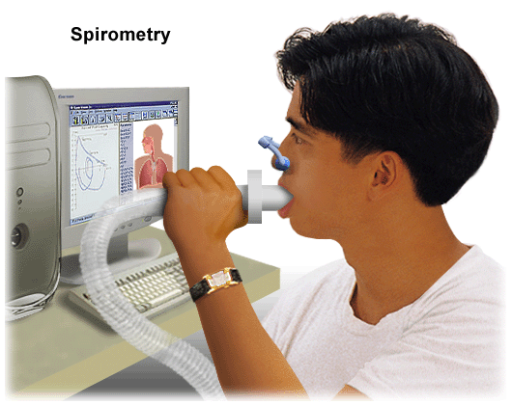
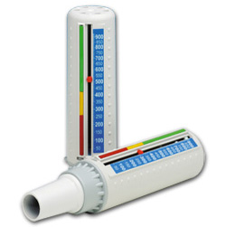
3) Investigation
There is currently not a precise physiologic, immunologic, or histologic test for diagnosing asthma. The diagnosis made based on the pattern of symptoms and response to therapy .
Pulmonary Function Tests
Peak flow meter

Slide 24
Spirometry Test
Measure (FEV1) and (FVC) volume-time curve
Normally FEV1/FVC ~ 75%
An obstructive pattern on spirometry is identified numerically by a reduction in the ratio of FEV1 to FVC.
Recommend spirometry at the time of initial diagnosis, after treatment is initiated and symptoms are stabilized

Slide 25
How spirometry test is done ?
During this painless test, a technician will ask you to take a deep breath in. Then, you'll blow as hard as you can into a tube connected to a small machine.
The machine is called a spirometer.
The machine measures how much air you breathe out. It also measures how fast you can blow air out.

Slide 26
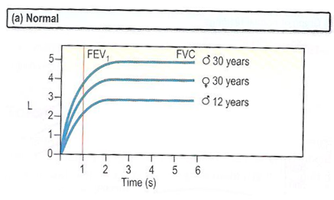
If FEV1 or FVC ^ By 12% after bronchodilator obstruction considered reversible.

Slide 27
Peak Expiratory Flow
Recommend in monitoring and long term assessment of patient disease and response to treatment
on waking prior to taking a bronchodilator and before bed after bronchodilator.
Also in assessment of possible occupational asthma.
At least 4 time/daily
for 2weeks at work
And 2weeks off work
In acute setting when patient is SOB, PEF is quickest method of diagnosis

Slide 28
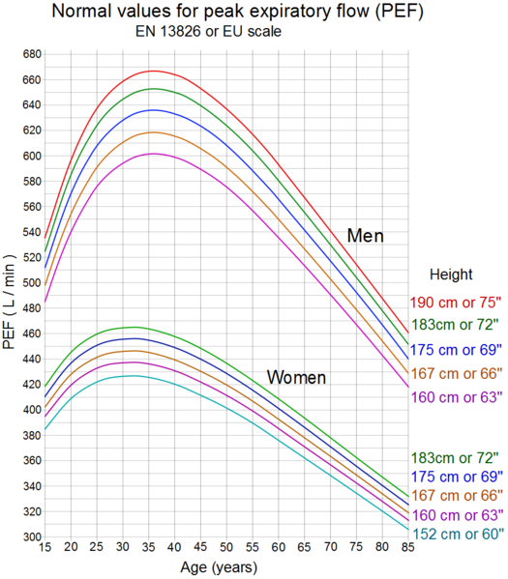
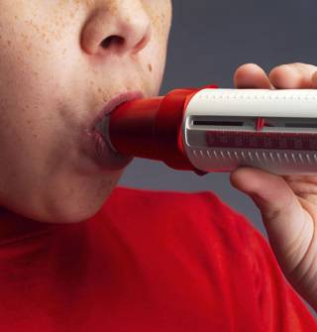
How PEF test is done?

Slide 29
Bronchoprovocation Challenge Testing
It evaluate the airway narrowing in response to stimuli.
Not for everyone! only done when symptoms suggest asthma, but normal spirometry , it may cause a severe asthma attack .
Also used for diagnosis of occupational asthma
How is Bronchoprovocation Testing Preformed?
Perform a spirometry test.
Inhale a nebulized aerosol with methacholine or histamine.
Perform another spirometry after nebulized the aerosol.
See if there is decrease in FEV1.
Hyperresponsive will develop at lower doses

Slide 30
Chest X-ray
Not recommended as routine Investigation
Normal in mild cases.
Only Sever asthma reveals hyperinflation
Recommended in the evaluation of severe "difficult-to-control" asthma or in atypical symptoms
Used to exclude other condition (mass with tracheal compression ,pneumothorax)

Slide 31
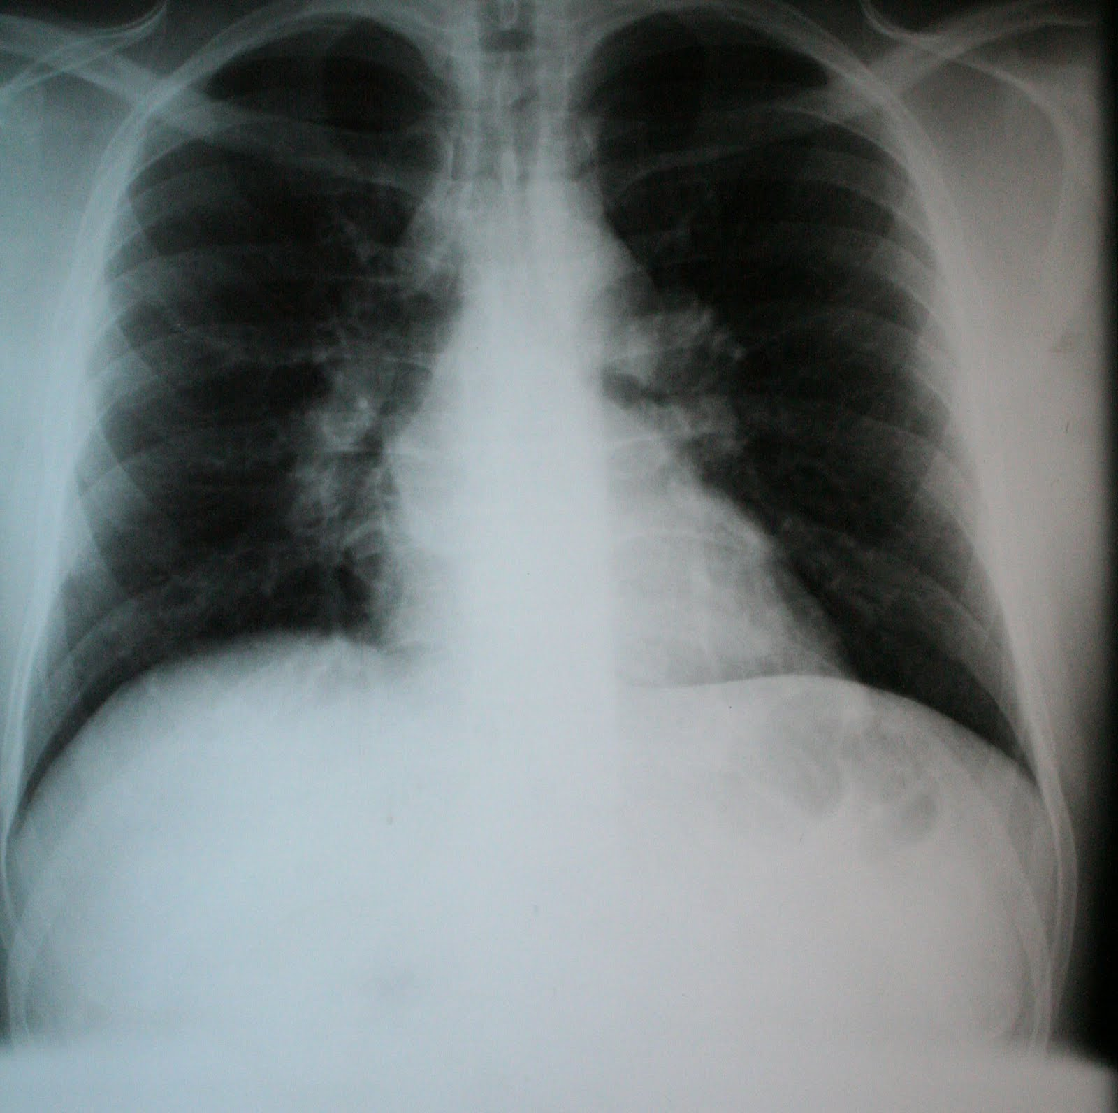
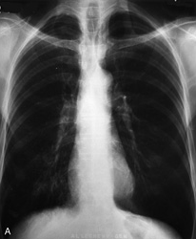
NORMAL
HYPERINFLATION

Slide 32
Other supportive tests

Slide 33
Arterial Blood Gases
Considered when
Severe respiratory distress (ASTHMA)
increased respiratory rate
Hypocapnia
Hypoxiemia may be present

Slide 34
Arterial Blood Gases
But
When Pco2 is normal or increased
Respiratory muscle fatigue or sever airway obstruction
The patient should be hospitalized and mechanical ventilation is considered

Slide 35
Measurements of allergic status
Allergens can be Identifeined by :
Skin testing
Level of specific IgE in the serum
- Provocation of the air ways with a suspected allergen especially in the occupational asthma. (But rarely useful and dangerous )

Slide 36
Allergy Skin test
The primary diagnostic tool in determining allergic status. Simple, rapid, low cost, highly sensitive

Slide 37
Special situation
Asthma

Slide 38
Exercise induced Asthma
A different type of asthma .
It can induce an asthmatic attack in people who have no other triggering factors .
People with exercise-induced asthma are believed to be more sensitive to changes in the temperature and humidity of the air.

Slide 39
Exercise induced Asthma
Main Point
When you are at rest, you breathe through your nose, which serves to warm, humidify, and cleanse the air you inhale to make it more like the air in the lungs.
But
When you are exercising, you breathe through your mouth, and the air that hits your lungs is colder and drier. The contrast between the warm air in the lungs and the cold inhaled air or the dry inhaled air and moist air in the lungs can trigger an attack.

Slide 40
Exercise induced Asthma
Symptoms usually begin about 5- 10min after finishing to exercise.
Rarely starts during the exercise .
Typically gone within an hour, but they may last longer.
It can happen under any weather but cold and dry weather is the most common .

Slide 41
Why It Is Important ?
When asthma is left untreated and the inflammation persists, permanent narrowing of the airways can occur then this chronic asthma can also be referred to as chronic obstructive pulmonary disease (COPD).

Slide 42
If patient think he may have exercise-induced asthma, he should promptly make an appointment with your health-care professional.
This plan should include instructions on
how to prevent an attack while exercising
what to do when an asthma attack occurs,
when to call the health-care professional,
and when to go to a hospital emergency

Slide 43
Assessment of severity of asthma
divided into 4 levels

Slide 45
Case
Fatemah 21 years old came to your clinic known as asthmatic patient .. she had 3 symptom of asthma during the day per weeks ..and more than 2 symptoms of asthma during the night per months.. In which levels of asthma Ali had !?
1-mild intermittent
2-mild persistence
3-moderate
4-sever

Slide 46
VIDEO

Slide 47
There are a number differences between COPD and asthma:
Age-An easy difference between COPD and asthma is the age when a diagnosis is made. Asthma is most often diagnosed in childhood or adolescence, while COPD is diagnosed later in life.
Smoking history- Nearly all patients with COPD either have smoked or have a significant environmental tobacco smoke exposure, while asthma patients are more commonly non-smokers.

Slide 48
Symptoms- Another difference between asthma and COPD is the intermittent symptoms seen with asthma versus the chronic, progressive symptoms seen in COPD.
Forced Expiratory Volume (FEV1) Changes-Reversibility of FEV1 represents another difference between asthma and COPD. In asthma, decreases in FEV1 return to normal between asthma attacks, while changes in FEV1 in COPD are generally not reversible.

Slide 49
Common coexisting conditions- In asthma you will commonly have coexisting allergic conditions such as allergic rhinitis or eczema, while COPD patients will have smoking related diseases like coronary heart disease or osteoporosis.
Inhaled steroids- While inhaled steroids are considered standard care in all stages of asthma beyond intermittent asthma, inhaled steroids only benefit a small number of patients with COPD.

Slide 50
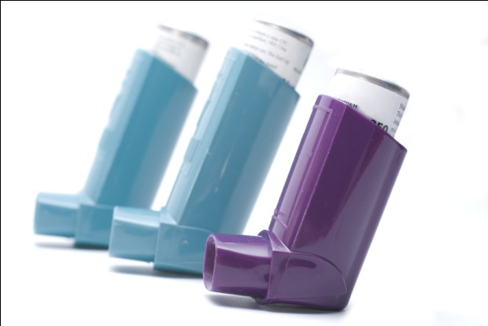
Treatment of Asthma
Global Initiative for Asthma (GINA) 6-point plan:
Educate patients to develop a partnership in asthma management
Provide regular follow-up care
Avoid exposure to risk factors
Assess and monitor asthma severity with symptom reports and measures of lung function as much as possible
Establish medication plans for chronic management in children and adults
Establish individual plans for managing exacerbations

Slide 51
Medications to control Asthma
Quick relievers :
1- Short-acting beta₂-agonists.
2- Anti-muscarinic.
Long-term controllers :
1- Corticosteroids.
2- Long-acting beta₂-agonists
3- Leukotriene modifiers
4-theophylline.

Slide 52
A) Quick relievers :
Short-acting beta₂-agonists(ventolin):
MOA:
increasing airflow through your lungs and relax the smooth muscle lining the airways of the lung and your airways open up.
Uses:
before the onset of exercise
exercise-induced asthma.

Slide 53
Ipratropium bromide
MOA:
It blocks the muscarinic acetylcholine receptors in the smooth muscles of the bronchi in the lungs, opening the bronchi.
Uses:
COPD
Acute Asthma Exacerbations

Slide 54
B) Long-term controllers
Corticosteroids:
There are many drugs such as :
Flunisolide.
Fluticasone propionate.
Beclometasone dipropionate.
MOA:
Steroids and other anti-inflammatory drugs work by reducing swelling and mucus production in the airways. As a result, the airways are less sensitive and less likely to react to asthma triggers.

Slide 55
Corticosteroids
USES:
prevent asthma symptoms, they do not relieve asthma symptoms during and attack
What Are the Side Effects of Inhaled Steroids?
higher doses, oral candidiasis and hoarseness may occur

Slide 56
Long-acting beta₂-agonists (adviar)
A LABA is a type of bronchodilator whose effects last for 12 hours or more. LABA benefits:
Improved lung function
Decreased asthma symptoms
Increased number of symptom-free days
Reduction in number of asthma attacks
Decreased recue inhaler use.
prevention of exercise induce asthma .

Slide 57
Long-acting beta₂-agonists (adviar , Symbicort)
MOA:
LABA relaxes smooth muscle lining of the airways.
Uses : for moderate, severe persistent asthma.
LABA + inhaled steroid.

Slide 58
Theophylline
Methylxanthines class
MOA:
A muscle relaxant, and it may have mild anti-inflammatory effect.
USES:
For persistent asthma,
theophylline is not considered the preferred first treatment because it has not been shown to be as effective as ICS. However, in some cases it may be prescribed as an additional medication if sufficient control is not achieved with steroids alone.

Slide 59
New Up Date in asthma medications
Omalizumab: (Xolair)
approval by the U.S. Food and Drug Administration (FDA) in 2003.
Used in treating patients 12 years and older with moderate to severe allergic asthma.

Slide 60
(Leukotrienes Receptor Antagonist) montileukast
MOA:
Leukotrienes are released from mast cell, eosinophil and basophil and lead to increased inflammation.
Uses:
Mild persistent asthma
Adjunctive therapy in combination with inhaled steroids.
prevention of exercise induce asthma.

Slide 62
When to Step up or Step down?
Step Up:
If asthma is not controlled on the current treatment regimen,.
But befor stepping up:
compliance, inhaler technique, and avoidance of risk factors. Generally, improvement within 1 month.
Step Down Gradually:
If control is maintained for at least 3 months, The goal is to decrease treatment to the least medication necessary to maintain control.

Slide 63
Pharmacotherapy for Infants and Young Children (<5 years)
The most effective bronchodilator available is SABA
If control is not achieved ➔ lowest dose of ICS
If control is not achieved ➔ double the initial dose of ICS
If further control is needed ➔ ICS dose can be increased to the maximum, AND/OR adding LTRA or theophylline.

Slide 64
Cont.
Low dose of oral corticosteroids for a few weeks to achieve control should be limited to sever uncontrolled cases to avoid their side effects.
For children with seasonal symptoms, daily controller therapy may be discontinued after the season, with the advice for a follow-up visit within 3-6 weeks.

Slide 65
Monitoring to maintain control
Typically, patients should be seen one to three months after the initial visit, and every three months thereafter.
After an exacerbation, follow-up should be offered within 2 weeks to 1 month.

Slide 66
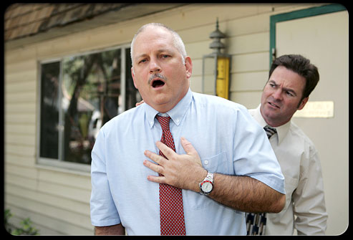
Management of Acute severe asthma

Slide 69
Special situations
Asthma and pregnancy:
it is very similar to not pregnant people. avoiding triggering factors ,Corticosteroids have a low but significant teratogenic effect

Slide 70
Special situations
Aspirin-induced asthma: up to 28% of adults with asthma suffer from exacerbations in response to aspirin.
Within minutes to 1 or 2 hours, an acute, sever attack develops, and is usually accompanied by: rhinorrhea, nasal obstruction, conjunctival irritation.
Typical history is considered adequate for diagnosis.

Slide 71
Cont.
Patients known to have AIA should avoid all aspirin-containing products.
However, patients for whom aspirin is considered essential, they should be referred to an allergy specialist for aspirin desensitization.

Slide 72
Special situations
GERD-triggered asthma:
The mechanisms include vagal mediated reflex and reflux secondary to micro-aspiration of gastric contents into the upper airways.
Treatment: treat GERD with proton pump inhibitor.

Slide 73
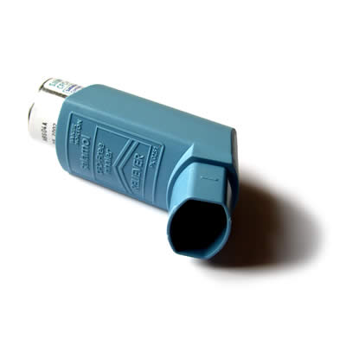
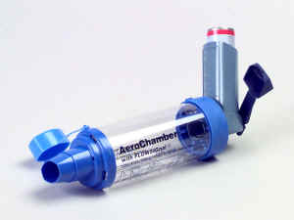
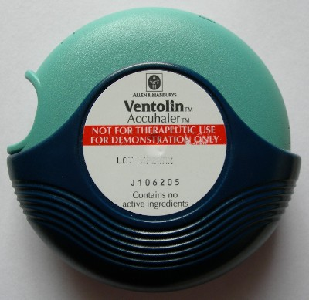
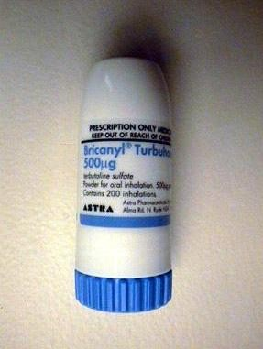
Types of asthma inhalers:
Metered dose inhalers.
Metered dose inhaler with a spacer
Dry powder inhaler

Slide 74
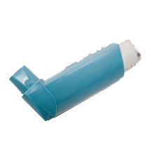
Metered-dose inhalers
Is the most common type of inhaler
the medication is most commonly stored in solution in a pressurized canister

Slide 75
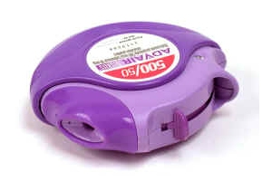
Dry powder inhalers
is a device that delivers medication to the lungs in the form of a dry powder.
It is an alternative to the metered-dose inhaler
The medication is commonly held either in a capsule for manual loading or a proprietary form from inside the inhaler.

Slide 76
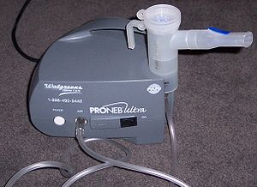
Nebulizers
a device used to administer medication in the form of a mist that inhaled into the lungs.
It use oxygen, compressed air or ultrasonic power to break up medical solutions/suspensions into small aerosol droplets that can be direclty inhaled from the mouthpiece of the device.
aerosol is a mixture of gas and liquid particles

Slide 77
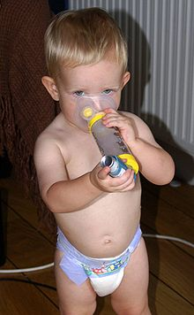
Spacer
is an add-on device used to increase the ease of administering aerosolized medication from a metered-dose inhaler
The spacer adds space in the form of a tube or “chamber” between the canister of medication and the patient’s mouth, allowing the patient to inhale the medication by breathing in slowly and deeply for five to 10 breaths.
Benefits:
-Reduce deposition in the mouth and throat
-Avoids timing issues and make it easier.

Slide 78
EDUCATION

Slide 79
Asthma education category
Education to the Patient
Education to the family

Slide 80
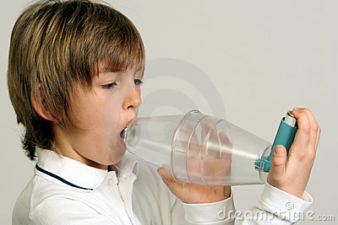
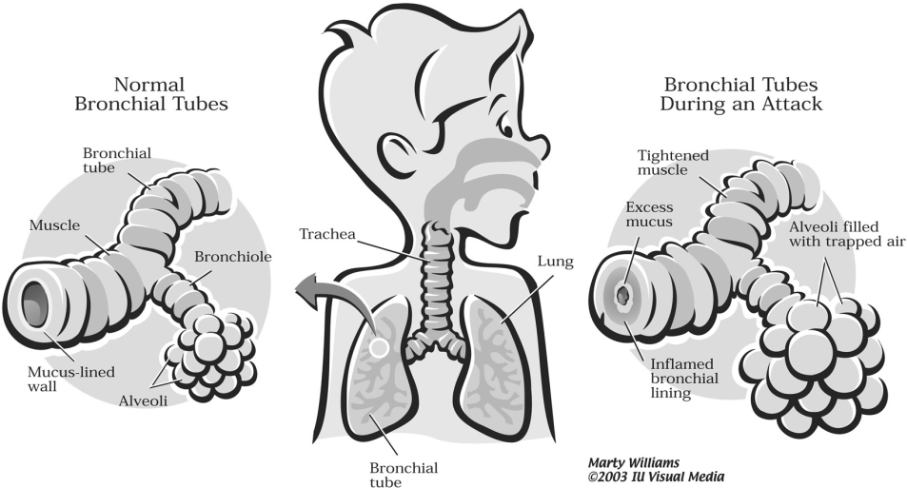
Education to the Patient
What is asthma?
What are triggers?
How to use the medication?
What is the benefit from the medication?
What are the goals of asthma treatment?

Slide 81
Role play
How can I encourage the patient on compliance?
How can I reduce the triggers?
How can I use the inhaler ( right technique)?

Slide 82
Reference
Global initiative for asthma guidelines
http://www.ginasthma.org/pdf/GINA_Report_2010.pdf
http://www.sinagroup.org/download/book_asthma_final.pdf
Saudi Thoracic committee

