Slide 1
SMOKING
Mazen Al-Fozan Mohammad Al-Ruwaili Mohammad Al-Harbi

Slide 2
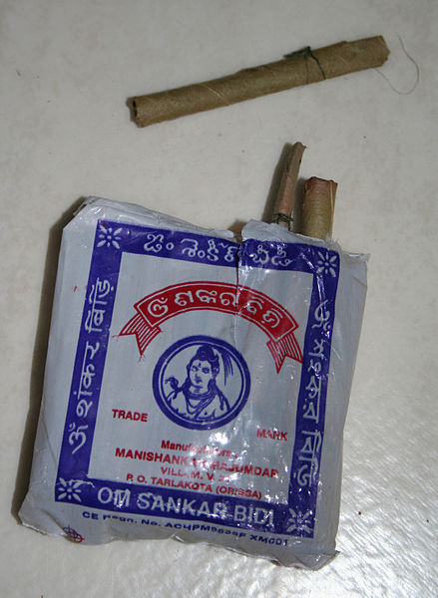
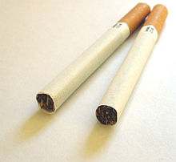
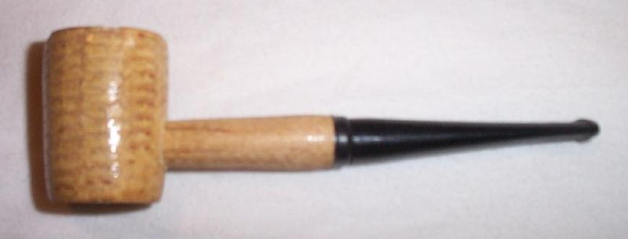
Definition
- Smoking refers to the inhalation and exhalation of fumes from burning tobacco in cigars, cigarettes and pipes.
- The most common method : cigarettes, primarily industrially manufactured but also hand-rolled from loose tobacco and rolling paper.
- Smoking is one of the most common forms of recreational drug use.
- Other smoking implements include pipes, cigars, bidis, hookahs, …. Etc.

Slide 3
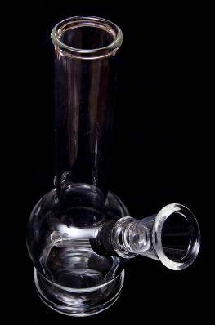
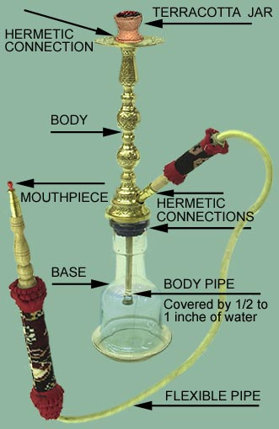
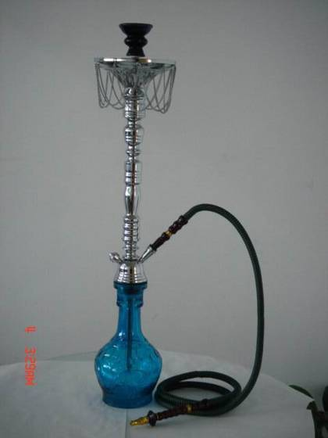
Water-Pipe:
- Not safer than regular tobacco smoke.
- Causes the same diseases
- Raises the risk of lip cancer, spreading infections like tuberculosis.
- Users ingest about 100 times more lead from hookah smoke than from a cigarette.

Slide 4
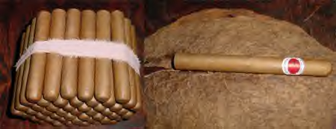
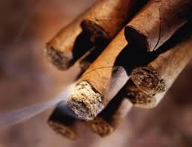
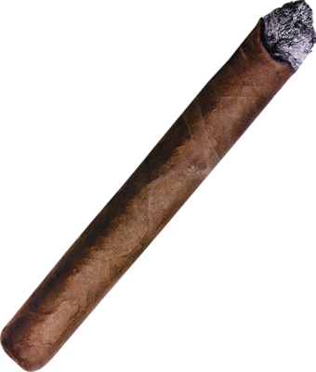
Cigars:
- Has larger amounts of tobacco than a cigarette
- Is tobacco rolled up in a tobacco leaf
- Does not have a filter

Slide 5
Magnitude of the problem:
- 5 million premature deaths each year. - 600,000 Death due to 2nd hand smoking. - one person dies every six seconds. - 80% of smokers live in low-middle income countries - World’s leading cause of death and disability in 2020/2030. - Approximately 1.1 billion smokers in the world - about 1/3 of the global population aged 15 years and over. - Consumption of tobacco is increasing globally, though it is decreasing in some high-income and upper middle-income countries.

Slide 6
Preventable Causes of Death
Smoking 400,000
Accidents 94,000
2nd Hand Smoke 38,000
Alcohol 45,000
HIV/AIDS 32,600
Suicide 31,000
Homicide 21,000
Drugs 14,200
Notes:
Coincides with BB presentation: use script from original Tobacco 101 presentation
“If you add smoking and SHS, it equals 438,000. If you add up all the non tobacco-related causes, it equals ½ of the people from tobacco-related. Given these numbers, helping people quit or reduce SHS exposure needs to be a health priority. Half of all teens who start to smoke will die of tobacco-related disease.”

Slide 7
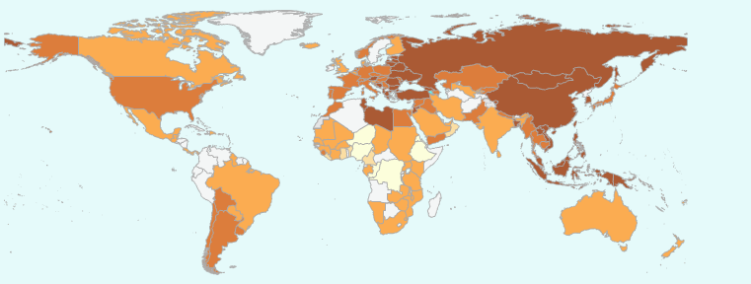
Prevalence of smoking in Men (2009).
Notes:
Kiribati = 70%, Greece: 65%, \ KSA = 15 - 30

Slide 8
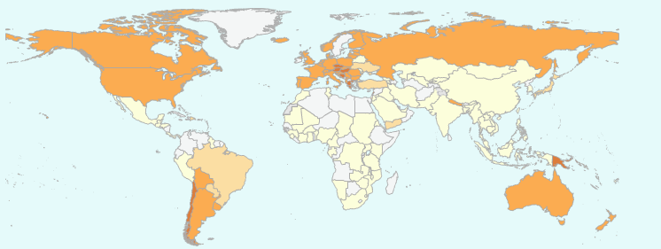
Prevalence of smoking in women (2009).
Notes:
Nauru 50%, Austria 45%, Greece 41 \ KSA = 1

Slide 9
Prevalence of smoking among developed and developing countries

Slide 10
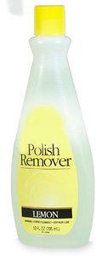
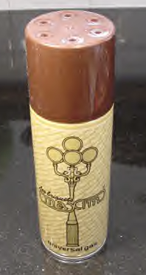
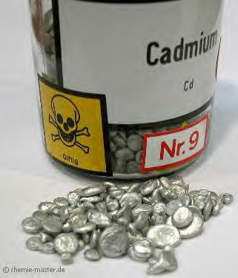
What is in cigars:
More than 4,000 substances, including:
Tar: black sticky substance used to pave roads
Nicotine: Insecticide
Carbon Monoxide: Car exhaust
²¹⁰ Polonium: radio-active substance
Acetone: Finger nail polish remover
Ammonia: Toilet Cleaner
Cadmium: used batteries
Ethanol: Alcohol
Arsenic: Rat poison
Butane: Lighter Fluid
Notes:
There are over 4,000 chemicals in cigarette smoke. These chemicals irritate the throat and cause cancer, lung and heart disease. Chemicals are added to: Make tobacco burn smoothly; Make the paper burn evenly Enhance the flavor; Boost the nicotine (ammonia); Kill the tobacco slugs Make sure the cigarette doesn’t go out in the ashtray when not puffing on it.
Myth: water-pipes and cigars are safe
Myth: It’s OK to smoke as long as it’s a “natural” cigarette
Myth: It’s OK to be next to a smoker in one room
Myth: Low tar-nicotine cigarettes are OK
Myth: Smoking is more a habit, rather than addiction

Slide 11
Smoking in KSA
There were 34 studies between 1987 – 2008.
1. Adolescence: Range from 12-30% (median 16.5%)
Global Youth Tobacco Survey (GYTS) in KSA
in 2010 (ages 13-15) = -15% currently use any tobacco product (20% boys , 10% Girls) - 8.9 % currently smoke cigarettes (boys = 13.0 %, girls = 5.0%); - 9.5 % currently smoke shisha (boys = 13.3 %, girls = 6.1%)

Slide 12
2. Early Adulthood: (university student) - 11 studies, mostly carried out on medical science student median of 14.5%
The KSA medical students WHO-GHPSS was a school-based survey of 3rd year medical students attending the 13 medical schools conducted in 2006 Results: 11.6% currently smoke cigarettes (Males = 13.1%, Females = 9.6%); 12.8% currently use any form of tobacco other than cigarettes (Males = 13.9%, Females = 11.3%)
3. Adulthood: - 10 studies, median of 22.6%
4. Elderly: 1 study , 50-89 years old , 25%

Slide 13
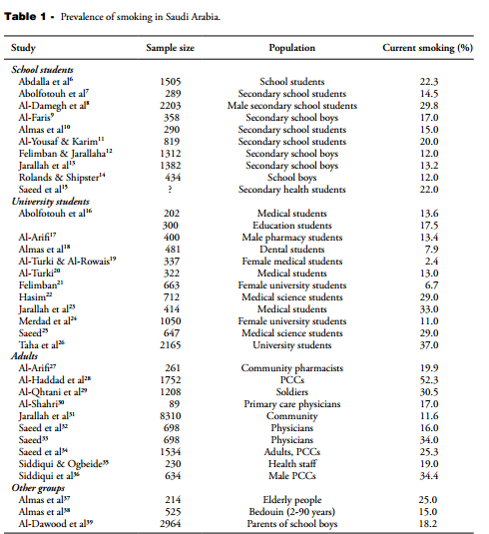
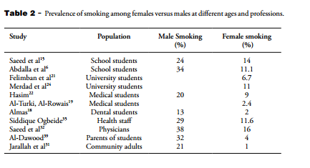

Slide 14
Risk of smoking

Slide 15
Risk of smoking
According to the 2004 Surgeon General’s Report
There is sufficient evidence that smoking causes the following conditions :
Cancers :
lung,
oral (laryngeal)
GI (esophageal, stomach, liver, pancreatic)
GU (bladder, kidney, cervical)
hematologic (myeloid leukemia)

Slide 16
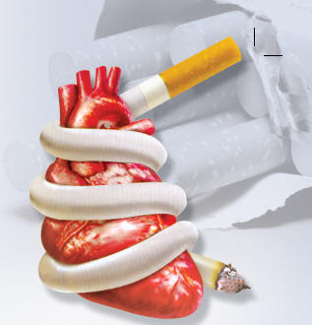
Risk of smoking
Cardiovascular disease:
atherosclerosis
cerebrovascular
coronary heart disease(CHD)
abdominal aortic aneurysm

Slide 17
Risk of smoking
Respiratory disease:
chronic obstructive pulmonary disease(COPD)
increased susceptibility to pneumonia
impaired lung growth during childhood and adolescence

Slide 18
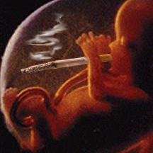
Risk of smoking
Reproductive effects:
decreased fertility in women,
complications of pregnancy , such as :
premature rupture of the membranes
placenta previa
placental abruption
miscarriage
still birth
low birth weight
reduced lung function in infants
sudden infantdeath syndrome (SIDS)

Slide 19
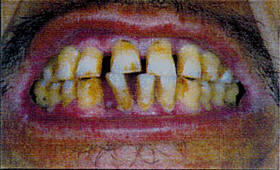
Risk of smoking
Oro-dental Problems:
Stained teeth
Gum inflammation
Black hairy tongue
Oral cancer
Delayed healing of the gums
Overall poor oral health

Slide 20
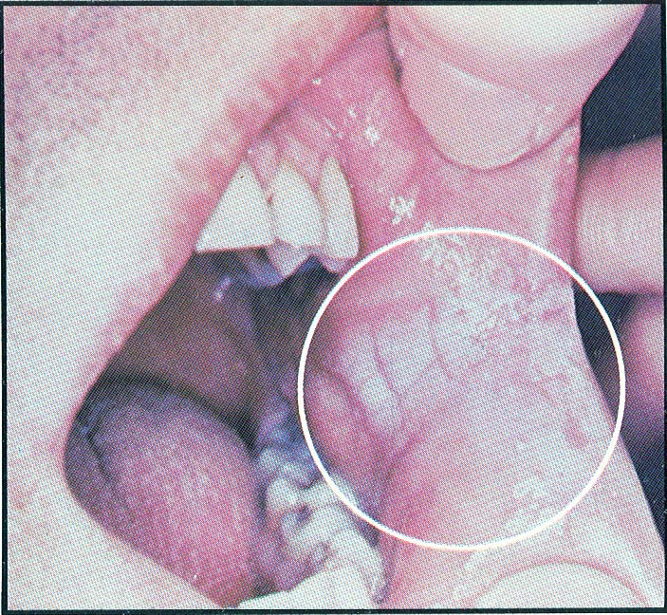
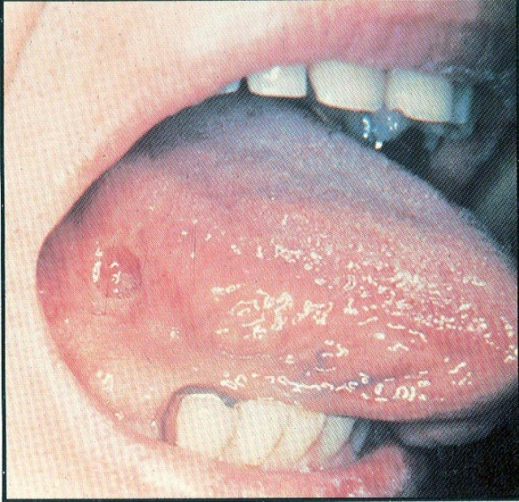
Risk of smoking
Consequences of chewing tobacco:
Leukoplakia is a condition which, in the mouth, can develop into cancer. Cigarette smoke – and smokeless tobacco – can cause this dangerous condition.
Leukoplakia
Oral cancer

Slide 21
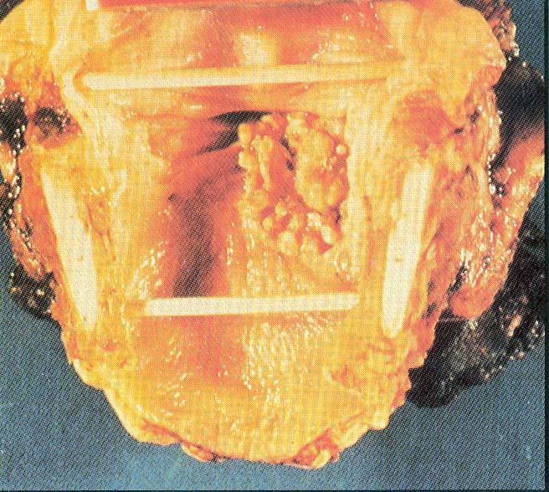
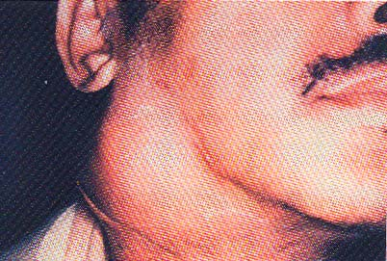
Risk of smoking
Laryngeal Cancer :
Symptoms:
Persistent hoarseness
Chronic sore throat
Painful swallowing
Pain in the ear
Lump in the neck
Over 80% of deaths from laryngeal cancer are linked to smoking

Slide 22
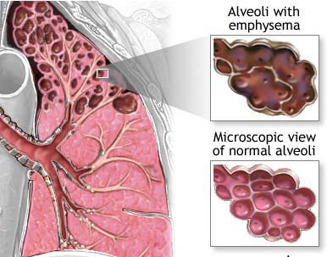
Risk of smoking
Emphysema :
Symptoms Include
Shortness of breath; chronic cough;
wheezing; anxiety; weight loss; ankle, feet and leg swelling; fatigue, etc

Slide 23
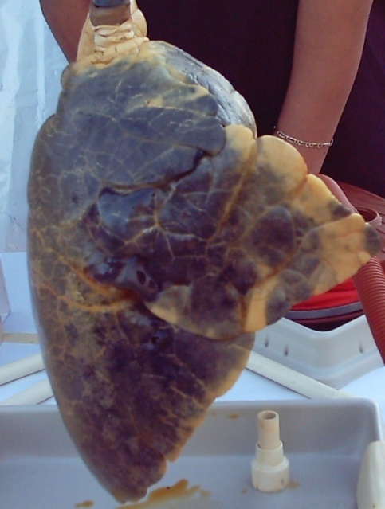
Risk of smoking
Lung Cancer:
The uncontrolled growth of abnormal cells in one or both lungs :
Lung cancer kills more people than any other type of cancer

Slide 24
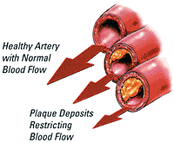
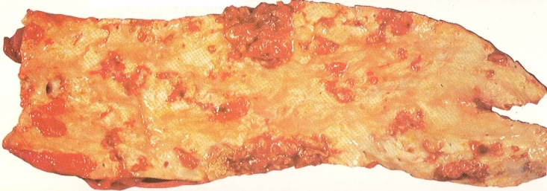
Risk of smoking
Arteriosclerosis and Atherosclerosis:
Nicotine affects fatty acids in the blood, increasing the overall blood cholesterol level. When cholesterol is too high, a hard substance called plaque builds up on the inside walls of the blood vessels. This condition is known as atherosclerosis. Plaque can clog the blood vessels, forcing the heart to pump harder. Smoking also constricts the arteries, leading to arteriosclerosis, or hardening of the arteries. These conditions greatly increase the risk for heart attacks or strokes.

Slide 25
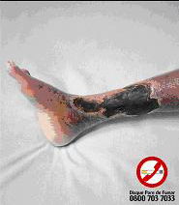
Risk of smoking
Peripheral Vascular Disease :
Peripheral vascular disease, or PVD, is caused by the gradual narrowing of the arteries in the arms and legs. Smoking greatly increases the risk and severity of this disease by contributing to atherosclerosis in these tiny arteries. PVD causes painful cramping during exercise, numbness and tingling, and weakness in the affected limbs .

Slide 26
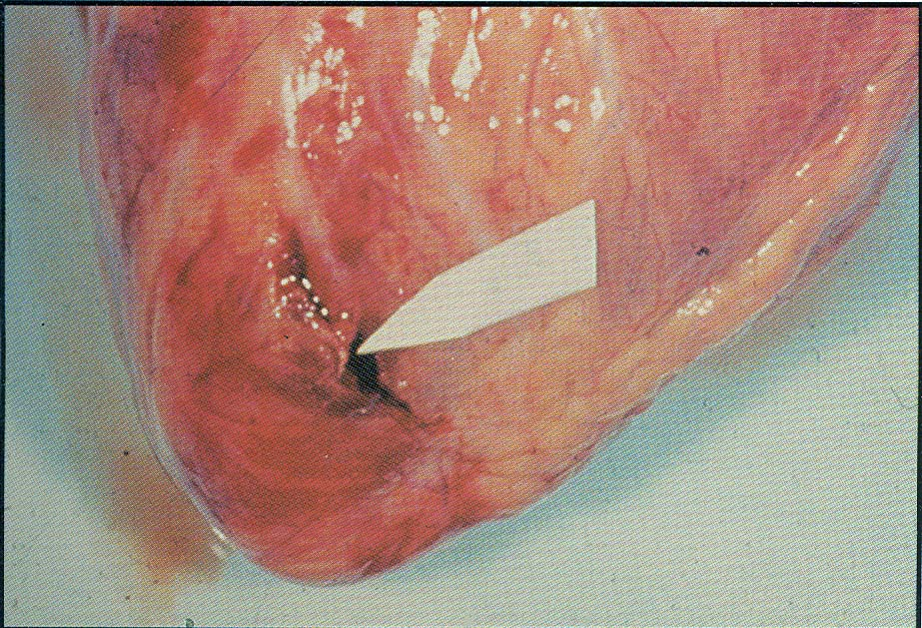
Risk of smoking
Heart Attack:
Smokers are twice as likely as Nonsmokers to have a heart attack
A heart attack is when the heart is damaged by a sudden lack of blood flow to the heart muscle. This happens because the arteries to the heart muscle become narrowed or blocked. Nicotine in cigarette smoke causes blood vessels to become narrow
Torn heart wall: Result of over-worked heart muscle

Slide 27
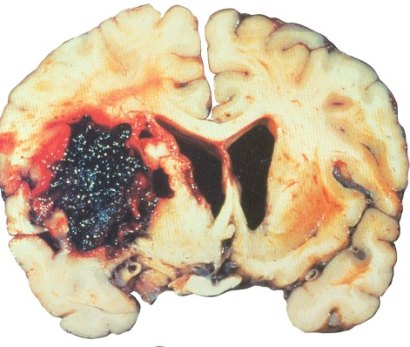
Risk of smoking
Stroke:
This brain shows stroke damage, which can cause death or severe mental or physical disability
A stroke occurs when an artery becomes clogged or bursts. Strokes can cause paralysis, brain damage, or death. Hardened arteries, high blood pressure, and clotting problems- all of which can be cause by smoking – increase the risk for strokes. The dark red area in the photo is where bleeding occurred

Slide 28
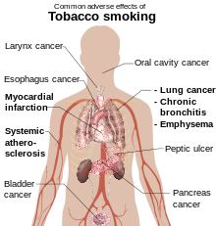
Risk of smoking
Other:
hip fractures
low bone density
peptic ulcer disease
cataracts
diminished health status

Slide 29
Risk of smoking
secondhand tobacco smoke :
Is a significant health risk for nonsmokers, especially those with pre-existing respiratory and cardiac conditions.
Is now a recognized carcinogen .
containing over 50 harmful chemicals, such as :
Formaldehyde
benzene
vinyl chloride
arsenic
ammonia
hydrogen cyanide.

Slide 30
Risk of smoking
Nonsmokers exposed to secondhand smoke at home or at work have about :
25% to 30% increased risk of heart disease
20% to 30% increased risk of lung cancer.

Slide 31
Risk of smoking
Remember that Tobacco use is: The single largest cause of preventable death

Slide 32
How are you going to help the smoker to quite?

Slide 33
QUITTING PLAN
Deciding to quit smoking
Sure, you may be able to list plenty of reasons to stop smoking. You may be worried about the health problems related to smoking, the social stigma, the expense or the pressure from loved ones. But only you can decide when you're ready to stop smoking. You may spend a lot of time thinking about quitting smoking before you're ready to actually do it. If you're thinking about quitting, go ahead and pick a specific day to quit

Slide 34
QUITTING PLAN
Picking a quit day
Pick a specific day within the next month to quit smoking. Don't set your quit day too far in the future, or you may find it hard to follow through. But don't do it before you have a quit-smoking plan in place, either.
Pick a random day as your quit day or pick a day that holds special meaning for you, such as a birthday, a holiday or a day of the week that's generally less stressful for you.

Slide 35
QUITTING PLAN
AT THE QUIT DAY :
Get rid of all cigarettes, ashtrays, lighters, and matches.
Have creative alternatives available, such as :
Using “meswak”
Sugarless gum
Sugarless candy
A ball to squeeze
Rubber bands
Tell a lot of people that you’ve quit smoking.

Slide 36
QUITTING PLAN
AFTER QUIT DAY :
Irritability, Fatigue, Insomnia, Cough, Dry throat, Nasal drip, Dizziness, Constipation, Gas, Hunger.
most symptoms pass within two to four weeks.
Craving for a cigarette.
1-Urges only last a few minutes.
2-Find out your personal reason and remembering them when things get a little tough
3-Do something to take your mind off smoking.
4-Don’t ever take a cigarette from your friend not even a puff.

Slide 37
Your Role as a Friend
1)Don’t nag, insult, or try to shame the smoker into quitting.
2) Let the smoker know that he is valued as a person.
3) Praise the smoker for even the smallest efforts to quit.

Slide 38
Role of PHC physician "smoking cessation clinic "

Slide 39
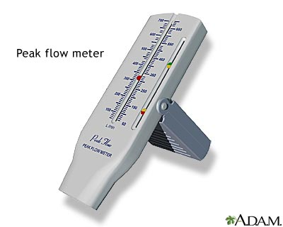
smoking cessation clinic
the phusician should take the following:-
1-Body weight and height
2-CO level
1-2 …(normal)
3-7….(mild smoking)
8-22…..(severe smoking)
- Peak flow meter

Slide 40
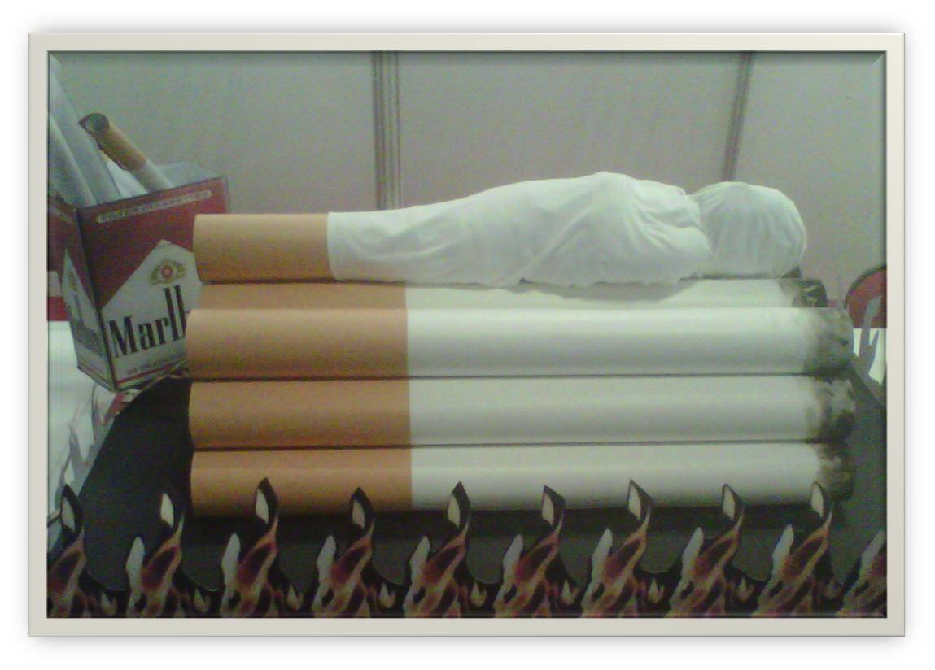
smoking cessation clinic
عند حضور المراجع للعيادة يتم تعريفه بالحكم الشرعي للتدخين وبأخطار التدخين الصحية والنفسية من خلال جلسة مع المشرف الاجتماعي ومن خلال المعرض الذي يحتوي على بعض المعروضات و المجسمات .

Slide 41
Management of smoking cessation

Slide 42
Management of smoking cessation
Pharmacological treatment .
Non pharmacological treatment ( behavioral therapy ).

Slide 43
Management of smoking cessation
Pharmacological treatment :
Nicotine based therapy
Non nicotine based therapy
Both nicotine and non nicotine based therapy can increase the chances of successful smoking cessation.

Slide 44
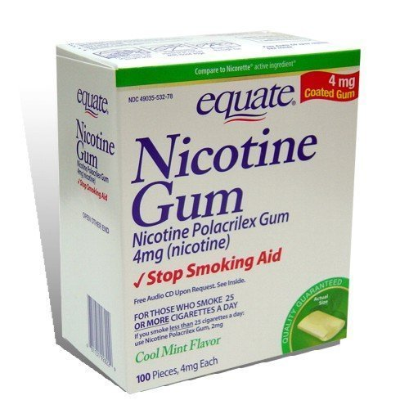
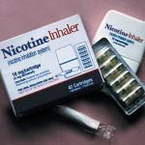
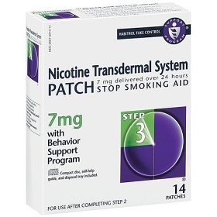
Management of smoking cessation
Nicotine based therapy (NBT) :
Nicotine replacement therapy (NRT) :
are available as transdermal patch, gum, nasal spray, inhaler, or iozenge.

Slide 45
Management of smoking cessation
NRT :
Reduces the withdrawal symptoms associated with smoking cessation such as anger, anxiety, craving, difficulty concentrating, hunger, impatience or restlessness.

Slide 46
Management of smoking cessation
Effectiveness of NRT :
There are two recent high-quality systematic reviews found all forms of NRT to be effective.
In this study observed that the main factor determining the effectiveness of NRT was the level of the nicotine dependence.
Anther study found little good evidence that NRT was effective for people who smoke fewer than 10-15 cigarettes daily . An additional cohort study found that nicotine patches were more effective in achieving long term cessation (52 weeks) in smoker with moderate dependence compared with those with mild to high dependence.

Slide 47
Management of smoking cessation
Side effects of NRT :
include local irritation depends on the route of administration.
NRT is generally safe in patients with stable cardiovascular disease.
Patient preference, cost, and side effect may be consideration when choosing NRT.

Slide 48
Management of smoking cessation
Non nicotine based therapy :
Antidepressants .
Nicotine partial receptor agonists .
Other drug therapy .

Slide 49
Management of smoking cessation
Antidepressants: such as
Bupropion is a selective serotonin\norepinephrine uptake inhibitor(SSNRI)

Slide 50
Management of smoking cessation
Mechanism of action :
Improving depressive symptoms precipitated by quitting smoking.
Substituting for possible antidepressant effects of nicotine.
Independent neurologic effects such as nicotine receptor antagonist.

Slide 51
Management of smoking cessation
Non nicotine based therapy :
2. Nicotine partial receptor agonists: such as
Varenicline
Cytistine : is the natural chemical from which varenicline was developed, so it like varencline but has a low price, is less well studies but may also aid smoking cessation .

Slide 52
Management of smoking cessation
3. Other drug therapies:
Clonidine a centrally acting antihypertensive agent, has been studied mostly in conjunction with behavioral counseling can increase smoking cessation 2-fold,but had side effect especially dry mouth and sedation which limit its use.

Slide 53
CASES
Date

Slide 54
A 54-year-old female is admitted to the hospital with chief complain of SOB for 2 days. She also complains of cough with wheezing, and denies chest pain, fever or chills.
she smokes about 1 pack/day for 23 years

Slide 55
Past medical history (PMH)
HTN
Medications
Aspirin, Lasix
Social history (SH)
Smoker

Slide 56
Laboratory results
Hgb 20 mg/dL (12.1 - 15.1 gm/dL )
Hct 60 (36.1% - 44.3% )
ABG on 4 L/min:
pH 7.39 (7.35 - 7.45)
pCO2 53 (35-45 mm Hg)
pO2 68 (80 to 100 mm Hg.)
SpO2 89% (95% to 100%)

Slide 57
diagnosis
Secondary polycythemia due to COPD due to heavy smoking

Slide 58
46 year-old gentleman with a persistent right lower lobe pulmonary mass after a successfully treated cavitary pneumonia 5 months ago. At the time of presentation he was clinically asymptomatic. The patient worked in the hospital and smoked one pack of cigarettes a day. He recently quit.

Slide 59
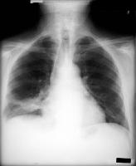
A chest CT scan revealed a right lower lobe lung mass and multiple small cavitary nodules.

Slide 60
What is the most likly diagnosis ?
PRIMARY ADENOCARCINOMA OF LUNG

Slide 61
A 54 years old male present to your clinic with the complaint of increased sputum production ,chronic cough ,and shortness of breath for the last several months , he has smoked two packs of cigarettes a day for the last 20 years .

Slide 62
What is your most likely diagnosis ?
COPD

