Slide 1
Upper Respiratory Tract Infection
Hassan alhamdi
Mohammad alfar
Sulaiman Al-gabbas

Slide 2
Objective
Overview of:
Sinusitis
Sore throat
Otitis media
Bacterial vs Viral
Antibiotic??

Slide 3
SINUSITIS
Inflammation of the lining of the paranasal sinuses.
Rarely occurs without concurrent rhinitis, rhinosinusitis is now the preferred term for this condition.

Slide 4
Incidence
According to the American Academy of Otolaryngology, this condition leads to direct health care costs of $3.4 billion per year and chronic sinusitis alone results in 18 to 22 million US physician office visits annually.

Slide 5
Classification
Acute sinusitis
lasting 4 weeks, symptoms resolve completely.
Subacute sinusitis
lasting between 4 - 12 weeks, then resolves completely .
Chronic sinusitis
symptoms lasting more than 12 weeks .
Recurrent acute sinusitis
is diagnosed when 2-4 episodes of infection occur per year with at least 8 weeks between episodes and, as in acute sinusitis, the sinus mucosa completely normalizes between attacks.

Slide 6
Etiology
May be a result from abrupt pressure changes (air planes, diving) or dental extractions or infections.
Purulent sinusitis can occur when ciliary clearance of sinus secretions decreases or when the sinus ostium becomes obstructed, which leads to retention of secretions then the environment is suitable for growth of pathogenic organisms.

Slide 7
Viral Infection
The vast majority of rhinosinusitis are caused by viral infection.
Most commonly Rhinovirus, but coronavirus, influenza a and b, Parainfluenza, respiratory syncytial virus, adenovirus, and Enterovirus are also causative agents.

Slide 8
Bacterial infection
The majority of bacterial sinusitis caused by:
Streptococcus pneumoniae
Haemophilus influenzae
Moraxella catarrhalis
Other causative organisms are:
Staphylococcus aureus
Streptococcus pyogenes,
Gram-negative bacilli

Slide 9
Diagnosis
Clinically on the basis of history and clinical examination.
It is characterized by:
Nasal congestion
Rhinorrhea
Facial pain
Hyposmia
And, if more severe, additional malaise and fever.

Slide 10
We should ask about
History of URTI or allergic rhinitis.
History of sinusitis episodes that did not respond to antibiotic treatment.
Any known structural abnormalities in the nose and face.
History of pressure change.
Pain, or tenderness over sinuses.
Persistent nasal discharge, often purulent.
Cough, worsens at night.
Mouth breathing, snoring.
Headache.

Slide 11
Clinical Examination
Press the over the air sinuses to check for
Tenderness
yellow to yellow-green nasal discharge
Check the inside of the nasal passages by torch to check the mucus and look for any structural abnormalities.

Slide 12
Special assessments
Not recommended:
Radiographic imaging x-ray
CT ( except in patient with severe disease, those who are immunocompromised and those with suspected complication).

Slide 13
DDx
Allergic and Environmental Asthma
Influenza
Bronchitis
Headache
Cluster
Tension
Migraine
Otitis Media
Allergic rhinitis

Slide 14
Management

Slide 15
Non-Pharmacological
Drink plenty of fluids to dilute the mucus.
Apply a warm, moist wash cloth on the face several times a day.
Inhale steam 2 - 4 times per day
A nasal wash (saline solution) can be helpful for removing mucus from the nose and relieving sinusitis symptoms.

Slide 17
Pharmacological
After using non pharmacological methods we may advise analgesics( paracetamol+/- ibuprofen)
Decongestant (little evidence of effectiveness).
Steriodal nasal spray (e.G. Beclometasone 2 puffs in each nostril twice daily)

Slide 18
Antibiotic
If:
The symptoms does not improve for 7-10 days.
Sever symptoms.
Frontal air sinus.
Amoxicillin 500 mg tab three times per day x 10-14 days, or 875 mg tab two times per day x 10-14 days.
In case of allergic to amoxicillin use erythromycin.
Based on recent theories on the role that fungus may play in the development of chronic sinusitis, antifungal treatments have been used, on a trial basis. These trials have had mixed results(2008).

Slide 19
Referral
Recommended in any of the following cases:
When continued deterioration occurs with appropriate antibiotic therapy.
When episodes of sinusitis recur.
When comorbid immunodeficiency, nosocomial infection, or complications of sinusitis are present.

Slide 20
Complication
Acute orbital complications:
Cellulitis.
Ophthalmoplegia.
Subperiosteal abscess.
Orbital abscess.
Intracranial complication(3.7%):
Meningitis.
Encephalitis.
Cavernous or sagittal sinus thrombosis.
Extradural, subdural, or intracerebral abscesses.

Slide 21
Case 1
Sultan, a 35 year old male, presented to PHC clinic with a history of lethargy, sneezing, clear rhinorrhoea and dry sore throat. Over the last two days he has also facial pain and his nasal discharge was green.
On examination he has bilateral maxillary facial tenderness. He has no known allergies.
Q1: what is the most likely diagnosis?
Q2: what is the management?

Slide 22
SORE THROAT

Slide 23
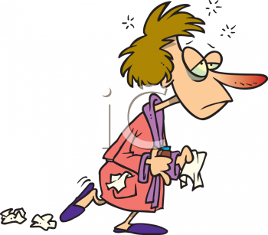

Slide 24
What causes a sore throat?
Viruses.
Bacteria.
Smoking.
Tonsillitis.
Gastroesophageal reflux.
Postnasal drip secondary to rhinitis.
Persistent cough.
Thyroiditis.
Foreign body.

Slide 25
Pharyngitis
Pharyngitis is one of the most common conditions encountered by the family physician.
Viral :
Viral pharyngitis, the most common cause of sore throat, has a wide differential.
Coryza.
Conjunctivitis.
Malaise or fatigue.
Hoarseness.
Low-grade fever suggest the presence of viral pharyngitis.
Children with viral pharyngitis also can present with atypical symptoms, such as
Mouth-breathing.
Vomiting.
Abdominal pain.
Diarrhea.

Slide 26
Bacterial :
Patients with bacterial pharyngitis generally do not have rhinorrhea, cough, or conjunctivitis.
The incidence of bacterial pharyngitis is increased in temperate climates during winter and early spring.
There is often a history of streptococcal throat infection (strep throat) within the past year.
Group A beta-hemolytic streptococcus (GABHS) is the most common bacterial cause of pharyngitis.
GABHS pharyngitis accounts for 15 to 30 percent of cases in children and 5 to 15 percent of cases in adults.

Slide 27
Identifying the cause of pharyngitis, especially GABHS, is important to prevent potential life-threatening complications.
Gabhs infection:
Symptoms of strep throat may include
Pharyngeal erythema.
Tonsillar exudate.
Edematous uvula.
Palatine petechiae.
Anterior cervical lymphadenopathy .
Gabhs pharyngitis is self-limited and resolves within a few days, even without treatmentm but effective antibiotic therapy shortens the infectious period to 24 hours, reduces the duration of symptoms by about one day, and prevents most complications.

Slide 28
Complications of GABHS Pharyngitis
Suppurative | Nonsuppurative
Bacteremia | Poststreptococcal glomerulonephritis
Cervical lymphadenitis
Endocarditis | Rheumatic fever
Mastoiditis
Meningitis
Otitis media
Peritonsillar/retropharyngeal abscess
Pneumonia

Slide 29
Other Bacterial Causes
Gonococcal pharyngitis occurs in sexually active patients.
Chlamydia pneumoniae and mycoplasma pneumoniae.

Slide 30
Diagnosis
GENERAL APPROACH:
When a patient presents with sore throat, the family physician must consider a wide range of illnesses. Infectious causes range from generally benign viruses to GABHS. Inflammatory presentations may be the result of allergy, reflux disease or, rarely, neoplasm.
Important historical elements include the
Onset.
Duration.
Progression.
Severity of the associated symptoms (e.g., fever, cough, respiratory difficulty, swollen lymph nodes).
Exposure to infections.
Presence of comorbid conditions (e.g., diabetes).
The pharynx should be examined for erythema, hypertrophy, foreign body, exudates, masses, petechiae, and adenopathy. It also is important to assess the patient for fever, rash, cervical adenopathy, and coryza.

Slide 31
Selected Laboratory Tests for Identifying the Cause of Pharyngitis
Name of test | Type of test | Sensitivity and specificity
Throat culture | Specimen obtained by throat swab of posterior tonsillopharyngeal area and inoculated onto 5 percent sheep-blood agar plate to which a bacitracin disk is applied; results in 24 to 48 hours | Sensitivity: 97 percent; specificity: 99 percent; results dependent on the technique, medium, and incubation
Rapid antigen detection test or rapid streptococcal antigen test | Detects presence of group A streptococcal carbohydrate on a throat swab (change in color indicates a positive result); results available within minutes; in-office test | Specificity: > 95 percent; sensitivity: 80 to 97 percent, depending on the test
Monospot test | Rapid slide agglutination test for mononucleosis | Overall sensitivity: 86 percent; overall specificity: 99 percent First week sensitivity: 69 percent; specificity: 88 percent Second week: sensitivity: 81 percent; specificity: 88 percent

Slide 32
While most patients with sore throat have an infectious cause (pharyngitis), fewer than 20 percent have a clear indication for antibiotic therapy (i.e., group A beta-hemolytic streptococcal infection).

Slide 33
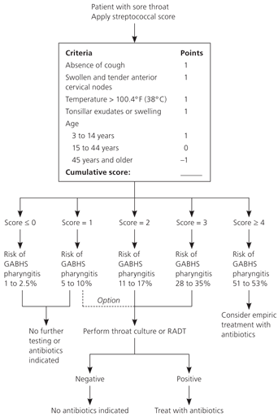
Clinical Decision Rule for Management of Sore Throat

Slide 34
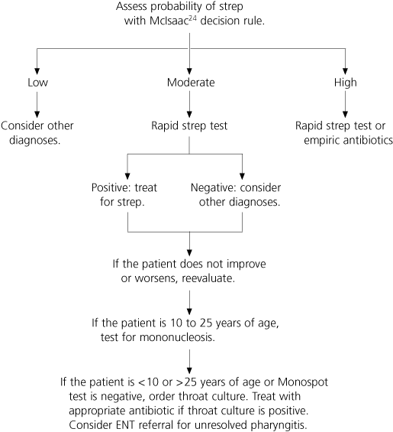
Suggested Approach to the Evaluation of Patients with Sore Throat

Slide 35
ANTIBIOTIC SELECTION
Effectiveness, spectrum of activity, safety, dosing schedule, cost, and compliance issues all require consideration. Penicillin, penicillin congeners (ampicillin or amoxicillin), clindamycin (Cleocin), and certain cephalosporins and macrolides are effective against GABHS.
First line treatment is penicillin.
Oral amoxicillin suspension is often substituted for penicillin because it tastes better.

Slide 36
Treatment for patients with penicillin allergy (recommended by current guidelines)
Erythromycin ethylsuccinate | Macrolide | Oral | Children: 30 to 50 mg per kg per day in two to four divided doses | 10 days | $4
 |  |  | Adults: 50 mg per kg per day in three to four divided doses
Erythromycin estolate | Macrolide | Oral | Children: 20 to 40 mg per kg per day in two to four divided doses | 10 days | $4
 |  |  | Adults: not recommended‡
Cefadroxil (Duricef; brand no longer available in the United States) | Cephalosporin (first generation) | Oral | Children: 30 mg per kg per day in two divided doses | 10 days | $45
 |  |  | Adults: 1 g one to two times per day
Cephalexin (Keflex) | Cephalosporin (first generation) | Oral | Children: 25 to 50 mg per kg per day in two to four divided doses | 10 days | $4
 |  |  | Adults: 500 mg two times per day

Slide 37
Case 1
A 25 year old man comes to your office with the complaint of a bad sore throat for 2 days. He has felt chills and fever today but has not measured his temperature. He has some pain on swallowing. He has a slight runny nose and denies cough and other symptoms. He was previously healthy.
T= 38.5
PE: ears - TM's normal
nose – clear
neck - no cervical adenopathy
lungs – clear

Slide 38
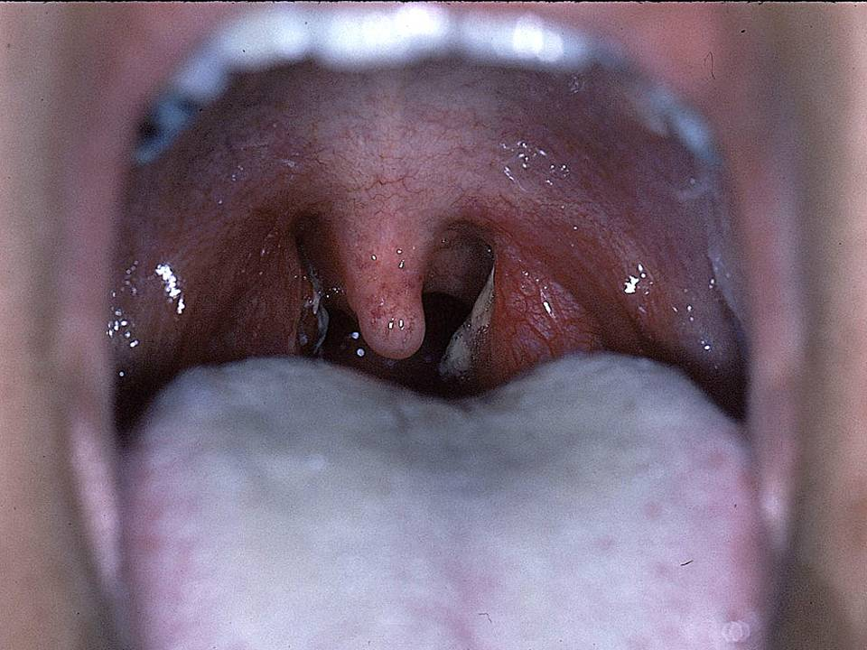
Case 1
Notes:
Another strep throat

Slide 39
How many points does our patient have?
Fever over 38 C Absence of cough Tender ant. cervical adenopathy Tonsillar swelling or exudate Age< 15 y Age> 45 Total = 3 Pretest probability= 35% | 1 1 0 1 0 0

Slide 41
OTITIS MEDIA

Slide 42
Otitis media is an infection of the middle ear common in young children.
Most cases occur in infants aged 6-18 months, though anyone can get an ear infection.
For reasons that are unclear they are more common in boys than girls.

Slide 43
Symptoms of otitis media
In most cases the symptoms of otitis media develop quickly and resolve in a few days – often referred to as acute otitis media.
Main symptoms of acute otitis media include:
Otalgia
Pyrexia
Lack of energy
Slight deafness

Slide 44
Symptoms of otitis media
Other signs to look for in younger children include:
Pulling, tugging or rubbing their ear
Irritability
Poor feeding
Restlessness at night
Coughing
Rhinorrhea
Diarrhea
Loss of balance

Slide 45
When to seek medical advice
If the symptoms show no sign of improvement after 24 hours.
They seem to be in a lot of pain.
A discharge of pus or fluid from their ear.
Sometimes, in some cases, the tympanic membrane will become perforated and pus may run out of the ear. This can help to relieve the pain by releasing the pressure on the tympanic membrane, but it may also lead to re-infection.

Slide 46
Chronic Otitis Media
Ear infections that last for more than 3 months are known as Chronic Suppurative Otitis Media (CSOM). This condition is less common, affecting around 1 in 100 children and 1 in 50 adults.
CSOM involves a perforation of the tympanic membrane and active bacterial infection within the middle ear space for several weeks or more.
The most common symptom of CSOM is a persistent and usually painless drainage from the affected ear.
Some degree of hearing loss in the affected ear is also common.

Slide 47
Causes of otitis media
Most cases of otitis media are caused when a bacterial or viral infection, such as a cold, spreads into the Eustachian tube.
The Eustachian tube is a thin tube that runs from the middle ear to the back of the nose.
It has two main functions:
to ventilate the middle ear, helping to maintain normal air pressure.
to help drain away mucus and other debris from the ear.

Slide 48
Causes of otitis media
Enlarged tonsils or adenoids (nasopharyngeal tonsils, above the tonsils) may block the Eustachian tube. Adenoids and tonsils can be removed if they cause a persistent or frequently reoccurring ear infection, this is more common in children than in adults.
A child's Eustachian tube is smaller than an adult's, which makes it more likely to become blocked. A child’s adenoids are much larger than an adult’s in relative terms.
Other things that can increase the risk of developing an ear infection include:
Attending a nursery or day care center – this increases a child’s likely exposure to infection from other children
Being exposed to tobacco smoke (passive smoking)
Not being breastfed (The 2007 review for AHRQ* found that breastfeeding reduced the risk of acute otitis media, non-specific gastroenteritis, and severe lower respiratory tract infections.
*Agency for Healthcare Research and Quality (AHRQ)

Slide 49
Diagnosing middle ear infection
An ear infection (otitis media) can usually be diagnosed using a tool known as a pneumatic otoscope.
A pneumatic otoscope is a small, hand-held device that has a magnifying glass and a light source at the end. It is used to study the inside of the ear.
An otoscope can detect certain signs that would indicate fluid in the middle ear, which in turn may indicate an infection.

Slide 50
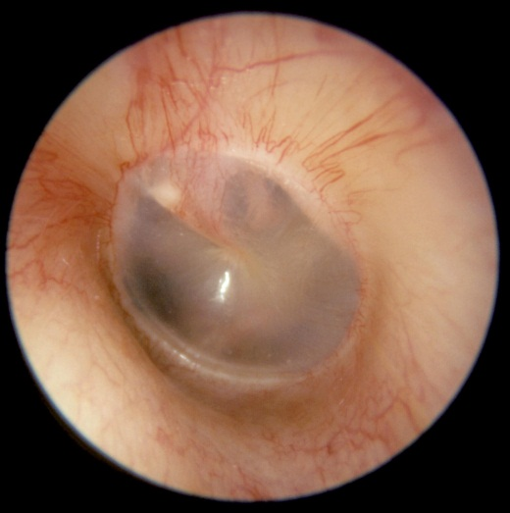
Diagnosing middle ear infection
These include the ear drum:
bulging
Being an unusual color
Having a cloudy appearance, and bubbles and fluid inside the ear
The Otoscope can also be used to blow a small puff of air into the ear. If the Eustachian tube is clear, the Tympanic membrane will move slightly. If it is blocked, the Tympanic membrane will remain still.
The examination will also show whether the Tympanic membrane is perforated.

Slide 51
Diagnosing middle ear infection
Other tests are usually only required if treatment is not working or complications develop.
These tests are:
Tympanometry
Tympanocentesis
CT scans

Slide 52
Treating middle ear infection
Most cases of otitis media “80%” will resolve within 72 hours without the need for treatment.
You can relieve the symptoms of earache and fever using over-the-counter painkillers such as Ibuprofen and Paracetamol.
Aspirin should not be given to children under 16 years of age.
Placing a warm flannel or washcloth over the affected ear may also help relieve the pain.

Slide 53
Treating middle ear infection
Antibiotics are usually only recommended if:
Your child has a serious health condition that makes them more vulnerable to infection such as cystic fibrosis or congenital heart disease
Your child is under the age of three months
Your child’s symptoms show no signs of improvement after four days

Slide 54
Treating middle ear infection
Antibiotics:
Symptoms resolve 24 hours earlier with antibiotics but they have side-effects and may increase community antibiotic resistance.
Many GPs are now using a delayed approach prescribing antibiotics only if the symptoms did not resolve after 3 days.
Perforated ear drum:
Most GPs prescribe antibiotics (e.g. amoxicillin 250 - 500mg for 5-7d.) at presentation if a perforation is present.
Refer: If recurrent attacks or if acute perforation does not heal in less than a month.

Slide 55
If antibiotics are needed then a five days course of amoxicillin is sufficient for uncomplicated ear infections in children:
under 2 years, 125mg three times daily
2-10 years, 250 mg three times daily
over 10 years, 500 mg three times daily
If your child is allergic to amoxicillin, alternative antibiotics such as erythromycin can be used.

Slide 56
Common side effects of amoxicillin include:
Skin rash
Feeling sick
Diarrhea
Adults who develop a long-term middle ear infection (chronic suppurative otitis media) may benefit from antibiotic ear drops.

Slide 57
Additional treatment
Myringotomy
Grommets

Slide 58
Complications of otitis media are now less common than they were in the past.
Very young children may have an increased risk of developing complications as their immune systems are still developing.
Some of the most commonly reported complications are:
Mastoiditis
Cholesteatoma: destructive and expanding growth consisting of keratinizing squamous epithelium in the middle ear and/or mastoid process.
Labyrinthitis
Facial paralysis
Meningitis
Brain abscess

Slide 59
References
Oxford Handbook of General Practitioner, 3rd edition.
American Academy of Family Physicians (http://www.aafp.org/afp/2009/0215/p320.html)
Acute sinusitis article written by Dr. Itzhak Brook (http://emedicine.medscape.com/article/232670-overview)
The National Health Service in England

