Slide 1
Ocular Emergencies
King Saud University
College of Medicine
Abdulrahman Al-Muammar, MD, FRCSC

Slide 2
Ocular Emergencies
Corneal abrasion.
Corneal ulcer.
Chemical injury.
Uveitis.
Acute angle closure glaucoma.
Orbital cellulitis.
Endophthalmitis.
Retinal detachment.
Orbital/Ocular trauma:
Corneal and conjunctival foreign bodies.
Hyphema.
Ruptured globe.
Orbital wall fracture.
Lid Laceration.

Slide 3
Corneal Abrasion

Slide 4
Corneal Abrasions
History of scratching the eye.
Symptoms:
Foreign body sensation.
Pain.
Tearing.
Photophobia.

Slide 5
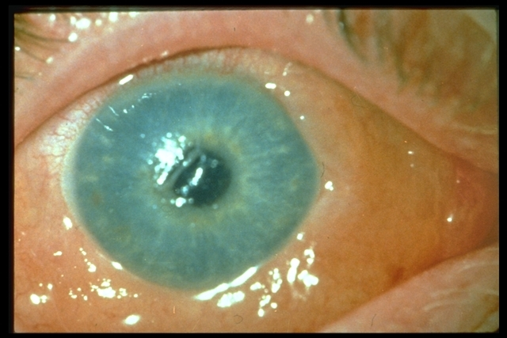
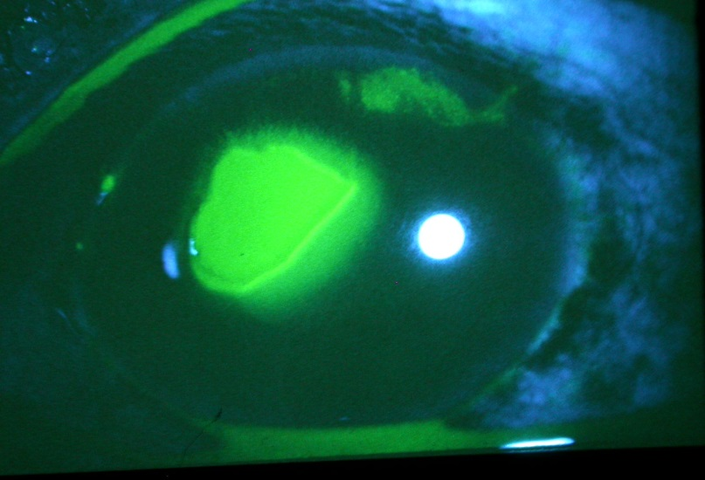

Slide 6
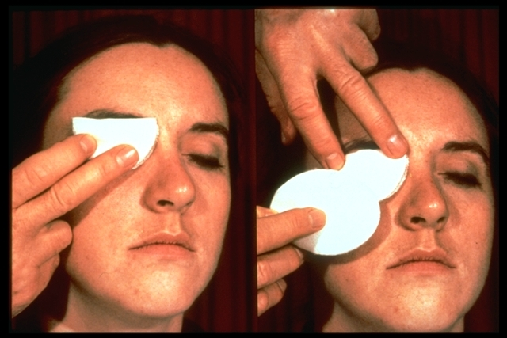
Corneal Abrasions
Treatment:
Topical antibiotic.
Pressure patch over the eye.
Refer to ophthalmologist.

Slide 7
Corneal Ulcer
Corneal ulcer occur secondary to lid and conjunctival inflammation but is often due to trauma or contact lens wear.
Bacterial, viral, fungal or parasitic.

Slide 8
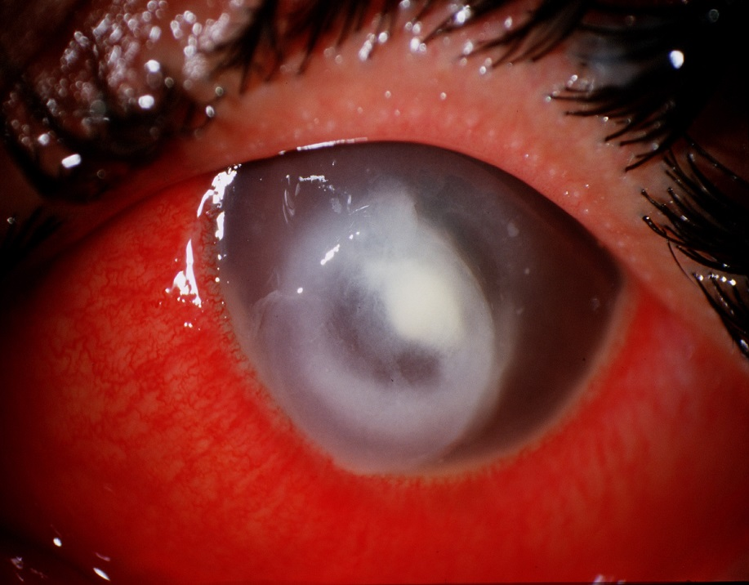
Corneal Ulcer
Ocular pain, redness and discharge with decrease vision and white lesion on the cornea.

Slide 9
Corneal Ulcer
Prompt diagnosis of the etiology by doing corneal scraping.
Treatment with appropriate antimicrobial therapy are essential to minimize visual loss.

Slide 10
Contact lens wearer
Any redness occurring for patients who wear contact lens should be managed with extreme caution.
Remove lens.
Rule out corneal infection.
Antibiotics for gram negative organisms
Do not patch.
Follow up with ophthalmologist in 24 hours.

Slide 11
Chemical Injuries
A vision-threatening emergency.
The offending chemical may be in the form of a solid, liquid, powder, mist, or vapor.
Can occur in the home, most commonly from detergents, disinfectants, solvents, cosmetics, drain cleaners…..

Slide 12
Chemical Injuries
Can range in severity from mild irritation to complete destruction of the ocular surface.
Management:
Instill topical anesthetic.
Check for and remove foreign bodies.

Slide 13
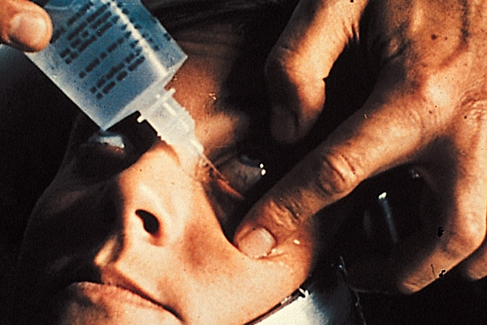
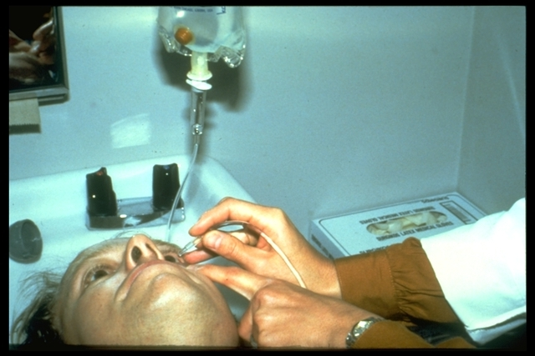
Chemical Injuries
Immediate irrigation essential, preferably with saline or Ringer’s lactate solution, for at least 30 minutes.

Slide 14
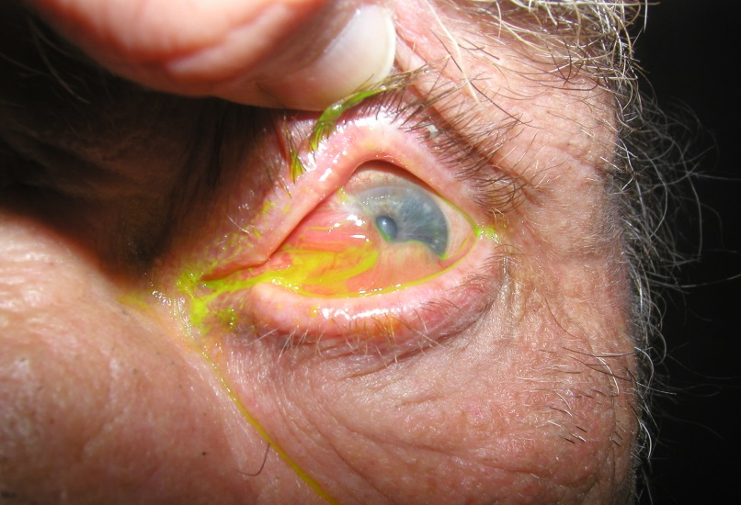
Chemicals Injuries
Irrigation should be continued until neutral pH is reached (i.e.,7.0).
Instill topical antibiotic.
Frequent lubrications.
Oral pain medication.
Refer promptly to
ophthalmologist.

Slide 15
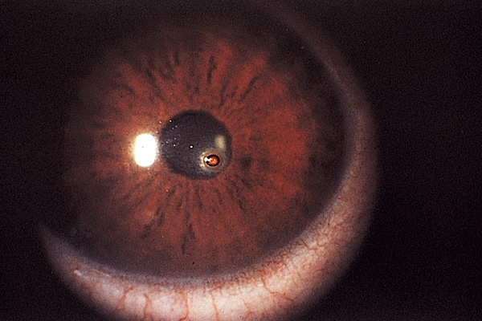
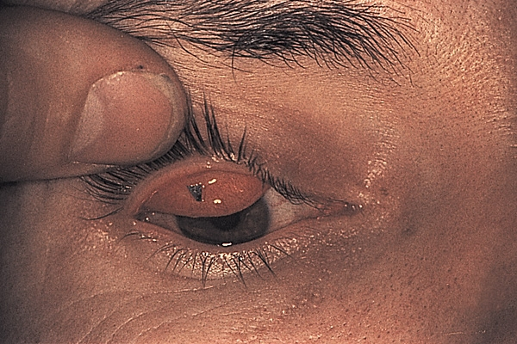
Corneal and Conjunctival Foreign Bodies
History of trauma.
Foreign body sensation-Tearing.

Slide 16
Corneal and Conjunctival Foreign Bodies
Management:
Instill topical anesthetic.
Removal of the foreign body.
Topical antibiotic.
Treat corneal abrasion.

Slide 17
Uveitis
Inflammation of the uveal tissue (iris, ciliary body, or choroid), retina, blood vessels, optic disc, and vitreous can be involved.
Etiology:
Idiopathic.
Inflammatory diseases:
HLA B27, Ankylosing spondylitis, IBD, Reiter’s syndrome, Psoriatic arthritis.
Sarcoidosis, Behcet’s, Vogt-Koyanagi-Harada Syndrome.
Infectious:
Toxoplasmosis.
Tuberculosis.
Syphilis.

Slide 18
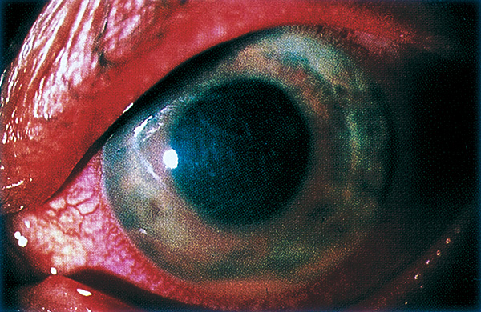
Uveitis

Slide 19
Uveitis

Slide 20
Uveitis
Management:
Identify possible cause.
Topical steroid.
Topical cycloplegic.
Systemic immunosuppressive medication:
Steroid.
Cyclosporine.
Methotrexate.
Azathioprine.
Cyclophosphamide.
Immunomodulating agents:
Infliximab.

Slide 21
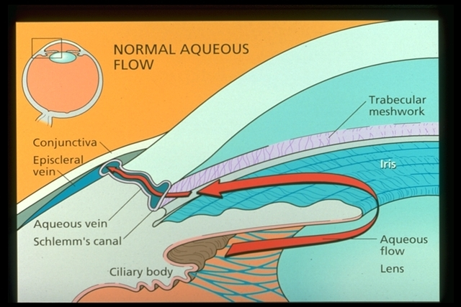
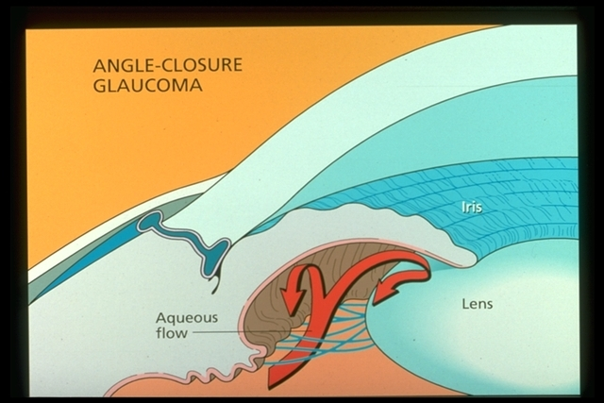
Acute Angle Closure Glaucoma
Result from peripheral iris blocking the outflow of fluid.

Slide 22
Acute Angle Closure Glaucoma
Present with pain, redness, mid-dilated pupil with decrease vision and coloured haloes around lights.
Severe headache or nausea and vomiting.
Intraocular pressure is elevated.
Can cause severe visual loss due to optic nerve damage.
Medical Tx and peripheral laser iridotomy will be curative in most cases.

Slide 23
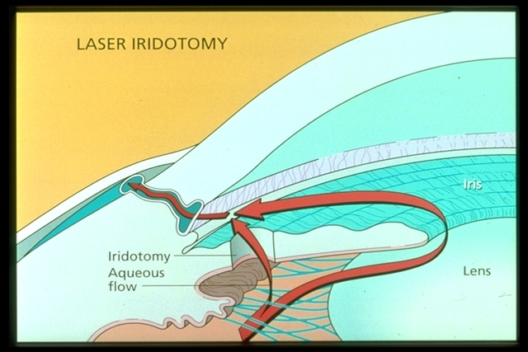
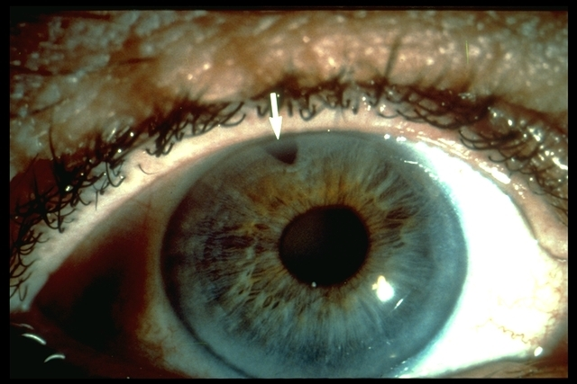
Acute Angle Closure Glaucoma
Medical Tx and peripheral laser iridotomy will be curative in most cases.

Slide 24
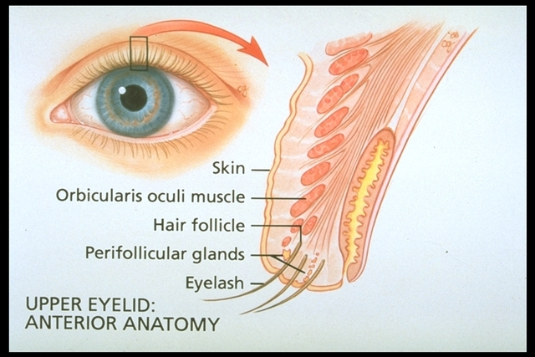
Preseptal Cellulitis

Slide 25
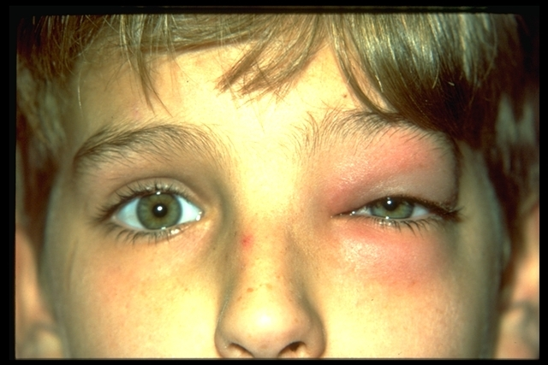
Preseptal Cellulitis
Lid swelling and erythema.
Visual acuity, motility, pupils, and globe are normal.

Slide 26
Preseptal Cellulitis
Etiology:
Puncture wound.
Laceration.
Retained foreign body from trauma.
Vascular extension, or extension from sinuses or another infectious site (e.g.,dacryocystitis, chalazion)
Organisms:
Staph aureus – Streptococci- H.influenzae

Slide 27
Preseptal Cellulitis
Management:
Warm compresses.
Systemic antibiotics.
CT sinuses and orbit if not better or +ve history of trauma.

Slide 28
Orbital Cellulitis
Pain.
Decreased vision.
Impaired ocular motility/double vision.
Afferent pupillary defect.
Conjunctival chemosis and injection.
Proptosis.
Optic nerve swelling.

Slide 30
Orbital Cellulitis
Management:
Admission.
Intravenous antibiotics.
Nasopharynx and blood cultures.
Surgery maybe necessary.

Slide 31
Orbital Cellulitis

Slide 32
Endophthalmitis
Potentially devastating complication of any intraocular surgery.
Any patient in the early postoperative period (within 6 weeks of surgery) c/o pain or decrease vision should be evaluated immediately.

Slide 33
Endophthalmitis

Slide 34
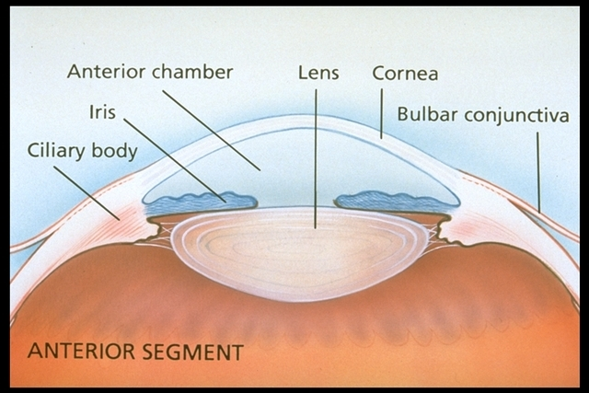
Endophthalmitis
Management:
Vitreous sample for culture.
Intravitreal antibiotics injection plus topical antibiotics.

Slide 35
Retinal Detachment
Symptoms:
Flashes, floaters, a curtain or shadow moving over the field of vision.
Peripheral and/ or central visual loss.

Slide 36
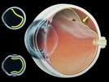
Retinal Detachment

Slide 37
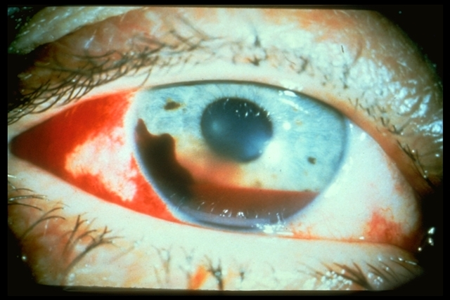
Hyphema
Can occur with blunt or penetrating injury.
Blood in the anterior chamber.

Slide 38
Hyphema
Can lead to high intraocular pressure.
Detailed history (Sickle cell).
Management:
Bed rest.
Topical steroid.
Topical cycloplegic.
Antifibrinolysis agents (Tranexamic acid).
Surgical evacuation.

Slide 39
Ruptured Globe
Suspect a ruptured globe if:
Severe blunt trauma.
Sharp object.

Slide 40
Ruptured globe
Suspect a ruptured globe if:
Bullous subconjunctival hemorrhage.
Uveal prolapse (Iris or ciliary body).
Irregular pupil.
Hyphema.
Vitreous hemorrhage.
Lens opacity.
Lowered intraocular pressure.

Slide 41
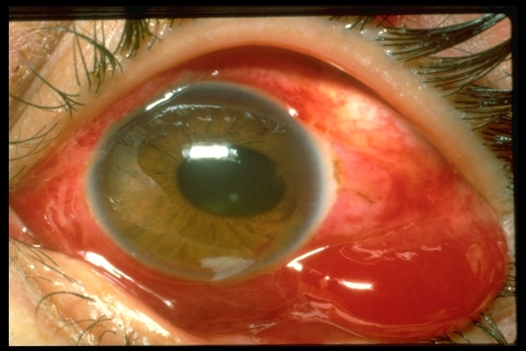
Ruptured Globe
Bullous subconjunctival hemorrhage.

Slide 42
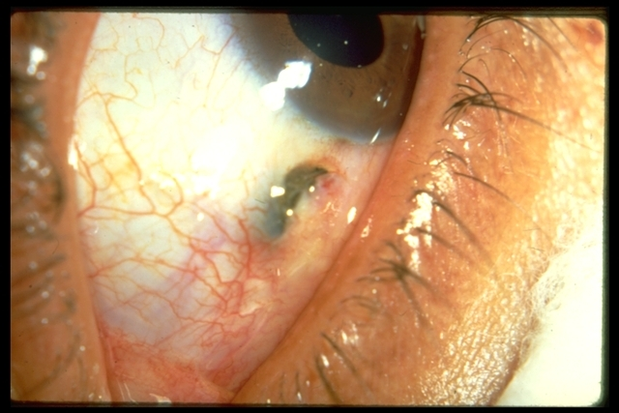
Ruptured Globe
Uveal prolapse (Iris or ciliary body).

Slide 43
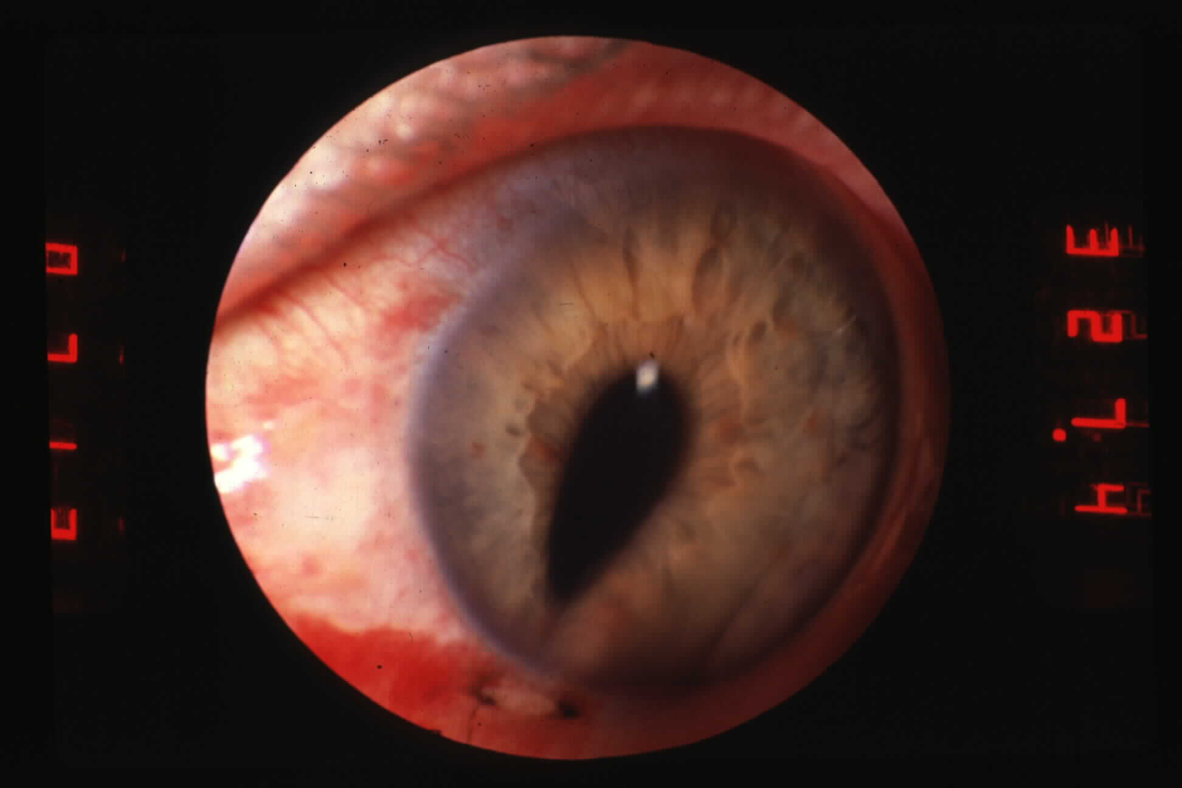
Ruptured Globe
Irregular pupil.

Slide 44
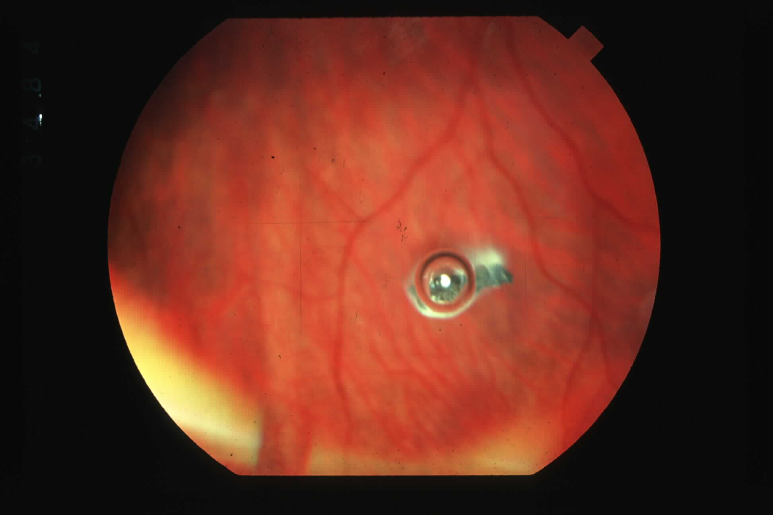
Ruptured Globe
Intraocular foreign body.

Slide 45
If globe ruptured or laceration is suspected
Stop examination.
Shield the eye.
Give tetanus prophylaxis.
Refer immediately to ophthalmologist.

Slide 46
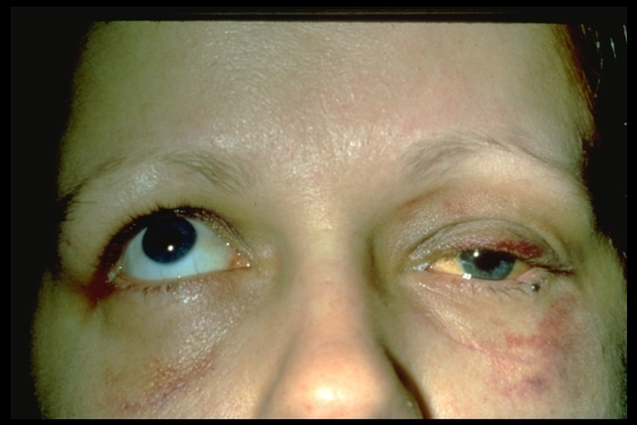
Orbital Fractures
Assess ocular motility.
Assess sensation over cheek and lip.
Palpate for bony abnormality.

Slide 47
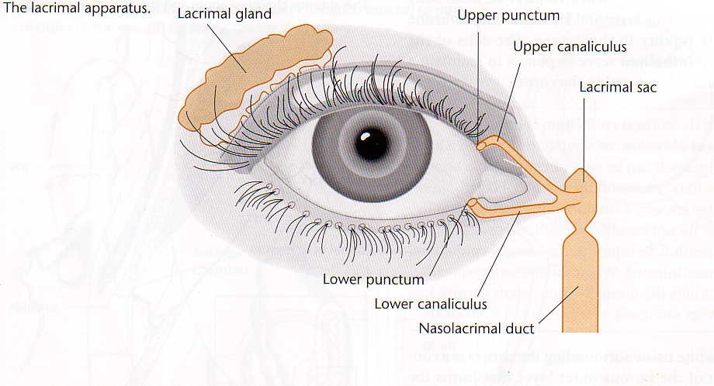
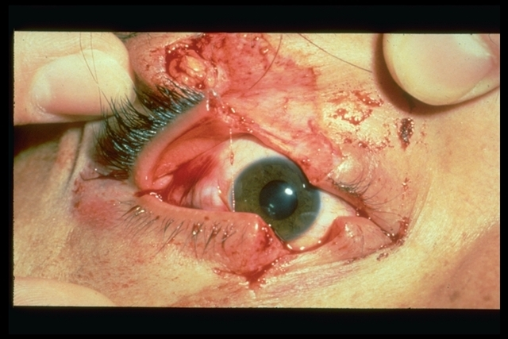
Lid Laceration
Can result from sharp or blunt trauma.
Rule out associated ocular injury.

Slide 48
Thank You

