Slide 1
King Saud University
College of Medicine
RED EYE
Abdulrahman Al-Muammar, MD, FRCSC

Slide 2
Introduction
Relevance.
Red Eye.
Frequent presentation to GP.
Must be able to differentiate between serious vision threatening conditions and simple benign conditions.

Slide 3
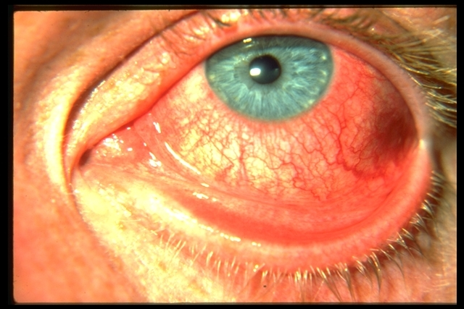
Basics
Red Eye
Refers to hyperemia of the superficially visible vessels of the conjunctiva, episclera, or the sclera.
Caused by disorders of these structures themselves, or of adjacent structures like the eyelids, cornea, iris, and ciliary body.

Slide 4
Differential diagnosis of red eye
Conjunctival:
Blepharoconjunctivitis.
Bacterial conjunctivitis.
Viral conjunctivitis.
Chlamydial conjunctivitis.
Allergic conjunctivitis.
Toxic/chemical reaction.
Dry eye.
Pinguecula/pteyrgium.
Lid diseases:
Clalazion.
Sty.
Abnormal lid function.
Corneal disease:
Abrasion.
Ulcer.
Foreign body:
Dacryoadenitis.
Dacryocystitis.
Masquerade syndrome.
Carotid and dural fistula.
Acute angle glaucoma.
Anterior uveitis.
Episcleritis/scleritis.
Subconjunctival hemorrhage.
Factitious.

Slide 5
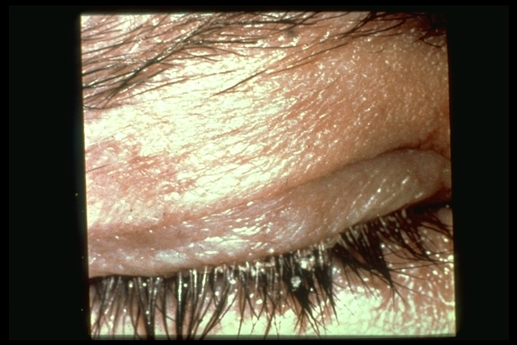
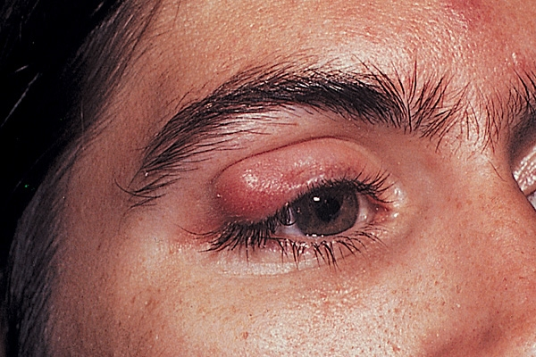
-

Slide 6
Blepharitis
Adults > children.
Inflammation of the lid margin.
Frequently associated with styes.
Meibomian gland dysfunction.
Lid hygiene, topical antibiotics, and lubricants are the mainstays of treatment.

Slide 7
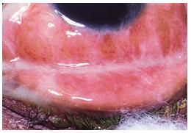
-

Slide 8
Bacterial Conjunctivitis
Both adults and children.
Tearing, foreign body sensation, burning, stinging and photophobia.
Mucopurulent or purulent discharge.
Lid and conjunctiva maybe edematous.
Streptococcus pneumoniae, Haemophilus influenzae, and staphylococcus aureus and epidermidis.
Conjunctival swab for culture.
Topical broad spectrum antibiotics.

Slide 9
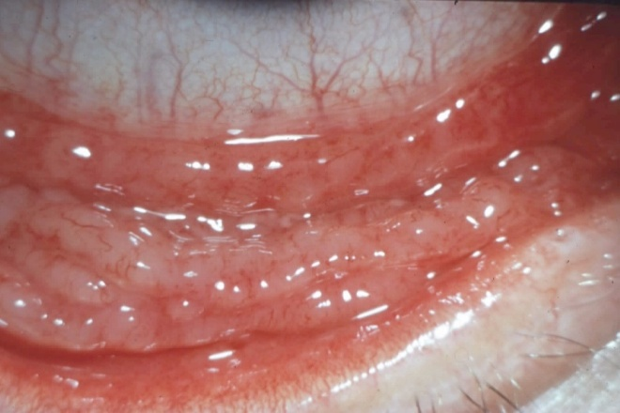
Viral Conjunctivitis
Acute, watery red eye with soreness, foreign body sensation and photophobia.
Conjunctiva is often intensely hyperaemic and there maybe follicles, haemorrhages, inflammatory membranes and a pre-auricular node.
The most common cause is an adenoviral infection.
No specific therapy but cold compresses are helpful.

Slide 10
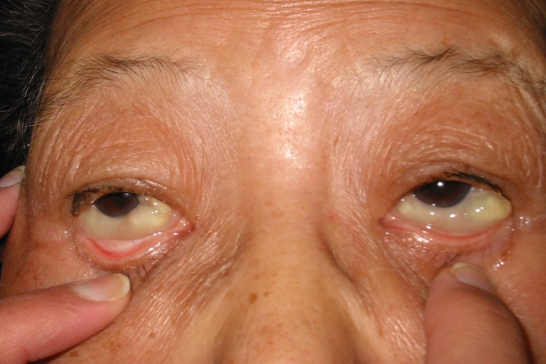
-

Slide 11
Allergic Conjunctivitis
Encompasses a spectrum of clinical condition.
All associated with the hallmark symptom of itching.
There is often a history of rhinitis, asthma and family history of atopy.
Signs may include mildly red eyes, watery discharge, chemosis, papillary hypertrophy and giant papillae.
Treatment consist of cold compresses, antihistamines, nonsteroidals, mast cells stabilizers, topical corticosteroids and cyclosporine.

Slide 12
Chlamydial Conjunctivitis
Usually occur in sexually active individuals with or without an associated genital infection.
Conjunctivitis usually unilateral with tearing, foreign body sensation, lid crusting, conjunctival discharge and follicles.
There is often non-tender preauricular node.
Treatments requires oral tetracycline or azithromycin.

Slide 13
Dry Eye
Symptoms:
Burning or foreign body sensation.
Tearing.
Usually bilateral.
Etiology:
Idiopathic.
Collagen vascular diseases.
Conjunctival scarring.
Infiltration of the lacrimal gland.
Vitamin A deficiency.
Treatment:
Artificial tears.

Slide 14
Pterygium

Slide 15
Ectropion

Slide 16
Trichiasis

Slide 17
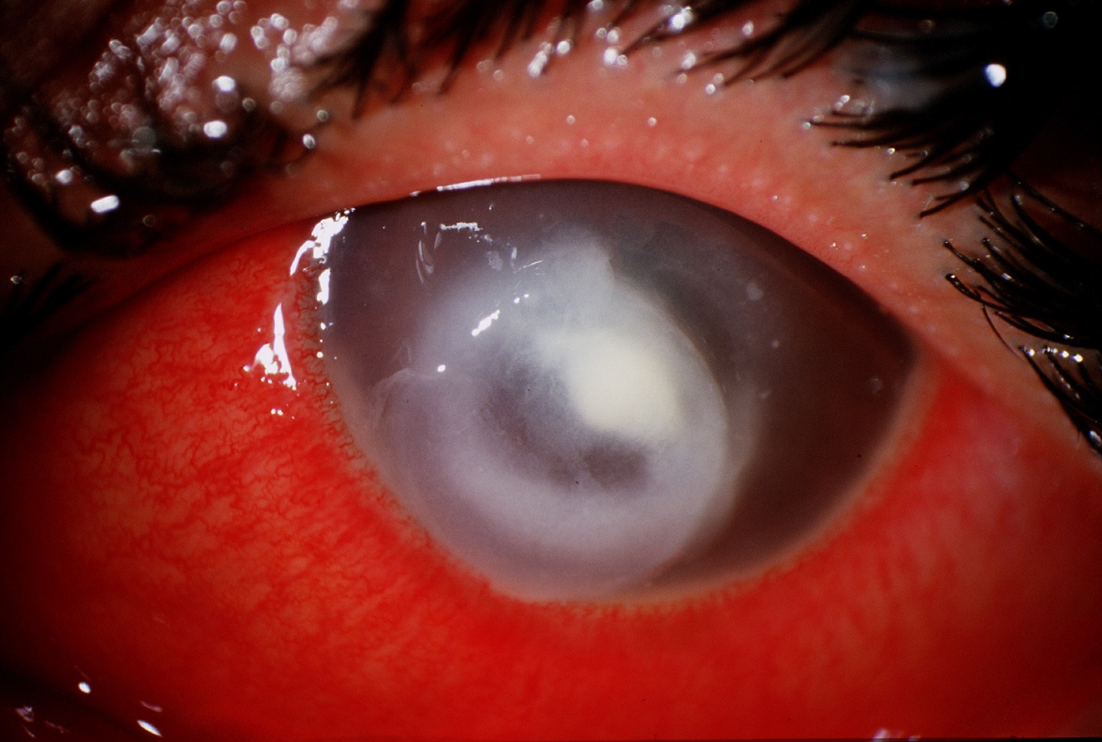
Infectious keratitis

Slide 18
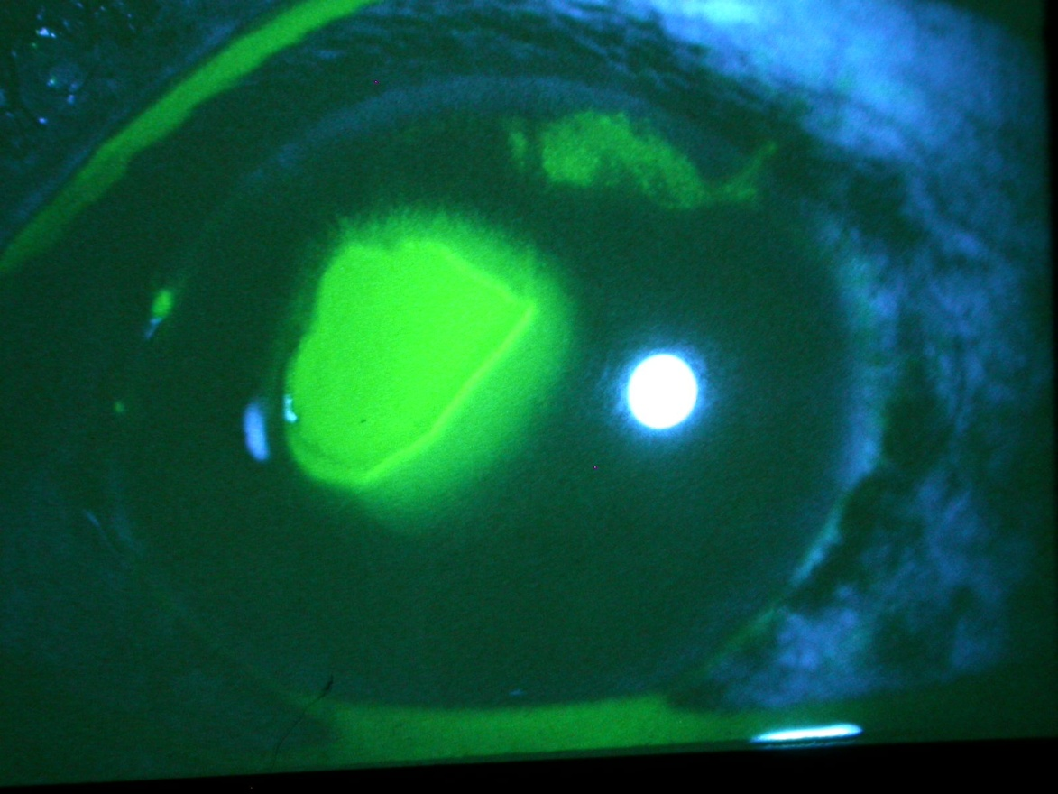
Corneal abrasion

Slide 19
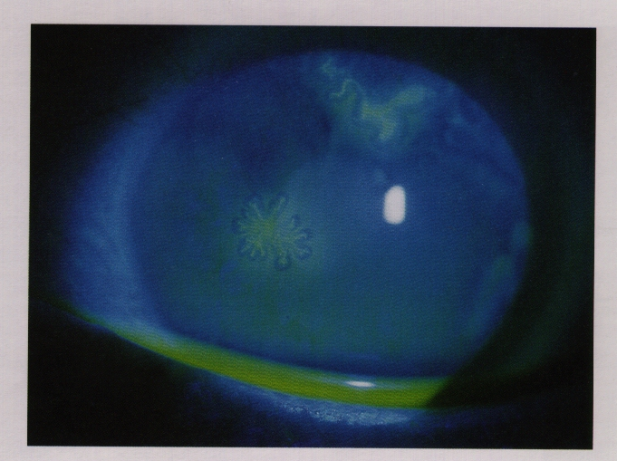
HSV dendrites

Slide 20
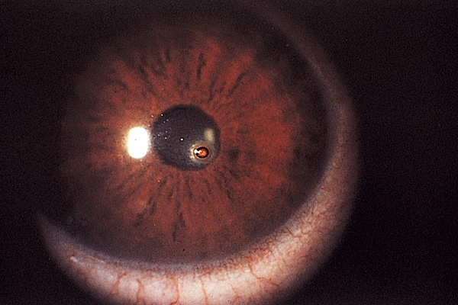
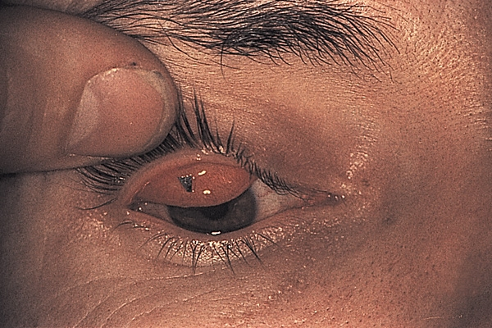
Foreign Body

Slide 21
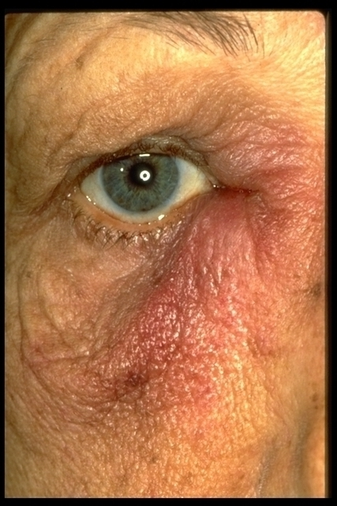
Nasolacrimal Obstruction
Can lead to Dacryocystitis:
Pain, redness, and swelling over the innermost aspect of the lower eyelid, tearing, discharge.
Organisms.
Staphylococci, streptococci, and diphtheoids.
Treatment:
Systemic antibiotics.
Surgical drainage.

Slide 22
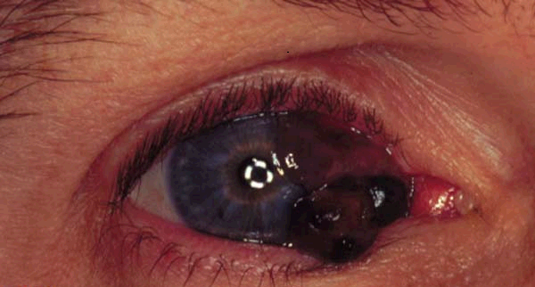
Conjunctival tumor

Slide 23
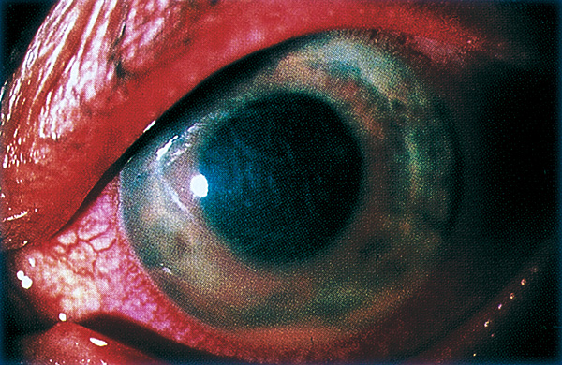
Iritis

Slide 24
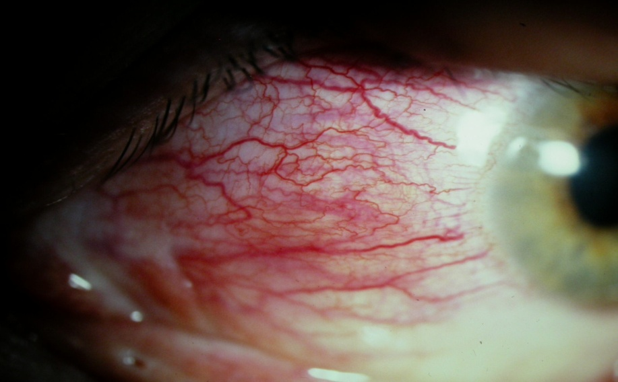
Episcleritis
Episcleritis:
Can be localized (sectorial) or diffuse redness.
Often asymptomatic.
Usually self limited.
Treatment is topical or systemic NSAIDs.

Slide 25
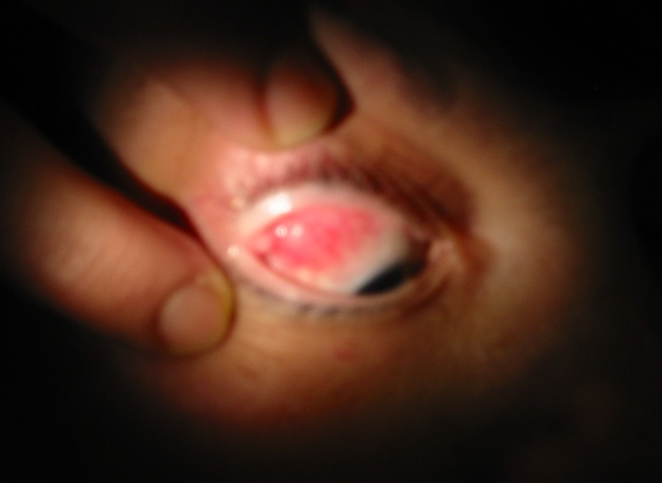
Scleritis
Pain which maybe severe with tenderness, tearing and photophobia.
Maybe localized, diffuse or associated with nodules.
Can result in scleral necrosis (scleromalacia perforance).
30 to 60 % may have an associated systemic diseases
RA ………
May need systemic steroid.

Slide 26
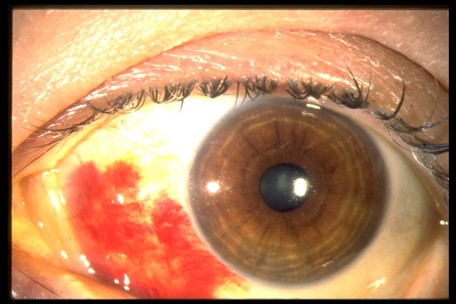
Subconjunctival Hemorrhage
Usually asymptomatic.
Blood underneath the conjunctiva, often in a sector of the eye.
Etiology:
Valsalva (coughing or straining).
Traumatic.
Hypertension.
Bleeding disorder.
Idiopathic.

Slide 27
Red Eye Treatment Algorithm
History:
Trauma.
Contact lens wearer.
Severe pain/photophobia.
Significant vision changes.
History of prior ocular diseases.
Exam:
Abnormal pupil.
Ocular tenderness.
White corneal opacity.
Increased intraocular pressure.
YES
Refer urgently to
ophthalmologist

Slide 28
Is it conjunctivitis?
History
Itching.
Exposure to person with red eye.
URTI.
Past history of conjunctivitis.
Discharge with morning crusting.
Exposure to drugs.
Signs
Discharge.
Lid and conjunctival edema
Conjunctival redness.
Preauricular lymph node.
Facial or eye lid vesicles.

Slide 29
-
Thank You

