Slide 1
PERIOPERATIVE FLUID THERAPY
Dr. Sayeed Nawaz
Consultant anesthesit
Department of Anesthesiology
KKUH. King Saud University

Slide 2
Total Body Water (TBW)
Varies with age, gender
55% body weight in males
45% body weight in females
80% body weight in infants
Less in obese: fat contains little water

Slide 3
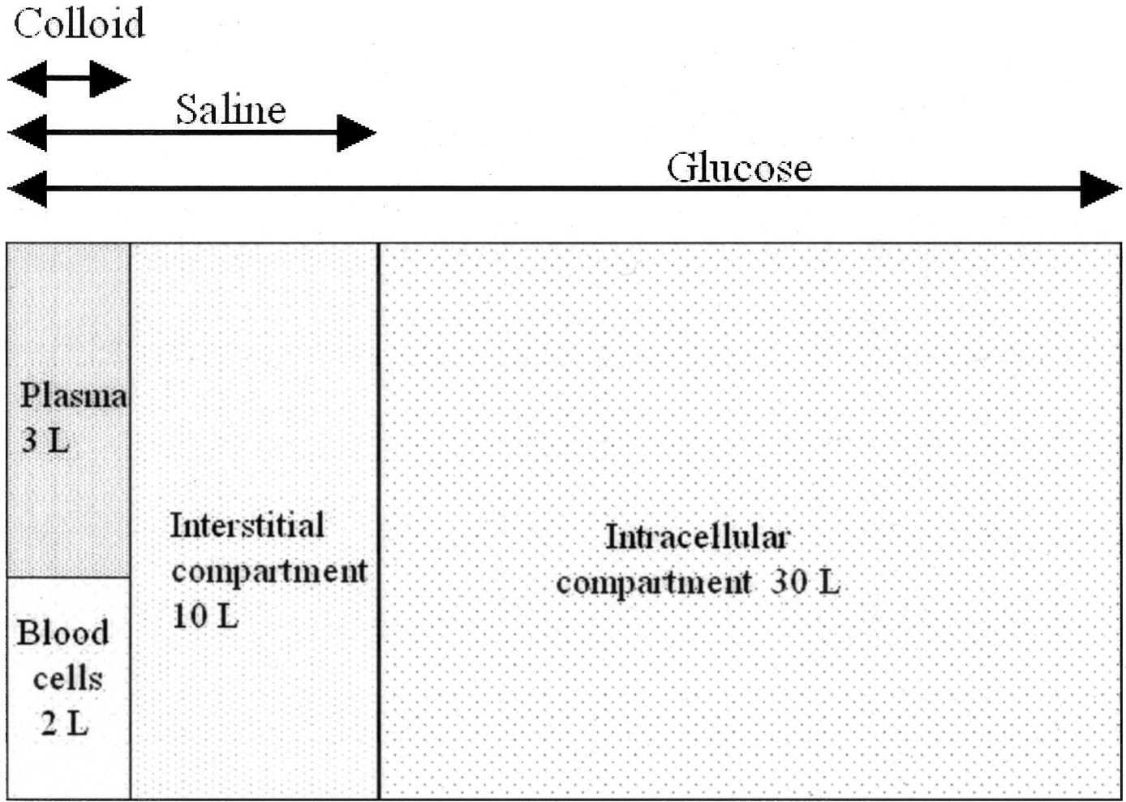

Slide 4
Final Goals of Fluid resuscitation
- Achievement of normovolemia& hemodynamic stability
- Correction of major acid-base disturbances
- Compensation of internal fluid fluxes
- Improvement of microvascular blood flow
- Prevention of cascade system activation
- Normalization of O2 delivery
- Prevention of reperfusion cellular injury
- Achievement of adequate urine output

Slide 5
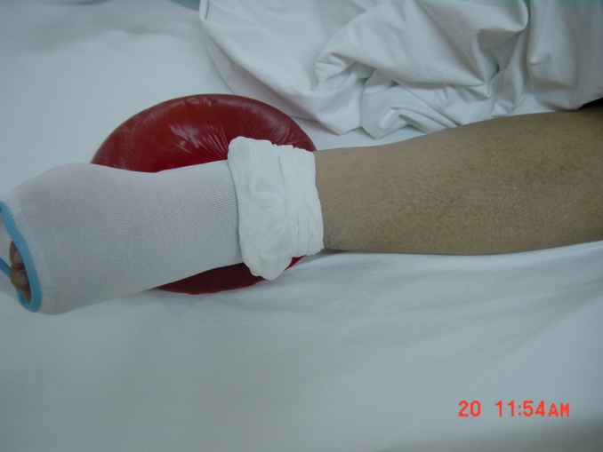
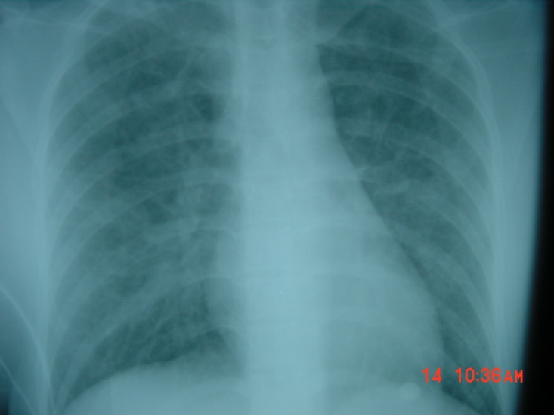
Desirable outcome of fluid resuscitation
- No peripheral edema
- No ARDS

Slide 6
Fluid and Electrolyte Regulation
Volume Regulation
  Antidiuretic Hormone
  Renin/angiotensin/aldosterone system
  Baroreceptors in carotid arteries and aorta
  Stretch receptors in atrium and juxtaglomerular apparatus
  Cortisol

Slide 7
Preoperative Evaluation of Fluid Status
Factors to Assess:
  History of intake and output
  blood pressure: supine and standing
  heart rate
  skin
  Urinary output
  mental status

Slide 8
Orthostatic Hypotension
Systolic blood pressure decrease of greater than 20mmHg from supine to standing
Indicates fluid deficit of 6-8% body weight
  - Heart rate should increase as a compensatory measure
  - If no increase in heart rate, may indicate autonomic dysfunction or antihypertensive drug therapy

Slide 9
Perioperative Fluid Requirements
The following factors must be taken into account:
1- Maintenance fluid requirements
2- NPO deficits
3- Third space and invisible losses
4- Special additional losses: diarrhea, bowel preparation, tracheostomy,
5- Replacement of blood loss

Slide 10
1- Maintenance Fluid Requirements
  Insensible losses such as evaporation of water from respiratory tract, sweat, feces, urinary excretion. Occurs continually.
  Adults: approximately 1.5 ml/kg/hr
  “4-2-1 Rule”
    - 4 ml/kg/hour for the first 10 kg of body weight
    - 2 ml/kg/hour for the second 10 kg body weight
    - 1 ml/kg/hour subsequent kg body weight

Slide 11
2- NPO and other deficits
NPO deficit = number of NPO hours x maintenance fluid requirement
Add about 1 liter, if bowel preparation is done
Measurable fluid losses, e.g. NG suctioning, vomiting, colostomy output, surgical drains.

Slide 12
3- Third Space & invisible Losses
Isotonic transfer of ECF from functional body fluid compartments to non-functional compartments.
Depends on location and duration of surgical procedure, amount of tissue trauma, ambient temperature, room ventilation.

Slide 13
Replacing invisible Losses
Superficial surgical trauma: 1-2 ml/kg/hr
Minimal Surgical Trauma: 3-4 ml/kg/hr
  - head and neck, hernia, knee surgery
Moderate Surgical Trauma: 5-6 ml/kg/hr
  - hysterectomy, chest surgery
Severe surgical trauma: 8-10 ml/kg/hr (or more)
  - AAA repair, nehprectomy

Slide 14
4- Blood Loss
Replace 3 cc of crystalloid solution per cc of blood loss (crystalloid solutions leave the intravascular space)
When using blood products or colloids replace blood loss volume per volume

Slide 15
5- Other additional losses
Ongoing fluid losses from other sites:
  - gastric drainage
  - ostomy output
  - diarrhea
Replace volume per volume with crystalloid solutions

Slide 16
Example
62 y/o male, 80 kg, for hemicolectomy
NPO after 10 PM, surgery at 8 AM,
Received bowel preparation
3 hours long procedure with blood loss of 500 ml
What is his estimated intraoperative fluid requirement?

Slide 17
Fluid requirement of this patient
Fluid deficit (NPO): 1.5 ml/kg/hr x 10 hrs = 1200 ml + 1000 ml for bowel preparation = 2200 ml is total deficit: (Replace 1/2 first hour, 1/4 2nd hour, 1/4 3rd hour).
Maintenance: 1.5 ml/kg/hr x 3hrs = 360mls
invisible Losses: 6 ml/kg/hour x 3 hours =1440 ml
Blood Loss: 500ml x 3 = 1500ml
Total = 2200+360+1440+1500=5500mls

Slide 18
Intravenous Fluids:
Conventional Crystalloids
Colloids
Hypertonic Solutions
Blood/blood products and blood substitutes

Slide 19
Crystalloids
Combination of water and electrolytes
  Balanced salt solution: electrolyte composition and osmolality similar to plasma; example: lactated Ringer
  Hypotonic salt solution: electrolyte composition lower than that of plasma; example: D₅W.
  Hypertonic salt solution: 2.7% NaCl.

Slide 20
Crystalloids in trauma
Advantages:
-Balanced electrolyte solution
-Easy to administer
-No risk of adverse reactions
-No disturbance of hemostasis
-Promote diuresis
-Inexpensive

Slide 21
Crystalloids
Disadvantages:
-Poor plasma volume support
-Large quantities needed
-Risk of Hypothermia
-Reduced plasma oncotic pressure
-Risk of edema

Slide 22
Tonicity of the fluids
Cells can be exposed to three types of solutions in the body
Isotonic : solute concentration is the same out and inside the cell
Hypotonic : more solutes inside the cells than outside
Hypertonic : more solutes outside the cell than inside

Slide 23
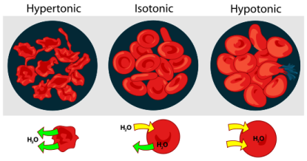
Fluid movement as per tonicity

Slide 24
Hypertonic Solutions
Fluids containing sodium concentrations greater than normal saline.
Available in 1.8%, 2.7%, 3%, 5%, 7.5%, 10% solutions.
Hyperosmolarity creates a gradient that draws water out of cells; therefore, cellular dehydration is a potential problem.

Slide 25
Hypertonic saline
Advantages:
-Small volume for resuscitation.
-Osmotic effect
-Direct vasodilator effect
-Increase MAP, CO
-Increase renal, mesenteric, splanchnic, coronary blood flow.

Slide 26
Hypertonic saline
Disadvantages:
increase hemorrhage from open vessels.
Hypernatremia
Hyperchloremia.
Metabolic acidosis.

Slide 27
Crystalloids
Lactated Ringer's
Composition: Na 130, cl 109, K 4, ca 3, Lactate 28, Osmolarity 273 mosmol/l
-Sydney Ringer 1880
-Hartmann added Lactate=LR
-Minor advantage over NaCl
Disadvantages:
-Not to be used for dilution of blood (Ca citrate)

Slide 28
Crystalloids
Dextrose 5%
Composition: 50 gm /liter, provides 170 kcal /liter
Disadvantages:
-enhance CO2 production
-enhance lactate production

Slide 29
Composition

Slide 30
Colloids
Fluids containing molecules sufficiently large enough to prevent transfer across capillary membranes.
Solutions stay in the space into which they are infused.
Examples: hetastarch (Hespan), albumin, dextran.

Slide 31
Colloids
Advantages:
-Prolonged plasma volume support
-Moderate volume needed
-minimal risk of tissue edema
-enhances microvascular flow

Slide 32
Colloids
Disadvantages:
Risk of volume overload
Adverse effect on haemostasis
Anaphylactic reaction
Expensive

Slide 33

Crystalloids versus colloids
Charactor Crystalloids Colloids
In the vein Poor Good
Hemody. Stability Transient Prolong
Infusion volume Large Moderate
Plasma COP Reduced Maintain
Tissue edema Obvious Insignificant
Anaphylaxis Non-exist low-mod
Cost Inexpensive Expensive

Slide 34
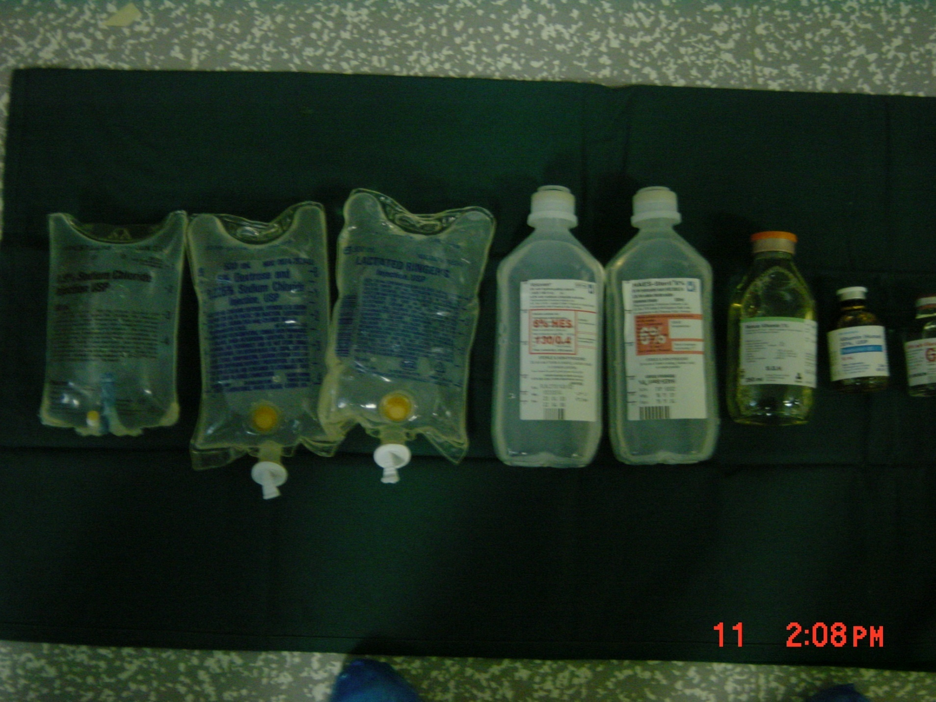

Slide 35
Assessment of fluid status
1. Urine Output: at least 1.0 ml/kg/hour
2. Vital Signs: Blood pressure and heart rate
3. Physical Assessment: texture of skin and mucous membranes; thirst in an awake patient
4. Invasive monitoring; CVP may be used as a guide
5. Laboratory tests: periodic monitoring of hemoglobin and hematocrit

Slide 36
Summary
Fluid therapy is critically important during the perioperative period.
The most important goal is to maintain hemodynamic stability and protect vital organs from hypoperfusion (heart, liver, brain, kidneys).
All sources of fluid losses must be accounted for.
Good fluid management goes a long way toward preventing problems.

Slide 37
Transfusion Therapy
  - 60% of transfusions occur perioperatively.
  - responsibility of transfusing perioperatively is with the anesthesiologist.

Slide 38
Blood Groups
Antigen on Plasma Incidence
Blood Group erythrocyte Antibodies White African-
Americans
A A Anti-B 40% 27%
B B Anti-A 11 20
AB AB None 4 4
O None Anti-A 45 49
Anti-B
Rh Rh 42 17

Slide 39
Type and Screen
Donated blood that has been tested for ABO/Rh antigens and screened for common antibodies (not mixed with recipient blood).
  - Used when usage of blood is unlikely, but needs to be available (hysterectomy).
  - Chance of hemolytic reaction: 1:10,000.

Slide 40
Cross Match
Major:
  - Donor’s erythrocytes incubated with recipients plasma
Minor:
  - Donor’s plasma incubated with recipients erythrocytes
Agglutination:
  - Occurs if either is incompatible
Type Specific:
  - Only ABO-Rh determined;

Slide 41
Screening before transfusion
Various bacterial and viral screening
Hepatitis B
Hepatitis C
HIV 1
HIV 2
Syphilis

Slide 42
Blood Components
Red Blood cells
All WBCs are removed
Red cells are stored in a bag containing CPD-A
( Citrate – Phosphate – Dextrose – Adenine)
Shelf life is 35 days, store always at 2-6 degrees
Use with in 30 min, and finish before 4 hours.
Never store blood in domestic fridge

Slide 43
Blood components platelets
For platelet deficiency and hemorrhagic disorders
Shelf life 5-6 days
Stored at 20 degrees, Do not refrigerate

Slide 44
Blood components
FFP and cryoprecipitate
Plasma frozen to -30 degrees with in 4 hours
It contains proteins, enzymes, hormones and electrolyte
Supplied at 4 degrees
Should be consumed as soon as possible (12 Hrs)
Bacterial proliferation
Cryoprecipitate is specially rich in factor VIII

Slide 45

Transfusion Complications
Acute Transfusion Reactions (ATR’s)
Chronic Transfusion Reactions
Transfusion related infections

Slide 46
Acute Transfusion Reactions
Hemolytic Reactions (AHTR)
Febrile Reactions
Allergic Reactions
TRALI
Coagulopathy with Massive transfusions
Bacteremia

Slide 47
Complications of Blood Therapy (cont.)
Hemolytic:
  Wrong blood type administered (oops).
  Activation of complement system leads to intravascular hemolysis, spontaneous hemorrhage.

Slide 48
Complications of Blood Therapy (cont.)
    Hypotension
    Chills, rigors, fever
    dyspnea, skin flushing,
    substernal pain , Back/abdominal pain
    Oliguria Dark urine,
    Pallor
  Signs are easily masked by general anesthesia.
  Free Hgb in plasma or urine
  Acute renal failure
  Disseminated Intravascular Coagulation (DIC)

Slide 49
Complications (cont.)
Transmission of Viral Diseases:
  Hepatitis C; 1:30,000 per unit
  Hepatitis B; 1:200,000 per unit
  HIV; 1:450,000-1:600,000 per unit
  Parasitic and bacterial transmission very low

Slide 50
What to do?
If an AHTR occurs
STOP TRANSFUSION
ABC’s
Maintain IV access and run IVF (NS or LR)
Monitor and maintain BP/pulse
Give diuretic
Obtain blood and urine for transfusion reaction workup
Send remaining blood back to Blood Bank

Slide 51
Monitoring in AHTR
Monitor patient clinical status and vital signs
Monitor renal status (BUN, creatinine)
Monitor coagulation status (DIC panel– PT/PTT, fibrinogen, D-dimer/FDP, Antithrombin-III)
Monitor for signs of hemolysis

Slide 52
Massive Blood Transfusion
Massive transfusion
More than patients blood volume in 24 hours
More than 10 units in 24 hours
50% blood volume replaced in 4 hours

Slide 53
Problems of massive transfusion
Dilutional thrombocytopenia and coagulopathy
Citrate toxicity
Hypothermia
Metobolic alkalosis
Hyperkalemia ( stored blood )
DIC

Slide 54
How to avoid problems of massive transfusion
Use autologous blood transfusion
Cell saver technology
Substitute to blood
artificial blood ( perflurocarbons )

Slide 55
Blood Substitutes (cont.)
Potential Advantages:
  No cross-match requirements
  Long-term shelf storage
  No blood-bourne transmission
  Rapid restoration of oxygen delivery in traumatized patients
  Easy access to product (available on ambulances, field hospitals, hospital ships)

Slide 56


