Slide 1
GENERAL REVISION
Dr Jumana Baaj
Consultant anesthesit
Assistant professor
KKUH- KSU

Slide 2
Role of anaesthetist in the preoperative care Lecture
Obtain a full history and physical examination including allergies, current medications, past anesthetic history, family anesthetic history
The medical student will understand how patient co-morbidities can affect the anesthetic plan.
The medical student will be able to understand potential anesthetic options for a given surgical procedure.

Slide 3
General anaesthesia technique
Definition of general Anaesthesia
Learn about several agents used on induction of general anaesthesia including intravenous agents, inhalation agents, neuromuscular blocking agents and reversal agents.
Understand basic advantages and disadvantages of these agents.
Complications commonly encountered during general anaesthesia

Slide 4
Airway Management and equipment
Learn about basic airway anatomy
Conduct a preoperative airway assessment
Identify a potentially difficult airway
Understand the issues around aspiration and its prevention
Learn about the management of airway obstruction
Become familiar with airway equipment
Practice airway management skills including bag and mask ventilation, laryngeal mask insertion, endotracheal intubation
Learn about controlled ventilation and become familiar with ventilatory parameters
Appreciate the different ways of monitoring oxygenation and ventilation

Slide 5
RegionalAnaesthesia Techniques
What are the risks and benefits of regional (epidural/spinal) anesthesia/analgesia?
What are the contraindications to regional anesthesia?
How do you prevent hypotension following epidural/spinal anesthesia?

Slide 6
Spinal Anaesthesia
Describe the technique of spinal anesthesia.
At what level does the adult spinal cord end?
Name some of the surgical procedures that can be done with a spinal anesthetic.
What are the contraindications to spinal anesthesia?
What are the complications?
Describe the patient's perception as spinal anesthetic takes effect.
What are the expected cardiovascular changes associated with sensory level at T10? T1?
How do you treat post-lumbar puncture headache?

Slide 7
Epidural Anaesthesia
Discuss the differences between spinal and epidural anesthesia.
What are the advantages and disadvantages of epidural compared to spinal anesthesia?
Study the size and tip of the epidural needle.
Name some of the surgical procedures that can be done with an epidural anesthetic.
What role does epidural has for post-operative pain control?
Local Anesthetics Pharmacology and toxicity (Lidocaine, Bupivacaine

Slide 8
Case senareo
A 26 year old male patient is admitted to the emergency department diagnosed to have perforated appendix for urgent emergency appendectomy . last meal 2hours ago.
Vital signs: BP 120/70mm Hg and HR 90/min.Chest
The patient was previously healthy .
PE: patient currently look ill. and CVS normal .last meal 1hours ago

Slide 9
Professional behavior
Introduce your self ,
-Greeting the patient ,
-Take permission to examine her .
-Explain to the patient what you will do .
-don’t be tough , no misbehavior.

Slide 10
What is your preoperative assessment
Anesthesia plan

Slide 11
Preoperative assessment
1 history
• age
• present illness
• drugs
• allergies
• past history (operations and anaesthetics)
• anaesthetic family history
• social (smoking, alcohol)
2 examination
• airway
• teeth
• general examination
3 specific assessment
4 investigations
5 consent
6 premedication

Slide 12
The patient was previously healthy .
PE: patient currently look ill. and CVS normal last meal 2hours ago
Surgical Hx : no previous Hx
- Allergy Hx .:not known to have any allergy .
- Family history :not significant .
- Review investigation :all within normal range .

Slide 13
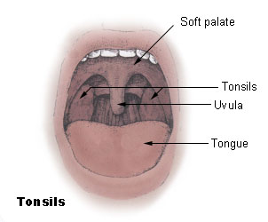

Slide 14
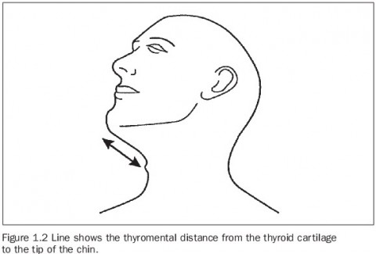
Thyromental distance 7 cm

Slide 15
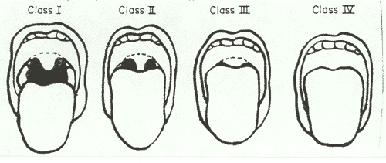
Airway Evaluation
Oropharyngeal visualization
Mallampati Score
Sitting position, protrude tongue, don’t say “AHH”

Slide 16
Airway assessment
Take very seriously history of prior difficult intubation difficulty
Short immobile neck
Full set of teeth, buck teeth
High arch palate
Poor mouth opening – less than three fingers gap between upper and lower teeth
Receding mandible (may be hidden by a beard)
Inability to sublux the jaw (forward protrusion of the lower incisors beyond
the upper incisors)

Slide 17
- ModifiedMallampati scoring system
Grade 1: faucial pillars, soft palate and uvula visible
• Grade 2: faucial pillars, soft palate visible, but uvula masked by the base of
the tongue
• Grade 3: soft palate and hard palate only visible
• Grade 4: hard palate not visible
Head and neck movement
Flexion and extension are greater than 90◦ in normal people.
- Jaw movement and mandible
Check that the patient’s mouth opens normally. It should have an interincisor gap of greater than 5 cm(about three finger breadths)
Thyromental distance
if the distance is more than 6.5 cm,problems should not occur with intubation.
Other tests
Indirect laryngoscopy and various x-ray procedures are occasionally used.

Slide 18
Example
A 80 years old patient booked for TURP under spinal anesthesia

Slide 19
What I should expect from you
Performance Steps correctly
Taking Consent from the patient
Assessment (indications and contraindications)
Connect monitors SPO2, ETCO2, ECG , non invasive blood pressure
Start iv fluids
Mask, cap, gown and gloves
Prepare the back with antiseptic
Place a sterile Drape Over The Area
Identify the anatomical landmarks
Inject local anaesthetic into the skin and deeper tissue
Insert the large introducer needle into the selected spinal interspace
Direct the spinal needle through the introducer and into the
subarachnoid space
Free flow of CSF confirms proper placement
Aspirate for CSF if clear inject the proper anaesthetic
Remove the needle, introducer and drape sheet
Have the patient lie down

Slide 20
Example
39 years old patient booked for emergency CS due to fetal distress
How you will manage ?

Slide 21
What I should expect from you
1.Preoxygenate with 100% oxygen by non-rebreather mask for at least 3 full, deep breaths. Preoxygenate four minutes if situation allows.
2. Administer propofol OR etomidate.
3. Apply cricoid pressure and hold until patient has been intubated, balloon of ETT has been inflated, position of tube tip has been assured, and ETT has been secured in place.
5. Administer succinylcholine 1 mg/kg IVP (100 mg for average 70kg patient) and wait for paralysis to occur.
6. Intubate.
7. When successfully intubated, confirm placement by
a. Bilateral breath sounds, and
b. Chest wall rise, and
c. Absense of gastric sounds, and
d. End tidal CO₂ measurement, and
8. fixed

Slide 22
Anesthesia OSCE
The exam with be 5 stations, with clinical scenarios in each station.
Objectives:
Pre-operative assessment.
(General and anesthesia specific questions)
Airway examination.
Malampati classification
Atlanto-occipital joint extension
Thyro-mental distance
X-ray
Prolonged apnea *IMP*
Anesthesia Complication:

Slide 23
Anesthesia Complication: (tachycardia – bradicardia- hypoxia- hypercapnia….)
Common instruments , Name the instrument
Uses , Complications
Central venous cannula
Epidural
Spinal
How to induce a pt.
Pain will not be included in the OCSE
Know your ABC , and start with it if you were asked about the management .

