Slide 1
Blood Products and blood transfusion
Dr. Jumana Baaj
Consultant anesthesit - Assistant professor
KKUH – KSU
15 / 9 /2013

Slide 2
Objective
Indication of blood transfusion
Blood groups
Blood component
Blood transfusion complication
treatment
Alternatives to Blood Products

Slide 3
Transfusion Therapy
  - 60% of transfusions occur perioperatively.
  - responsibility of transfusing perioperatively is with the anesthesiologist.

Slide 4
Blood Transfusion
Up to 30% of blood volume can be treated with crystalloids

Slide 5
Blood Transfusion
Why?
Increase oxygen carrying capacity
Restoration of red cell mass
Correction of bleeding caused by platelet dysfunction
Correction of bleeding caused by factor deficiencies

Slide 6
When is Transfusion Necessary?

Slide 7
“Transfusion Trigger”: Hgb level at which transfusion should be given.
  - Varies with patients and procedures
Tolerance of acute anemia depends on:
  - Maintenance of intravascular volume
  - Ability to increase cardiac output
  - Increases in 2,3-DPG to deliver more of the carried oxygen to tissues

Slide 8
Oxygen Delivery
Oxygen Delivery (DO₂) is the oxygen that is delivered to the tissues
DO₂= COP x CaO₂
Cardiac Output (CO) = HR x SV
Oxygen Content (CaO₂):
  - (Hgb x 1.39)O₂ saturation + PaO₂(0.003)
  - Hgb is the main determinant of oxygen content in the blood

Slide 9
Oxygen Delivery (cont.)
Therefore: DO₂ = HR x SV x CaO₂
If HR or SV are unable to compensate, Hgb is the major deterimant factor in O₂ delivery
Healthy patients have excellent compensatory mechanisms and can tolerate Hgb levels of 7 gm/dL.
Compromised patients may require Hgb levels above 10 gm/dL.

Slide 10
“Transfusion Trigger”: Hgb level at which transfusion should be given.
  - Varies with patients and procedures
Tolerance of acute anemia depends on:
  - Maintenance of intravascular volume
  - Ability to increase cardiac output
  - Increases in 2,3-DPG to deliver more of the carried oxygen to tissues

Slide 11
Differential Centrifugation
First Centrifugation
Closed System
Whole Blood
Main Bag
Satellite Bag
1
Satellite Bag
2
First
Platelet-rich
Plasma
RBC’s

Slide 12
Differential Centrifugation
Second Centrifugation
RBC’s
Platelet-rich
Plasma
Second
Platelet
Concentrate
Plasma
RBC’s

Slide 13
Blood components
Prepared from Whole blood collection
Whole blood is separated by differential centrifugation

Slide 14
Antibodies
  specific immunoglobulin’s produced in response to an antigenic challenge.
Antigen:
  a foreign substance that can elicit an immune (antibody) response.

Slide 15
Two major antigen systems on the red blood cell are the ABO system and the Rhesus (Rh) system.
Group A individuals have the A antigen present on their red blood cells.
Group B individuals have the B antigen present on their red blood cells.
Group AB individuals have antigens A and B present on their red blood cells.
Group O have neither antigens A nor B present on their red blood cells

Slide 16
Normal healthy individuals make antibodies against the A and B antigen
The antibodies are found in the individual’s plasma and are referred to as naturally occurring.
Group A individuals have anti B antibodies
Group B individuals have anti A antibodies
Group O individuals have anti A and anti B antibodies
Group AB individuals have no antibodies

Slide 17
The Rh system encompasses multiple antigens.
Rh (D) negative indicates that the Rh (D) antigen is not present on the red cell

Slide 18
Universal Blood
Blood group O is considered the universal donor for red cells because it lacks the A and B antigen.
Group O Rh negative can be considered for recipients of all blood groups.
Blood group AB is considered the universal donor for platelets,

Slide 19
Blood Groups
Antigen on Plasma Incidence
Blood Group erythrocyte Antibodies White African-
A A Anti-B 40% 27%
B B Anti-A 11 20
AB AB None 4 4
O None Anti-A 45 49
Anti-B
Rh Rh 42 17

Slide 20
Cross Match
Major:
  - Donor’s erythrocytes incubated with recipients plasma
Minor:
  - Donor’s plasma incubated with recipients erythrocytes
Agglutination:
  - Occurs if either is incompatible
Type Specific:
  - Only ABO-Rh determined; chance of hemolytic reaction is 1:1000 with TS blood

Slide 21
Type and Screen
Donated blood that has been tested for ABO/Rh antigens and screened for common antibodies
(not mixed with recipient blood).
  - Used when usage of blood is unlikely, but needs to be available (hysterectomy).
  - Allows blood to available for other patients.
  - Chance of hemolytic reaction: 1:10,000.

Slide 22
Blood components
  packed red blood cells (pRBC’s)
  platelet concentrate
  fresh frozen plasma (contains all clotting factors)
  cryoprecipitate (contains factors VIII and fibrinogen; used in Von Willebrand’s disease)
  albumin
  plasma protein fraction
  leukocyte poor blood
  factor VIII
  antibody concentrates

Slide 23
Packed Red Blood Cells
1 unit = 250 ml. Hct. = 70-80%.
1 unit pRBC’s raises Hgb 1 gm/dL.
Mixed with saline: LR(lactate ringer ) has Calcium which may cause clotting if mixed with PRBC’s.

Slide 24
RBC Transfusions
Administration
Dose
  Usual dose of 10 cc/kg infused over 2-4 hours
  Maximum dose 15-20 cc/kg can be given to hemodynamically stable patient
Procedure
  May need Premedication (Tylenol and/or Benadryl)
  Filter use—routinely leukodepleted
  Monitoring—VS q 15 minutes, clinical status
  Do NOT mix with medications
Complications
  Rapid infusion may result in Pulmonary edema
  Transfusion Reaction

Slide 25
Platelet Concentrate
Storage
  Up to 5 days at 20-24°
Indications
  Thrombocytopenia, Plt <15,000
  Bleeding and Plt <50,000
  Invasive procedure and Plt <50,000
Considerations
  Contain Leukocytes and cytokines
  1 unit/10 kg of body weight increases Plt count by 50,000
  Donor and Recipient must be ABO identical

Slide 26
Plasma and FFP
Contents—Coagulation Factors (1 unit/ml)
Storage
  FFP--12 months at –18 degrees or colder
Indications
  Coagulation Factor deficiency, fibrinogen replacement, DIC, liver disease, exchange transfusion, massive transfusion
Considerations
  Plasma should be recipient RBC ABO compatible
  In children, should also be Rh compatible
  Usual dose is 20 cc/kg to raise coagulation factors approx 20%

Slide 27
Blood transfusion complication
Physical
  Circulatory overload
  Embolism (air, micro aggregate)
  Hypothermia
Immunological
  Pyrogenic
  Type 1hypersensitivity
  Graft versus host reactions
Biochemical
  Acid base disturbances
  Hyperkalaemia
  Citrate toxicity
  Impaired oxygen release
Infective
Hemolytic transfusion reaction
Disseminated intravascular coagulation

Slide 28
Acute Transfusion Reactions
Hemolytic Reactions (AHTR)
Febrile Reactions (FNHTR)
Allergic Reactions
TRALI
Coagulopathy with Massive transfusions
Bacteremia

Slide 29
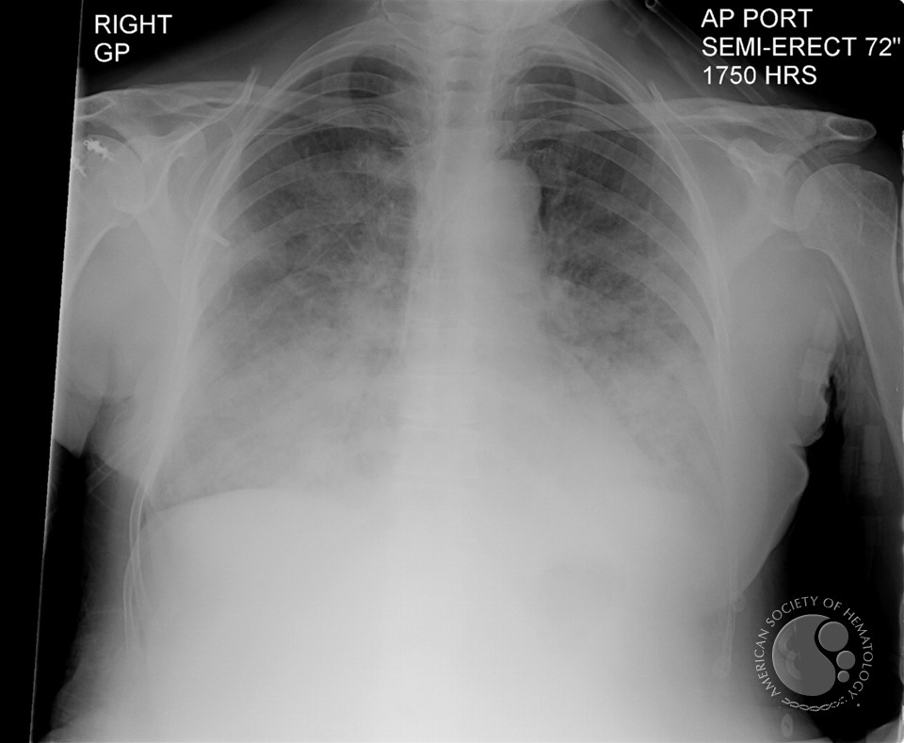
TRANSFUSION RELATED ACUTE LUNG INJURY

Slide 30
Complications of Blood Therapy (cont.)
  Signs are easily masked by general anesthesia.
  Free Hgb in plasma or urine
  Acute renal failure
  Disseminated Intravascular Coagulation (DIC)

Slide 31
Complications (cont.)
Transmission of Viral Diseases:
  Hepatitis C; 1:30,000 per unit
  Hepatitis B; 1:200,000 per unit
  HIV; 1:450,000-1:600,000 per unit
  22 day window for HIV infection and test detection
  CMV may be the most common agent transmitted, but only effects immuno-compromised patients
  Parasitic and bacterial transmission very low

Slide 32
Other Complications
  Decreased 2,3-DPG with storage: ? Significance
  Citrate: metabolism to bicarbonate; Calcium binding
  Microaggregates (platelets, leukocytes): micropore filters controversial
  Hypothermia: warmers used to prevent
  Coagulation disorders: massive transfusion (>10 units) may lead to dilution of platelets and factor V and VIII.
  DIC: uncontrolled activation of coagulation system

Slide 33
Treatment of Acute Hemolytic Reactions
Immediate discontinuation of blood products and send blood bags to lab.
Maintenance of urine output with crystalloid infusions
Administration of mannitol or Furosemide for diuretic effect

Slide 34
Massive blood transfusion
Blood volume formula
Neonate - 90 ml/kg
Infants 2 years ago - 80ml/kg
Adult male - 70ml/kg
Adult female - 60ml/kg

Slide 35
Massive blood transfusion
Defined one of three ways
  Acute administration of more than 1,5 times of estimated blood volume
  The replacement of patients blood volume by stored bank blood in less than 24 hours
  The acute administration of more than blood volume in less than 24 hours

Slide 36
Massive blood transfusion
Basic screening test after six-unit transfusion
  Hemoglobin and platelets count
  Coagulation profile ( Pt prothrompine time , activated partial thromboplastine time
  Plasma fibrinogen concentration
  Fibrin degradation products
  PH from arterial blood gas analysis
  Plasma Electrolyte

Slide 37
Massive blood transfusion
DIC
Coagulopathy
Citrate Toxicity
Hypothermia
metabolic alkalosis

Slide 38
Massive Blood Transfusion
Coagulopathy due to dilutional thrombocytopenia. And dilution of the coagulation factors
Citrate Toxicity does not occur in most normal patients unless the transfusion rate exceeds 1 U every 5 min
Hypothermia
Acid–Base Balance The most consistent acid–base abnormality after massive blood transfusion is postoperative metabolic alkalosis

Slide 39
Massive Blood Transfusion
Serum Potassium Concentration
The extracellular concentration of potassium in stored blood steadily increases with time.
The amount of extra-cellular potassium transfused with each unit less than 4 mEq per unit. Hyperkalemia can develop regardless of the age of the blood when transfusion rates exceed 100 mL/min.

Slide 40
Massive blood transfusion
Diagnosis of DIC
  Increase APTT , PT , fibrin degradation product
  Decrease platelet count , fibrinogen concentration
Treatment
  4 units of FFP
  6-8 units of platelets
  Cryoprecipitate if fibrinogen level less than 1 g/l
  PH less than 7,2 administrate 50 mmol bicarbonate
  Recombinant activated factor VIIa if bleeding continue in spite of use FFP platelets and cryoprecipatae

Slide 41
Alternatives to Blood Products
Autotransfusion
Blood substitutes

Slide 42
Administering Blood Products
  Consent necessary for elective transfusion
  Unit is checked by 2 people for Unit #, patient ID, expiration date, physical appearance.
  pRBC’s are mixed with saline solution (not LR)
  Products are warmed mechanically and given slowly if condition permits
  Close observation of patient for signs of complications
  If complications suspected, infusion discontinued, blood bank notified, proper steps taken.

Slide 43
Administering Blood Products
  Consent necessary for elective transfusion
  Unit is checked by 2 people for Unit #, patient ID, expiration date, physical appearance.
  pRBC’s are mixed with saline solution (not LR)
  Products are warmed mechanically and given slowly if condition permits
  Close observation of patient for signs of complications
  If complications suspected, infusion discontinued, blood bank notified, proper steps taken.

Slide 44
What to do?
If an AHTR occurs
STOP TRANSFUSION
ABC’s
Maintain IV access and run IVF (NS or LR)
Monitor and maintain BP/pulse
Give diuretic
Obtain blood and urine for transfusion reaction workup
Send remaining blood back to Blood Bank

Slide 45
Blood Bank Work-up of AHTR
Check paperwork to assure no errors
Check plasma for hemoglobin
Repeat crossmatch
Repeat Blood group typing
Blood culture

Slide 46
Monitoring in AHTR
Monitor patient clinical status and vital signs
Monitor renal status (BUN, creatinine)
Monitor coagulation status (DIC panel– PT/PTT, fibrinogen, D-dimer/FDP, Plt, Antithrombin-III)
Monitor for signs of hemolysis (LDH, bili, haptoglobin)

Slide 47
Auto-transfusion
Techniques:
Pre-deposit transfusion
Intra-operative acute normovolemic hemodilution
Intra-operative cell salvage

Slide 48
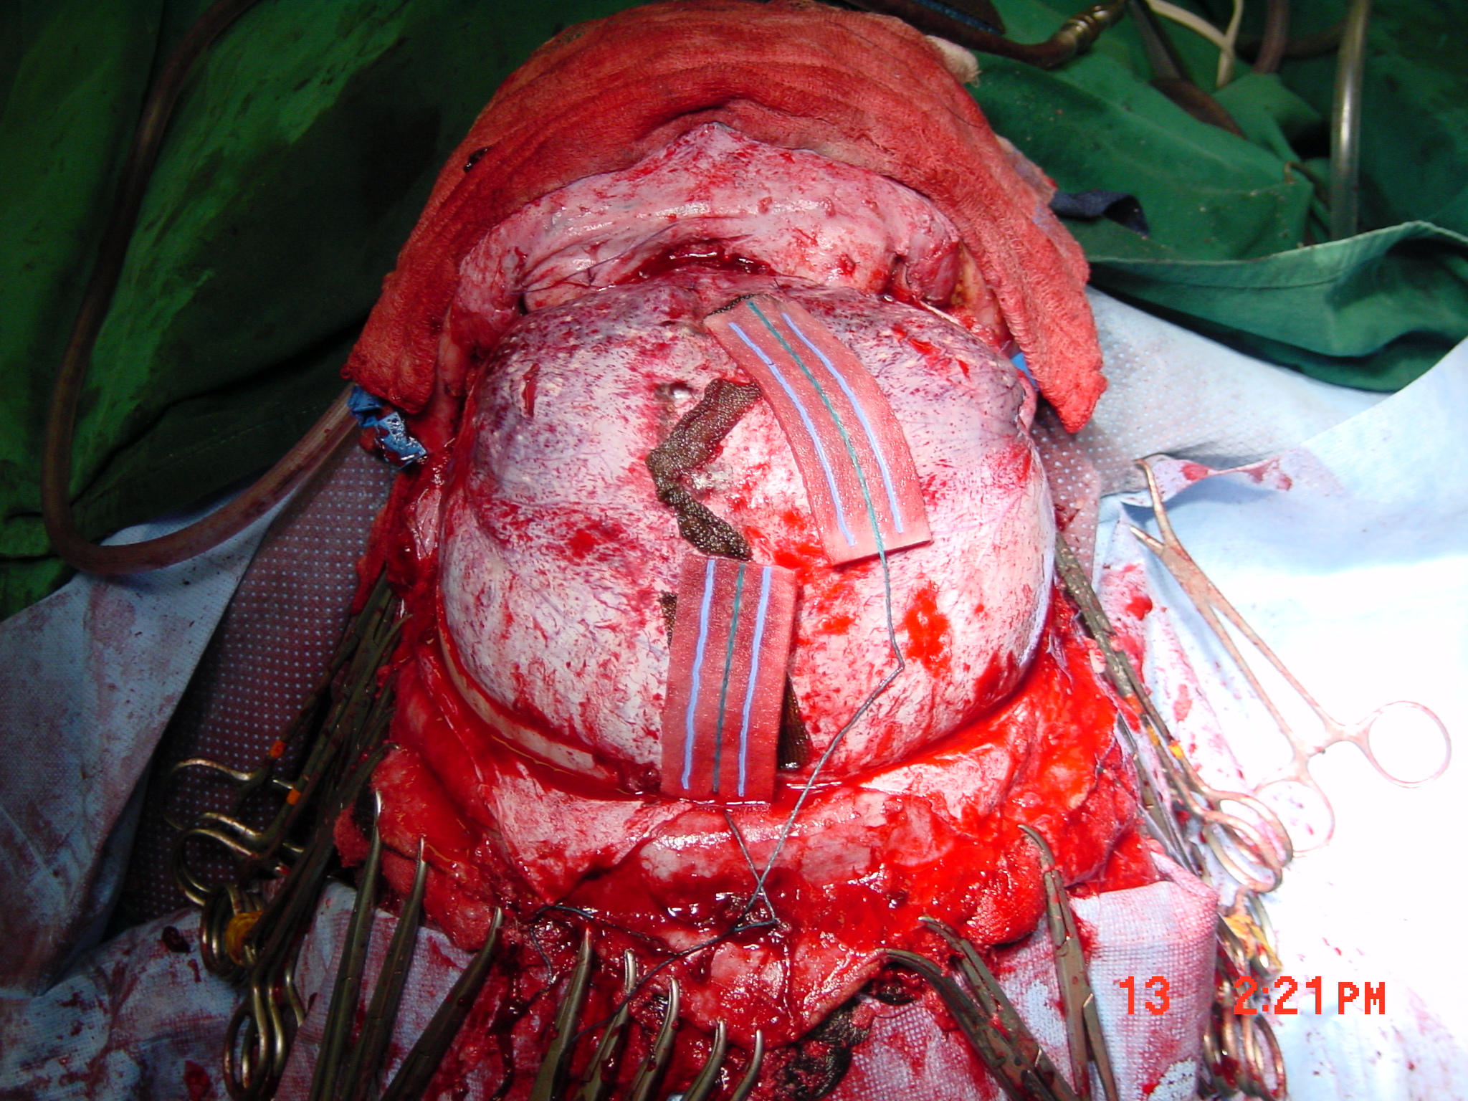

Slide 49
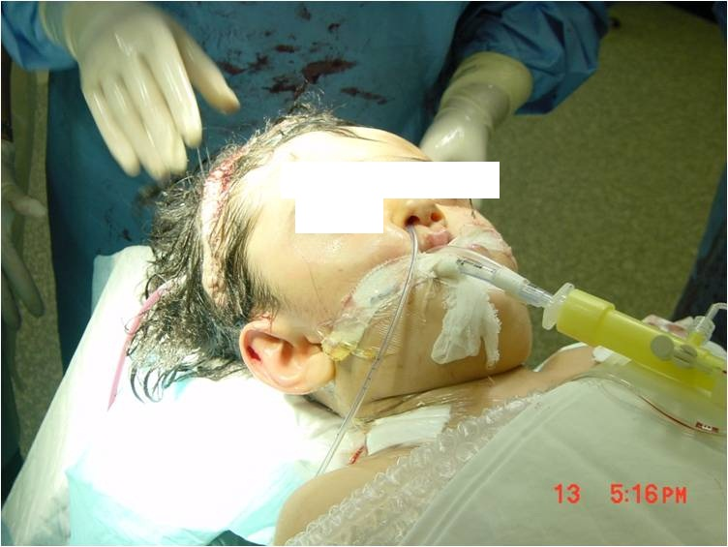
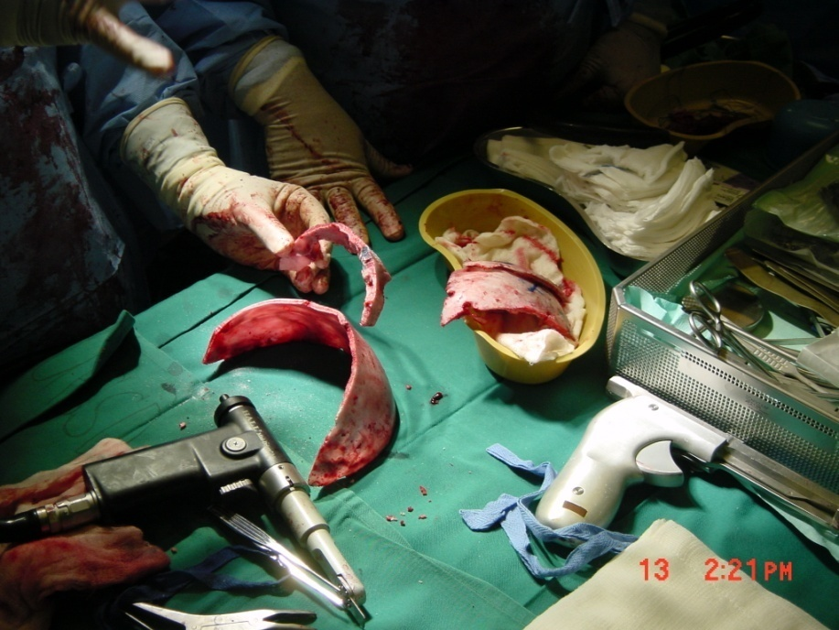

Slide 50
Pre-deposit transfusion
-blood collection begins 3-5 weeks preoperatively (2-4 units store)
Eliminates risk of viral transmission
Reduces risk of immunological reactions
Collection is expensive and time consuming
Only suitable for elective surgery

Slide 51
Intra-operative acute normovolemic hemodilution
-1-1.5L can be collected with volume replacement
-Blood stored in OR
-Re-infused during or after surgery
-Cheaper than pre-deposit
-Little risk of clerical error
-Suitable for elective surgery

Slide 52
Intra-operative cell salvage
-shed blood is collected from surgical field
-heparin added
-cells washed with saline and concentrated by centrifugation.
-concentrate transfused
-large volume could be used
-platelets and clotting factors are consumed
-suitable for cardiac surgery
-contraindicated in contaminated surgical field

Slide 53
Intraoperative and Postoperative Management of Blood Loss and Transfusions
Intraoperative and postoperative interventions include
(A) red blood cell transfusion, (B) management of coagulopathy,
and (C) monitoring and treatment of adverse
effects of transfusion.

Slide 54
Recommendations from ASA
1. Monitoring for blood loss.
2. Monitoring for inadequate perfusion and oxygenation of vital organs(blood pressure, heart rate, oxygen saturation, urine output, electrocardiography).
3. Monitoring for transfusion indications (hemoglobin and hematocrit) .

Slide 55
Transfusion Therapy Summary
Decision to transfuse involves many factors
Availability of component factors allows treatment of specific deficiency
Risks of transfusion must be understood and explained to patients and patient should be consented
Vigilance necessary when transfusing any blood product

Slide 56
Reference book and Journal reference
American Society of Anesthesiologists Task Force on Perioperative Blood Transfusion and Adjuvant Therapies. Practice guidelines for perioperative blood transfusion and adjuvant therapies. http://www.asahq.org/publicationsAndServices/practiceparam.htm#blood.

Slide 57


