Slide 1
Intravenous Access
The ability to obtain intravenous (IV) access is an essential skill in medicine and is performed in a variety of settings by paramedics, nurses and physicians.
Although the procedure can appear deceptively simple when performed by an expert, it is in fact a difficult skill which requires considerable practice to perfect.

Slide 2
Intravenous Access
Used for access to body's circulation
Indications:
Administer fluids
Administer drugs
Obtain laboratory specimens
Route of choice for fluid replacement is peripheral vein in an extremity

Slide 3
Intravenous Access
No general or regional anaesthetic procedure should start without intravenous access.
A large bore cannula (14 or 16 gauge) or occasionally a small cannula (21 or 23 gauge)may be used, depending on the type of surgery.
For any surgical procedure in which rapid blood loss may occur, nothing smaller than a 16 gauge cannula should be used.

Slide 4
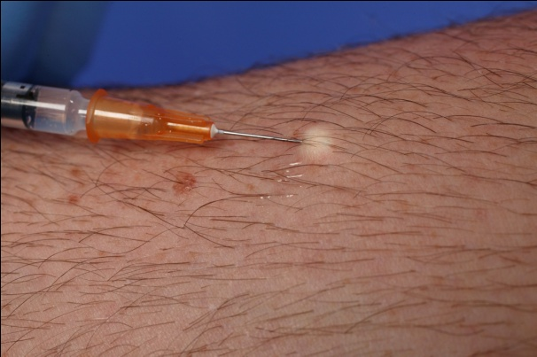
Intravenous Access
For major surgery at least one 14 gauge cannula is essential.
The major determinant of the flow rate achieved through a cannula is the fourth power of the internal radius.
All large-bore intravenous cannulae that are inserted before induction of anaesthesia should be placed after the intradermal infiltration of lignocaine using a 25 gauge needle.
The ‘sting’ of the local anaesthetic is trivial compared with the pain of a large intravenous cannula pushed through the skin.

Slide 5
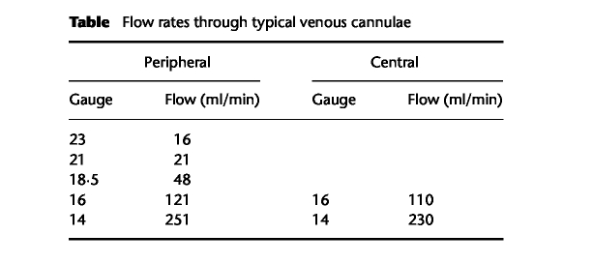
Intravenous Access

Slide 6
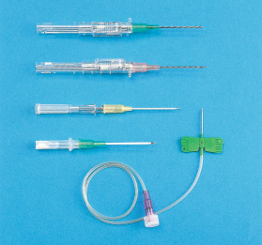
Intravenous Access Types of IV Catheters
Hollow needles
Butterfly type
Indwelling plastic catheter over hollow needle
Indwelling plastic catheter inserted through a hollow needle
Intracath

Slide 7
Intravenous Access Indications
By starting a peripheral IV, you gain access to the peripheral circulation of a patient, which will enable you to sample blood as well as infuse fluids and IV medications.
IV access is essential to manage problems in all critically ill patients.
High volume fluid resuscitation may be required for the trauma patient, in which case at least two large bore (14-16 G) IV catheters are usually inserted.
All critically ill patients require IV access in anticipation of future potential problems, when fluid and/or medication resuscitation may be necessary.

Slide 8
Intravenous Access Contraindications
Some patients have anatomy that poses a risk for fluid extravasation or inadequate flow and peripheral IVs should be avoided in these situations.
Examples include extremities that have massive edema, burns or injury; in these cases other IV sites need to be accessed.
For the patient with severe abdominal trauma, it is preferable to start the IV in an upper extremity because of the potential for injury to vessels between the lower extremities and the heart.
For the patient with cellulitis of an extremity, the area of infection should be avoided when starting an IV because of the risk of inoculating the circulation with bacteria.

Slide 9
Intravenous Access Contraindications
Avoid sites that have injury or disease:
Trauma
Dialysis fistula
History of mastectomy
(concerns about adequate vascular flow)

Slide 10
Intravenous Access Complications
The main complications of an IV catheter are infection at the site and development of superficial thrombophlebitis in the vein that is catheterized.
It is also common for the IV sites to leak interstitially.

Slide 11
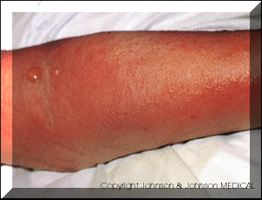
Intravenous Access Complications
Cellulitis
Inflammation of loose connective tissue around insertion site.
- Caused by poor insertion technique
- Red swollen area spreads from insertion site outwardly in a diffuse circular pattern
- Treated w/antibiotics

Slide 12
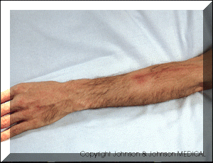
Intravenous Access Complications
Phlebitis/Thrombophlebitis
Chemical
- Infusate chemically erodes internal layers. Warm compresses may help while the infusate is stopped/changed. Anti-inflammatory and analgesic medications are often used no matter what the cause
Mechanical
- Caused by irritation to internal lumen of vein during insertion of vascular access device and usually appears shortly after insertion. The device may need to be removed and warm compresses applied
Bacterial
- Caused by introduction of bacteria into the vein. Remove the device immediately and treat w/antibiotics. The arm will be painful, red and warm; edema may accompany

Slide 13
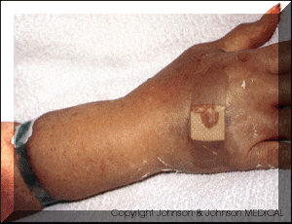
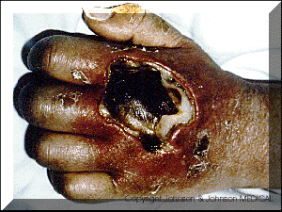
Intravenous Access Complications
Infiltration/Extravasation
The most common cause is damage to the wall during insertion or angle of placement.
STOP INFUSION and treat as indicated by Pharmacy, Medication package insert or drug reference book.

Slide 14
Intravenous Access Complications
Septicemia/Pulmonary Edema/Embolism
Septicemia
- Severe infection that occurs to a system or entire body
- Most often caused by poor insertion technique or poor site care
- Discontinue device immediately, culture and treat appropriately
Pulmonary edema- caused by rapid infusion
Pulmonary embolism - Caused by any free floating substances that require thrombolytic therapy for several months. Increased risk w/lower ext.
Air embolism- caused by air injected into IV system. Keep insertion site below level of heart

Slide 15
Intravenous Access Universal precautions
The potential for contact with a patient's blood while starting an IV is high and increases with the inexperience of the operator.
Gloves must be worn while starting an IV and if the risk of blood splatter is high, such as an agitated patient, the operator should consider face and eye protection as well as a gown.
Trauma protocol calls for all team members to wear gloves, face and eye protection and gowns.
As well, once removed from the protective sheath, IV catheters should either go into the patient or into an appropriate sharps container.

Slide 16
Intravenous Access Universal precautions
Important: Recapping needles, putting catheters back into their sheath or dropping sharps to the floor (an unfortunately common practice in trauma) should be strictly avoided.
Recapping of needles is one of the commonest causes of preventable needle stick injuries in health care workers.

Slide 17
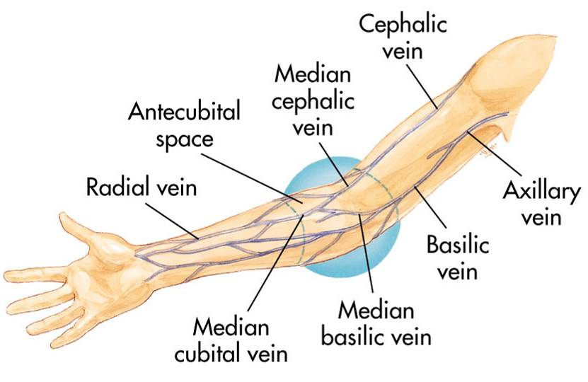
Intravenous Access Peripheral IV sites
Generally IV's are started at the most peripheral site that is available and appropriate for the situation.
This allows cannulation of a more proximal site if your initial attempt fails.
If you puncture a proximal vein first, and then try to start an IV distal to that site, the fluid may leak from the injured proximal vessel.
The preferred site in the emergency department is the veins of the forearm, followed by the median cubital vein that crosses the antecubital fossa.
In trauma patients, it is common to go directly to the median cubital vein as the first choice because it will accommodate a large bore IV and it is generally easy to catheterize.

Slide 18
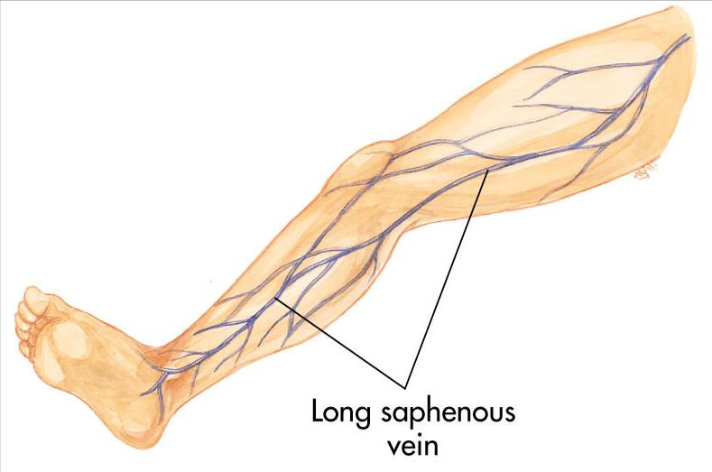
Intravenous Access Peripheral IV sites
In circumstances where the veins of the upper extremities are inaccessible, the veins of the dorsum of the foot or the saphenous vein of the lower leg can be used.
In circumstances in which no peripheral IV access is possible a central IV can be started.

Slide 19
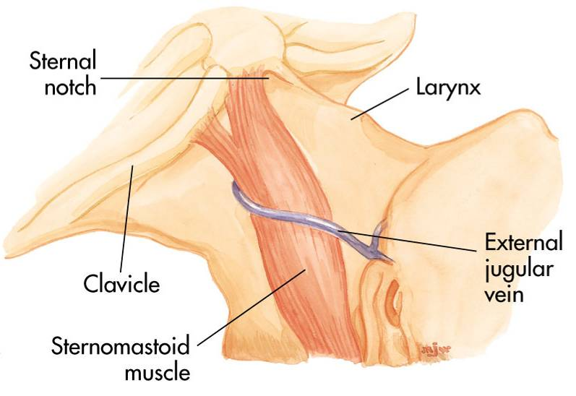
Intravenous Access Alternate sites
External jugular veins
Central vein

Slide 20
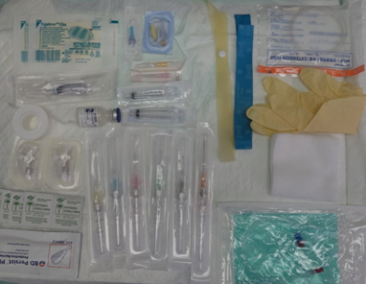
Intravenous Access Equipment
All necessary equipment should be prepared, assembled and available at the bedside prior to starting the IV. Basic equipment includes:
gloves and protective equipment
appropirate size catheter 14-25 G IV catheter
non-latex tourniquet
alcohol swab/other cleaning instrument
non-sterile 2x2 gauze
sterile 2x2 gauze (this is not practiced in nursing)
6x7cm Tegaderm™ Transparent Dressing
3 pieces of 2.5 cm tape approximately 10 cm in length
IV bag with solution set (tubing) (flushed and ready) or saline lock
sharps container

Slide 21
Intravenous Access Establishing a peripheral intravenous line
Explain procedure
Inspect fluid for contamination, appearance, and expiration date
Prepare infusion set
Attach infusion set to bag of solution
Assemble your equipment.
Put a pair of appropriately sized non-latex examination gloves.
Apply tourniquet to the IV arm above the site.
Visualize and palpate the vein.
Cleanse the site with a chlorhexidine swab using an expanding circular motion.

Slide 22
Intravenous Access Establishing a peripheral intravenous line
Prepare and inspect the catheter: Remove the catheter from the package. Push down on the flashback chamber to ensure it is tight. Remove the protective cover. Inspect the catheter and needle for any damage or contaminants. Spin the hub of the catheter to ensure that it moves freely on the needle Do not move the catheter tip over the bevel of the stylet.

Slide 23
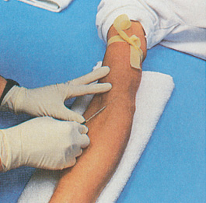
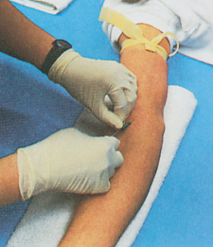
Intravenous Access Establishing a peripheral intravenous line
Stabilize the vein and apply countertension to the skin.
Insert the stylet through the skin and then reduce the angle as you advance through the vein.
Observe for "flash back" as blood slowly fills the flash back chamber.
Advance the needle approximately 1 cm further into the vein.
Holding the end of the catheter with your thumb and index finger, pull the needle (only) back 1 cm with your middle finger.
Slowly advance the catheter into the vein while keeping tension on the vein and skin.

Slide 24
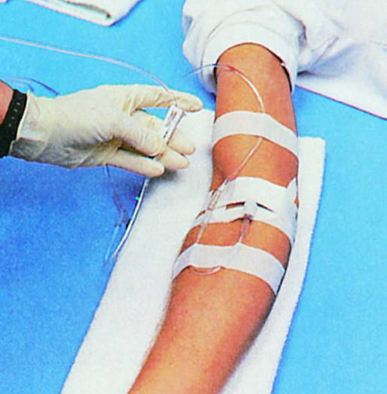
Intravenous Access Establishing a peripheral intravenous line
Remove the tourniquet.
Secure the catheter by placing the Tegaderm™ over the lower half of the catheter hub taking care not to cover the IV tubing connection
Occlude the distal end of the catheter with the 3rd, 4th and 5th fingers of your non-dominant hand.
Cover puncture site dressing

Slide 25
Intravenous Access Establishing a peripheral intravenous line
Antibiotic ointment if indicated by protocol
Anchor tubing
Secure catheter
Document procedure
Monitor flow

Slide 26
Intravenous Access Establishing a peripheral intravenous line
http://www.youtube.com/watch?v=R7CJkgjSkvk

Slide 27
Intravenous Access Establishing a peripheral intravenous line
http://www.youtube.com/watch?v=R7CJkgjSkvk

Slide 28
Intravenous Access Removal of the IV
Shut off the IV by closing the roller camp.
Remove the tape and Tegaderm™ from the tubing and catheter.
Place a non-sterile 2x2 gauze over the IV site and remove the catheter from the arm and secure it in place with a piece of tape.

Slide 29
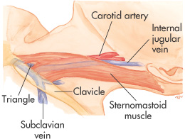
Intravenous Access Central line
Internal Jugular Anatomy

Slide 30
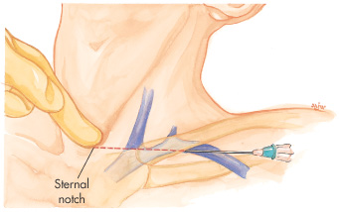
Intravenous Access Central line Subcalvian Vein Anatomy

Slide 31
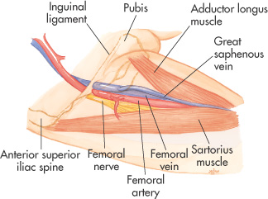
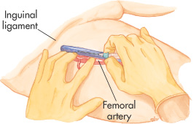
Intravenous Access Central line
Femoral Vein Anatomy

Slide 32
Intravenous Access Central line

Slide 33
Intravenous Access Central line
IJ Ultrasound Guidance for Central Venous Access, Part 1 (8 min)
http://www.youtube.com/watch?v=vRIIaMZL9XI&feature=player_detailpage
IJ Ultrasound Guidance for Central Venous Access - Part 2 - SonoSite, Inc. (9min)
http://www.youtube.com/watch?v=zV3hw_QbgK4&feature=player_detailpage#t=13s
PLACEMENT OF A FEMORAL VENOUS CATHETER (13min)
http://www.youtube.com/watch?v=GHfGdpVJuMA&feature=player_detailpage
US GUIDED SUBCLAVIAN CENTRAL LINE (12min)
http://www.youtube.com/watch?v=jzv99DBa2jE&feature=player_detailpage
Percutaneous Sheath insertion
http://www.youtube.com/watch?v=0EPTfXx0Np8

Slide 34
Intravenous Access Central line
Advantages
Available when peripheral vessels collapse
Access to central pressure measurements
In-hospital procedure
Safer vasopressor administration

Slide 35
Intravenous Access Central line
Disadvantages
Excessive time for placement
Sterile technique
Special equipment
Skill deterioration
High complication rate
Pneumothorax, arterial injury, abnormal placement
Chest x-ray should be obtained immediately

Slide 36
Intravenous Access Central line
Air Embolism
Uncommon but can be fatal
Air enters bloodstream through catheter tubing
Risk greatest with catheter in central circulation
Negative pressure may pull air in

Slide 37
Intravenous Access Central line
Air Embolism
Signs and symptoms
Hypotension
Cyanosis
Weak and rapid pulse
Loss of consciousness

Slide 38
Intravenous Access Central line
Air Embolism
Management
Close the tubing
Turn patient on left side with head down
Check tubing for leaks
Administer high-concentration oxygen
Aspirate

Slide 39
Intravenous Access Central line
Complications
Air/Thrombus embolism
Arrythmias
Hematoma
Pneumothorax
Hemothorax
Chylothorax
Cardiac perforation
Cardiac tamponade
Trauma to nearby nerves and arteries
Thrombosis

Slide 40
Intravenous Access Central line
Complications
Line infection
Blood stream infection

