Slide 1
Problem Based Learning Anesthesia for the “Healthy” Patient
A 52-year-old man has had progressive knee pain with swelling, and a Baker cyst just behind his right knee. Recently, the pain has increased in intensity, and has kept him from sleeping at night. His orthopedic surgeon has tentatively diagnosed a torn meniscus, and recommended an arthroscopy as an outpatient. The patient has had no major illnesses other than the typical childhood diseases. He has had no previous operations or anesthetics, nor a family history of problems with anesthesia. He has no allergies to medications, does not smoke, and consumes alcohol occasionally at social events. His laboratory results and physical examination by an internist were all normal. He has had nothing to eat or drink since he went to bed last night. On examination, the patient weighs 160 lb and is 5 ft, 8 in tall. His neck appears to be supple and mobile. He opens his mouth without difficulty, and with his head extended and tongue protruding, his uvula is completely visible.

Slide 2
Problem Based Learning Anesthesia for the “Healthy” Patient
- How are a patient's general medical condition, and his risk for difficult airway management classified?
- Which components of a pre-anesthetic evaluation are often not included in a patient's typical history and physical examination?

Slide 3
Problem Based Learning Anesthesia for the “Healthy” Patient
Summary: A 52-year-old healthy patient with persistent and increasing knee pain is scheduled for an outpatient arthroscopy. His uvula is completely visible.
How to evaluate the anesthetic risk of this patient?
What should be included in the preoperative evaluation?

Slide 4
Problem Based Learning Anesthesia for the “Healthy” Patient
Summary: A 52-year-old healthy patient with persistent and increasing knee pain is scheduled for an outpatient arthroscopy. His uvula is completely visible.
How to evaluate the anesthetic risk of this patient?
What should be included in the preoperative evaluation?

Slide 5
Problem Based Learning Anesthesia for the “Healthy” Patient
CLINICAL APPROACH
The preparation for any surgical procedure includes
a history
a physical examination
and laboratory tests
which are appropriate when considering the patient's age, medical problems, and the type of procedure.
In addition to the typical presurgical "work up,"
an 'anesthetic evaluation is also important prior to the administration of anesthesia—whether general, regional anesthesia, or monitored anesthesia care (local infiltration with monitoring and sedation by an anesthesia provider).

Slide 6
Problem Based Learning Anesthesia for the “Healthy” Patient
Summary: A 52-year-old healthy patient with persistent and increasing knee pain is scheduled for an outpatient arthroscopy. His uvula is completely visible.
Categorizes patients according to their comorbidities.
Cardiac
Pulmorary
Renal
Neurologic
Endocrine
Musculoskeletal
Allergy and Immunology
Other

Slide 7
Problem Based Learning Anesthesia for the “Healthy” Patient
Considerations
A commonly-used method of describing the complexity of a patient's medical condition is the American Society of Anesthesiologists' (ASA) Physical Status Classification

Slide 8
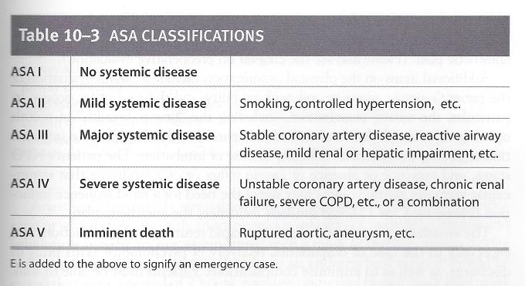
Problem Based Learning Anesthesia for the “Healthy” Patient

Slide 9
Problem Based Learning Anesthesia for the “Healthy” Patient
Comorbidities are often associated with an increase in postoperative complications.
Both comorbidities and complications influence the likelihood that this ambulatory patient could be discharged on the day of surgery, versus needing to remain in the hospital.
For an emergency case, an "E" is added.
The ASA classifications are also commonly used by other specialties.

Slide 10
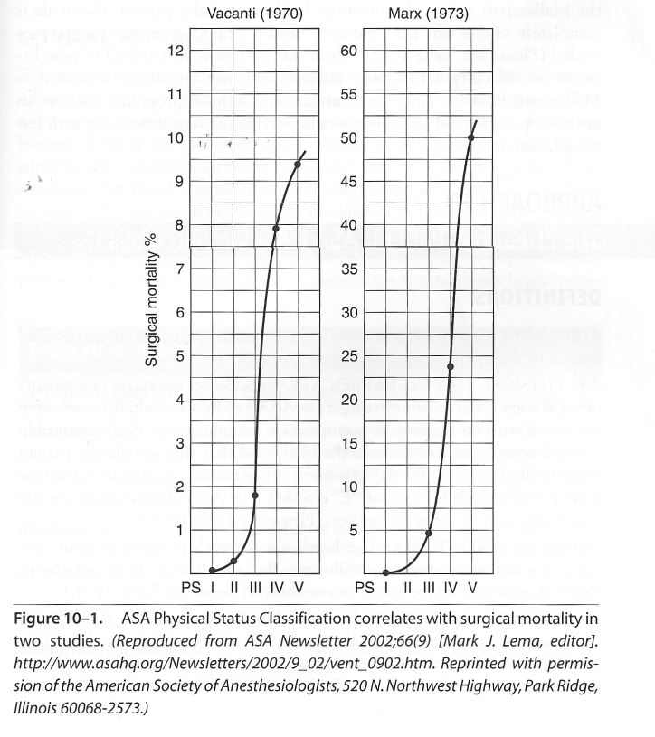
Problem Based Learning Anesthesia for the “Healthy” Patient
Considerations

Slide 11
Problem Based Learning Anesthesia for the “Healthy” Patient
The pre-anesthesia evaluation addresses factors such as
the patient's NPO status
the presence or absence of gastric reflux
his or her response to previous anesthetics
a reconciliation of medications taken on the day of surgery
and any pertinent family history including direct queries regarding malignant hyperthermia or pseudocholinesterase deficiency.
In addition to the routine history and physical, this information is necessary to allow the formulation of a safe and effective anesthetic plan.

Slide 12
Problem Based Learning Anesthesia for the “Healthy” Patient
Additional items on the physical examination include
a careful evaluation of the patient's airway anatomy and neck mobility
and the ease of i.v. access.
In particular, the airway examination, including the "fingers breadth" of mouth opening, hyomental distance, and Mallampati classification, provide information regarding the potential difficulty or ease of intubation.
The patient's NPO status, and presence or absence of gastric reflux or of a syndrome that significantly increases gastric volume may signal the need for a rapid sequence induction ,and similarly influences the anesthetic plan.

Slide 13
Problem Based Learning Anesthesia for the “Healthy” Patient
An anesthetic evaluation prior to surgery should include the following:
Considerations

Slide 14
Problem Based Learning Anesthesia for the “Healthy” Patient
So this patient is ASA ?

Slide 15
Problem Based Learning Anesthesia for the “Healthy” Patient
So this patient is ASA 1

Slide 16
Problem Based Learning Anesthesia for the “Healthy” Patient
So this patient is ASA 1
ASA PHYSICAL STATUS CLASSIFICATION: Addresses the extent of a patient's medical comorbidities prior to surgery as ASA I to IV.
This classification is a useful indicator of surgical mortality.
Since this patient has no medical comorbidities, he is classified as an "ASA Class 1."

Slide 17
Problem Based Learning Anesthesia for the “Healthy” Patient
AIRWAY ASSESSMENT

Slide 18
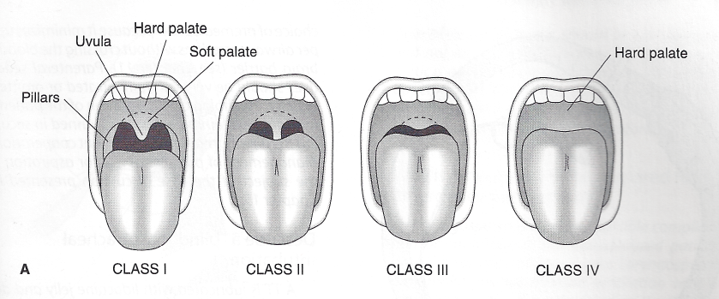
Problem Based Learning Anesthesia for the “Healthy” Patient

Slide 19
Problem Based Learning Anesthesia for the “Healthy” Patient
APPROACH TO
The "Healthy"" Patient: ASA I, Mallampati Class
DEFINITIONS
MALLAMPATI CLASSIFICATION: One of the factors predicting the difficulty of airway management and the placement of an endotracheal tube. It refers to the amount of the uvula visible when a patient's head is extended and his or her tongue protruded.

Slide 20
Problem Based Learning Anesthesia for the “Healthy” Patient
So this patient is Mallampati class?

Slide 21
Problem Based Learning Anesthesia for the “Healthy” Patient
So this patient is Mallampati class 1

Slide 22
Problem Based Learning Anesthesia for the “Healthy” Patient
Summary: A 52-year-old healthy patient with persistent and increasing knee pain is scheduled for an outpatient arthroscopy. His uvula is completely visible.
A patient's ASA Physical Status Classification, noted as ASA I-IV, categorizes patients according to their comorbidities.
The Mallampati airway classification describes the amount of a patient's uvula visible when a patient extends his neck and protrudes his tongue, and is one predictor of the risk of difficult airway management.

Slide 23
Problem Based Learning Anesthesia for the “Healthy” Patient
The potential ease or difficulty of intubation is often addressed using the Mallampati airway classification.
In this particular patient, the uvula is completely visible when the patient's head is extended and his tongue protruded

Slide 24
Problem Based Learning Anesthesia for the “Healthy” Patient
APPROACH TO
The "Healthy"" Patient: ASA I, Mallampati Class I
DEFINITIONS
AIRWAY PROTECTION: The ability to prevent the aspiration of gastric contents into the lungs which could cause pneumonia.
Lost during anesthesia

Slide 25
Problem Based Learning Anesthesia for the “Healthy” Patient
APPROACH TO
The "Healthy"" Patient: ASA I, Mallampati Class I
DEFINITIONS
AIRWAY PROTECTION: The ability to prevent the aspiration of gastric contents into the lungs which could cause pneumonia.
Lost during anesthesia
He has not had anything to eat or drink since midnight, so he can be considered as "NPO."

Slide 26
Problem Based Learning Anesthesia for the “Healthy” Patient
Considerations
Thus, this patient is anticipated to pose little or no difficulty with airway management and his airway is classed as Mallampati Class 1.
Since he is undergoing a quick procedure such as an arthroscopy, a general anesthetic would provide the fastest recovery with few complications.

Slide 27
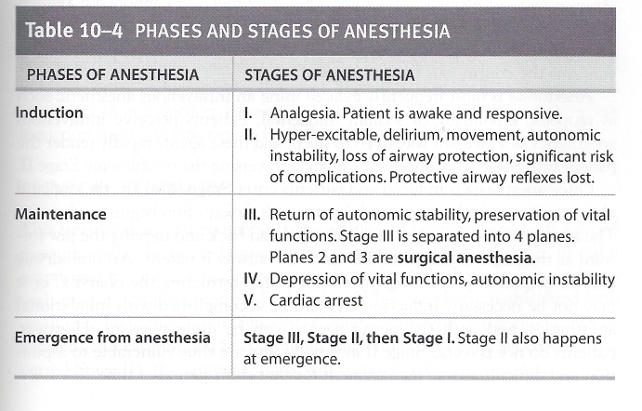
Problem Based Learning Anesthesia for the “Healthy” Patient
“Stages” of Anesthesia

Slide 28
Problem Based Learning Anesthesia for the “Healthy” Patient
The anesthetic plan should allow for a rapid return of mental function, and especially in the case of outpatients, recovery of psychomotor skills prior to discharge, as well as to minimize complications. Patients must be able to walk (if they could walk prior to the procedure), be medically stable, and free of pain, and nausea or vomiting prior to discharge from the hospital.

Slide 29
Problem Based Learning Anesthesia for the “Healthy” Patient
Prior to the induction of anesthesia, monitors are placed including
a blood pressure cuff,
an electrocardiogram,
a pulse oximeter,
a capnograph (which monitors end-tidal CO₂ detecting any deficit in ventilation or metabolism or elimination of CO₂),
an oxygen analyzer in the breathing circuit (which confirms the continuous flow of oxygen).
Anesthesia is most frequently induced using an intravenous anesthetic such as propofol, etomidate, or sodium thiopental.
Patients perceive intravenous anesthetics as a pleasant way to go to sleep, and these agents rapidly render the patient unconscious

Slide 30
Problem Based Learning Anesthesia for the “Healthy” Patient
Once anesthesia is induced , the oral and pharyngeal muscles lose tone and the patient's airway often begins to obstruct.
The airway can be managed by tilting the head back and moving the jaw forward at the angle of the mandible until the airway is patent.
An oral airway may be helpful in preventing the tongue from obstructing the pharynx, or it may not be necessary. Induction can also be accomplished with inhalational anesthetics, and with the newer agents, can be quite pleasant.

Slide 31
Problem Based Learning Anesthesia for the “Healthy” Patient
Anesthesia is typically maintained with an inhalation agent such as desflurane or sevoflurane, or with an intravenous infusion of propofol.
Oxygen and inhalation anesthetics are administered with a mask or through airway device such as a laryngeal mask airway (LMA) or an endotracheal tube. It should be noted that after a period of 2 hours, pressure on nerves from a mask may cause nerve palsies involving small branches of the facial nerves, particularly in the perioral region, potentially yielding hyperesthesia or analgesia on the face.
The laryngeal mask airway can similarly cause pressure on the recurrent larynzeal nerves, leading to (usually transient) vocal cord paralysis.

Slide 32
Problem Based Learning Anesthesia for the “Healthy” Patient

Slide 33
Problem Based Learning Anesthesia for the “Healthy” Patient
Unlike a mask or laryngeal mask airway, the placement of an endotracheal tube usually requires paralyzing a patient with a neuromuscular blocker.
Since paralysis removes the patient's `ability to breathe, and since intubation requires the mechanical instrumentation of the pharynx and trachea (which can lead to complications), intubation is only performed when there is an indication.

Slide 34
Problem Based Learning Anesthesia for the “Healthy” Patient
The maintenance of anesthesia is often supplemented with an opiate to reduce pain during and after surgery.
This in turn facilitates a reduction in the amount of anesthetic that is required. This patient, for example, would receive desflurane as the inhalation agent, 0₂, and a small amount of fentanyl , and may be added near the end of the procedure to minimize postoperative pain.

Slide 35
Problem Based Learning Anesthesia for the “Healthy” Patient
As wound closure begins, the anesthetic agent is discontinued.
Emergence begins, and the patient is allowed to awaken.

Slide 36
Problem Based Learning Anesthesia for the “Healthy” Patient
CLINICAL SUMMARY
This healthy man undergoing an arthroscopy will be monitored with a blood pressure cuff, electrocardiogram, pulse oximeter, end-tidal CO₂ monitor (capnograph), and a circuit oxygen analyzer.
His anesthetic will be induced with propofol, a laryngeal mask placed, and his anesthetic maintained with desflurane including a small amount of opiate at the end of the case.
Once he awakens and can respond to commands the laryngeal mask will be removed.

Slide 37
Problem Based Learning Anesthesia for the “Healthy” Patient
Comprehension Questions
10.1. A 32-year-old woman is scheduled for a laparoscopic tubal ligation. A surgical admission history and physical, and pre-anesthesia evaluation are performed. The patient's personal and family history of problems with anesthesia (ie, malignant hyperthermia or pseudocholinesterase deficiency), her NPO status, the presence or absence of gastric reflux, and medications taken on the day of surgery are elicited. Which of the following should also be included in her preoperative management?
A. An abdominal examination, noting any tenderness and/or
rebound.
B. An electrocardiogram and chest x-ray.
C. An airway examination including the degree of mouth opening and neck range of motion.
D. A prescription for postoperative analgesics.

Slide 38
Problem Based Learning Anesthesia for the “Healthy” Patient
ANSWERS
10.1. C.
An anesthetic evaluation includes an airway examination addressing the patient's degree of mouth opening typically expressed in "fingers breadths," and neck range of motion including flexion and extension, and side-to-side motions.
An electrocardiogram is not necessary for young, healthy patients, and a chest x-ray is only necessary as medically indicated.

Slide 39
Problem Based Learning Anesthesia for the “Healthy” Patient
Comprehension Questions
10.2. A 63-year-old man presents for an elective laparoscopic cholecystectomy. He is obese, has angina unpredictably and at rest, and chronic obstructive pulmonary disease (COPD). Which of the following would be his ASA classification?
A. ASA I
B. ASA II
C. ASA III
D. ASA IV
E. ASA V

Slide 40
Problem Based Learning Anesthesia for the “Healthy” Patient
ANSWERS
10.2. D.
The patient is obese, with angina unpredictably and at rest, and COPD.
His angina at rest represents a systemic disease which is unstable, and which could be life threatening.
In addition, he also has another comorbidity, COPD. His classification is ASA IV. Because this is a scheduled case, no "E" is added after the "IV."

Slide 41
Problem Based Learning Anesthesia for the “Healthy” Patient
Comprehension Questions
10.3. With his neck extended, mouth open, and tongue protruded, the patient's uvula is not visible. His airway should be classed as which of the following?
A. Mallampati 1
B. Mallampati 2
C. Mallampati 3
D. Mallampati 4

Slide 42
Problem Based Learning Anesthesia for the “Healthy” Patient
ANSWERS
10.3. C.
Since this patient's uvula is not visible, his airway is classed as Mallampati 3, suggesting a difficult intubation.

Slide 43
Problem Based Learning Anesthesia for the “Healthy” Patient
Comprehension Questions
10.4. As this patient awakens from a general anesthetic for an arthroscopy, he coughs, moves his arm, squirms on the table, and phonates when touched by the surgeon. He does not open his eyes or squeeze his hand on command. Which of the following is most accurate?
A. Movement and phonation indicate that the patient is "awake."
B. The patient is emerging from anesthesia. Since he can phonate, he can protect his airway.
C. Stage II is the stage at which the risk of complications is greatest.
D. This stage of anesthesia is observed more frequently at induction than emergence.

Slide 44
Problem Based Learning Anesthesia for the “Healthy” Patient
ANSWERS
10.4. C.
During Stage II of anesthesia, patients are hyperexcitable to external stimuli, and may phonate, move, manifest autonomic instability including arrhythmias, and cannot protect their airways.
This is the stage at, which the risk of complications is greatest.
Because of the rapidity with which patients receiving intravenous induction agents pass through Stage II, this stage of anesthesia is observed more frequently at emergence than induction.
The patient's ability to phonate is not related to his ability to protect his airway.

Slide 45
Problem Based Learning Anesthesia for the “Healthy” Patient
Clinical Pearls
The pre-anesthetic evaluation determines the anesthetic plan.
Difficult intubations may often be predicted.
The excitement stage of anesthesia (Stage II) happens at induction and emergence.
Intubation requires an indication.

