Slide 1
INTRODUCTION TO DERMATOLOGY
DR. MOHAMMAD AL SHAHWAN

Slide 2
Lecture outlines
-Function , Structure of the skin.
-Approach to dermatology patient.
-Morphology of skin lesions.
-Important signs and Investigations.
-Topical therapy and others.

Slide 3
Introduction to dermatology
The skin is a complex, dynamic organ.
It is the largest organ of the body.

Slide 4
Introduction to dermatology
It consist of many cell types and Specialized structures like “the Basement Membrane”
It serves multiple functions that are crucial to health and survival.
Notes:
D

Slide 5
Function:
Barrier to harmful exogenous substance & pathogens
Prevents loss of water & proteins
Sensory organ protects against physical injury
Regulates body temperature
Important component of immune system
Vit .D production by absorbing UVB
Has psychological and cosmetic importance such as hair, nails

Slide 6
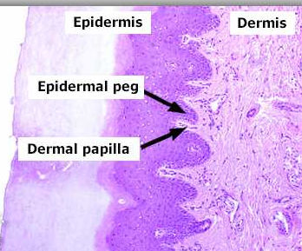
Skin Structure
The skin consists of:
Epidermis
Basement membrane
Dermis
Subcutaneous tissue
Skin appendages

Slide 7
Skin Structure
Epidermis: Consist of several zones
Basal layer (stratum basale) :columnar dividing cells.
Spinous layer (stratum spinosum): polyhedral cells
attached by desmosomes.
Granular layer (stratum granulosum): flat cells
containing keratohyaline granules.
Cornified layer (stratum corneum ):dead cell with no organells.
7

Slide 8
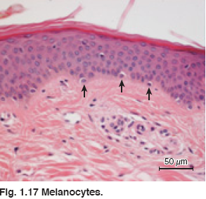
Skin Structure
Basal cell layer
keratinocytes :rest on the basement membrane and divides continuously and move upwards.
Melanocytes :dendritic cells lying between basal cells in a ratio of 1:10 and they synthesize melanin stored in melanosomes.
10 Keratinocytes

Slide 9
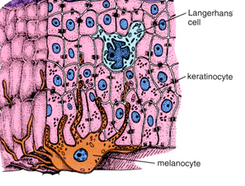
Skin Structure
Melanosomes are transferred to adjacent cells by means of dendrites thus forming the
“Epidermal Melanin Unit”
The size of melaosomes and
packaging differentiate white
from dark skin.
“The number of melanocytes are equal in white and dark skin”

Slide 10
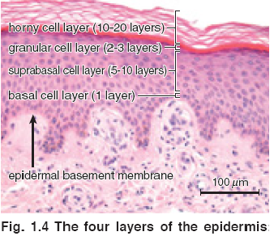
Skin Structure
Spinous cell layer:
Keratinocyte adhere to each other by desmosomes (complex modification of the cell membrane ) which appear like spines
Langerhans cells are antigen presenting

Slide 11
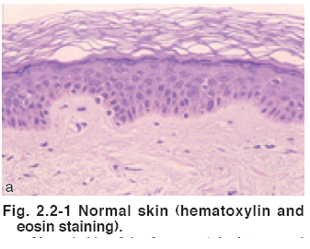
Skin Structure
Granular cell layer :
Diamond shaped cells.
Cytoplasm is filled with
keratohyaline granules.
Thickness of this layer is
proportional to the thickness of the stratum cornium
“In thin skin it is 1 -3- cell
layers and 10 cell layers in thick skin like palms and soles”

Slide 12
Skin Structure
Stratum corneum
The cells in this layer have no nucleus . It is 25 cell layer .
Cells have thick envelope
that resist chemicals.

Slide 13
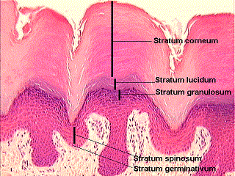
Skin Structure
Stratum lucidum is found in thick skin below Stratum cornium.

Slide 14
Basement membrane
It is a pink undulated
homogenous area between the epidermis and dermis
It consist of number of
proteins.
It is the site of attack injury in blistering diseases.

Slide 15
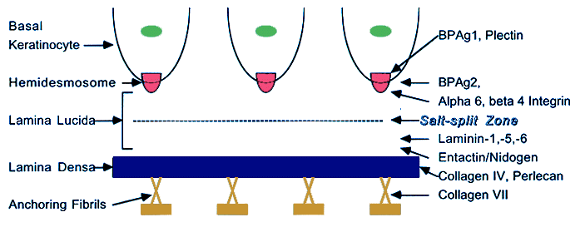
Skin Structure
Basement membrane
Formed by:
Plasma membrane of basal cells and hemidesmosomes
Thin clear amorphous
space (lamina lucida)
An electron dense area
(lamina densa )
Anchoring fibrils that anchors the epidermis to dermis .

Slide 16
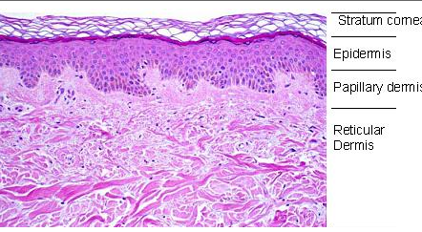
Skin structure
Dermis is divided into
Papillary dermis
Reticular dermis
Consists of :
1.Collagen fibers
Provides strength
Thin fibers in papillary
Dermis but thick and coarse in the reticular dermis .

Slide 17
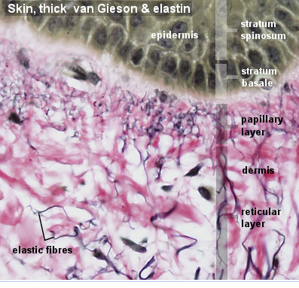
Skin Structure
2. Elastic Fibers.
Provides elasticity
Protection against shearing
forces.

Slide 18
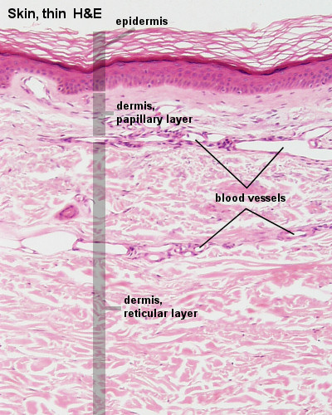
Skin structure
3. Ground substance
Binds water and maintains
the skin turgor.
4. Blood vessels and nerve
To nourish the overlying
epidermis also.
“Fibroblasts
Produce the above
elements”

Slide 19
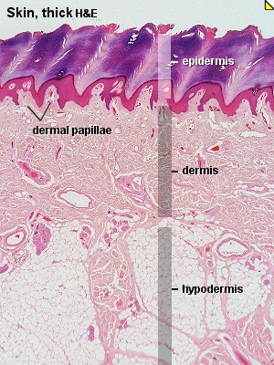
Skin Structure
Function of dermis:
It provides nourishment to the epidermis and interact with it during wound repair.
It gives the skin its strength ,elasticity, and softness.

Slide 20
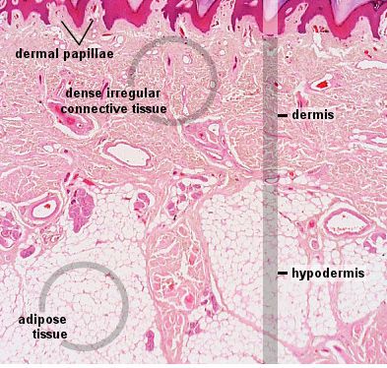
Skin structure
Subcutaneous Fat:
Composed of lipocytes

Slide 21
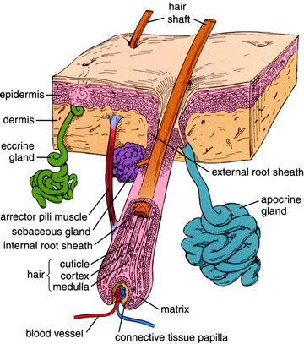
Skin Structure
Skin Appendages include:
Eccrine/ apocrine sweat
glands.
Sebaceous glands.
Hair Follicles.
Nails

Slide 22
Skin appendages
Eccrine sweat glands
Tubular structures open
freely on the skin ;not
attached to hair follicles.
Under the influence of
cholinergic stimuli.

Slide 23
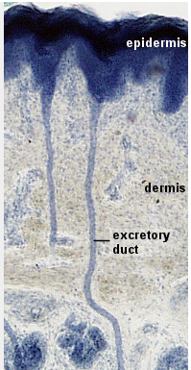
Skin appendages
Eccrine sweat glands.
Present everywhere except
“the vermilion border ; nail beds ; labia minora ; glans”
Abundant in “palms &soles”

Slide 24
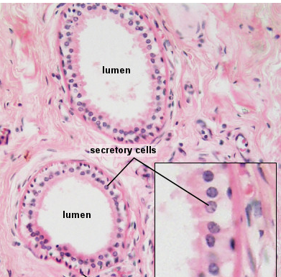
Skin appendages
Apocrine sweat glands:
Secrete viscous material
that give musky odor when
acted upon by bacteria.

Slide 25
Skin appendages
Apocrine sweat glands:
Present in the axillae ;
anogenital area ; modified
glands in the external ear
canal ; the eye lids and areolae.
Under adrenergic stimuli.

Slide 26
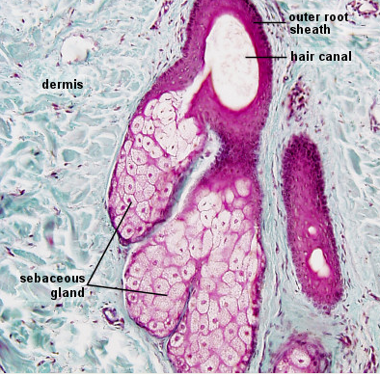
Skin appendages
Sebaceous glands:
Attached to hair follicles or open
freely.
Present in the scalp, forehead, face
upper chest except palms and soles.

Slide 27
Skin appendages
Sebaceous glands:.
In the areola as Montgomery
tubercles
In the eye lids as Meibomian
glands.
Ectopic glands in the mucous
membrane are called fordyce
spots.
Under the control of androgens.

Slide 28
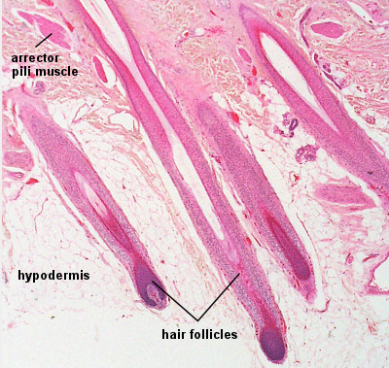
Skin Appendages
Hair follicles:
The hair follicle with it’s
attached sebaceous gland
Form the Pilosebaceous
Unit.

Slide 29
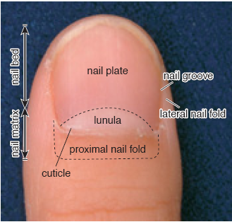
Skin appendages:
Nails.
The nail plate is formed of hard keratin
Proximal nail fold
morphology can be altered in connective tissue disease

Slide 30
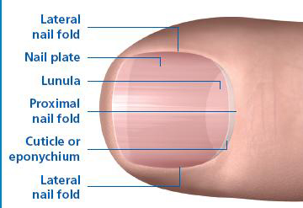
Skin appendages:
The lunula is the visible
part of the matrix
The matrix covers the
midportion of the distal
Phalanx
Fingernails grow
3mm/month
Toenails grow 1mm/month

Slide 31
Cornification (keratinization)
It is the cytoplasmic events that occur in the cytoplasm of epidermal keratinocytes
during their terminal
differantiation into dead
horny cell(corneocyte)
The total process takes
approximately 2 months.

Slide 32
Cornification (keratinization)
Abnormalities in this process leads to roughness and scaling of the skin like psoriasis

Slide 33
Lecture Outlines
-Function , Structure of the skin
-Approach to dermatology patient.
-Morphology of skin lesions
-Important signs and Investigations
-Topical therapy & others.

Slide 34
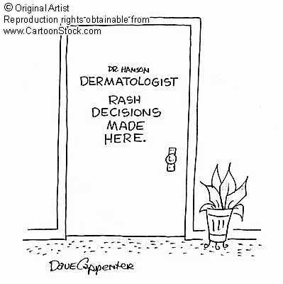
Approach to Dermatology Patient
Step 1: Start with basics
Age
Race
Sex
Occupation

Slide 35
Approach to Dermatology Patient
Step 2 :
Present complaints .

Slide 36
Approach to Dermatology Patient
History of skin lesion
Onset - when?
Where? site of onset.
Extension of lesions.
Evolution.
Itchy/ painful
Provocative factors (sun ,
cold, friction).
Treatment.

Slide 37
Approach to dermatology patient
Past medical history.
Family history.
Drug history.
Recreational and social
history.

Slide 38
Examination
Use good light when
examining a patient.
Examine nails & mucous
membrane.

Slide 39
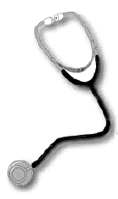
Examination:
Describe the general
appearance of patient.
Describe distribution of lesions
Describe arrangement of
lesions
Describe the type of the lesion
Describe the shape.
Describe the color.
Describe size.

Slide 40
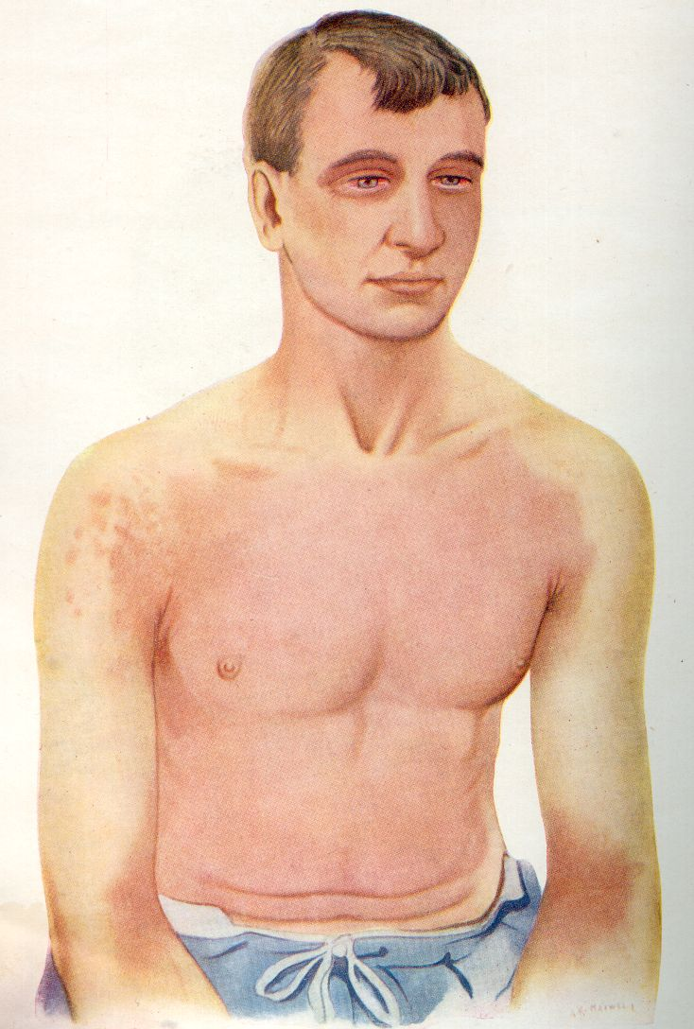
Distribution
Generalized :
1.Symmetrical
2. Asymmetrical
Focal :
1.Unilateral
2.Bilateral

Slide 41
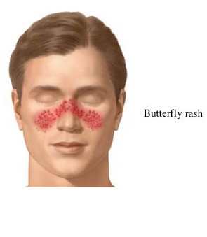
Distribution
Localized to:
-Acral
-Sun exposed.
-Trauma sites.
-Flexures.
-Specific part.

Slide 42
Configuration
The relation of lesions to each other.
-Linear.
-Grouped.
-Annular.
-Reticular.
-Circinate (circular)
-Arciform (arc like)
-Dermatomal.

Slide 43
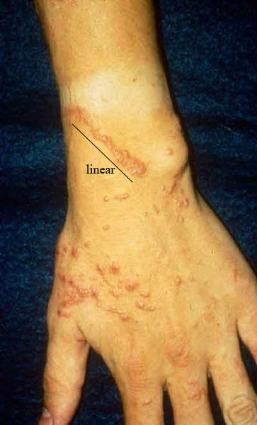
Configuration
Linear:
Forms a line .

Slide 44
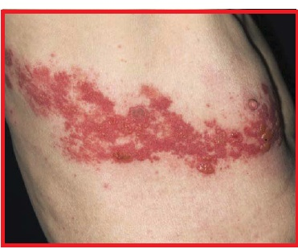
Configuration
Dermatomal.

Slide 45
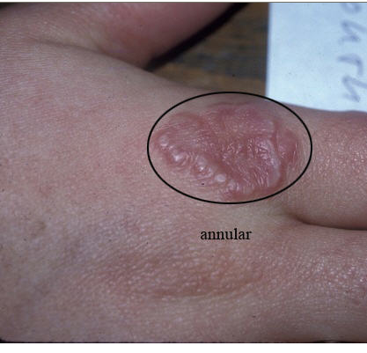
Configuration
Annular
Ring like .

Slide 46
Configuration
Grouped

Slide 47
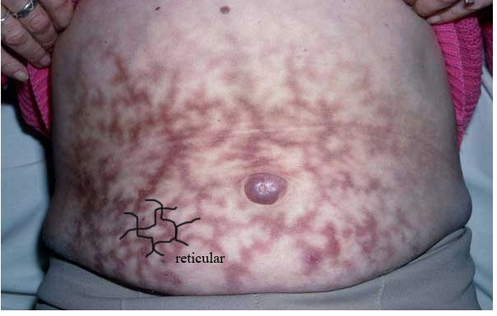
Configuration
Reticular
Net like .

Slide 48
Lecture outlines
-Function , Structure of the skin.
-Approach to dermatology patient.
-Morphology of skin lesions.
-Important signs and Investigations
-Topical therapy &others.

Slide 49
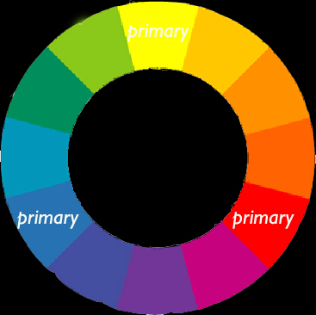
Morphology
“Shape /type of lesion”
Skin lesions are divided into
Primary =Basic lesion.
Secondary= Develop
during evolution of skin
disease created by
scratching or infection

Slide 50
Morphology
Primary lesions
Macule/patch
Papule/plaque
Nodule
Cyst
Wheal
Secondary lesions
Excoriation
Erosion
Scale
Fissure
Ulcer

Slide 51
Morphology
Primary lesions
Vesicle/bulla
Pustule
Purpura
Burrow
Secondary lesions
Excoriation
Erosion
Scale
Fissure
Ulcer

Slide 52
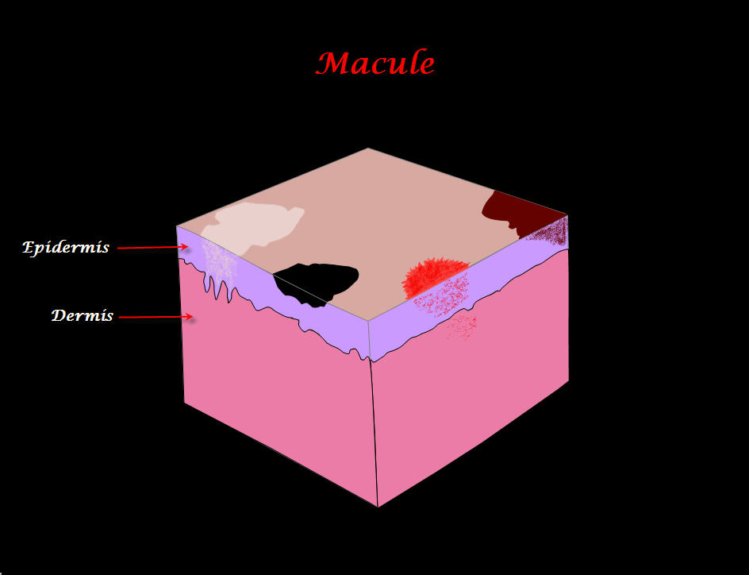
Primary Skin Lesions
Macule :
Flat circumscribed
discoloration that lacks
surface elevation or
depression (<0.5 cm).

Slide 53
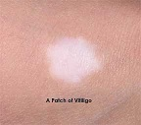
Primary lesions
Patch:
Flat circumscribed skin
discoloration; a large
Macule (> 0.5cm).

Slide 54
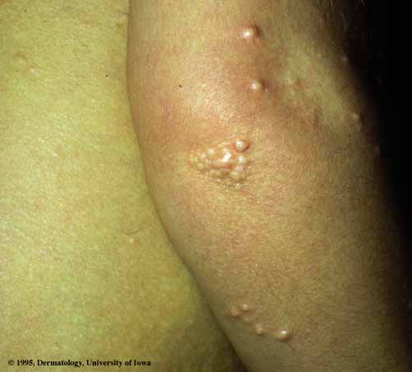
Primary Skin Lesions
Papule :
Elevated, Solid lesion
< 0.5cm in diameter.
Notice color and surface
changes eg.Umblicated,
Keratotic,Papillomatous
Flat topped.

Slide 55
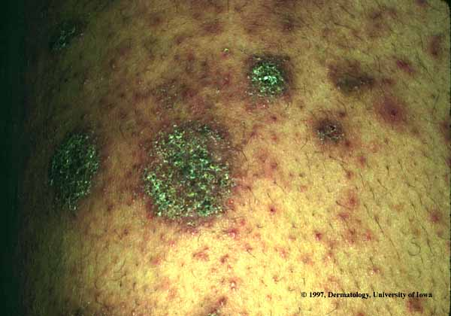
Primary Skin Lesion
Plaque:
Elevated, solid confluence
or expansion of papules
> 0.5 (lacks a deep
component ).

Slide 56
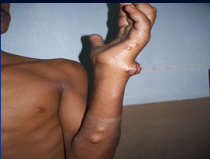
Primary Skin Lesions
Nodule :
Elevated, Solid lesion
> 0.5 cm in diameter;
with deep component

Slide 57
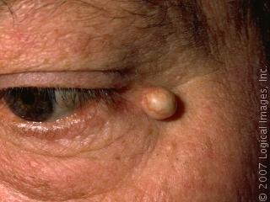
Primary Skin Lesions
Cyst:
Nodule that contains fluid or semisolid material.

Slide 58
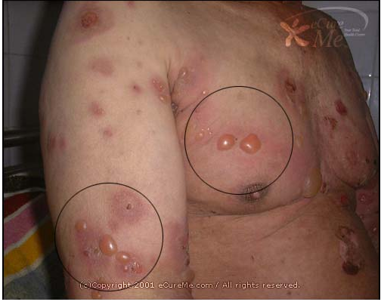
Primary Skin Lesions
Vesicle:
Elevation that
contains clear fluid.
Bulla:
Localized fluid
collection >0.5cm in
diameter a large vesicle

Slide 59
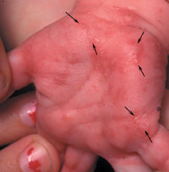
Primary Skin Lesions
Burrow:
Linear tunnel in the
epidermis induced by
scabies mite

Slide 60
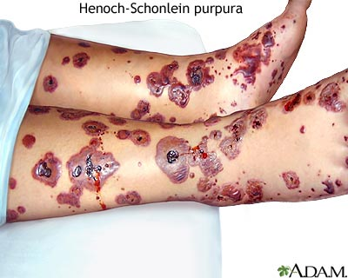
Primary Skin Lesions
Purpura:
Extra-vasation of red
blood cells giving non-
blanchable erythema

Slide 61
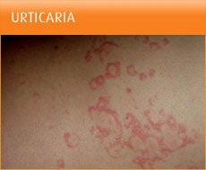
Primary Skin Lesion
Wheal:
Firm, edematous plaque that is evanescent (short
lived)and pruritic; a hive.

Slide 62
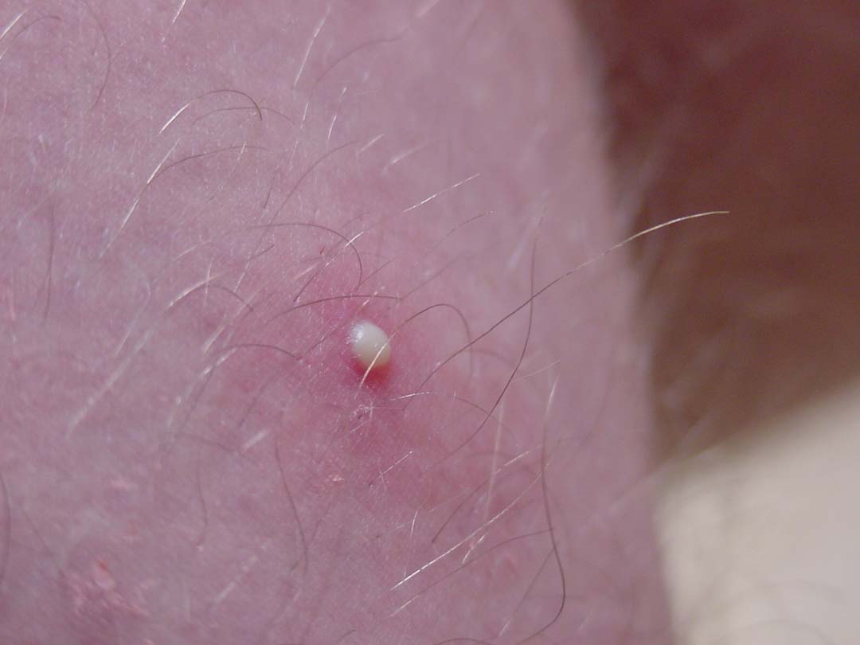
Primary Skin Lesions
Pustule:
Elevation that contains
purulent material.

Slide 63
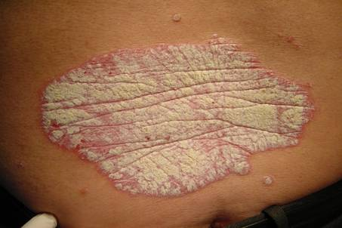
Secondary Skin Lesions
Scale:
Thick stratum cornium

Slide 64
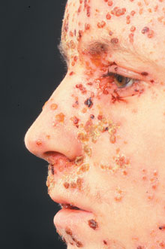
Secondary Skin Lesion
Crust:
A collection of cellular debris, dried serum and blood .
Antecedent primary
lesion usually a vesicle,
bulla, or pustule.

Slide 65
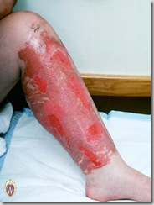
Secondary Skin Lesions
Erosion:
A partial focal loss of
epidermis that heals
without scarring.

Slide 66
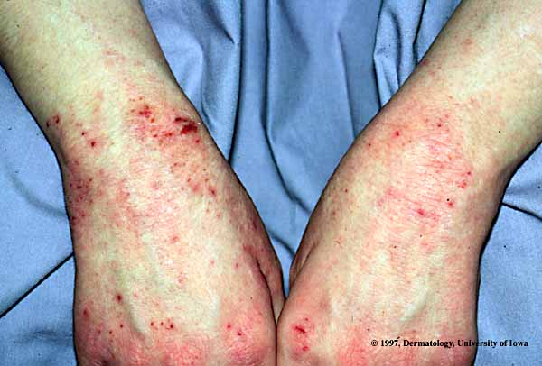
Secondary Skin Lesions
Excoriation :
Linear erosion induced by scratching

Slide 67
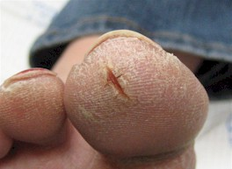
Secondary Skin Lesions
Fissure :
Vertical loss of epidermis and dermis with sharply defined walls: crack in skin

Slide 68
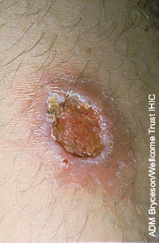
Secondary Skin Lesion
Ulcer :
A full thickness focal loss of epidermis and dermis; heals with scarring

Slide 69
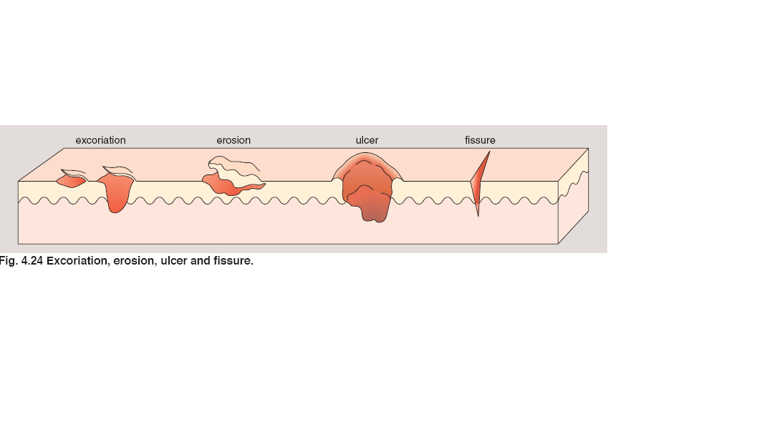

Slide 70
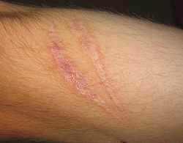
Secondary Skin Lesions
Scar:
A collection of new
connective tissue; may
be hypertrophic or
Atrophic; implies
dermoepidermal
damage

Slide 71
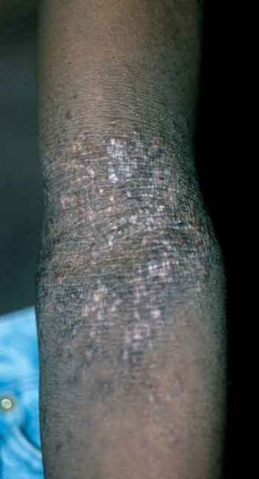
Secondary Skin Lesions
Lichenification:
Increased skin markings
secondary to scratching.

Slide 72
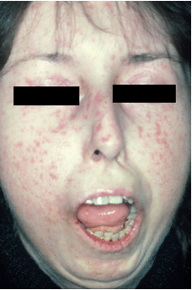
Specialized Terminology
Sclerosis:
Hardening of the skin .
Skin is un-pinchable .

Slide 73
Quiz
Bilateral yellow plaques

Slide 74
Quiz
Keratotic papillomatous skin colored plaque

Slide 75
Quiz
Umblicated pearly papules, some are grouped

Slide 76
Quiz
Annular erythematous scaly plaque

Slide 77
Quiz
Grouped vesicles on erythematous base

Slide 78
Quiz
Yellow crust, erosions, flaccid bulla on erythematous base

Slide 79
Quiz
1 cm cyst with telangiectasia

Slide 80
Quiz
Unilateral erythematous patch

Slide 81
Lecture Outlines
-Function , Structure of the skin.
-Approach to dermatology patient.
-Morphology of skin lesions.
-Important signs and Investigations.
-Topical therapy & others.

Slide 82
Important Sign in Dermatology:
A
NIKOLSKY SIGN:
Rubbing of apparently
normal skin induce
blistering
Seen in pemphigus vulgaris
and toxic epidermal
necrolysis (TEN)

Slide 83
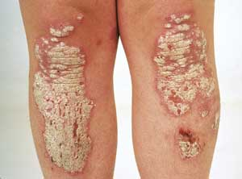
Important Signs in Dermatology
AUSPITZ SIGN
Removal of scale on top of a red papule produces bleeding points
Seen in psoriasis

Slide 84
Important Sign in Dermatology:
Koebner’s phenomenon:
Trauma to the skin produce
certain diseases like
a.Psoriasis
b.Vitiligo
c.Lichen planus.
d.Warts.

Slide 85
Important Signs in Dermatology
DERMATOGRAPHISM
Firm stroking of the skin
produce erythema and
wheal
Seen in physical urticaria
And in patient with atopy.

Slide 86
Investigations
Wood’s lamp :
Produces long wave UVL (360 nm)
Useful in
*Tinea Versicolor-Yellow green flourescence
* Tinea Capitis -yellow green
flourescence in ( M.canis, M.
Andouini)

Slide 87
Investigations
Woods lamp :
*Vitiligo - Milky white.
* Erythrasma –coral red
flourescence

Slide 88
Investigation:
KOH preparation for
fungus:
Cleanse skin with alcohol
Swab.
Scrape skin with edge of microscope slide onto a second microscope slide

Slide 89
Investigation:
KOH preparation for
fungus:
Put on a drop of 10% KOH
Apply a cover slip and
warm gently
Examine with microscope
objective lens

Slide 90
Investigation:
Tzank smear :
Important in diagnosing
Herpes simplex or VZV
(multinucleated giant cells)
Pemphigus Vulgaris
(acantholytic cells).

Slide 91
Investigation:
Tzank smear:
METHOD
Select a fresh vesicle.
De-roof and scrape base of the vesicle.
Smear onto a slide.
Fix with 95% alcohol.
Stain with Giemsa stain.
Examine under
microscope.

Slide 92
Investigation
Prick test :
Put a drop of allergen
containing solution
A nonbleeding prick is
made through the drop.
After 15-20 mins the
antigen is washed , the
reaction is recorded.

Slide 93
Investigation
Prick test :
A positive test shows
urticarial reaction at site of prick.
Detects immediate-type
IgE mediated reaction
Emergency theraputic
measures should be
available in case of
anaphylaxis.

Slide 94
Investigations
PATCH SKIN TEST
Important in contact dermatitis
Select the most probable
substance causing dermatitis
Apply the test material over the back
Read after 48 & 72 hr. look for (erythema, edema, vesiculation)

Slide 95
Investigations
Positive patch test showing
erythema and edema.
In severe positive reaction
vesicles may be seen

Slide 96
Investigation
SKIN PUNCH BIOPSY
Clean skin with alcohol
Infiltrate with 1-2%
xylocaine with adrenaline
Rotate 2-6 mm diameter
Punch into the lesions

Slide 97
Investigation
Lift specimen and cut at
base of lesion
Put in 10% formalin
“For Immunoflourescence
Put in normal saline”

Slide 98
Investigations
Direct immunoflouresence DIF
Used to diagnose autoimmune diseases e.g.
PemphigusVulgaris
Bullous pemphigoid

Slide 99
Investigations
Direct immunoflouresence ( DIF)
Detects immunoglobulin
and complement deposits
in skin.

Slide 100
Investigations
Direct immunoflouresence
Fluorescence will be noted if
immunoglobulin deposits are
Intercellularly between the
epidermal cells as in
pemphigus vulgaris
or at the Basement membrane
zone as in bullous pempigoid

Slide 101
Investigation:
Indirect Immuno
Fluorescence : IDIF
Detect auto antibodies in the serum
It is used to confirm a diagnosis
To differentiate between bullous diseases
To monitor disease activity

Slide 102
Lecture Outlines
-Function , Structure of the skin.
-Approach to dermatology patient.
-Morphology of skin lesions.
-Important signs and Investigations.
-Topical therapy and others.

Slide 103
Topical Therapy
A wide variety of topical
agents are available.
Delivers the drug to target site.
If the lesion is dry -wet it
if wet -dry it.(Golden rule)

Slide 104
Topical Therapy
Wet compresses - dries wet lesions.
Like KMNO4
Wet compresses are
Antibacterial
Cause debridment
Suppress inflammation.

Slide 105
Topical Therapy
Topical drugs consist of
Active substance like steroids, antimicrobial agents and vehicle.
Vehicle:
Is the base in which the active ingredient is dispersed.

Slide 106
Topical therapy
Topical steroids side effects:
Atrophy and striae.
Telangiectasia and purpura.
Masking the initial lesion.
Perioral dermatitis and rosacea or acne.
Systemic absorption.
Tachyphylaxis. (sudden loss of response)

Slide 107
Topical therapy
Guidelines regarding steroid use:
Avoid high potency steroid on flexures and face.
Avoid high potency steroid in children.
Avoid use for extended periods of time.

Slide 108
Topical Therapy
Creams are mixture of oils and water in which the active substance is dispersed.
Creams are white in color- useful in folds.

Slide 109
Topical Therapy
Ointments are primarily
grease. They are useful in
dry lesions e.g. petrolatum
jelly and mineral oil.
They are translucent

Slide 110
Topical Therapy
Gels are mixtures of
propylene glycol and water.
Sometimes they contain
alcohol . They are
translucent and are best
used in wet disorders and hairy regions

Slide 111
How much to use?
Finger tip unit:
The amount of cream/ointment expressed
from 5mm nozzle.
It weighs 0.5g.
It covers 2 hand units.

Slide 112
Finger Tip Unit

Slide 113
Phototherapy machine/NBUVB

Slide 114
Hand and feet narrow band UVB

Slide 115
Vitiligo treated by NBUVB
Other indications include psoriasis
Lichen planus
Eczema

Slide 116
Liquid nitrogen gun
(Cryotherapy)
Used to treat warts

Slide 117
Electric cautery
Used to destroy skin tags
Malignant tumors

Slide 118
Quiz
Linear nodules with ulceration

Slide 119
Quiz
Multiple erosions

Slide 120
Annular bulla
Quiz
Erosions, crusts, annular bullae

Slide 121
plaques
scar
hyperpigmentation
erosion
scales
Quiz
Scales, plaques, scars , erosions, hyperpigmentation

Slide 122
Quiz
Confluent flat topped papules forming plaques

Slide 123
Quiz
Erythematous papules

