Slide 1
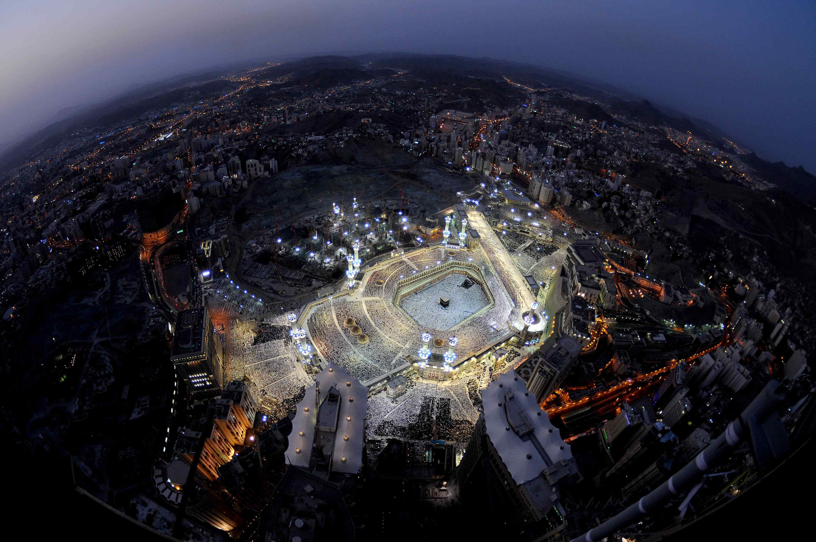
Hair and Pigmentary
Alopecia and Vitiligo
ABDULMAJEED ALAJLAN, MD
ASSOCIATE PROFESSOR
DERMATOLOGY DEPT.
HAIR TRANSPLANT SURGERY
HEAD OF LASER AND PHOTOTHERAPY UNIT

Slide 2
Objectives
To know the anatomy and physiology of hair
To recognize the primary presentation of main types of hair loss
To understand the possible pathogenesis of each type.
To know the scheme of managements lines

Slide 3
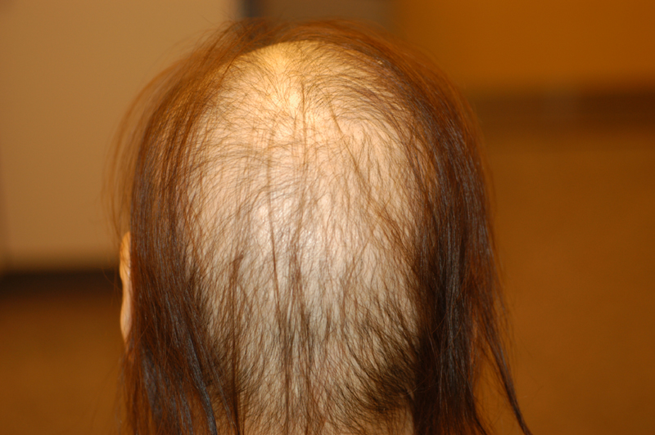
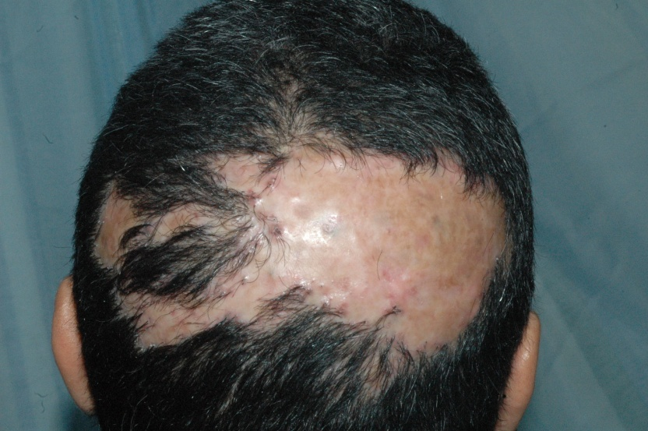
Alopecia
None Scaring
Scaring
.
X

Slide 4
Introduction & definition
Alopecia = HAIR LOSS
Basic hair anatomy and Physiology
Hair growth is very dynamic
Vellus and Terminal hair

Slide 5
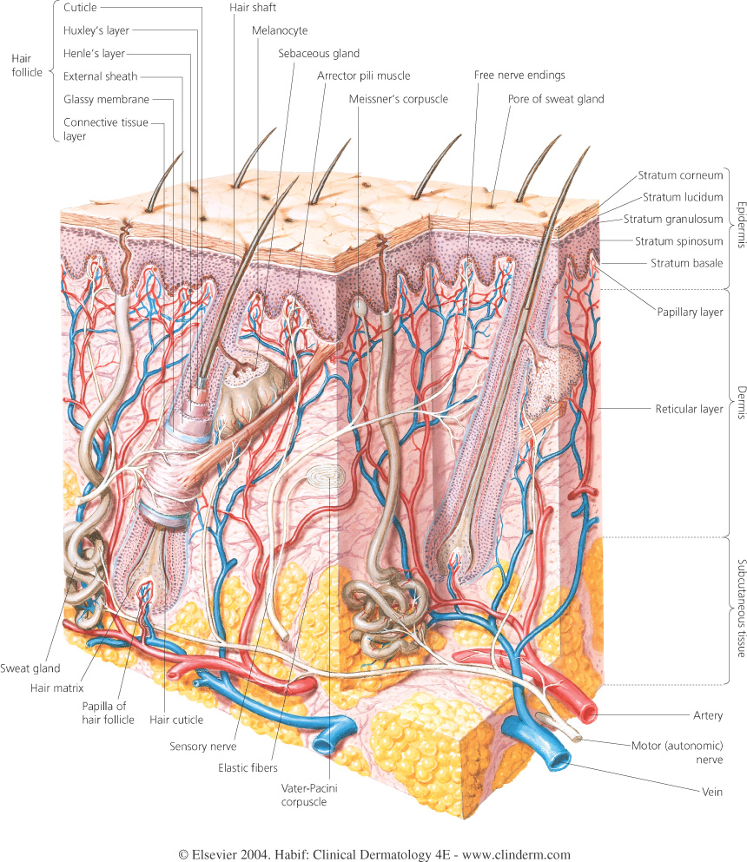
Introduction & definition

Slide 6
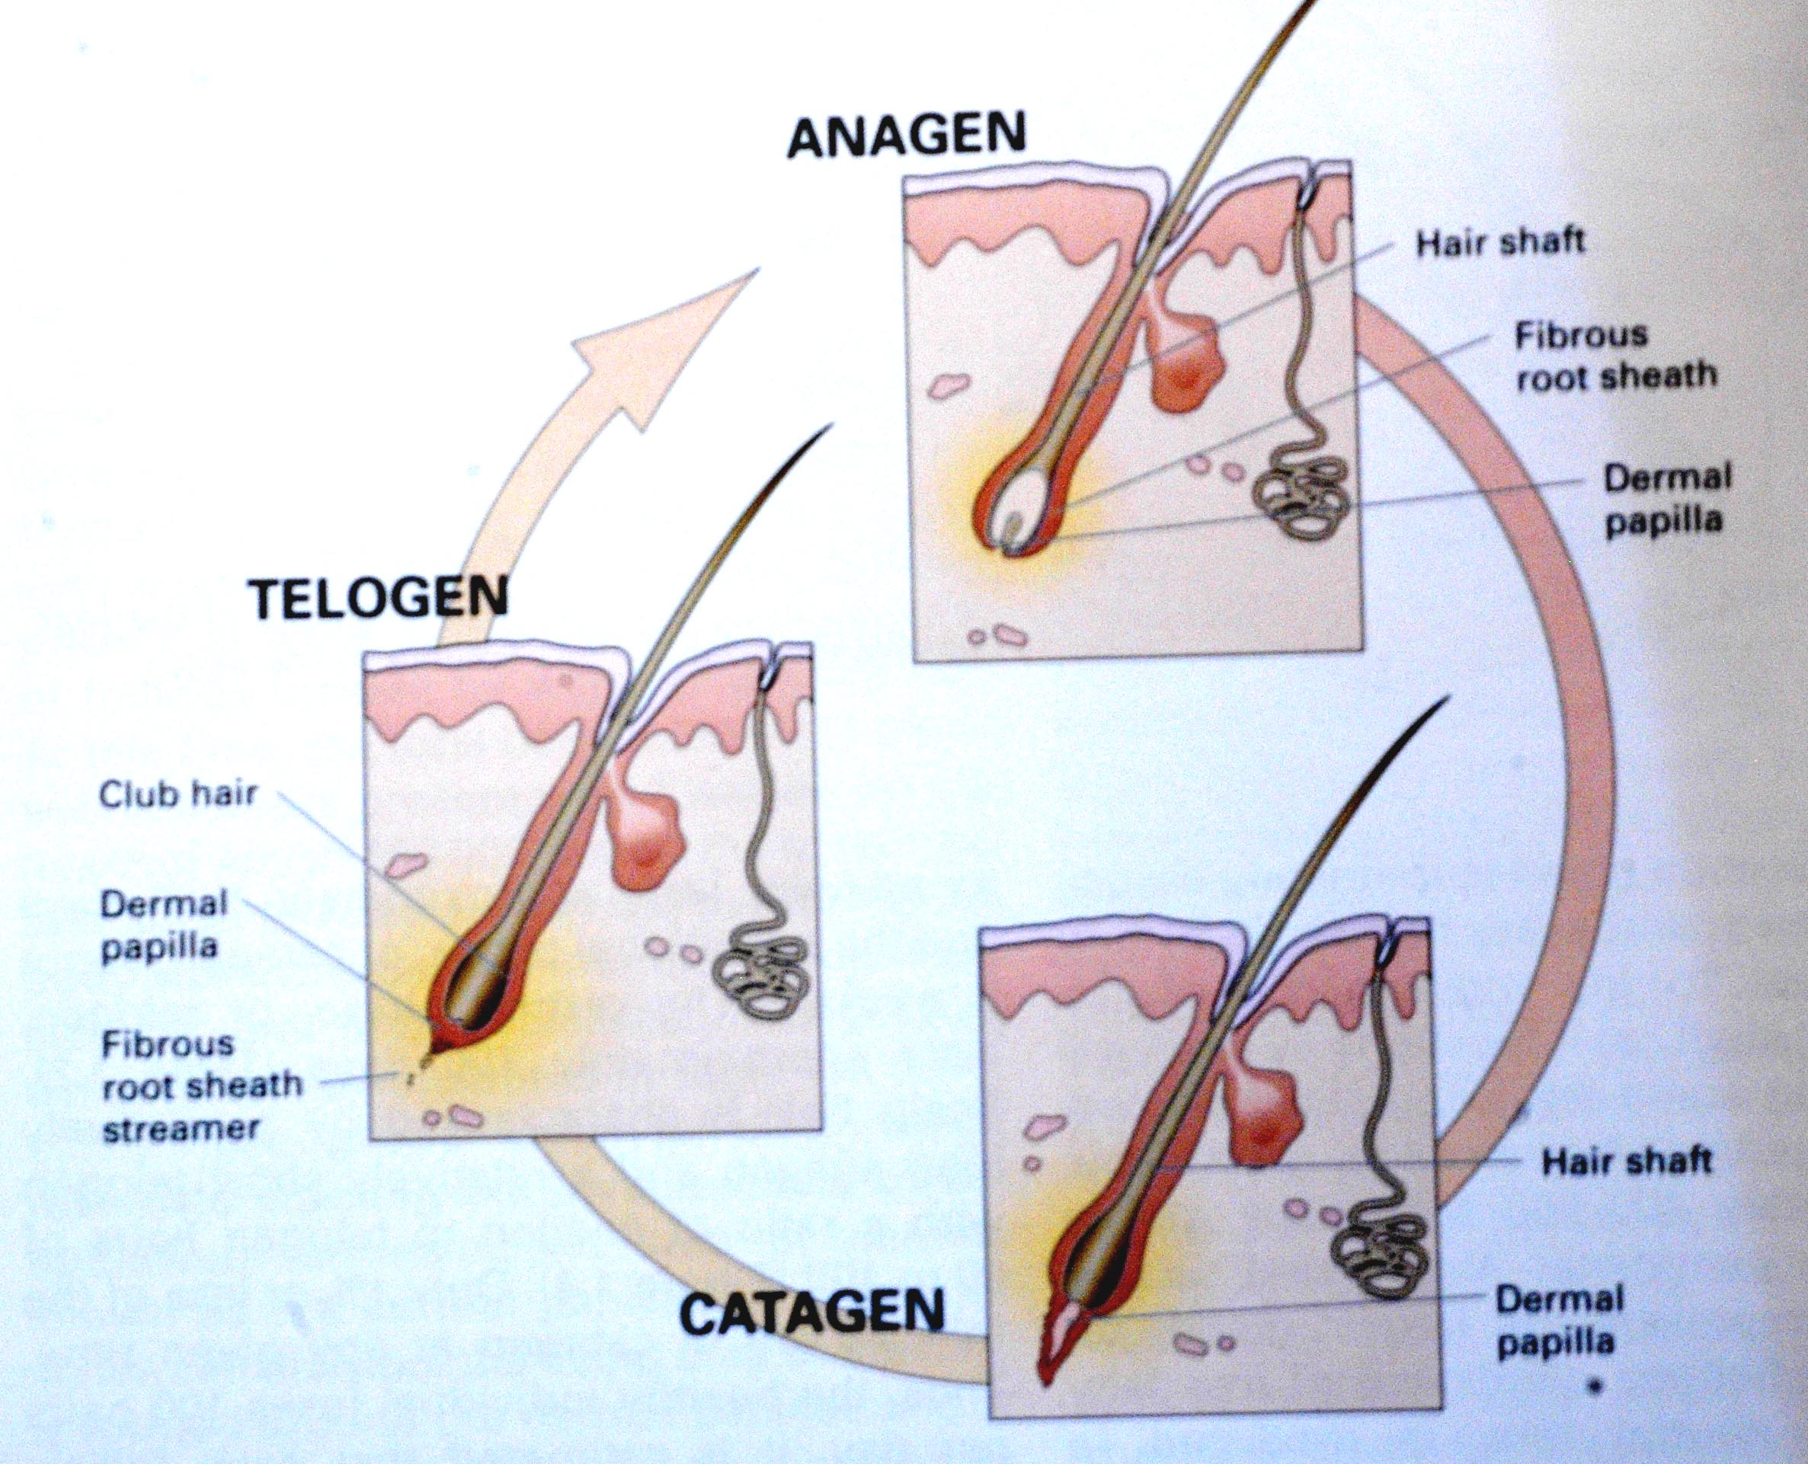
Introduction & definition

Slide 7
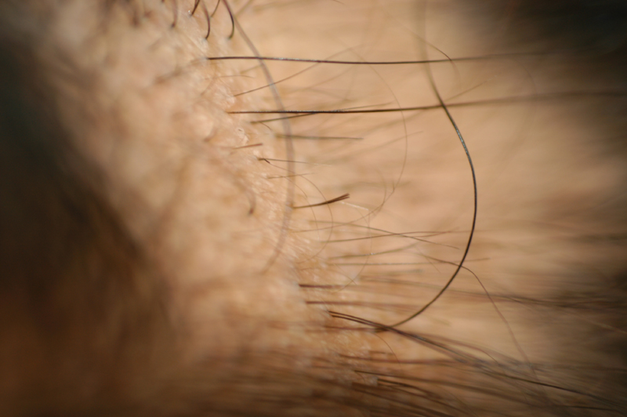

Slide 8
Introduction & definition
Alopecia = HAIR LOSS
Basic hair anatomy and Physiology
Hair growth is very dynamic
Vellus and Terminal hair
How many hairs in the body?
5 millions hairs; 100,000 in the scalp
Growth rate?
0.3mm/day for scalp hair

Slide 9
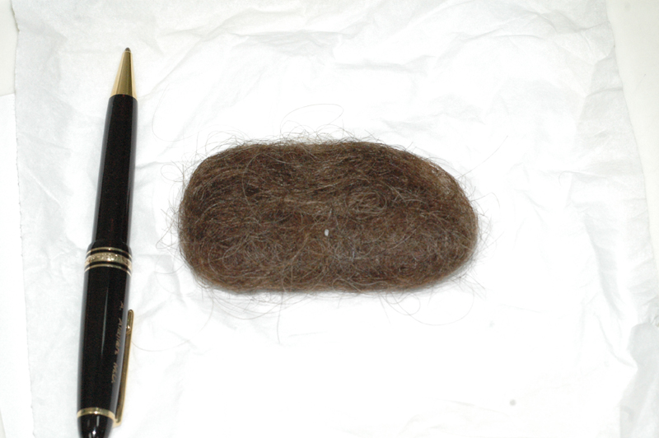

Slide 10
Androgenetic Alopecia
(Male and Female Pattern Hair Loss)

Slide 11
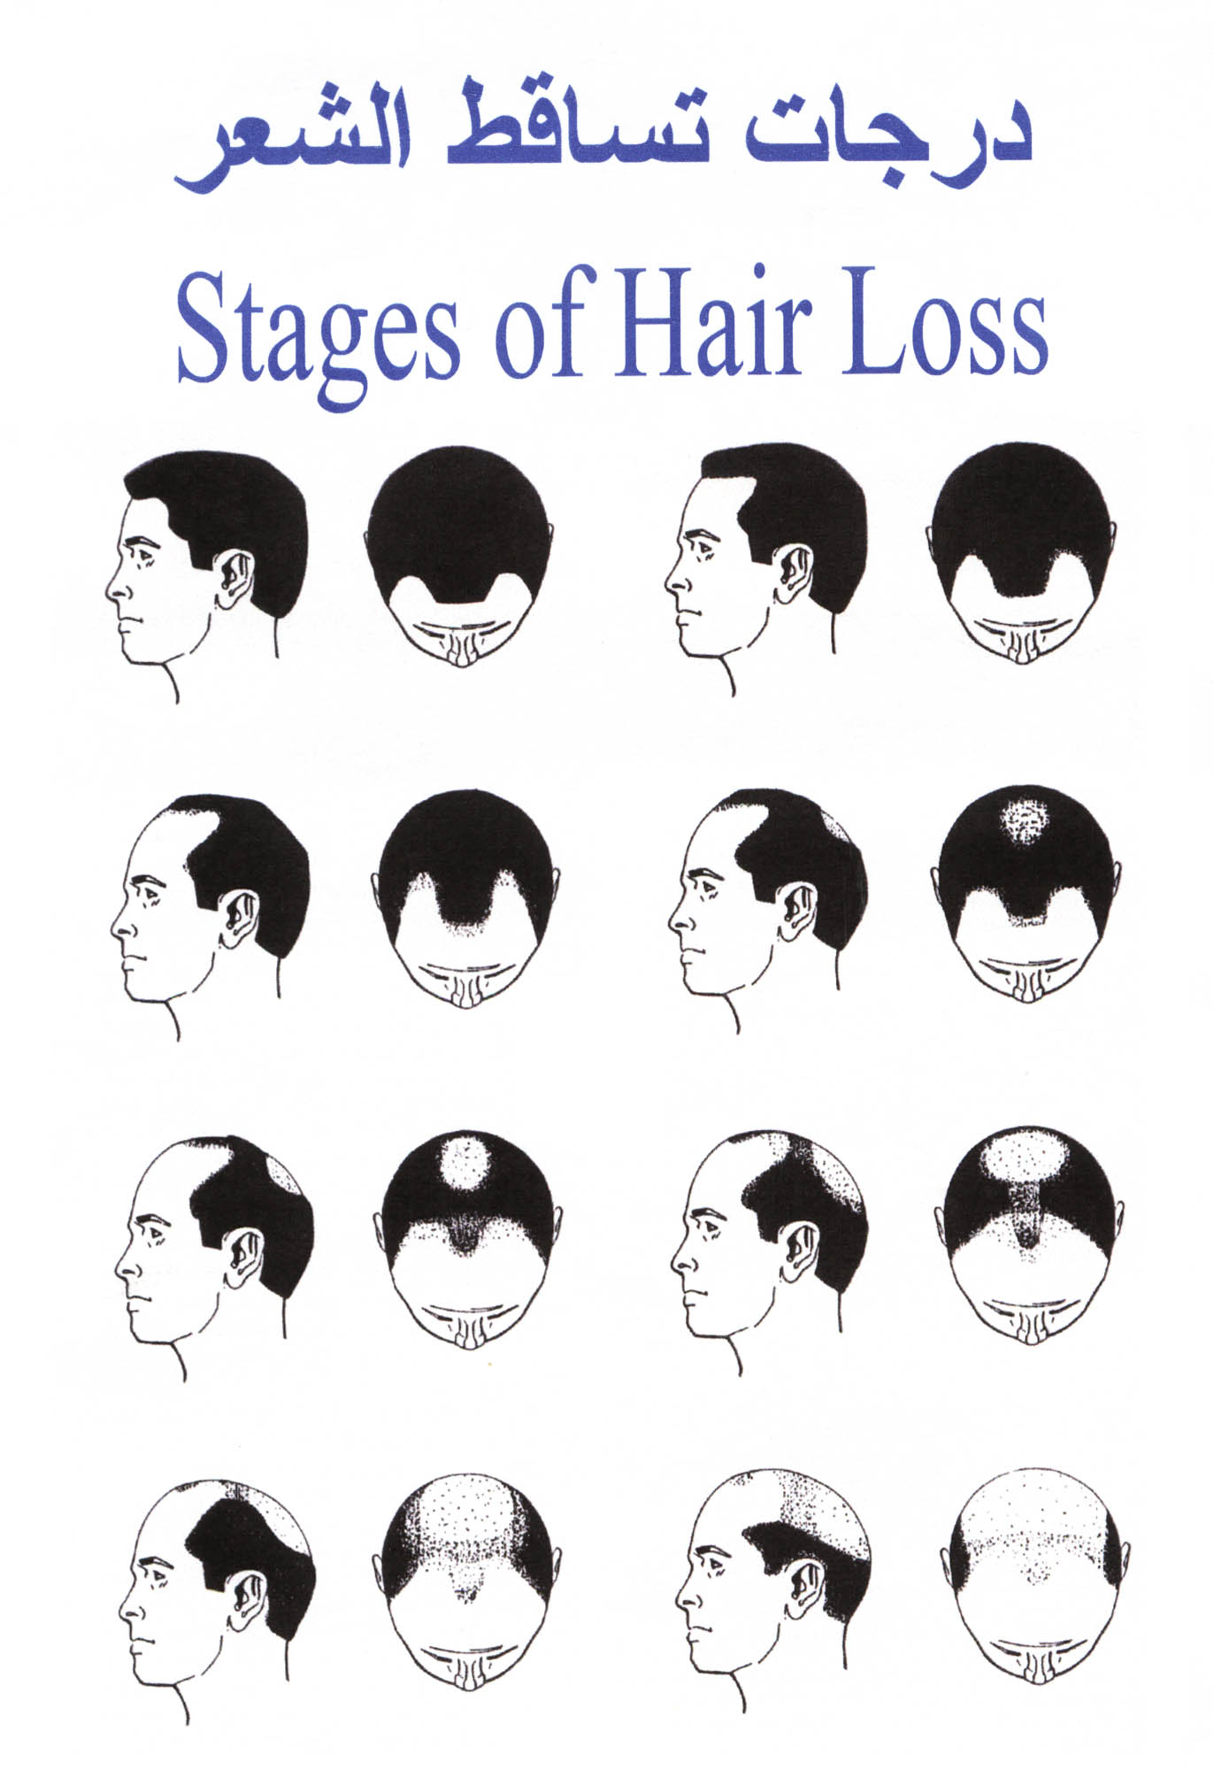

Slide 12
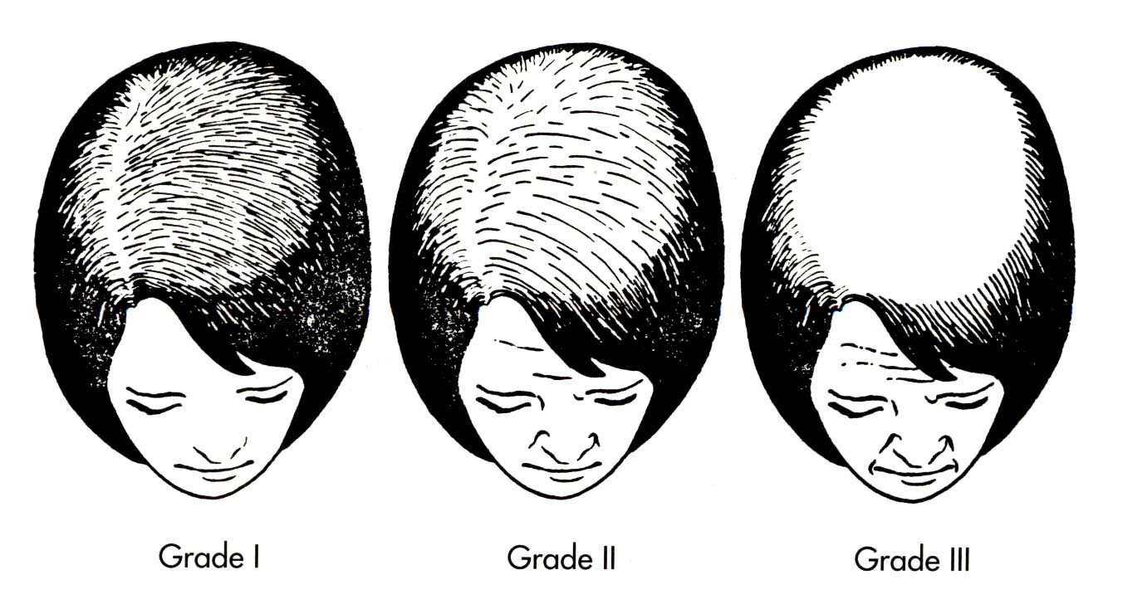
Female Pattern Alopecia
.

Slide 13
Androgenetic Alopecia
Androgenetic Alopecia affects up to 50% of males and 40% of females
Autosomal dominant with variable penetrance
85% : +ve family history
Role of androgens in the pathogenesis

Slide 14
5 ALPHA Reductase
X
Fenastride
Testosterone
DihydorTestosterone (Active)

Slide 15
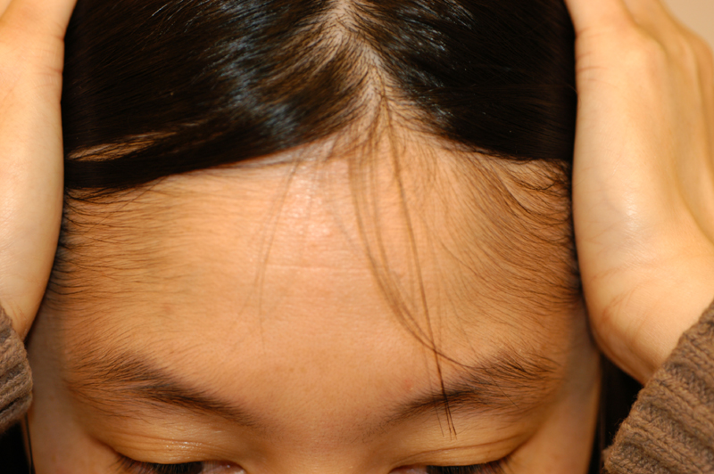
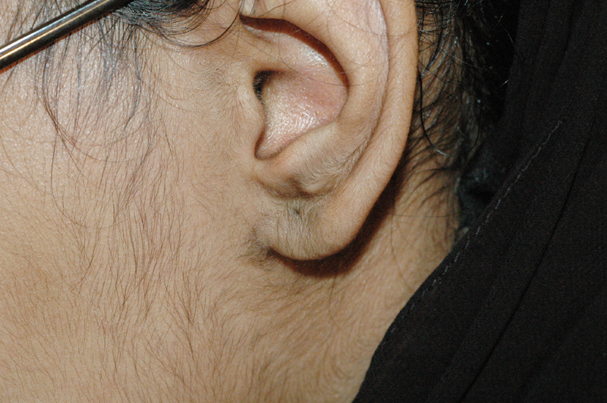
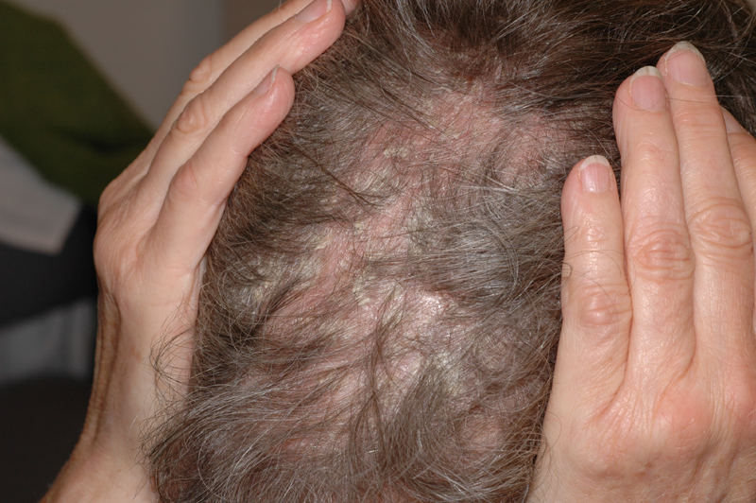
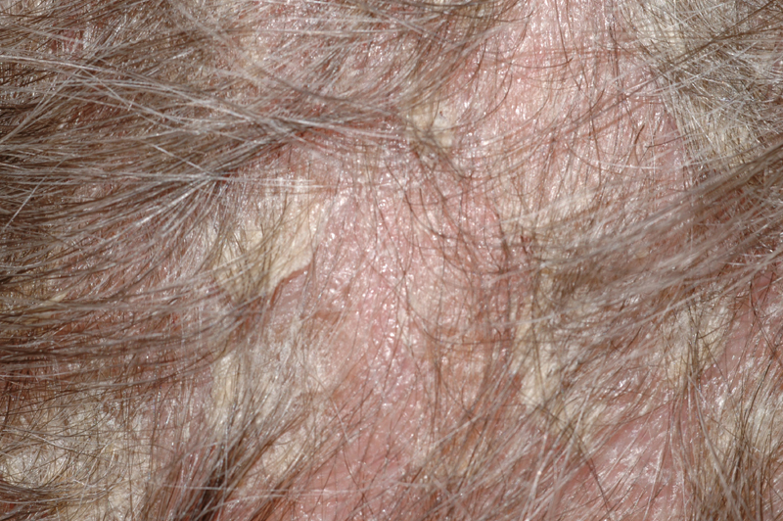
Minoxidil 2% and 5%
Alajlan/Vitiligo 1433

Slide 16
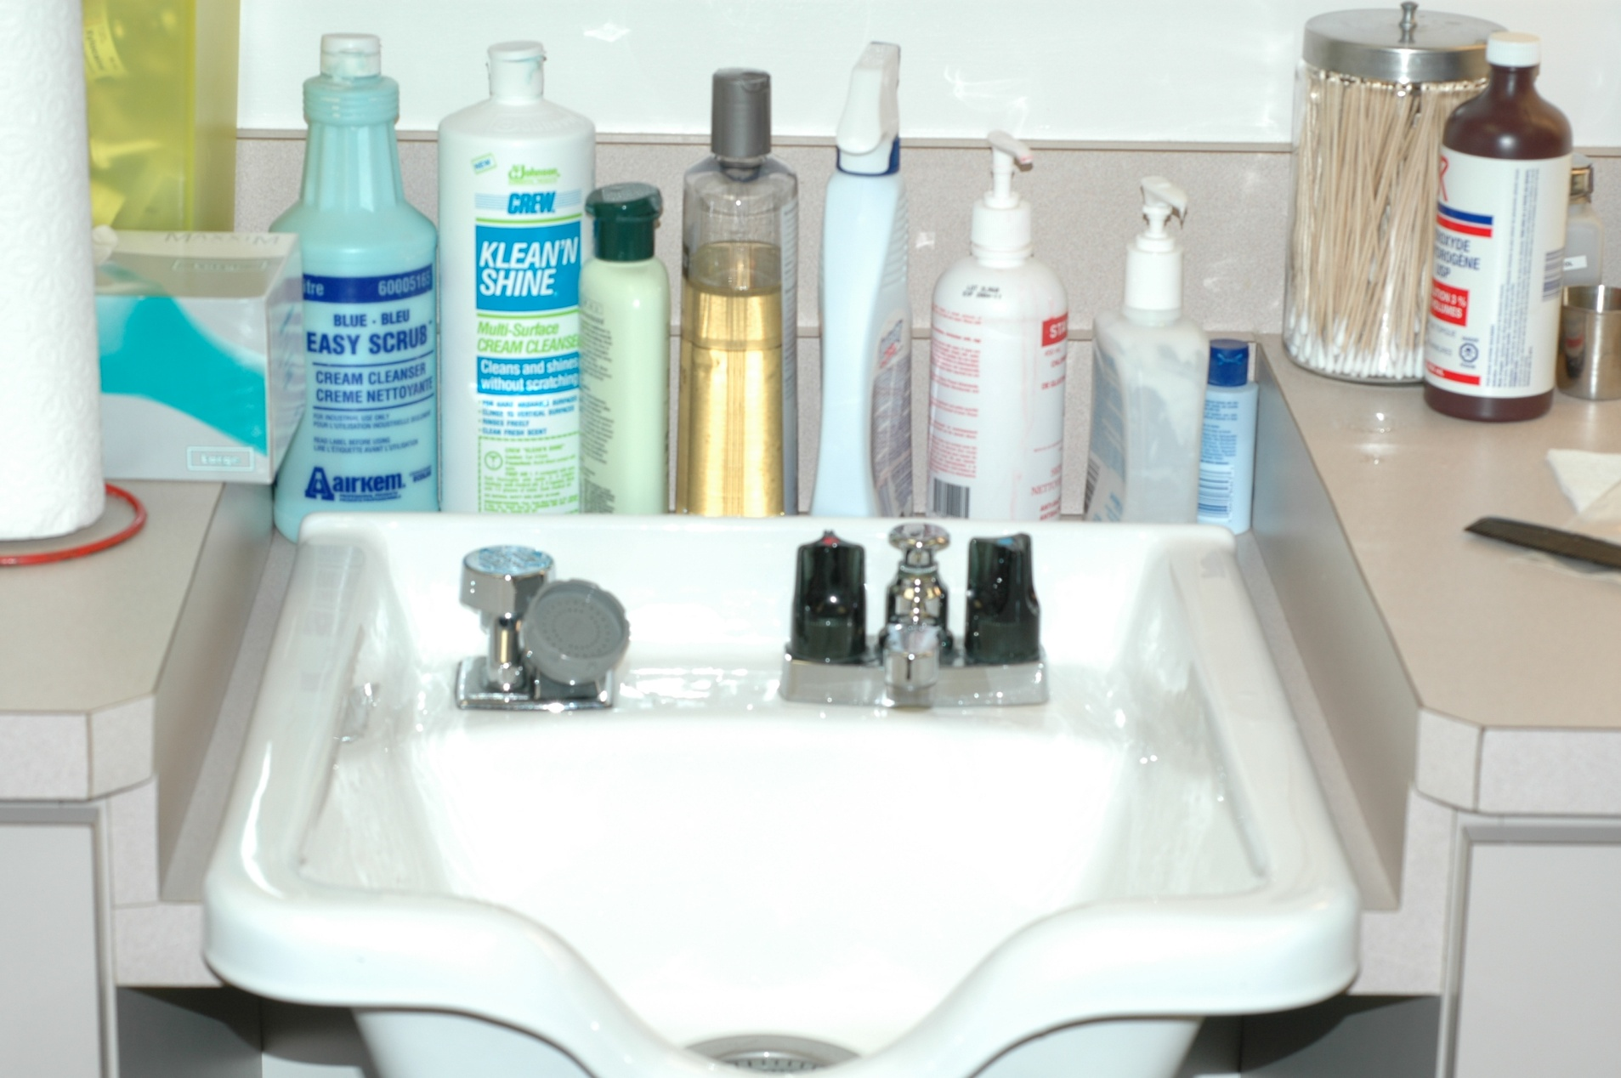
NO

Slide 17
Alopecia Areata

Slide 18
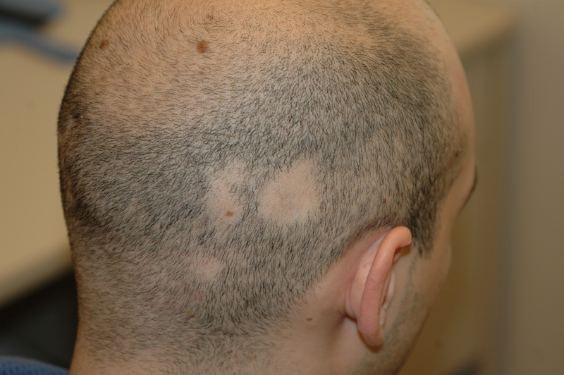

Slide 19
Alopecia Areata
Alopecia Areata affects up to 2%
30%: +ve Family history
75% : Self recovery
Role of immune system in the pathogenesis

Slide 20
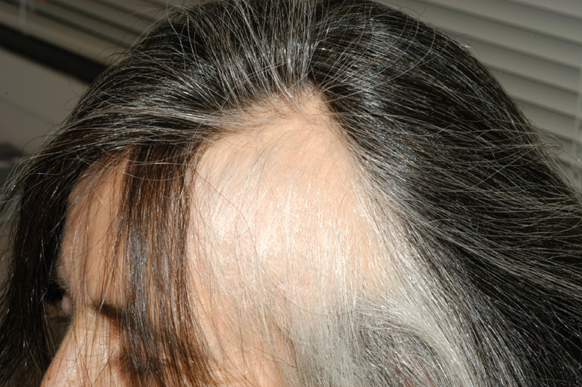
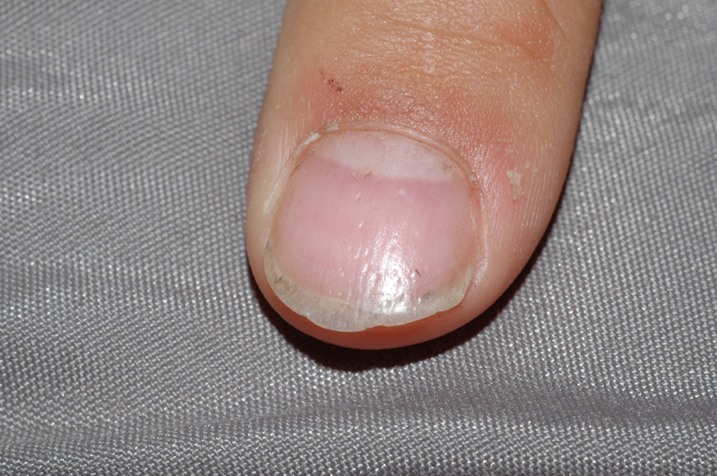

Slide 21
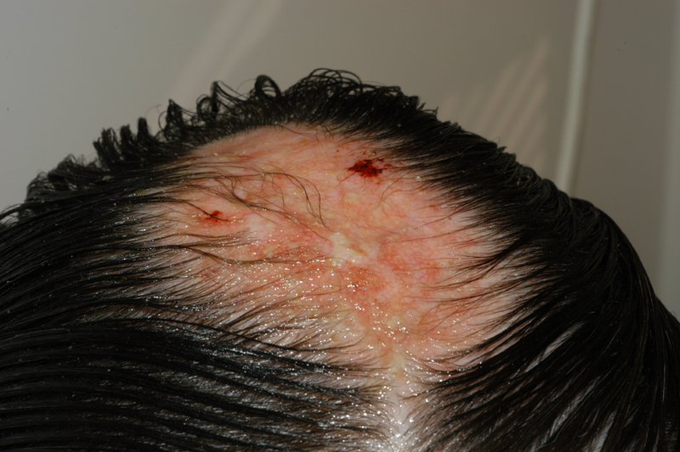

Slide 22
Treatment
… No Rx and wait for spontaneous recovery

Slide 23
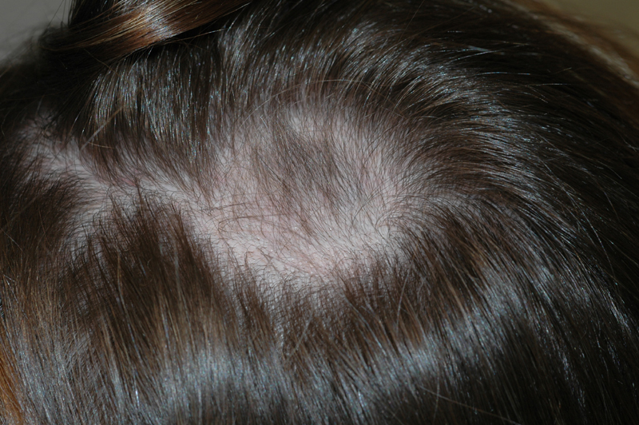
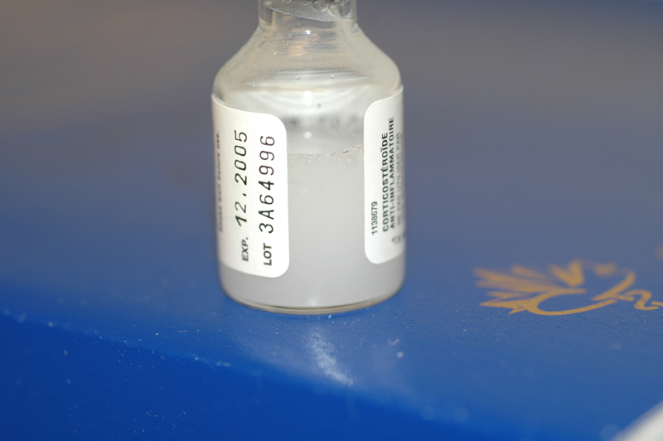
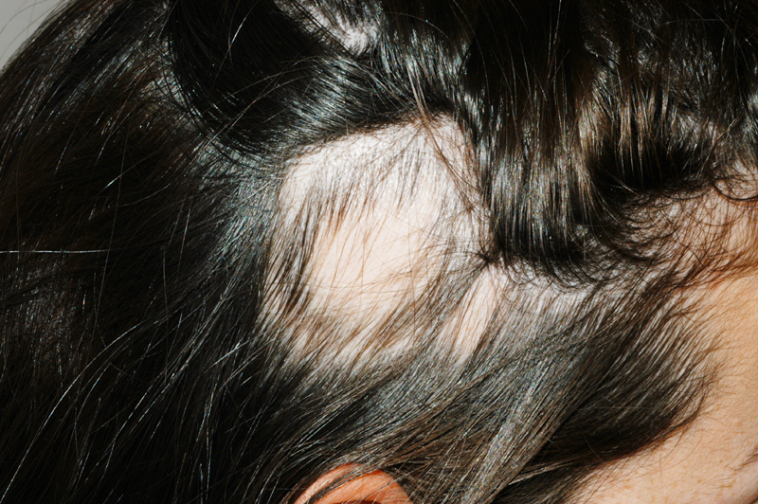
Treatment
2. Intralesional corticosteroid

Slide 24
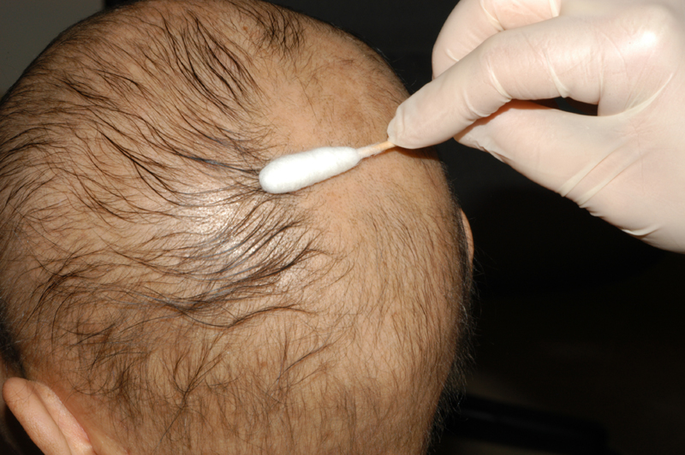
Skin Sensitizers
Immune modulating Rx

Slide 25
Other Rx
3-Topical steroids
4-Systemic Steroids
5- Cytotoxic Rx
6- Phototherapy
7-Minoxidil
Hair Transplant
X

Slide 26
3-Anagen effluvium 4-Telogen effluvium
Other types of hair fall diseases:

Slide 27
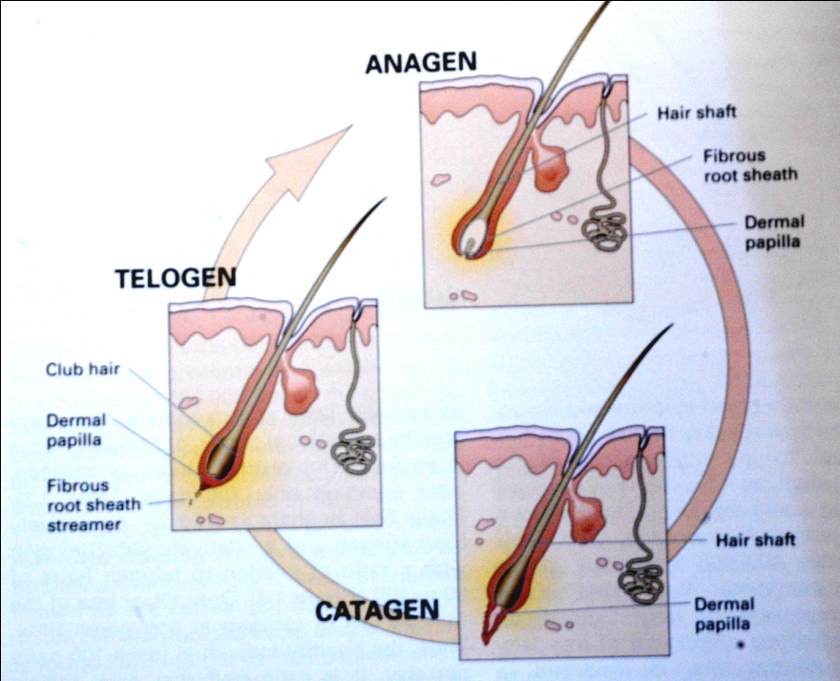
Anagen effluvium
Always related cytotoxic chemotherapy
Acute and severe alopecia
Mostly reversible but not always
Could it be preventable?

Slide 28
Anagen effluvium

Slide 29
Telogen effluvium Chronic alopecia Anemia with chronic disease
Common and None specific
Additional cause:
drugs
Weight loss
Acute blood loss
General anasthesia
Low iron
Stress?
Reversible (…become chronic)
Could it be preventable?

Slide 30
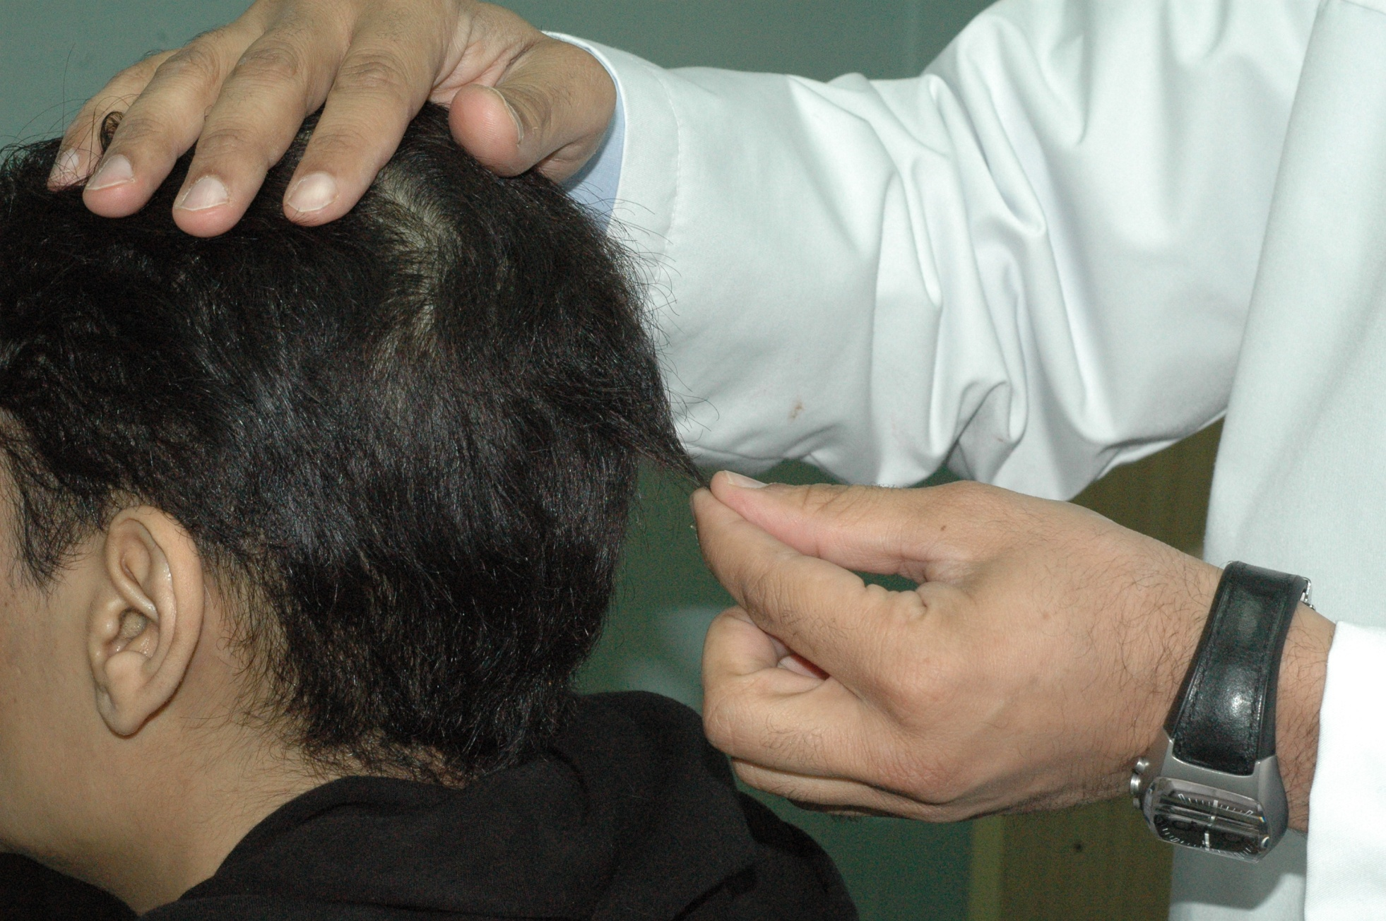

Slide 31
Vitiligo
Alajlan/Vitiligo 1433

Slide 32
Objectives
To know the anatomy and physiology of melanocytes
To recognize the primary presentation of vitiligo
To understand the possible pathogenesis of vitiligo
To know the scheme of managements lines

Slide 33
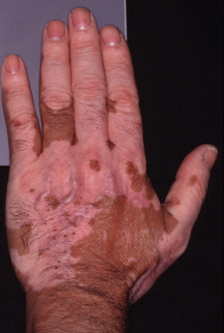
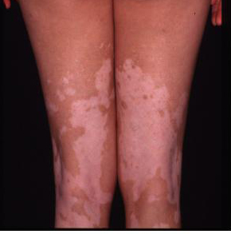
Alajlan/Vitiligo 1433

Slide 34
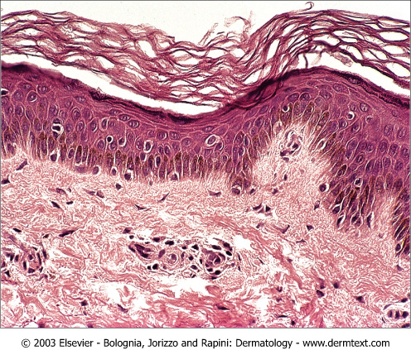
Vitiligo
Introduction to skin pigments
Alajlan/Vitiligo 1433

Slide 35
Vitiligo
Introduction to skin pigments
Definition: it is an autoimmune disease results in a well defined depigmented (complete loss of melanin) macules and patches that can be localized or generalized
Alajlan/Vitiligo 1433

Slide 36
Vitiligo
Introduction to skin pigments
Definition
Types: localized and generalized
Alajlan/Vitiligo 1433

Slide 37
Vitiligo
Introduction to skin pigments
Definition
Types: localized and generalized
Pathogenesis
Alajlan/Vitiligo 1433

Slide 38
Vitiligo
Introduction to skin pigments
Definition
Types: localized and generalized
Pathogenesis: three theories most accepted is the autoimmune theory
Other associated diseases: thyroiditis, Addison's disease, pernicious anemia
Natural course: rarely repigment without treatement
Alajlan/Vitiligo 1433

Slide 39
Treatment
No single effective Rx
Topicals: .Corticosteroids
.Immunomodulators
Light Therapy: 1. UVA or UVB
2. UVA + Psoralen = PUVA (Topical and Systemic)
3. UVB = Laser
Systemic Treatment: NOT USED
Surgical Rx: .Melanocyte Transplant
.Skin Grafts Transplant
Bleaching Agents: Depigment all skin
Alajlan/Vitiligo 1433

Slide 40
Treatment Pearls
Tips of fingers and toes
Lips
Bony prominence
Recurrence
Rarely 100% repigmentation for large area
Adverse effect of Rx
Alajlan/Vitiligo 1433

